Slide 1
(MTH 250)
Calculus
Lecture 8

Slide 2
Previous Lecture’s Summary
    Formal definition of continuity
    Important results of continuity
    Hyperbolic trigonometric functions
    Inverse hyperbolic trigonometric functions
    Boundedness of continuous functions
    Uniform continuity
    Tangent lines

Slide 3
Today’s Lecture
    Tangent lines: Recalls
    Introduction to derivatives
    Derivatives as rate of change
    Differentiability and continuity
    Non-differentiable functions
    Some useful derivatives

Slide 4
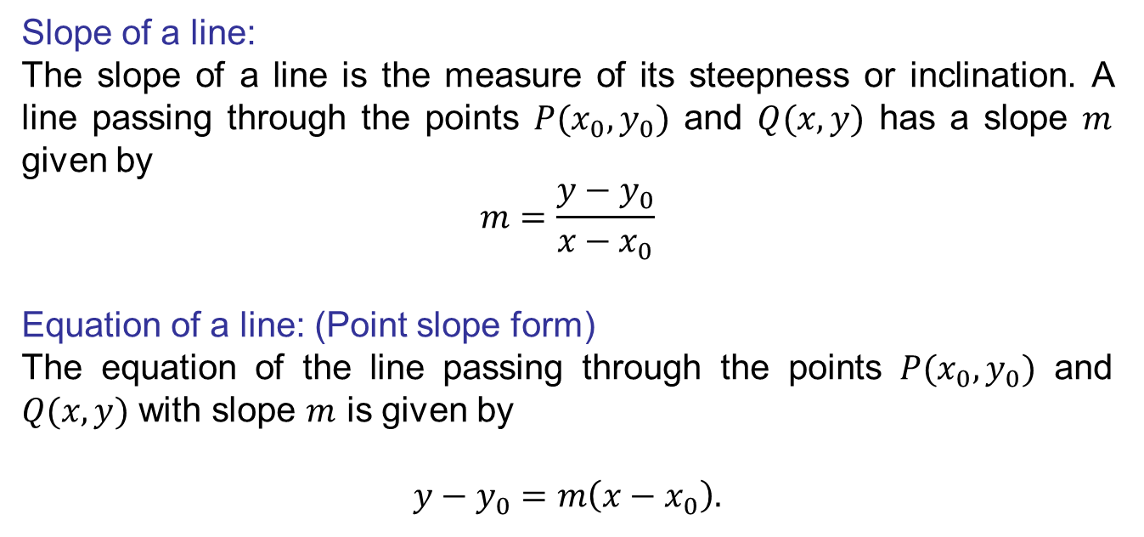
Tangent lines: Recalls
Slope of a line:
The slope of a line is the measure of its steepness or inclination. A line passing through the points $P(x_{0},y_{0})$ and $Q(x,y)$has a slope$m$given by
$$m=\frac{y−y_{0}}{x−x_{0}}$$
Equation of a line: (Point slope form)
The equation of the line passing through the points $P(x_{0},y_{0})$ and $Q(x,y)$ with slope $m$ is given by
$$y−y_{0}=m\left({x−x}_{0}\right).$$

Slide 5
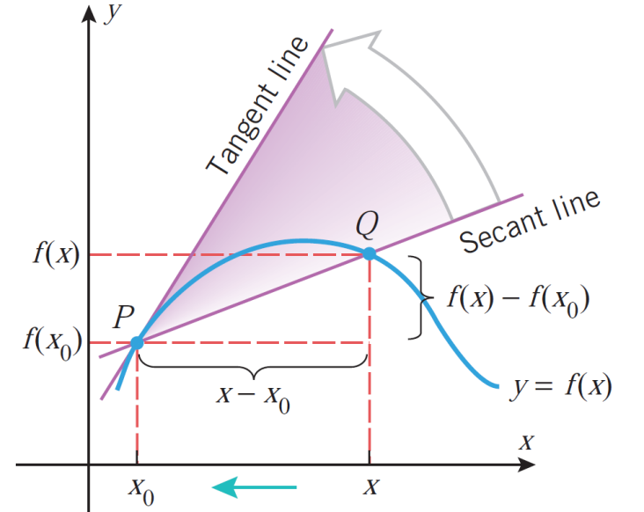
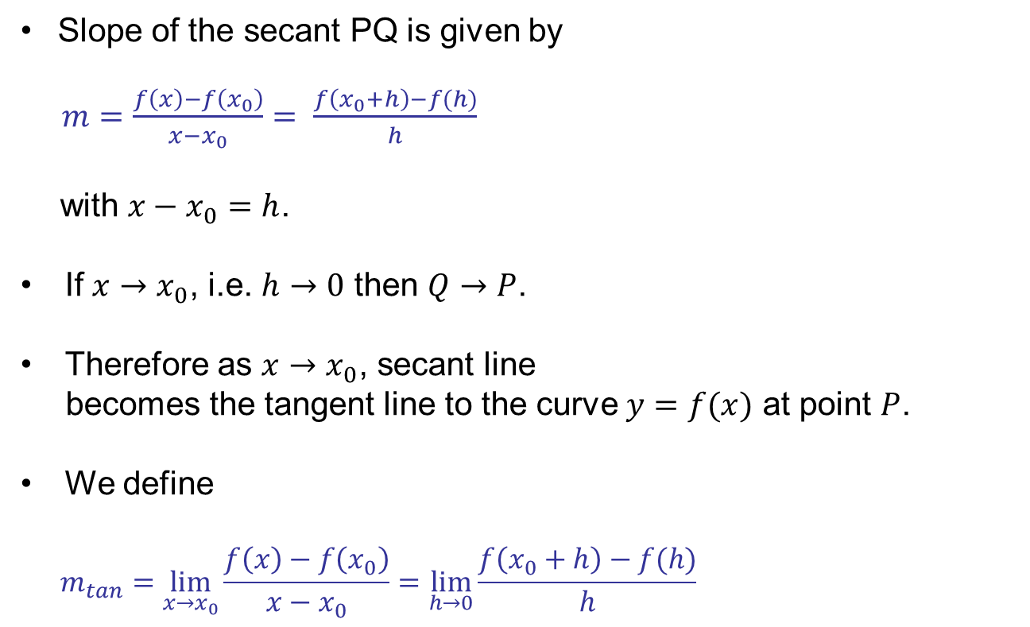
Tangent lines: Recalls
Slope of the secant PQ isgiven by
$m=\frac{f\left(x\right)−f\left(x_{0}\right)}{x−x_{0}}= \frac{f\left(x_{0}+h\right)−f(h)}{h}$
with $x−x_{0}=h$.
If$x→x_{0}$, i.e. $h→0$ then $Q→P$.
Therefore as $x→x_{0}$, secant line
becomes the tangent line to the curve$y=f(x)$at point $P$.
Wedefine
$$m_{tan}=\lim_{x→x_{0}}{\frac{f\left(x\right)−f\left(x_{0}\right)}{x−x_{0}}=\lim_{h→0}{\frac{f\left(x_{0}+h\right)−f(h)}{h}}}$$

Slide 6
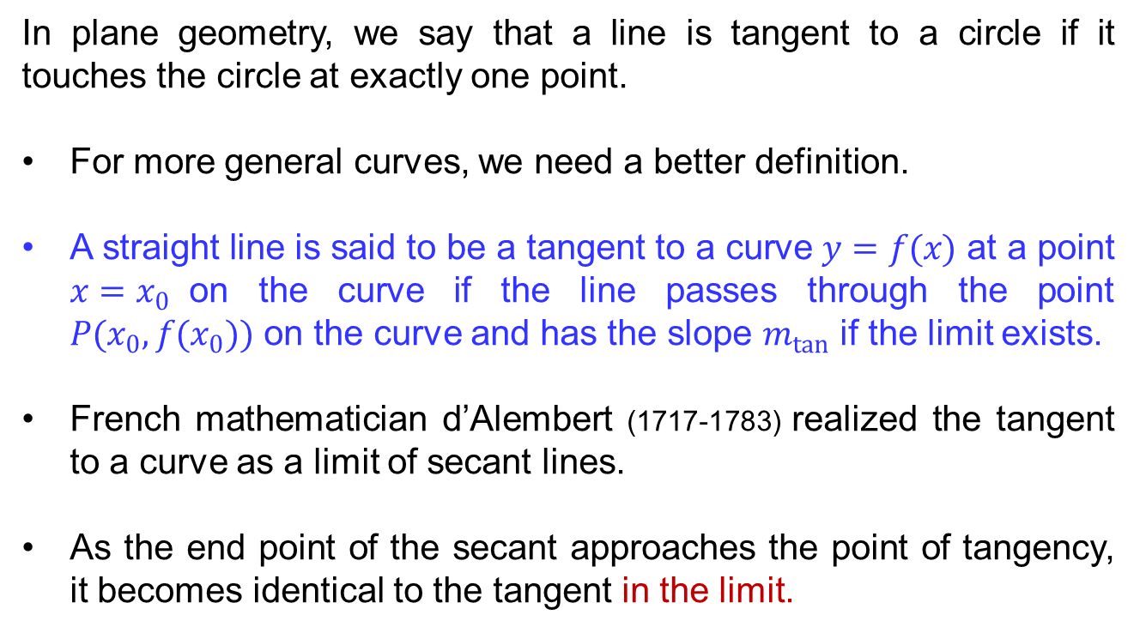
Tangent lines: Recalls
In plane geometry, we say that a line is tangent to a circle if it touches the circle at exactly one point.
For more general curves, we need a better definition.
A straight line is said to be a tangent to a curve $y=f(x)$ at a point $x=x_{0}$on the curve if the line passes through the point $P(x_{0}, f(x_{0}))$ on the curve and has the slope $m_{tan}$ if the limit exists.
French mathematician d’Alembert(1717-1783)realized the tangent to a curve as a limit of secant lines.
As the end point of the secant approaches the point of tangency, it becomes identical to the tangent in the limit.

Slide 7
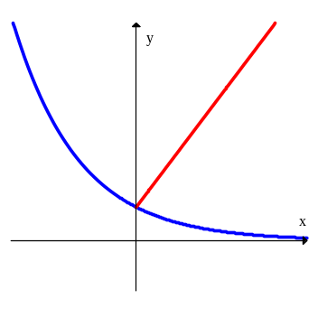
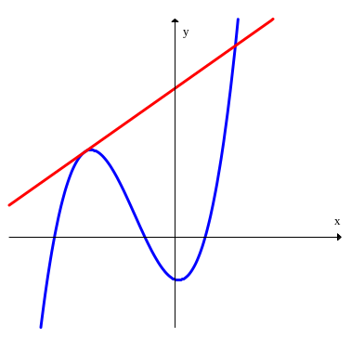
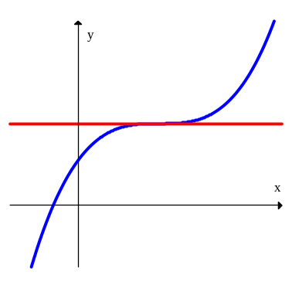
Tangent lines: Recalls
Common Misconceptions:
A line is tangent to a curve if it touches the curve only once. (wrong)
A line is tangent to a curve if it crosses the curve in exactly one point. (wrong)
A line is tangent to a curve if it touches the curve at only one point but does not cross the curve. (wrong)
Not Tangent line
Tangent line
Tangent line

Slide 8
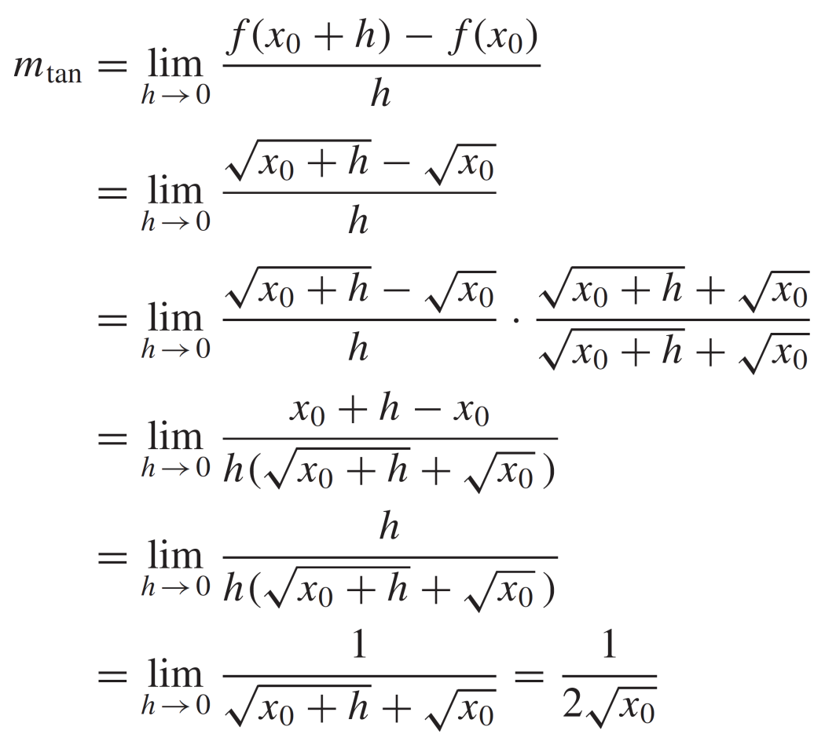

Tangent lines: Recalls
Find the slope of the tangent to $y=\sqrt{x}$at$x=x_{0}.$
Solution: We have

Slide 9
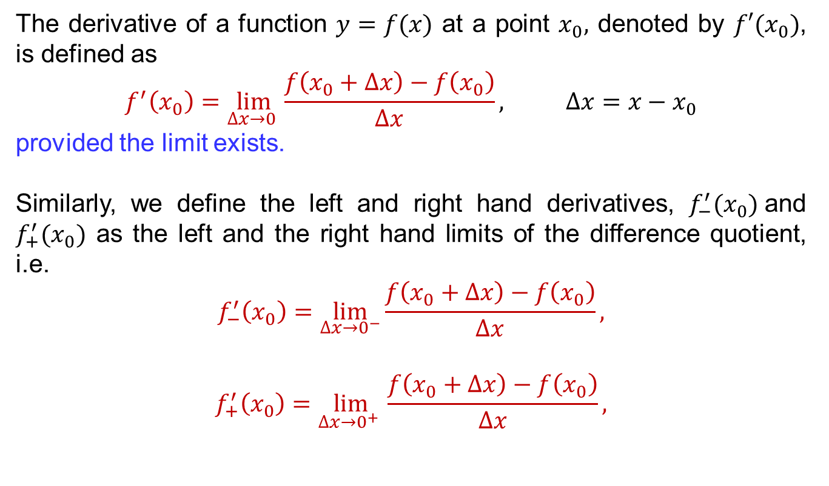
Introduction to derivative
The derivative of a function $y=f(x)$ at a point $x_{0},$ denoted by $f′(x_{0})$, is defined as
$$f^{′}\left(x_{0}\right)=\lim_{∆x→0 }\frac{f\left(x_{0}+∆x\right)−f\left(x_{0}\right)}{∆x}, ∆x=x−x_{0}$$
provided the limit exists.
Similarly, we define the left and right hand derivatives, $f_{−}^{′}(x_{0})$and $f_{+}^{′}(x_{0})$ as the left and the right hand limits of the difference quotient, i.e.
$$f_{−}^{′}\left(x_{0}\right)=\lim_{\begin{aligned}∆x→0^{−} \\ \end{aligned}}\frac{f\left(x_{0}+∆x\right)−f\left(x_{0}\right)}{∆x},$$
$$f_{+}^{′}\left(x_{0}\right)=\lim_{∆x→0^{+} }\frac{f\left(x_{0}+∆x\right)−f\left(x_{0}\right)}{∆x},$$

Slide 10
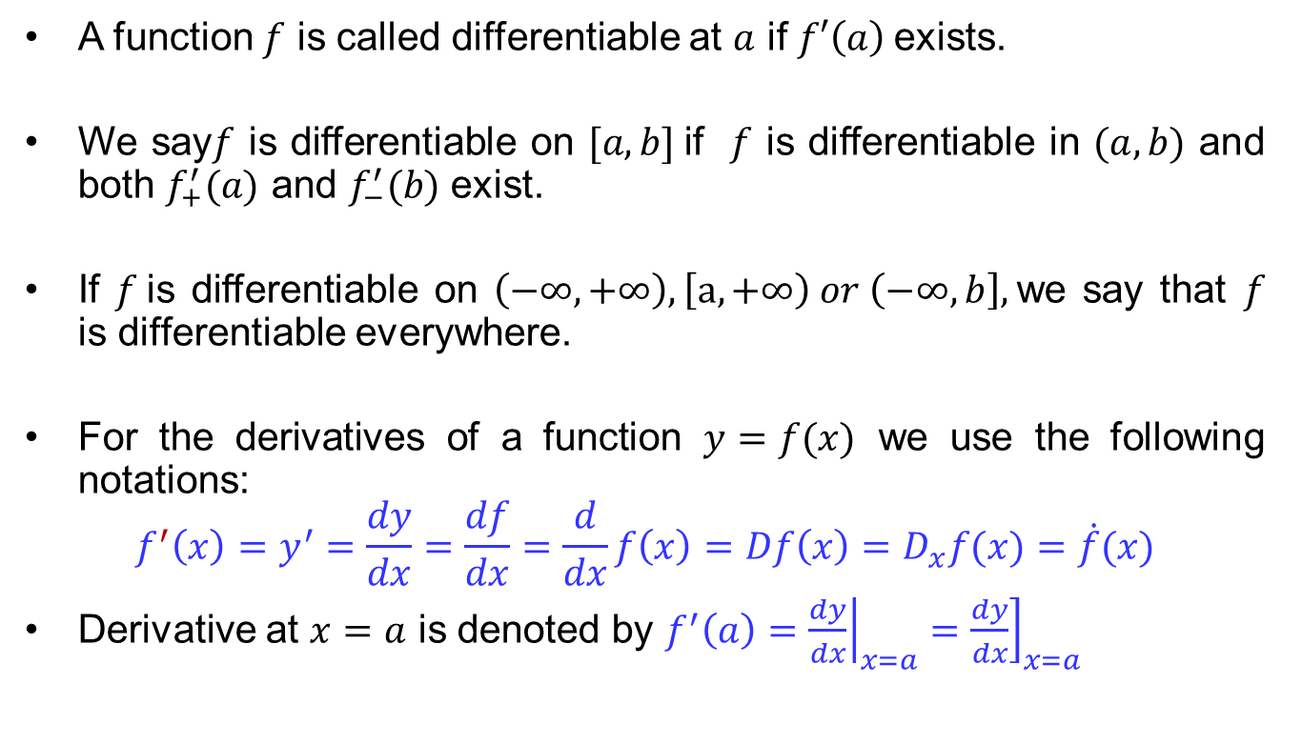
Introduction to derivative
A function $f$ is called differentiable at $a$ if $f′\left(a\right)$exists.
We say$f$ is differentiable on $[a,b]$if $f$ is differentiable in $(a,b)$ and both $f_{+}^{′}(a)$ and $f_{−}^{′}(b)$ exist.
If $f$is differentiable on $\left(−∞,+∞\right), \left[a,+∞\right) or \left(−∞,b\right],$ we say that $f$ is differentiable everywhere.
For the derivatives of a function $y=f(x)$ we use the following notations:
$$f^{′}\left(x\right)=y^{′}=\frac{dy}{dx}=\frac{df}{dx}=\frac{d}{dx}f\left(x\right)=Df\left(x\right)=D_{x}f(x)=\dot{f}(x)$$
Derivative at $x=a$ is denoted by$f^{′}\left(a\right)={\left.\frac{dy}{dx}\right|}_{x=a}={\left.\frac{dy}{dx}\right]}_{x=a}$

Slide 11
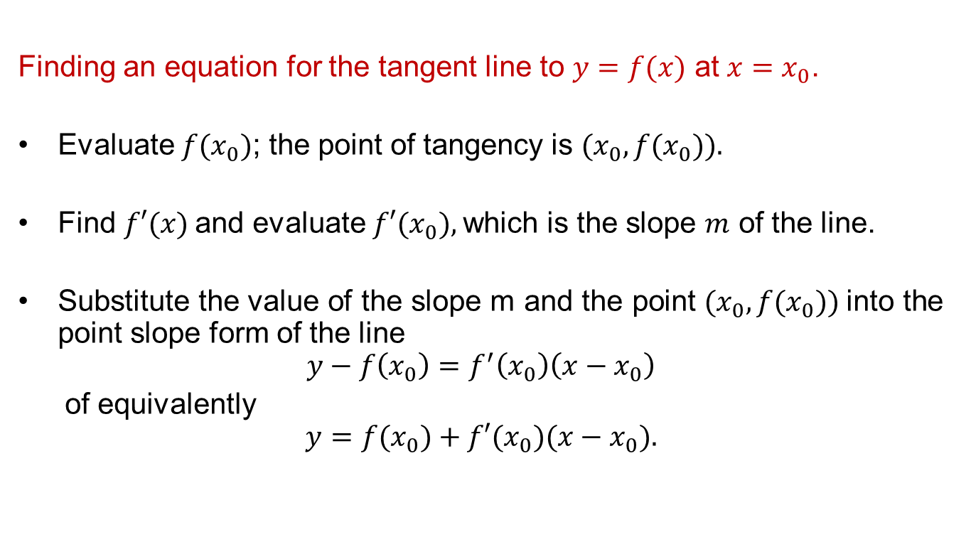
Introduction to derivative
Finding an equation for the tangent line to $y=f(x)$ at $x=x_{0}$.
Evaluate $f(x_{0})$; the point of tangency is $(x_{0}, f(x_{0})).$
Find $f′(x)$and evaluate $f′(x_{0}),$which is the slope $m$ of the line.
Substitute the value of the slope m and the point $(x_{0},f(x_{0}))$into the point slope form of the line
$$y−f\left(x_{0}\right)=f^{′}\left(x_{0}\right)\left(x−x_{0}\right)$$
of equivalently
$$y=f(x_{0})+f′(x_{0})(x−x_{0}).$$

Slide 12
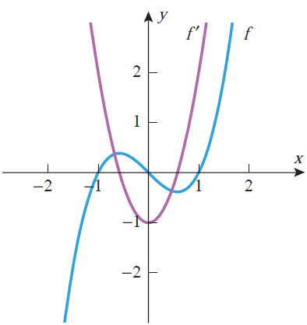
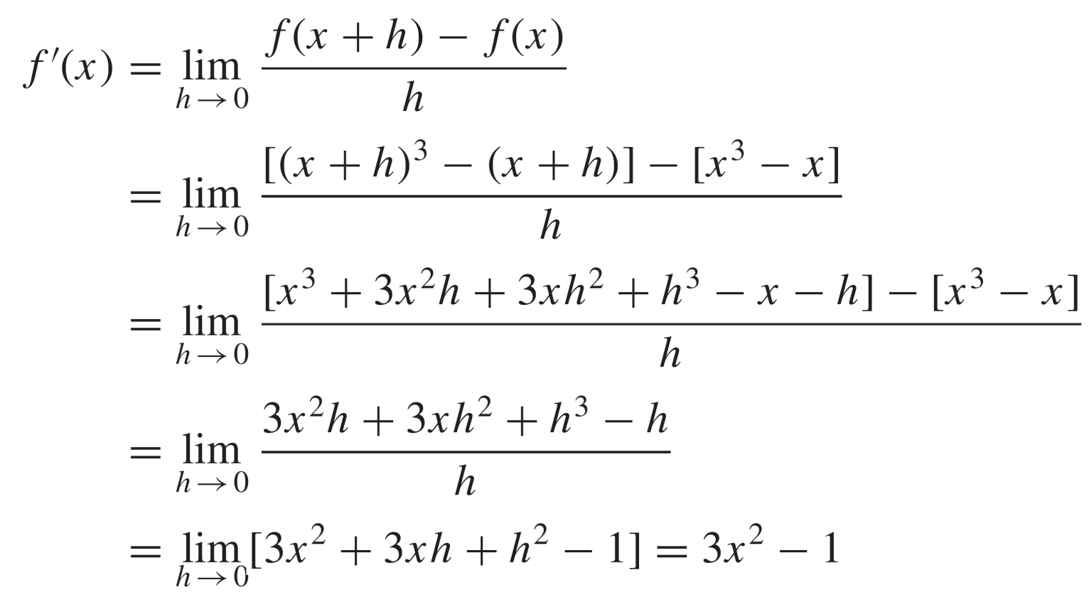
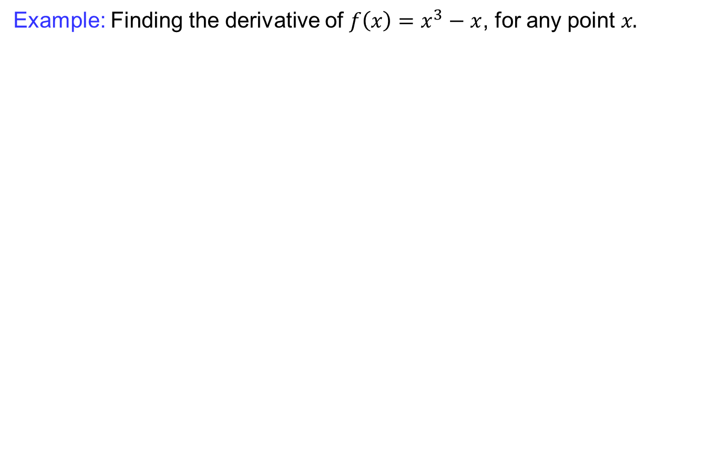
Introduction to derivative
Example: Finding the derivative of $f\left(x\right)=x^{3}−x$, for any point $x.$

Slide 13

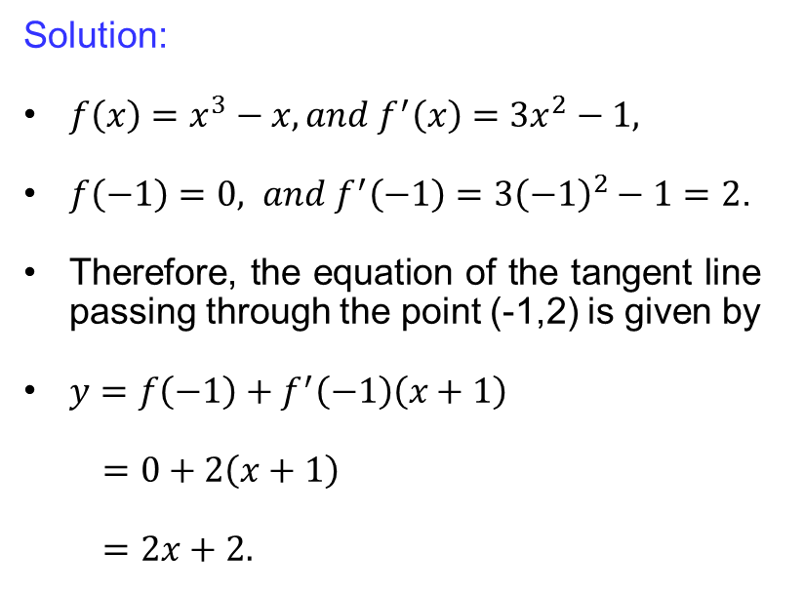
Introduction to derivative
Example: Finding the equation of the tangent to $f\left(x\right)=x^{3}−x$, at point $x=−1$.
Solution:
${f\left(x\right)=x^{3}−x, and f}^{′}\left(x\right)=3x^{2}−1,$
$f\left(−1\right)=0, and f^{′}\left(−1\right)=3{\left(−1\right)}^{2}−1=2$.
Therefore, the equation of the tangent line passing through the point (-1,2) is given by
$y=f\left(−1\right)+f^{′}\left(−1\right)\left(x+1\right)$
$=0+2\left(x+1\right)$
$=2x+2.$
$$y=2x+2.$$

Slide 14
Derivative as rate of change
One of the most important themes in calculus is the study of motion.
To describe the motion of an object completely, one must specify its speed and the direction in which it is moving.
The speed and direction together comprise what is called velocity of the object.
For the moment, we will consider only the motion of an object along a line: this is called rectilinear motion.
Examples: A car moving along a straight track, motion of a free falling body, ball thrown straight up and coming down along the same path.

Slide 15
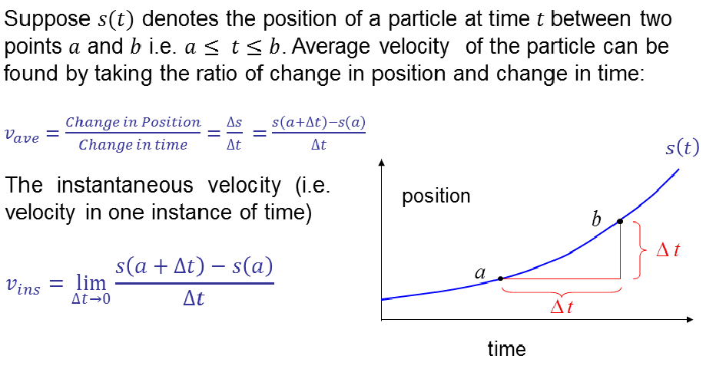
Derivative as rate of change

Slide 16
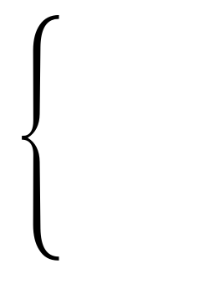
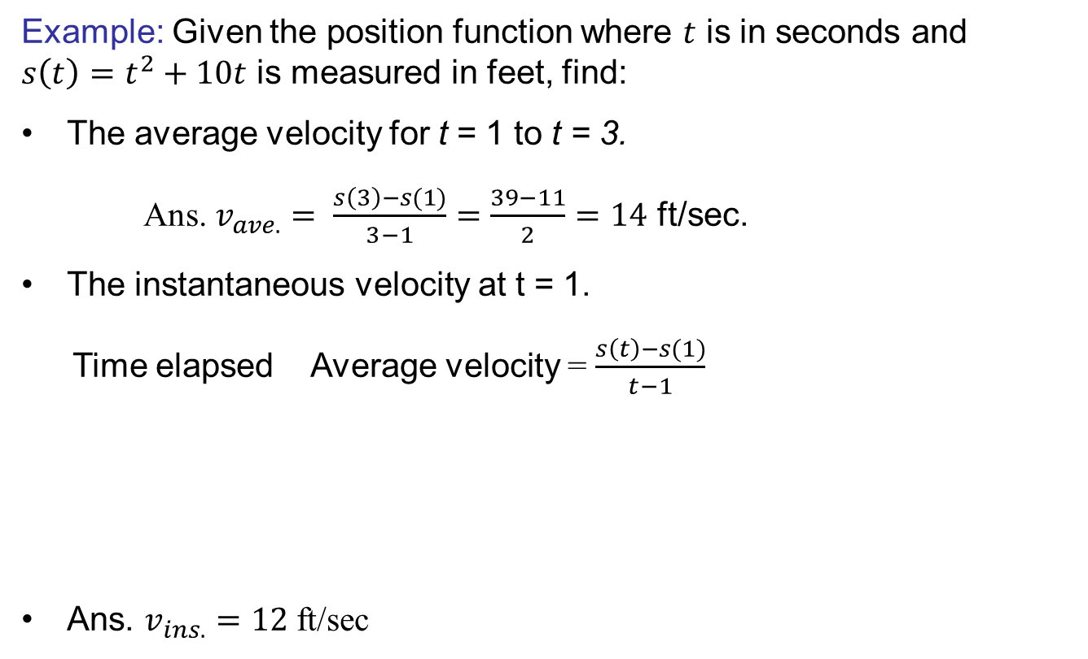
Derivative as rate of change
Example: Given the position function where $t$ is in seconds and $s\left(t\right)=t^{2}+10t$ is measured in feet, find:
The average velocity for t = 1 to t = 3.
Ans. $v_{ave.}= \frac{s\left(3\right)−s(1)}{3−1}=\frac{39−11}{2}=14$ft/sec.
The instantaneous velocity at t = 1.
Time elapsed Average velocity = $\frac{s\left(t\right)−s(1)}{t−1}$
Ans. $v_{ins.}=12$ft/sec
1.1 12.1
1.01 12.01
1.001 12.001

Slide 17
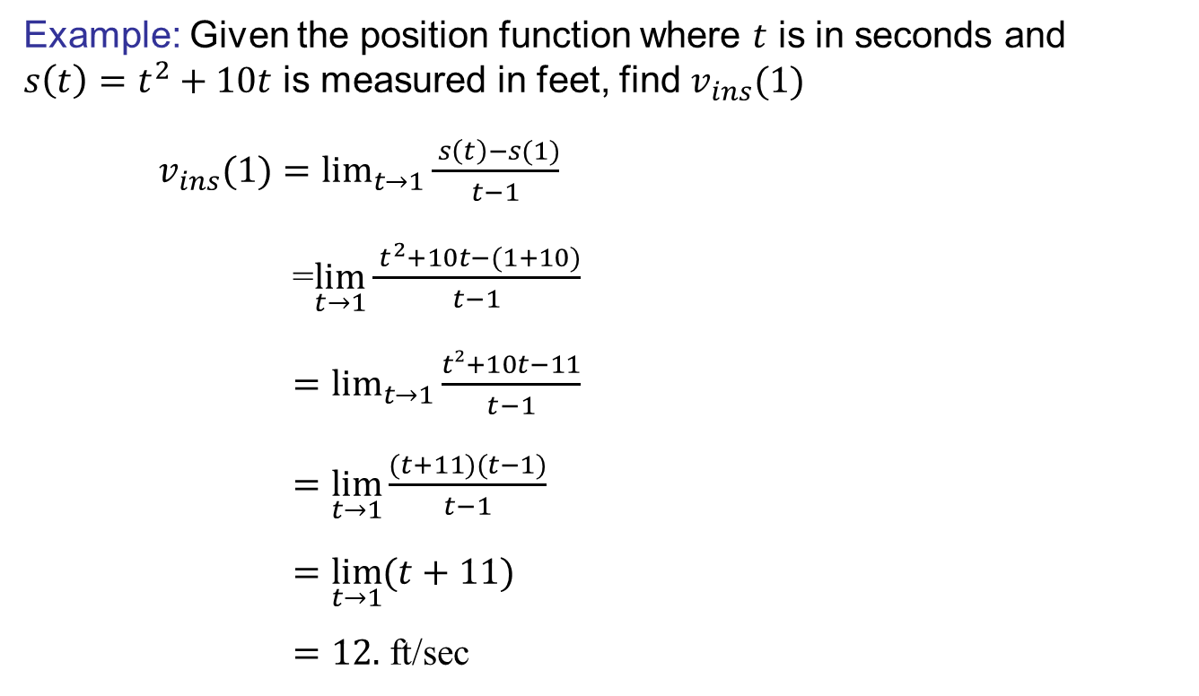
Derivative as rate of change
Example: Given the position function where $t$ is in seconds and $s\left(t\right)=t^{2}+10t$ is measured in feet, find$v_{ins}(1)$
$v_{ins}(1)=\lim_{t→1}{\frac{ s\left(t\right)−s(1)}{t−1}}$
=$\lim_{t→1}{\frac{ t^{2}+10t−(1+10)}{t−1}}$
$=\lim_{t→1}{\frac{t²+10t−11}{t−1}}$
$=\lim_{t→1}{\frac{(t+11)(t−1)}{t−1}}$
$=\lim_{t→1}{(t+11)}$
$=12.$ft/sec

Slide 18
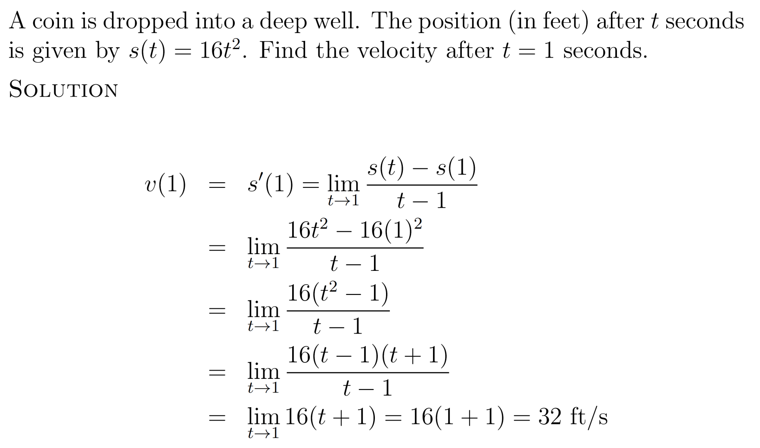
Derivative as rate of change

Slide 19
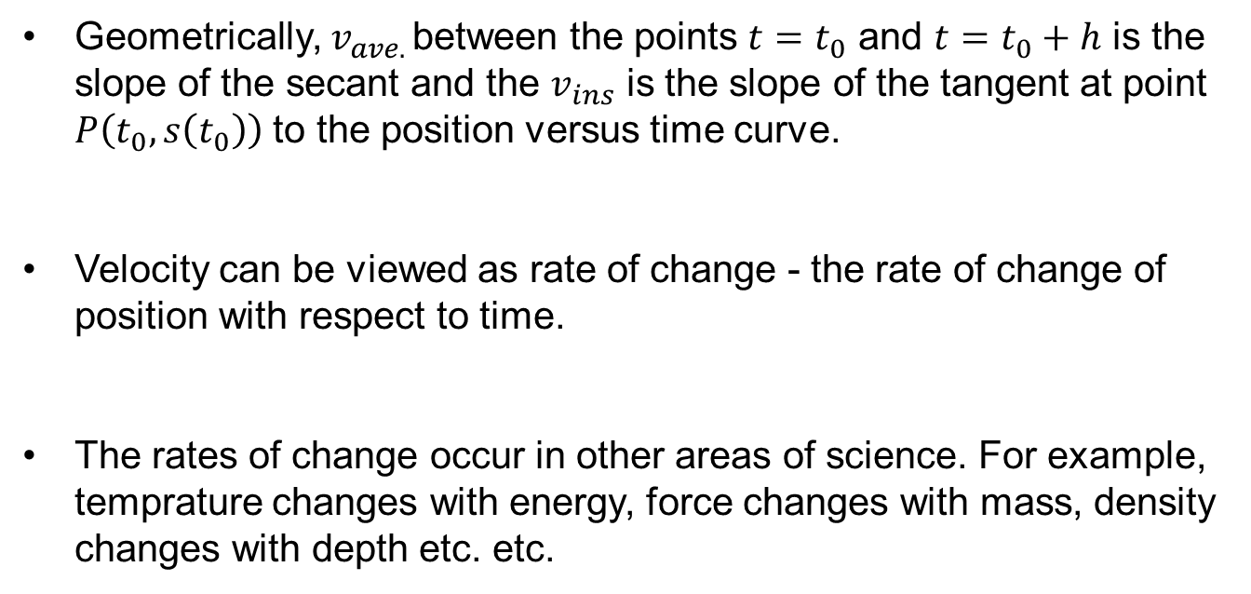
Derivative as rate of change
Geometrically, $v_{ave. }$between the points $t=t_{0}$ and $t=t_{0}+h$is the slope of the secant and the $v_{ins}$is the slope of the tangent at point $P\left(t_{0}, s\left(t_{0}\right)\right)$ to the position versus time curve.
Velocitycanbeviewed as rate of change - the rate of change of position with respect to time.
The rates of change occur in other areas of science. For example, temprature changes withenergy, force changes with mass, density changes withdepth etc. etc.

Slide 20
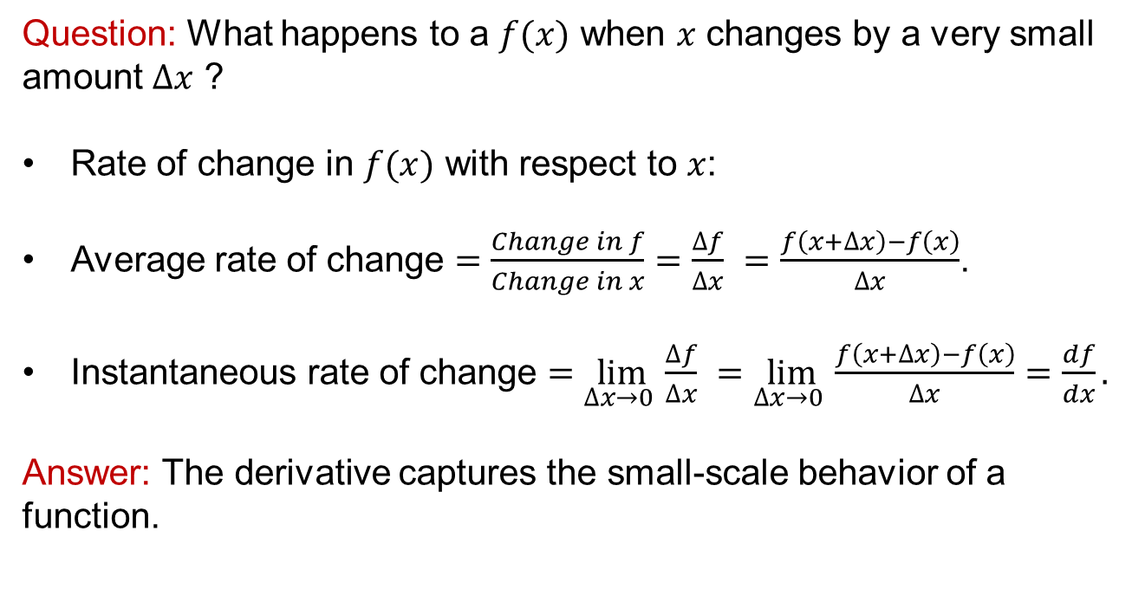
Derivative as rate of change
Question: What happens to a $f(x)$when $x$ changes by a very small amount $∆x$ ?
Rate of change in $f(x)$with respect to $x$:
Average rate of change $=\frac{Change in f}{Change in x}=\frac{∆f}{∆x}$$=\frac{f\left(x+∆x\right)−f\left(x\right)}{∆x}$.
Instantaneous rate of change $=\lim_{∆x→0 }{\frac{∆f}{∆x}}$$=\lim_{∆x→0 }\frac{f\left(x+∆x\right)−f\left(x\right)}{∆x}=\frac{df}{dx}.$
Answer: The derivative captures the small-scale behavior of a function.

Slide 21

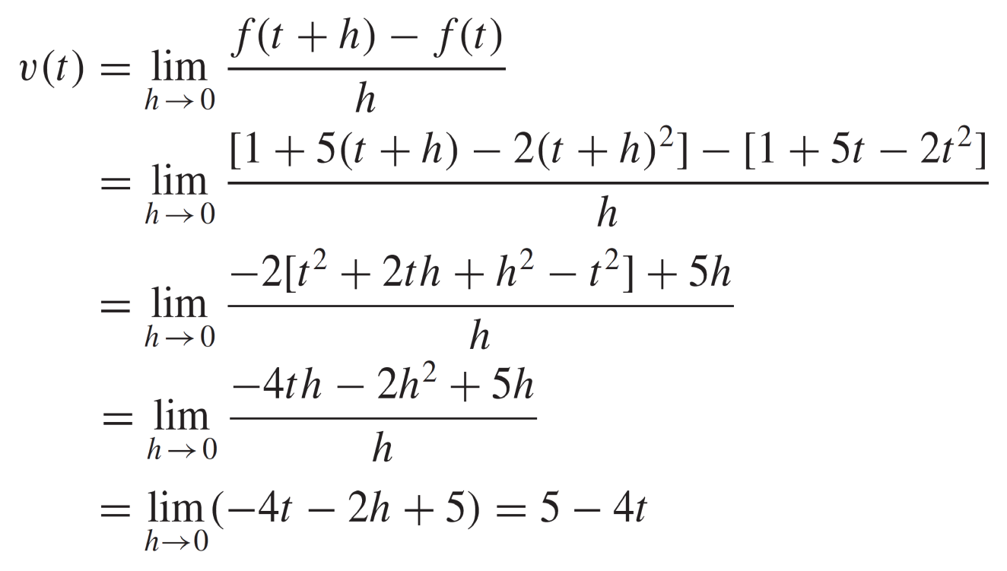
Derivative as rate of change

Slide 22
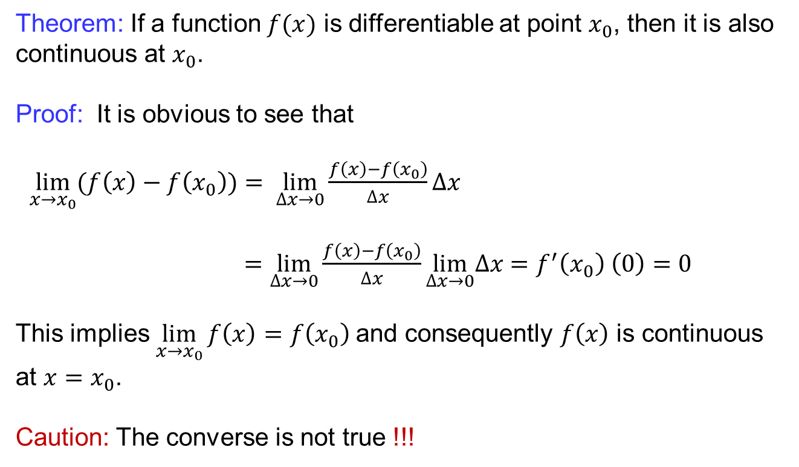
Differentiability and continuity
Theorem: If a function$f(x)$isdifferentiableat point $x_{0}$, thenitisalsocontinuousat$x_{0}$.
Proof: It isobvious to seethat
$\lim_{x→x_{0}}{(f\left(x\right)−f\left(x_{0}\right)})= \lim_{∆x→0}\frac{f\left(x\right)−f\left(x_{0}\right)}{∆x}∆x$
$=$$\lim_{∆x→0}\frac{f\left(x\right)−f\left(x_{0}\right)}{∆x}\lim_{∆x→0}∆x=f^{′}\left(x_{0}\right) \left(0\right)=0$
This implies $\lim_{x→x_{0}}{f\left(x\right)=f\left(x_{0}\right)}$and consequently $f\left(x\right)$ is continuous at $x=x_{0}$.
Caution: The converse is not true !!!

Slide 23
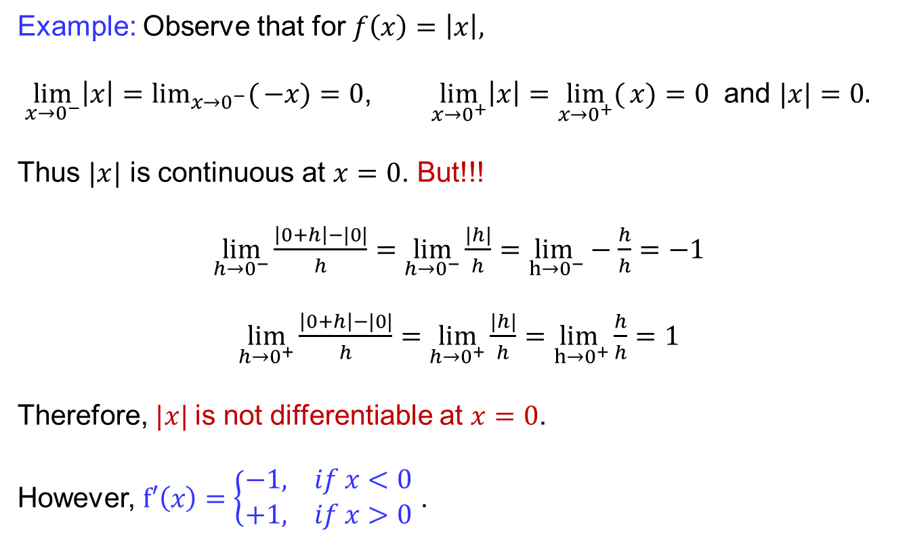
Differentiability and continuity
Example: Observe that for $f\left(x\right)=\left|x\right|,$
$\lim_{x→0^{−}}\left|x\right|=\lim_{x→0^{−}}({−x)}=0$, $\lim_{x→0^{+}}\left|x\right|=\lim_{x→0^{+}}({x})=0$ and $|x|=0.$
Thus$|x|$iscontinuousat$x=0$. But!!!
$\lim_{h→0^{−}}{\frac{\left|0+h\right|−|0|}{h}}=\lim_{h→0^{−}}{\frac{|h|}{h}}=\lim_{h→0^{−}}−\frac{h}{h}=−1$
$\lim_{h→0^{+}}{\frac{\left|0+h\right|−|0|}{h}}=\lim_{h→0^{+}}{\frac{|h|}{h}}=\lim_{h→0^{+}}\frac{h}{h}=1$
Therefore, $|x|$is not differentiableat$x=0$.
However, $f′\left(x\right)=\left\{\begin{aligned}−1, if x<0 \\ +1, if x>0\end{aligned}\right.$.

Slide 24
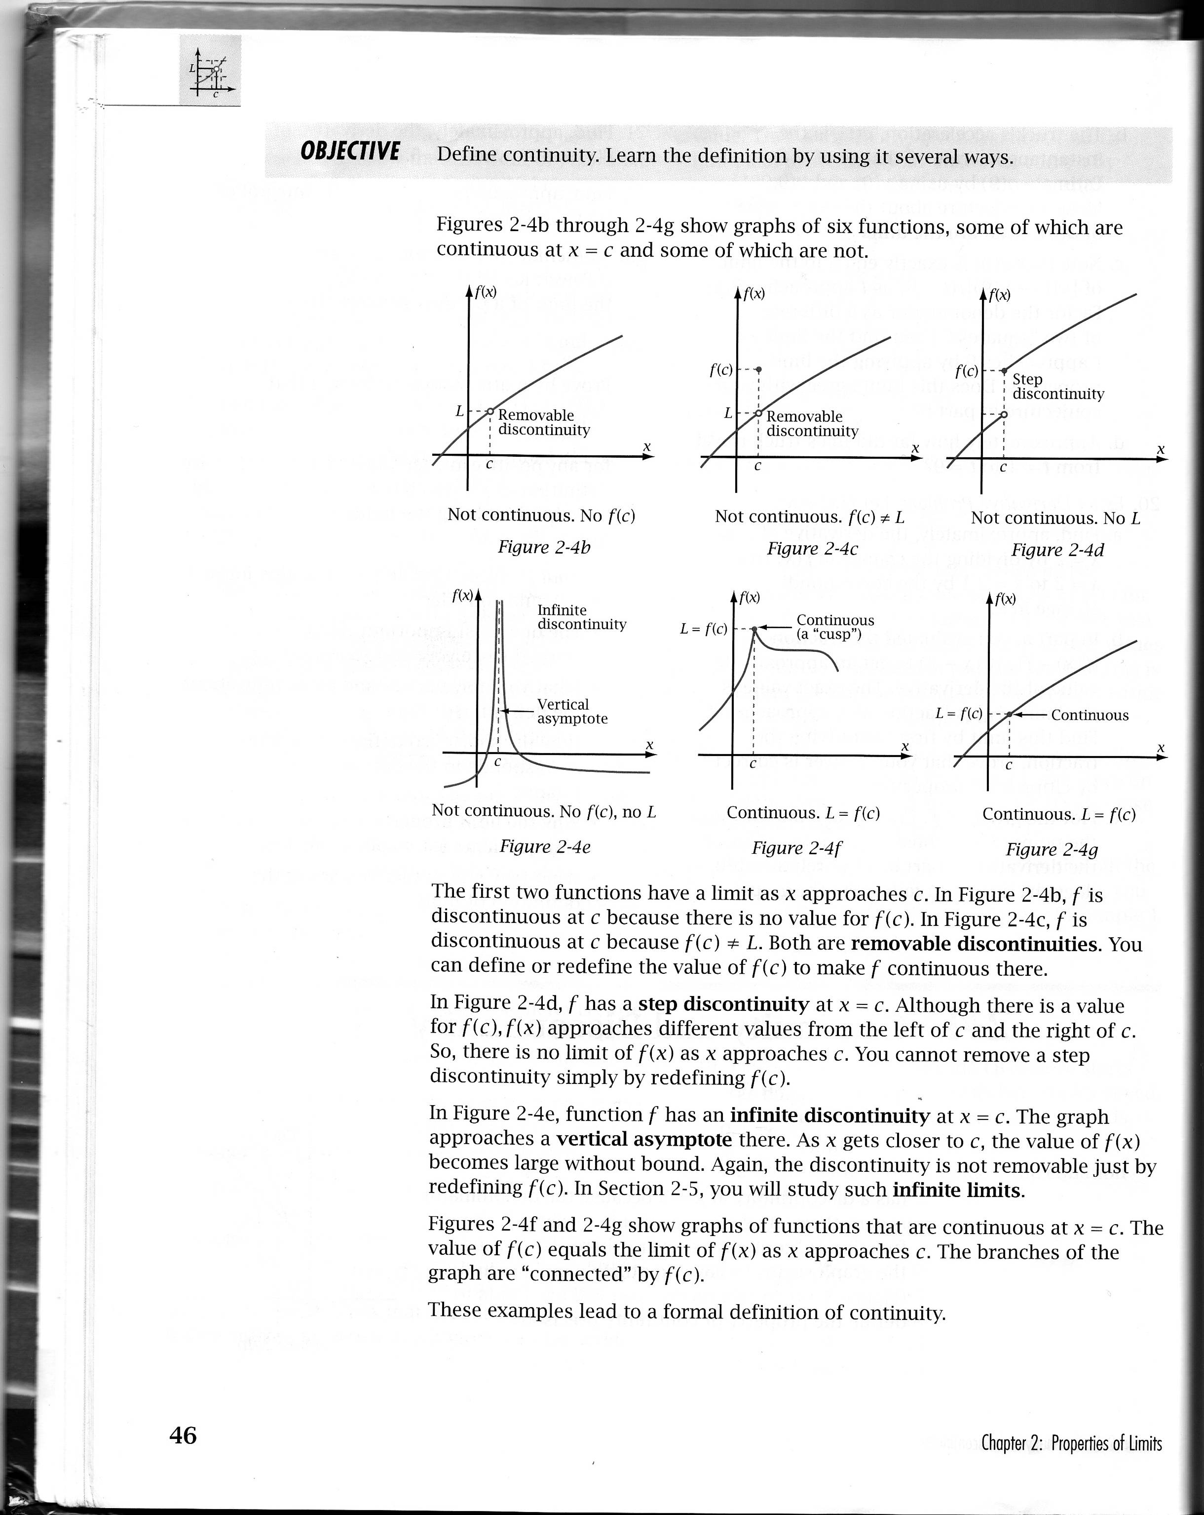
Non-differentiable functions
Cusp: A cusp is a point on the graph at which the function is continuous but the derivative is discontinuous. Verbally, cusp is a sharp point or an abrupt change in direction.

Slide 25
Non-differentiable functions
If a function is discontinuous at a point then it is not differentiable at that point.
As the slope of a vertical line is undefined. Therefore, if the slope of the tangent line to a graph is vertical at a point, then the derivative of the function will be undefined at that point.
It is possible for a function to be continuous at a point but not be differentiable i.e. the function has a cusp at some point, then the function is not differentiable at that point. If the graph has a cusp at a point, it would be possible to draw an infinite number of lines that look like tangent lines, and so there is finally no tangent line.

Slide 26
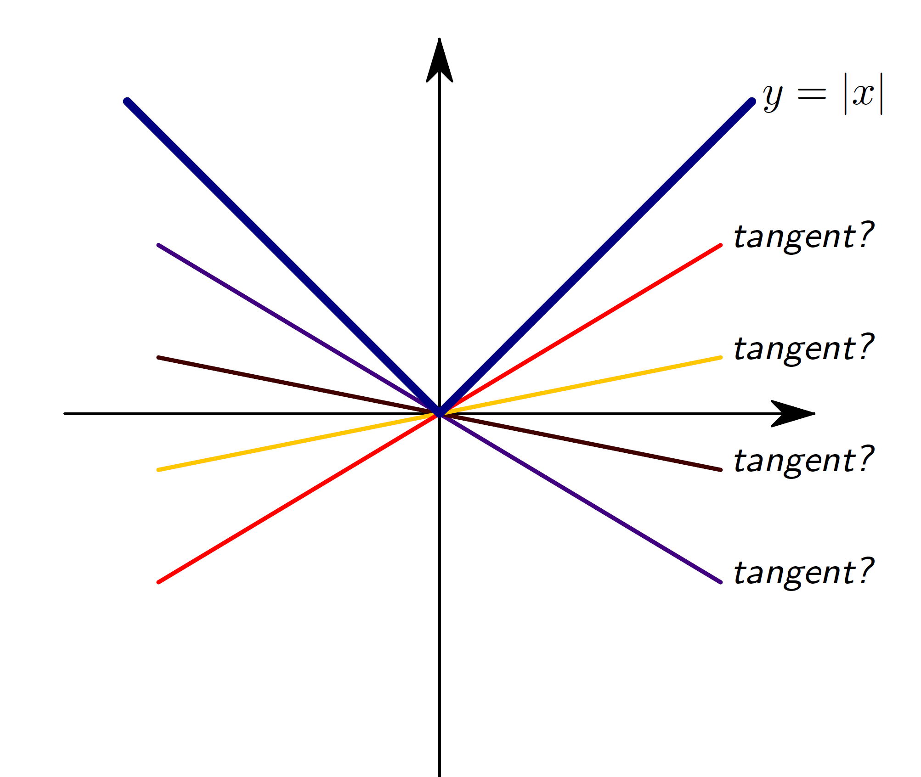
Non-differentiable functions

Slide 27
Non-differentiable functions
If a function is differentiable at $x = a$, then it is continuous at $x = a$.
Not Continuous
Still Continuous
Not Differentiable

Slide 28
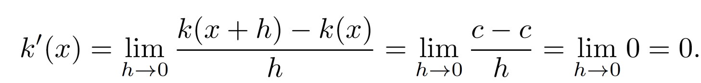
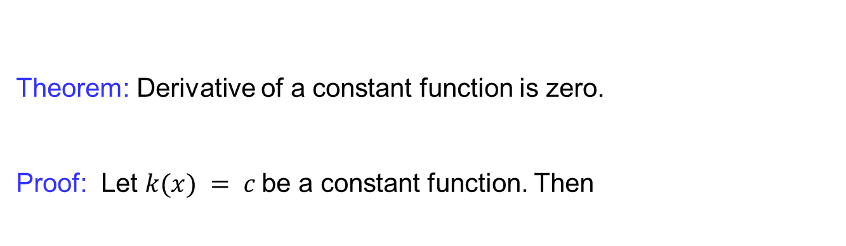
Useful derivatives
Theorem: Derivative of a constant functioniszero.
Proof: Let $k(x) = c$be a constant function. Then

Slide 29
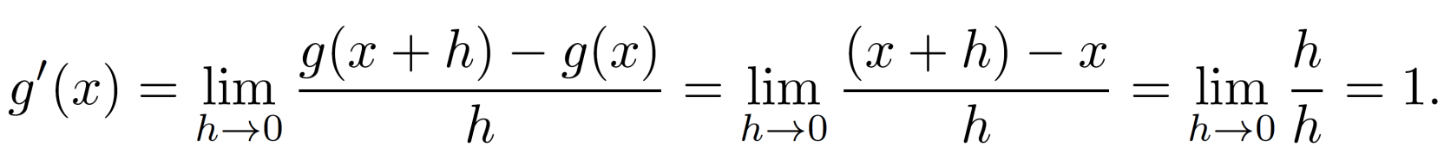
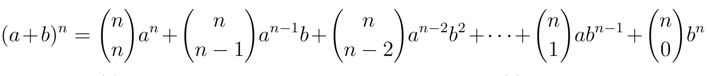
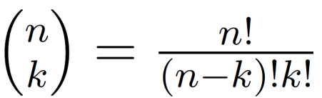
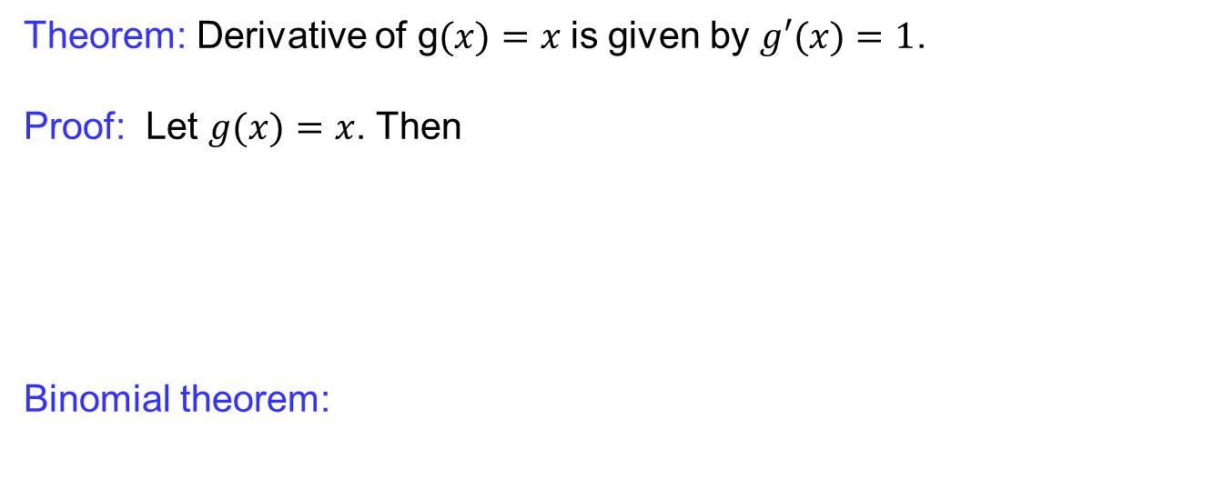
Useful derivatives
Theorem: Derivative of g$(x)=x$is given by $g′(x)=1$.
Proof: Let $g(x)=x$. Then
Binomial theorem:

Slide 30
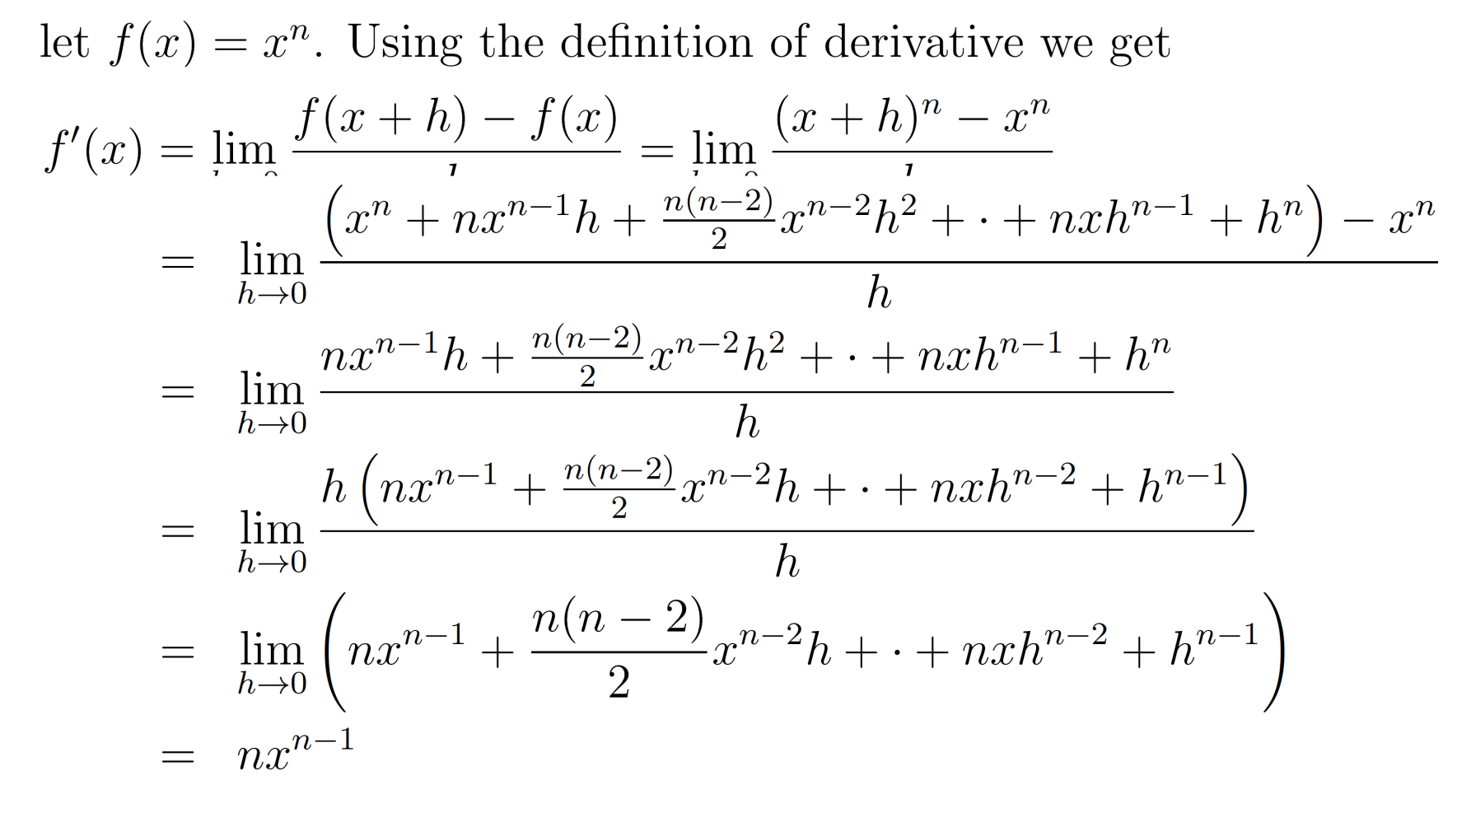
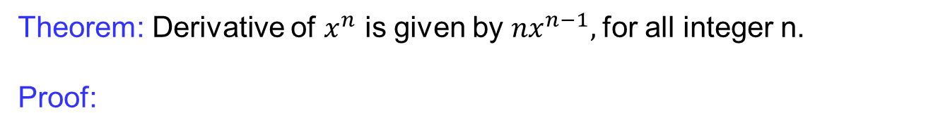
Useful derivatives
Theorem: Derivative of $x^{n}$ is given by $nx^{n−1},$for all integer n.
Proof:

Slide 31
Lecture Summary
    Tangent lines: Recalls
    Introduction to derivatives
    Derivatives as rate of change
    Differentiability and continuity
    Non-differentiable functions
    Some useful derivatives

