Slide 1
(MTH 250)
Calculus
Lecture 7

Slide 2
Previous Lecture’s Summary
    Limits by definition
    Formal definition of one-sided limits
    Comparison theorem
    Sandwich theorem
    Golden rules for limits
    Introduction to continuity
    Discontinuity
    Piecewise continuous functions
    Continuous extension
    Intermediate value theorem

Slide 3
Today’s Lecture
    Formal definition of continuity
    Important results of continuity
    Hyperbolic trigonometric functions
    Inverse hyperbolic trigonometric functions
    Boundedness of continuous functions
    Uniform continuity
    Tangent lines

Slide 4
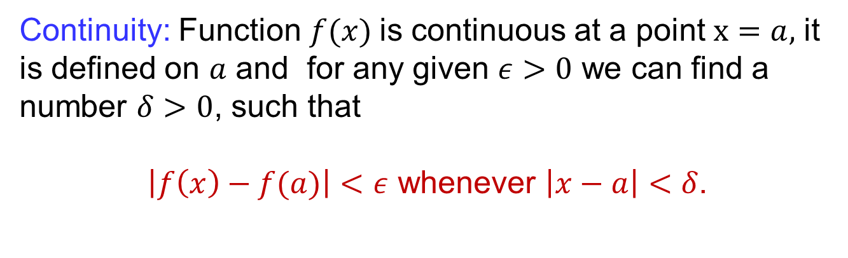
Formal definition of continuity
Continuity: Function $f(x)$is continuous at a point $x=a,$ it is defined on $a$ and for any given $ε>0$ we can find a number $δ>0$, such that
$\left|f\left(x\right)−f(a)\right|<ε$ whenever $\left|x−a\right|<δ$.

Slide 5
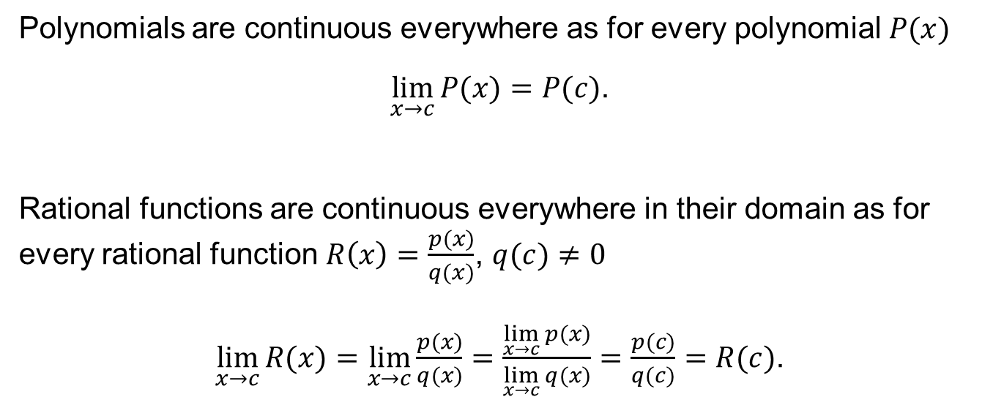
Important continuity results
Polynomials are continuous everywhere as for every polynomial $P(x)$
$\lim_{x→c}{P(x)}=P(c)$.
Rational functions are continuous everywhere in their domain as for every rational function $R\left(x\right)=\frac{p(x)}{q(x)}$, $q(c)≠0$
$\lim_{x→c}{R(x)}=\lim_{x→c}{\frac{p(x)}{q(x)}}=\frac{\lim_{x→c}{p(x)}}{\lim_{x→c}{q(x)}}=\frac{p(c)}{q(c)}=R(c)$.

Slide 6
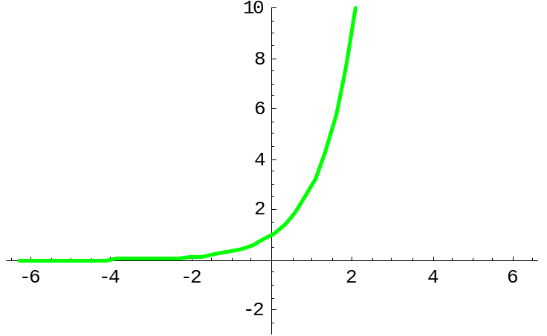
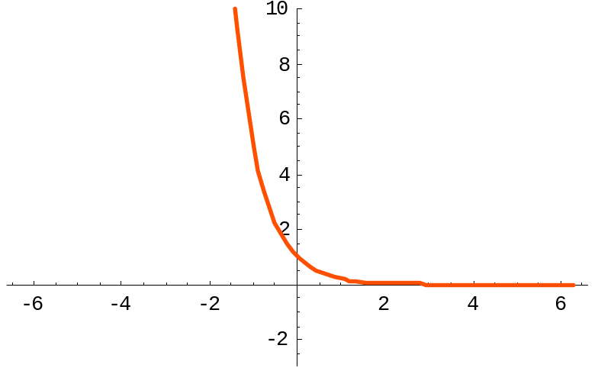
Important continuity results
Exponential functions are continuous everywhere since

Slide 7
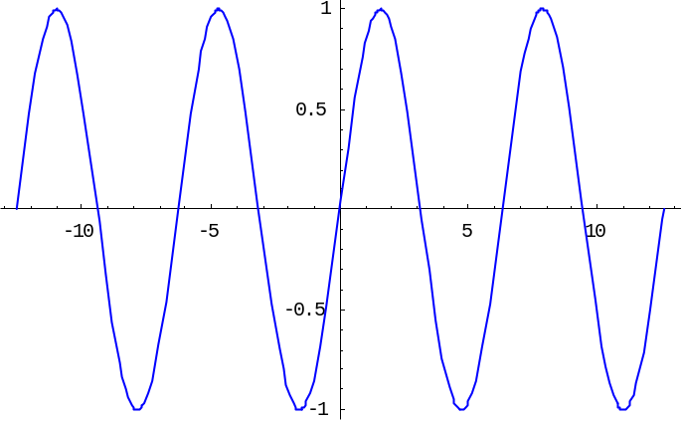
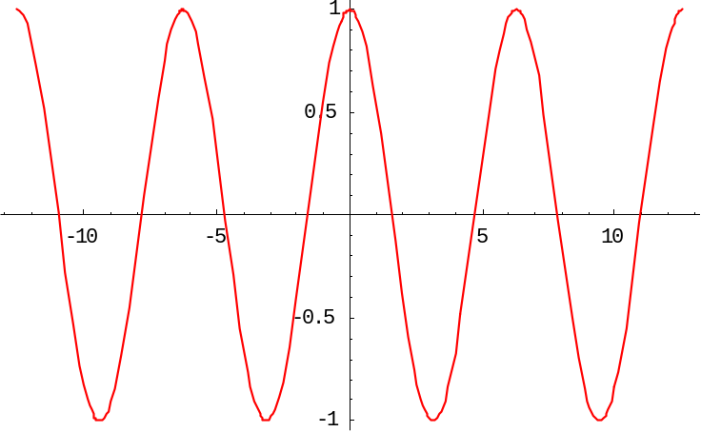


Important continuity results
Sine and Cosine functions are continuous everywhere since
$$y=sinx$$
$$y=cosx$$

Slide 8
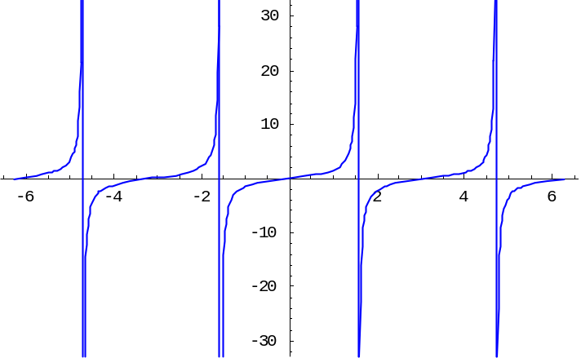
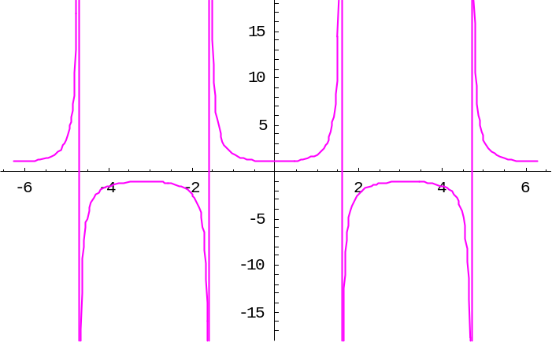

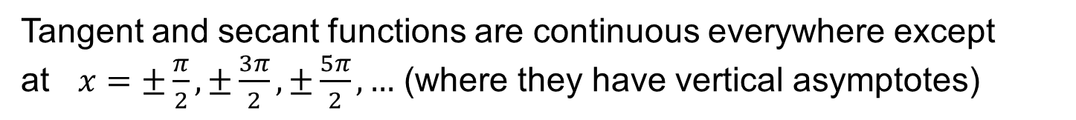

Important continuity results
Tangent and secant functions are continuous everywhere except at $x=±\frac{π}{2},±\frac{3π}{2}, ±\frac{5π}{2}, …$ (where they have vertical asymptotes)
$$y=tanx$$
$$y=secx$$

Slide 9
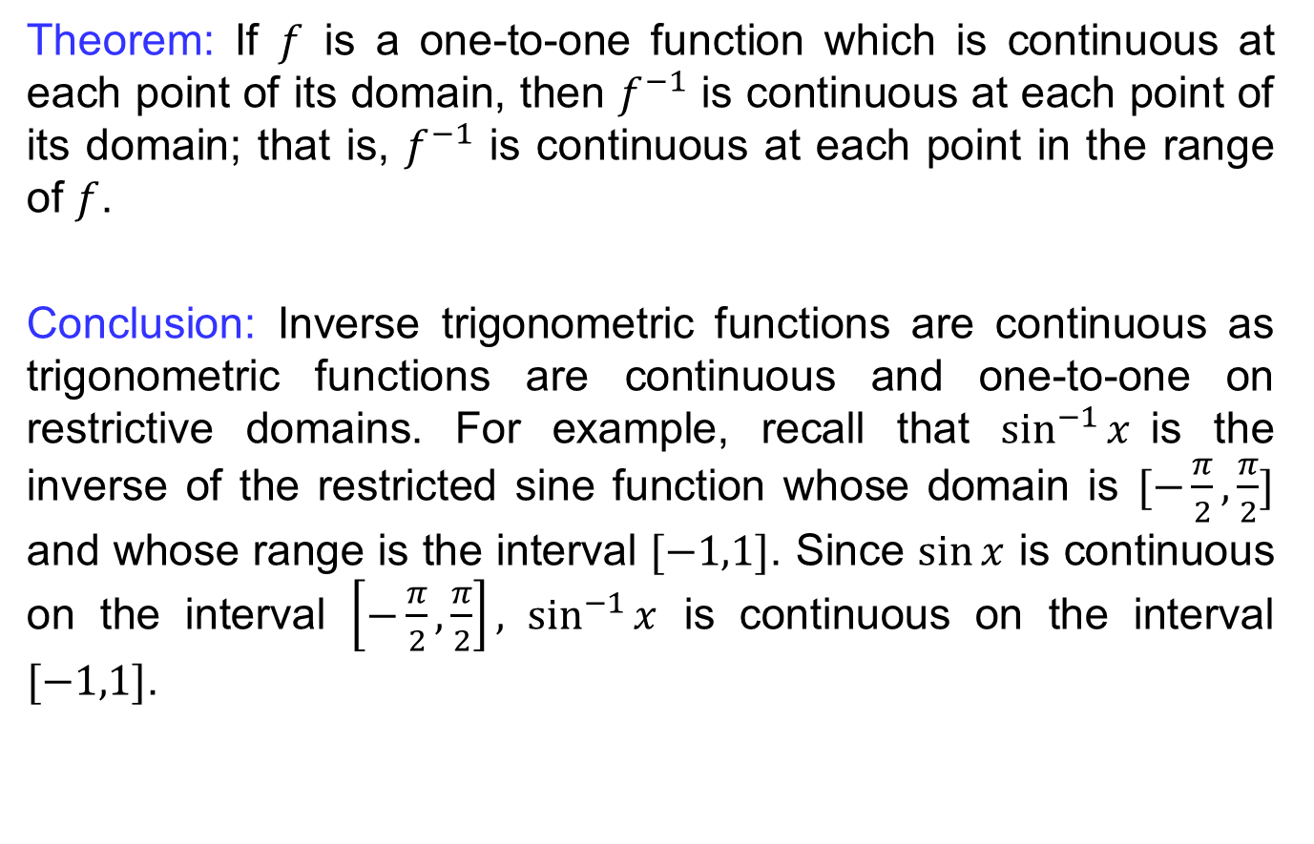
Important continuity results
Theorem: If $f$ is a one-to-one function which is continuous at each point of its domain, then $f^{−1}$ is continuous at each point of its domain; that is, $f^{−1}$ is continuous at each point in the range of $f$.
Conclusion: Inverse trigonometric functions are continuous as trigonometric functions are continuous and one-to-one on restrictive domains. For example, recall that $\sin^{−1}{x}$is the inverse of the restricted sine function whose domain is $[−\frac{π}{2},\frac{π}{2}]$ and whose range is the interval $[−1,1]$. Since $\sin{x}$ is continuous on the interval $\left[−\frac{π}{2},\frac{π}{2}\right], \sin^{−1}{x}$ is continuous on the interval $[−1,1]$.

Slide 10
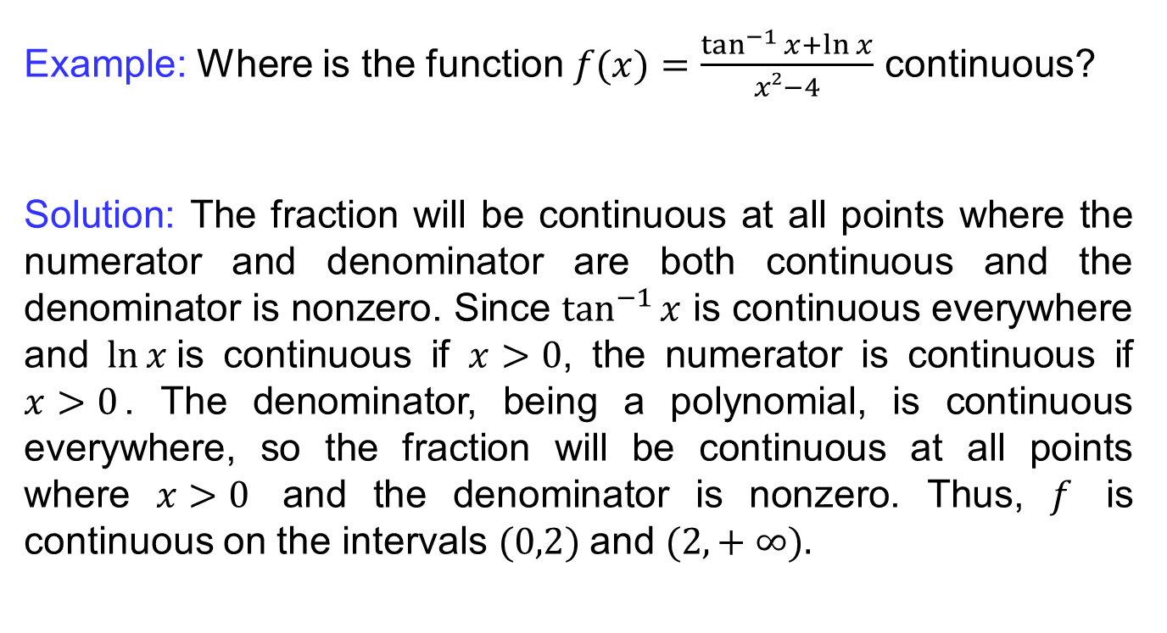
Important continuity results
Example: Where is the function $f(x)=\frac{\tan^{−1}{x}+\ln{x}}{x²−4}$ continuous?
Solution: The fraction will be continuous at all points where the numerator and denominator are both continuous and the denominator is nonzero. Since $\tan^{−1}{x}$ is continuous everywhere and $\ln{x }$is continuous if $x>0$, the numerator is continuous if $x>0$. The denominator, being a polynomial, is continuous everywhere, so the fraction will be continuous at all points where $x>0$ and the denominator is nonzero. Thus, $f$ is continuous on the intervals $(0,2)$and $(2, + ∞).$

Slide 11
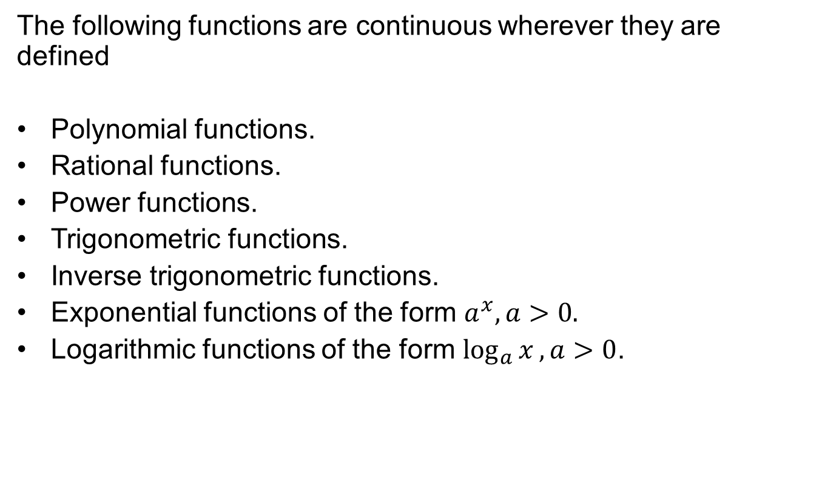
Important continuity results
The following functions are continuous wherever they are defined
Polynomial functions.
Rational functions.
Power functions.
Trigonometric functions.
Inverse trigonometric functions.
Exponential functions of the form $a^{x}, a>0.$
Logarithmic functions of the form $\log_{a}{x}, a>0$.

Slide 12
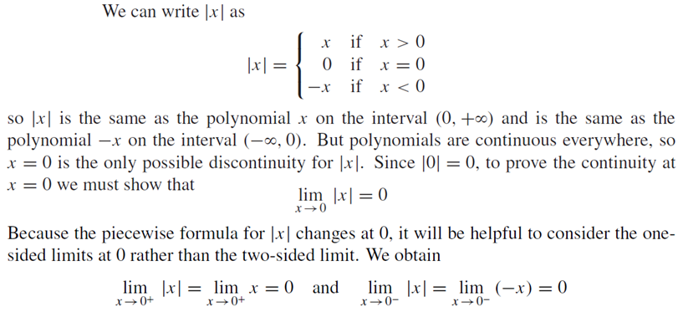
Important continuity results
Example: |x| is continuous everywhere.

Slide 13
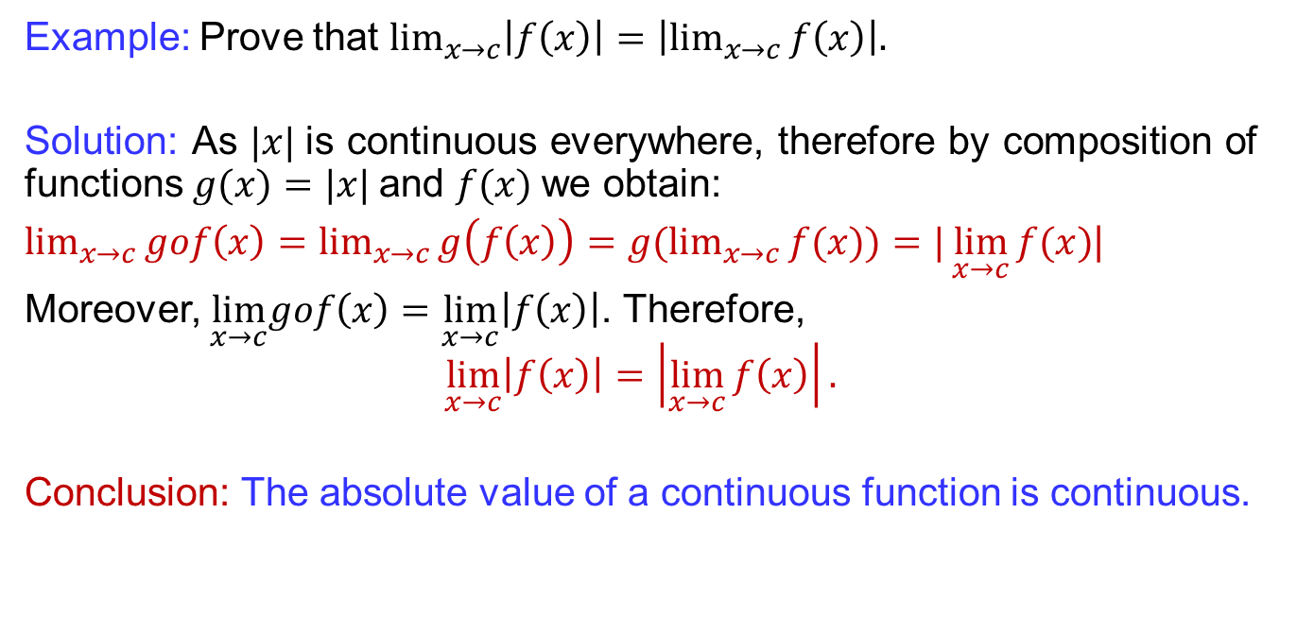
Important continuity results
Example: Prove that $\lim_{x→c}\left|f\left(x\right)\right|=\left|\lim_{x→c}{f\left(x\right)}\right|.$
Solution: As $|x|$is continuous everywhere, therefore by composition of functions $g(x)=|x|$and $f(x)$we obtain:
$\lim_{x→c}{gof\left(x\right)=\lim_{x→c}{g\left(f\left(x\right)\right)}=g(\lim_{x→c}{f(x))}=|\lim_{x→c}{f(x)}}$|
Moreover, $\lim_{x→c}gof\left(x\right)=\lim_{x→c}\left|f\left(x\right)\right|$. Therefore,
$$\lim_{x→c}\left|f\left(x\right)\right|=\left|\lim_{x→c}{f\left(x\right)}\right|.$$
Conclusion: The absolute value of a continuous function is continuous.

Slide 14
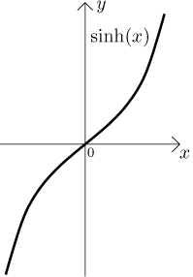
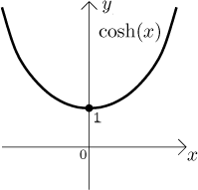
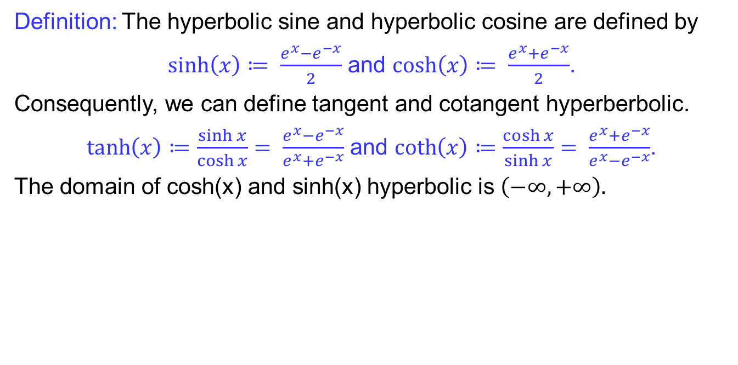
Hyperbolic functions
Definition: The hyperbolic sine and hyperbolic cosine are defined by
$\sinh\left(x\right)≔ \frac{e^{x}−e^{−x}}{2}$ and $\cosh\left(x\right)≔ \frac{e^{x}+e^{−x}}{2}$.
Consequently, we can define tangent and cotangent hyperberbolic.
$\tanh\left(x\right)≔\frac{\sinh{x}}{\cosh{x}}= \frac{e^{x}−e^{−x}}{e^{x}+e^{−x}}$ and $\coth\left(x\right)≔\frac{\cosh{x}}{\sinh{x}}= \frac{e^{x}+e^{−x}}{e^{x}−e^{−x}}$.
The domain of cosh(x) and sinh(x) hyperbolic is $\left(−∞,+∞\right).$

Slide 15
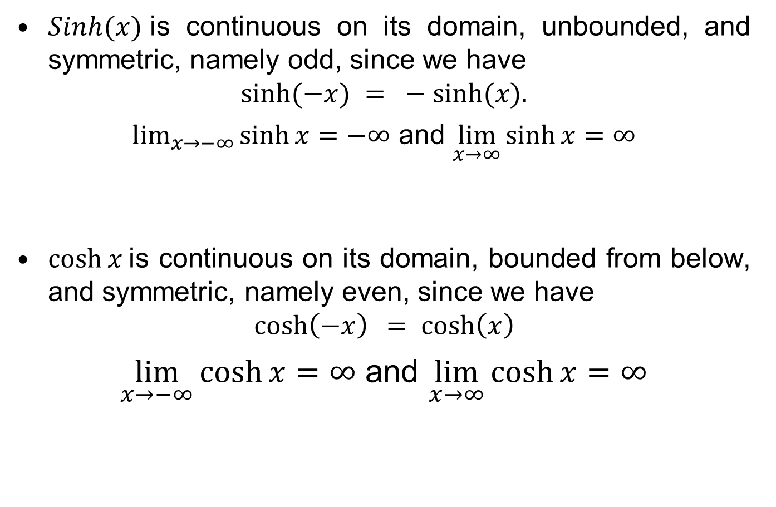
Hyperbolic functions
$Sinh(x)$is continuous on its domain, unbounded, and symmetric, namely odd, since we have
$$sinh⁡(−x) = −sinh⁡(x).$$
$\lim_{x→−∞}{\sinh{x}}=−∞$ and $\lim_{x→∞}{\sinh{x}}=∞$
$\cosh{x}$is continuous on its domain, bounded from below, and symmetric, namely even, since we have
$$\cosh\left(−x\right) =\cosh\left(x\right)$$
$\lim_{x→−∞}{\cosh{x}}=∞$ and $\lim_{x→∞}{\cosh{x}}=∞$

Slide 16
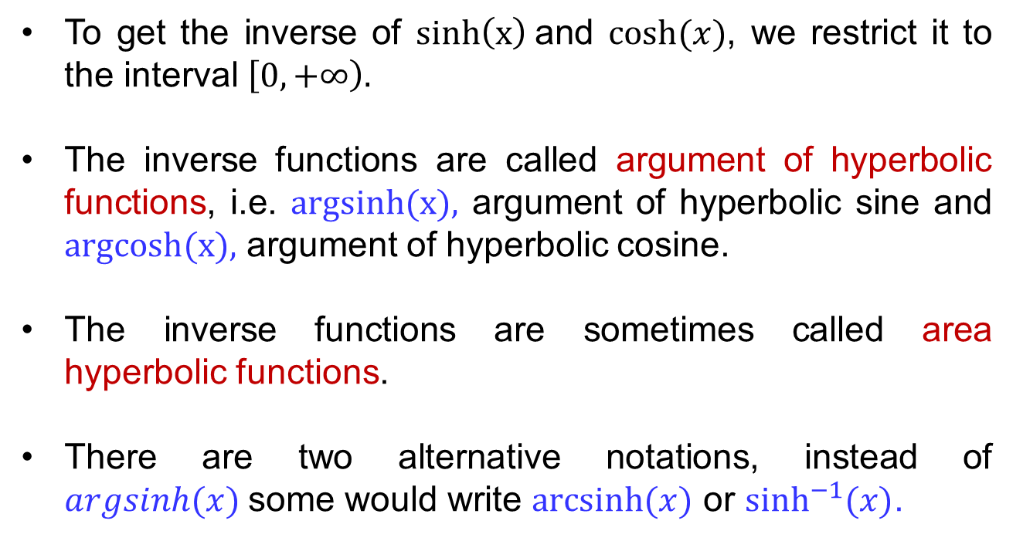
Inverse hyperbolic functions
To get the inverse of $sinh\left(x\right)$and $cosh⁡(x)$, we restrict it to the interval $\left[0,+∞\right).$
The inverse functions are called argument of hyperbolic functions, i.e. $argsinh(x),$ argument of hyperbolic sine and $argcosh(x),$ argument of hyperbolic cosine.
The inverse functions are sometimes called area hyperbolic functions.
There are two alternative notations, instead of $argsinh(x)$some would write $arcsinh⁡(x)$ or $\sinh^{−1}(x)$.

Slide 17
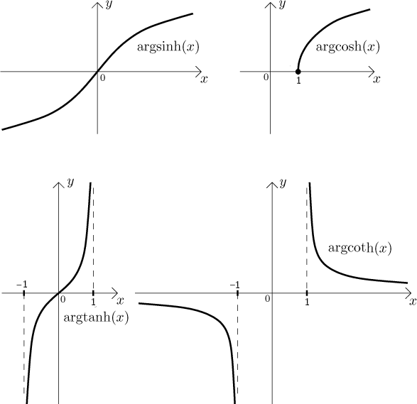
Inverse hyperbolic functions

Slide 18
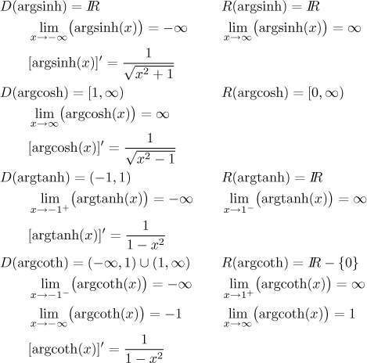
Inverse hyperbolic functions

Slide 19
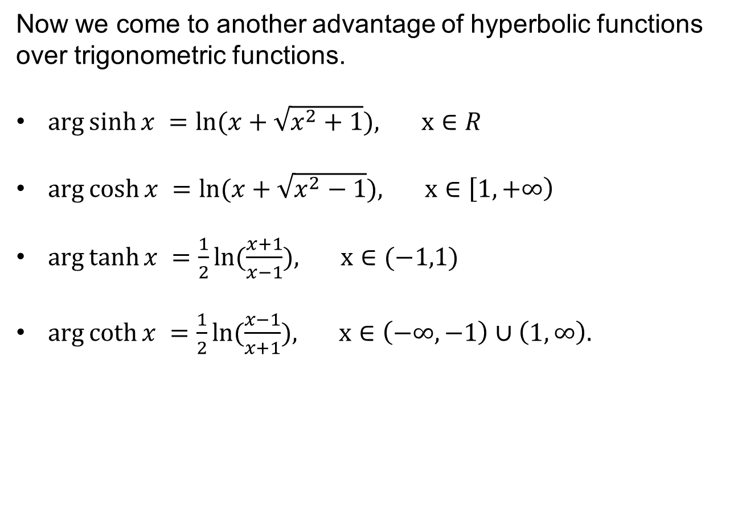
Inverse hyperbolic functions
Now we come to another advantage of hyperbolic functions over trigonometric functions.
$\arg{\sinh{x }}=\ln{(x+\sqrt{x^{2}+1}}), x∈R$
$\arg{\cosh{x }}=\ln{(x+\sqrt{x^{2}−1}}), x∈\left[1,+∞\right)$
$\arg{\tanh{x }}=\frac{1}{2}ln{(\frac{x+1}{x−1}}), x∈(−1,1)$
$\arg{\coth{x }}=\frac{1}{2}ln{(\frac{x−1}{x+1}}), x∈\left(−∞,−1\right)∪\left(1,∞\right).$

Slide 20
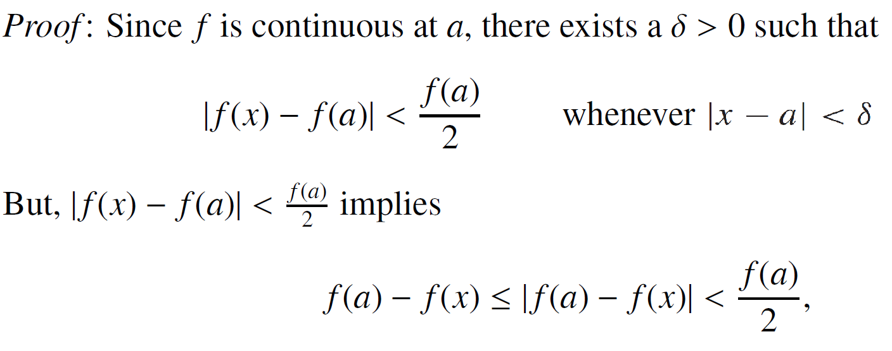
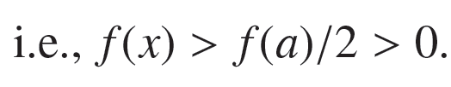

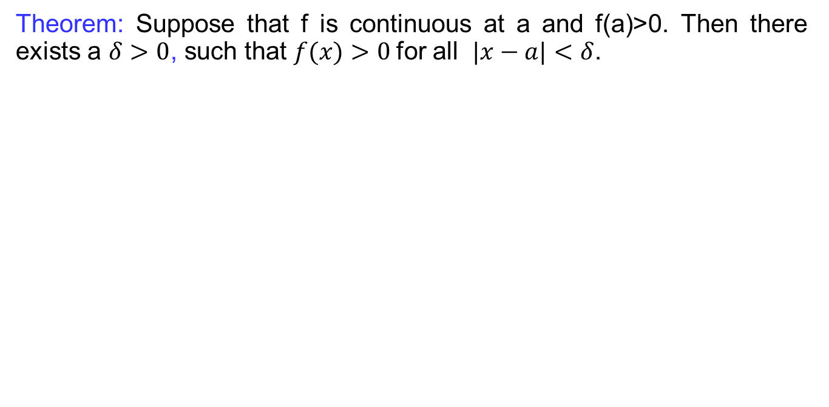
Boundedness of continuous functions
Theorem: Suppose that f is continuous at a and f(a)>0. Then there exists a $δ>0$, such that $f(x)>0$for all $|x−a|<δ$.

Slide 21
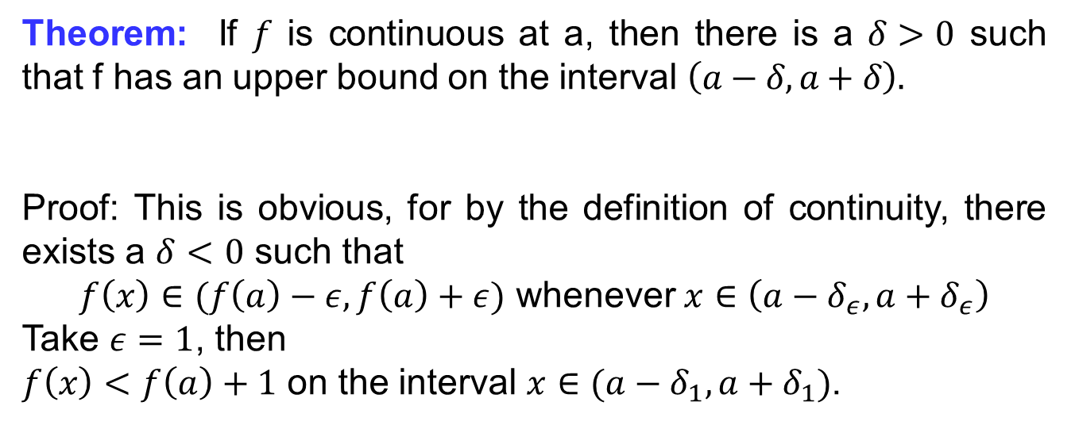
Boundedness of continuous functions
Theorem: If $f$ is continuous at a, then there is a $δ>0$ such that f has an upper bound on the interval $\left(a−δ,a+δ\right).$
Proof: This is obvious, for by the definition of continuity, there exists a $δ<0$ such that
$f\left(x\right)∈(f\left(a\right)−ε,f\left(a\right)+ε)$ whenever $x∈\left(a−δ_{ε},a+δ_{ε}\right)$
Take $ε=1$, then
$f\left(x\right)<f\left(a\right)+1$ on the interval $x∈(a−δ_{1}, a+δ_{1})$.

Slide 22
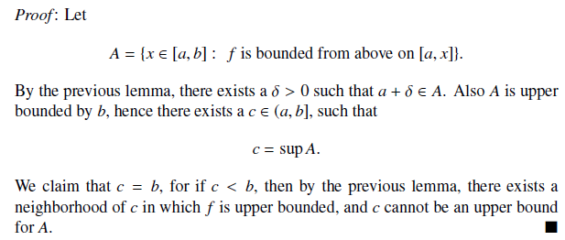
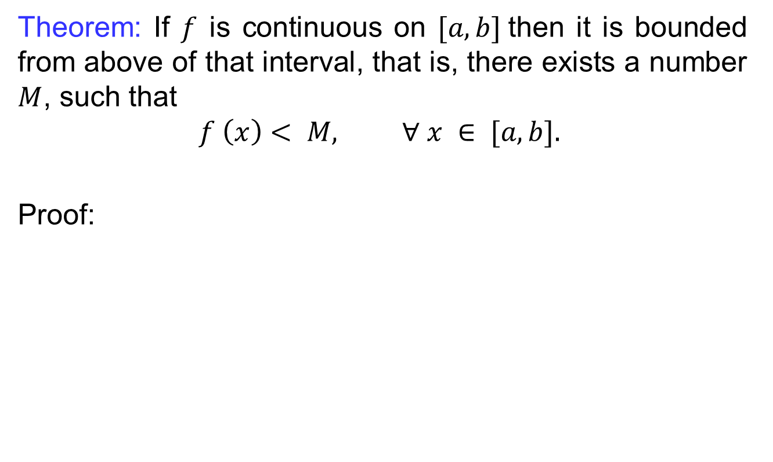
Boundedness of continuous functions
Theorem: If $f$ is continuous on $[a, b]$then it is bounded from above of that interval, that is, there exists a number $M$, such that
$$f \left(x\right)< M, ∀ x ∈ [a, b].$$
Proof:

Slide 23
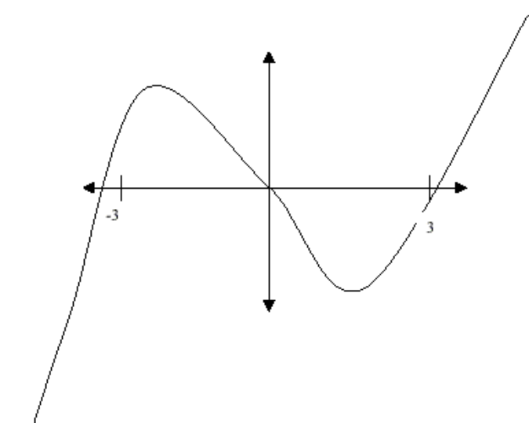
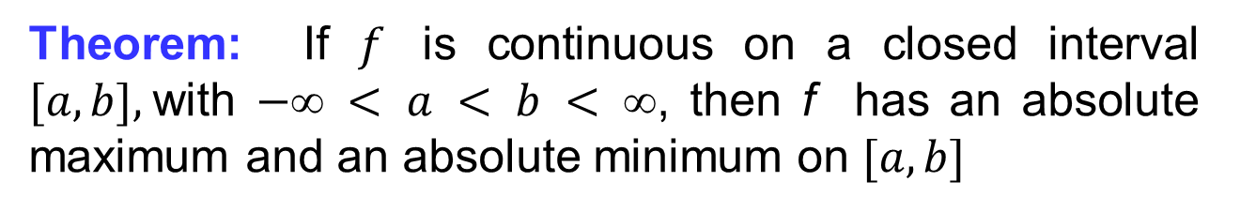
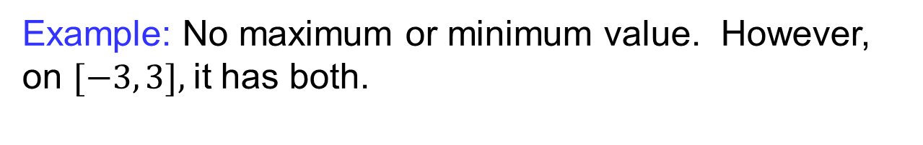
Boundedness of continuous functions
Theorem: If $f$ is continuous on a closed interval $[a,b],$with $− < a < b < $, then f has an absolute maximum and an absolute minimum on $[a, b]$
Example: No maximum or minimum value. However, on $[−3, 3],$it has both.

Slide 24
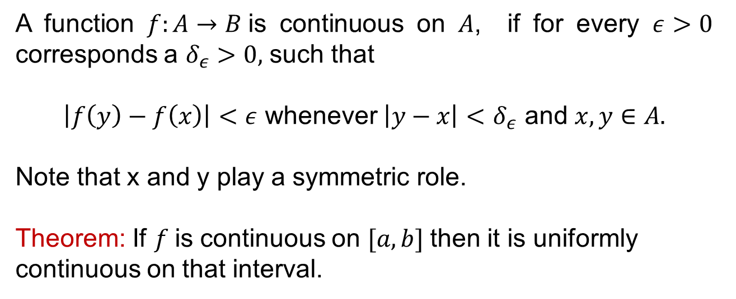
Uniform continuity
A function $f:A→B$is continuous on $A$, if for every $ε>0$ corresponds a $δ_{ε}>0,$ such that
$\left|f\left(y\right)−f\left(x\right)\right|<ε$ whenever $\left|y−x\right|<$ $δ_{ε}$ and $x,y∈A.$
Note that x and y play a symmetric role.
Theorem: If $f$is continuous on $[a,b]$then it is uniformly continuous on that interval.

Slide 25
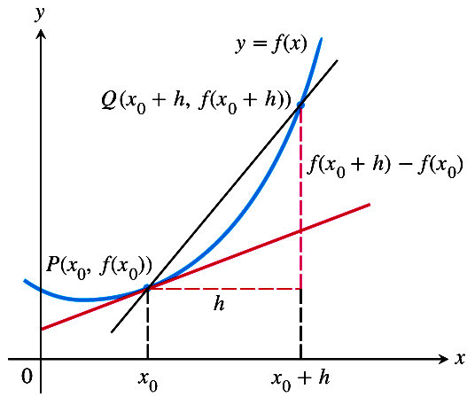
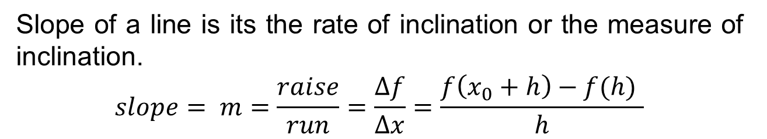
Tangent lines
Slope of a line is its the rate of inclination or the measure of inclination.
$$slope= m=\frac{raise}{run}=\frac{∆f}{∆x}=\frac{f\left(x_{0}+h\right)−f(h) }{h}$$

Slide 26
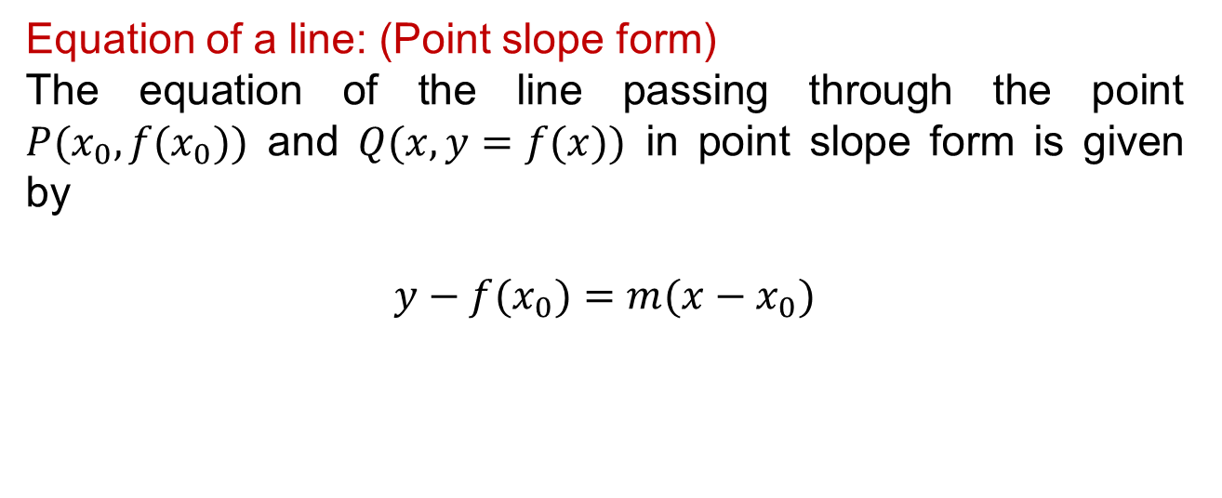
Tangent lines
Equation of a line: (Point slope form)
The equation of the line passing through the point $P(x_{0},f(x_{0}))$ and $Q(x,y=f(x))$ in point slope form is given by
$$y−f(x_{0})=m({x−x}_{0})$$

Slide 27
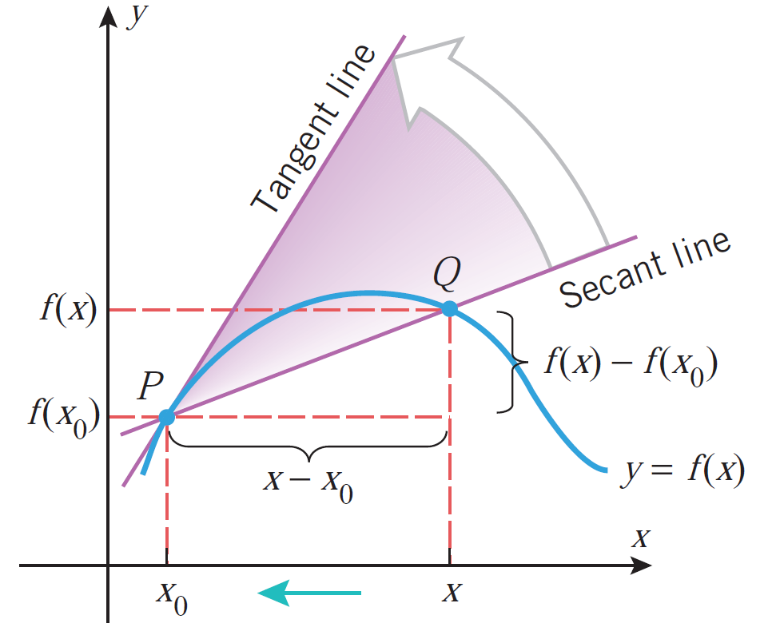
Tangent lines

Slide 28
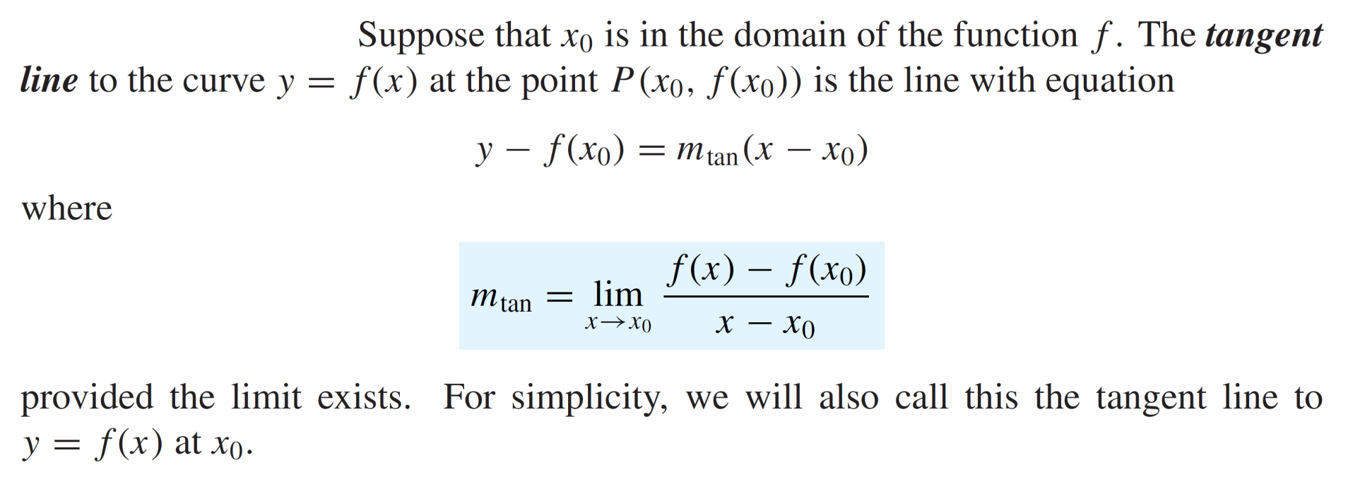

Tangent lines

Slide 29
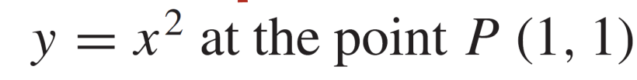
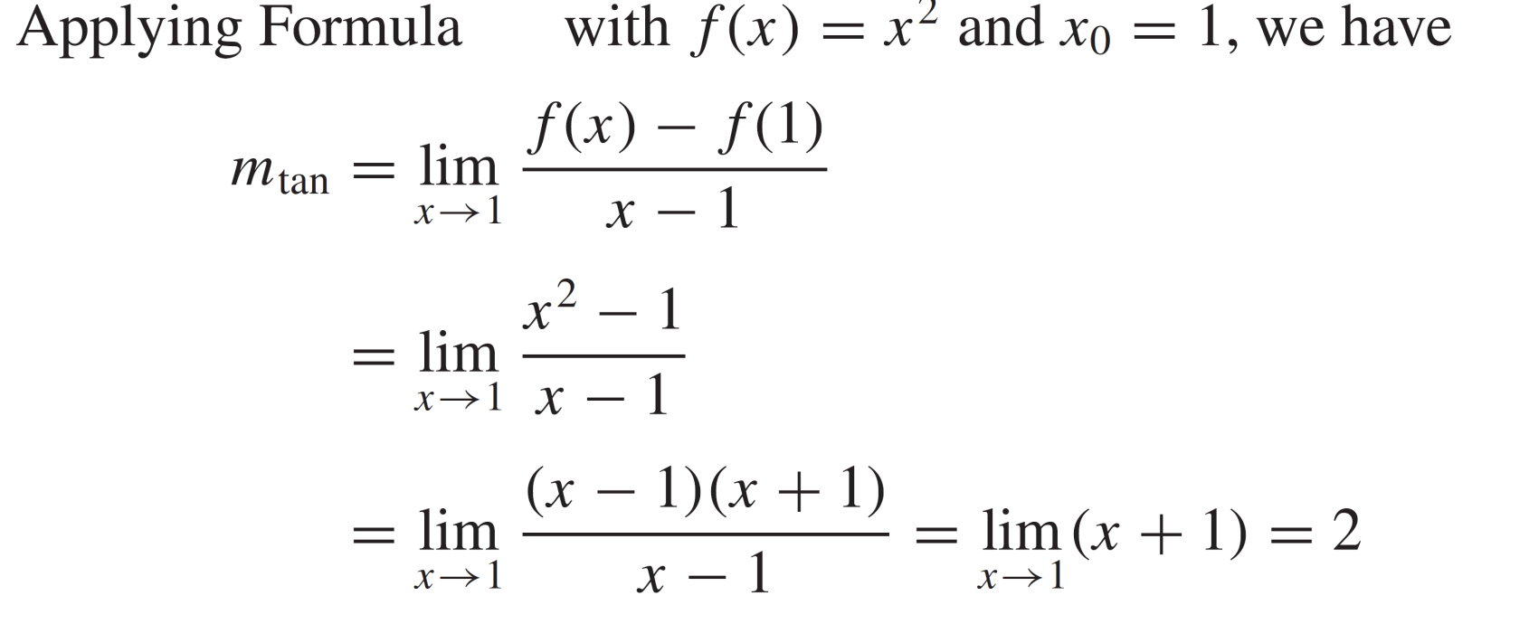
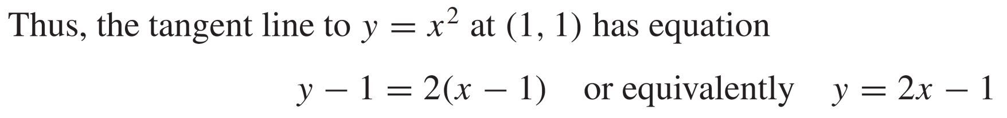
Tangent lines
Example: Find the tangent line to

Slide 30
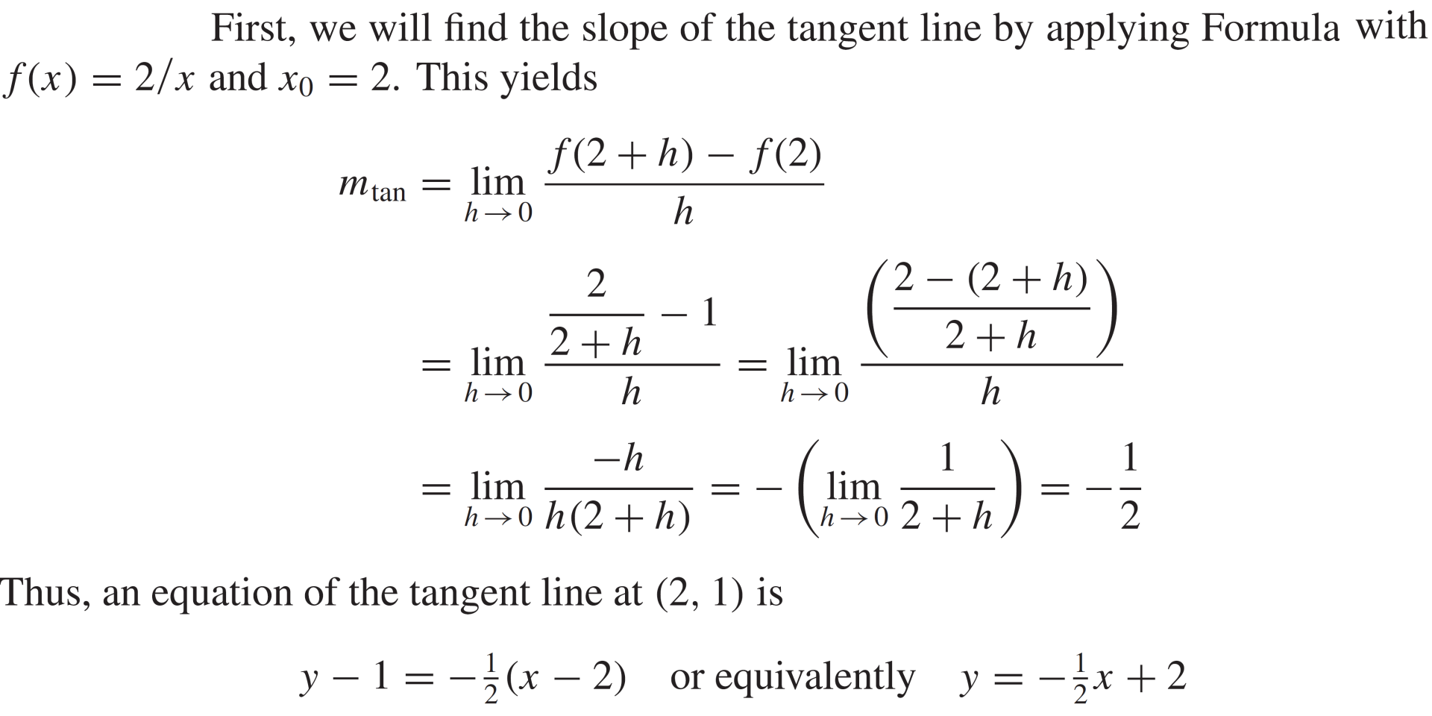
Tangent lines
Tangent lines
Example

Slide 31
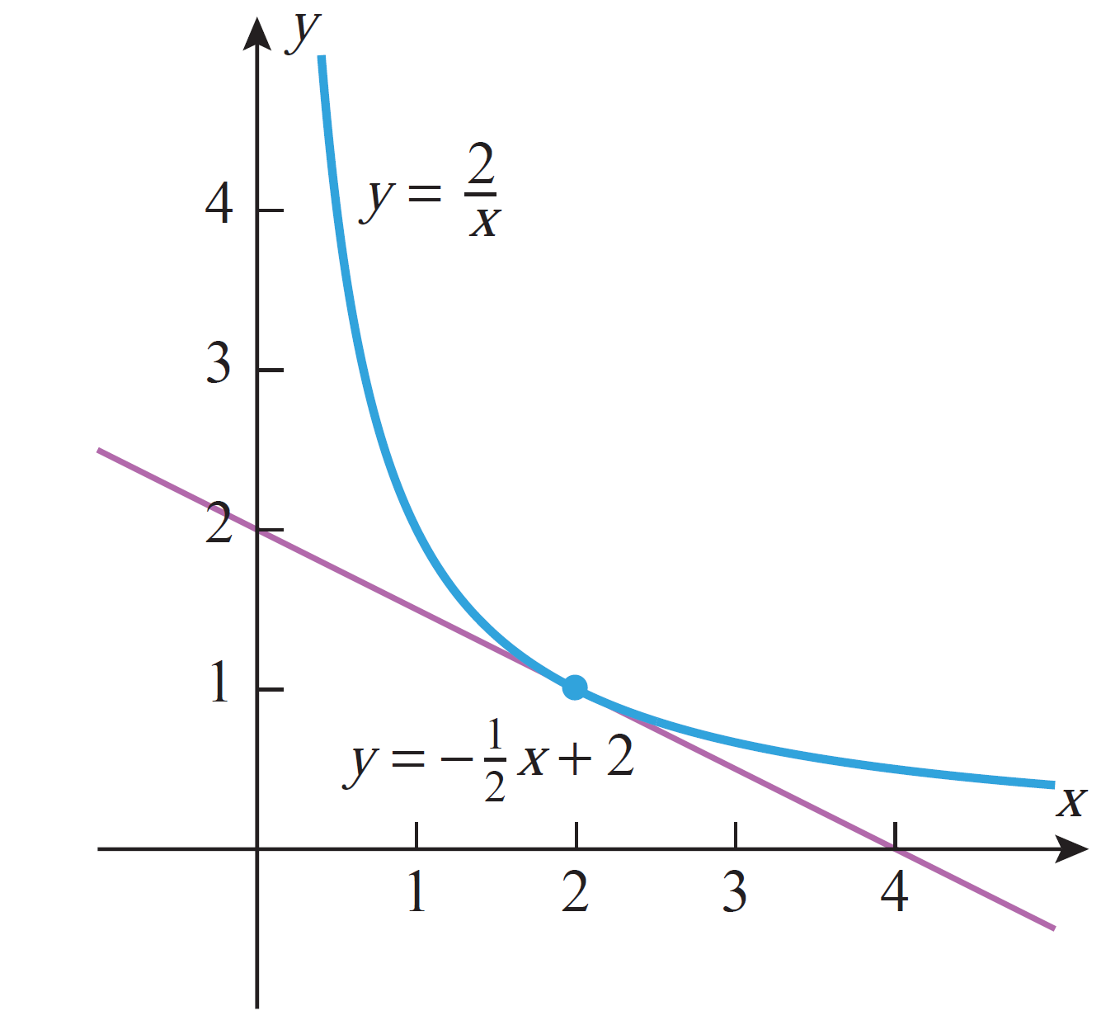
Tangent lines

Slide 32
Lecture Summary
    Formal definition of continuity
    Important results of continuity
    Hyperbolic trigonometric functions
    Inverse hyperbolic trigonometric functions
    Boundedness of continuous functions
    Uniform continuity
    Tangent lines

