Slide 1
(MTH 250)
Calculus
Lecture 6

Slide 2
Previous Lecture’s Summary
    Some working rules
    Limit at infinity
    Horizontal asymptotes
    Laws of Limit at infinity
    Limits of log and exp functions
    Formal definition of limit
    Uniqueness of a Limit

Slide 3
Today’s Lecture
    Limits by definition
    Formal definition of one-sided limits
    Comparison theorem
    Sandwich theorem
    Golden rules for limits
    Introduction to continuity
    Discontinuity
    Piecewise continuous functions
    Continuous extension
    Intermediate value theorem

Slide 4
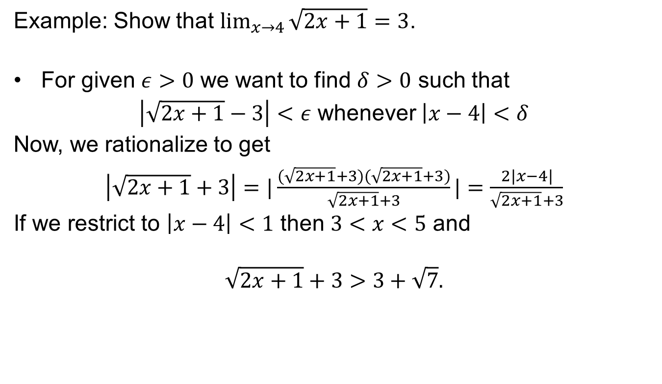
Limits by definition
Example: Show that $\lim_{x→4}{\sqrt{2x+1}=3}$.
For given $ε>0$ we want to find $δ>0$ such that
$\left|\sqrt{2x+1}−3\right|<ε$ whenever $\left|x−4\right|<δ$
Now, we rationalize to get
$\left|\sqrt{2x+1}+3\right|=|\frac{(\sqrt{2x+1}+3)(\sqrt{2x+1}+3)}{\sqrt{2x+1}+3}|=\frac{2|x−4|}{\sqrt{2x+1}+3}$
If we restrict to $\left|x−4\right|<1$ then $3<x<5$ and
$$\sqrt{2x+1}+3>3+\sqrt{7}.$$

Slide 5
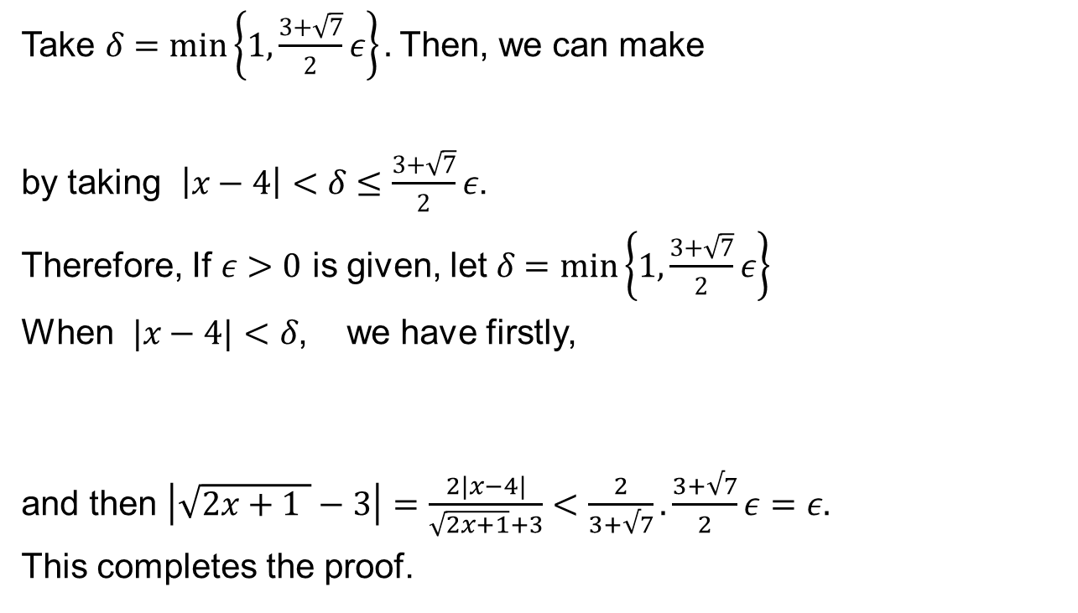

Limits by definition
Take $δ=\min\left\{1, \frac{3+\sqrt{7}}{2}ε\right\}.$Then, we can make
by taking $\left|x−4\right|<δ≤\frac{3+\sqrt{7}}{2}ε$.
Therefore, If $ε>0$ is given, let$δ=\min\left\{1, \frac{3+\sqrt{7}}{2}ε\right\}$
When $|x−4|<δ$, we have firstly,
and then $\left|\sqrt{2x+1 }−3\right|=\frac{2|x−4|}{\sqrt{2x+1}+3}<\frac{2}{3+√7}.\frac{3+√7}{2}ε=ε.$
This completes the proof.
$\left|\sqrt{2x+1}−3\right|<ε$

Slide 6
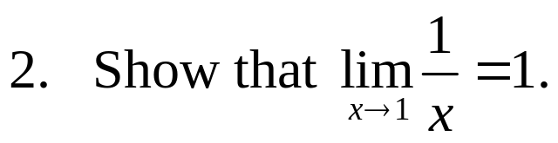
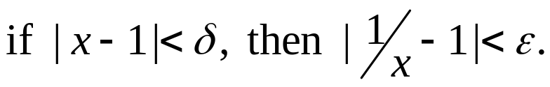
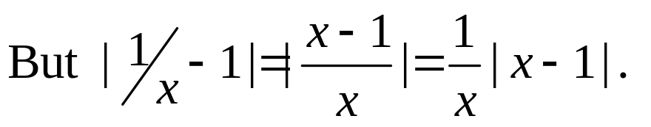
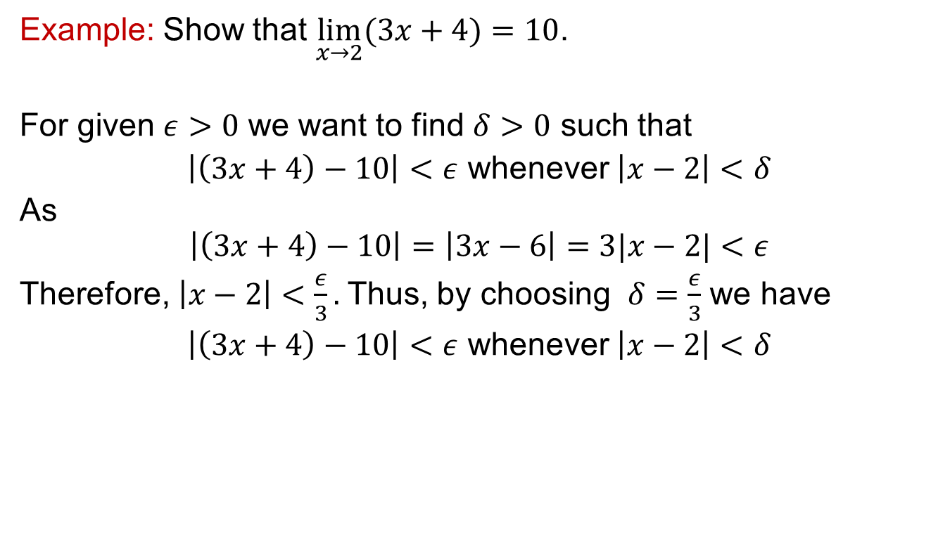
Limits by definition
Example: Show that $\lim_{x→2}{(3x+4)=10}$.
For given $ε>0$ we want to find $δ>0$ such that
$\left|\left(3x+4\right)−10\right|<ε$ whenever $\left|x−2\right|<δ$
As
$$\left|\left(3x+4\right)−10\right|=\left|3x−6\right|=3|x−2|<ε$$
Therefore, $\left|x−2\right|<\frac{ε}{3}.$Thus, by choosing $δ=\frac{ε}{3}$ we have
$\left|\left(3x+4\right)−10\right|<ε$ whenever $\left|x−2\right|<δ$
What do we do with the x?

Slide 7
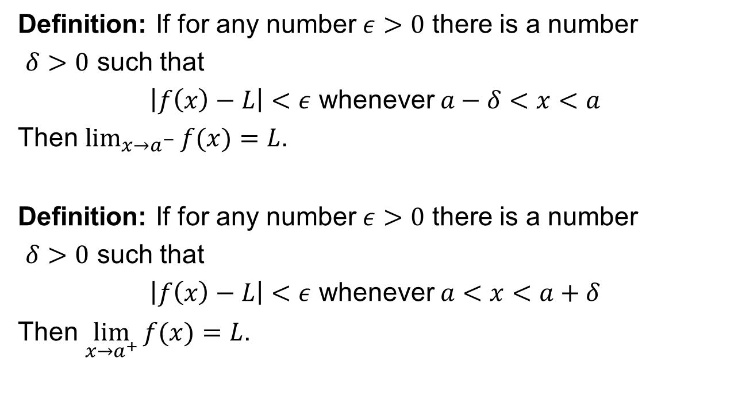
Formal definition of one sided limit
Definition: If for any number $ε>0$ there is a number
$δ>0$ such that
$\left|f\left(x\right)−L\right|<ε$ whenever $a−δ<x<a$
Then $\lim_{x→a^{−}}{f(x)}=L$.
Definition: If for any number $ε>0$ there is a number
$δ>0$ such that
$\left|f\left(x\right)−L\right|<ε$ whenever $a<x<a+δ$
Then $\lim_{x→a^{+}}{f(x)}=L$.

Slide 8
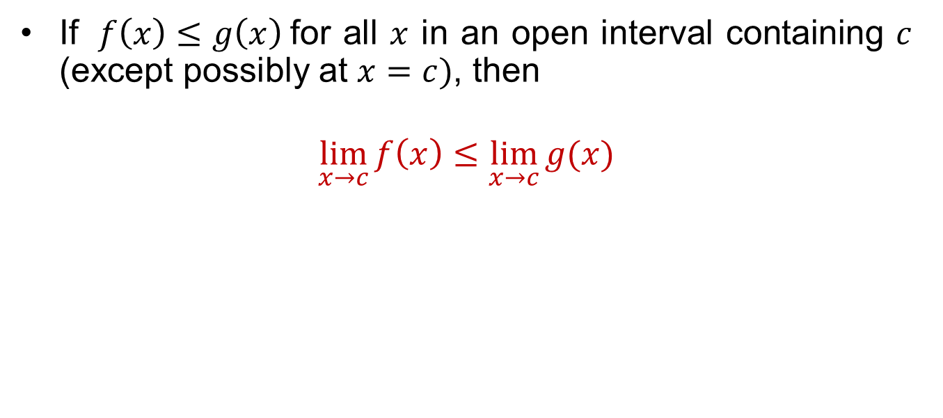
Comparison theorem
If $f\left(x\right)≤g\left(x\right)$for all $x$ in an open interval containing $c$ (except possibly at $x=c)$, then
$$\lim_{x→c}{f\left(x\right)≤\lim_{x→c}{g(x)}}$$

Slide 9
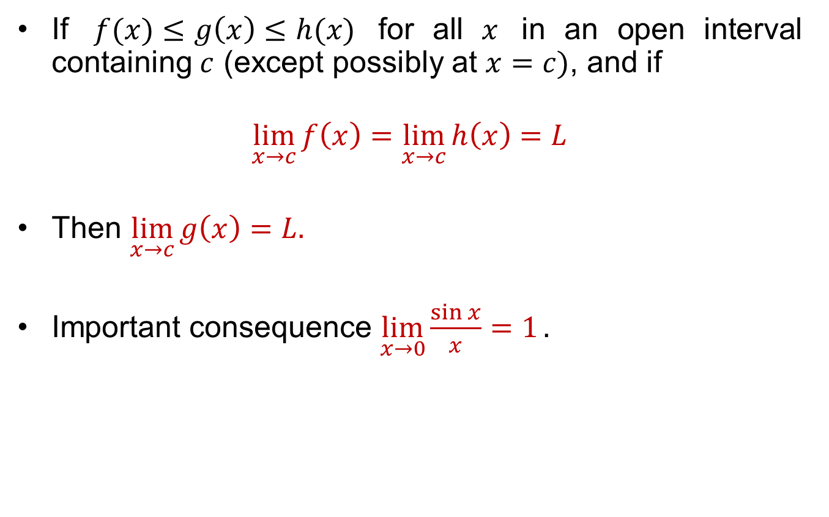
Sandwich theorem
If $f(x)≤g\left(x\right)≤h(x)$ for all $x$ in an open interval containing $c$ (except possibly at $x=c)$, and if
$$\lim_{x→c}{f\left(x\right)=\lim_{x→c}{h\left(x\right)=L}}$$
Then $\lim_{x→c}{g\left(x\right)=L.}$
Important consequence $\lim_{x→0}{\frac{\sin{x}}{x}=1}.$

Slide 10
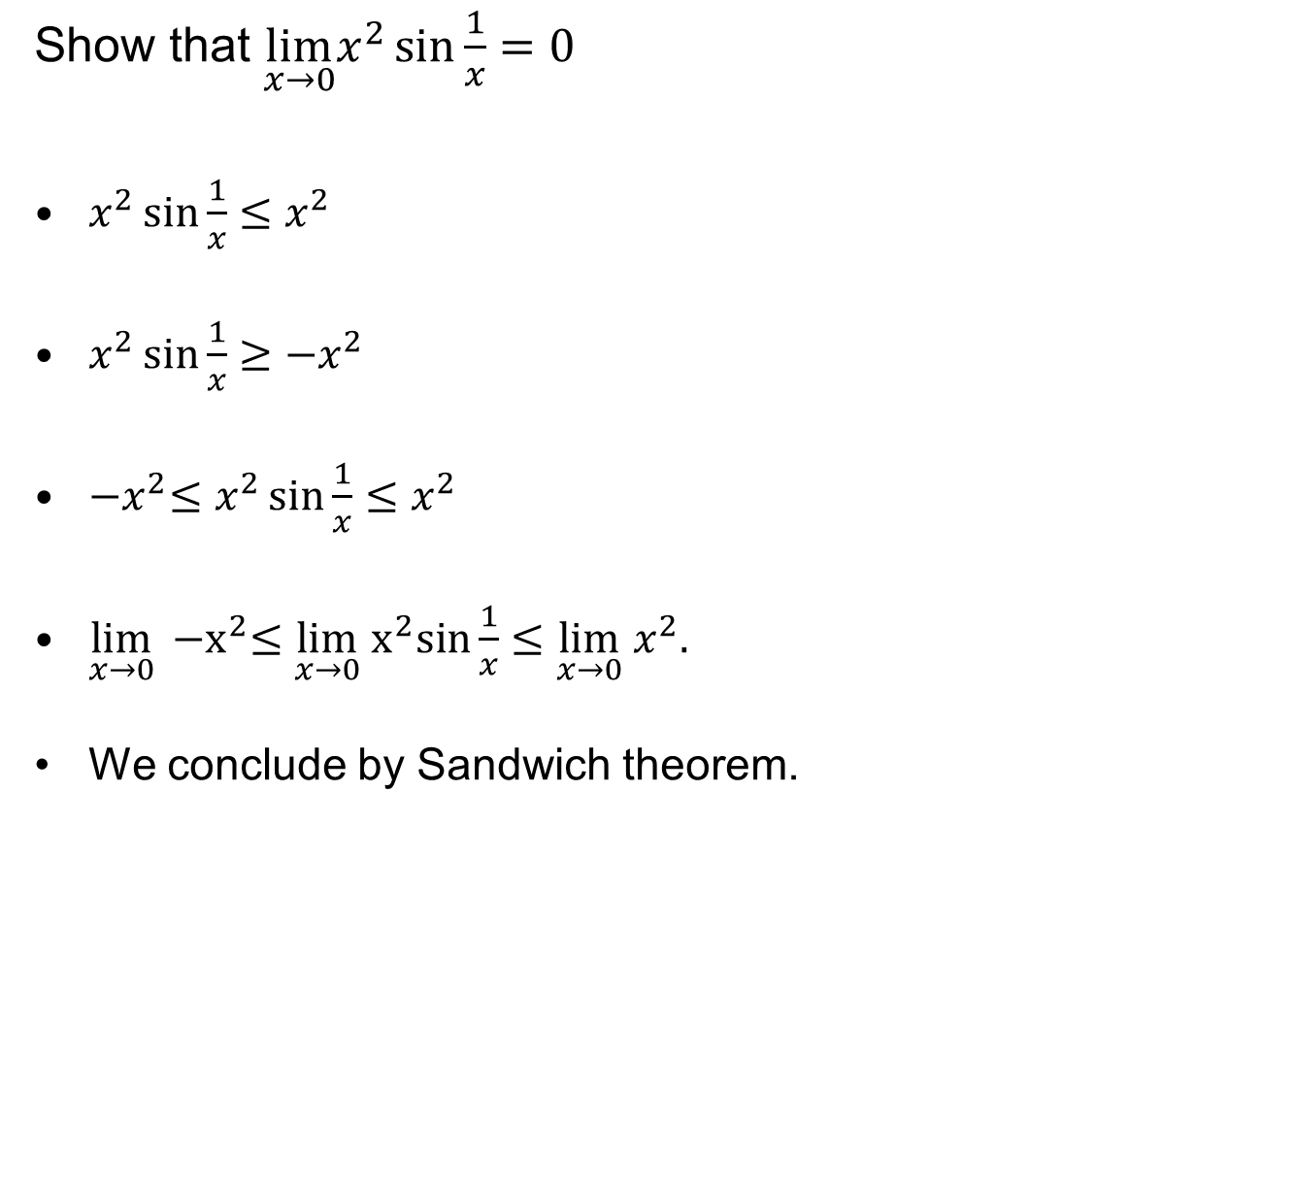
Sandwich theorem
Show that $\lim_{x→0}x^{2}{\sin{\frac{1}{x}}=0}$
$x^{2}\sin{\frac{1}{x}≤x^{2}}$
$x^{2}\sin{\frac{1}{x}≥−x^{2}}$
${−x}^{2}≤x^{2}\sin{\frac{1}{x}≤x^{2}}$
$\lim_{x→0}{{−x}^{2}≤\lim_{x→0} x^{2}sin{\frac{1}{x}}≤\lim_{x→0} x^{2}.}$
We conclude by Sandwich theorem.

Slide 11
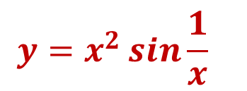
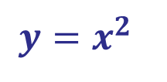
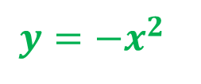
Sandwich theorem
$$y=x^{2}$$
$$y=x^{2}\sin{\frac{1}{x} }$$
$$y={−x}^{2}$$

Slide 12
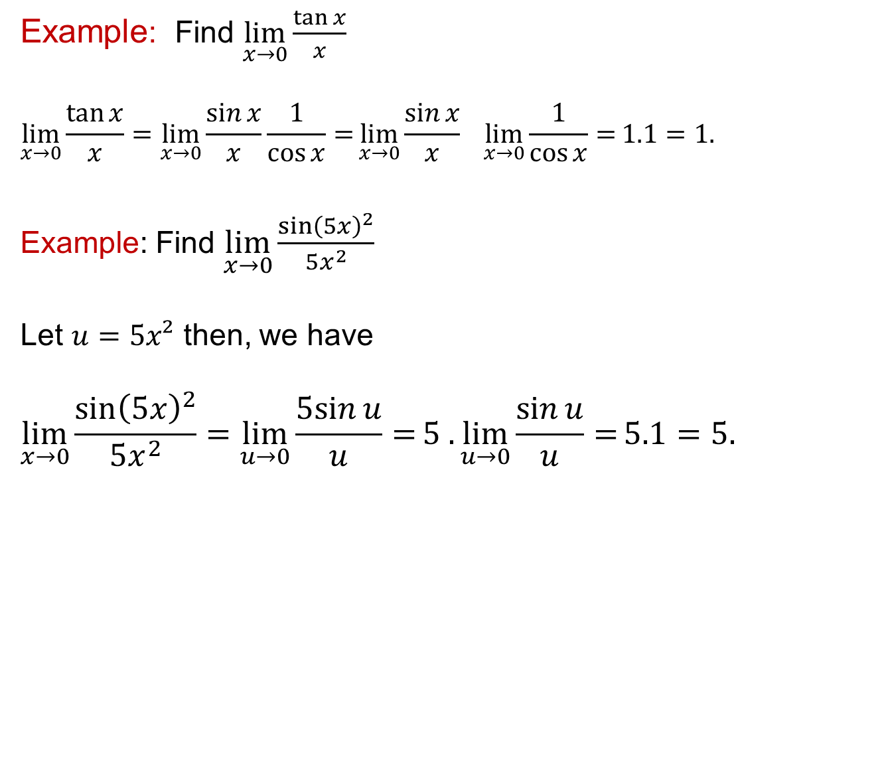
Sandwich theorem
Example: Find $\lim_{x→0}\frac{\tan{x}}{x}$
$$\lim_{x→0}\frac{\tan{x}}{x}=\lim_{x→0}{\frac{\sin{x}}{x}\frac{1}{\cos{x}}=}\lim_{x→0}{\frac{\sin{x}}{x}\lim_{x→0}{\frac{1}{\cos{x}}}=}1.1=1.$$
Example: Find $\lim_{x→0}\frac{\sin{{\left(5x\right)}^{2}}}{5x^{2}}$
Let $u=5x²$ then, we have
$$\lim_{x→0}\frac{\sin{{\left(5x\right)}^{2}}}{5x^{2}}=\lim_{u→0}{\frac{5sin{u}}{u}=}5 .\lim_{u→0}{\frac{\sin{u}}{u}=}5.1=5.$$

Slide 13
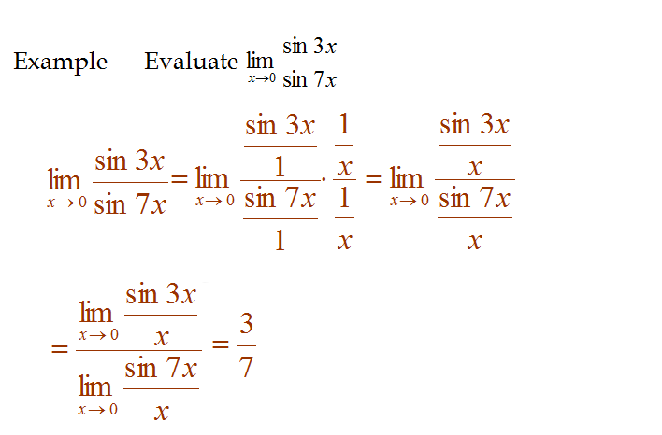
Sandwich theorem

Slide 14
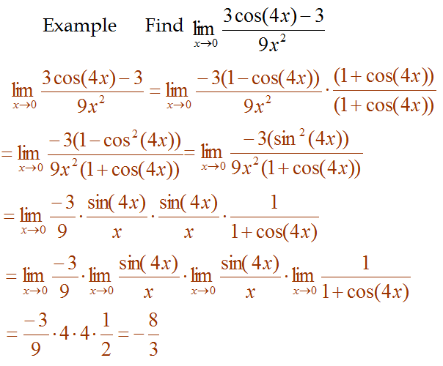
Sandwich theorem

Slide 15
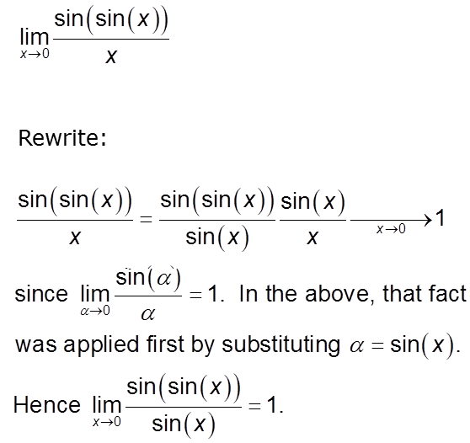
Sandwich theorem

Slide 16
Golden rules for limits
There are four basic methods that you need to remember for limits:
Direct substitution
Plug in x=a into the function (easy but does not work always)
Cancelation
Factor and cancel like terms, then substitute x=a.
    Rationalization
    Multiply by the conjugate to eliminate radicals
    Trigonometric Rules
    Apply special trigonometric limits.

Slide 17
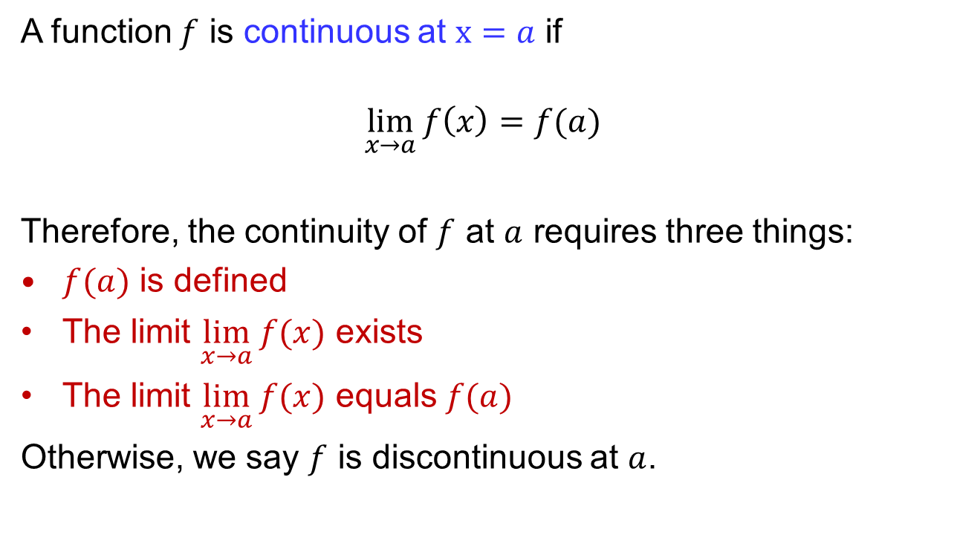
Introduction to continuity
.
A function $f$ is continuous at $x=a$ if
$$\lim_{x→a}{f\left(x\right)=f(a)}$$
Therefore, the continuity of $f$ at $a$ requires three things:
$f(a)$ is defined
The limit $\lim_{x→a}{f(x)}$ exists
The limit $\lim_{x→a}{f(x)}$ equals $f(a)$
Otherwise, we say $f$ is discontinuous at $a$.

Slide 18
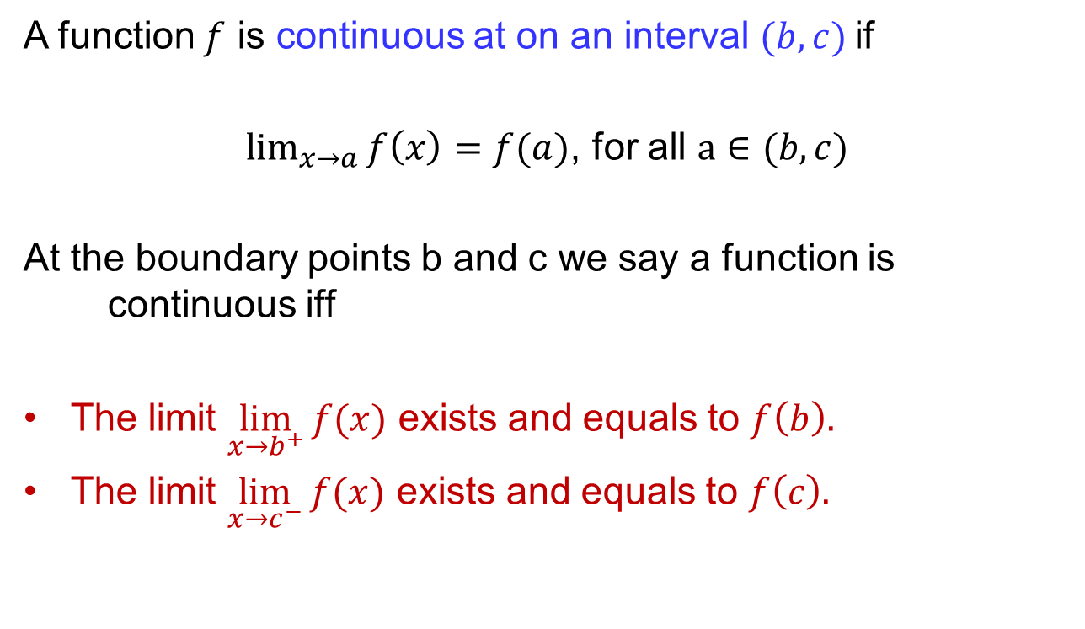
Introduction to continuity
.
A function $f$ is continuous at on an interval $(b,c)$if
$\lim_{x→a}{f\left(x\right)=f(a)}$, for all $a∈(b,c)$
At the boundary points b and c we say a function is continuous iff
The limit $\lim_{x→b^{+}}{f(x)}$ exists and equals to $f\left(b\right).$
The limit $\lim_{x→c^{−}}{f(x)}$ exists and equals to $f\left(c\right).$

Slide 19
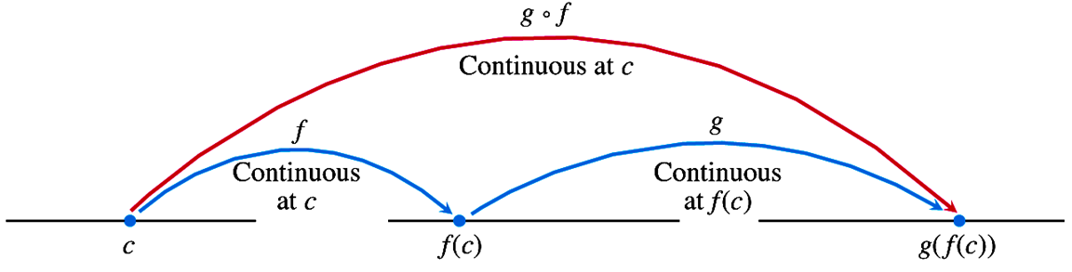
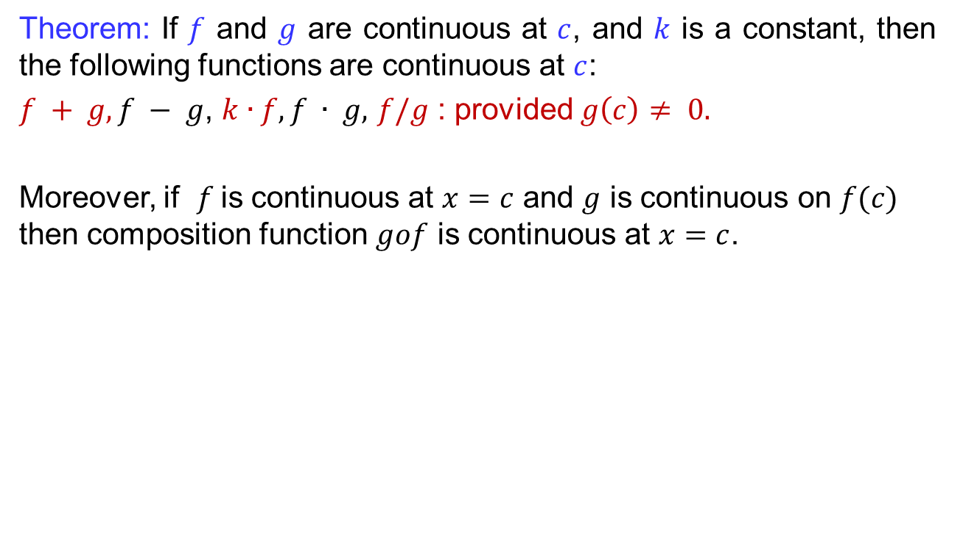
Introduction to continuity
.
Theorem: If $f$ and $g$ are continuous at $c$, and $k$ is a constant, then the following functions are continuous at $c$:
$f + g, f − g$, $k∙f, f ∙ g,$ $f/g$ : provided $g\left(c\right)≠ 0.$
Moreover, if $f$is continuous at $x=c$ and $g$ is continuous on $f(c)$ then composition function $gof$ is continuous at $x=c$.

Slide 20
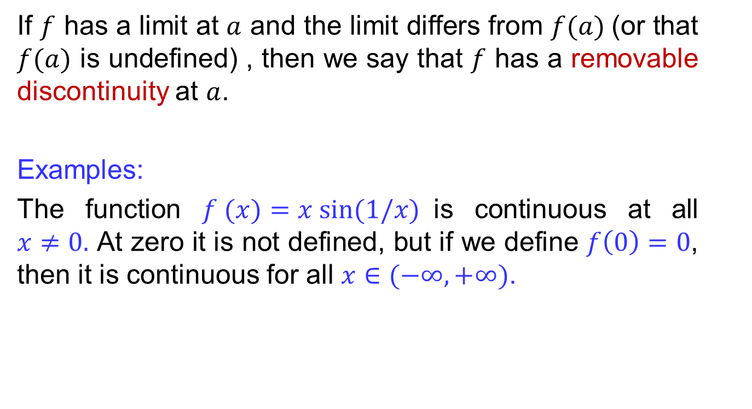
Discontinuities
If $f$ has a limit at $a$ and the limit differs from $f(a)$(or that $f(a)$ is undefined) , then we say that $f$ has a removable discontinuity at $a$.
Examples:
The function $f (x)=x sin⁡(1/x)$is continuous at all $x≠0.$ At zero it is not defined, but if we define $f\left(0\right)=0$, then it is continuous for all $x∈(−∞,+∞)$.

Slide 21
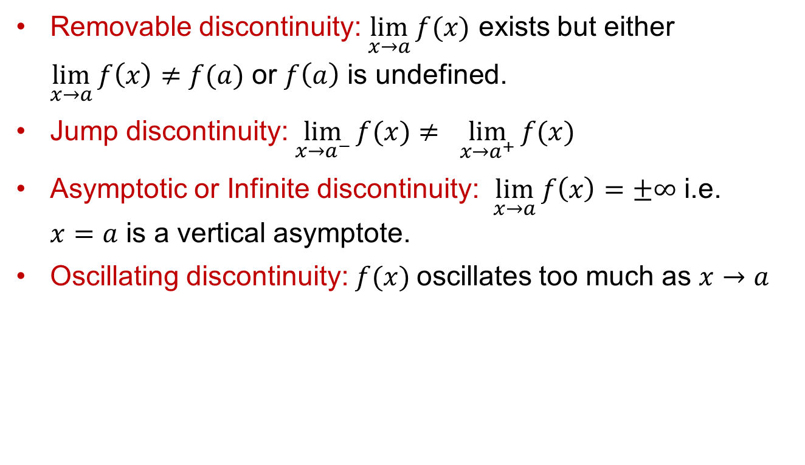
Discontinuities
Types of discontinuities
Removable discontinuity: $\lim_{x→a}{f(x)}$ exists but either $\lim_{x→a}{f\left(x\right)≠f(a)}$ or $f\left(a\right)$ is undefined.
Jump discontinuity: $\lim_{x→a^{−}}{f(x)}≠ \lim_{x→a^{+}}{f(x)}$
Asymptotic or Infinite discontinuity: $\lim_{x→a}{f\left(x\right)=±∞}$ i.e. $x=a$ is a vertical asymptote.
Oscillating discontinuity: $f(x)$oscillates too much as $x→a$

Slide 22
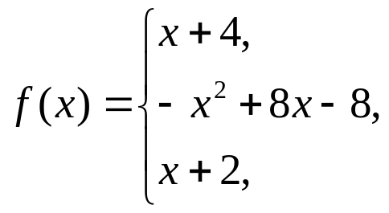
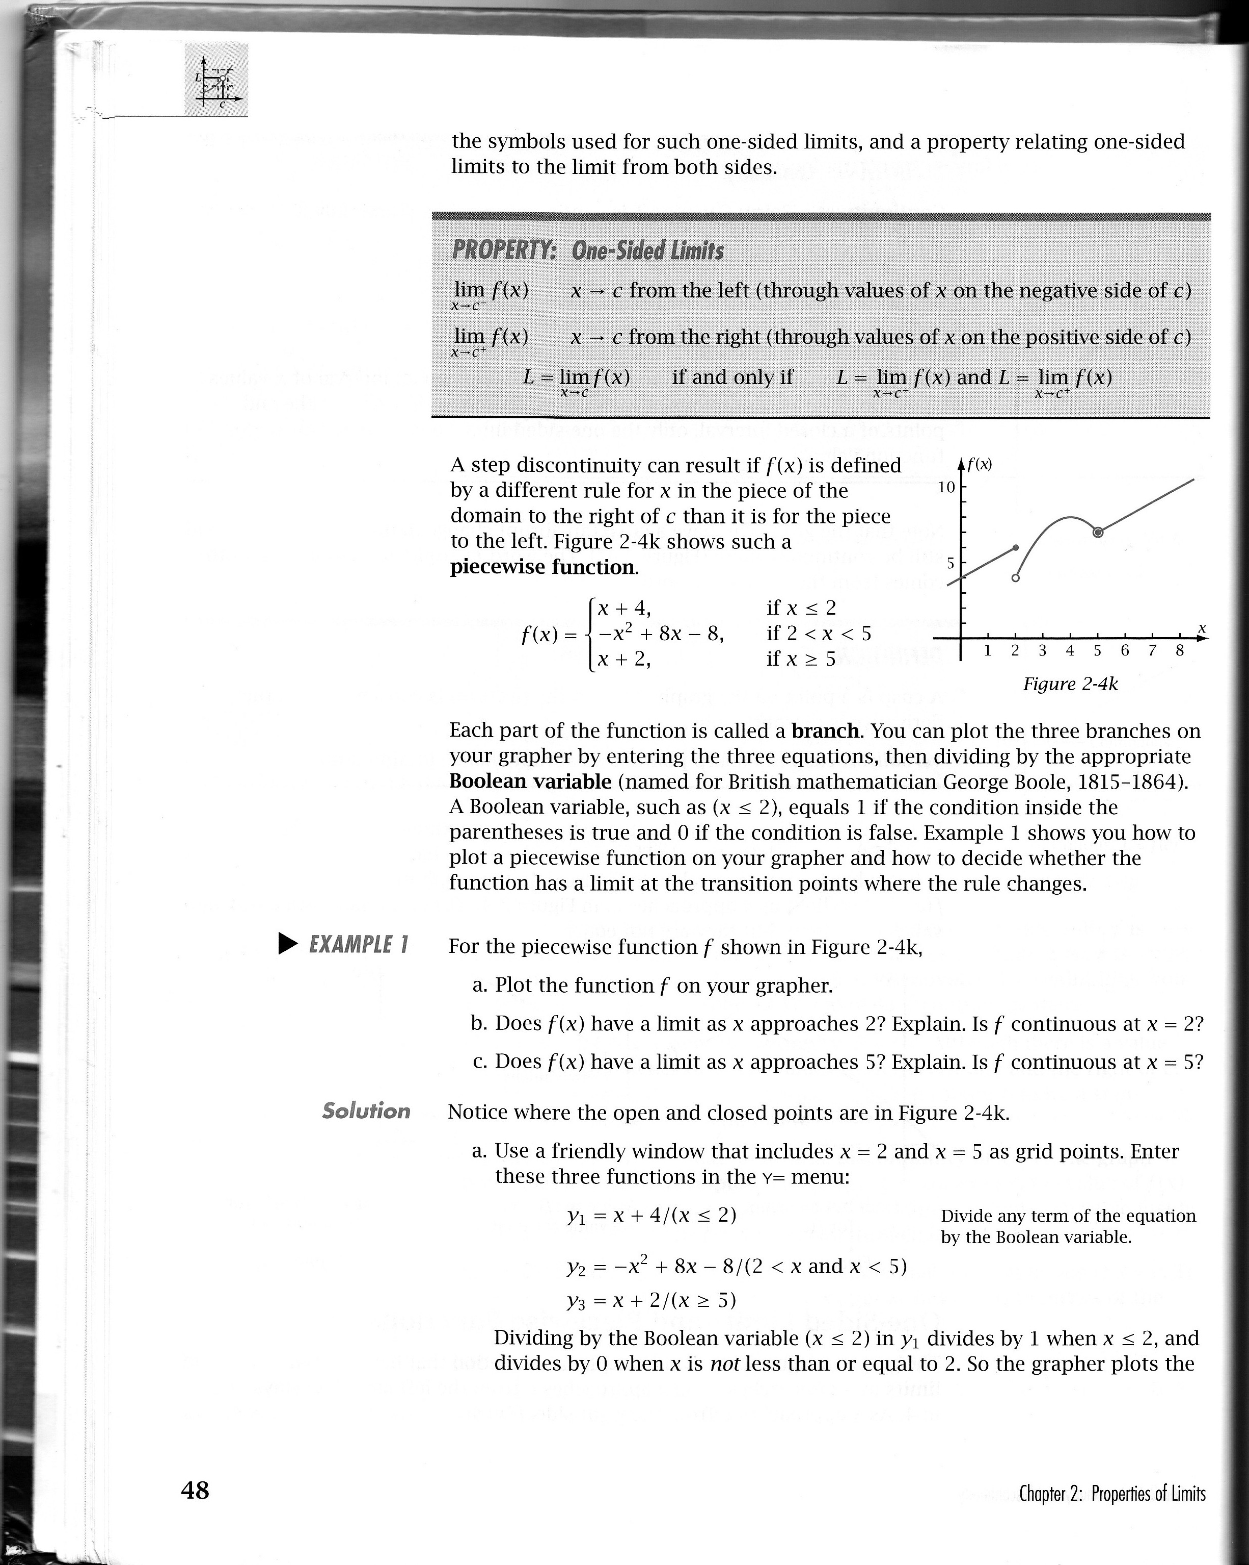
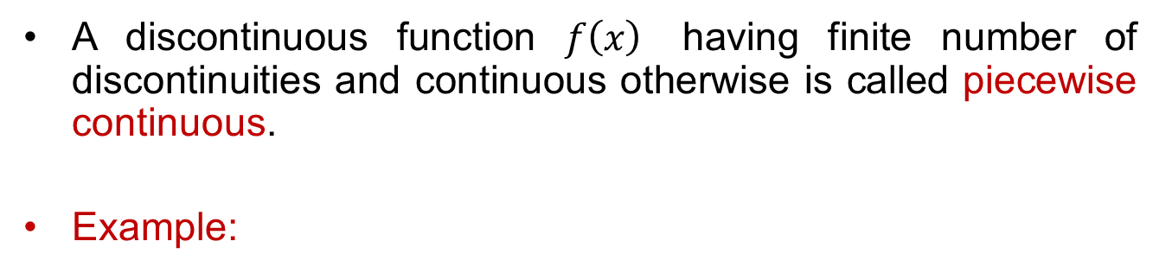
Piecewise continuous functions
A discontinuous function $f\left(x\right)$ having finite number of discontinuities and continuous otherwise is called piecewise continuous.
Example:
if x ≤ 2
if 2 < x < 5
if x ≥ 5

Slide 23
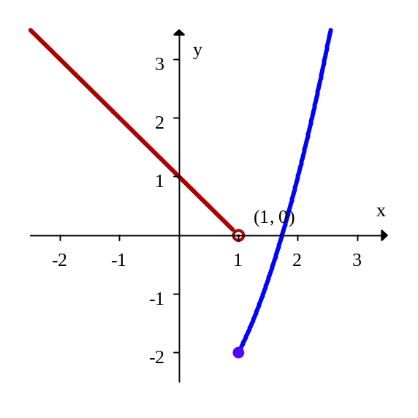
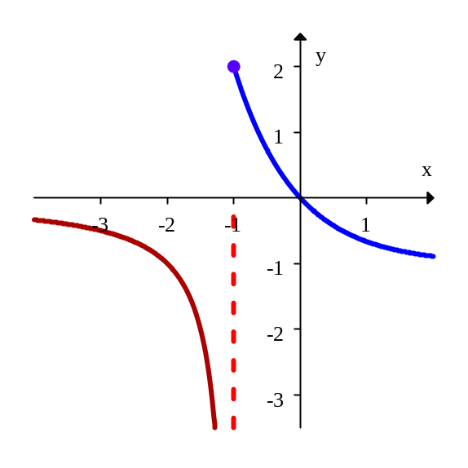


Piecewise continuous functions
Jump discontinuity at $x=1$
Asymptotic discontinuity at $x=−1$

Slide 24
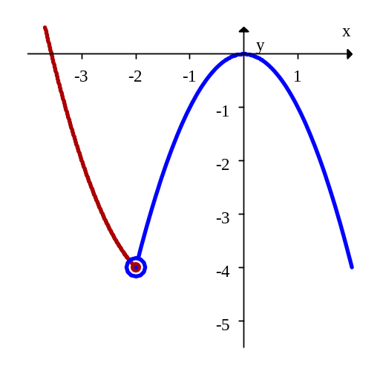
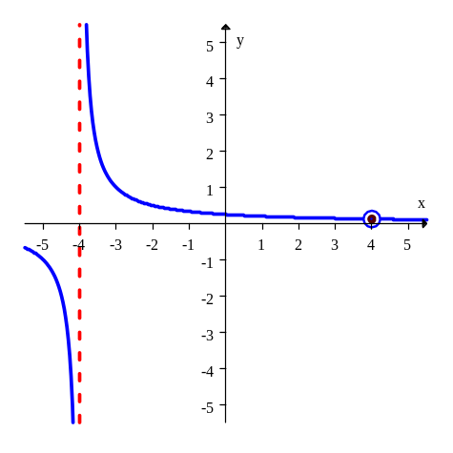


Piecewise continuous functions
Continuous at $x=$4
Continuous at $x=−2$

Slide 25
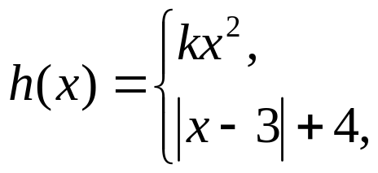
Piecewise continuous functions
Example: Find the value of k so that the function h(x) is continuous at x=2
Solution: We
As h(x) is continuous at x=2, therefore,
if x < 2
if x ≥ 2

Slide 26
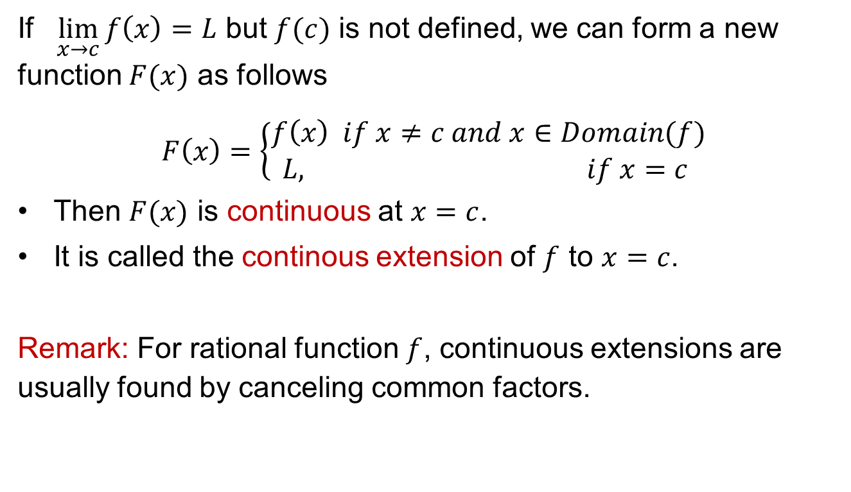
Continuous extension
If $\lim_{x→c}{f\left(x\right)=L}$ but $f(c)$ is not defined, we can form a new function $F(x)$ as follows
$F\left(x\right)=\left\{\begin{matrix}f\left(x\right) if x≠c and x∈Domain(f) \\ L, if x=c \end{matrix}\right.$
Then $F(x)$ is continuous at $x=c$.
It is called the continous extension of $f$ to $x=c$.
Remark: For rational function $f$, continuous extensions are usually found by canceling common factors.

Slide 27
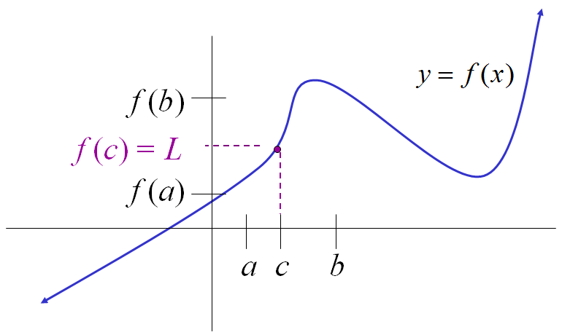
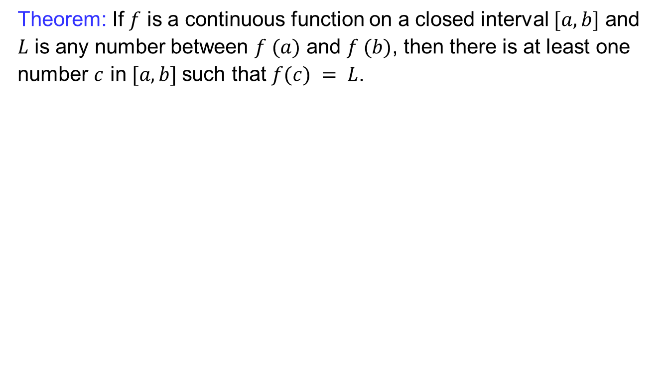
Intermediate value theorem
Theorem: If $f$ is a continuous function on a closed interval $[a, b]$ and $L$ is any number between $f (a)$ and $f (b)$, then there is at least one number $c$ in $[a, b]$such that $f(c) = L$.

Slide 28
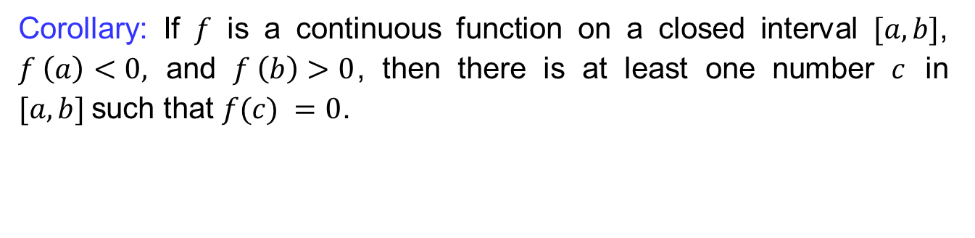
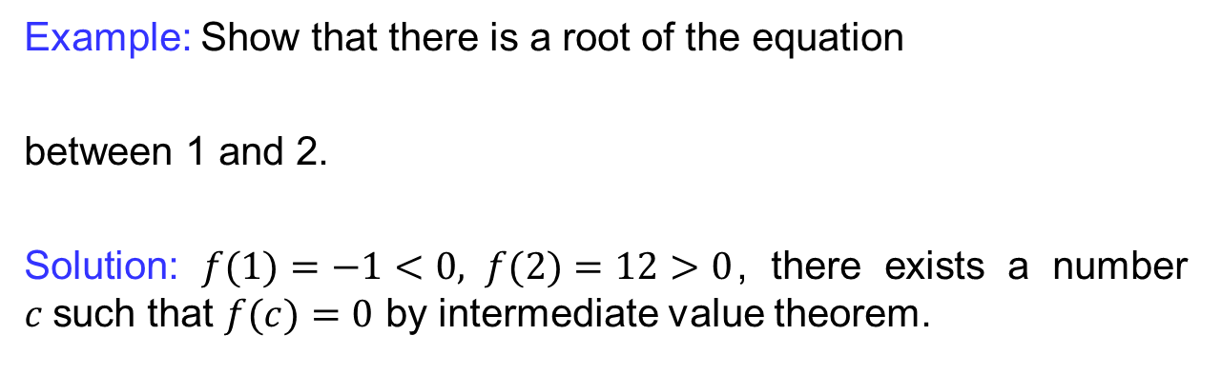
Intermediate value theorem
Corollary: If $f$ is a continuous function on a closed interval $[a, b]$, $f \left(a\right)<0,$ and $f \left(b\right)>0$, then there is at least one number $c$ in $[a, b]$such that $f(c) =0$.
Example: Show that there is a root of the equation
between 1 and 2.
Solution: $f(1)=−1<0, f(2)=12>0$, there exists a number $c$such that $f(c)=0$ by intermediate value theorem.

Slide 29
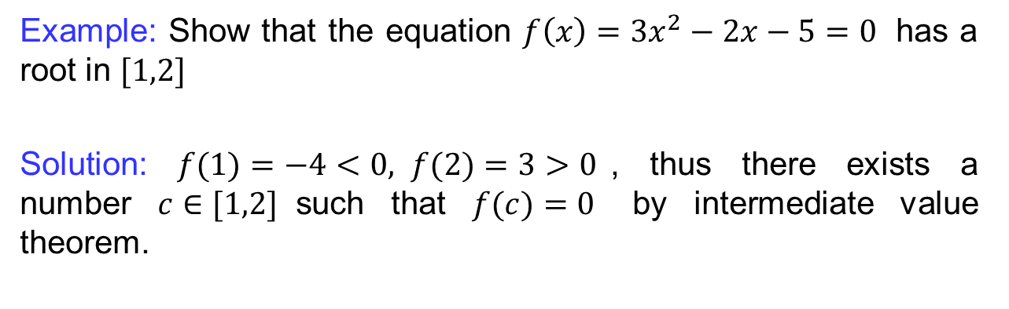
Intermediate value theorem
Corollary: If $f$ is a continuous function on a closed interval $[a, b]$, $f \left(a\right)<0,$ and $f \left(b\right)>0$, then there is at least one number $c$ in $[a, b]$such that $f(c) =0$.
Example: Show that the equation $f\left(x\right)=3x^{2}−2x−5=0$ has a root in $[1,2]$
Solution: $f(1)=−4<0, f(2)=3>0$, thus there exists a number $c∈[1,2]$such that $f(c)=0$ by intermediate value theorem.

Slide 30
Lecture Summary
    Limits by definition
    Formal definition of one-sided limits
    Comparison theorem
    Sandwich theorem
    Golden rules for limits
    Introduction to continuity
    Discontinuity
    Piecewise continuous functions
    Continuous extension
    Intermediate value theorem

