Slide 1
(MTH 250)
Calculus
Lecture 5

Slide 2
Previous Lecture’s Summary
    Logarithmic functions.
    Inverse trigonometric functions
    Introduction to limits
    One sided limits
    Limits that don’t exist
    Vertical asymptotes
    Laws of limit

Slide 3
Today’s Lecture
    Some working rules
    Limit at infinity
    Horizontal asymptotes
    Laws of Limit at infinity
    Limits of log and exp functions
    Formal definition of limit
    Uniqueness of a Limit

Slide 4
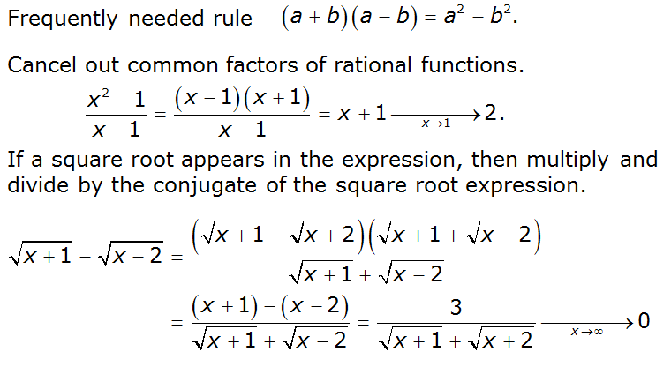
Some working rules

Slide 5
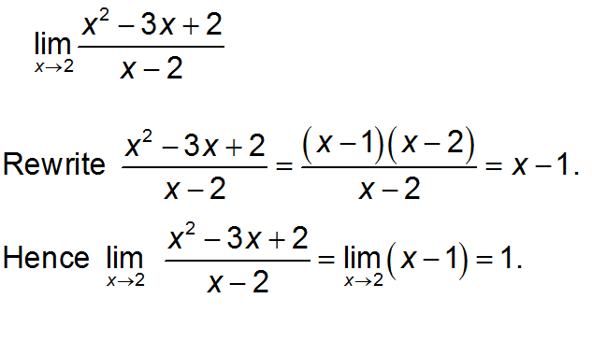
Some working rules

Slide 6

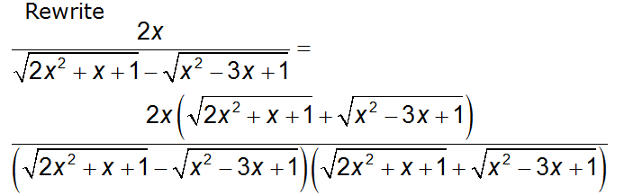
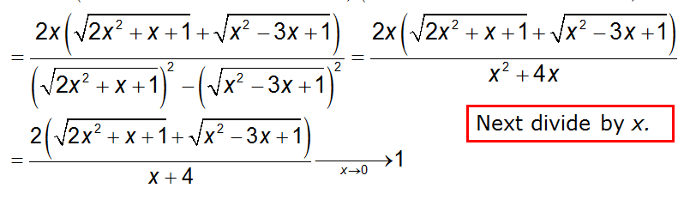
Some working rules

Slide 7
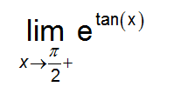
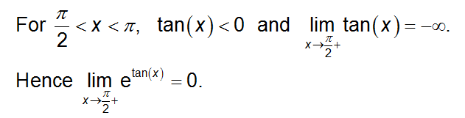
Some working rules

Slide 8
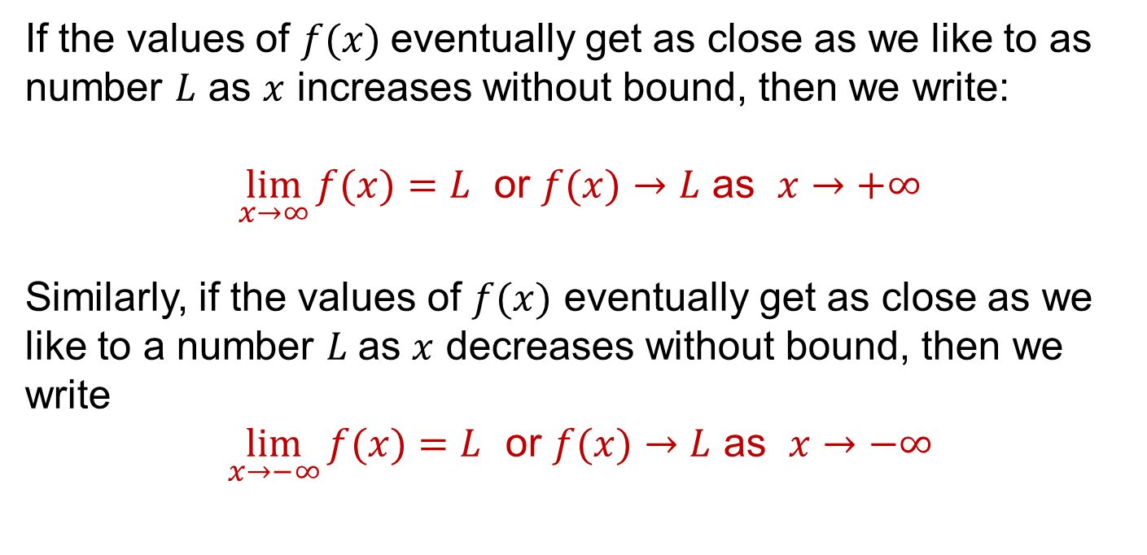
Limit at infinity
If the values of $f(x)$eventually get as close as we like to as number $L$ as $x$ increases without bound, then we write:
$\lim_{x→∞}{f(x)}=L$ or $f(x)→L$ as $x→+∞$
Similarly, if the values of $f(x)$ eventually get as close as we like to a number $L$as $x$ decreases without bound, then we write
$\lim_{x→−∞}{f(x)}=L$ or $f(x)→L$ as $x→−∞$

Slide 9
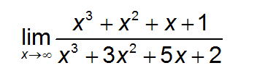
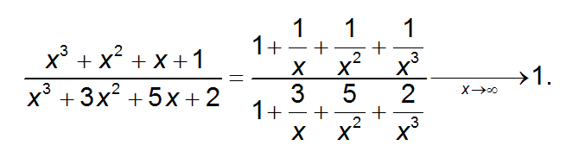
Limit at infinity

Slide 10

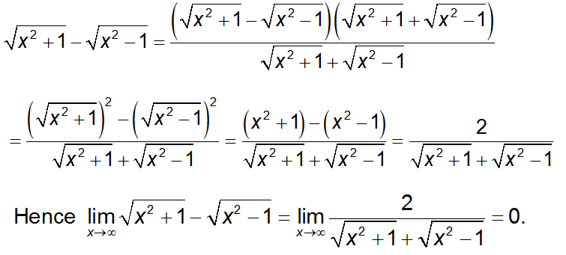
Limit at infinity

Slide 11
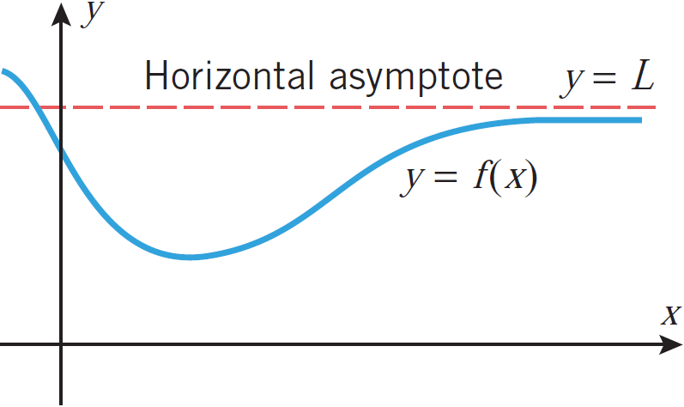
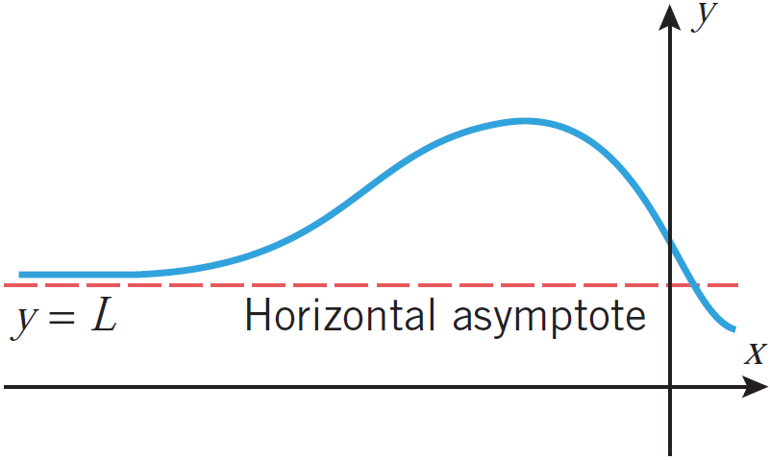
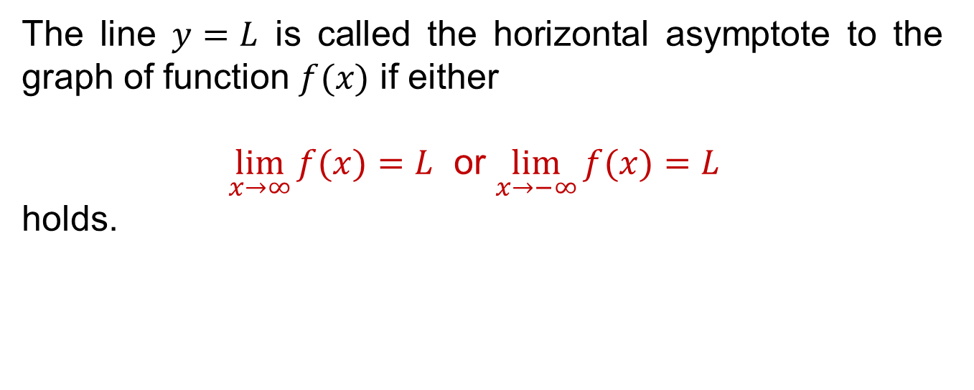
Horizontal asymptotes
The line $y=L$ is called the horizontal asymptote to the graph of function $f(x)$ if either
$\lim_{x→∞}{f(x)}=L$ or $\lim_{x→−∞}{f(x)}=L$
holds.

Slide 12
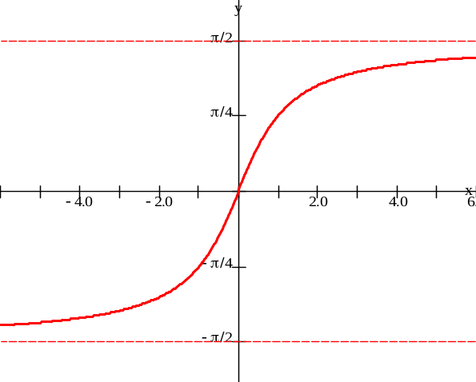
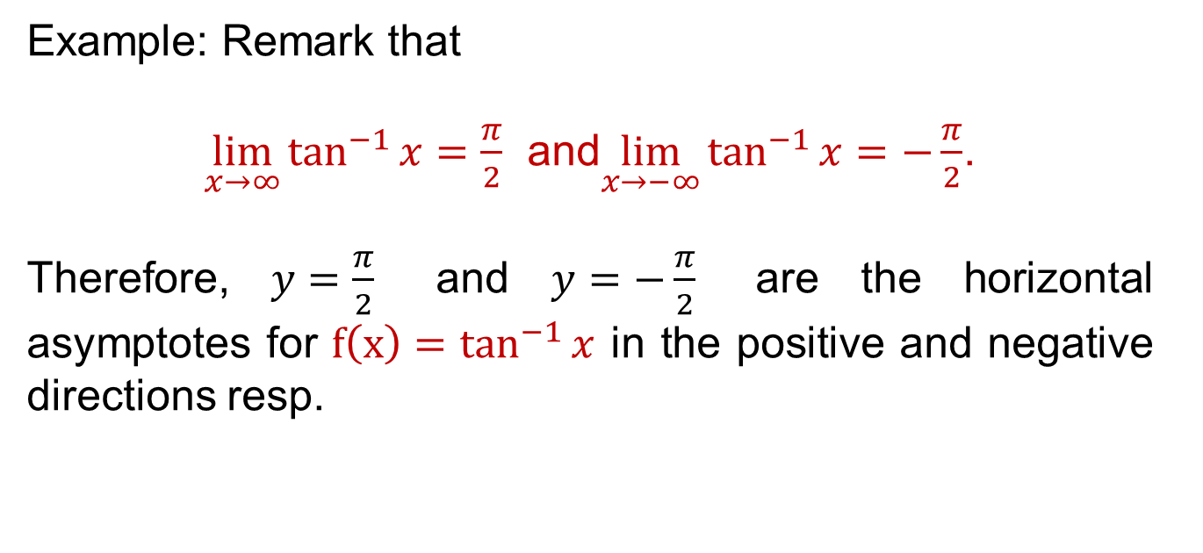

Horizontal asymptotes
Example: Remark that
$\lim_{x→∞}{\tan^{−1}{x}}=\frac{π}{2}$and$\lim_{x→−∞}{\tan^{−1}{x}}=−\frac{π}{2}$.
Therefore, $y=\frac{π}{2}$ and $y=−\frac{π}{2}$ are the horizontal asymptotes for $f\left(x\right)=\tan^{−1}{x}$ in the positive and negative directions resp.
$$y=\tan^{−1}{x}$$

Slide 13
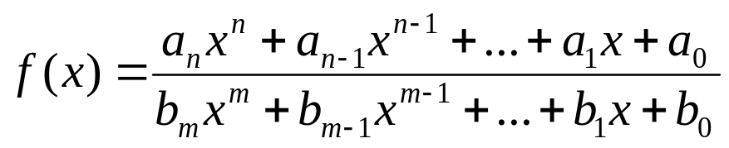

Horizontal asymptotes
Consider:
If you examine the degree of the numerator and denominator, there’s one of three possibilities:
  n > m: The degree of the numerator is bigger than the denominator (top heavy)
    L =
  n < m: The degree of the numerator is smaller than the denominator (bottom heavy)
    L = 0
  n = m: The degree of the numerator is equal to the denominator
    L =
There is no horizontal asymptote
The horizontal asymptote is y = 0
The horizontal asymptote is y =

Slide 14
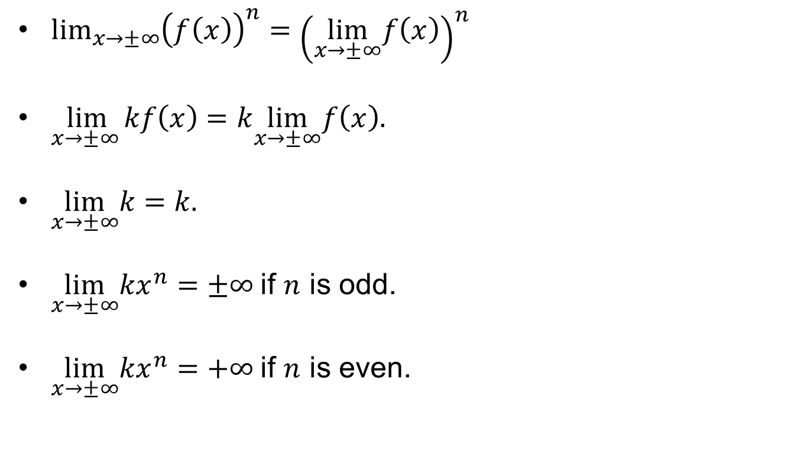
Laws of limits at infinity
$\lim_{x→±∞}{{\left(f\left(x\right)\right)}^{n}={\left(\lim_{x→±∞}f\left(x\right)\right)}^{n}}$
$\lim_{x→±∞ }kf\left(x\right)=k\lim_{x→±∞}f\left(x\right).$
$\lim_{x→±∞}k=k.$
$\lim_{x→±∞}kx^{n}=±∞$if $n$ is odd.
$\lim_{x→±∞}kx^{n}=+∞$if $n$ is even.

Slide 15
Laws of limits at infinity
$\lim_{x→±∞}{{\left(f\left(x\right)\right)}^{n}={\left(\lim_{x→±∞}f\left(x\right)\right)}^{n}}$
$\lim_{x→±∞ }kf\left(x\right)=k\lim_{x→±∞}f\left(x\right).$
$\lim_{x→±∞}k=k.$
$\lim_{x→±∞}kx^{n}=±∞$if $n$ is odd.
$\lim_{x→±∞}kx^{n}=+∞$if $n$ is even.

Slide 16
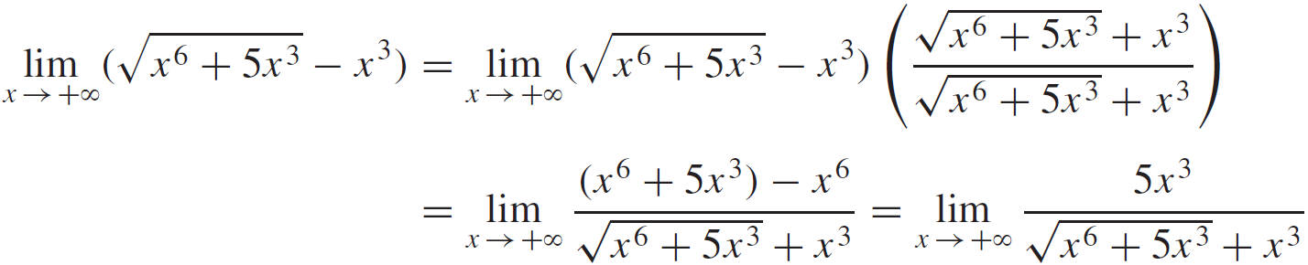
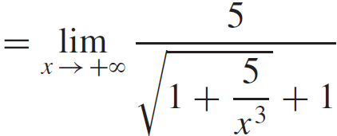
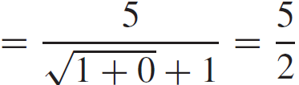

Laws of limits at infinity
Evaluate $\lim_{x→+∞}{(\sqrt{x^{6}+5x^{3}}−x^{3})}$

Slide 17
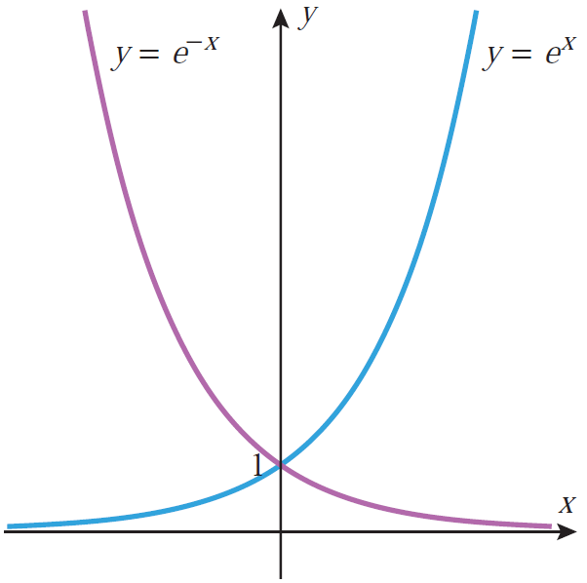
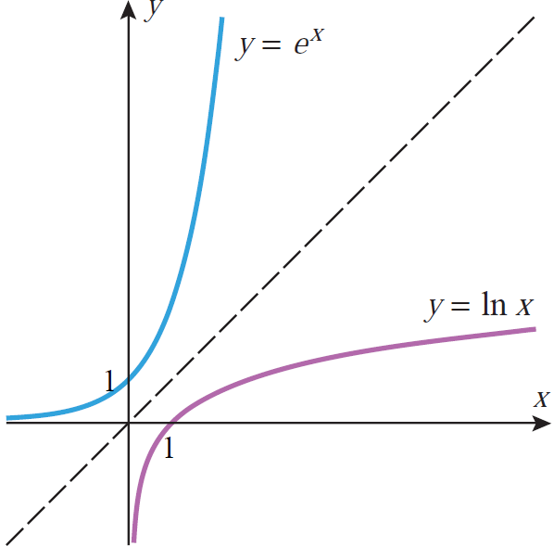
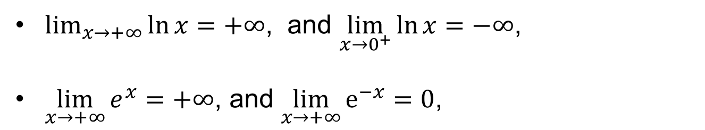
Limits of Log and Exp functions
$\lim_{x→+∞}{\ln{x}}=+∞$, and $\lim_{x→0^{+}}{\ln{x}}=−∞$,
$\lim_{x→+∞}{e^{x}}=+∞$,and $\lim_{x→+∞}{e^{−x}}=0$,

Slide 18
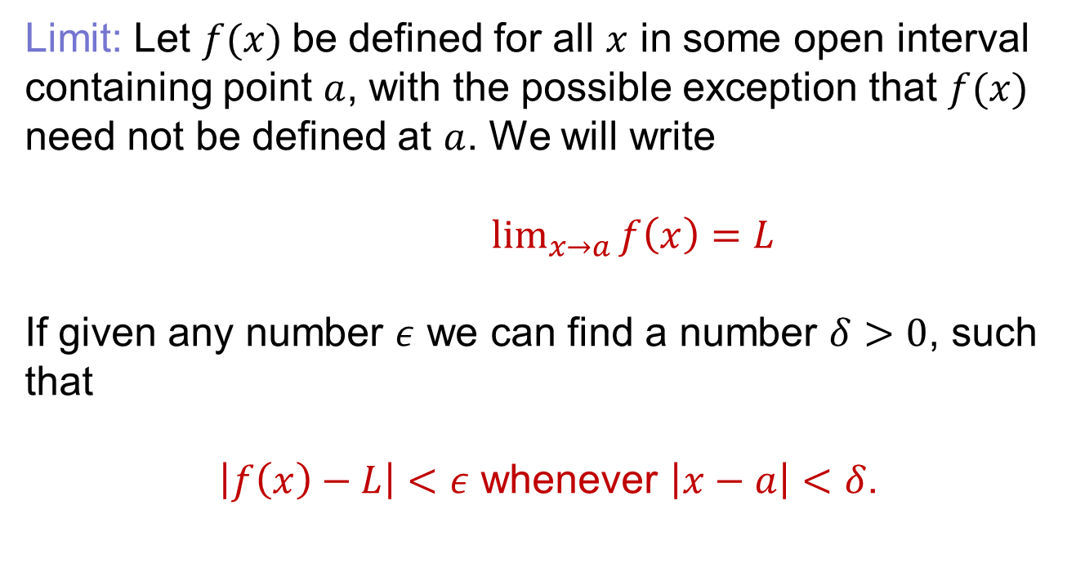
Formal definition of limit
Limit: Let $f(x)$be defined for all $x$ in some open interval containing point $a$, with the possible exception that $f(x)$ need not be defined at $a$. We will write
$\lim_{x→a}{f\left(x\right)=L}$
If given any number $ε$we can find a number $δ>0$, such that
$\left|f\left(x\right)−L\right|<ε$ whenever $\left|x−a\right|<δ$.

Slide 19
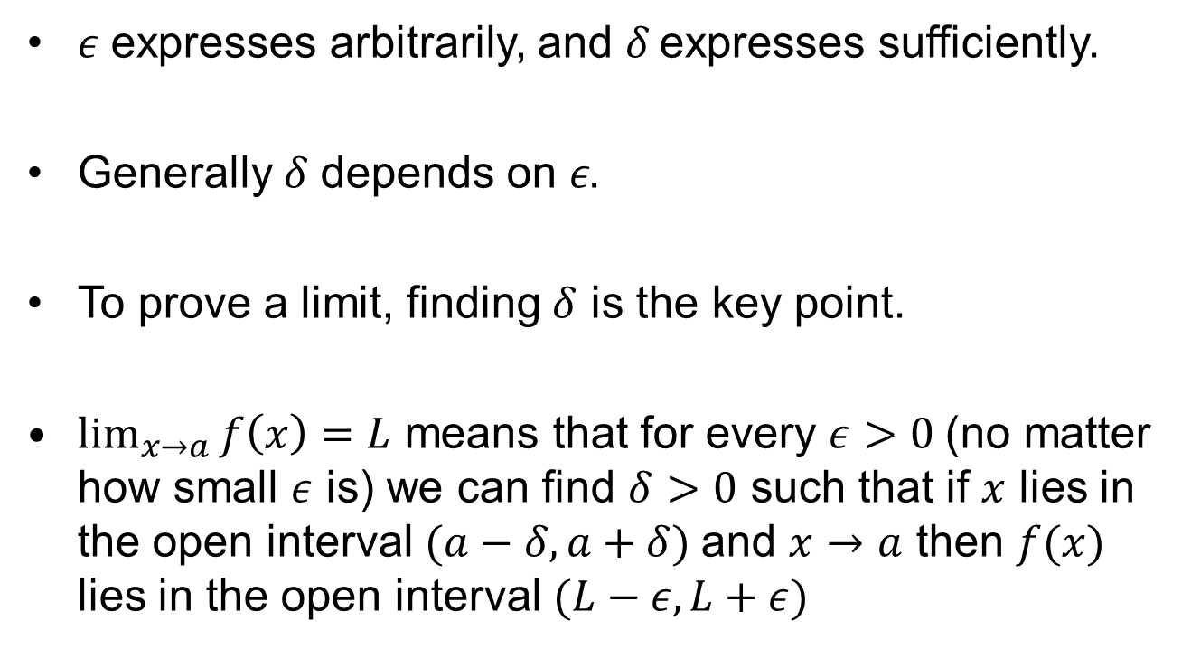
Formal definition of limit
$ε$ expresses arbitrarily, and $δ$expresses sufficiently.
Generally $δ$depends on $ε.$
To prove a limit, finding $δ$ is the key point.
$\lim_{x→a}{f\left(x\right)}=L$ means that for every $ε>0$(no matter how small $ε$ is) we can find $δ>0$ such that if $x$ lies in the open interval$(a−δ, a+δ)$ and $x→a$ then $f(x)$ lies in the open interval $(L−ε, L+ε)$

Slide 20
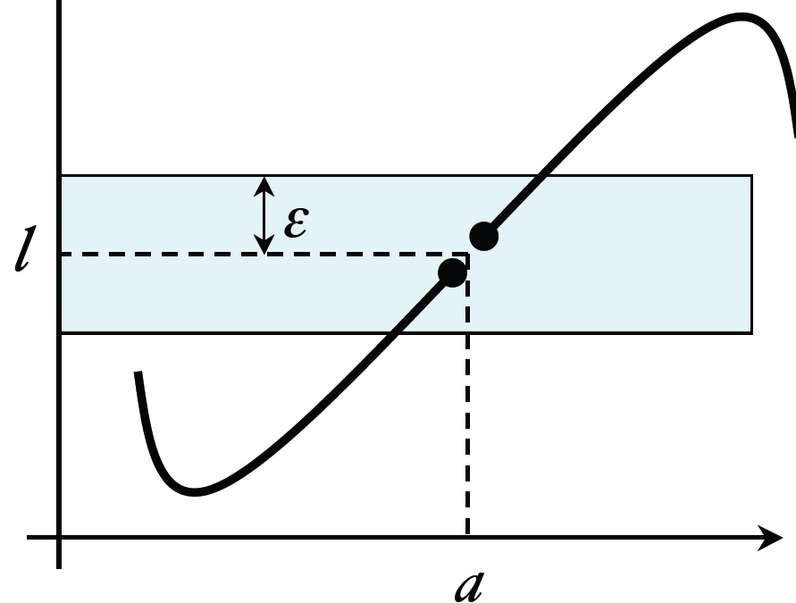
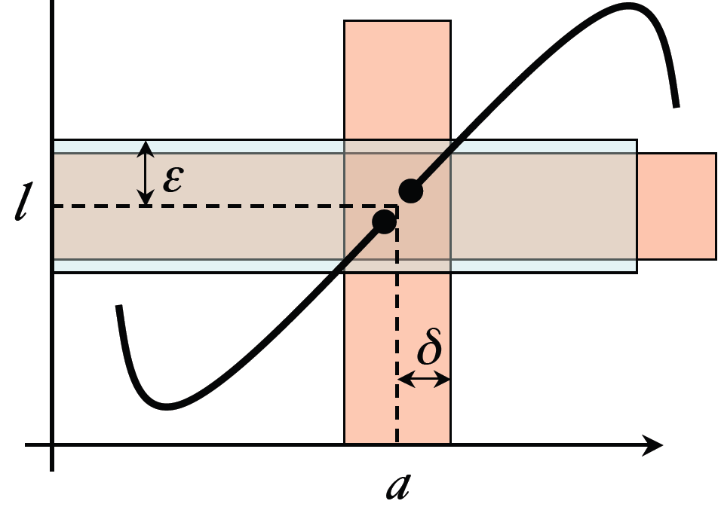
Formal definition of limit

Slide 21
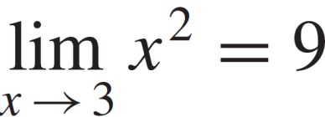

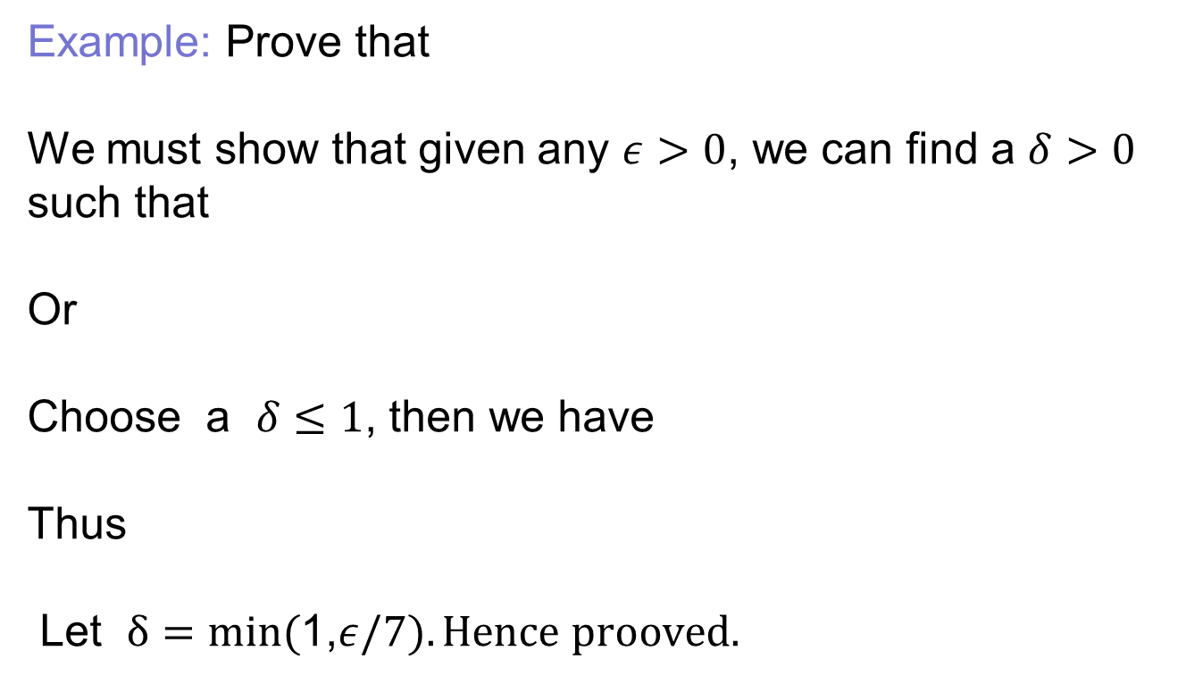
Formal definition of limit
Example: Prove that
We must show that given any $ε>0$, we can find a $δ>0$ such that
Or
Choose a $δ≤1$, then we have
Thus
Let $δ=min⁡($1,$ε/7). Hence prooved.$

Slide 22
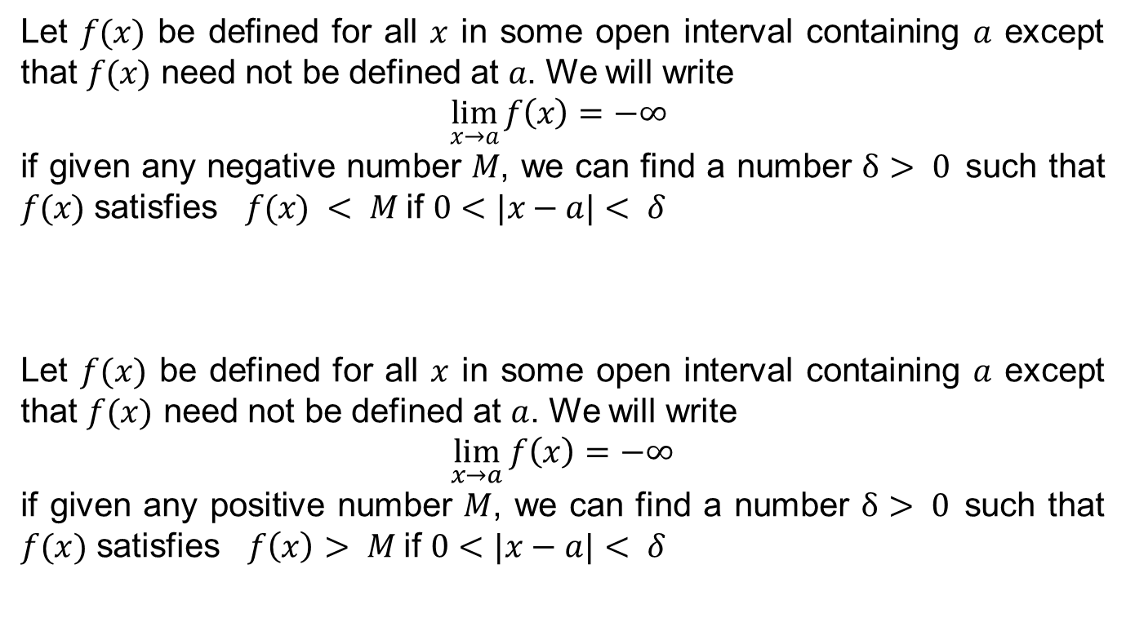
Formal definition of limit
Let $f(x)$ be defined for all $x$ in some open interval containing $a$ except that $f(x)$ need not be defined at $a$. We will write
$$\lim_{x→a}{f\left(x\right)=−∞}$$
if given any negative number $M$, we can find a number $δ> 0$such that $f(x)$ satisfies $f(x) < M$if $0<|x−a|< δ$
Let $f(x)$ be defined for all $x$ in some open interval containing $a$ except that $f(x)$ need not be defined at $a$. We will write
$$\lim_{x→a}{f\left(x\right)=−∞}$$
if given any positive number $M$, we can find a number $δ> 0$such that $f(x)$ satisfies $f\left(x\right)> M$if $0<|x−a|< δ$

Slide 23
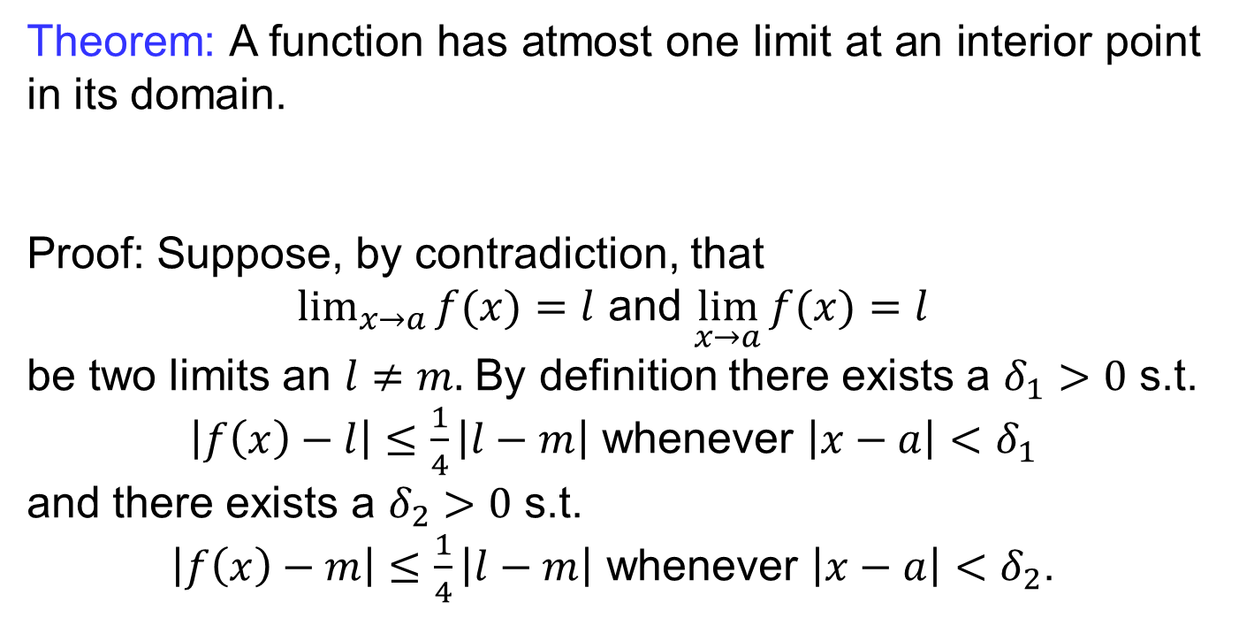
Uniqueness of limit
Theorem: A function has atmost one limit at an interior point in its domain.
Proof: Suppose, by contradiction, that
$\lim_{x→a}{f(x)}=l$ and $\lim_{x→a}{f(x)}=l$
be two limits an $l≠m.$ By definition there exists a $δ_{1}>0$s.t.
$\left|f\left(x\right)−l\right|≤\frac{1}{4}\left|l−m\right|$ whenever $\left|x−a\right|<$$δ_{1}$
and there exists a $δ_{2}>0$s.t.
$\left|f\left(x\right)−m\right|≤\frac{1}{4}\left|l−m\right|$ whenever $\left|x−a\right|<$$δ_{2}$.

Slide 24
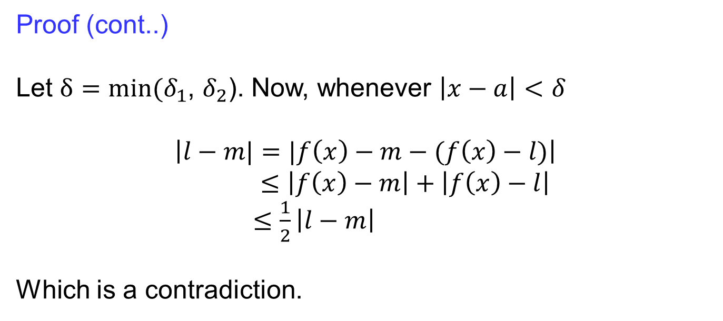
Uniqueness of limit
Proof (cont..)
Let $δ=min⁡(δ_{1}$, $δ_{2}$). Now, whenever $\left|x−a\right|<$$δ$
$$\left|l−m|=|f\left(x\right)−m−(f\left(x\right)−l)\right|$$
$≤\left|f\left(x\right)−m\right|+\left|f\left(x\right)−l\right|$
$≤\frac{1}{2}\left|l−m\right|$
Which is a contradiction.

Slide 25
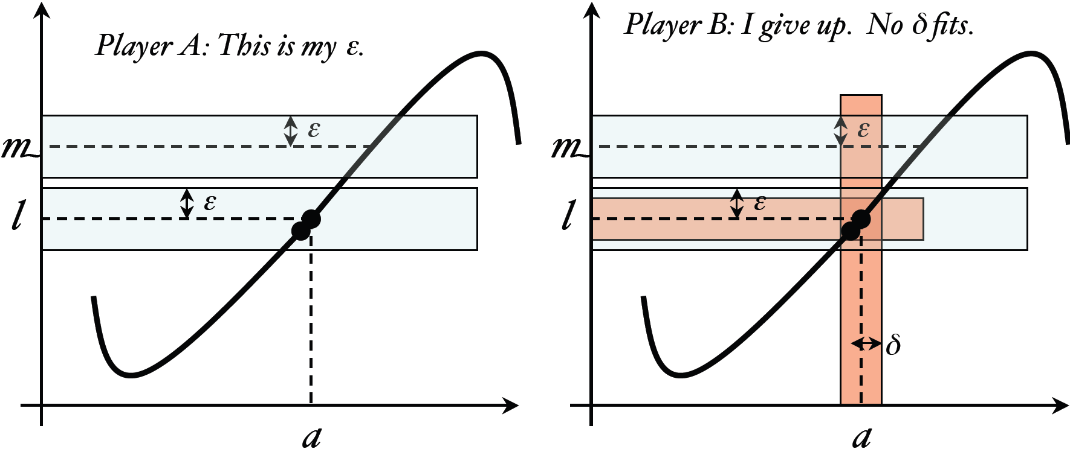
Uniqueness of limit

Slide 26
Lecture Summary
    Working rules for limits
    Limit at infinity
    Horizontal asymptotes
    Laws of Limit at infinity
    Limits of log and exp functions
    Formal definition of limit
    Uniqueness of a Limit

