Slide 1
(MTH 250)
Calculus
Lecture 4

Slide 2
Previous Lecture’s Summary
    Symmetry test
    Algebraic operations on functions
    Composition of functions
    Trigonometric functions
    Inverse of a function
    Domain and range of inverse functions
    Horizontal line test

Slide 3
Today’s Lecture
    Logarithmic functions.
    Inverse trigonometric functions
    Introduction to limits
    One sided limits
    Limits that don’t exist
    Vertical asymptotes
    Laws of limit

Slide 4
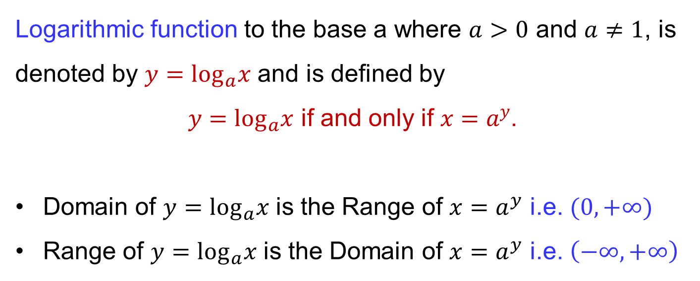
Logarithmic functions
    Logarithmic function to the base a where $a>0$ and $a≠1$, is denoted by $y=\log_{a}x$ and is defined by
    $y=\log_{a}x$ if and only if $x=a^{y}$.
    Domain of $y=\log_{a}x$ is the Range of $x=a^{y}$ i.e. $(0,+∞)$
    Range of $y=\log_{a}x$ is the Domain of $x=a^{y}$ i.e. $\left(−∞,+∞\right)$

Slide 5
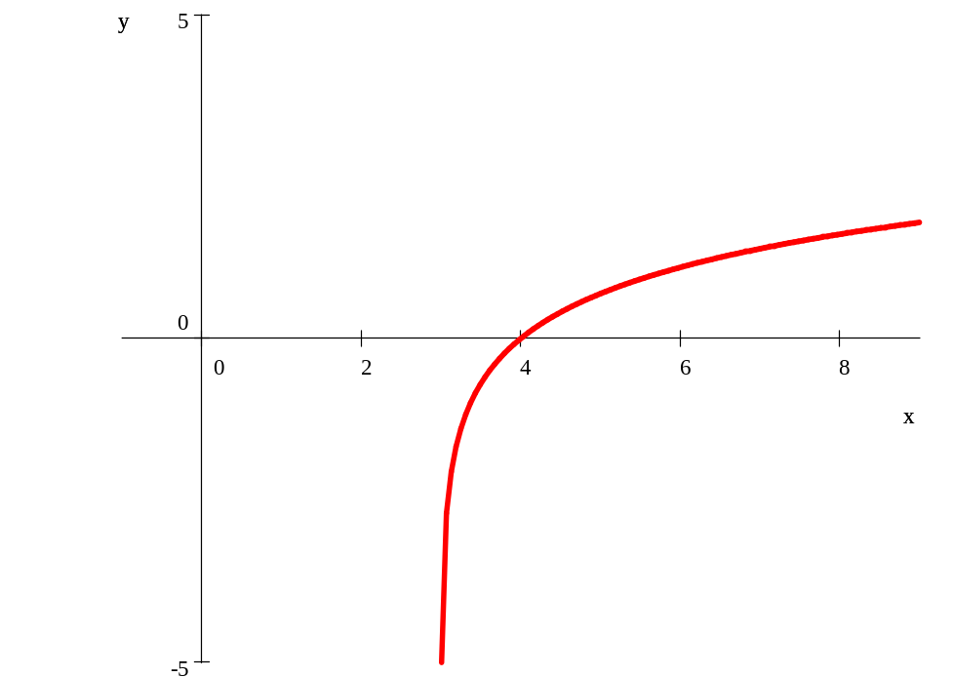

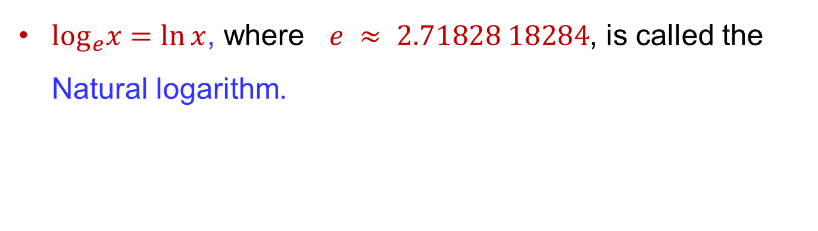


Logarithmic functions
    $\log_{e}x=\ln{x}$, where $e ≈ 2.71828 18284$, is called the Natural logarithm.
$$(e+3,1)$$
$$(4,0)$$

Slide 6
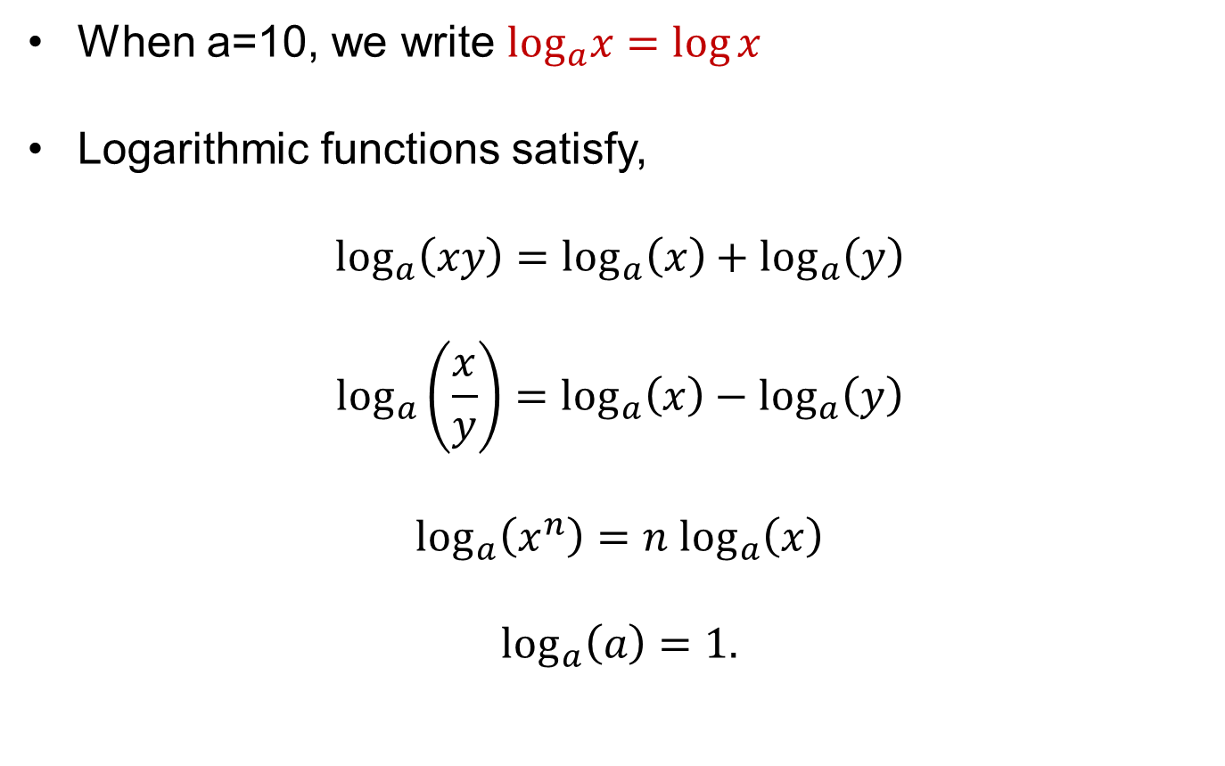
Logarithmic functions
    When a=10, we write $\log_{a}x=\log{x}$
    Logarithmic functions satisfy,
    $$\log_{a}\left(xy\right)=\log_{a}\left(x\right)+\log_{a}\left(y\right)$$
    $$\log_{a}\left(\frac{x}{y}\right)=\log_{a}\left(x\right)−\log_{a}\left(y\right)$$
    $$\log_{a}\left(x^{n}\right)=n \log_{a}\left(x\right)$$
    $$\log_{a}\left(a\right)=1.$$

Slide 7
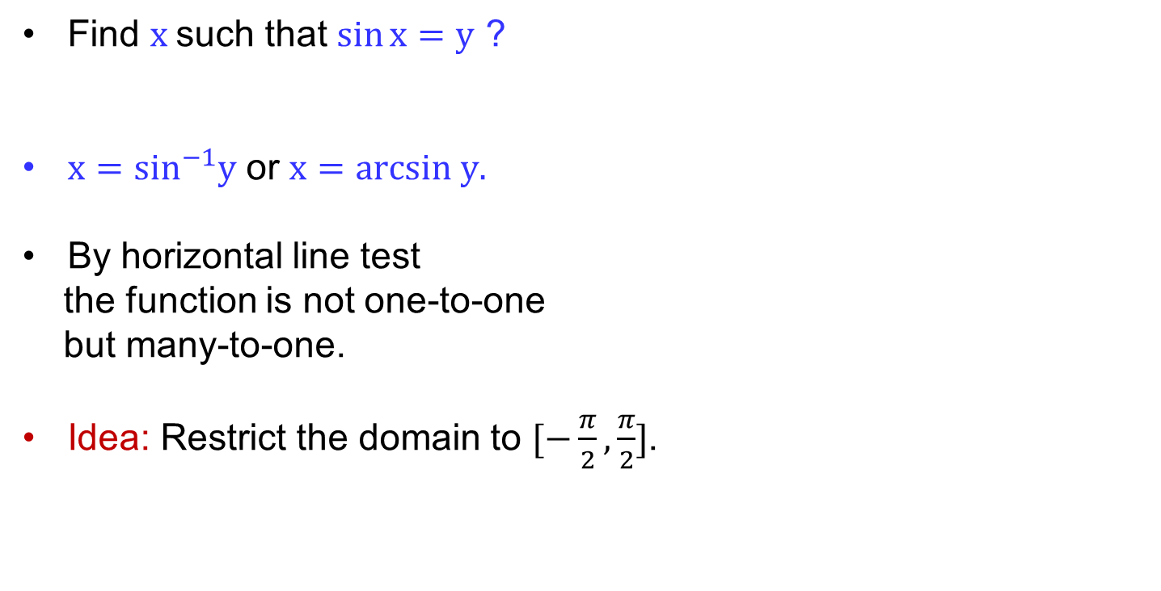
Inverse trigonometric functions
y = sin x
    Find $x$such that $\sin{x=y}$ ?
    $x=\sin^{−1}y$ or $x=arcsin y.$
    By horizontal line test
    the function is not one-to-one
    but many-to-one.
    Idea: Restrict the domain to $[−\frac{π}{2},\frac{π}{2}]$.
y
y = sin^{–1} x
x

Slide 8




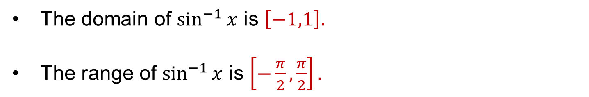
Inverse trigonometric functions
y
y
y = sin^{–1} x
y = sin^{–1} x
1
y = sin x
x
x
–1
–1
1
1
–1
    The domain of $\sin^{−1}{x}$ is $\left[−1,1\right].$
    The range of $\sin^{−1}{x}$ is $\left[−\frac{π}{2},\frac{π}{2}\right].$

Slide 9
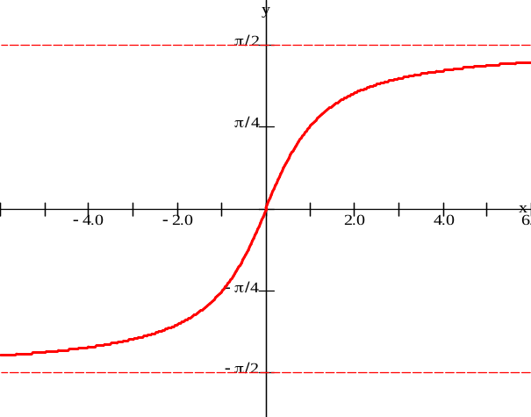

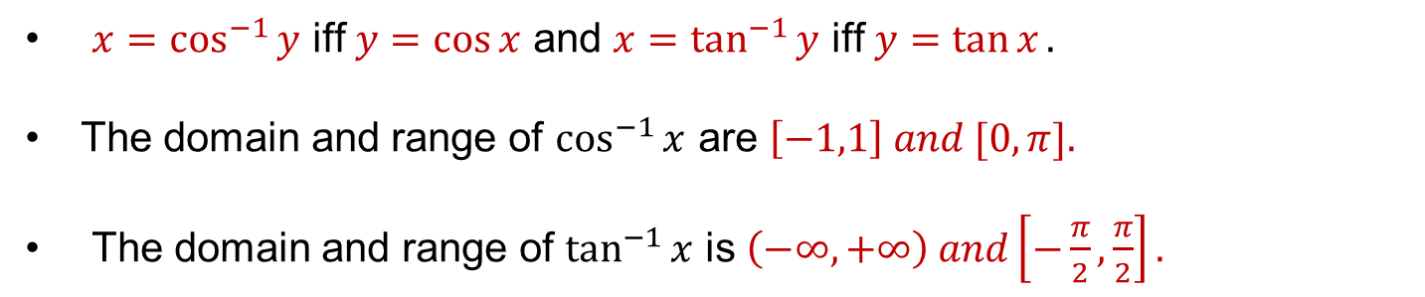
Inverse trigonometric functions
y
y = cos^{–1} x
$$y=\tan^{−1}{x}$$
–1
0
1
x
    $x=\cos^{−1}{y}$ iff $y=\cos{x}$ and $x=\tan^{−1}{y}$ iff $y=\tan{x}.$
    The domain and range of $\cos^{−1}{x}$ are $\left[−1,1\right] and [0, π].$
    The domain and range of $\tan^{−1}{x}$ is $\left(−∞,+∞\right) and\left[−\frac{π}{2},\frac{π}{2}\right].$

Slide 10
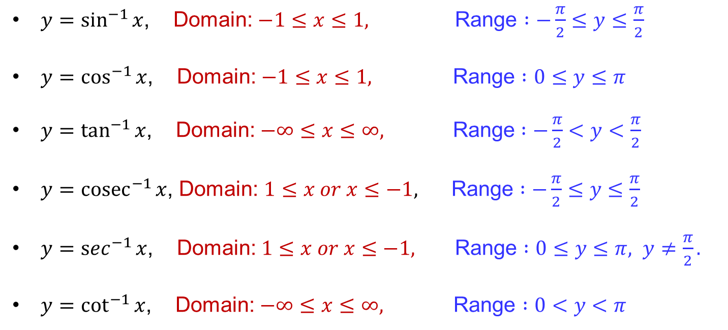
Inverse trigonometric functions
    $y=\sin^{−1}{x}$, Domain: $−1≤x≤1,$ Range $:−\frac{π}{2}≤y≤\frac{π}{2}$
    $y=\cos^{−1}{x}$, Domain: $−1≤x≤1,$ Range $:0≤y≤π$
    $y=\tan^{−1}{x}$, Domain: $−∞≤x≤∞,$ Range $:−\frac{π}{2}<y<\frac{π}{2}$
    $y={cosec}^{−1}{x}$, Domain: $1≤x or x≤−1,$ Range $:−\frac{π}{2}≤y≤\frac{π}{2}$
    $y=\sec^{−1}{x}$, Domain: $1≤x or x≤−1,$ Range $:0≤y≤π, y≠\frac{π}{2}.$
    $y=\cot^{−1}{x}$, Domain: $−∞≤x≤∞,$ Range $:0<y<π$

Slide 11
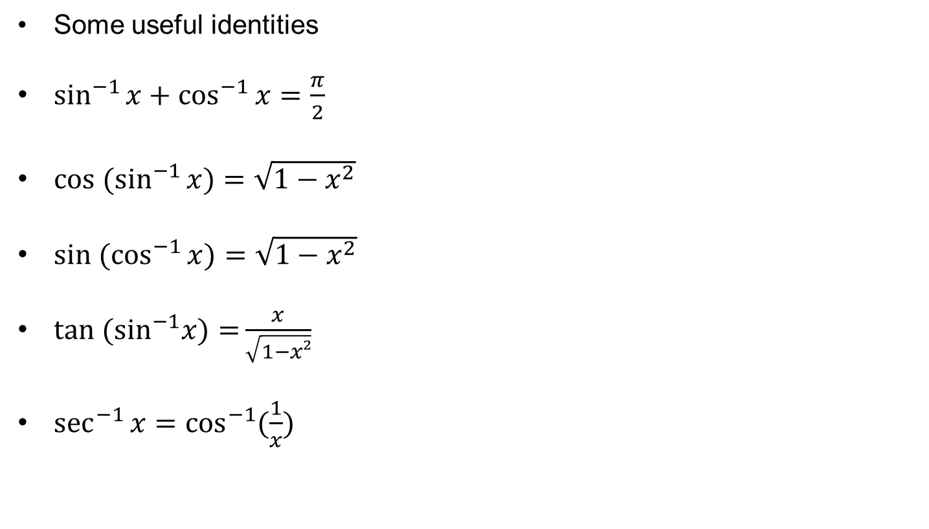
Inverse trigonometric functions
    Some useful identities
    $\sin^{−1}{x+\cos^{−1}{x=\frac{π}{2}}}$
    ${cos (sin}^{−1}{x)=\sqrt{1−x^{2}}}$
    ${sin (cos}^{−1}{x)=\sqrt{1−x^{2}}}$
    ${tan (sin}^{−1}x)={\frac{x}{\sqrt{1−x²}}}$
    $\sec^{−1}{x=\cos^{−1}{(\frac{1}{x}) }}$

Slide 12
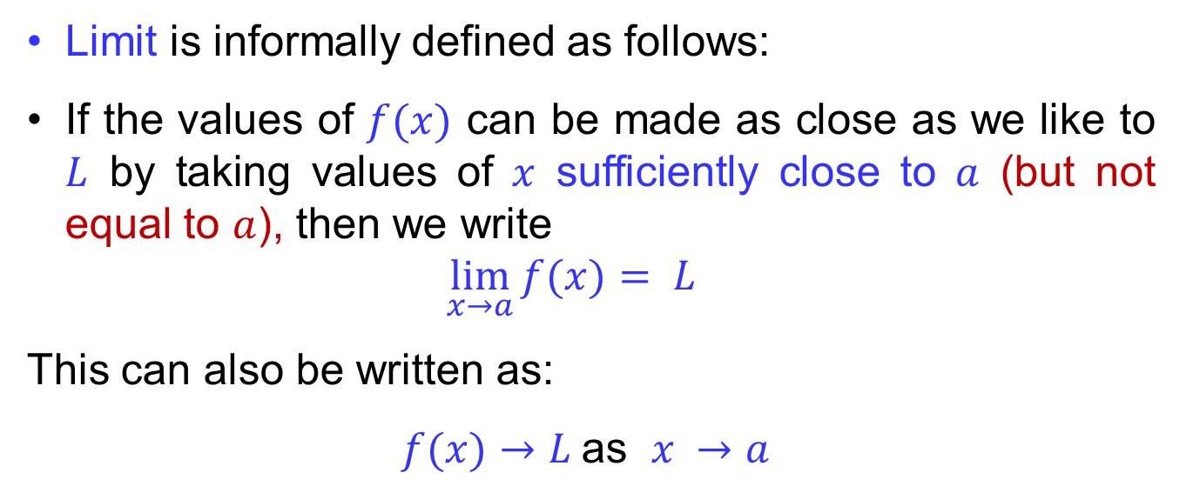
Introduction to limits
Limit is informally defined as follows:
If the values of $f(x)$ can be made as close as we like to $L$ by taking values of $x$ sufficiently close to $a$ (but not equal to $a$), then we write
$$\lim_{x→a}{f(x)}= L$$
This can also be written as:
$f(x)→L$ as $x →a$

Slide 13
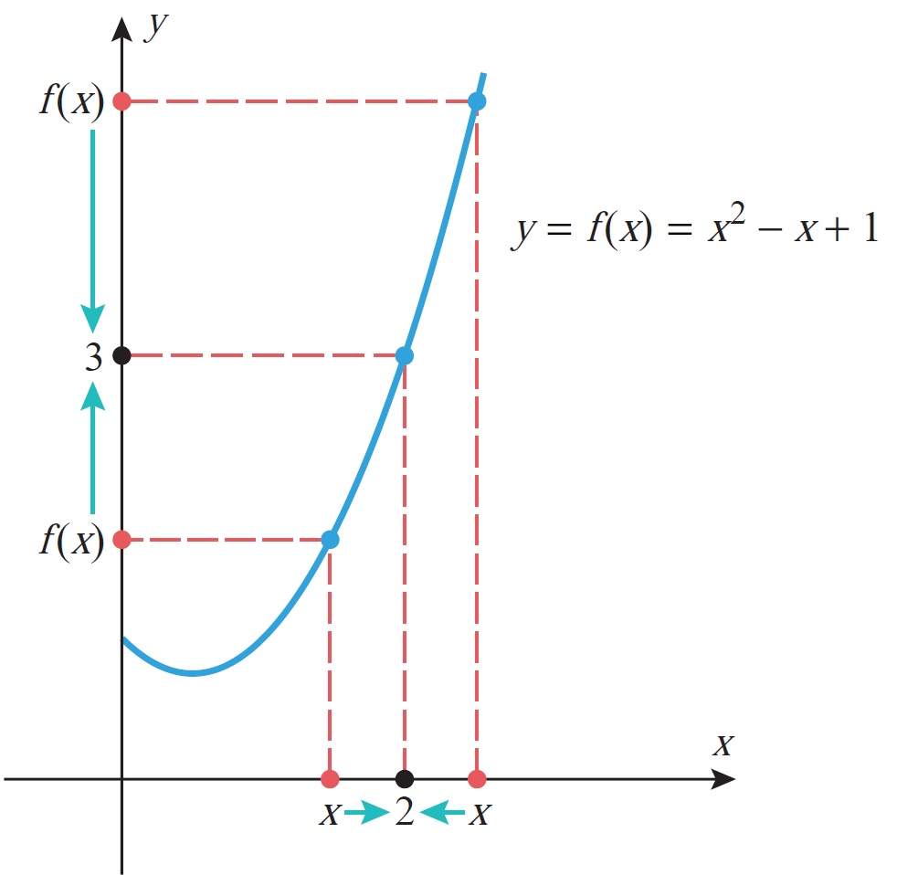
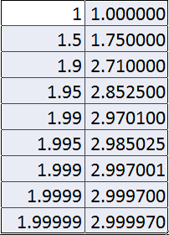
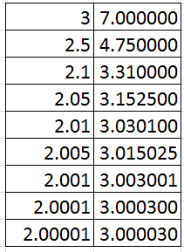
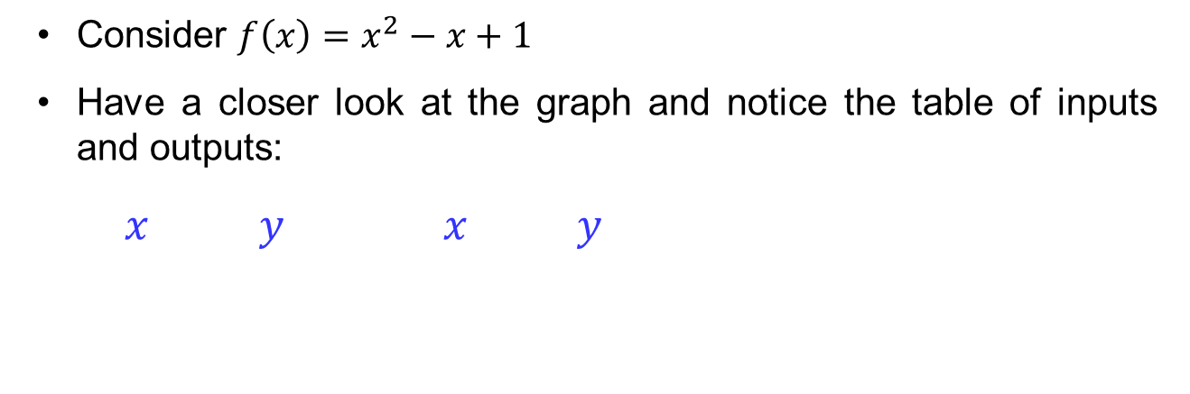
Introduction to limits
Consider $f\left(x\right)=x^{2}−x+1$
Have a closer look at the graph and notice the table of inputs and outputs:
$x y x y$

Slide 14
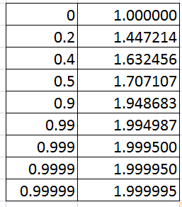
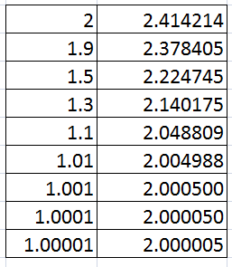
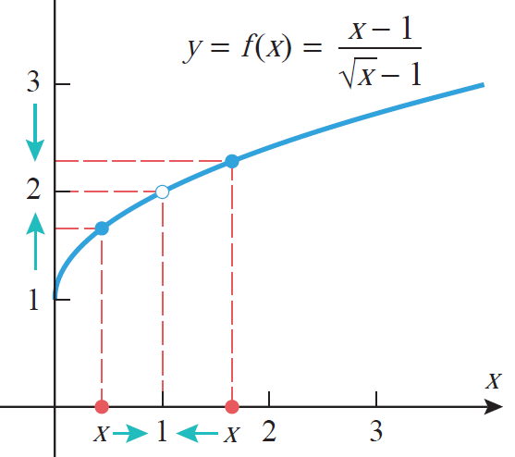
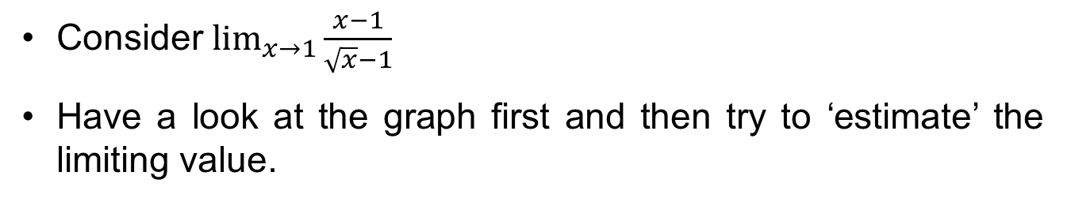
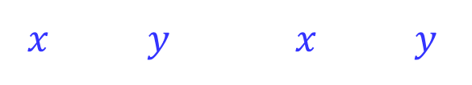
Introduction to limits
Consider $\lim_{x→1}{\frac{x−1}{\sqrt{x}−1}}$
Have a look at the graph first and then try to ‘estimate’ the limiting value.
$x y x y$

Slide 15
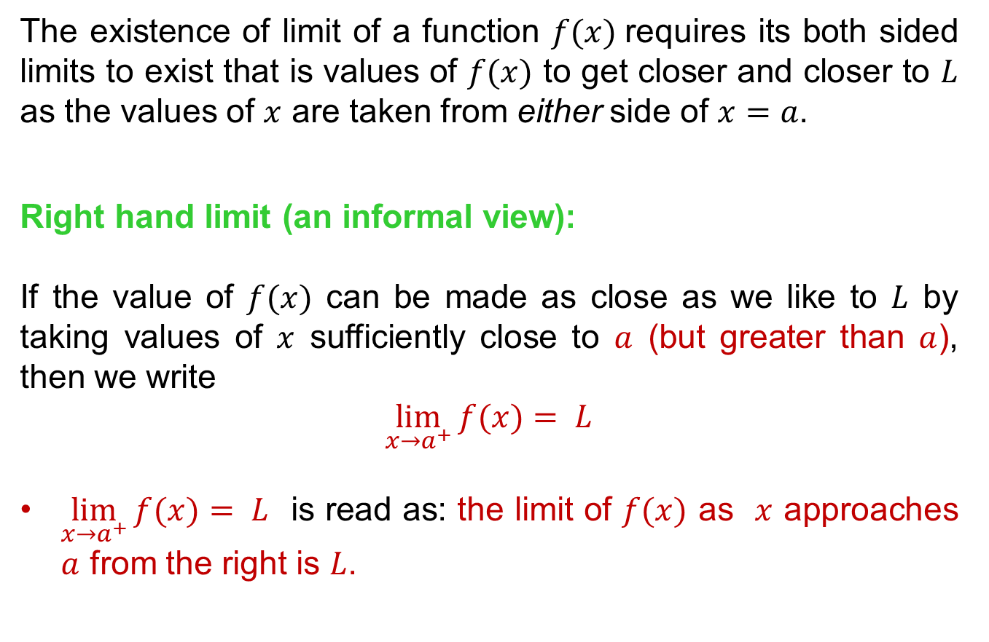
One sided limits
The existence of limit of a function $f(x)$requires its both sided limits to exist that is values of $f(x)$ to get closer and closer to $L$ as the values of $x$ are taken from either side of $x=a$.
Right hand limit (an informal view):
If the value of $f(x)$ can be made as close as we like to $L$ by taking values of $x$ sufficiently close to $a$ (but greater than $a$), then we write
$$\lim_{x→a^{+}}{f(x)}= L$$
$\lim_{x→a^{+}}{f(x)}= L$ is read as: the limit of $f(x)$ as $x$ approaches $a$ from the right is $L$.

Slide 16
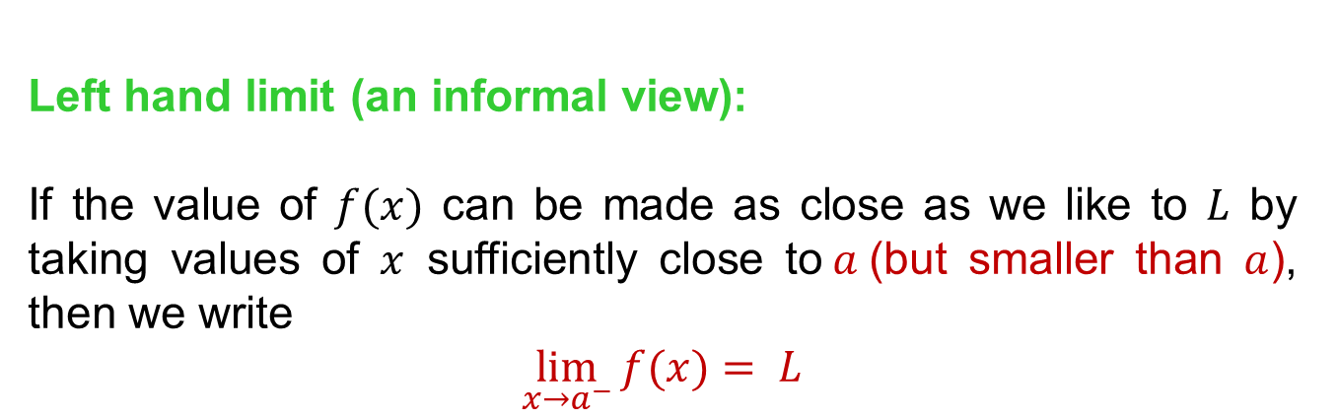
One sided limits
Left hand limit (an informal view):
If the value of $f(x)$ can be made as close as we like to $L$ by taking values of $x$ sufficiently close to$a$(but smaller than $a$), then we write
$$\lim_{x→a^{−}}{f(x)}= L$$

Slide 17
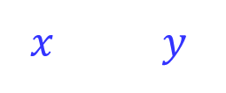
One sided limits
Consider $\lim_{x→1^{−}}{\frac{x−1}{\sqrt{x}−1}}$
$x y$

Slide 18
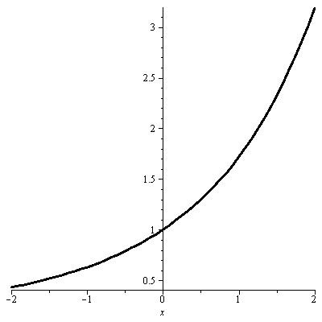
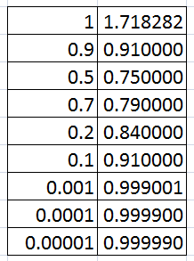
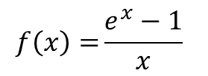
One sided limits
Consider$\lim_{x→0^{−}}$ $\frac{e^{x}−1}{x}$
$x y$
$$f\left(x\right)={\frac{e^{x}−1}{x}}$$

Slide 19
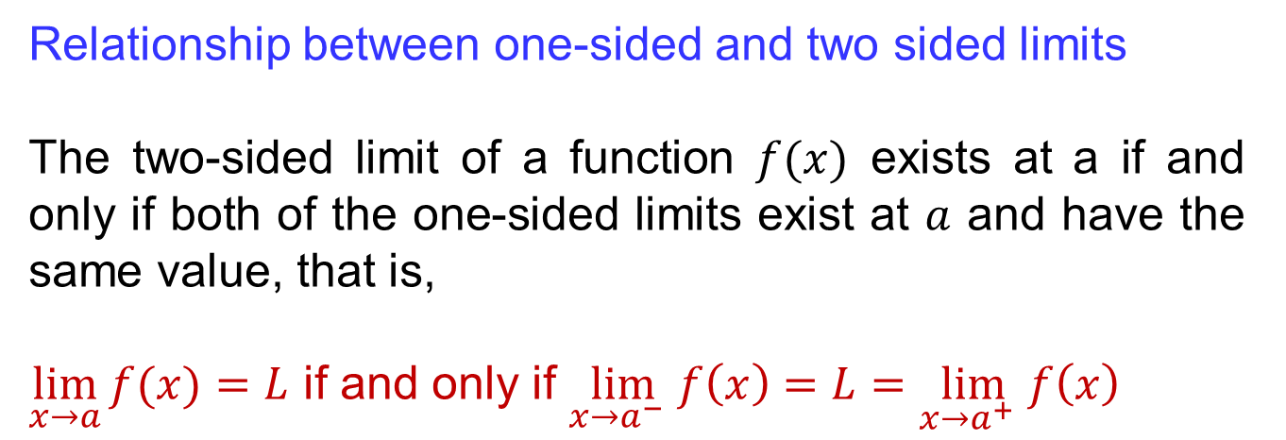
One sided limits
Relationship between one-sided and two sided limits
The two-sided limit of a function $f(x)$ exists at a if and only if both of the one-sided limits exist at $a$ and have the same value, that is,
$\lim_{x→a}{f(x)}=L$ if and only if $\lim_{x→a^{−} }f\left(x\right)=L=\lim_{x→a^{+} }f\left(x\right)$

Slide 20
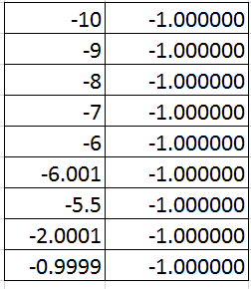
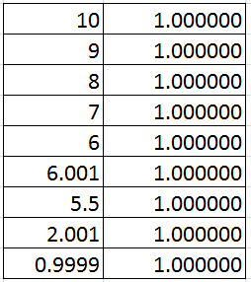
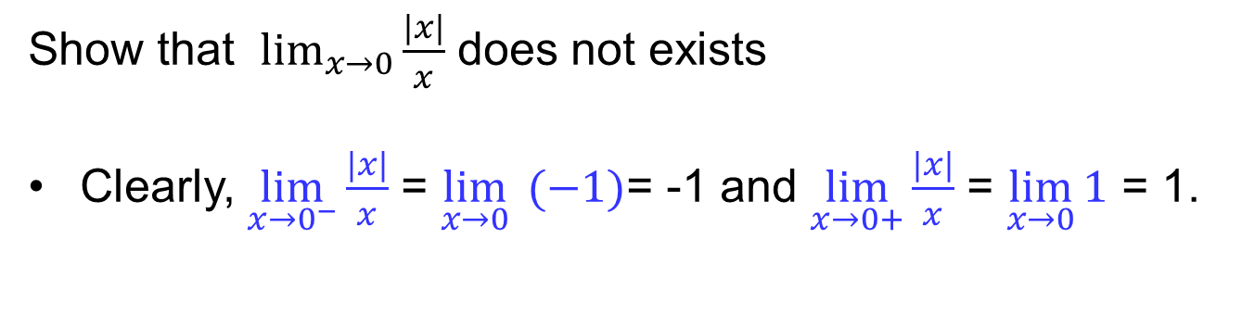
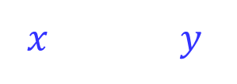
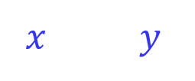
Limits that don’t exist
Show that $\lim_{x→0}{\frac{|x|}{x}}$ does not exists
Clearly, $\lim_{x→0^{−}}{\frac{|x|}{x}}$ = $\lim_{x→0}{ (−1)}$= -1 and $\lim_{x→0+}{\frac{|x|}{x}}$ = $\lim_{x→0}{1}$ = 1.
$x y$
$x y$

Slide 21
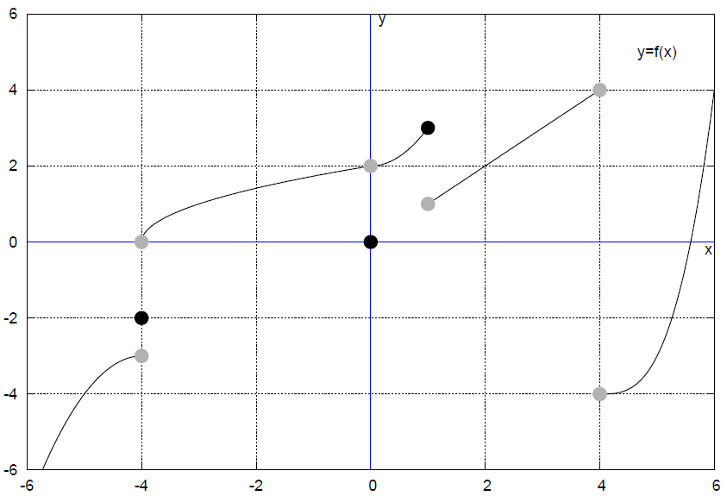
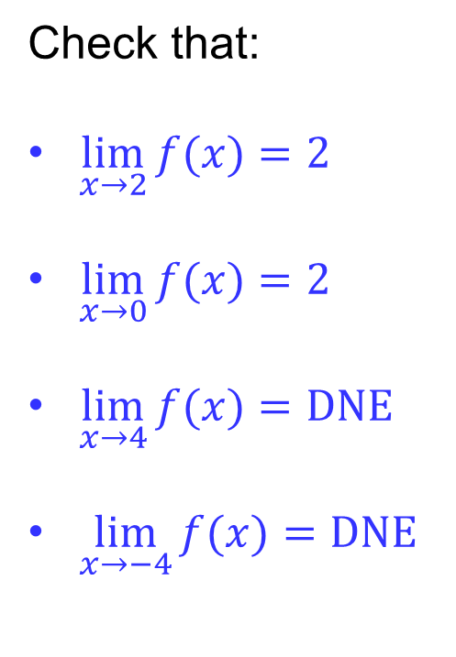

Limits that don’t exist
Check that:
$\lim_{x→2}{f(x)}=2$
$\lim_{x→0}{f(x)}=2$
$\lim_{x→4}{f(x)}=DNE$
$\lim_{x→−4}{f(x)}=DNE$
$$y=f(x)$$

Slide 22
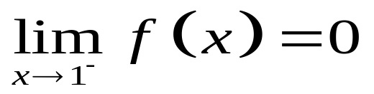

Limits that don’t exist
2
1
1
2
3
4
At $x=1:$

Slide 23
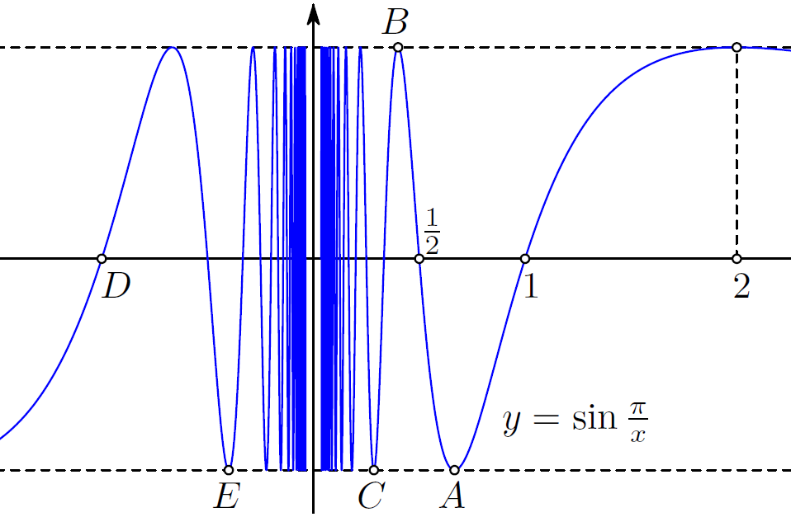
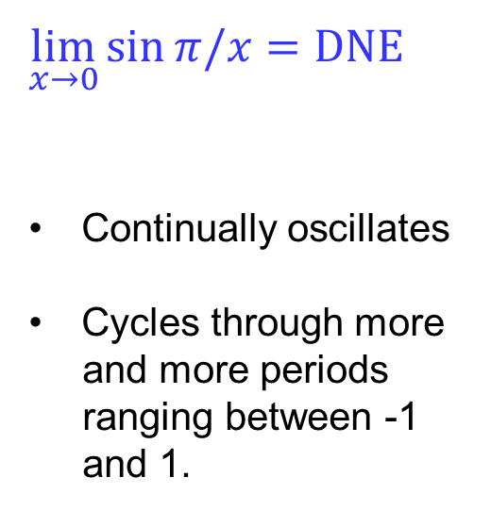
Limits that don’t exist
$$\lim_{x→0}{\sin{π/x}}=DNE$$
Continually oscillates
Cycles through more
and more periods
ranging between -1
and 1.
What about $\lim_{x→2}{\sqrt{1−x^{2}}} ?$

Slide 24
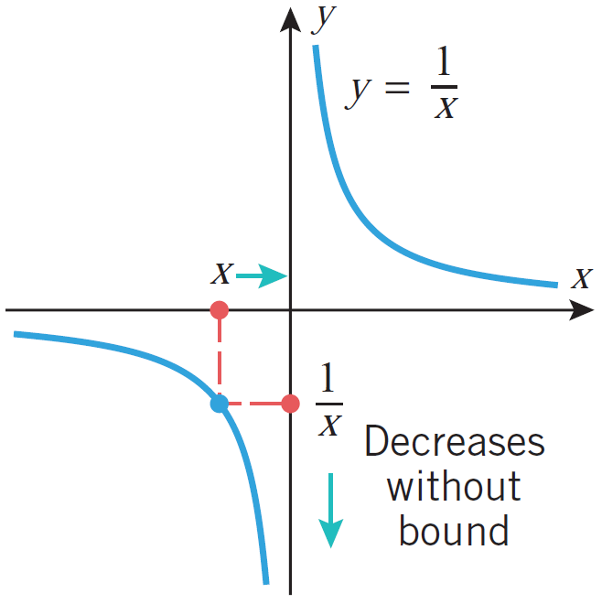
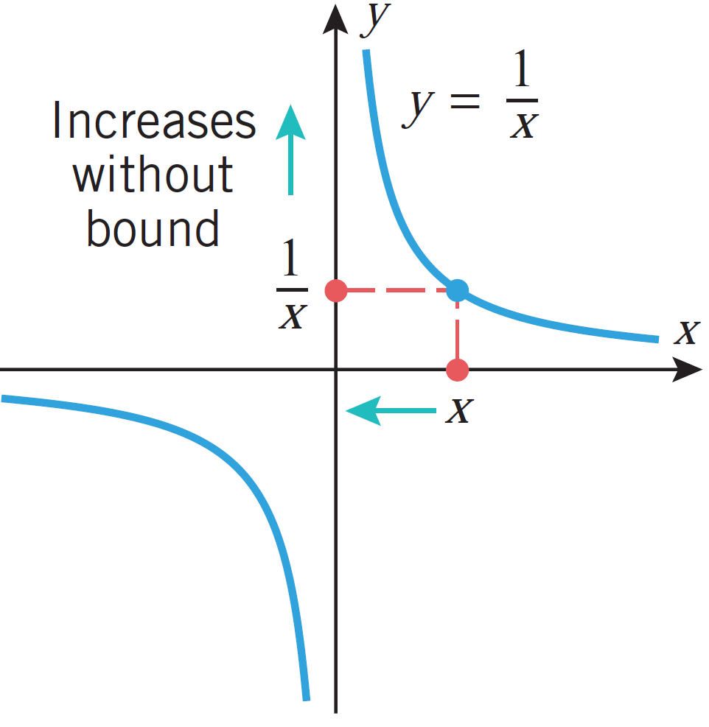
Limits that don’t exist
$\lim_{x→0}{{1/x}}=DNE$ as $\lim_{x→0^{+}}{{1/x}}=+∞$ and $\lim_{x→0^{+}}{{1/x}}=−∞$

Slide 25
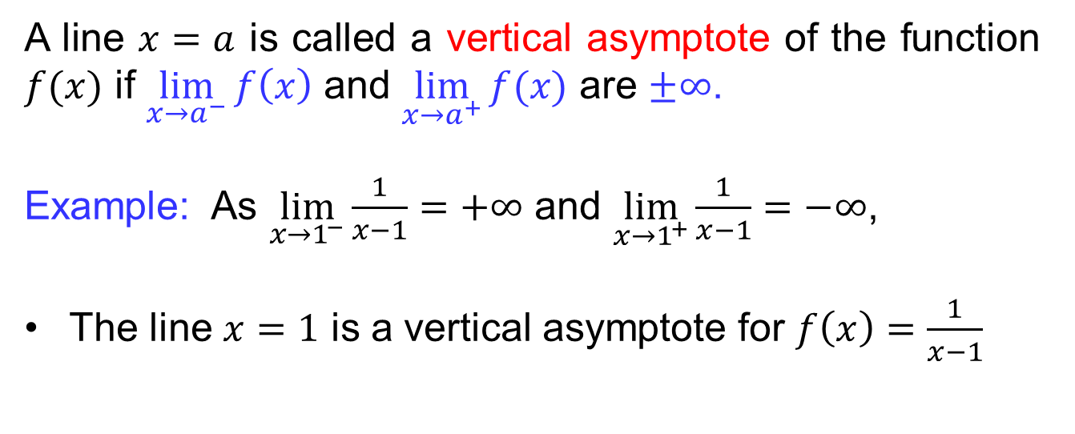
Vertical Asymptotes
A line $x=a$ is called a vertical asymptote of the function $f(x)$ if $\lim_{x→a^{−}}{f\left(x\right)}$ and $\lim_{x→a^{+}}{f(x)}$ are $±∞$.
Example: As $\lim_{x→1^{−}}\frac{1}{x−1}=+∞$ and $\lim_{x→1^{+}}\frac{1}{x−1}=−∞$,
The line $x=1$ is a vertical asymptote for $f\left(x\right)=\frac{1}{x−1}$

Slide 26
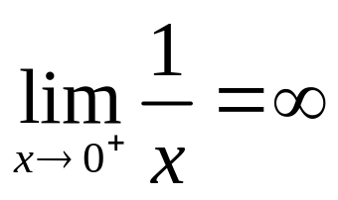
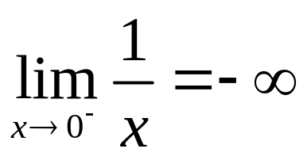
Vertical Asymptotes
vertical asymptote at x=0.

Slide 27
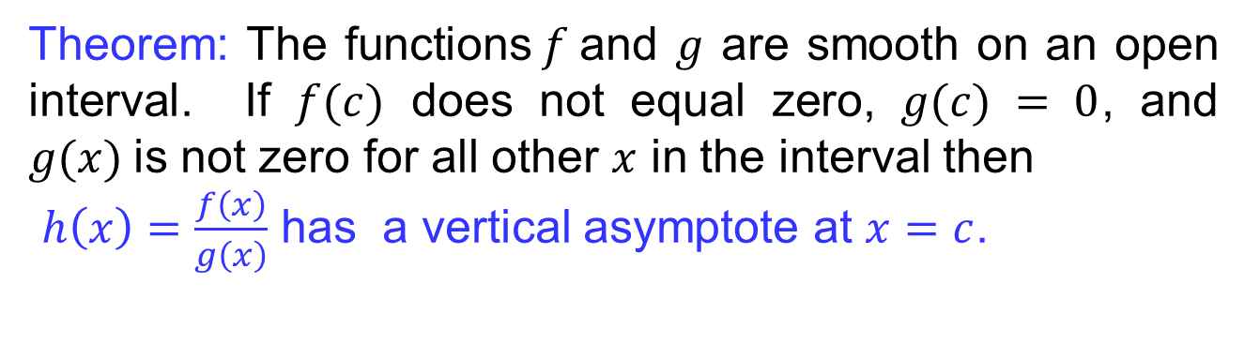
Vertical Asymptotes
Theorem: The functions$f$and $g$ are smooth on an open interval. If $f(c)$ does not equal zero, $g(c) = 0$, and $g(x)$is not zero for all other $x$ in the interval then
$h\left(x\right)=\frac{f\left(x\right)}{g\left(x\right)}$ has a vertical asymptote at $x=c$.

Slide 28
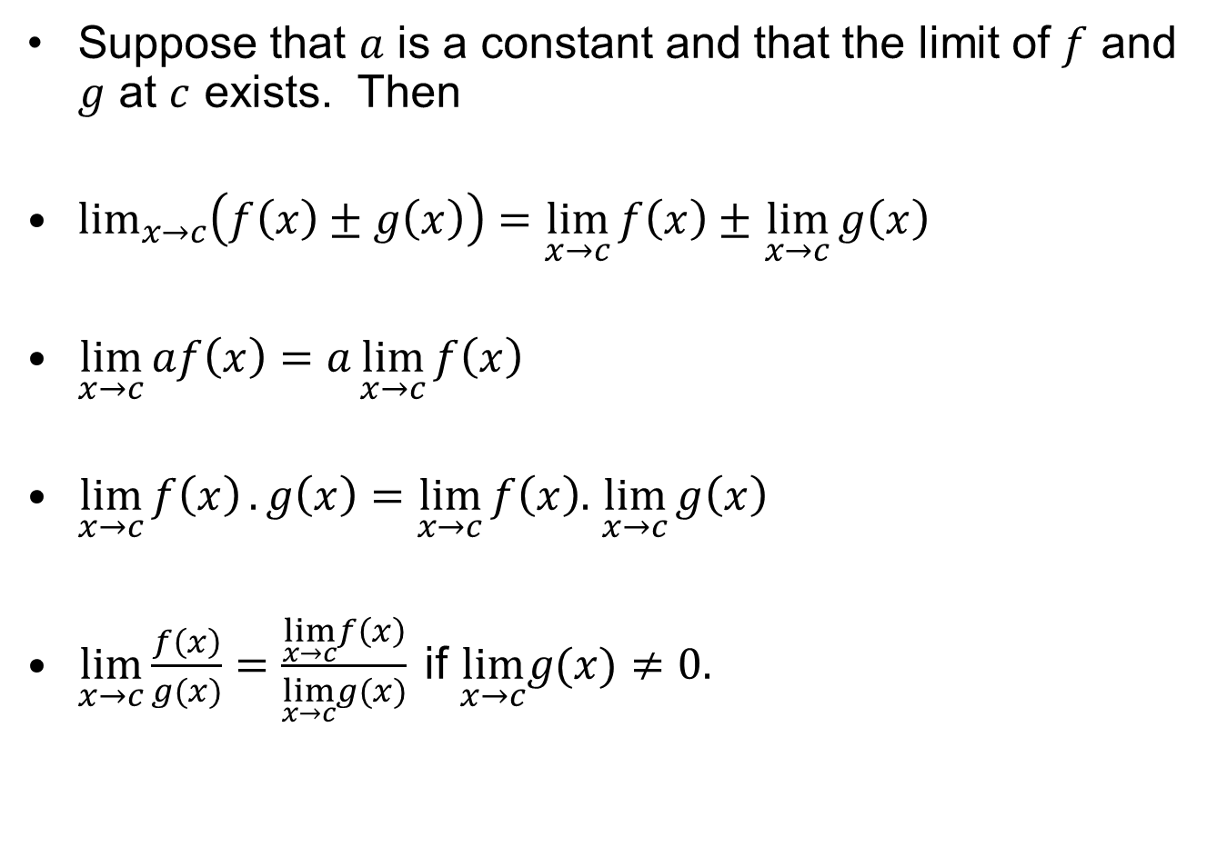
Laws of limits
Suppose that $a$ is a constant and that the limit of $f$ and $g$ at $c$ exists. Then
$\lim_{x→c}\left(f\left(x\right)±g\left(x\right)\right)=\lim_{x→c}{f\left(x\right)±}$ $\lim_{x→c}{g\left(x\right)}$
$\lim_{x→c}{af\left(x\right)=a\lim_{x→c}{f\left(x\right)}}$
$\lim_{x→c}{f\left(x\right)}.g\left(x\right)=\lim_{x→c}{f\left(x\right).}$ $\lim_{x→c}{g\left(x\right)}$
$\lim_{x→c}{\frac{f\left(x\right)}{g(x)}=\frac{\lim_{x→c}f\left(x\right)}{\lim_{x→c}g(x)}{ }}$if $\lim_{x→c}g(x)≠0.$

Slide 29
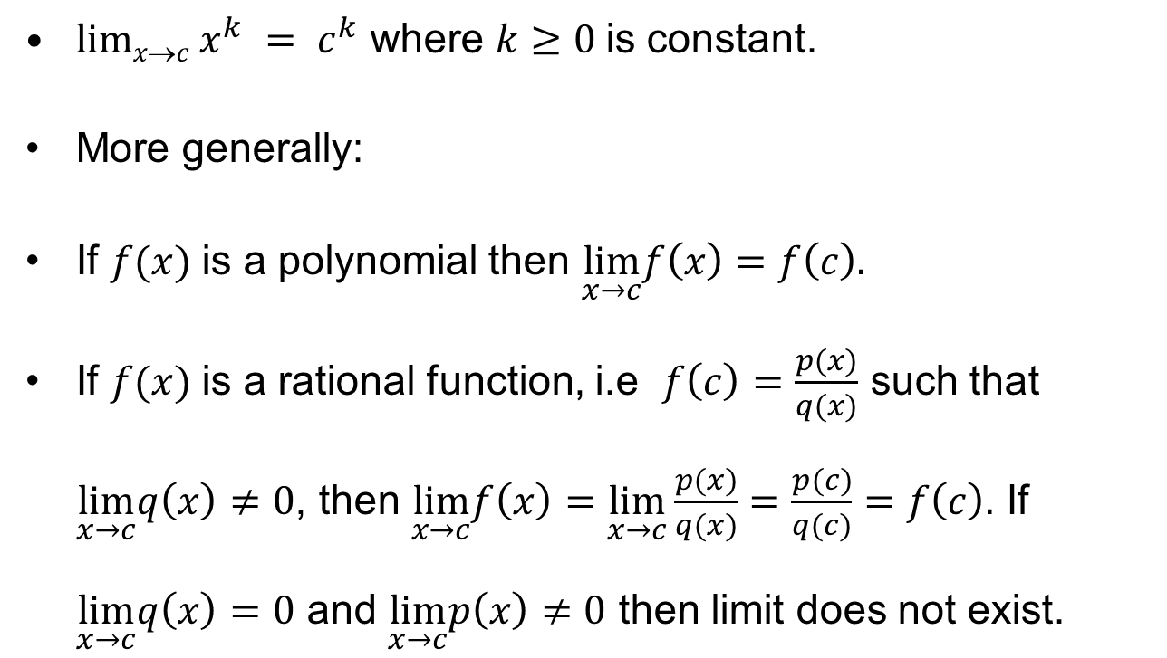
Laws of limits
$limxc x^{k} = c^{k}$ where $k≥0$is constant.
More generally:
If $f(x)$is a polynomial then $\lim_{x→c}f\left(x\right)=f\left(c\right).$
If $f(x)$is a rational function, i.e $f\left(c\right)=\frac{p(x)}{q(x)}$ such that $\lim_{x→c}q\left(x\right)≠0$, then $\lim_{x→c}f\left(x\right)=\lim_{x→c}\frac{p(x)}{q(x)}=\frac{p(c)}{q(c)}=f\left(c\right).$ If $\lim_{x→c}q\left(x\right)=0$ and $\lim_{x→c}p\left(x\right)≠0$ then limit does not exist.

Slide 30
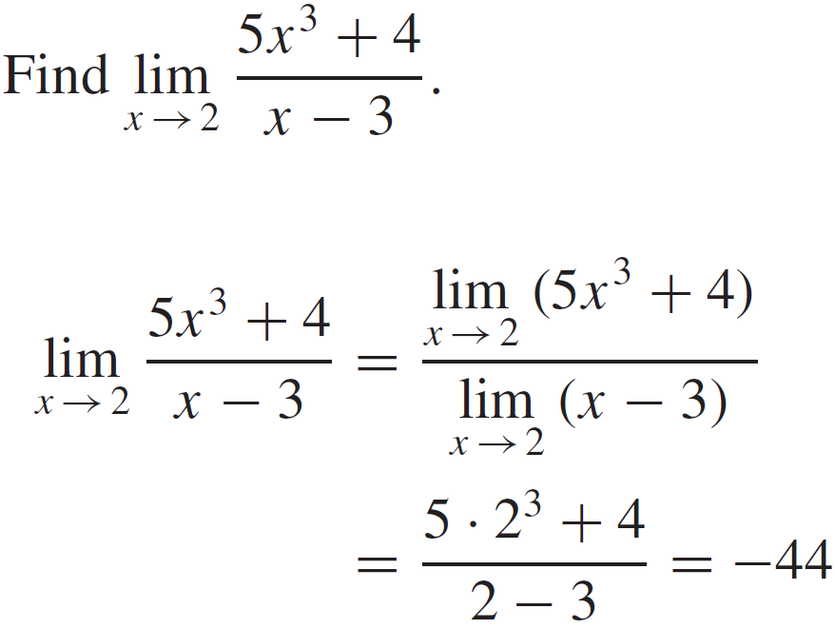
Laws of limits

Slide 31
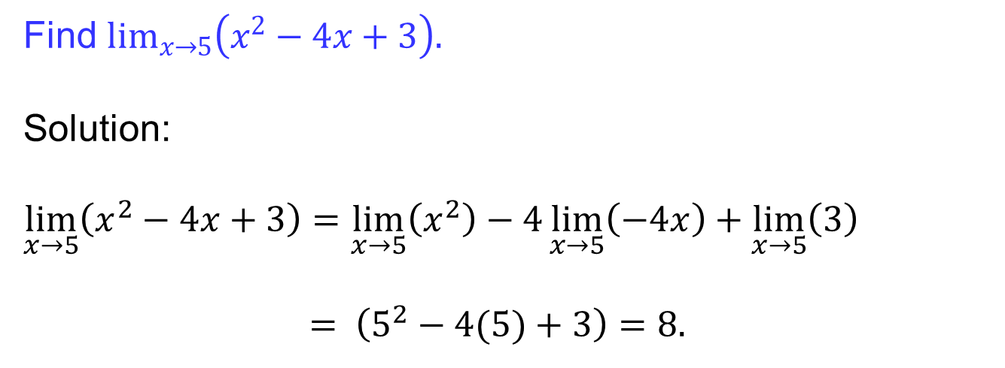
Laws of limits
Find $\lim_{x→5}\left(x^{2}−4x+3\right).$
Solution:
$$\lim_{x→5}\left(x^{2}−4x+3\right)=\lim_{x→5}\left(x^{2}\right)−4\lim_{x→5}\left(−4x\right)+\lim_{x→5}\left(3\right)$$
$= \left(5^{2}−4(5)+3\right){=8.}$

Slide 32
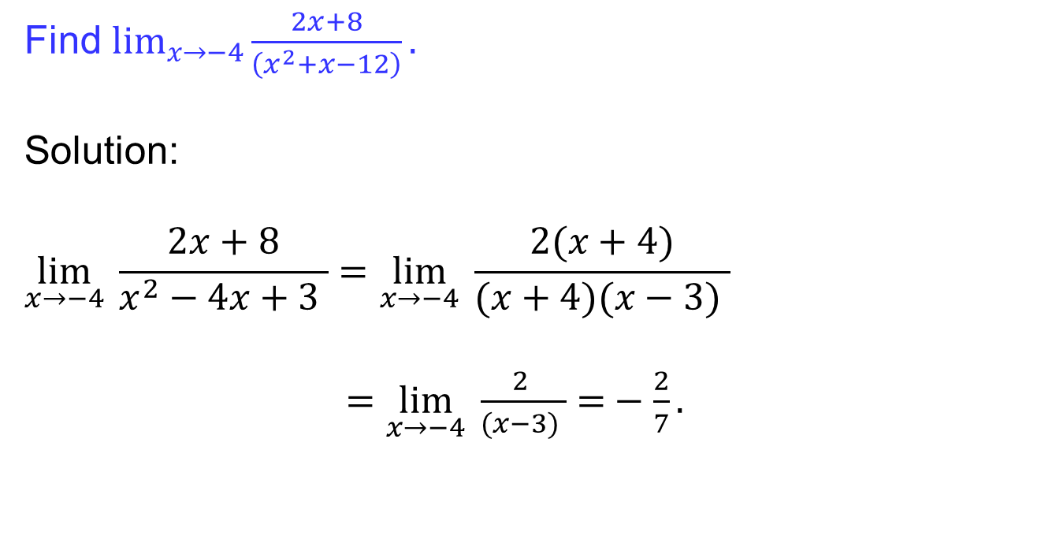
Laws of limits
Find $\lim_{x→−4}{\frac{2x+8}{\left(x^{2}+x−12\right)}.}$
Solution:
$$\lim_{x→−4}{ \frac{2x+8}{x^{2}−4x+3 }=\lim_{x→−4}{ \frac{2(x+4)}{(x+4)(x−3) }}}$$
$=\lim_{x→−4}{ \frac{2 }{(x−3) }=}−\frac{2}{7}.$

Slide 33
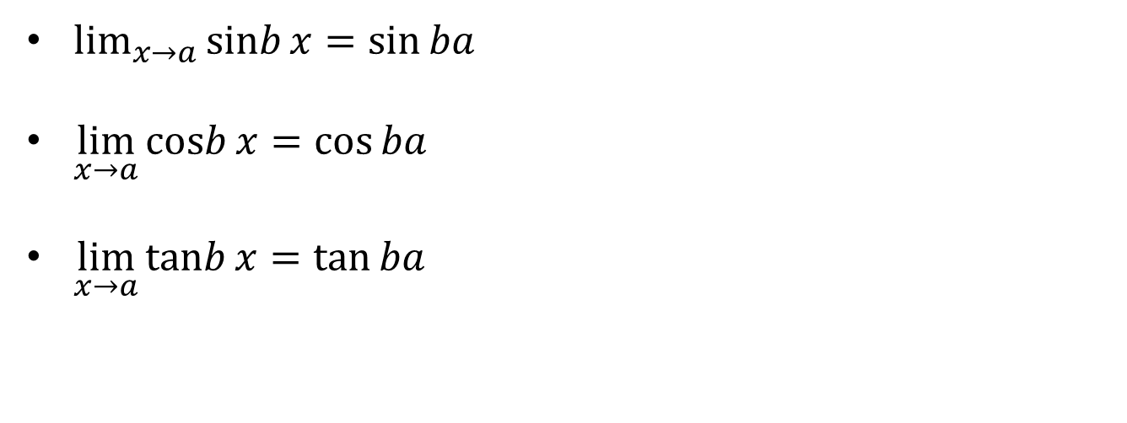
Laws of limits
$\lim_{x→a}{\operatorname{sinb}{x=\sin{ba}}}$
$\lim_{x→a}{\operatorname{cosb}{x=\cos{ba}}}$
$\lim_{x→a}{\operatorname{tanb}{x=\tan{ba}}}$

Slide 34
Lecture Summary
    Logarithmic functions.
    Inverse trigonometric functions
    Introduction to limits
    One sided limits
    Limits that don’t exist
    Vertical asymptotes
    Laws of limit

