Slide 1
Differential Equations
MTH 242
Lecture # 07
Dr. Manshoor Ahmed

Slide 2
Summary (Recall)
Applications first order linear differential equations.
Basic assumption for growth and decay processes.
Governing equation and solution.
Problems for growth.
Radioactive decay and half-life.
Problems related to decay process.

Slide 3
Carbon dating
About 1950, the chemist Willard Libby devised a method of using
radio active carbon as a means of determining the approximate
age of fossils, such as remains of woods, bones, etc.
The half-life of a radio active carbon is about 5600 years.
The ratio of Carbon 14 to ordinary Carbon in the atmosphere
is constant, and this ratio also applies to animals and plants
tissue as long as they are alive.
However, when the animals or plants die, the Carbon-14 starts
to decay through radioactivity, while the ordinary carbon does
not disappear.
Thus knowing the ratio of C-14 to ordinary carbon we can determine
an approximation to the year of death.

Slide 4
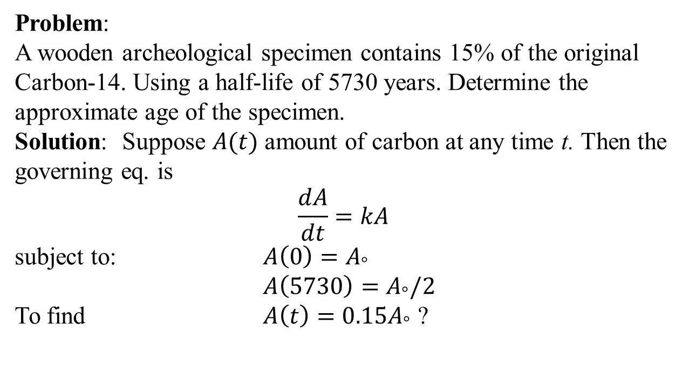
Problem:
A wooden archeological specimen contains 15% of the original Carbon-14. Using a half-life of 5730 years. Determine the approximate age of the specimen.
Solution: Suppose $A(t)$ amount of carbon at any time t. Then the governing eq. is
$$\frac{dA}{dt}=kA$$
subject to: ${A\left(0\right)=A}_{°}$
${A\left(5730\right)=A}_{°}/2$
To find ${A\left(t\right)=0.15A}_{°}$ ?

Slide 6
Problem 2:
A fossilized bone is found to contain 1/1000 of the original amount of C–14. Determine the age of the fossil.
Solution: Complete your self.

Slide 7




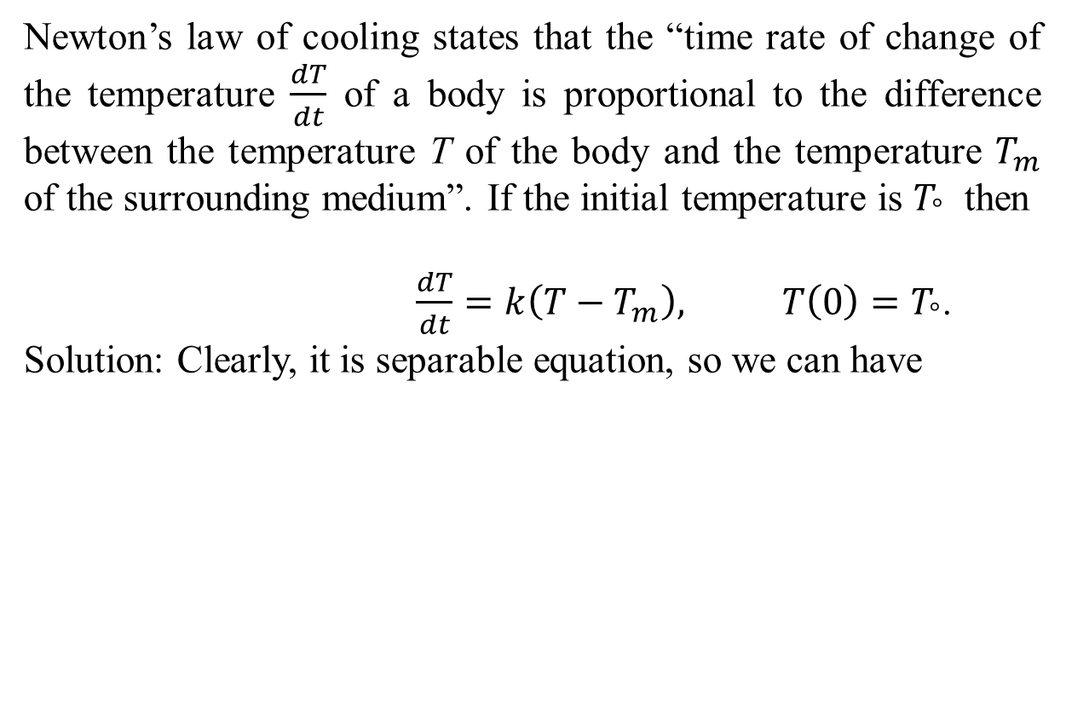
Newton’s Law of cooling
Newton’s law of cooling states that the “time rate of change of the temperature $\frac{dT}{dt}$ of a body is proportional to the difference between the temperature T of the body and the temperature $T_{m}$ of the surrounding medium”. If the initial temperature is $T_{°}$ then
$\frac{dT}{dt}=k\left(T−T_{m}\right), T\left(0\right)=T_{°}$.
Solution: Clearly, it is separable equation, so we can have

Slide 8


By applying the initial condition
Therefore, the final solution becomes

Slide 9
Problem 1:
A pot of boiling water is removed from the fire
and allowed to cool at room temperature. If after two
minutes the temperature of the water in the pot is find.
1. The time it will take the water to be at
2. The temperature of the water after five minutes.
Solution:

Slide 11
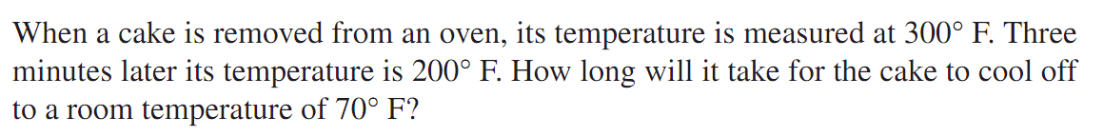
Problem 2: (Cooling of a cake)

Slide 13
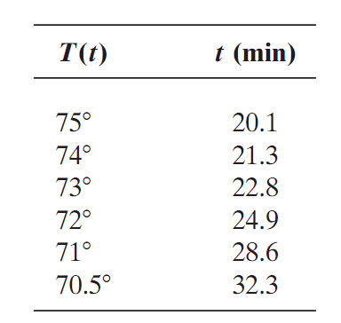
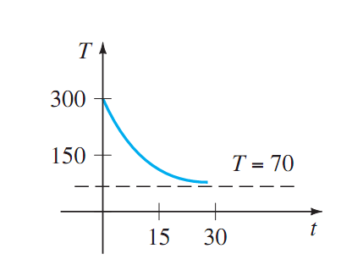
No need to worry , because, the figures clearly show that the cake will be approximately at room temperature in
about one-half hour.

Slide 15
Problem # 3:
A thermometer is taken from inside of room where the air
temperature is . After one minute the temperature reads
and after 5 minutes the reading . Find the temperature
at t = 0.
Solution:

Slide 17
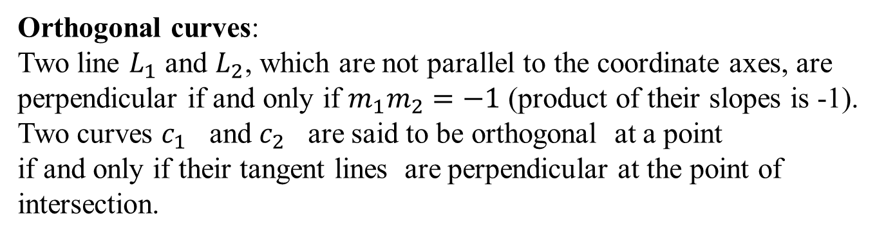
Orthogonal Trajectories
Orthogonal curves:
Two line $L_{1}$ and $L_{2}$, which are not parallel to the coordinate axes, are
perpendicular if and only if $m_{1}m_{2}=−1$ (product of their slopes is -1).
Two curves $c_{1}$ and $c_{2}$ are said to be orthogonal at a point
if and only if their tangent lines are perpendicular at the point of
intersection.

Slide 18
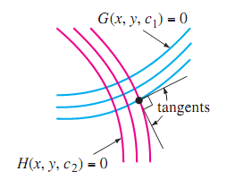
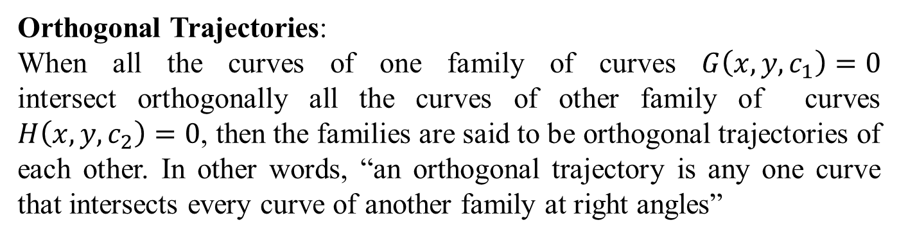
Orthogonal Trajectories:
When all the curves of one family of curves $G\left(x,y,c_{1}\right)=0$ intersect orthogonally all the curves of other family of curves $H\left(x,y,c_{2}\right)=0$, then the families are said to be orthogonal trajectories of each other. In other words, “an orthogonal trajectory is any one curve that intersects every curve of another family at right angles”

Slide 19
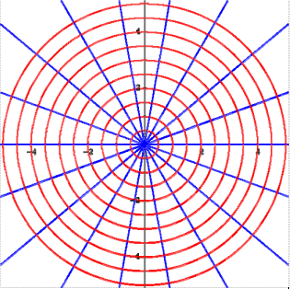
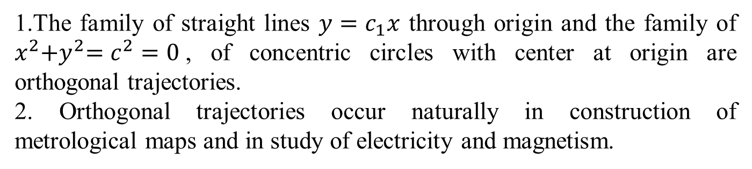
Examples
1.The family of straight lines $y=c_{1}x$ through origin and the family of $x^{2}{+y}^{2}=c^{2}=0$, of concentric circles with center at origin are orthogonal trajectories.
2. Orthogonal trajectories occur naturally in construction of metrological maps and in study of electricity and magnetism.

Slide 20
General Method:
To find the orthogonal trajectory of a given family
of curves, first we find the differential equation
That describes the family and second orthogonal
family is given by

Slide 21
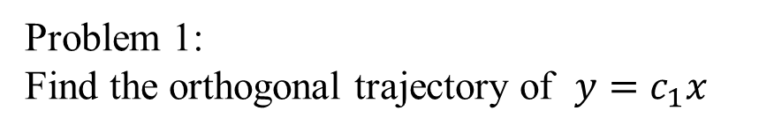
Problem 1:
Find the orthogonal trajectory of $y=c_{1}x$

Slide 22
Summary
Carbon dating (used find the age of fossils).
Newton’s law of cooling.
Orthogonal trajectories

