Slide 1
Differential Equations
MTH 242
Lecture # 06
Dr. Manshoor Ahmed

Slide 2
Summary (Recall)
Linear differential equation.
Solution method.
Bernoulli’s differential equation.
Solution of Bernoulli’s equation.

Slide 3
Applications of First Order Differential Equations
By the term mathematical modeling we mean the process whereby the behavior of a real life system or phenomenon, whether physical, sociological, or even economics is described by a set of mathematical relations, after approximation and idealizations. The following basic steps are involved in building such a model :
Step 1: We clearly state the assumptions on which the model will be based. These assumptions should describe the relationships among the quantities to be studied.
Step 2: Completely describe the parameters and variables to be used in the model.
Step 3: Use the assumptions (from Step 1) to derive mathematical equations relating the parameters and variables (from Step 2).
The mathematical models for physical phenomenon often lead to a differential equation or a set of differential equations.

Slide 4
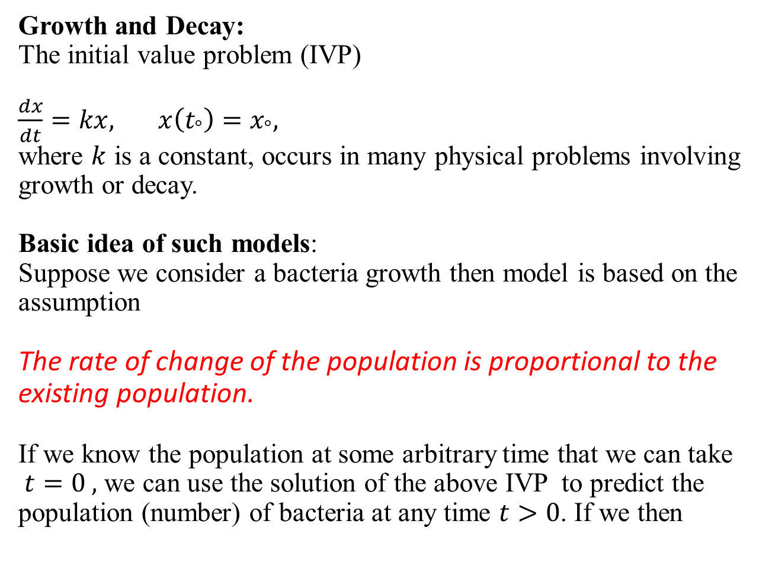
Applications to some linear first order models
Growth and Decay:
The initial value problem (IVP)
$\frac{dx}{dt}=kx, x\left(t_{°}\right)=x_{°},$
where $k$ is a constant, occurs in many physical problems involving growth or decay.
Basic idea of such models:
Suppose we consider a bacteria growth then model is based on the assumption
The rate of change of the population is proportional to the existing population.
If we know the population at some arbitrary time that we can take $t=0 ,$ we can use the solution of the above IVP to predict the population (number) of bacteria at any time $t>0$. If we then
.

Slide 5
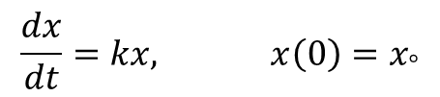
Solution of IVP
$$\frac{dx}{dt}=kx, x\left(0\right)=x_{°}$$

Slide 6
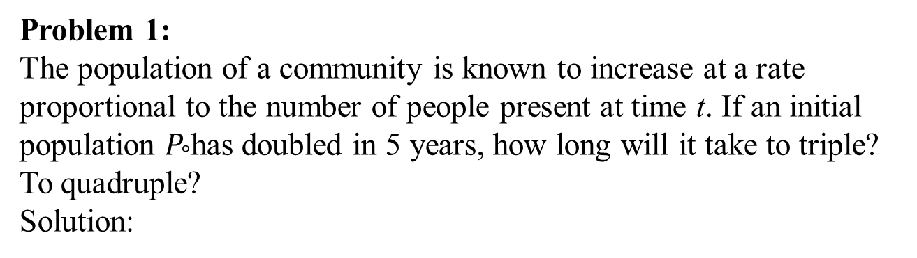
Problem 1:
The population of a community is known to increase at a rate proportional to the number of people present at time t. If an initial population $P_{°}$has doubled in 5 years, how long will it take to triple? To quadruple?
Solution:

Slide 8
Problem 2:
Bacteria in a certain culture increases at a rate proportional to the number present. If the number of bacteria is 2000 after one hour and 4000 after two hrs. What was their initial numbers?
Solution:

Slide 10
Radioactive Decay
In physics a radioactive substance disintegrates or transmutes into the atoms of another element.
Examples:
(i) Radium is a radioactive chemical element which has symbol Ra. Radium is used in medicines to produce radon gas which in turn is use as a cancer treatment.
(ii) Uranium is another example of radioactive element. However, Radium is over one million times more radioactive than the same mass of Uranium.

Slide 11
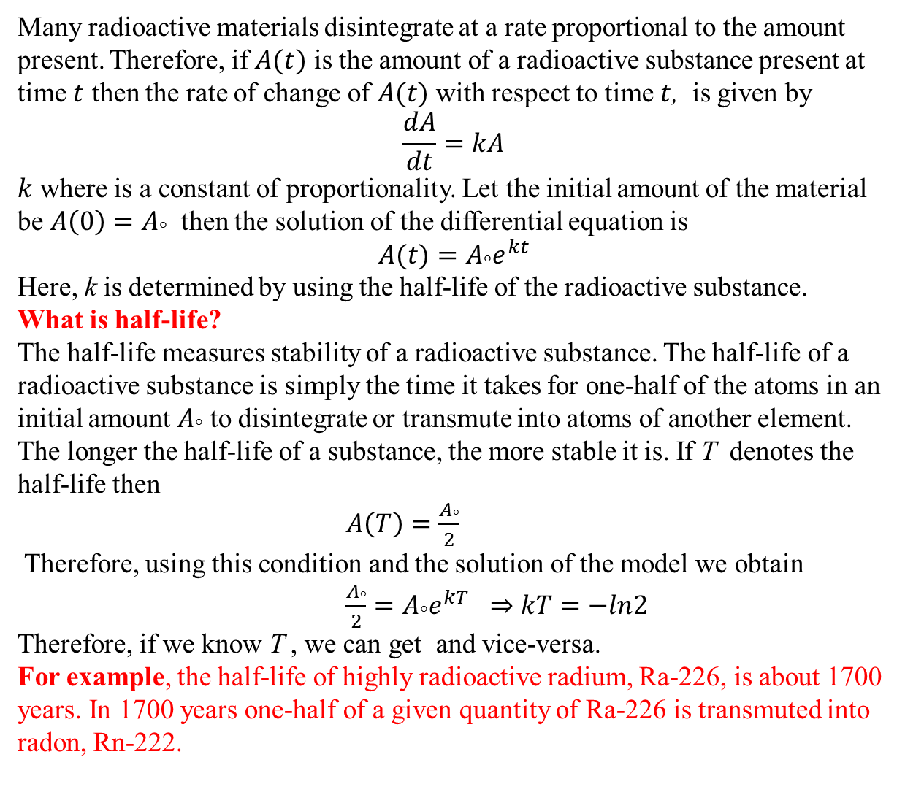
Many radioactive materials disintegrate at a rate proportional to the amount present. Therefore, if $A(t)$ is the amount of a radioactive substance present at time $t$ then the rate of change of $A(t)$ with respect to time $t$, is given by
$$\frac{dA}{dt}=kA$$
$k$ where is a constant of proportionality. Let the initial amount of the material be ${A\left(0\right)=A}_{°}$ then the solution of the differential equation is
$${A(t)=A}_{°}e^{kt}$$
Here, k is determined by using the half-life of the radioactive substance.
What is half-life?
The half-life measures stability of a radioactive substance. The half-life of a radioactive substance is simply the time it takes for one-half of the atoms in an initial amount $A_{°}$ to disintegrate or transmute into atoms of another element. The longer the half-life of a substance, the more stable it is. If T denotes the half-life then
$A\left(T\right)=\frac{A_{°}}{2}$
Therefore, using this condition and the solution of the model we obtain
${\frac{A_{°}}{2}=A}_{°}e^{kT}$ $kT=−ln2$
Therefore, if we know T , we can get and vice-versa.
For example, the half-life of highly radioactive radium, Ra-226, is about 1700 years. In 1700 years one-half of a given quantity of Ra-226 is transmuted into radon, Rn-222.

Slide 12
Problem:
Radium decomposes at a rate proportional to the quantity of radium present. If 100 mg reduces to 90 mg in 20 years. How many mg will remain at the end of 1000 years? How long will it take for one-half of the original amount to decompose?
Solution:

Slide 14
Problem:
Initially there were 100mg of a radioactive substance present.
After 6hrs the mass decreased by 3%. If the rate of decay is proportional to the amount of the substance present at any time,
find the amount remaining after 24 hrs?
Solution

Slide 16
Problem:
The breeder reactor converts stable Uranium 238 into the isotope Platinum 239. After 15 years it is determined that 0.043% of the initial amount of the platinum has disintegrated. Find the half-life of this isotope.
Solution:

Slide 18
Exercise
Do questions 1-10 of exercise 3.1 from your text book
A First Course in Differential Equations with Modeling Applications
By Dennis G. Zill [7th Edition]

Slide 19
Summary
Applications first order linear differential equations.
Basic assumption for growth and decay processes.
Governing equation and solution.
Problems for growth.
Radioactive decay and half-life.
Problems related to decay process.

