Slide 1
Differential Equations
MTH 242
Lecture # 05
Dr. Manshoor Ahmed

Slide 2
Summary (Recall)
Total differential.
Exact differential equation.
Solution Method for Exact differential equation.
Differential equations which are not exact.
Integrating factor.

Slide 3
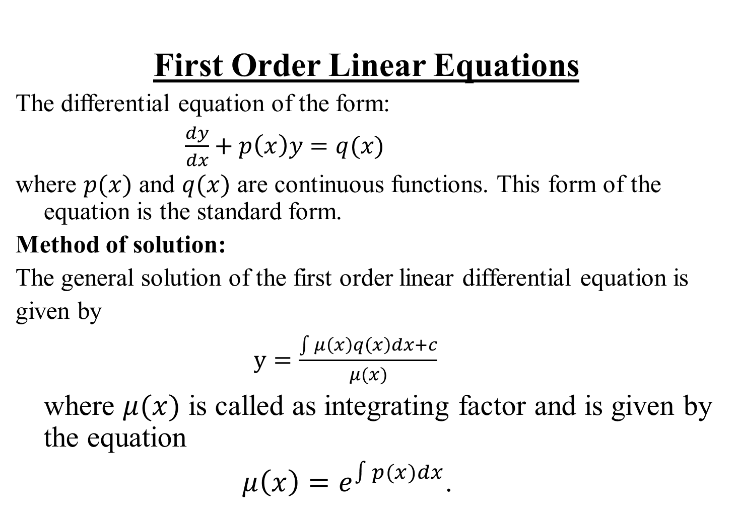
First Order Linear Equations
The differential equation of the form:
$\frac{dy}{dx}+p\left(x\right)y=q(x)$
where $p(x)$ and $q(x)$ are continuous functions. This form of the equation is the standard form.
Method of solution:
The general solution of the first order linear differential equation is
given by
$y=\frac{\int{μ\left(x\right)}q\left(x\right)dx+c}{μ(x)}$
where $μ(x)$ is called as integrating factor and is given by the equation
$μ\left(x\right)=e^{\int{p(x)}dx}$.

Slide 4
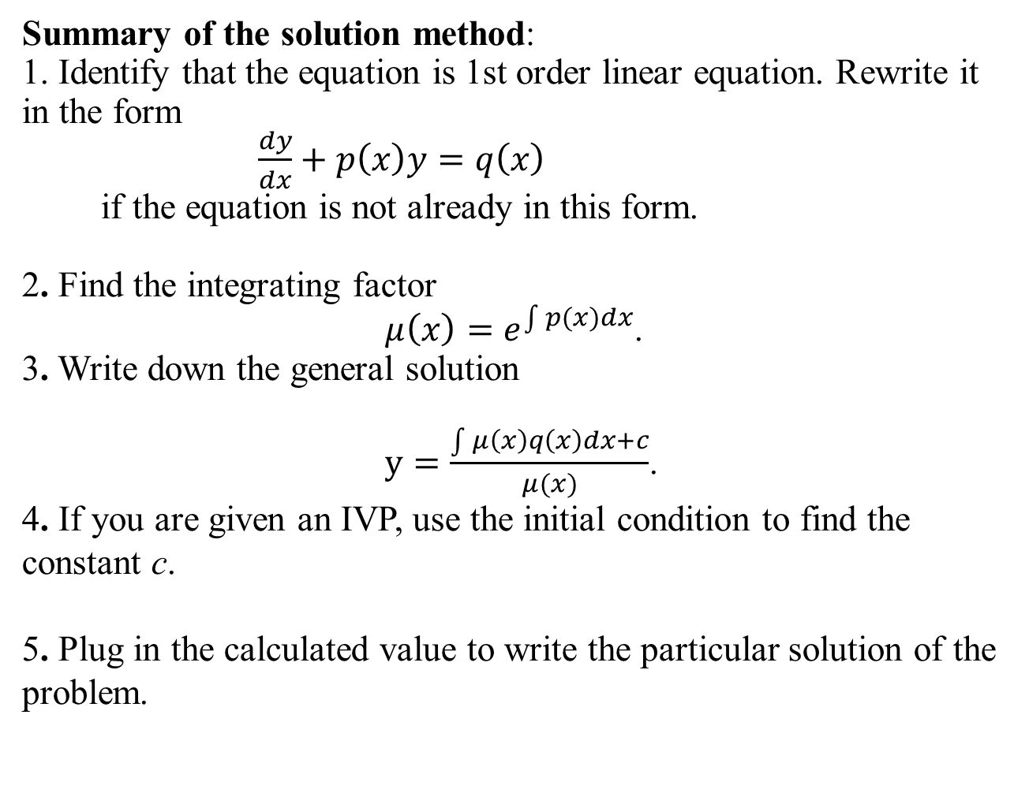
Summary of the solution method:
1. Identify that the equation is 1st order linear equation. Rewrite it in the form
$\frac{dy}{dx}+p\left(x\right)y=q\left(x\right)$
if the equation is not already in this form.
2. Find the integrating factor
$μ\left(x\right)=e^{\int{p(x)}dx}$.
3. Write down the general solution
$y=\frac{\int{μ\left(x\right)}q\left(x\right)dx+c}{μ(x)}$.
4. If you are given an IVP, use the initial condition to find the constant c.
5. Plug inthe calculated value to write the particular solution of the problem.
.

Slide 5
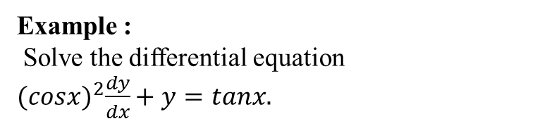
Example :
Solve the differential equation
${(cosx)}^{2}\frac{dy}{dx}+y=tanx.$

Slide 7
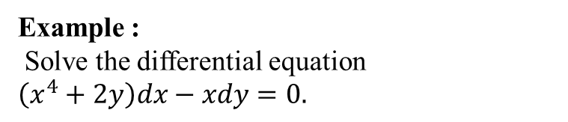
Example :
Solve the differential equation
$\left(x^{4}+2y\right)dx−xdy=0.$

Slide 9
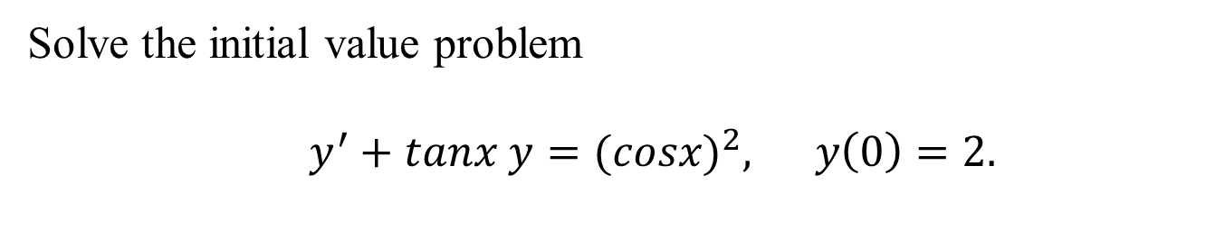
Solve the initial value problem
$y^{′}+tanx y={(cosx)}^{2}, y\left(0\right)=2.$

Slide 11
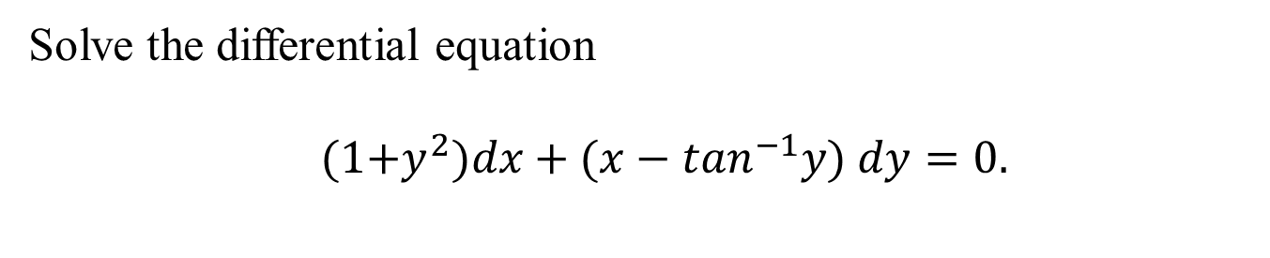
Solve the differential equation
$(1{+y}^{2})dx+({x−tan}^{−1}y) dy=0.$

Slide 14
Bernoulli’s Equation
Sometimes it is possible to convert non-linear equation into a linear equation by change of the dependent variable
Definition
An equation of the form
………………. (1)
is called a Bernoulli’s differential equation, where n is any real number.
For n = 0 equation (1) becomes linear and for n = 1 equation (1)
becomes separable & linear in y. Now for y eq (1) can be writen as
……………….. (2)
If we let,
, then
..…………….. (3)

Slide 15
…………………(4)
With the help of eq. (3) & (4). Eq. (2) can be simplified to the linear eq
………………..(5)
,
Solving (5) for v and using leads to the solution of eq (1)
,
,
,

Slide 16
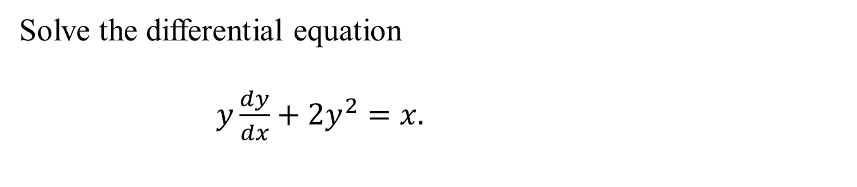
Solve the differential equation
$y\frac{dy}{dx}+2y^{2}=x.$

Slide 18
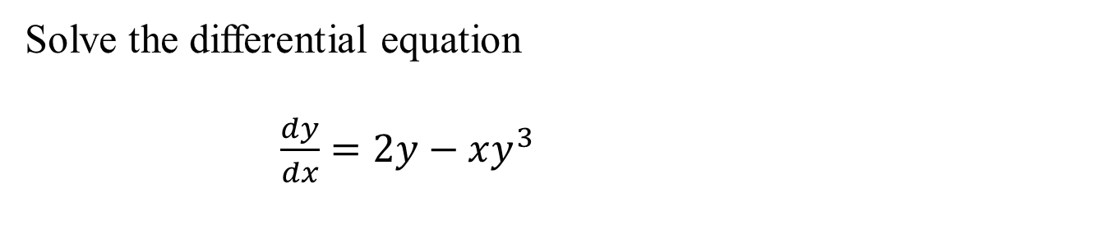
Solve the differential equation
$\frac{dy}{dx}=2y−xy^{3}$

Slide 20
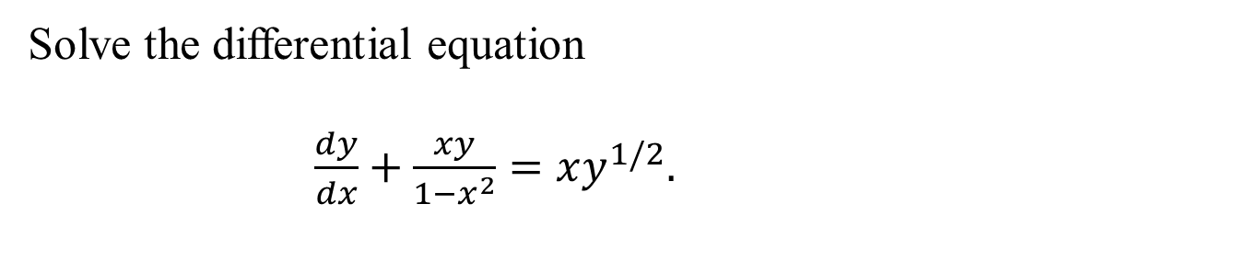
Solve the differential equation
$\frac{dy}{dx}+\frac{xy}{1−x^{2}}=xy^{1/2}.$

Slide 22
Summary
Linear differential equation.
Solution method.
Bernoulli’s differential equation.
Solution of Bernoulli’s equation.

