Slide 1
Differential Equations
MTH 242
Lecture # 04
Dr. Manshoor Ahmed

Slide 2
Summary (Recall)
Separable differential equation.
Homogeneous function and homogeneous differential equation.
Equations reducible to homogeneous.

Slide 3
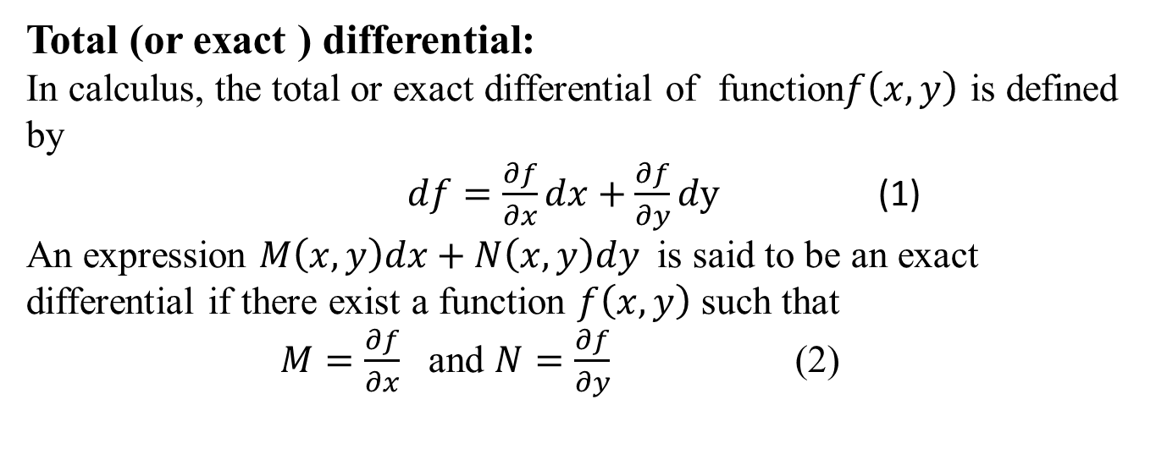
Exact differential equation
Total (or exact ) differential:
In calculus, the total or exact differential of function$f\left(x,y\right)$ is defined by
$df=\frac{∂f}{∂x}dx+\frac{∂f}{∂y}dy$ (1)
An expression $M\left(x,y\right)dx+N\left(x,y\right)dy$ is said to be an exact differential if there exist a function $f\left(x,y\right)$ such that
$M=\frac{∂f}{∂x}$ and $N=\frac{∂f}{∂y}$ (2)
.

Slide 4
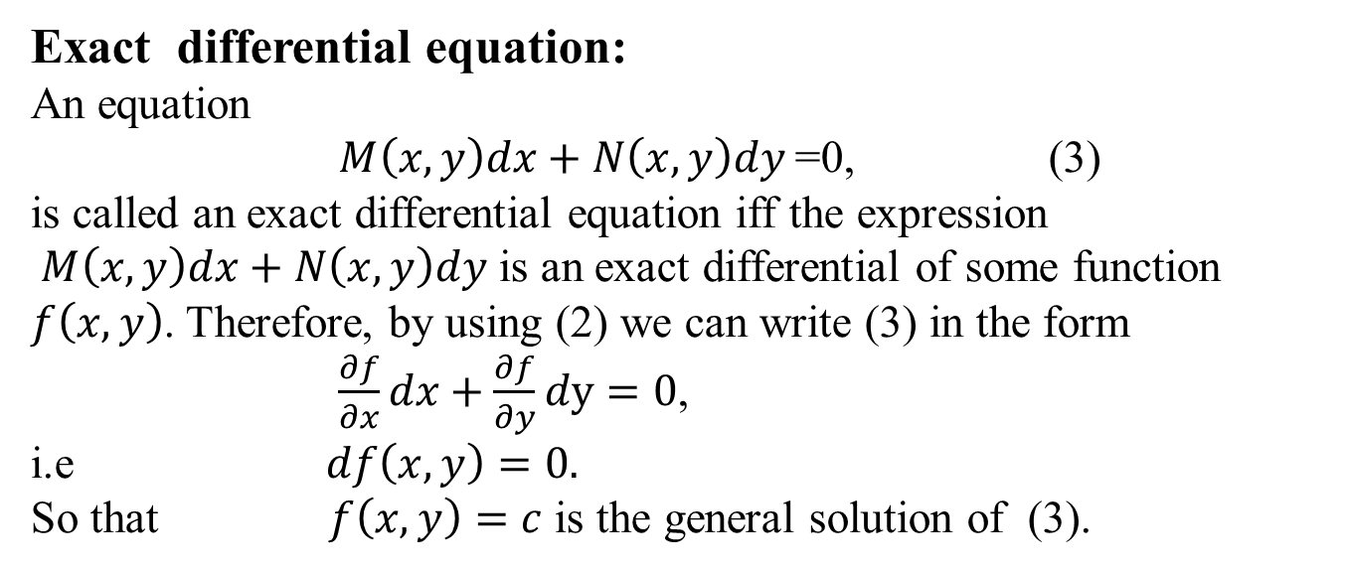
Exact differential equation:
An equation
$M\left(x,y\right)dx+N\left(x,y\right)dy$=0, (3)
is called an exact differential equation iff the expression
$M\left(x,y\right)dx+N\left(x,y\right)dy$ is an exact differential of some function $f\left(x,y\right)$. Therefore, by using (2) we can write (3) in the form
$\frac{∂f}{∂x}dx+\frac{∂f}{∂y}dy=0$,
i.e$df\left(x,y\right)=0.$
So that $f\left(x,y\right)=c$ is the general solution of (3).

Slide 5
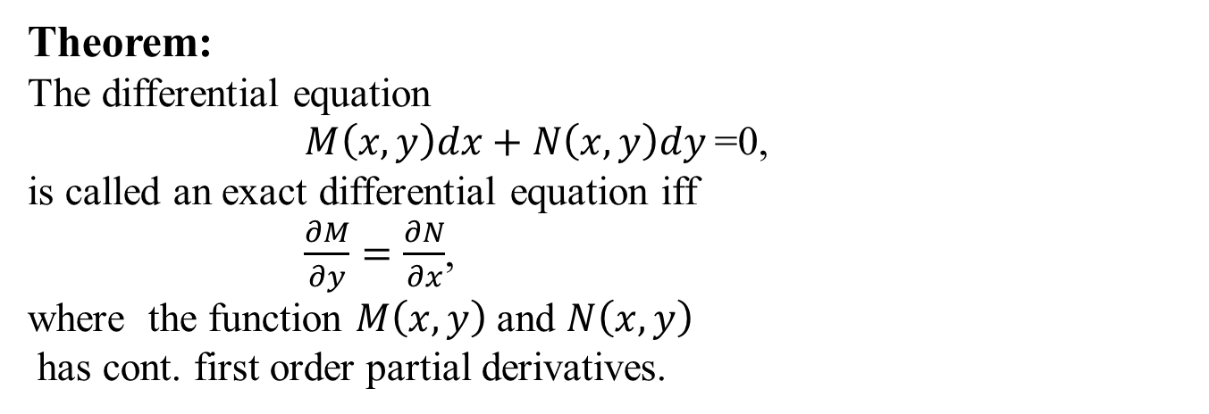
Theorem:
The differential equation
$M\left(x,y\right)dx+N\left(x,y\right)dy$=0,
is called an exact differential equation iff
$\frac{∂M}{∂y}=\frac{∂N}{∂x}$,
where the function $M\left(x,y\right)$ and $N\left(x,y\right)$
has cont. first order partial derivatives.

Slide 6
Method of Solution:
If the given equation is exact then the solution procedure consists of
the following steps:
Step 1. Check that the equation is exact by verifying the condition
Step 2. Write down the system
Step 3. Integrate either the 1st equation w. r. to x or 2nd w. r. to y. If
we choose the 1st equation then
The function is an arbitrary function of y, integration w.r.to x;
y being constant.

Slide 7
Step 4. Use second equation in step 2 and the equation in step 3 to find .
Step 5. Integrate to find and write down the function F (x, y);
Step 6. All the solutions are given by the implicit equation
Step 7. If you are given an IVP, plug in the initial condition to find
the constant C.
Caution: x should disappear from . Otherwise something is
wrong!

Slide 8

Solve the differential equation
$(3x^{2}y+2)dx+(x^{3}+y) dy=0$

Slide 10
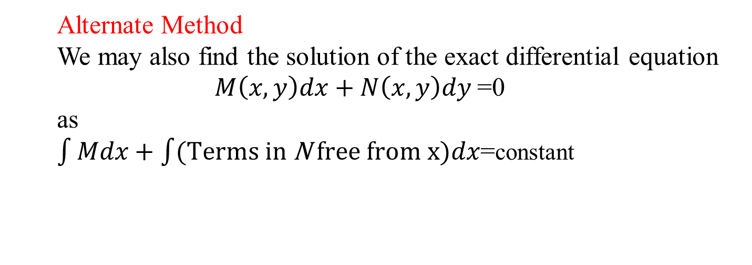
Alternate Method
We may also find the solution of the exact differential equation
$M\left(x,y\right)dx+N\left(x,y\right)dy$=0
as
$\int{Mdx+\int{(\text{Terms} \text{in} \text{N} \text{free} \text{from} \text{x}\text{)}dx}}$=constant

Slide 11
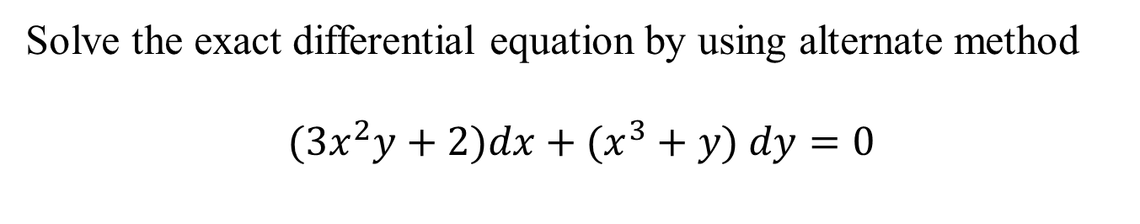
Solve the exact differential equation by using alternate method
$(3x^{2}y+2)dx+(x^{3}+y) dy=0$

Slide 12
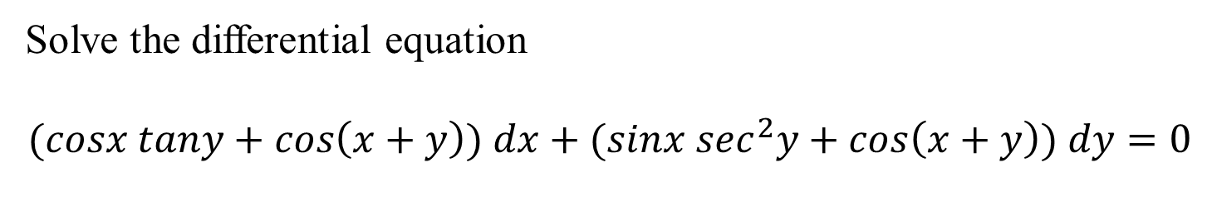
Solve the differential equation
$$(cosx tany+cos\left(x+y\right)) dx+(sinx \sec^{2}y+cos\left(x+y\right)) dy=0$$

Slide 16
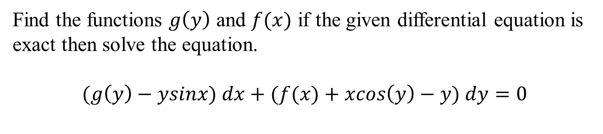
Find the functions $g\left(y\right)$ and $f(x)$ if the given differential equation is exact then solve the equation.
$$(g\left(y\right)−ysinx) dx+(f(x)+xcos\left(y\right)−y) dy=0$$

Slide 18
Integrating Factor Technique
If the equation
is not exact, then we must have
Therefore, we look for a function u (x, y) such that the equation
becomes exact. The function u (x, y) (if it exists) is called the
integrating factor (IF) and it satisfies the equation due to the
condition of exactness.

Slide 19
Example 1
Show that is an integrating factor for the equation
and then solve the equation.
Solution: Since
Therefore
So that
and the equation is not exact. However, if the equation is multiplied by
then the equation becomes

Slide 20
Now
Therefore
So that this new equation is exact. The equation can be solved.
However, it is simpler to observe that the given equation can also
written
or
Hence, integrating, we have

Slide 21
Example 2 Solve the differential equation
whose integrating factor is x.
Solution:
The given differential equation can be written in form
Therefore, and
Now

Slide 22
Multiplying the given equation with the IF, we obtain
which is exact.
Since , the equation is exact.
2. We find F (x, y) by solving the system
3. We integrate the first equation to get
4. We differentiate w. r. t y and use the second equation of the system in step 2 to obtain

Slide 23
Example Solve , with IF
Solution: Here
The equation is not exact.
The IF is Multiplying the equation by y, we have
or
or
Integrating, we have
which is the required solution.

Slide 24
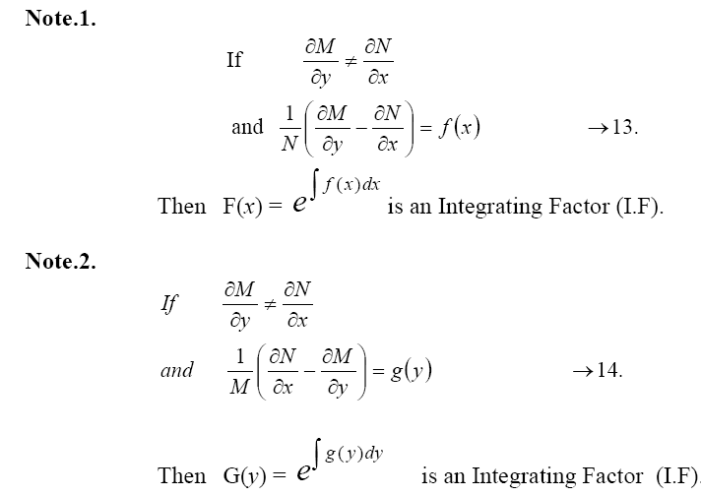
Rules to find I.F

Slide 25
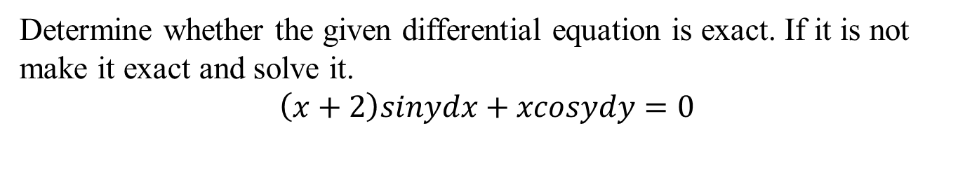
Determine whether the given differential equation is exact. If it is not make it exact and solve it.
$$\left(x+2\right)sinydx+xcosydy=0$$

Slide 27
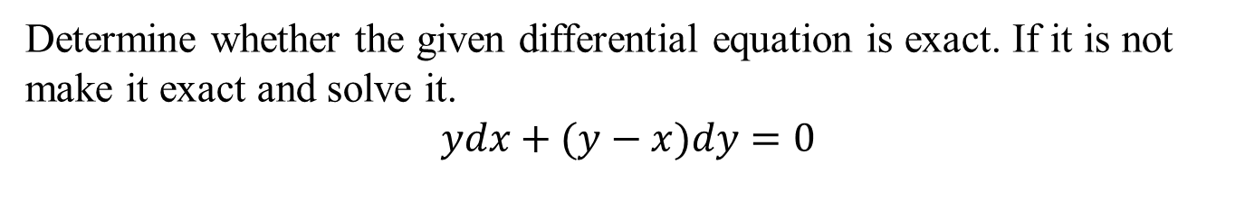
Determine whether the given differential equation is exact. If it is not make it exact and solve it.
$$ydx+(y−x)dy=0$$

Slide 29
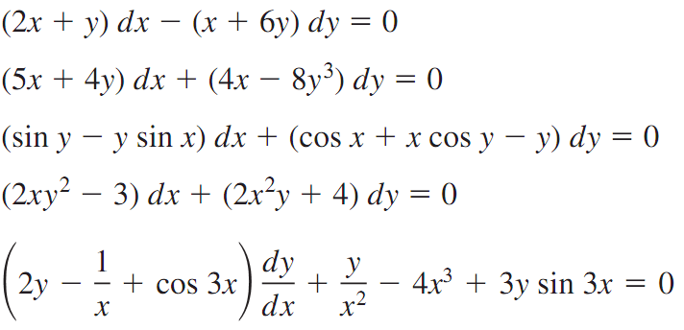
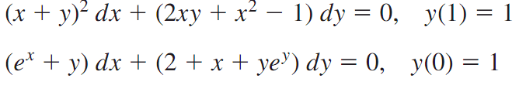
Some questions for practice
Determine whether the given differential equation is exact. If it is exact, solve it.
solve the initial value problems.

Slide 30
Summary
Total differential.
Exact differential equation.
Solution Method for Exact differential equation.
Differential equations which are not exact.
Integrating factor.

