Slide 1
Differential Equations
MTH 242
Lecture # 03
Dr. Manshoor Ahmed

Slide 2
Summary (Recall)
Solution of differential equation.
Interval of the solution.
Trivial, general, particular and singular Solutions.
Families of solutions.
Initial Value Problems.
Existence and uniqueness theorem.

Slide 3
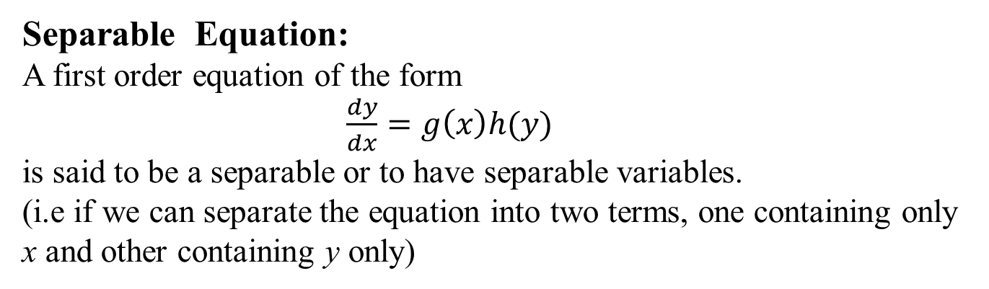
First Order ODEs
Separable Equation:
A first order equation of the form
$\frac{dy}{dx}=g\left(x\right)h(y)$
is said to be a separable or to have separable variables.
(i.e if we can separate the equation into two terms, one containing only x and other containing y only)
.

Slide 4
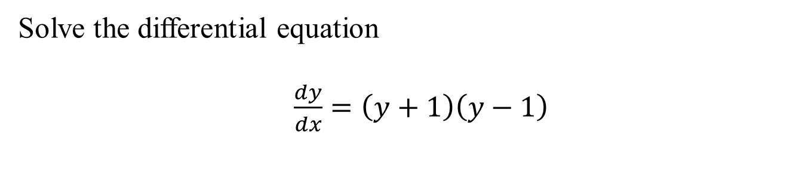
Solution of separable equation
Solve the differential equation
$\frac{dy}{dx}=\left(y+1\right)\left(y−1\right)$

Slide 7
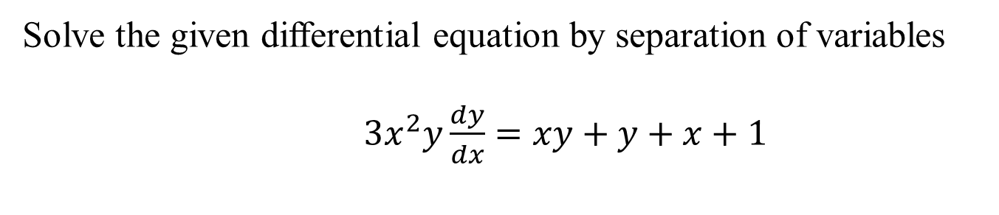
Solve the given differential equation by separation of variables
$3x^{2}y\frac{dy}{dx}=xy+y+x+1$

Slide 9
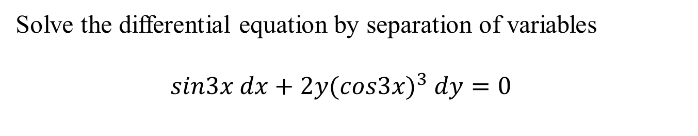
Solve the differential equation by separation of variables
$sin3x dx+2y{(cos3x)}^{3} dy=0$

Slide 10
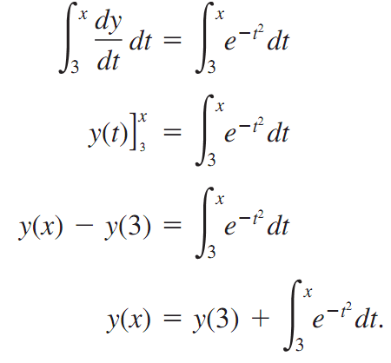
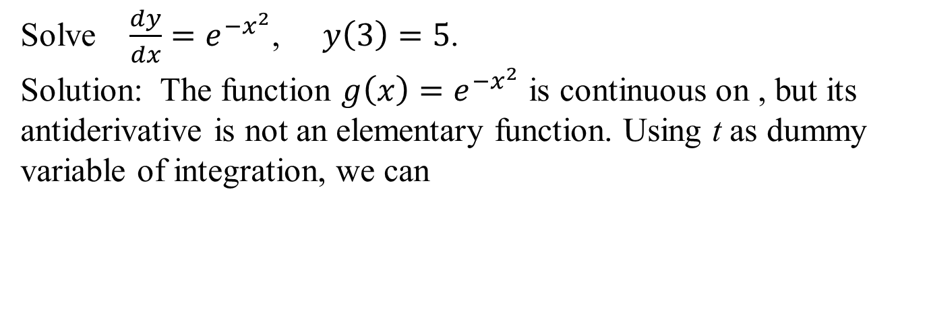
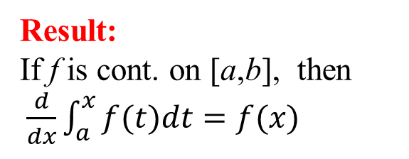
An initial value problem
Solve $\frac{dy}{dx}=e^{−x^{2}}$, $y\left(3\right)=5$.
Solution: The function ${g\left(x\right)=e}^{−x^{2}}$is continuous on , but its antiderivative is not an elementary function. Using t as dummy variable of integration, we can
Result:
If f is cont. on [a,b], then $\frac{d}{dx}\int_{a}^{x}{f(t)dt=f(x)}$

Slide 11

Solve the initial value problem

Slide 12
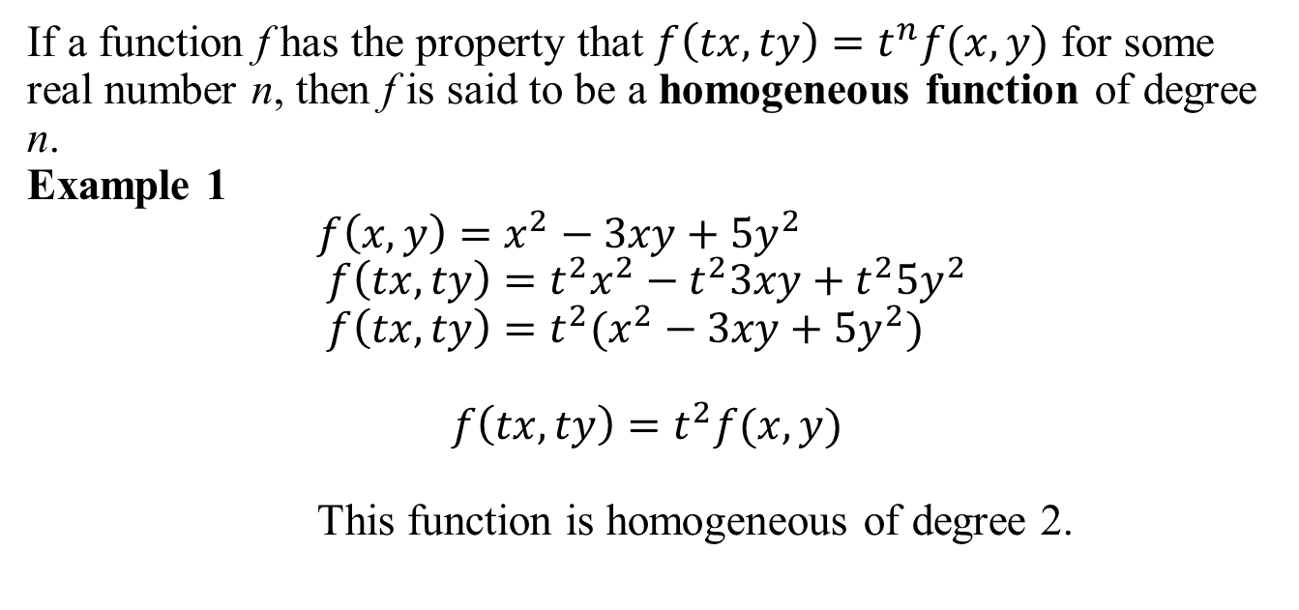
Homogeneous function
If a function f has the property that $f\left(tx, ty\right)=t^{n}f(x,y)$ for some real number n, then f is said to be a homogeneous function of degree n.
Example 1
$f\left(x,y\right)=x^{2}−3xy+5y^{2}$
$f\left(tx,ty\right)={t^{2}x}^{2}−t^{2}3xy+t^{2}5y^{2}$
$f\left(tx,ty\right)={t^{2}(x}^{2}−3xy+5y^{2})$
$$f\left(tx,ty\right)=t^{2}f(x,y)$$
This function is homogeneous of degree 2.

Slide 13
Example 2
Example 3

Slide 14
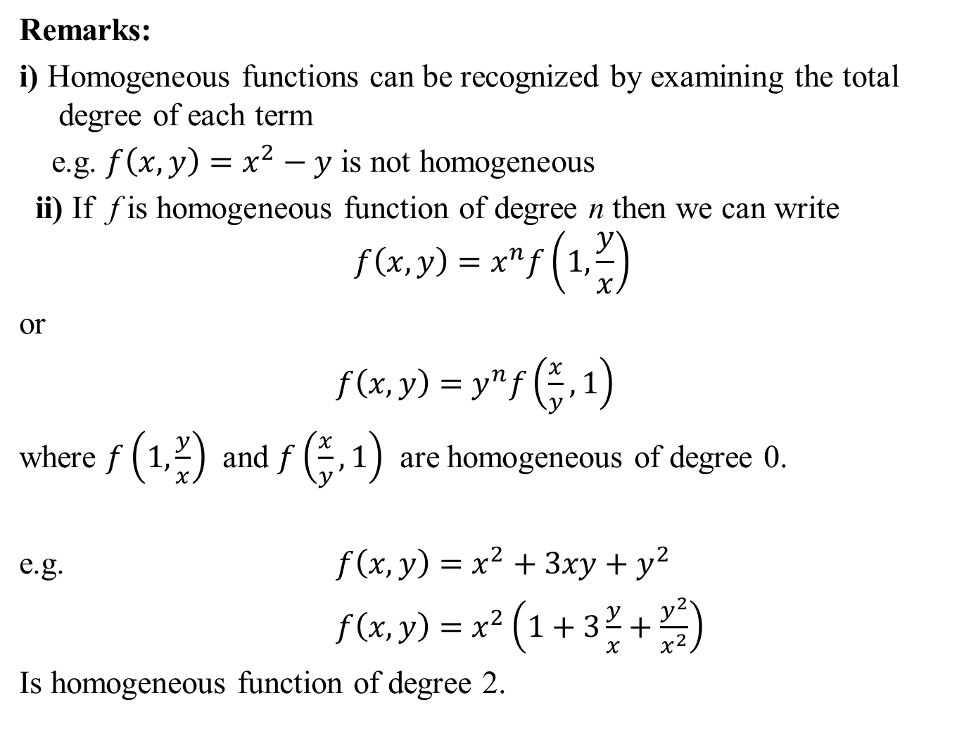
Remarks:
i) Homogeneous functions can be recognized by examining the total degree of each term
e.g. $f\left(x,y\right)=x^{2}−y$ is not homogeneous
ii) If f is homogeneous function of degree n then we can write
$$f\left(x,y\right)=x^{n}f\left(1,\frac{y}{x}\right)$$
or
$f\left(x,y\right)=y^{n}f\left(\frac{x}{y},1\right)$
where $f\left(1,\frac{y}{x}\right)$ and $f\left(\frac{x}{y},1\right)$ are homogeneous of degree 0.
e.g. $f\left(x,y\right)=x^{2}+3xy+y^{2}$
$f\left(x,y\right)=x^{2}\left(1+3\frac{y}{x}+\frac{y^{2}}{x^{2}}\right)$
Is homogeneous function of degree 2.

Slide 15
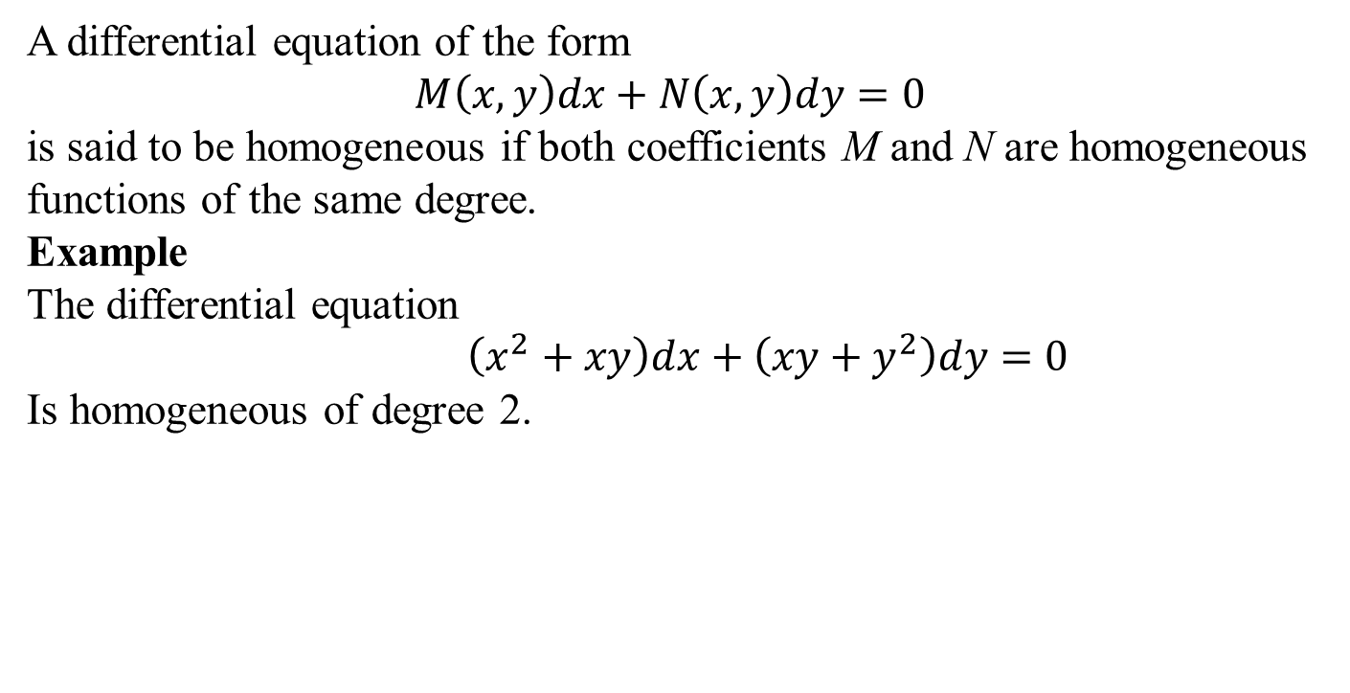
Homogeneous Differential Equation
A differential equation of the form
$$M\left(x,y\right)dx+N\left(x,y\right)dy=0$$
is said to be homogeneous if both coefficients M and N are homogeneous functions of the same degree.
Example
The differential equation
$\left(x^{2}+xy\right)dx+\left({xy+y}^{2}\right)dy=0$
Is homogeneous of degree 2.

Slide 16
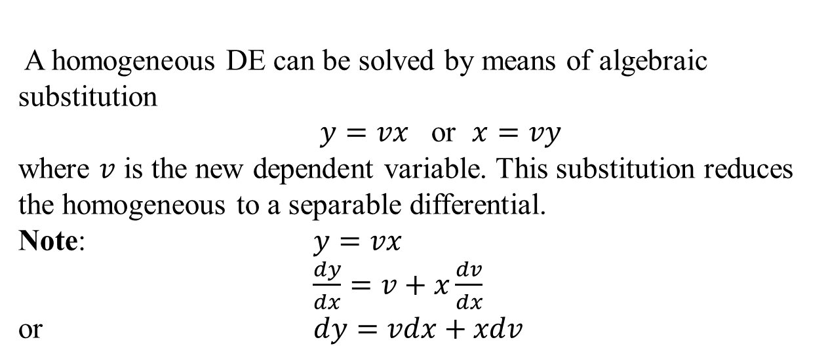
Method of solution
A homogeneous DE can be solved by means of algebraic substitution
$y=vx$ or $x=vy$
where $v$is the new dependent variable. This substitution reduces the homogeneous to a separable differential.
Note: $y=vx$
$\frac{dy}{dx}=v+x\frac{dv}{dx}$
or $dy=vdx+xdv$

Slide 17
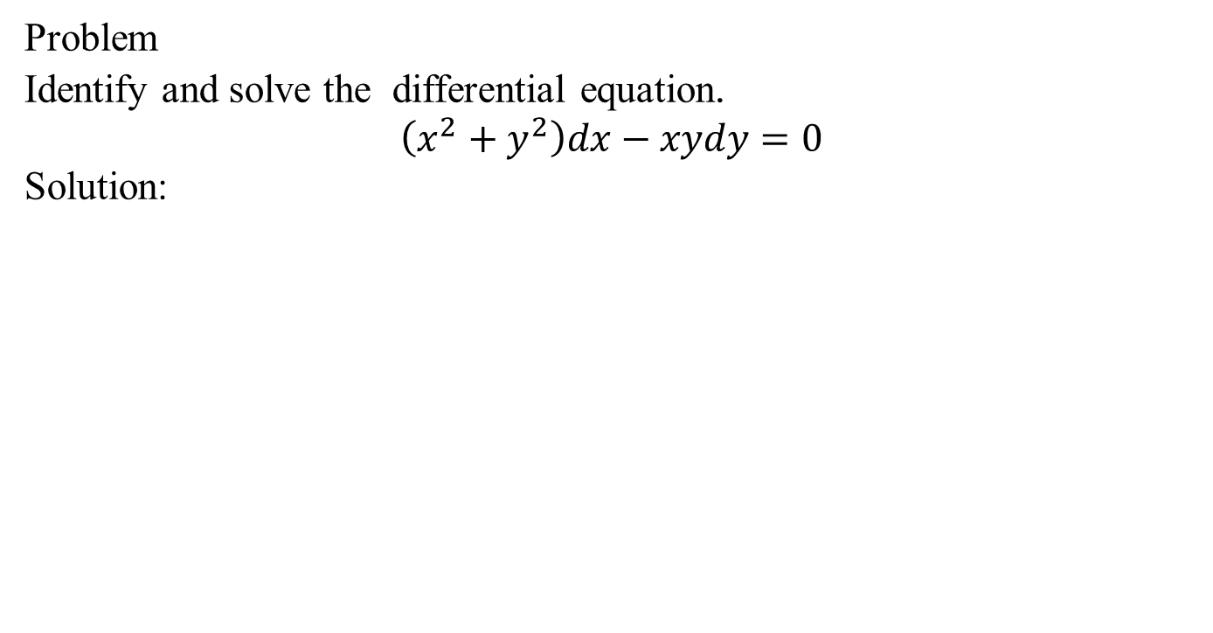
Solution of problems
Problem
Identify and solve the differential equation.
$$\left(x^{2}+y^{2}\right)dx−xydy=0$$
Solution:

Slide 19
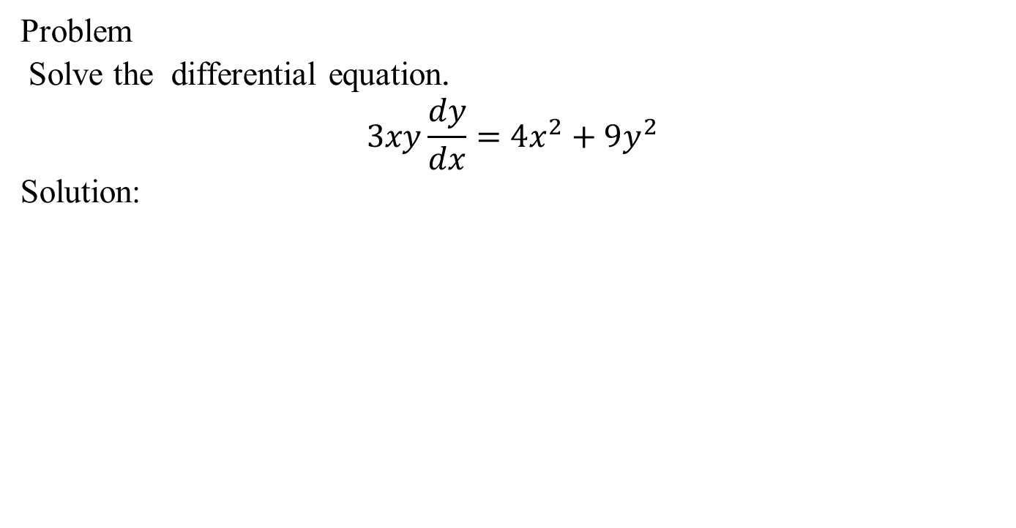
Problem
Solve the differential equation.
$$3xy\frac{dy}{dx}=4x^{2}+9y^{2}$$
Solution:

Slide 21
Equations reducible to homogenous form
The differential equations
is not homogenous. However, it can be reduced to a homogenous
form as detailed below
Case 1:
We use the substitution which reduces the equation to a
separable equation in the variables x & z. Solving the resulting
separable equation and replacing z with , we obtain the
solution of the given differential equation.

Slide 22
Case 2:
In this case we substitute
where h and k are constants to be determined. Then the equation
Becomes
We choose h and k such that

Slide 23
which reduces the equation to
which is homogenous differential equation in X and Y, and can
be solved accordingly. After having solved the last equation we
come back to the old variables x and y.

Slide 24
Example
Solve the differential equation
Solution:
Since , we substitute , so that
Thus the equation becomes
i.e.
which is a variable separable form, and can be written as

Slide 25
Integrating both sides we get
Simplifying and replacing z with , we obtain
or

Slide 26
Example 4 Solve the differential equation
Solution:
By substitution
The given differential equation reduces to
We choose h and k such that
Solving these equations we have h=2 , k=1. Therefore, we have
which is a homogenous equation.

Slide 27
We substitute to obtain
or
Resolving into partial fractions and integrating both sides we obtain
or
Now substituting , , and simplifying
we get

Slide 29
Summary
Separable differential equation.
Homogeneous function and homogeneous differential equation.
Equations reducible to homogeneous.

