Slide 1
Differential Equations
MTH 242
Lecture # 02
Dr. Manshoor Ahmed

Slide 2
Summary (Recall)
Motivation and introduction.
What is a differential equation?
Classification by types.
Classification by order.
Degree of the DE.
Classification by linearity.

Slide 3
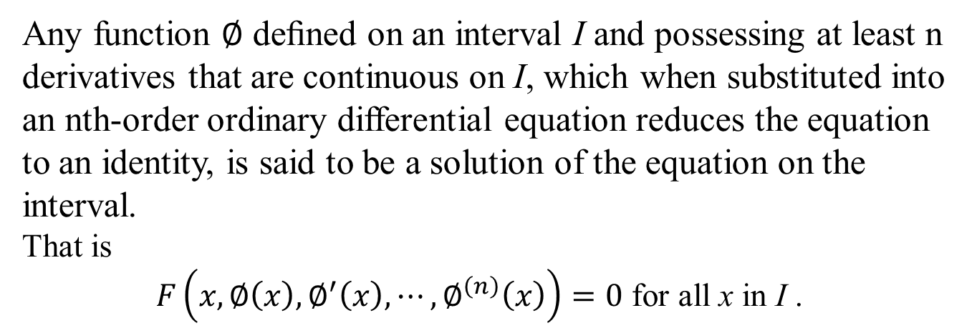
Solution of an ODE
Any function $∅$deﬁned on an interval I and possessing at least n derivatives that are continuous on I, which when substituted into an nth-order ordinary differential equation reduces the equation to an identity, is said to be a solution of the equation on the interval.
That is
$F\left(x,∅\left(x\right),∅^{′}\left(x\right),⋯,∅^{\left(n\right)}\left(x\right)\right)=0$ for all x in I .
However, for convenience we write solution as $y(x)$.
The interval I in deﬁnition is called as the interval of deﬁnition/ existence/ validity/ the domain of the solution.
.

Slide 4
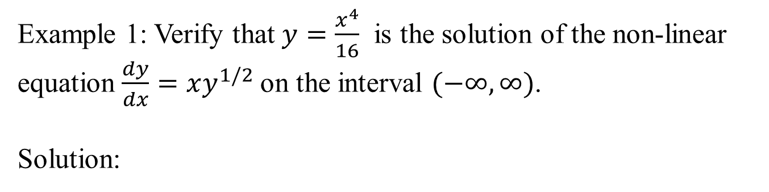
Veriﬁcation of a Solution
Example 1: Verify that $y=\frac{x^{4}}{16}$ is the solution of the non-linear equation $\frac{dy}{dx}=xy^{1/2}$on the interval $(−∞,∞)$.
Solution:

Slide 5
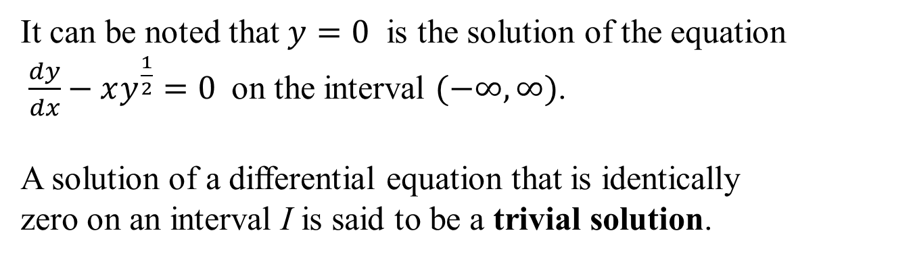
It can be noted that $y=0$ is the solution of the equation
$\frac{dy}{dx}−xy^{\frac{1}{2}}=0$on the interval $(−∞,∞)$.
A solution of a differential equation that is identically
zero on an interval I is said to be a trivial solution.

Slide 6
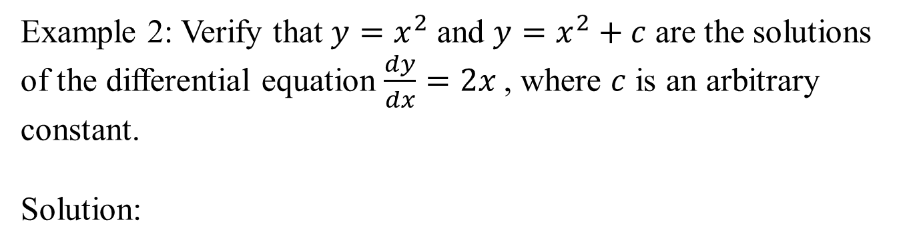
Example 2: Verify that $y=x^{2}$ and $y=x^{2}+c$ are the solutions of the differential equation $\frac{dy}{dx}=2x$, where $c$ is an arbitrary constant.
Solution:

Slide 7
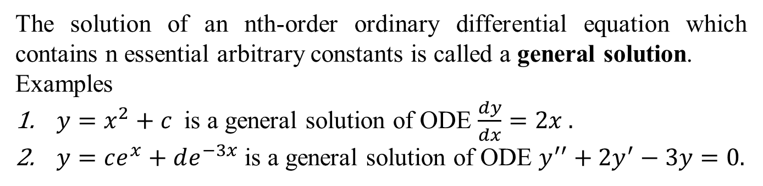
General Solution of an ODE
The solution of an nth-order ordinary differential equation which contains n essential arbitrary constants is called a general solution.
Examples
$y=x^{2}+c$ is a general solution of ODE $\frac{dy}{dx}=2x .$
$y=ce^{x}+de^{−3x}$ is a general solution of ODE $y^{′′}+{2y}^{′}−3y=0.$

Slide 8
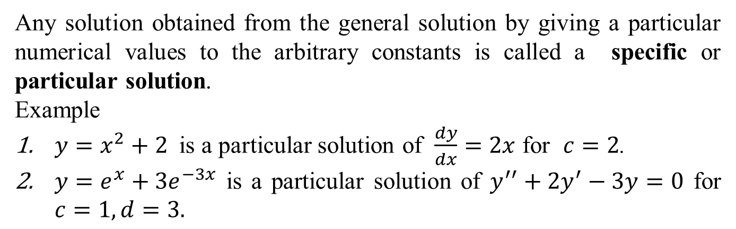
Particular Solution of an ODE
Any solution obtained from the general solution by giving a particular numerical values to the arbitrary constants is called a specific or particular solution.
Example
$y=x^{2}+2$ is a particular solution of $\frac{dy}{dx}=2x$ for $c=2$.
$y=e^{x}+3e^{−3x}$ is a particular solution of $y^{′′}+{2y}^{′}−3y=0$ for $c=1,d=3.$

Slide 9
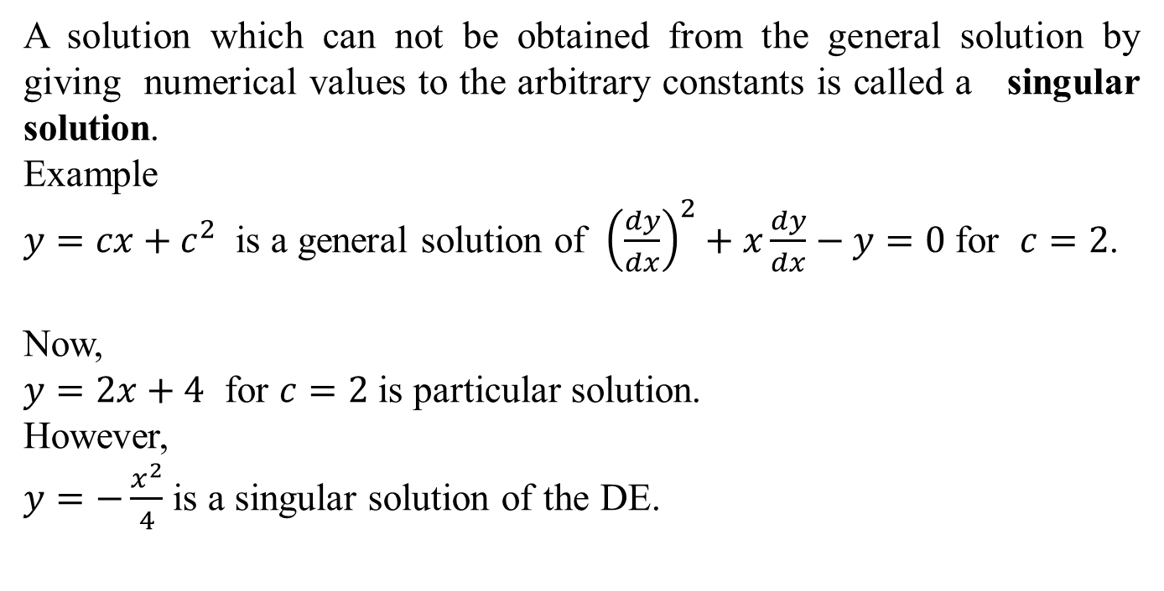
Singular Solution of an ODE
A solution which can not be obtained from the general solution by giving numerical values to the arbitrary constants is called a singular solution.
Example
$y={cx+c}^{2}$ is a general solution of ${\left(\frac{dy}{dx}\right)}^{2}+x\frac{dy}{dx}−y=0$ for $c=2$.
Now,
$y=2x+4$for $c=2$ is particular solution.
However,
$y=−\frac{x^{2}}{4}$ is a singular solution of the DE.

Slide 10
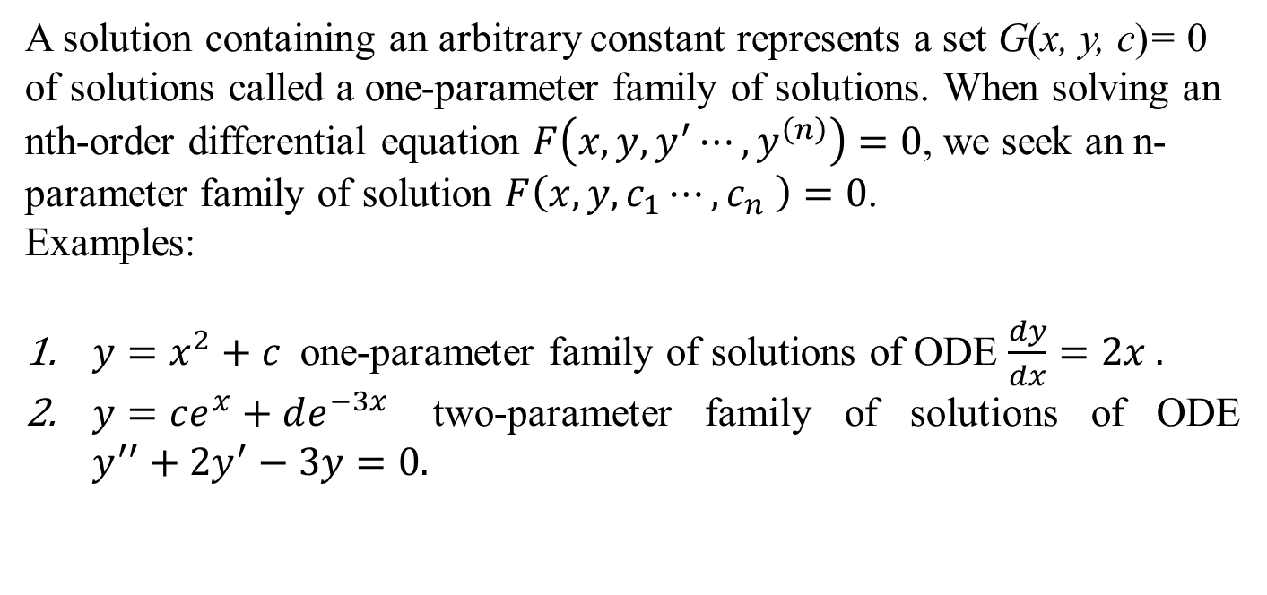
Families of Solution
A solution containing an arbitrary constant represents a set G(x, y, c)= 0 of solutions called a one-parameter family of solutions. When solving an nth-order differential equation$F\left(x,{y,y}^{′}⋯,y^{\left(n\right)}\right)=0$, we seek an n-parameter family of solution $F\left(x,y, c_{1}⋯,c_{n} \right)=0$.
Examples:
$y=x^{2}+c$one-parameter family of solutions of ODE $\frac{dy}{dx}=2x .$
$y=ce^{x}+de^{−3x}$two-parameter family of solutions of ODE $y^{′′}+{2y}^{′}−3y=0.$
Note:
This means that a single differential equation can possess an inﬁnite number of solutions corresponding to the unlimited number of choices
for the parameter(s).

Slide 11
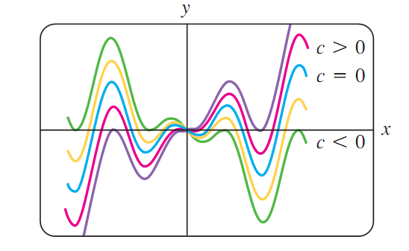
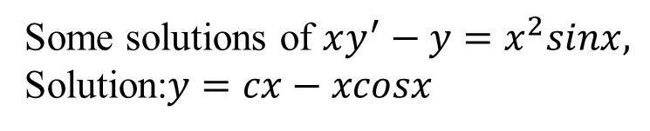
Some solutions of $xy^{′}−y=x^{2}sinx,$
Solution:$y=cx−xcosx$

Slide 12
Graphs of $y=x^{2}+c$

Slide 13
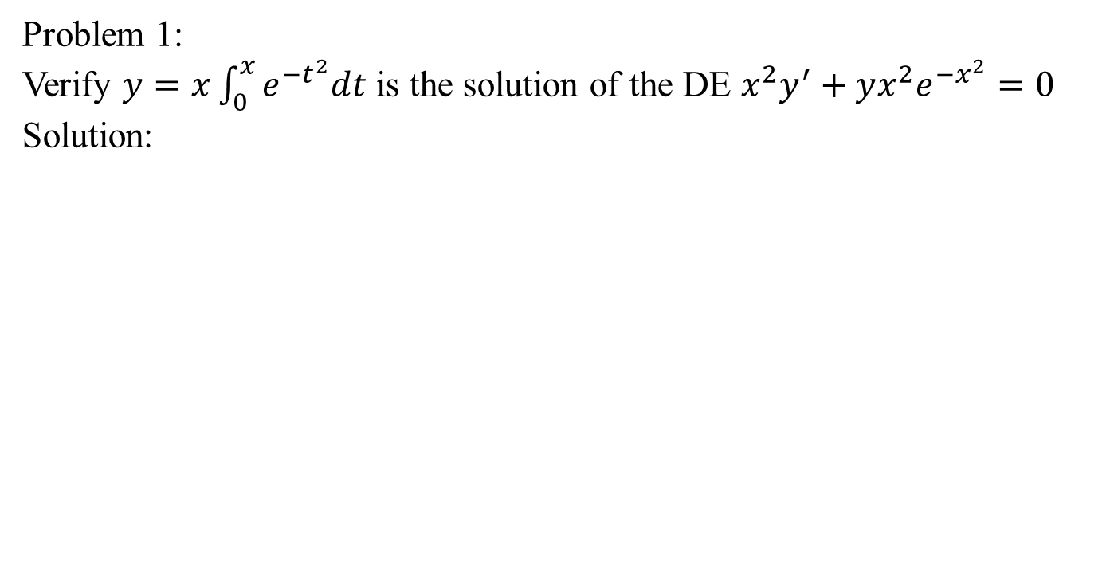
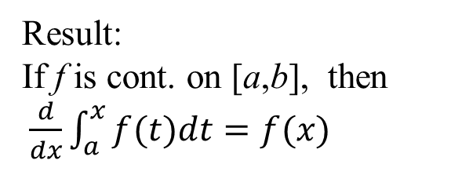
Problem Solution
Problem 1:
Verify $y=x\int_{0}^{x}{e^{−t^{2}}dt}$ is the solution of the DE $x^{2}y^{′}+yx^{2}e^{−x^{2}}=0$
Solution:
Result:
If f is cont. on [a,b], then $\frac{d}{dx}\int_{a}^{x}{f(t)dt=f(x)}$

Slide 15
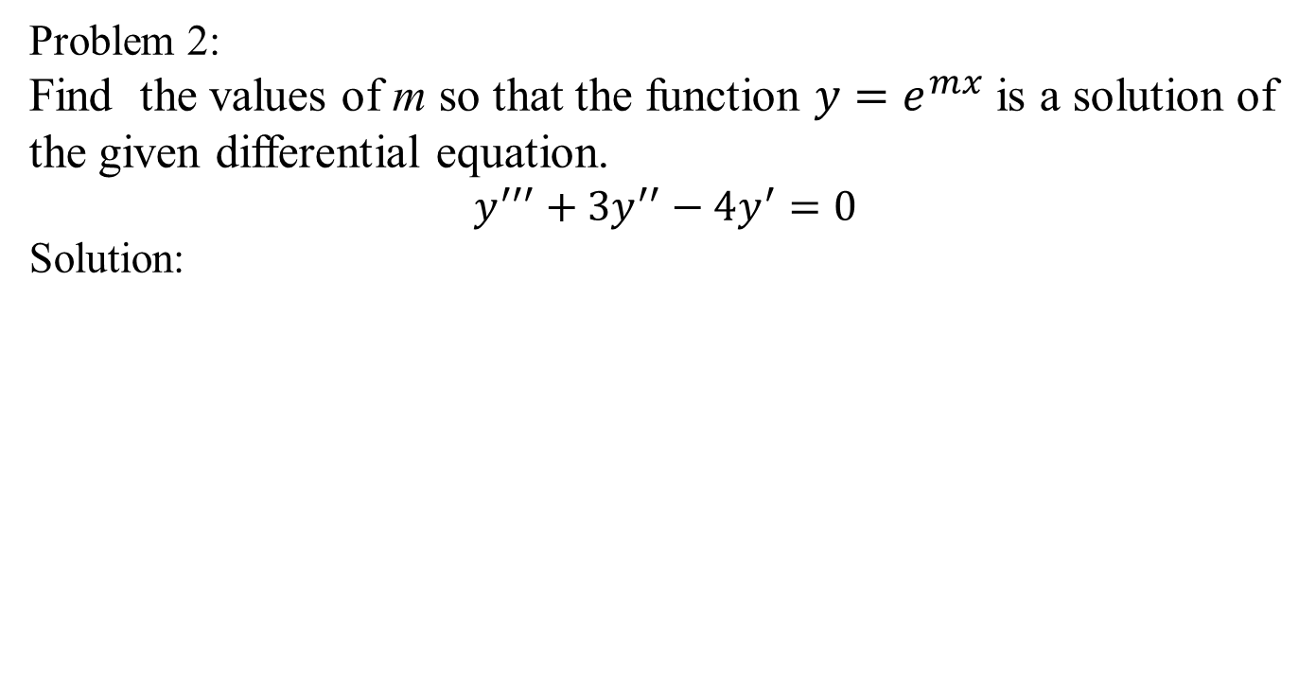
Problem Solution
Problem 2:
Find the values of m so that the function $y=e^{mx}$ is a solution of the given differential equation.
$$y^{′′′}+{3y}^{′′}−4y^{′}=0$$
Solution:

Slide 16
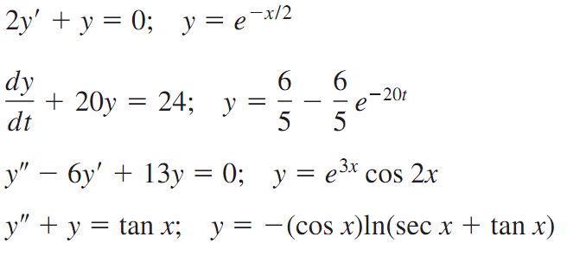
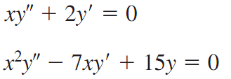
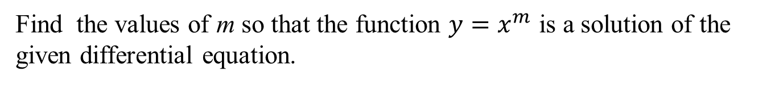
Practice Questions
In the following problems verify that the indicated function is an explicit solution of the given differential equation.
Find the values of m so that the function $y=x^{m}$is a solution of the given differential equation.

Slide 17
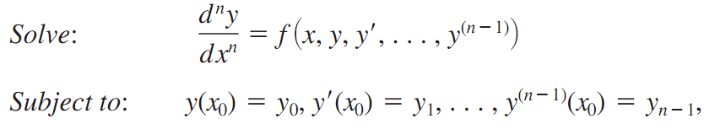
Initial Value Problems
The initial value problems arise in physical system, the n-th order Initial Value Problem.

Slide 18
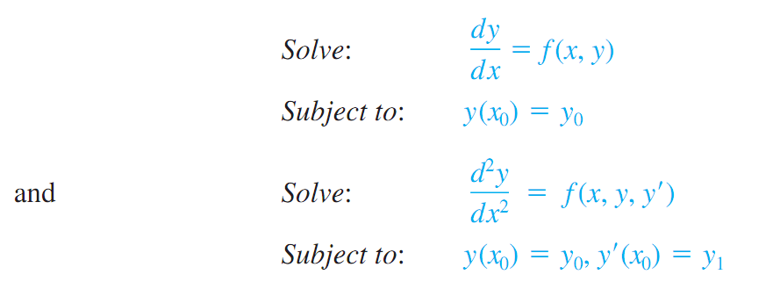
First and second order Initial Value Problems

Slide 19
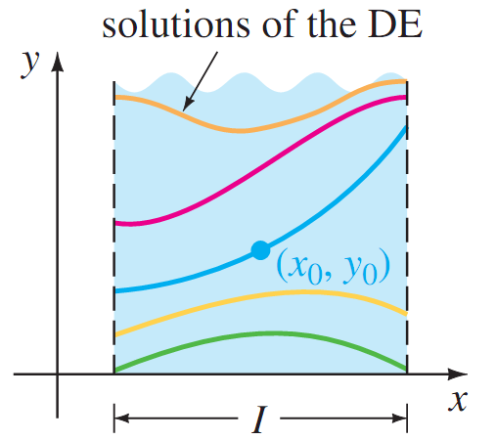

Slide 20
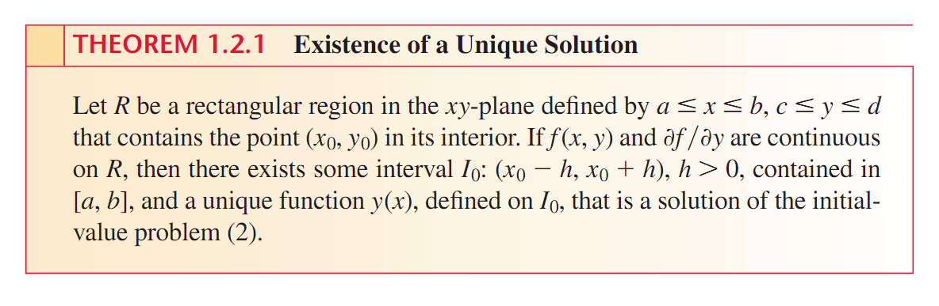
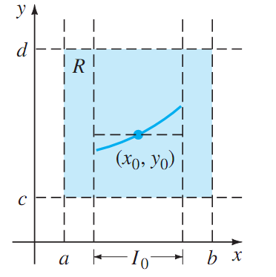
Existence and Uniqueness of the solution

Slide 21
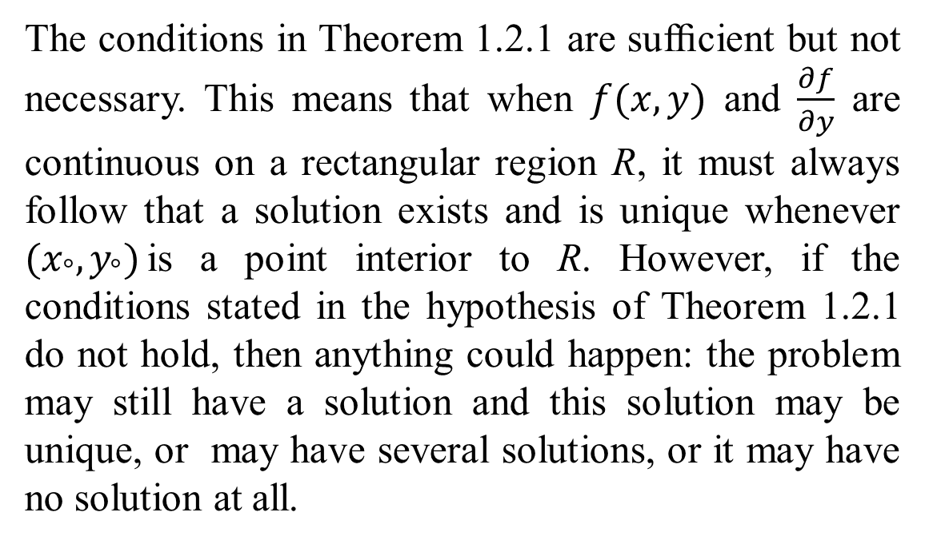
Important Remark
The conditions in Theorem 1.2.1 are sufﬁcient but not necessary. This means that when $f(x,y)$and $\frac{∂f}{∂y}$are continuous on a rectangular region R, it must always follow that a solution exists and is unique whenever $(x_{°},y_{°})$is a point interior to R. However, if the conditions stated in the hypothesis of Theorem 1.2.1 do not hold, then anything could happen: the problem may still have a solution and this solution may be unique, or may have several solutions, or it may have no solution at all.

Slide 22



Problem solution

Slide 23
Summary
Solution of differential equation.
Interval of the solution.
Trivial, general, particular and singular Solutions.
Families of solution.
Initial Value Problems.
Existence and uniqueness theorem

