Slide 1
MTH 161: Introduction To Statistics
Lecture 09
Dr. MUMTAZ AHMED

Slide 2
Review of Previous Lecture
In last lecture we discussed:
Measures of Central Tendency
  Weighted Mean
  Combined Mean
  Merits and demerits of Arithmetic Mean
Median
  Median for Ungrouped Data

Slide 3
Objectives of Current Lecture
Measures of Central Tendency
Median
    Median for grouped Data
    Merits and demerits of Median
Mode
    Mode for Grouped Data
    Mode for Ungrouped Data
    Merits and demerits of Mode

Slide 4
Objectives of Current Lecture
Measures of Central Tendency
Geometric Mean
    Geometric Mean for Grouped Data
    Geometric Mean for Ungrouped Data
    Merits and demerits of Geometric Mean

Slide 5
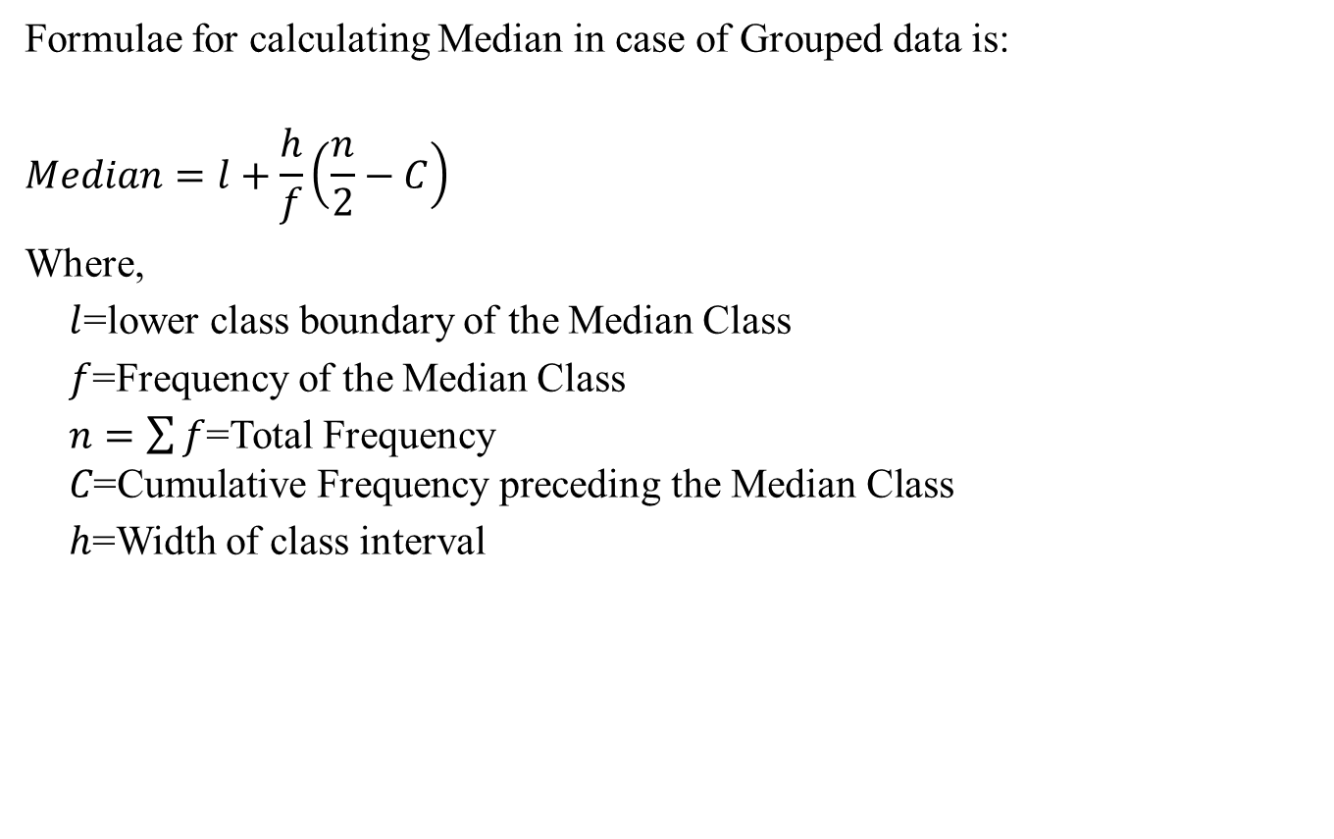
Median for Grouped Data

Slide 6
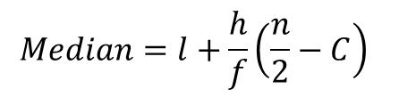
Median for Grouped Data
Example: Calculate Median for the distribution of examination marks provided below:
Marks | No of Students (f)
30-39 | 8
40-49 | 87
50-59 | 190
60-69 | 304
70-79 | 211
80-89 | 85
90-99 | 20

Slide 7
Median for Grouped Data
Calculate Class Boundaries
Marks | Class Boundaries | No of Students (f)
30-39 |  | 8
40-49 |  | 87
50-59 |  | 190
60-69 |  | 304
70-79 |  | 211
80-89 |  | 85
90-99 |  | 20

Slide 8
Median for Grouped Data
Calculate Class Boundaries
Marks | Class Boundaries | No of Students (f)
30-39 | 29.5-39.5 | 8
40-49 |  | 87
50-59 |  | 190
60-69 |  | 304
70-79 |  | 211
80-89 |  | 85
90-99 |  | 20

Slide 9
Median for Grouped Data
Calculate Class Boundaries
Marks | Class Boundaries | No of Students (f)
30-39 | 29.5-39.5 | 8
40-49 | 39.5-49.5 | 87
50-59 | 49.5-59.5 | 190
60-69 | 59.5-69.6 | 304
70-79 | 69.5-79.5 | 211
80-89 | 79.5-89.5 | 85
90-99 | 89.5-99.5 | 20

Slide 10
Median for Grouped Data
Calculate Cumulative Frequency (cf)
Marks | Class Boundaries | No of Students (f) | Cumulative Freq (cf)
30-39 | 29.5-39.5 | 8 | 8
40-49 | 39.5-49.5 | 87
50-59 | 49.5-59.5 | 190
60-69 | 59.5-69.6 | 304
70-79 | 69.5-79.5 | 211
80-89 | 79.5-89.5 | 85
90-99 | 89.5-99.5 | 20

Slide 11
Median for Grouped Data
Calculate Cumulative Frequency (cf)
Marks | Class Boundaries | No of Students (f) | Cumulative Freq (cf)
30-39 | 29.5-39.5 | 8 | 8
40-49 | 39.5-49.5 | 87 | 8+87=95
50-59 | 49.5-59.5 | 190
60-69 | 59.5-69.6 | 304
70-79 | 69.5-79.5 | 211
80-89 | 79.5-89.5 | 85
90-99 | 89.5-99.5 | 20

Slide 12
Median for Grouped Data
Calculate Cumulative Frequency (cf)
Marks | Class Boundaries | No of Students (f) | Cumulative Freq (cf)
30-39 | 29.5-39.5 | 8 | 8
40-49 | 39.5-49.5 | 87 | 95
50-59 | 49.5-59.5 | 190 | 285
60-69 | 59.5-69.6 | 304 | 589
70-79 | 69.5-79.5 | 211 | 800
80-89 | 79.5-89.5 | 85 | 885
90-99 | 89.5-99.5 | 20 | 905

Slide 13
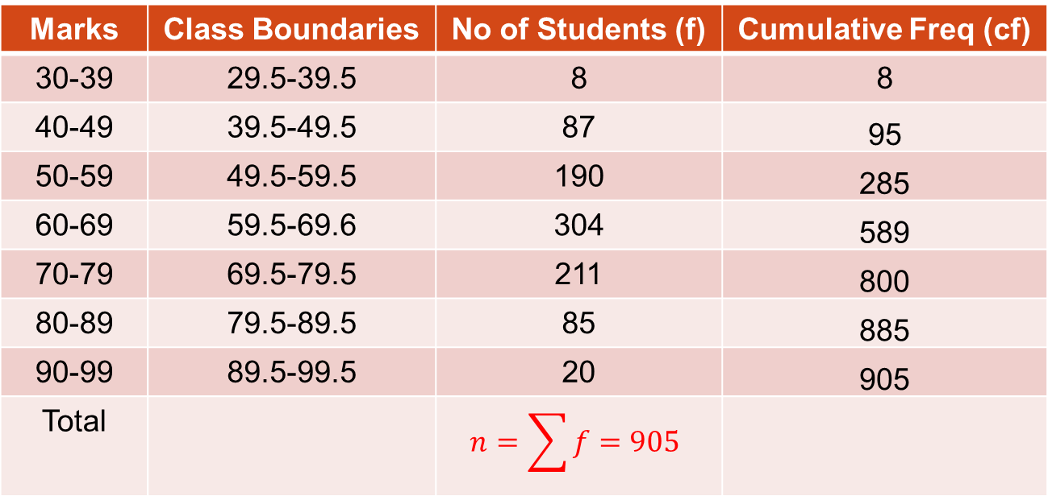
Median for Grouped Data
Find Median Class:
Median=Marks obtained by (n/2)^{th} student=905/2=452.5th student
Locate 452.5 in the Cumulative Freq. column.
Marks | Class Boundaries | No of Students (f) | Cumulative Freq (cf)
30-39 | 29.5-39.5 | 8 | 8
40-49 | 39.5-49.5 | 87 | 95
50-59 | 49.5-59.5 | 190 | 285
60-69 | 59.5-69.6 | 304 | 589
70-79 | 69.5-79.5 | 211 | 800
80-89 | 79.5-89.5 | 85 | 885
90-99 | 89.5-99.5 | 20 | 905
Total

Slide 14
Median for Grouped Data
Find Median Class:
452.5 in the Cumulative Freq. column.
Hence 59.5-69.5 is the Median Class.
Marks | Class Boundaries | No of Students (f) | Cumulative Freq (cf)
30-39 | 29.5-39.5 | 8 | 8
40-49 | 39.5-49.5 | 87 | 95
50-59 | 49.5-59.5 | 190 | 285
60-69 | 59.5-69.6 | 304 | 589
70-79 | 69.5-79.5 | 211 | 800
80-89 | 79.5-89.5 | 85 | 885
90-99 | 89.5-99.5 | 20 | 905

Slide 15
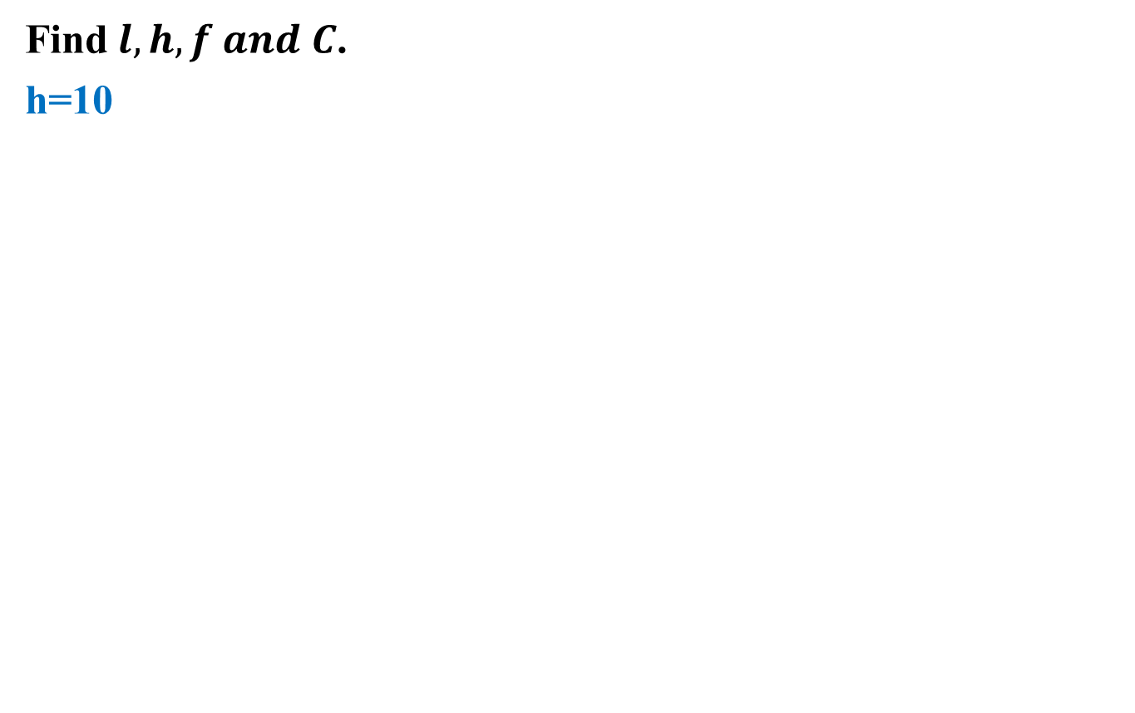
Median for Grouped Data
Marks | Class Boundaries | No of Students (f) | Cumulative Freq (cf)
30-39 | 29.5-39.5 | 8 | 8
40-49 | 39.5-49.5 | 87 | 95
50-59 | 49.5-59.5 | 190 | 285=C
60-69 | l=59.5-69.5 | 304=f | 589
70-79 | 69.5-79.5 | 211 | 800
80-89 | 79.5-89.5 | 85 | 885
90-99 | 89.5-99.5 | 20 | 905

Slide 16
Merits of Median
Merits of Median are:
Easy to calculate and understand.
Median works well in case of Symmetric as well as in skewed distributions as opposed to Mean which works well only in case of Symmetric Distributions.
It is NOT affected by extreme values.
Example:
Median of 1, 2, 3, 4, 5 is 3.
If we change last number 5 to 20 then Median will still be 3.
Hence Median is not affected by extreme values.

Slide 17
De-Merits of Median
De-Merits of Median are:
It requires the data to be arranged in some order which can be time consuming and tedious, though now-a-days we can sort the data via computer very easily.

Slide 18
Mode
Mode is a value which occurs most frequently in a data.
Mode is a French word meaning ‘fashion’, adopted for most frequent value.
Calculation:
The mode is the value in a dataset which occurs most often or maximum number of times.

Slide 19
Mode for Ungrouped Data
Example 1: Marks: 10, 5, 3, 6, 10 Mode=10
Example 2: Runs: 5, 2, 3, 6, 2 , 11, 7 Mode=2
Often, there is no mode or there are several modes in a set of data.
Example: marks: 10, 5, 3, 6, 7 No Mode
Sometimes we may have several modes in a set of data.
Example: marks: 10, 5, 3, 6, 10, 5, 4, 2, 1, 9 Two modes (5 and 10)

Slide 20
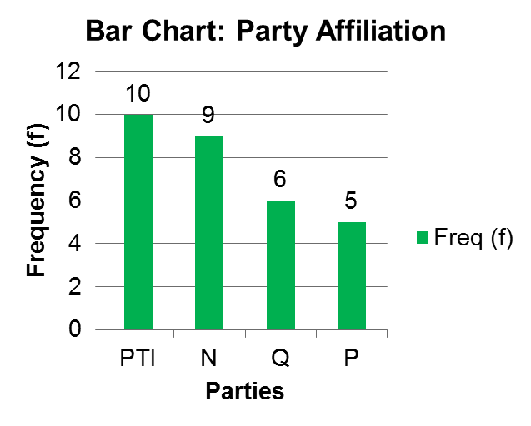
Mode for Qualitative Data
Mode is mostly used for qualitative data.
Mode is PTI

Slide 21
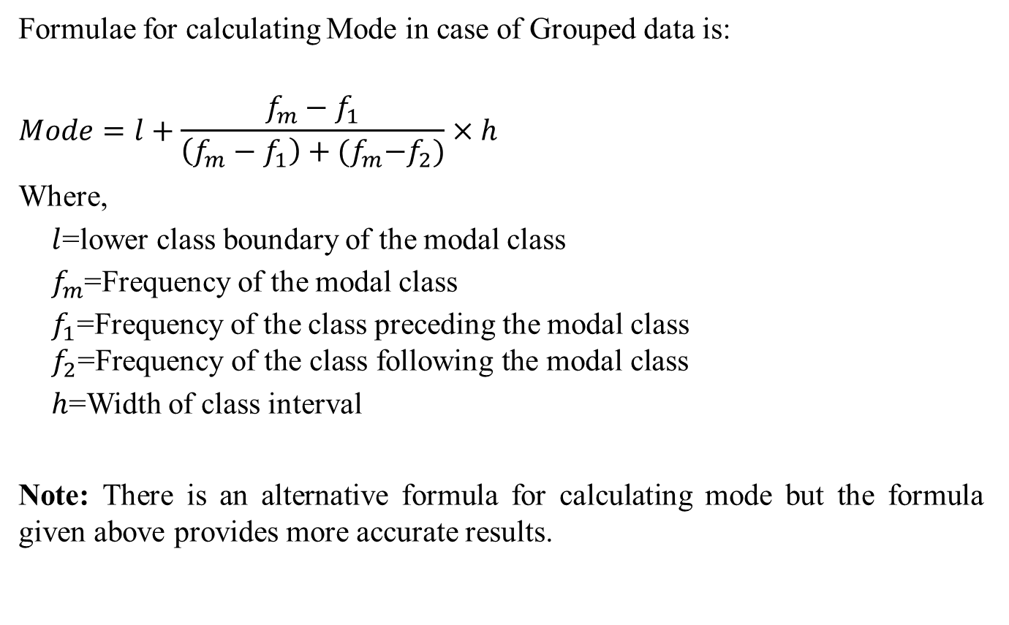
Mode for Grouped Data
Formulae for calculating Mode in case of Grouped data is:
$$Mode=l+\frac{f_{m}−f_{1}}{\left(f_{m}−f_{1}\right)+{(f}_{m}−f_{2})}×h$$
Where,
  $l$=lower class boundary of the modal class
  $f_{m}$=Frequency of the modal class
  $f_{1}$=Frequency of the class preceding the modal class
  $$f_{2}\text{=}\text{Frequency} \text{of} \text{the} \text{class} \text{following} \text{the} \text{modal} \text{class}$$
  $h$=Width of class interval
Note: There is an alternative formula for calculating mode but the formula given above provides more accurate results.

Slide 22
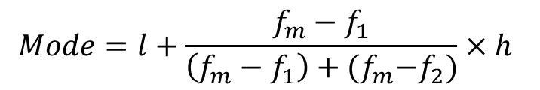
Mode for Grouped Data
Example: Calculate Mode for the distribution of examination marks provided below:
Marks | No of Students (f)
30-39 | 8
40-49 | 87
50-59 | 190
60-69 | 304
70-79 | 211
80-89 | 85
90-99 | 20
$$Mode=l+\frac{f_{m}−f_{1}}{\left(f_{m}−f_{1}\right)+{(f}_{m}−f_{2})}×h$$

Slide 23
Mode for Grouped Data
Calculate Class Boundaries
Marks | Class Boundaries | No of Students (f)
30-39 |  | 8
40-49 |  | 87
50-59 |  | 190
60-69 |  | 304
70-79 |  | 211
80-89 |  | 85
90-99 |  | 20
$$Mode=l+\frac{f_{m}−f_{1}}{\left(f_{m}−f_{1}\right)+{(f}_{m}−f_{2})}×h$$

Slide 24
Mode for Grouped Data
Calculate Class Boundaries
Marks | Class Boundaries | No of Students (f)
30-39 | 29.5-39.5 | 8
40-49 |  | 87
50-59 |  | 190
60-69 |  | 304
70-79 |  | 211
80-89 |  | 85
90-99 |  | 20
$$Mode=l+\frac{f_{m}−f_{1}}{\left(f_{m}−f_{1}\right)+{(f}_{m}−f_{2})}×h$$

Slide 25
Mode for Grouped Data
Calculate Class Boundaries
Marks | Class Boundaries | No of Students (f)
30-39 | 29.5-39.5 | 8
40-49 | 39.5-49.5 | 87
50-59 | 49.5-59.5 | 190
60-69 | 59.5-69.6 | 304
70-79 | 69.5-79.5 | 211
80-89 | 79.5-89.5 | 85
90-99 | 89.5-99.5 | 20
$$Mode=l+\frac{f_{m}−f_{1}}{\left(f_{m}−f_{1}\right)+{(f}_{m}−f_{2})}×h$$

Slide 26
Mode for Grouped Data
Find Modal Class (class with the highest frequency)
Marks | Class Boundaries | No of Students (f)
30-39 | 29.5-39.5 | 8
40-49 | 39.5-49.5 | 87
50-59 | 49.5-59.5 | 190
60-69 | 59.5-69.5 | 304
70-79 | 69.5-79.5 | 211
80-89 | 79.5-89.5 | 85
90-99 | 89.5-99.5 | 20
$$Mode=l+\frac{f_{m}−f_{1}}{\left(f_{m}−f_{1}\right)+{(f}_{m}−f_{2})}×h$$

Slide 27
Mode for Grouped Data
Find Modal Class (class with the highest frequency)
Marks | Class Boundaries | No of Students (f)
30-39 | 29.5-39.5 | 8
40-49 | 39.5-49.5 | 87
50-59 | 49.5-59.5 | 190
60-69 | 59.5-69.5 | 304
70-79 | 69.5-79.5 | 211
80-89 | 79.5-89.5 | 85
90-99 | 89.5-99.5 | 20
$$Mode=l+\frac{f_{m}−f_{1}}{\left(f_{m}−f_{1}\right)+{(f}_{m}−f_{2})}×h$$

Slide 28
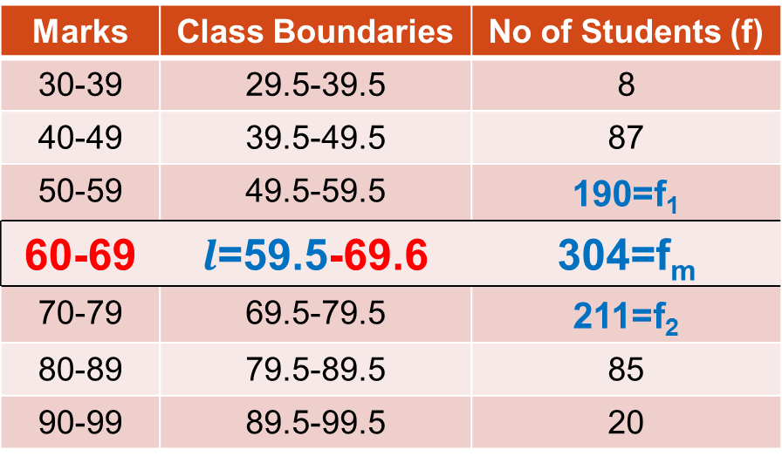

Mode for Grouped Data
Find ${l, f}_{m},f_{1}, f_{2} and h$.
h=10
Marks | Class Boundaries | No of Students (f)
30-39 | 29.5-39.5 | 8
40-49 | 39.5-49.5 | 87
50-59 | 49.5-59.5 | 190=f₁
60-69 |  | 304=f_{m}
70-79 | 69.5-79.5 | 211=f₂
80-89 | 79.5-89.5 | 85
90-99 | 89.5-99.5 | 20
$Mode=l+\frac{f_{m}−f_{1}}{\left(f_{m}−f_{1}\right)+{(f}_{m}−f_{2})}×h=59.5+\frac{(304−190)}{\left(304−190\right)+(304−211)}×10$=65.3 Marks

Slide 29
Merits of Mode
Merits of Mode are:
Easy to calculate and understand. In many cases, it is extremely easy to locate it.
It works well even in case of extreme values.
It can be determined for qualitative as well as quantitative data.

Slide 30
De-Merits of Mode
De-Merits of Mode are:
It is not based on all observations.
When the data contains small number of observations, the mode may not exist.

Slide 31
Geometric Mean
When you want to measure the rate of change of a variable over time, you need to use the geometric mean instead of the arithmetic mean.
Calculation:
The geometric mean is the nth root of the product of n values.

Slide 32
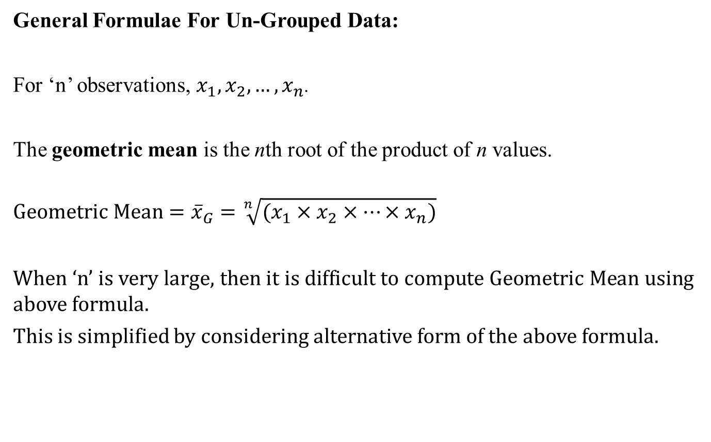
Geometric Mean for Ungrouped Data
General Formulae For Un-Grouped Data:
For ‘n’ observations, $x_{1},x_{2},…,x_{n}$.
The geometric mean is the nth root of the product of n values.
$$Geometric Mean={\overline{x}}_{G}=\sqrt[n]{(x_{1}×x_{2}×…×x_{n})}$$
When ‘n’ is very large, then it is difficult to compute Geometric Mean using above formula.
This is simplified by considering alternative form of the above formula.

Slide 33
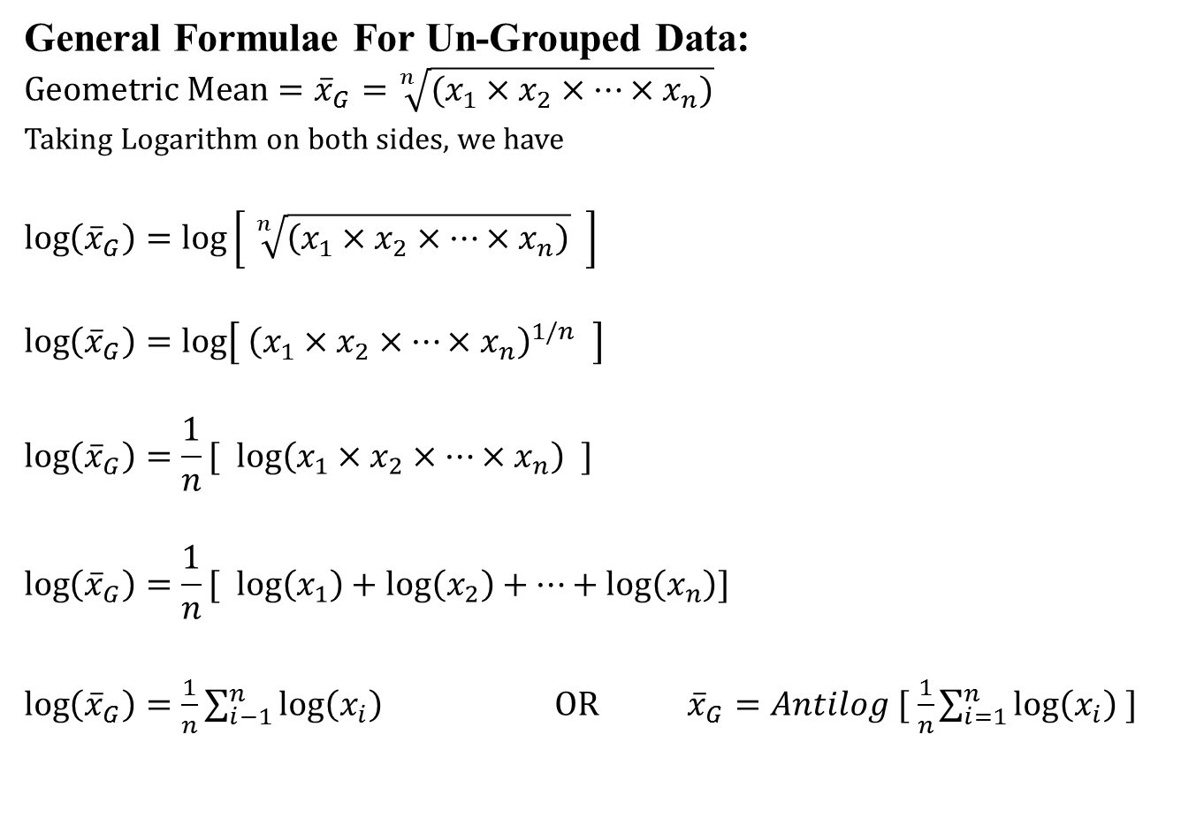
Geometric Mean for Ungrouped Data
General Formulae For Un-Grouped Data:
$$Geometric Mean={\overline{x}}_{G}=\sqrt[n]{(x_{1}×x_{2}×…×x_{n})}$$
Taking Logarithm on both sides, we have
$$\log\left({\overline{x}}_{G}\right)=log\left[ \sqrt[n]{\left(x_{1}×x_{2}×…×x_{n}\right)} \right]$$
$$\log\left({\overline{x}}_{G}\right)=log\left[ {\left(x_{1}×x_{2}×…×x_{n}\right)}^{1/n} \right]$$
$$\log\left({\overline{x}}_{G}\right)=\frac{1}{n}[ log\left(x_{1}×x_{2}×…×x_{n}\right) ]$$
$$\log\left({\overline{x}}_{G}\right)=\frac{1}{n}[ log\left(x_{1}\right)+log\left(x_{2}\right)+…+log\left(x_{n}\right)]$$
$\log\left({\overline{x}}_{G}\right)=\frac{1}{n}\sum_{i−1}^{n}{log\left(x_{i}\right)}$ OR ${\overline{x}}_{G}=Antilog [ \frac{1}{n}\sum_{i=1}^{n}{log\left(x_{i}\right)} ]$

Slide 34
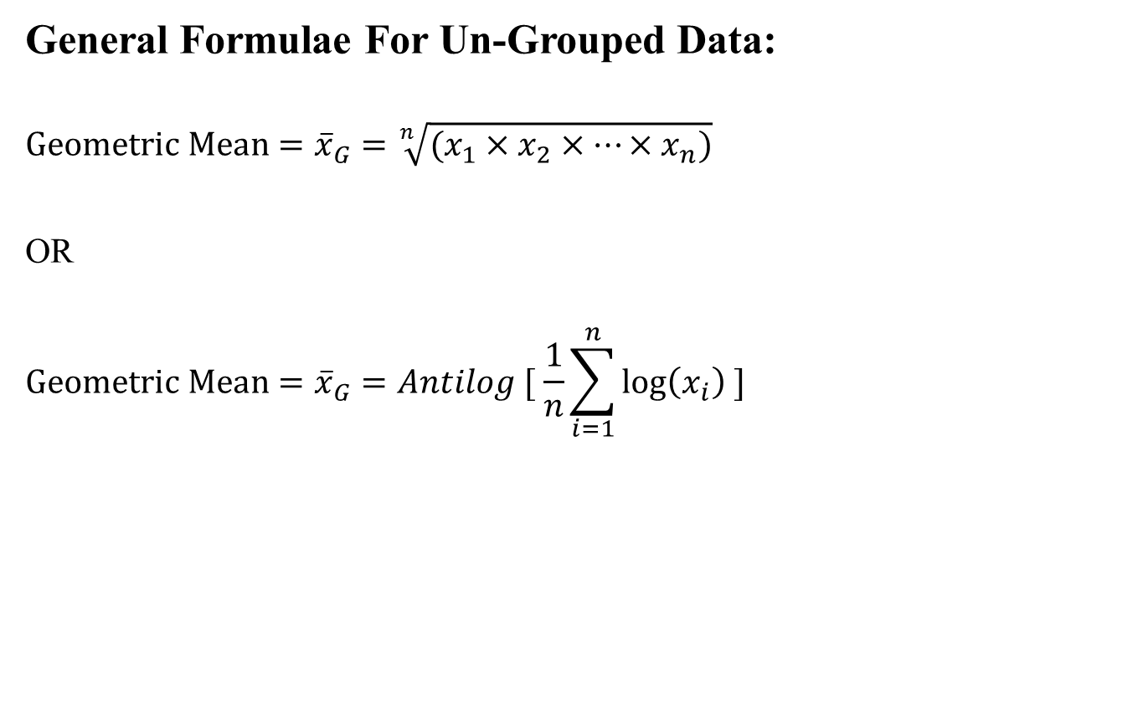
Geometric Mean for Ungrouped Data
General Formulae For Un-Grouped Data:
$$Geometric Mean={\overline{x}}_{G}=\sqrt[n]{(x_{1}×x_{2}×…×x_{n})}$$
OR
$$Geometric Mean={\overline{x}}_{G}=Antilog [ \frac{1}{n}\sum_{i=1}^{n}{log\left(x_{i}\right)} ]$$

Slide 35
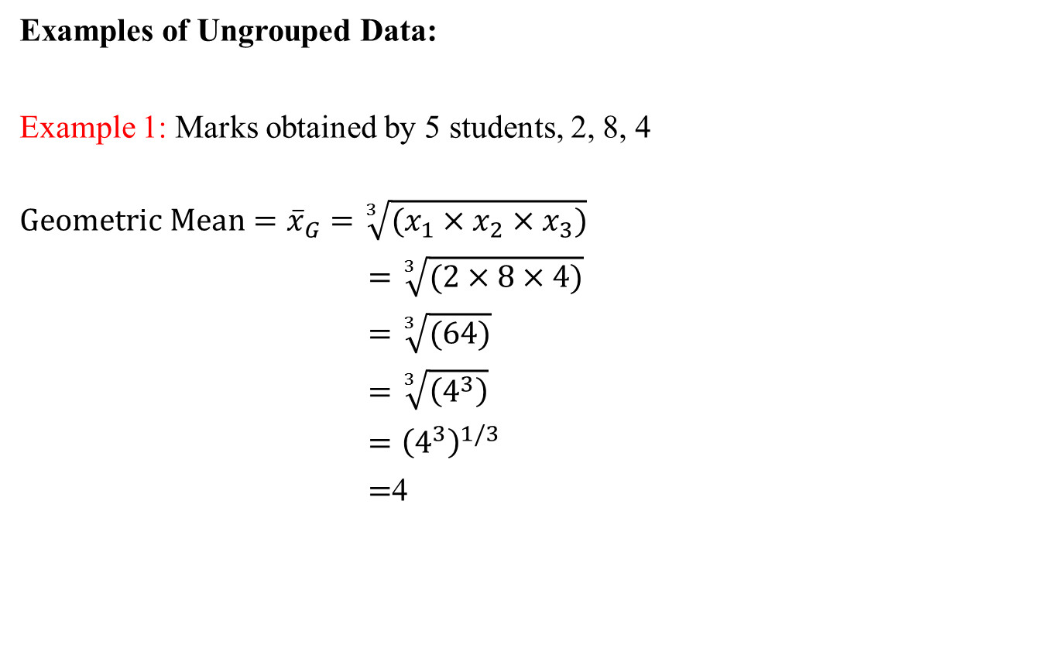
Geometric Mean for Ungrouped Data
Examples of Ungrouped Data:
Example 1: Marks obtained by 5 students, 2, 8, 4
$$Geometric Mean={\overline{x}}_{G}=\sqrt[3]{(x_{1}×x_{2}×x_{3})}$$
$=\sqrt[3]{(2×8×4)}$
$=\sqrt[3]{(64)}$
$=\sqrt[3]{\left(4^{3}\right)}$
$={\left(4^{3}\right)}^{1/3}$
$=$4

Slide 36
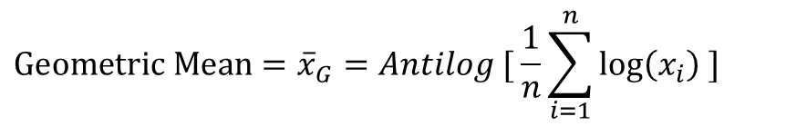
Geometric Mean for Ungrouped Data
Examples of Ungrouped Data:
Example 1: Marks obtained by 5 students, 2, 8, 4 (Alternative Method)
$$Geometric Mean={\overline{x}}_{G}=Antilog [ \frac{1}{n}\sum_{i=1}^{n}{log\left(x_{i}\right)} ]$$

Slide 37
Geometric Mean for Ungrouped Data
Examples of Ungrouped Data:
Example 1: Marks obtained by 5 students, 2, 8, 4 (Alternative Method)
$$Geometric Mean={\overline{x}}_{G}=Antilog [ \frac{1}{n}\sum_{i=1}^{n}{log\left(x_{i}\right)} ]$$
Marks (x) | Log(x)
2 | Log(2)=0.30103
8
4

Slide 38
Geometric Mean for Ungrouped Data
Examples of Ungrouped Data:
Example 1: Marks obtained by 5 students, 2, 8, 4 (Alternative Method)
$$Geometric Mean={\overline{x}}_{G}=Antilog [ \frac{1}{n}\sum_{i=1}^{n}{log\left(x_{i}\right)} ]$$
Marks (x) | Log(x)
2 | Log(2)=0.30103
8 | 0.90309
4 | 0.60206

Slide 39
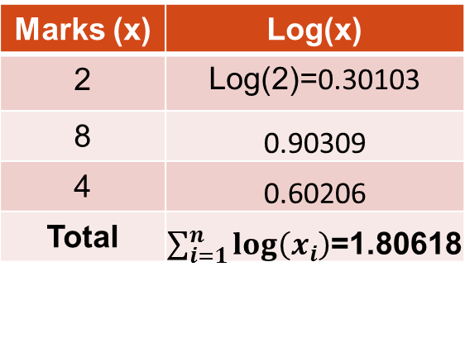
Geometric Mean for Ungrouped Data
Examples of Ungrouped Data:
Example 1: Marks obtained by 5 students, 2, 8, 4 (Alternative Method)
$$Geometric Mean={\overline{x}}_{G}=Antilog [ \frac{1}{n}\sum_{i=1}^{n}{log\left(x_{i}\right)} ]$$
Marks (x) | Log(x)
2 | Log(2)=0.30103
8 | 0.90309
4 | 0.60206
Total | $\sum_{i=1}^{n}{log\left(x_{i}\right)}$=1.80618

Slide 40
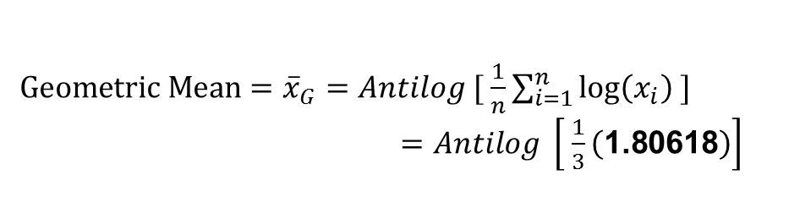
Geometric Mean for Ungrouped Data
Examples of Ungrouped Data:
Example 1: Marks obtained by 5 students, 2, 8, 4
$Geometric Mean={\overline{x}}_{G}=Antilog [ \frac{1}{n}\sum_{i=1}^{n}{log\left(x_{i}\right)} ]$
$=Antilog \left[ \frac{1}{3}\left(\text{1.80618}\right)\right]$
Marks (x) | Log(x)
2 | Log(2)=0.30103
8 | 0.90309
4 | 0.60206
Total | $\sum_{i=1}^{n}{log\left(x_{i}\right)}$=1.80618

Slide 41
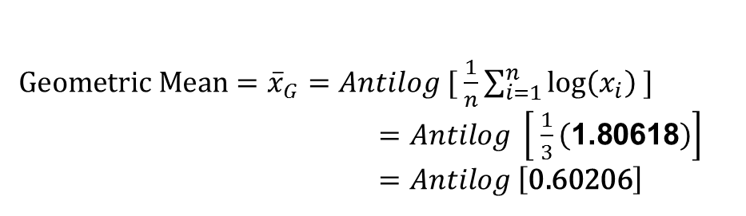
Geometric Mean for Ungrouped Data
Examples of Ungrouped Data:
Example 1: Marks obtained by 5 students, 2, 8, 4
$Geometric Mean={\overline{x}}_{G}=Antilog [ \frac{1}{n}\sum_{i=1}^{n}{log\left(x_{i}\right)} ]$
$=Antilog \left[ \frac{1}{3}\left(\text{1.80618}\right)\right]$
$=Antilog \left[\text{0.60206}\right]$
Marks (x) | Log(x)
2 | Log(2)=0.30103
8 | 0.90309
4 | 0.60206
Total | $\sum_{i=1}^{n}{log\left(x_{i}\right)}$=1.80618

Slide 42
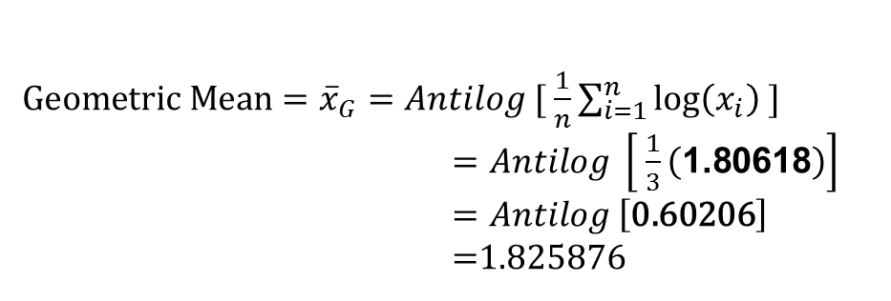
Geometric Mean for Ungrouped Data
Examples of Ungrouped Data:
Example 1: Marks obtained by 5 students, 2, 8, 4
$Geometric Mean={\overline{x}}_{G}=Antilog [ \frac{1}{n}\sum_{i=1}^{n}{log\left(x_{i}\right)} ]$
$=Antilog \left[ \frac{1}{3}\left(\text{1.80618}\right)\right]$
$=Antilog \left[\text{0.60206}\right]$
$=$1.825876
Marks (x) | Log(x)
2 | Log(2)=0.30103
8 | 0.90309
4 | 0.60206
Total | $\sum_{i=1}^{n}{log\left(x_{i}\right)}$=1.80618

Slide 43
Review
Let’s review the main concepts:
Measures of Central Tendency
Median
    Median for grouped Data
    Merits and demerits of Median
Mode
    Mode for Grouped Data
    Mode for Ungrouped Data
    Merits and demerits of Mode

Slide 44
Review
Let’s review the main concepts:
Measures of Central Tendency
Geometric Mean
    Geometric Mean for Ungrouped Data

Slide 45
Next Lecture
In next lecture, we will study:
Geometric Mean
    Geometric Mean for Grouped Data
    Merits and demerits of Geometric Mean
Harmonic Mean
    Harmonic Mean for Grouped Data
    Harmonic Mean for Ungrouped Data
    Merits and demerits of Harmonic Mean

