Slide 1
MTH 161: Introduction To Statistics
Lecture 07
Dr. MUMTAZ AHMED

Slide 2
Review of Previous Lecture
In last lecture we discussed:
An overview of MS-Excel
Creating Charts in MS-Excel
  Graphs for Qualitative Data
    Bar Chart
      Simple Bar Chart
      Multiple Bar Chart
      Component Bar Chart
    Pie Chart
  Graphs for Quantitative Data
    Scatter Plot
    Histogram

Slide 3
Objectives of Current Lecture
Use of Excel Add-ins
  Activating Excel Add-ins
  Introduction to Analysis Tool Pack Excel Add-in
    Calculating Basic Summary Statistics using Data Analysis Tool Pack
    Constructing Histogram using Data Analysis Tool pack
Measures of Central Tendency
Characteristics of a good Average
  Arithmetic Mean (or simply Mean)
      Mean for ungrouped Data
      Mean for grouped Data
      Related Examples

Slide 4
Excel Add-ins
ADD-IN:
An Add-in is a software program that extends the capabilities of larger programs.
There are many Excel add-ins designed to complement the basic functionality offered by Excel.
Common Add-in for performing basic statistical functions in Excel is: ‘Analysis Tool Pack’.
Before using, we have to activate the add-in (if it is not already active).

Slide 5
Histograms For Quantitative Data
24
35
17
21
24
37
26
46
58
30
32
13
12
38
41
43
44
27
53
27
Example: Construct a Histogram for temperature data.

Slide 6
Measures of Central Tendency
Data, in nature, has a tendency to cluster around a central value.
That central value condenses the large mass of data into a single representative figure.
The central value can be obtained from sample values (called statistic) and population observations (called parameter).

Slide 7
Measures of Central Tendency
Definition:
Average is an attempt to find a single figure to describe a group of figures. (Clark, A famous Statistician)
Objectives for the study of measures of central tendency
Two main objectives:
To get one single value that represent the entire data.
To facilitate comparison among different data sets.

Slide 8
Characteristics of a Good Average
According to the statisticians Yule and Kendall, an average will be termed good or efficient if it possesses the following characteristics:
Should be easily understandable.
Should be rigidly defined.
It means that the definition should be so clear that the interpretation of the definition does not differ from person to person.
Should be mathematically expressed
Should be easy to calculate.
Should be based on all the values of the variable.
This means that in the formula for average all the values of the variable should be incorporated.

Slide 9
Characteristics of a Good Average
The value of average should not change significantly along with the change in sample.
This means that the values of the averages of different samples of the same size drawn from the same population should have small variations. In other words, an average should possess sampling stability.
Should be suitable for further mathematical treatment.
The average should be unduly affected by extreme values.
This means that the formula for average should be such, that it does not show large due to the presence of one or two very large or very small values of the variable.

Slide 10
Different Measures of Central Tendency
Mathematical Averages
  Arithmetic Mean or simply Mean or average
  Geometric Mean
  Harmonic Mean
Positional Averages
  Median
  Mode
In this lecture we will focus on Arithmetic Mean in Detail.
The discussion of other measures of Central Tendency will be in subsequent lectures.

Slide 11
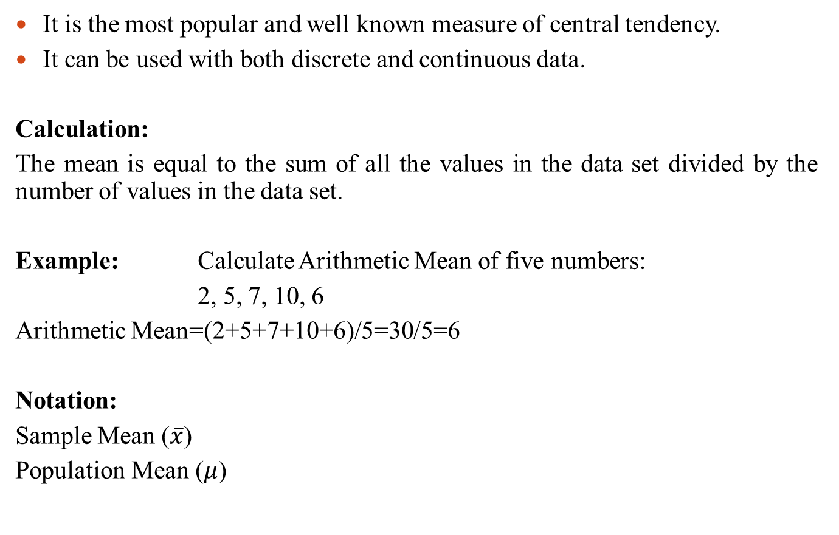
Arithmetic Mean (or Simply Mean)
It is the most popular and well known measure of central tendency.
It can be used with both discrete and continuous data.
Calculation:
The mean is equal to the sum of all the values in the data set divided by the number of values in the data set.
Example: Calculate Arithmetic Mean of five numbers:
2, 5, 7, 10, 6
Arithmetic Mean=(2+5+7+10+6)/5=30/5=6
Notation:
Sample Mean ($\overline{x}$)
Population Mean ($μ$)

Slide 12
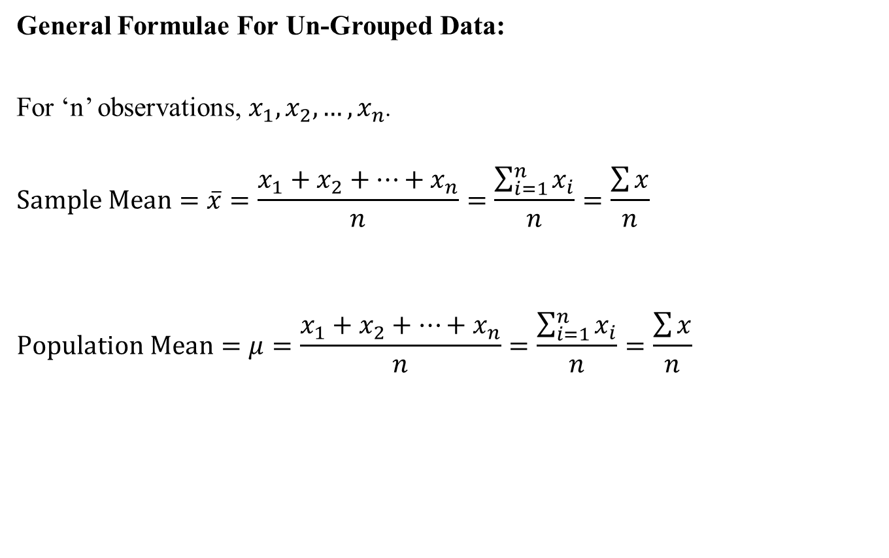
Arithmetic Mean for Ungrouped Data
General Formulae For Un-Grouped Data:
For ‘n’ observations, $x_{1},x_{2},…,x_{n}$.
$$Sample Mean=\overline{x}=\frac{x_{1}+x_{2}+…+x_{n}}{n}=\frac{\sum_{i=1}^{n}{x_{i}}}{n}=\frac{\sum{x}}{n}$$
$$Population Mean=μ=\frac{x_{1}+x_{2}+…+x_{n}}{n}=\frac{\sum_{i=1}^{n}{x_{i}}}{n}=\frac{\sum{x}}{n}$$

Slide 13
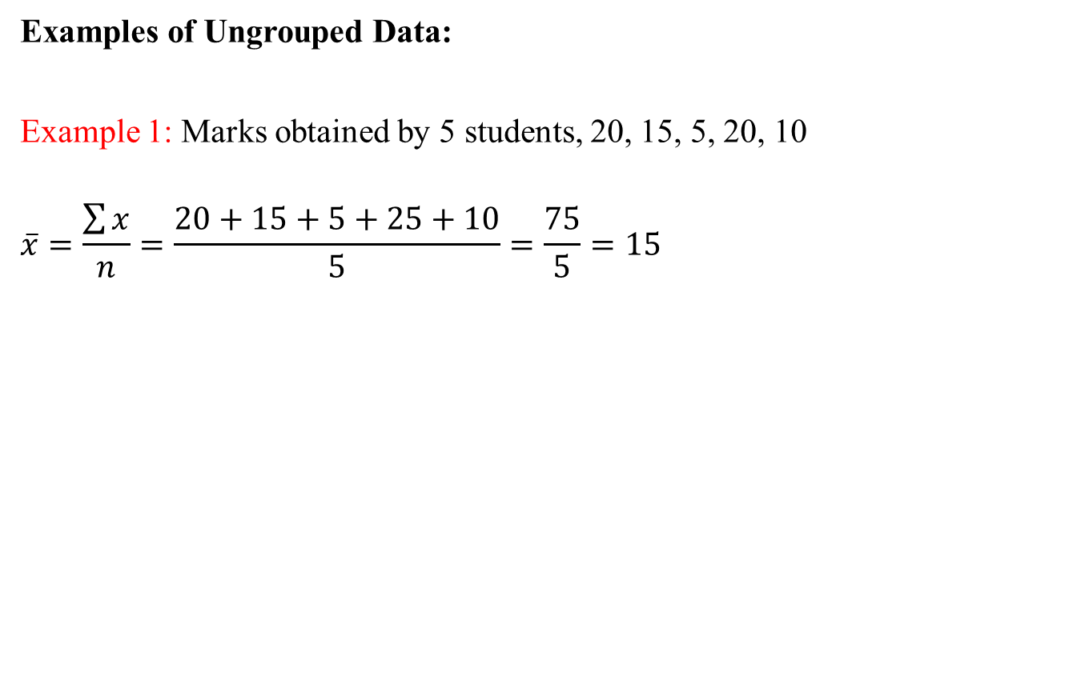
Arithmetic Mean for Ungrouped Data
Examples of Ungrouped Data:
Example 1: Marks obtained by 5 students, 20, 15, 5, 20, 10
$$\overline{x}=\frac{\sum{x}}{n}=\frac{20+15+5+25+10}{5}=\frac{75}{5}=15$$

Slide 14
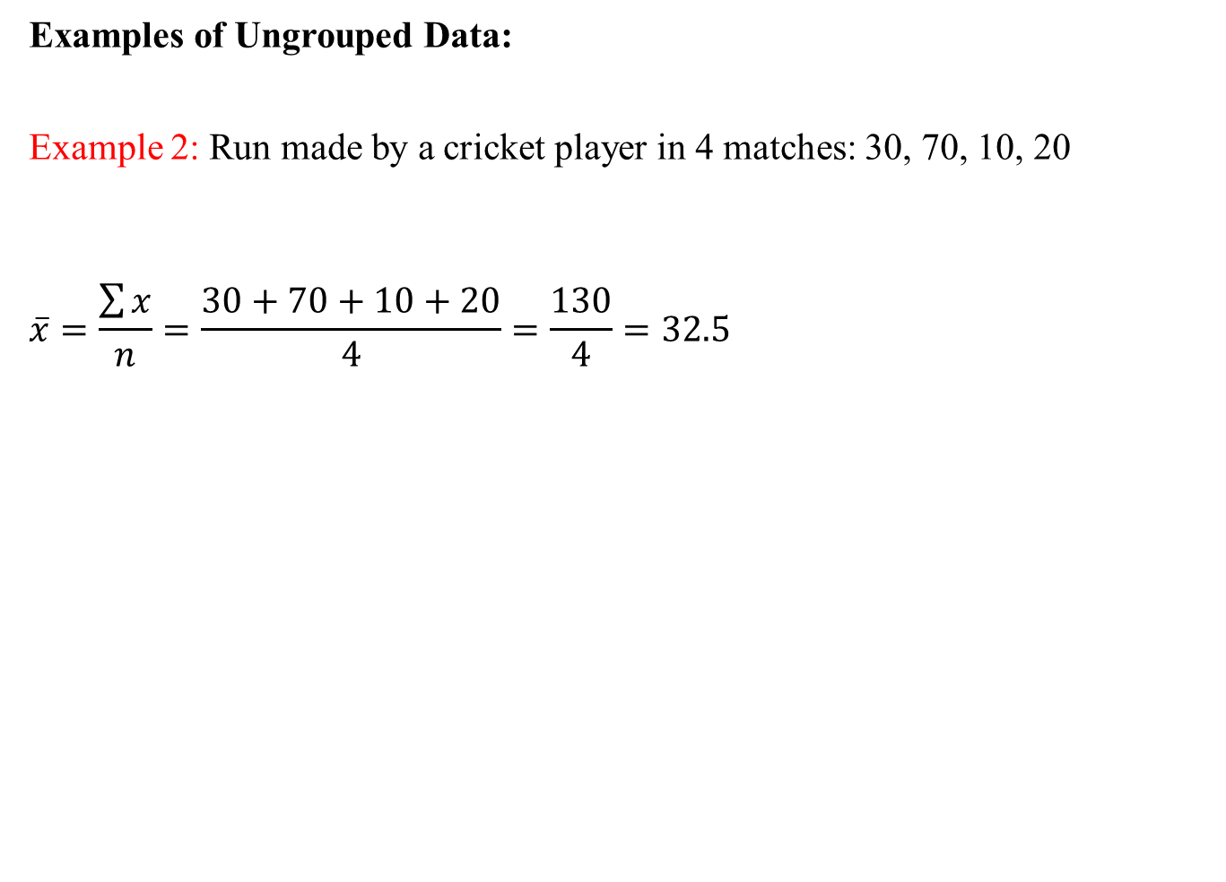
Arithmetic Mean for Ungrouped Data

Slide 15
Arithmetic Mean for Ungrouped Data
SS

Slide 16
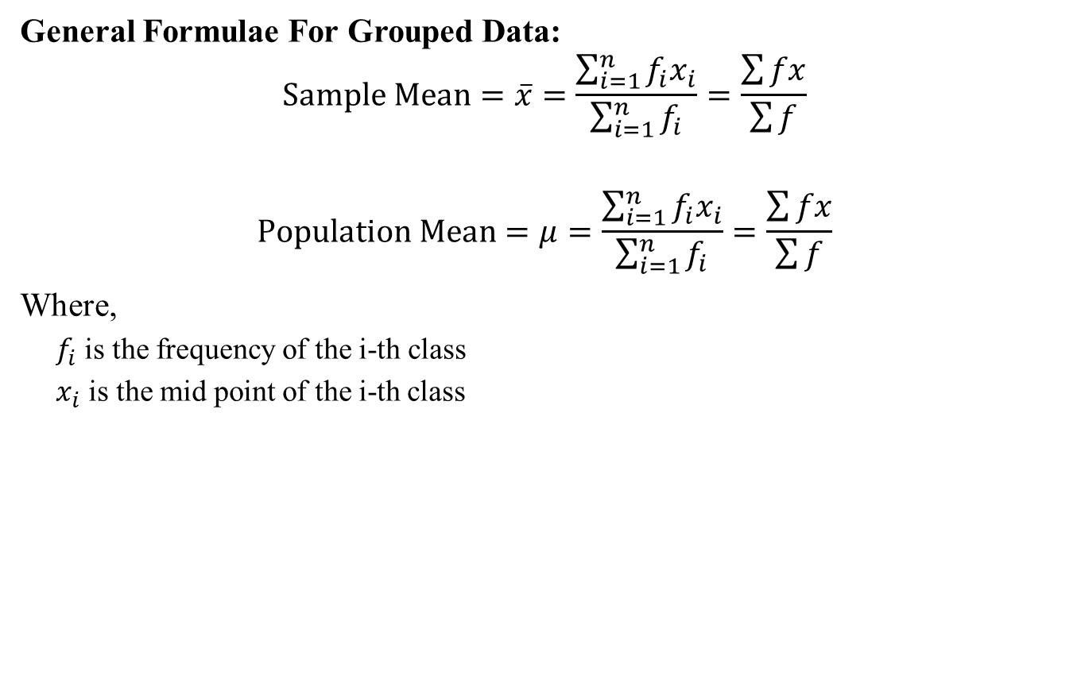
Arithmetic Mean for Grouped Data
General Formulae For Grouped Data:
$$Sample Mean=\overline{x}=\frac{\sum_{i=1}^{n}{f_{i}x_{i}}}{\sum_{i=1}^{n}{f_{i}}}=\frac{\sum{fx}}{\sum{f}}$$
$$Population Mean=μ=\frac{\sum_{i=1}^{n}{f_{i}x_{i}}}{\sum_{i=1}^{n}{f_{i}}}=\frac{\sum{fx}}{\sum{f}}$$
Where,
  $f_{i}$ is the frequency of the i-th class
  $x_{i}$ is the mid point of the i-thclass

Slide 17
Arithmetic Mean for Grouped Data
Example: Calculate Arithmetic Mean for the following frequency distribution of temperature data:
Classes | Frequency (f)
11-20 | 3
21-30 | 6
31-40 | 5
41-50 | 4
51-60 | 2

Slide 18
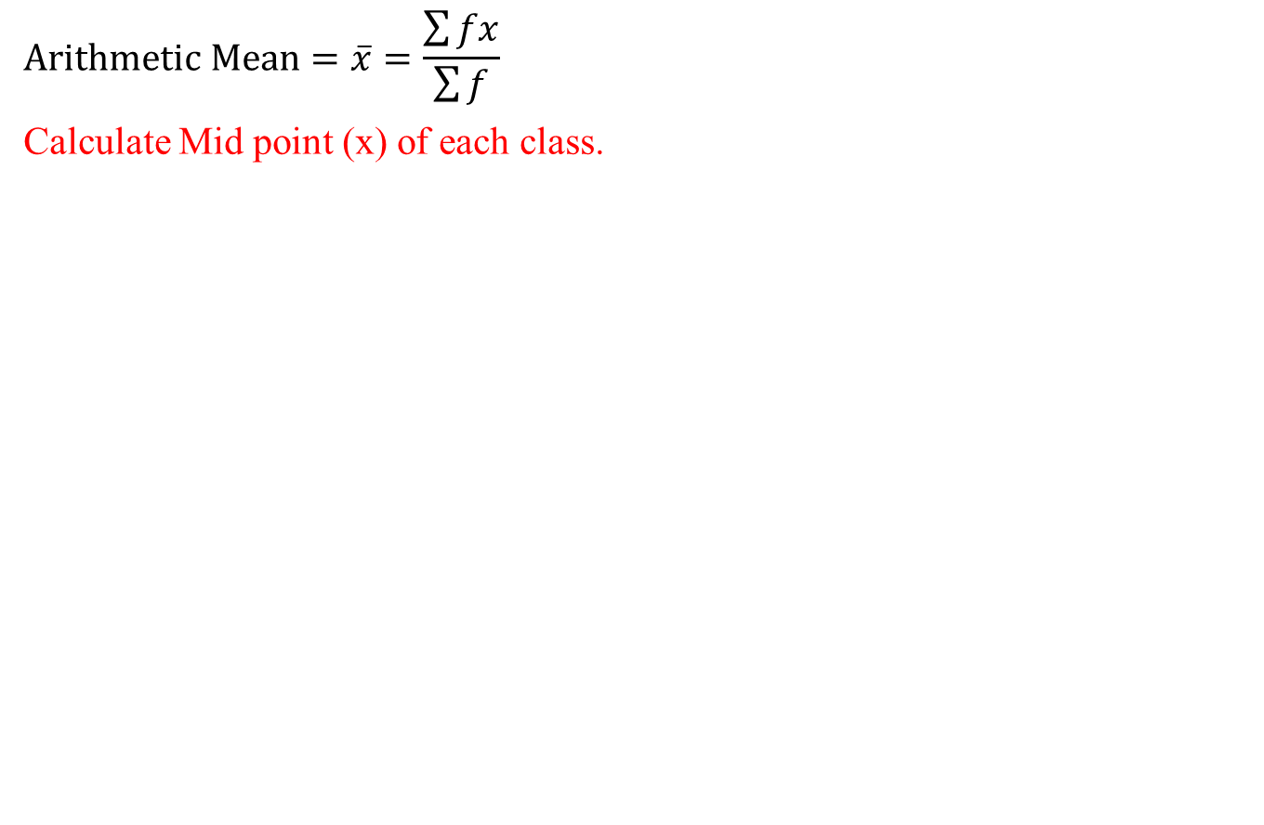
Arithmetic Mean for Grouped Data
$$Arithmetic Mean=\overline{x}=\frac{\sum{fx}}{\sum{f}}$$
Calculate Mid point (x) of each class.
Classes | Frequency (f)
11-20 | 3
21-30 | 6
31-40 | 5
41-50 | 4
51-60 | 2

Slide 19
Arithmetic Mean for Grouped Data
$$Arithmetic Mean=\overline{x}=\frac{\sum{fx}}{\sum{f}}$$
Calculate Mid point (x) of each class.
Classes | Frequency (f) | Mid Point (x)
11-20 | 3 | (11+20)/2=15.5
21-30 | 6 | 25.5
31-40 | 5 | 35.5
41-50 | 4 | 45.5
51-60 | 2 | 55.5

Slide 20
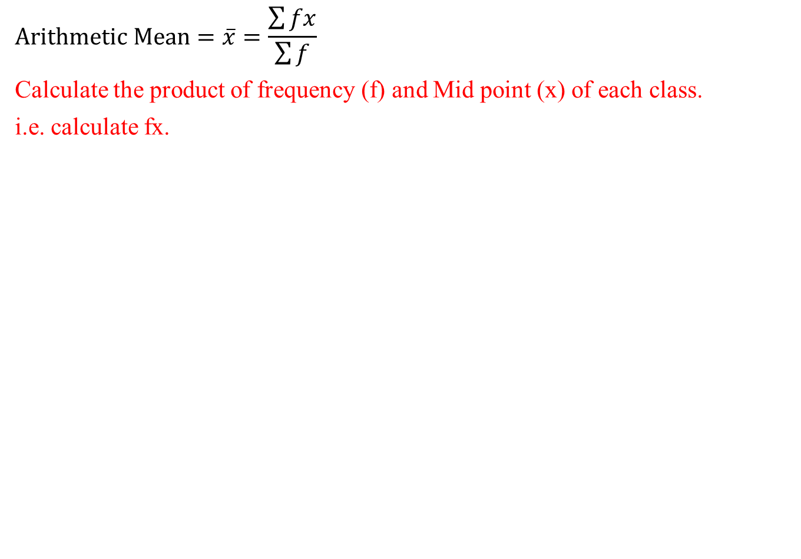
Arithmetic Mean for Grouped Data
$$Arithmetic Mean=\overline{x}=\frac{\sum{fx}}{\sum{f}}$$
Calculate the product of frequency (f) and Mid point (x) of each class.
i.e. calculate fx.
Classes | Frequency (f) | Mid Point (x)
11-20 | 3 | (11+20)/2=15.5
21-30 | 6 | 25.5
31-40 | 5 | 35.5
41-50 | 4 | 45.5
51-60 | 2 | 55.5

Slide 21
Arithmetic Mean for Grouped Data
$$Arithmetic Mean=\overline{x}=\frac{\sum{fx}}{\sum{f}}$$
Calculate the product of frequency (f) and Mid point (x) of each class.
i.e. calculate fx.
Classes | Frequency (f) | Mid Point (x) | fx
11-20 | 3 | (11+20)/2=15.5 | 46.5
21-30 | 6 | 25.5 | 153
31-40 | 5 | 35.5 | 177.5
41-50 | 4 | 45.5 | 182
51-60 | 2 | 55.5 | 111

Slide 22
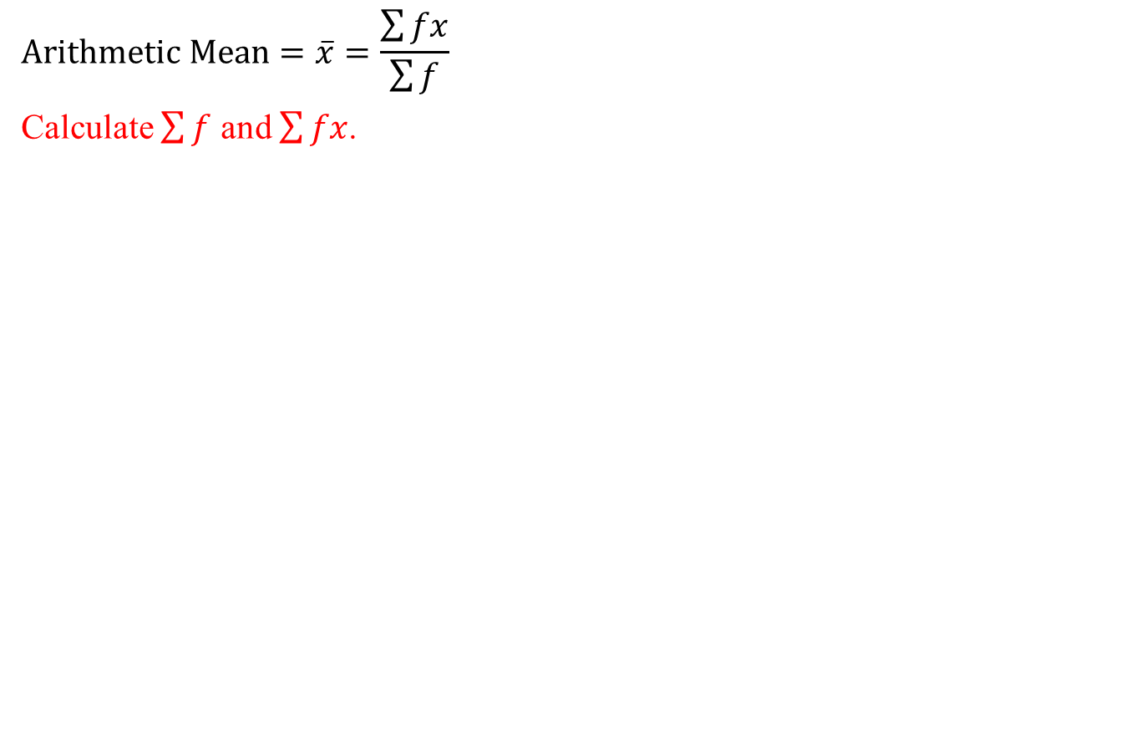
Arithmetic Mean for Grouped Data
$$Arithmetic Mean=\overline{x}=\frac{\sum{fx}}{\sum{f}}$$
Calculate $\sum{f}$ and $\sum{fx}$.
Classes | Frequency (f) | Mid Point (x) | fx
11-20 | 3 | (11+20)/2=15.5 | 46.5
21-30 | 6 | 25.5 | 153
31-40 | 5 | 35.5 | 177.5
41-50 | 4 | 45.5 | 182
51-60 | 2 | 55.5 | 111

Slide 23
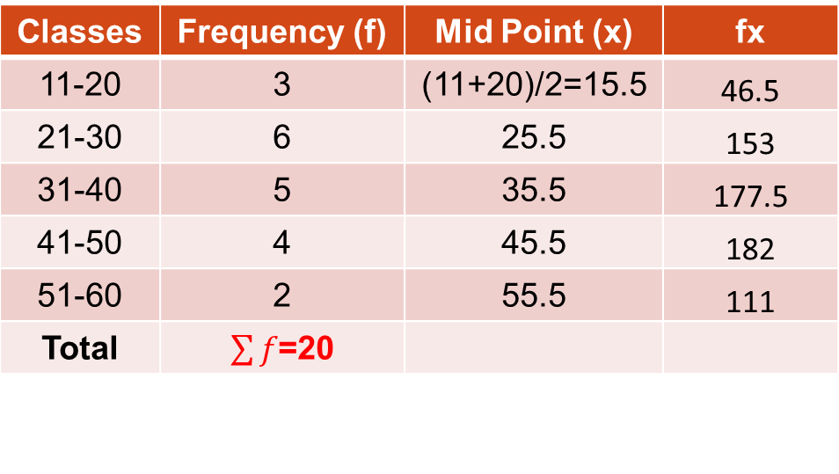
Arithmetic Mean for Grouped Data
$$Arithmetic Mean=\overline{x}=\frac{\sum{fx}}{\sum{f}}$$
Calculate $\sum{f}$ and $\sum{fx}$.
Classes | Frequency (f) | Mid Point (x) | fx
11-20 | 3 | (11+20)/2=15.5 | 46.5
21-30 | 6 | 25.5 | 153
31-40 | 5 | 35.5 | 177.5
41-50 | 4 | 45.5 | 182
51-60 | 2 | 55.5 | 111
Total | $\sum{f}$=20

Slide 24
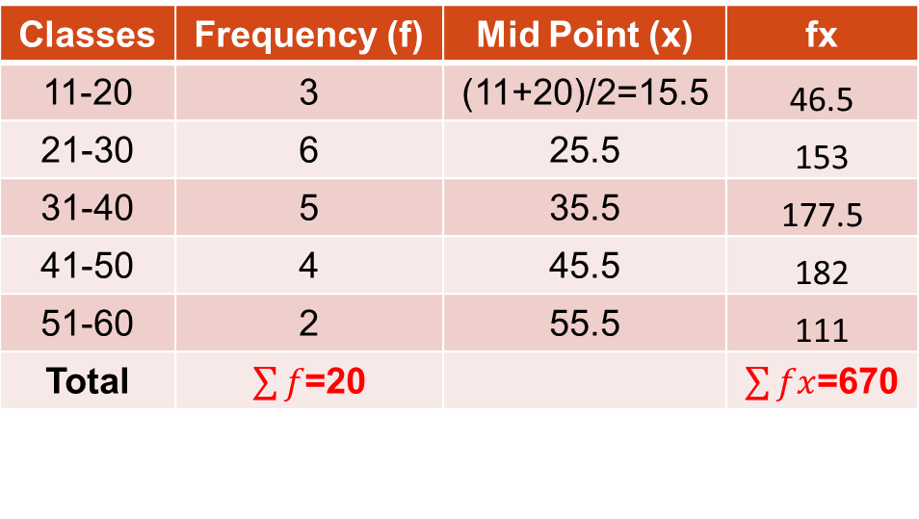
Arithmetic Mean for Grouped Data
$$Arithmetic Mean=\overline{x}=\frac{\sum{fx}}{\sum{f}}$$
Calculate $\sum{f}$ and $\sum{fx}$.
Classes | Frequency (f) | Mid Point (x) | fx
11-20 | 3 | (11+20)/2=15.5 | 46.5
21-30 | 6 | 25.5 | 153
31-40 | 5 | 35.5 | 177.5
41-50 | 4 | 45.5 | 182
51-60 | 2 | 55.5 | 111
Total | $\sum{f}$=20 |  | $\sum{fx}$=670

Slide 25
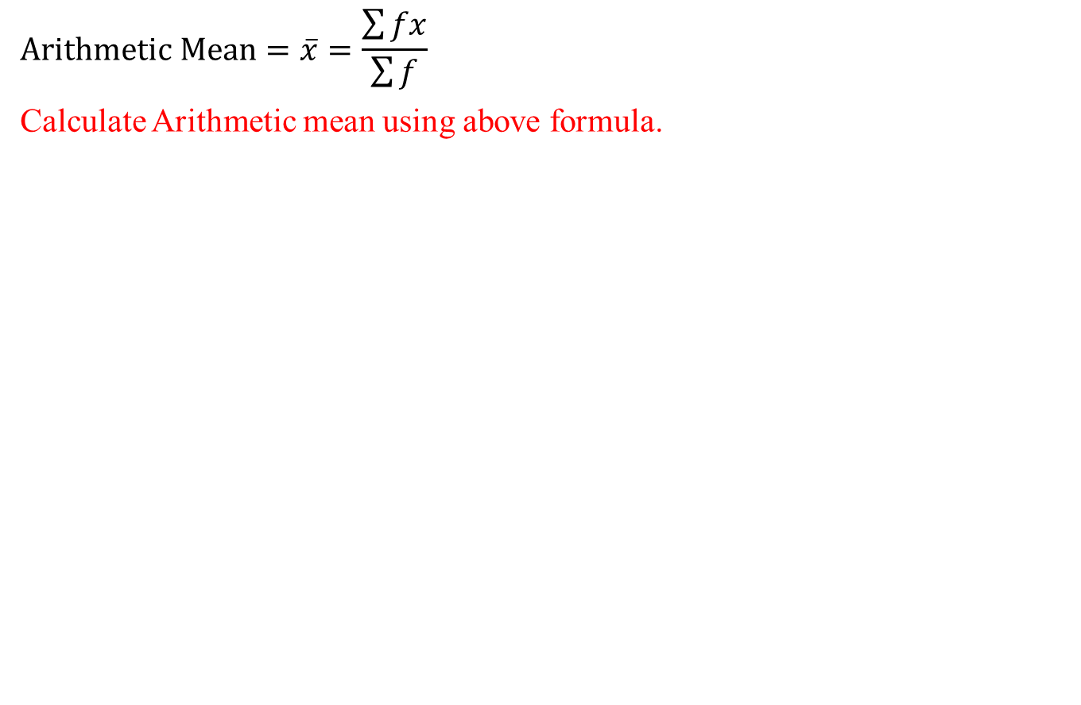
Arithmetic Mean for Grouped Data
$$Arithmetic Mean=\overline{x}=\frac{\sum{fx}}{\sum{f}}$$
Calculate Arithmetic mean using above formula.
Classes | Frequency (f) | Mid Point (x) | fx
11-20 | 3 | (11+20)/2=15.5 | 46.5
21-30 | 6 | 25.5 | 153
31-40 | 5 | 35.5 | 177.5
41-50 | 4 | 45.5 | 182
51-60 | 2 | 55.5 | 111
Total | $\sum{f}$=20 |  | $\sum{fx}$=670

Slide 26

Arithmetic Mean for Grouped Data
$$Arithmetic Mean=\overline{x}=\frac{\sum{fx}}{\sum{f}}$$
Calculate Arithmetic mean using above formula.
Classes | Frequency (f) | Mid Point (x) | fx
11-20 | 3 | (11+20)/2=15.5 | 46.5
21-30 | 6 | 25.5 | 153
31-40 | 5 | 35.5 | 177.5
41-50 | 4 | 45.5 | 182
51-60 | 2 | 55.5 | 111
Total | $\sum{f}$=20 |  | $\sum{fx}$=670
$$Arithmetic Mean=\overline{x}=\frac{\sum{fx}}{\sum{f}}=\frac{670}{20}=33.5$$

Slide 27
Review
Use of Excel Add-ins
  Activating Excel Add-ins
  Introduction to Analysis Tool Pack Excel Add-in
    Calculating Basic Summary Statistics using Data Analysis Tool Pack
    Constructing Histogram using Data Analysis Tool pack
Measures of Central Tendency
Characteristics of a good Average
  Arithmetic Mean (or simply Mean)
      Mean for ungrouped Data
      Mean for grouped Data
      Related Examples

Slide 28
Next Lecture
In next lecture, we will study:
Measures of Central Tendency
  Weighted Mean
  Combined Mean
  Merits and demerits of Arithmetic Mean
Median
    Median for Grouped Data
    Median for Ungrouped Data
    Merits and demerits of Median

