Slide 1
MTH 161: Introduction To Statistics
Lecture 04
Dr. MUMTAZ AHMED

Slide 2
Review of Previous Lecture
Graphical Methods of Data Presentations
  Graphs for qualitative data
    Bar Charts
      Simple Bar Chart
      Multiple Bar Chart
      Component Bar Chart
    Pie Charts

Slide 3
Objectives of Current Lecture
Graphical Methods of Data Presentations
  Graphs for quantitative data
    Histograms
    Frequency Polygon
    Cumulative Frequency Polygon (Frequency Ogive)

Slide 4
Graphs For Quantitative Data
Common methods for graphing quantitative data are:
Histogram
Frequency Polygon
Frequency Ogive

Slide 5
Histograms For Quantitative Data
A histogram is a graph that consists of a set of adjacent bars with heights proportional to the frequencies (or relative frequencies or percentages) and bars are marked off by class boundaries (NOT class limits).
It displays the classes on the horizontal axis and the frequencies (or relative frequencies or percentages) of the classes on the vertical axis.
The frequency of each class is represented by a vertical bar whose height is equal to the frequency of the class.
It is similar to a bar graph. However, a histogram utilizes classes or intervals and frequencies while a bar graph utilizes categories and frequencies.

Slide 6
Histograms For Quantitative Data
Example: Construct a Histogram for ages of telephone operators.
Age (years) | No of Operators
11-15 | 10
16-20 | 5
21-25 | 7
26-30 | 12
31-35 | 6
Total | 40

Slide 7
Histograms For Quantitative Data
Method: First construct Class Boundaries (CB).
Age (years) | No of Operators
11-15 | 10
16-20 | 5
21-25 | 7
26-30 | 12
31-35 | 6
Total | 40

Slide 8
Histograms For Quantitative Data
Method: First construct Class Boundaries (CB).
Age (years) | Class Boundaries | No of Operators
11-15 | 10.5-15.5 | 10
16-20 |  | 5
21-25 |  | 7
26-30 |  | 12
31-35 |  | 6
Total |  | 40

Slide 9
Histograms For Quantitative Data
Method: First construct Class Boundaries (CB).
Age (years) | Class Boundaries | No of Operators
11-15 | 10.5-15.5 | 10
16-20 | 15.5-20.5 | 5
21-25 | 20.5-25.5 | 7
26-30 | 25.5-30.5 | 12
31-35 | 30.5-35.5 | 6
Total |  | 40

Slide 10
Histograms For Quantitative Data
Method: Construct Histogram by taking CB along X-axis and frequencies along Y-axis.
Age (years) | Class Boundaries | No of Operators
11-15 | 10.5-15.5 | 10
16-20 | 15.5-20.5 | 5
21-25 | 20.5-25.5 | 7
26-30 | 25.5-30.5 | 12
31-35 | 30.5-35.5 | 6
Total |  | 40

Slide 11
Histograms For Quantitative Data
Method: Construct Histogram by taking CB along X-axis and frequencies along Y-axis.
Class Boundaries | No of Operators (f)
10.5-15.5 | 10
15.5-20.5 | 5
20.5-25.5 | 7
25.5-30.5 | 12
30.5-35.5 | 6
Total | 40

Slide 12
Histograms For Quantitative Data
Method: Construct Histogram by taking CB along X-axis and frequencies along Y-axis.
Class Boundaries | No of Operators (f)
10.5-15.5 | 10
15.5-20.5 | 5
20.5-25.5 | 7
25.5-30.5 | 12
30.5-35.5 | 6
Total | 40

Slide 13
Histograms For Quantitative Data
Method: Construct Histogram by taking CB along X-axis and frequencies along Y-axis.
Class Boundaries | No of Operators (f)
10.5-15.5 | 10
15.5-20.5 | 5
20.5-25.5 | 7
25.5-30.5 | 12
30.5-35.5 | 6
Total | 40

Slide 14
Histograms For Quantitative Data
Method: Construct Histogram by taking CB along X-axis and frequencies along Y-axis.
Class Boundaries | No of Operators (f)
10.5-15.5 | 10
15.5-20.5 | 5
20.5-25.5 | 7
25.5-30.5 | 12
30.5-35.5 | 6
Total | 40

Slide 15
Histograms For Quantitative Data
Method: Construct Histogram by taking CB along X-axis and frequencies along Y-axis.
Class Boundaries | No of Operators (f)
10.5-15.5 | 10
15.5-20.5 | 5
20.5-25.5 | 7
25.5-30.5 | 12
30.5-35.5 | 6
Total | 40

Slide 16
Histograms For Quantitative Data
Method: Construct Histogram by taking CB along X-axis and frequencies along Y-axis.
Class Boundaries | No of Operators (f)
10.5-15.5 | 10
15.5-20.5 | 5
20.5-25.5 | 7
25.5-30.5 | 12
30.5-35.5 | 6
Total | 40

Slide 17
Frequency Polygon For Quantitative Data
Graph of frequencies of each class against its mid point (also called class marks, denoted by X).
Class Mark (X) or Mid point: It is calculated by taking average of lower and upper class limits.
Example: (Ages of Telephone Operators)

Slide 18
Frequency Polygon For Quantitative Data
Graph of frequencies of each class against its mid point (also called class marks, denoted by X).
Class Mark (X) or Mid point: It is calculated by taking average of lower and upper class limits.
Example: (Ages of Telephone Operators)
Age (years) | No of Operators | Mid Point (X)
11-15 | 10 | (11+15)/2=13
16-20 | 5 | 18
21-25 | 7 | 23
26-30 | 12 | 28
31-35 | 6 | 33
Total | 40

Slide 19
Frequency Polygon For Quantitative Data
Method: Take Mid Points along X-axis and Frequency along Y-axis.

Slide 20
Frequency Polygon For Quantitative Data
Method: Take Mid Points along X-axis and Frequency along Y-axis.
Age (years) | No of Operators | Mid Point (X)
11-15 | 10 | (11+15)/2=13
16-20 | 5 | 18
21-25 | 7 | 23
26-30 | 12 | 28
31-35 | 6 | 33

Slide 21
Frequency Polygon For Quantitative Data
Method: Construct Bars with height proportional to the corresponding freq.
Age (years) | No of Operators | Mid Point (X)
11-15 | 10 | (11+15)/2=13
16-20 | 5 | 18
21-25 | 7 | 23
26-30 | 12 | 28
31-35 | 6 | 33

Slide 22
Frequency Polygon For Quantitative Data
Method: Construct Bars with height proportional to the corresponding freq.
Age (years) | No of Operators | Mid Point (X)
11-15 | 10 | (11+15)/2=13
16-20 | 5 | 18
21-25 | 7 | 23
26-30 | 12 | 28
31-35 | 6 | 33

Slide 23
Frequency Polygon For Quantitative Data
Method: Join Mid points to get Frequency Polygon.
Age (years) | No of Operators | Mid Point (X)
11-15 | 10 | (11+15)/2=13
16-20 | 5 | 18
21-25 | 7 | 23
26-30 | 12 | 28
31-35 | 6 | 33

Slide 24
Frequency Polygon For Quantitative Data
Method: Join Mid points to get Frequency Polygon.
Age (years) | No of Operators | Mid Point (X)
11-15 | 10 | (11+15)/2=13
16-20 | 5 | 18
21-25 | 7 | 23
26-30 | 12 | 28
31-35 | 6 | 33

Slide 25
Frequency Polygon For Quantitative Data
Method: Join Mid points to get Frequency Polygon.
Age (years) | No of Operators | Mid Point (X)
11-15 | 10 | (11+15)/2=13
16-20 | 5 | 18
21-25 | 7 | 23
26-30 | 12 | 28
31-35 | 6 | 33

Slide 26
Cumulative Frequency Polygon (called Ogive) For Quantitative Data
Ogive is pronounced as O’Jive (rhymes with alive).
Cumulative Frequency Polygon is a graph obtained by plotting the cumulative frequencies against the upper or lower class boundaries depending upon whether the cumulative is of ‘less than’ or ‘more than’ type.

Slide 27
Cumulative Frequency Polygon (called Ogive) For Quantitative Data
Ogive is pronounced as O’Jive (rhymes with alive).
Cumulative Frequency Polygon is a graph obtained by plotting the cumulative frequencies against the upper or lower class boundaries depending upon whether the cumulative is of ‘less than’ or ‘more than’ type.
Less than Cumulative Frequency
Age (years) | Class Boundaries | No of Operators (f) | Cumulative Frequency
11-15 | Less than 15.5 | 10 | 10
16-20 | Less than 20.5 | 5 | 15
21-25 | Less than 25.5 | 7 | 22
26-30 | Less than 30.5 | 12 | 34
31-35 | Less than 35.5 | 6 | 40
Total |  | 40

Slide 28
Cumulative Frequency Polygon (Ogive) For Quantitative Data
Method: Take Upper Class Boundaries along X-axis and Cumulative Frequency along Y-axis.

Slide 29
Cumulative Frequency Polygon (Ogive) For Quantitative Data
Method: Take Upper Class Boundaries along X-axis and Cumulative Frequency along Y-axis.
Class Boundaries | Cumulative Frequency
Less than 15.5 | 10
Less than 20.5 | 15
Less than 25.5 | 22
Less than 30.5 | 34
Less than 35.5 | 40

Slide 30
Cumulative Frequency Polygon (Ogive) For Quantitative Data
Method: Take Upper Class Boundaries along X-axis and Cumulative Frequency along Y-axis.
Class Boundaries | Cumulative Frequency
Less than 15.5 | 10
Less than 20.5 | 15
Less than 25.5 | 22
Less than 30.5 | 34
Less than 35.5 | 40

Slide 31
Cumulative Frequency Polygon (Ogive) For Quantitative Data
Method: Join less than Class Boundaries with corresponding Cumulative Frequencies.
Class Boundaries | Cumulative Frequency
Less than 15.5 | 10
Less than 20.5 | 15
Less than 25.5 | 22
Less than 30.5 | 34
Less than 35.5 | 40

Slide 32
Cumulative Frequency Polygon (Ogive) For Quantitative Data
Method: Join less than Class Boundaries with corresponding Cumulative Frequencies.
Class Boundaries | Cumulative Frequency
Less than 15.5 | 10
Less than 20.5 | 15
Less than 25.5 | 22
Less than 30.5 | 34
Less than 35.5 | 40

Slide 33
Distributional Shape
Distribution of a Data Set
A table, a graph, or a formula that provides the values of the data set and how often they occur.
An important aspect of the distribution of a quantitative data is its shape.
  The shape of a distribution frequently plays a role in determining the appropriate method of statistical analysis.
To identify the shape of a distribution, the best approach usually is to use a smooth curve that approximates the overall shape.

Slide 34
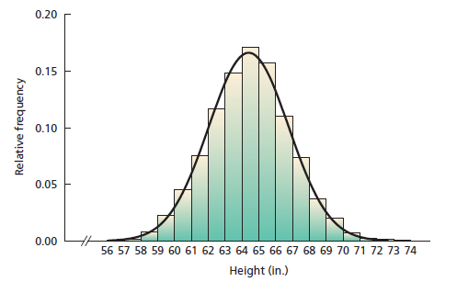
Distributional Shape
Figure displays a relative-frequency histogram for the heights of the 3000 female students.
It also includes a smooth curve that approximates the overall shape of the distribution.
Note: Both the histogram and the smooth curve show that this distribution of heights is bell shaped, but the smooth curve makes seeing the shape a little easier.
Advantage of smooth curves:
It skips minor differences in shape
and concentrate on overall patterns.

Slide 35
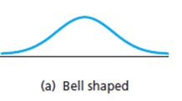
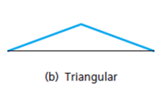
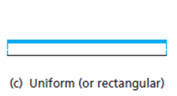
Frequency Distributions in Practice
Common Type of Frequency Distribution:
Symmetric Distribution
  Normal Distribution (or Bell Shaped)
  Triangular Distribution
  Uniform Distribution (or Rectangular)

Slide 36
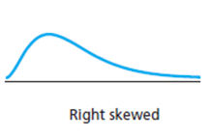
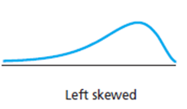
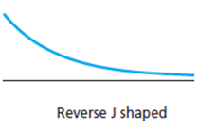
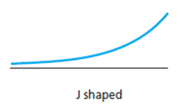
Frequency Distributions in Practice
Common Type of Frequency Distribution:
Asymmetric or skewed Distribution
  Right Skewed Distribution
  Left Skewed Distribution
  Reverse J-Shaped (or Extremely Right Skewed)
  J-Shaped (or Extremely Left Skewed)

Slide 37
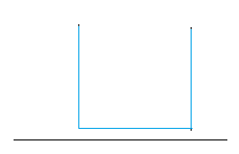
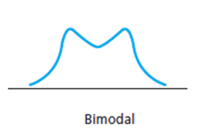
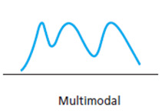
Frequency Distributions in Practice
Common Type of Frequency Distribution:
Bi-Modal Distribution
Multimodal Distribution
U-Shaped Distribution

Slide 38
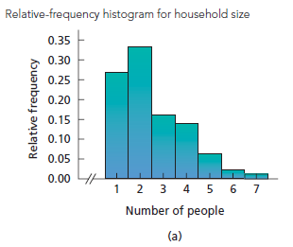
Identifying Distribution
Example: (Household Size): The relative-frequency histogram for household size in the United States is shown in figure.
Identify the distribution shape for sizes of U.S. households.

Slide 39
Identifying Distribution
To identify the distributional shape, Draw a smooth curve through the histogram.

Slide 40
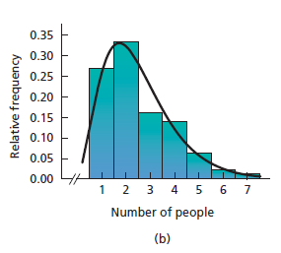
Identifying Distribution
To identify the distributional shape, Draw a smooth curve through the histogram.

Slide 41
Identifying Distribution
To identify the distributional shape, Draw a smooth curve through the histogram.
Decision:

Slide 42
Review
Let’s review the main concepts:
Graphical Methods of Data Presentations
  Graphs for quantitative data
    Histograms
    Frequency Polygon
    Cumulative Frequency Polygon (Frequency Ogive)

Slide 43
Next Lecture
In next lecture, we will study:
Introduction To MS-Excel
Constructing Frequency Table in MS-Excel
Constructing Graphs in MS-Excel

