Slide 1
MTH 161: Introduction To Statistics
Lecture 32
Dr. MUMTAZ AHMED

Slide 2
Review of Previous Lecture
In last lecture we discussed:
Simple Linear Regression Model
Method of Ordinary Least Squares (OLS)
Properties of OLS
Standard Error of Regression (SER)
Coefficient of Determination (R²)
An Example

Slide 3
Objectives of Current Lecture
In the current lecture:
An example of Simple Linear Regression Model
Introduction Multiple Linear Regression Model
Assumptions of Simple & Multiple Regression Models
Estimation and Interpretation

Slide 4
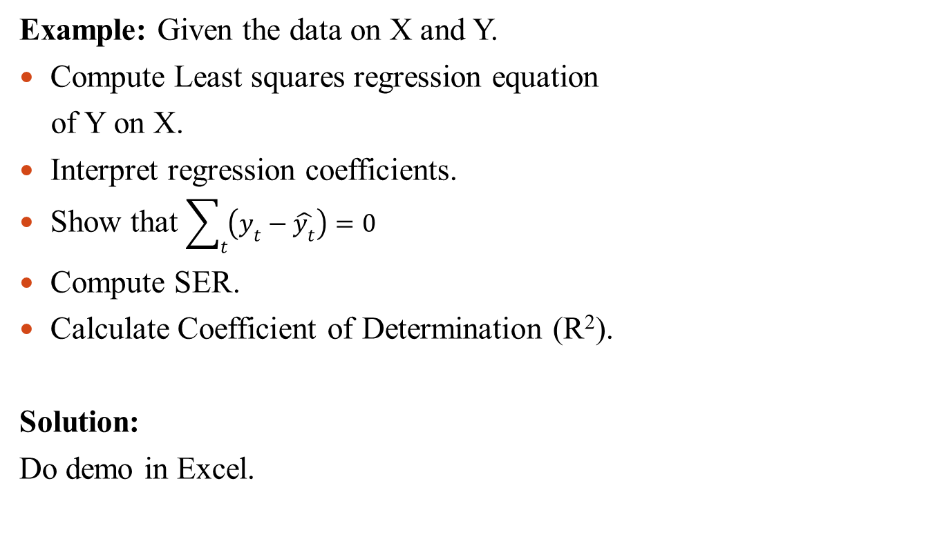
Regression: An Example
Example: Given the data on X and Y.
Compute Least squares regression equation
of Y on X.
Interpret regression coefficients.
Show that $\sum_{t}{\left(y_{t}−\hat{y_{t}}\right)=0}$
Compute SER.
Calculate Coefficient of Determination (R²).
Solution:
Do demo in Excel.
X | Y
5 | 16
6 | 19
8 | 23
10 | 28
12 | 36
13 | 41
15 | 44
16 | 45
17 | 50

Slide 5
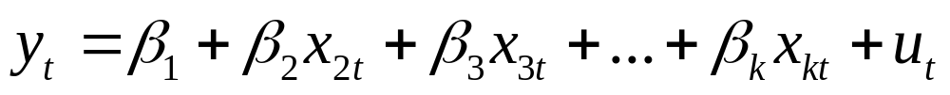

Multiple Linear Regression Model
General form of a Multiple Linear Regression Model:
t=1,2,….,n
Where,
  y_{i}’s are observations on dependent variable (y)
  x_{i}’s (i=1,2,…k) are k regressors each having n observations
  (i=1,2,…,k) are regression coefficients or parameters
  u_{i}’s are errors

Slide 6
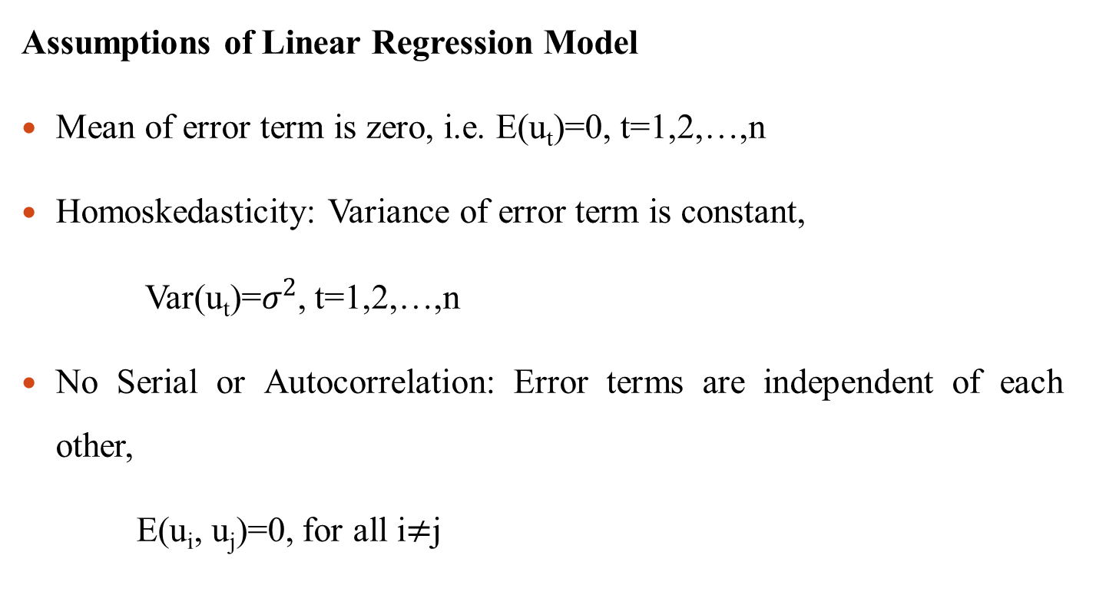
Multiple Linear Regression Model
Assumptions of Linear Regression Model
Mean of error term is zero, i.e. E(u_{t})=0, t=1,2,…,n
Homoskedasticity: Variance of error term is constant,
Var(u_{t})=$σ^{2}$, t=1,2,…,n
No Serial or Autocorrelation: Error terms are independent of each other,
E(u_{i}, u_{j})=0, for all i$≠$j

Slide 7
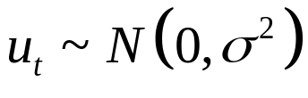
Multiple Linear Regression Model
Assumptions of Linear Regression Model
Regressor (X) and error term (u) are independent of each other, i.e. E(X, ui)=0
Error are normally distributed with a mean of zero and a constant variance, i.e.
No Multicollinearity between regressor

Slide 8
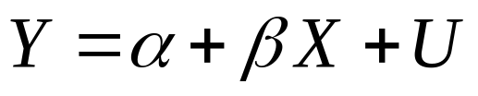
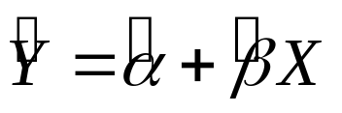
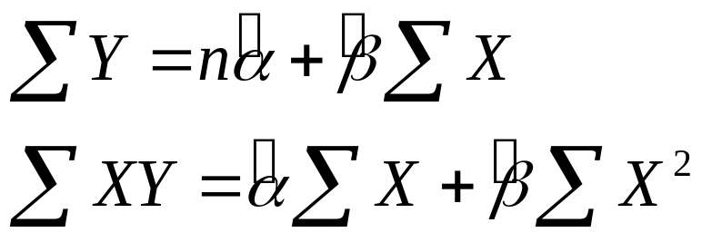
Multiple Linear Regression Model
Estimating Least Squares Estimates via Normal Equation
Simple linear regression model:
Estimated regression model is:
Normal Equation are:

Slide 9
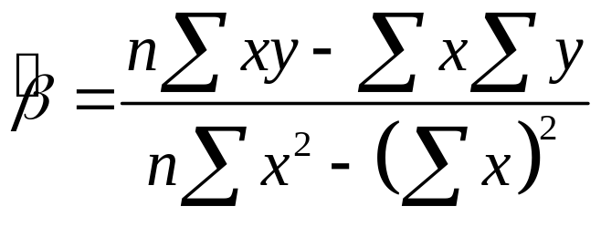
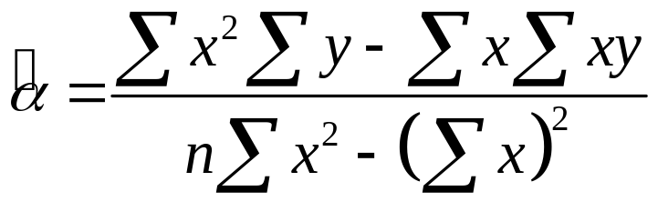
Multiple Linear Regression Model
Normal Equation are:
Solving normal equations simultaneously, we get:
So estimated regression line is:

Slide 10
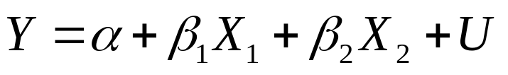
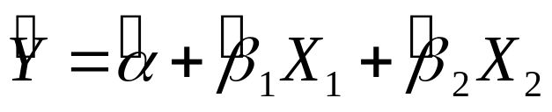
Multiple Linear Regression Model
Estimating Least Squares Estimates via Normal Equation
Multiple linear regression model:
Estimated regression model is:
Normal Equation are:

Slide 11
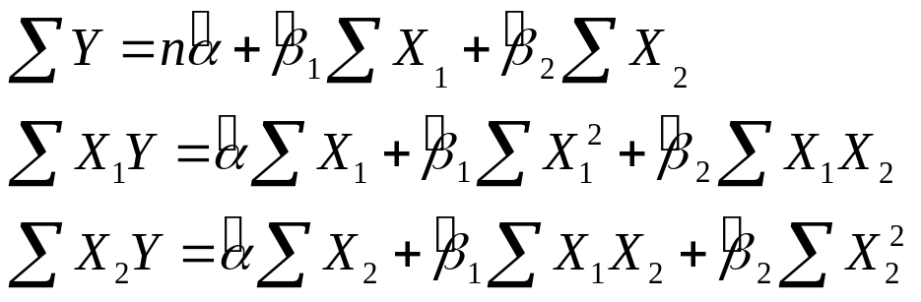
Multiple Linear Regression Model
Normal Equation are:

Slide 12
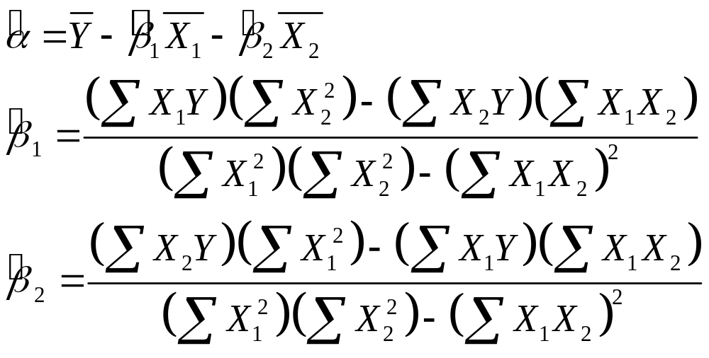
Multiple Linear Regression Model
Normal Equation are:
Solving normal equations simultaneously, we get:

Slide 13
Multiple Linear Regression Model
Example:
A statistician wants to predict the incomes of restaurants, using two independent variables, the number of restaurant employees and restaurant floor area. He collected the following data:
Calculate:
Estimated linear regression equation.
Solution:
Do the demo in Excel
Y | X₁ | X₂
30 | 10 | 15
22 | 5 | 8
16 | 10 | 12
7 | 3 | 7
14 | 2 | 10

Slide 14
Review
Let’s review the main concepts:
An example of Simple Linear Regression Model
Introduction Multiple Linear Regression Model
Assumptions of Simple & Multiple Regression Models
Estimation and Interpretation

Slide 15
Final Word
Best of Luck in the course

