Slide 1
MTH 161: Introduction To Statistics
Lecture 29
Dr. MUMTAZ AHMED

Slide 2
Review of Previous Lecture
In last lecture we discussed:
Joint Distributions
Moment Generating Functions
Covariance
Related Examples

Slide 3
Objectives of Current Lecture
In the current lecture:
Covariance: Some important Results
Describing Bivariate Data
Scatter Plot
Concept of Correlation
Properties of Correlation
Related examples and Excel Demo

Slide 4
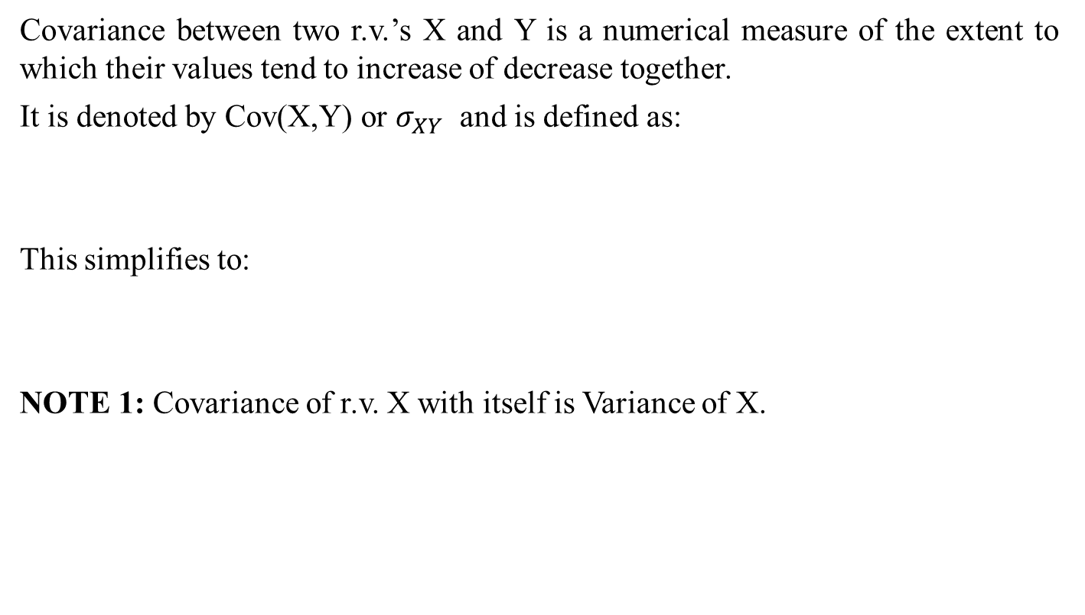
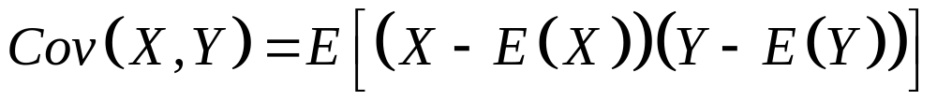
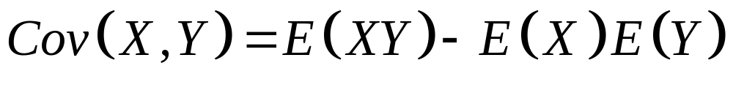
Covariance

Slide 5
Covariance
NOTE 2: If X and Y are INDEPENDENT, then E(XY)=E(X) E(Y)
Hence Cov(X,Y)=0
NOTE 3: Converse of above results DOESN’T Hold, i.e. if Cov(X,Y)=0 then it doesn’t mean X and Y are independent.
e.g. Let X be Normal r.v with mean zero and Y=X² then obviously X and Y are NOT independent.
Now Cov(X,Y)=Cov( X, X²)=E(X³)-E(X²)E(X)
=E(X³)-E(X²)*(0) [since E(X)=0]
=E(X³)
=0 [Since Normal is symmetric]
Hence, Zero Covariance doesn’t imply Independence.

Slide 6
Covariance
Do Excel Demo

Slide 7
Describing Bivariate Data
Sometimes, our interest lies in finding the “relationship”, or “association”, between two variables.
This can be done by the following methods:
Scatter Plot
Correlation
Regression Analysis

Slide 8
Scatter Plot
A first step in finding whether or not a relationship between two variables exists, is to plot each pair of independent-dependent observations {(Xi, Yi)}, i=1,2,..,n as a point on a graph paper.
Such a diagram is called a Scatter Diagram or Scatter Plot.
Usually, independent variable is taken along X-axis and dependent variable is taken along Y-axis.

Slide 9
Suppose we wished to graph the relationship between foot length
and height
of 20 subjects.
In order to create the graph, which is called a scatterplot or scattergram, we need the foot length and height for each of our subjects.
74
72
70
Height
68
66
64
62
60
58
4
6
8
10
12
14
Foot Length

Slide 10
Assume our first subject had a 12 inch foot and was 70 inches tall.
1. Find 12 inches on the x-axis.
2. Find 70 inches on the y-axis.
3. Locate the intersection of 12 and 70.
4. Place a dot at the intersection of 12 and 70.
Height
Foot Length

Slide 11
Assume that our second subject had an 8 inch foot and was 62 inches tall.
5. Find 8 inches on the x-axis.
6. Find 62 inches on the y-axis.
7. Locate the intersection of 8 and 62.
8. Place a dot at the intersection of 8 and 62.
9. Continue to plot points for each pair of scores.

Slide 12
Notice how the scores cluster to form a pattern.
The more closely they cluster to a line that is drawn through them, the stronger the linear relationship between the two variables is (in this case foot length and height).

Slide 13
Notice how the scores cluster to form a pattern.
The more closely they cluster to a line that is drawn through them, the stronger the linear relationship between the two variables is (in this case foot length and height).

Slide 14
If the points on the scatterplot have an upward movement from left to right,
we say the relationship between the variables is positive.

Slide 15
If the points on the scatterplot have an upward movement from left to right,
we say the relationship between the variables is positive.

Slide 16
If the points on the scatterplot have an upward movement from left to right,
we say the relationship between the variables is positive.
If the points on the scatterplot have a downward movement from left to right, we say the relationship between the variables is negative.

Slide 17
A positive relationship means that high scores on one variable
are associated with high scores on the other variable
are associated with low scores on the other variable.
It also indicates that low scores on one variable

Slide 18
A negative relationship means that high scores on one variable
are associated with low scores on the other variable.
are associated with high scores on the other variable.
It also indicates that low scores on one variable

Slide 19
Scatter Plot of No relationship

Slide 20
Correlation
Correlation measures the direction and strength of the linear relationship between two random variables.
In other words, two variables are said to be correlated if they tend to vary in some direction simultaneously.
If both variables tend to increase (or decrease) together, the correlation is said to be direct or positive. E.g. The length of an iron bar will increase as the temperature increases.
If one variable tends to increase as the other variable decreases, the correlation is said to be inverse or negative. E.g. If time spent on watching TV increases, then Grades of students decrease.
If a variable neither increases nor decreases in response to an increase or decrease in other variable then the correlation is said to be Zero. E.g. The correlation between the shoe price and time spent on exercise is zero.

Slide 21
Correlation
Notations:
  For population data, it is denoted by the Greek letter (ρ)
  For sample data it is denoted by the roman letter r or r_{xy}.
Range:
Correlation always lies between -1 and 1 inclusive.
  -1 means perfect negative linear association
  0 means No linear association
  +1 means perfect positive linear association

Slide 22
Correlation
Note:
  In correlation analysis, both the variables are random and hence treated symmetrically, i.e. there is NO distinction between dependent and independent variables.
  In regression analysis (to be discussed in forthcoming lectures), we are interested in determining the dependence of one variable (that is random) upon the other variable that is non-random or fixed and in addition, we are interested in predicting the average value of the dependent variable by using the known values of other variable (called independent variable).

Slide 23
Correlation
There is no assumption of causality
The fact that correlation exists between two variables does not imply any Cause and Effect relationship but it describes only the linear association.
Correlation is a necessary, but not a sufficient condition for determining causality.

Slide 24
Correlation
Example: Two unrelated variables such as ‘sale of bananas’ and ‘the death rate from cancer’ in a city, may produce a high positive correlation which may be due to a third unknown variable (called confounding variable, namely, the city population).
The larger the city, the more consumption of bananas and the higher will be the death rate from cancer.
Clearly, this is a false of merely incidental correlation which is the result of a third variable, the city size.
Such a false correlation between two unconnected variables is called Spurious or non-sense correlation.
Therefore one should be very careful in interpreting the correlation coefficient as a measure of relationship or interdependence between two variables.

Slide 25
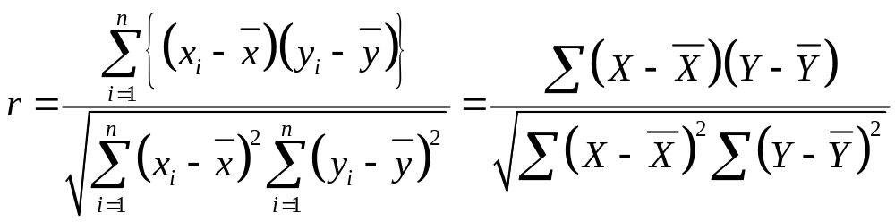
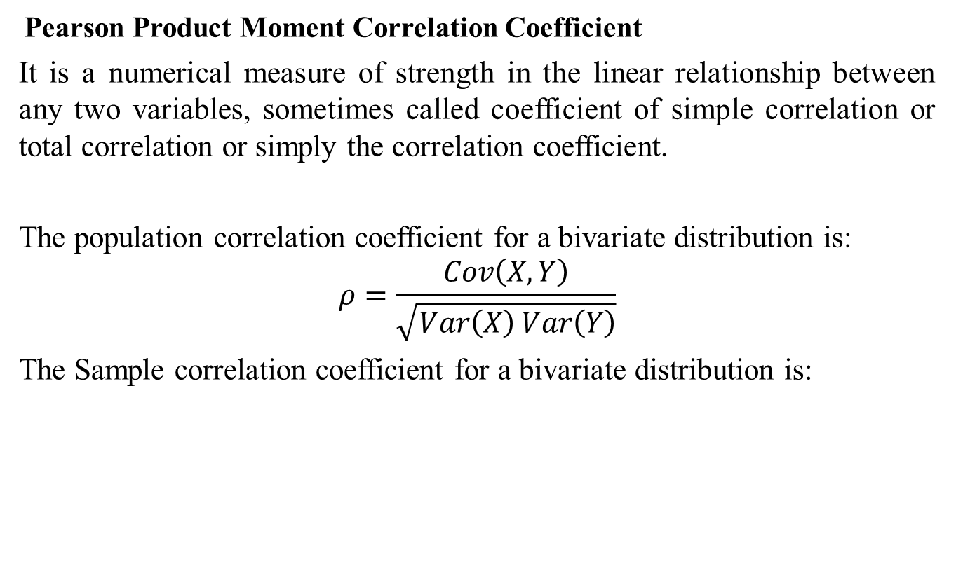
Correlation: Computation
Pearson Product Moment Correlation Coefficient
It is a numerical measure of strength in the linear relationship between any two variables, sometimes called coefficient of simple correlation or total correlation or simply the correlation coefficient.
The population correlation coefficient for a bivariate distribution is:
$$ρ=\frac{Cov\left(X,Y\right)}{\sqrt{Var\left(X\right) Var\left(Y\right)}}$$
The Sample correlation coefficient for a bivariate distribution is:

Slide 26
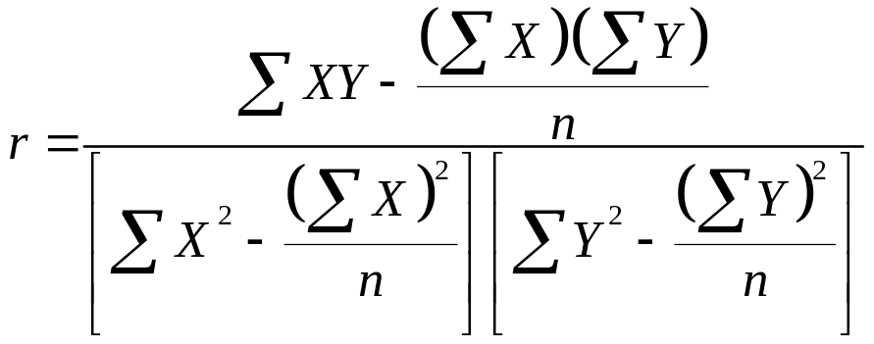
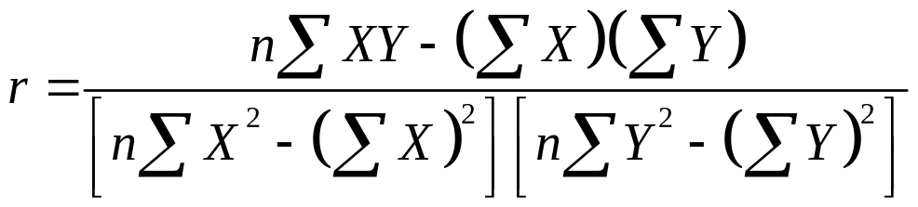
Correlation: Computation
Computationally easier version is:
OR
Note: r is a pure number and hence is unit less.

Slide 27
Correlation: Computation
Example: Consider a hypothetical data on two variables X and Y.
Calculate product moment coefficient of correlation between X and Y.
X | Y
1 | 2
2 | 5
3 | 3
4 | 8
5 | 7

Slide 28
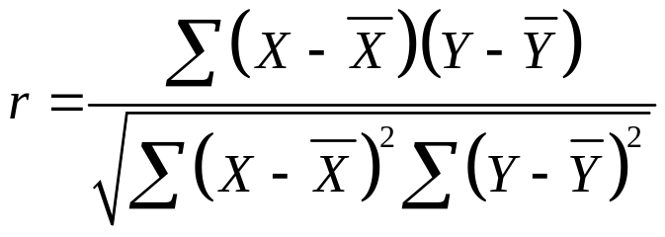
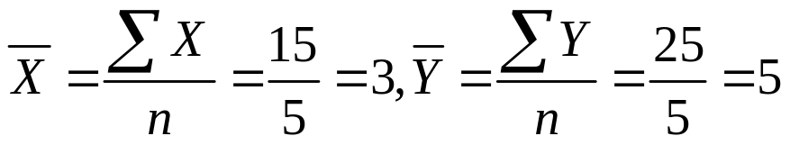
Correlation: Computation
Solution:
 | X | Y | (X-Xbar) | (X-Xbar)² | (Y-Ybar) | (Y-Ybar)² | (X-Xbar)* (Y-Ybar)
 | 1 | 2 | -2 | 4 | -3 | 9 | 6
 | 2 | 5 | -1 | 1 | 0 | 0 | 0
 | 3 | 3 | 0 | 0 | -2 | 4 | 0
 | 4 | 8 | 1 | 1 | 3 | 9 | 3
 | 5 | 7 | 2 | 4 | 2 | 4 | 4
Total= | 15 | 25 | 0 | 10 | 0 | 26 | 13

Slide 29
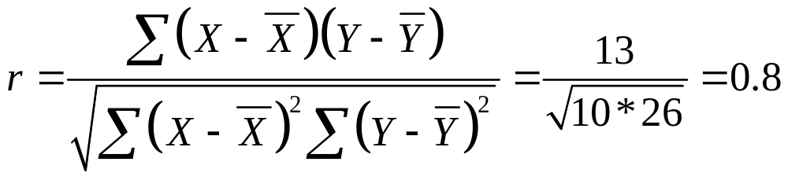
Correlation: Computation
Solution:
 | X | Y | (X-Xbar) | (X-Xbar)² | (Y-Ybar) | (Y-Ybar)² | (X-Xbar)* (Y-Ybar)
 | 1 | 2 | -2 | 4 | -3 | 9 | 6
 | 2 | 5 | -1 | 1 | 0 | 0 | 0
 | 3 | 3 | 0 | 0 | -2 | 4 | 0
 | 4 | 8 | 1 | 1 | 3 | 9 | 3
 | 5 | 7 | 2 | 4 | 2 | 4 | 4
Total= | 15 | 25 | 0 | 10 | 0 | 26 | 13

Slide 30
Correlation: Computation
Alternative Method:
 | X | Y
 | 1 | 2
 | 2 | 5
 | 3 | 3
 | 4 | 8
 | 5 | 7
Total= | 15 | 25

Slide 31
Correlation: Computation
Alternative Method:
replacing values and simplifying, we get, r=0.8
 | X | Y | X² | Y² | XY
 | 1 | 2 | 1 | 4 | 2
 | 2 | 5 | 4 | 25 | 10
 | 3 | 3 | 9 | 9 | 9
 | 4 | 8 | 16 | 64 | 32
 | 5 | 7 | 25 | 49 | 35
Total= | 15 | 25 | 55 | 151 | 88

Slide 32
Properties
Correlation only measures the strength of a linear relationship. There are other kinds of relationships besides linear.
Correlation is symmetrical with respect to the variables X and Y, i.e. r_{xy}=r_{yx}
Correlation coefficient ranges from -1 to +1.
Correlation is not affected by change of origin and scale.
i.e. correlation does not change if the you multiply, divide, add, or subtract a value to/from all the x-values or y-values.
Assumes a linear association between two variables.

Slide 33
Review
Let’s review the main concepts:
Covariance: Some important Results
Describing Bivariate Data
Scatter Plot
Concept of Correlation
Properties of Correlation
Related examples and Excel Demo

Slide 34
Next Lecture
In next lecture, we will study:
Common misconceptions about correlation
Related Examples

