Slide 1
MTH 161: Introduction To Statistics
Lecture 26
Dr. MUMTAZ AHMED

Slide 2
Review of Previous Lecture
In last lecture we discussed:
Normal Distribution
  Probability Density Function of Normal Distribution
  Properties of Normal Distribution
  Related examples

Slide 3
Objectives of Current Lecture
In the current lecture:
Finding Area under the Normal Distribution
Normal Approximation to Binomial Distribution
Related examples

Slide 4
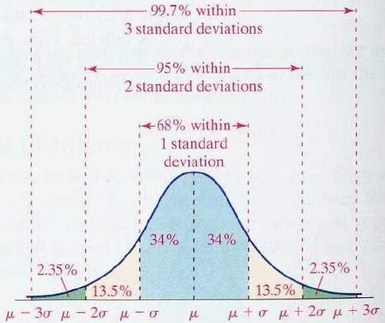
Properties of Normal Distribution
Empirical Rule:

Slide 5
Cumulative Normal Distribution
For a normal random variable X with mean μ and variance σ² , i.e., X~N(μ, σ²), the cumulative distribution function is
f(x)
0
x₀
x

Slide 6
Finding Normal Probabilities
a
μ
b
x
a
μ
b
x
a
μ
b
x

Slide 7
The Standardized Normal
Any normal distribution (with any mean and variance combination) can be transformed into the standardized normal distribution (Z), with mean 0 and variance 1.
Need to transform X units into Z units by subtracting the mean of X and dividing by its standard deviation
f(Z)
1
Z
0

Slide 8
Example
If X is distributed normally with mean of 100 and standard deviation of 50, the Z value for X = 200 is
This says that X = 200 is two standard deviations (2 increments of 50 units) above the mean of 100.

Slide 9
Comparing X and Z units
100
200
X
(μ = 100, σ = 50)
0
2.0
Z
(μ = 0, σ = 1)
Note that the distribution is the same, only the scale has changed.
We can express the problem in original units (X) or in standardized units (Z)

Slide 10
The Standardized Normal Probability
Density Function
The formula for the Standardized Normal Probability Density Function can be obtained by replacing μ=0 and σ=1
                OR

Slide 11
Finding Normal Probabilities
f(x)
a
µ
b
x
0
Z

Slide 12
Probability as Area Under the Curve
The total area under the curve is 1.0, and the curve is symmetric, so half is above the mean, half is below
f(X)
0.5
0.5
μ
X

Slide 13
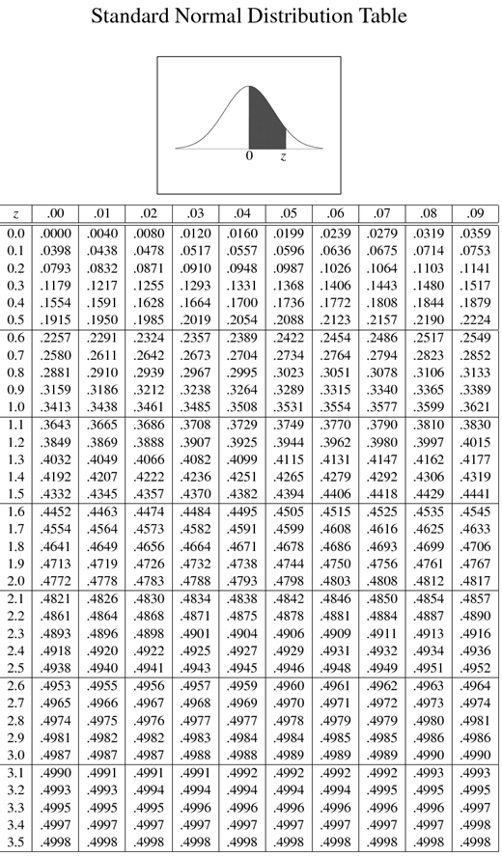
Standardized Normal Area Table
It gives the probability from 0 to Z,
i.e. P(0<Z<2)=0.4772
Since the distribution is symmetric, so
P(-2<Z<0)=0.4772

Slide 14
P(Z>2)=?
P(Z>2)=0.5-P(0<Z<2)
=0.5-0.4772
=0.0228
P(Z<-2)=?
P(Z<-2)=0.5-P(-2<Z<0)
=0.5-0.4772
=0.0228

Slide 15
P(-2<Z<+2)=?
P(-2<Z<+2)
= P(-2<Z<0)+ P(0<Z<+2)
= 0.4772 + 0.4772
=0.9544
P(+1<Z<+2)=?
P(+1<Z<+2)
= P(0<Z<+2) - P(0<Z<+1)
= 0.4772 - 0.3413
=0.1359

Slide 16
P(-2<Z<-1)=?
P(-2<Z<-1)
= P(-2<Z<0) - P(-1<Z<0)
= 0.4772 - 0.3413
=0.1359
P(Z>+1.96)=?
P(Z>+1.96)
= 0.5 - P(0<Z<+1.96)
= 0.5 – 0.4750
=0.025

Slide 17
P(<Z<-2.15)=?
P(Z<-2.15)
= 0.5 - P(-2.15<Z<0)
= 0.5 - 0.4842
=0.0158

Slide 18
General Procedure for Finding Probabilities
To find P(a < X < b) when X is distributed normally:
Draw the normal curve for the problem in terms of X
Translate X-values to Z-values
Use the Normal Table to find probabilities

Slide 19
Finding Normal Probabilities
Suppose X is normal with mean 8.0 and standard deviation 5.0. Find P(X < 8.6)
μ = 8
σ = 10
μ = 0
σ = 1
8
8.6
X
0
0.12
Z
P(X < 8.6)
P(Z < 0.12)

Slide 20
Finding Normal Probabilities
Suppose X is normal with mean 8 and standard deviation 5. Find P(7.4<X < 8.6)
P(7.4<X < 8.6)= P(-0.12<Z < +0.12)
= P(-0.12<Z<0)+ P(0<Z<+0.12)
=0.0478+ 0.0478
=0.0956

Slide 21
Review
Let’s review the main concepts:
Cumulative Distribution Function
Finding Area under the Normal Distribution
Related examples

Slide 22
Next Lecture
In next lecture, we will study:
Finding area under normal curve using MS-Excel
Normal Approximation to Binomial Distribution
Related Examples

