Slide 1
MTH 161: Introduction To Statistics
Lecture 25
Dr. MUMTAZ AHMED

Slide 2
Review of Previous Lecture
In last lecture we discussed:
Probability distributions of a Continuous random variable
  Uniform Distribution
    Properties of Uniform Distribution
    Generating Random numbers in MS-Excel
    Related examples

Slide 3
Objectives of Current Lecture
In the current lecture:
Normal Distribution
  Probability Density Function of Normal Distribution
  Properties of Normal Distribution
  Related examples

Slide 4
The Normal Distribution
Normal Distribution is considered as the cornerstone of the modern Statistical Theory.
It is also called Gaussian in the honor of great German Mathematician Carl F. Gauss (1777-1855).
Karl Pearson called it Normal Distribution and it is best known by this name.

Slide 5
Importance of Normal Distribution
Normal Distribution is useful because:
Many things actually are normally distributed, or very close to it.
For example: Height and intelligence are approximately normally distributed, measurement errors also often have a normal distribution.
The normal distribution is easy to work with mathematically.
Computations of probabilities are direct and elegant.
The normal probability distribution has led to good business decisions for a number of applications

Slide 6
Importance of Normal Distribution
In many practical cases, the methods developed using normal theory work quite well even when the distribution is not normal.
There is a very strong connection between the size of a sample N and the extent to which a sampling distribution approaches the normal form.
Many sampling distributions based on large N can be approximated by the normal distribution even though the population distribution itself is not normal.
Hence we can say that:
The normal distribution closely approximates the probability distributions of a wide range of random variables.

Slide 7
The Normal Distribution
‘Bell Shaped
Symmetrical
Mean, Median and Mode
are Equal
Location is determined by the mean, μ
Spread is determined by the standard deviation, σ
The random variable has an infinite theoretical range:
- ∞ to + ∞
f(x)
σ
x
μ
Mean
= Median
= Mode

Slide 8
The Normal Probability
Density Function
The formula for the normal probability density function is
Where e = the mathematical constant approximated by 2.71828
π = the mathematical constant approximated by 3.14159
μ = the population mean
σ = the population standard deviation
x = any value of the continuous variable, −∞ < x < ∞
X is r.v. which follows Normal Distribution with mean ‘μ’ and variance ‘σ² ’, we use the notation:

Slide 9
Plotting Normal Probability
Density Function in MS-Excel
Working Steps in MS-Excel:
Take Mean and SD (any values)
Take any X values from -5 to +5 with a step size of 1
Calculate normal probabilities using the probability density function formula with corresponding to each value of x.
Construct a Scatter plot of X against f(x) to get Bell-Shaped Curve.

Slide 10
The Normal Distribution Shape
f(x)
Changing μ shifts the distribution left or right.
Changing σ increases or decreases the spread.
σ
μ
x

Slide 11
Many Normal Distributions
By varying the parameters μ and σ, we obtain different normal distributions

Slide 12
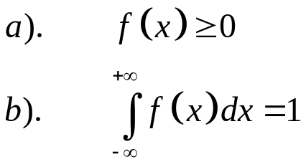
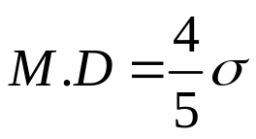
Properties of Normal Distribution
The function f(x) defining the normal distribution is a proper p.d.f. i.e.
Mean and variance of Normal Distribution are μ and σ² respectively.
The Median and the Mode of the Normal Distribution are each equal to the Mean of the distribution. i.e. Mean=Median=Mode
The Mean Deviation (M.D) of the Normal Distribution is approximately 4/5 of its standard deviation. i.e.

Slide 13
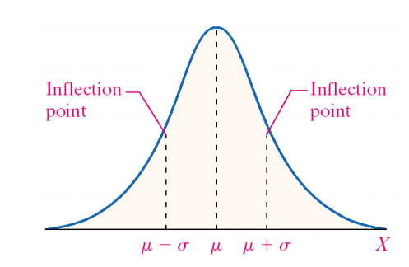
Properties of Normal Distribution
The Normal Distribution has points of inflection which are equidistant from the mean. i.e. μ – σ and μ + σ.
Definition: Point of Inflection: A point at which the concavity of the function changes.

Slide 14
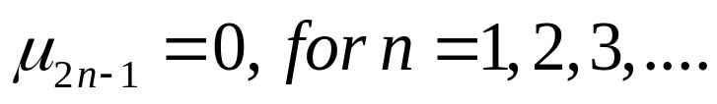
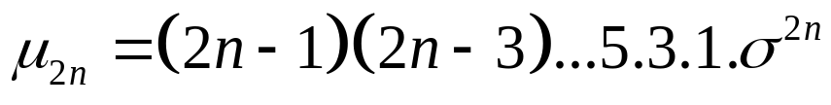
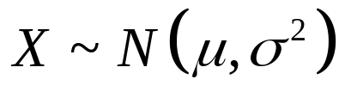

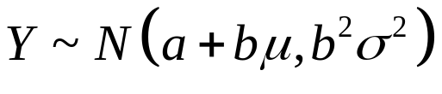
Properties of Normal Distribution
For the Normal Distribution, all odd order moments about mean are Zero. i.e.
For the Normal Distribution, even order moments about mean are given by:
If and if
then

Slide 15
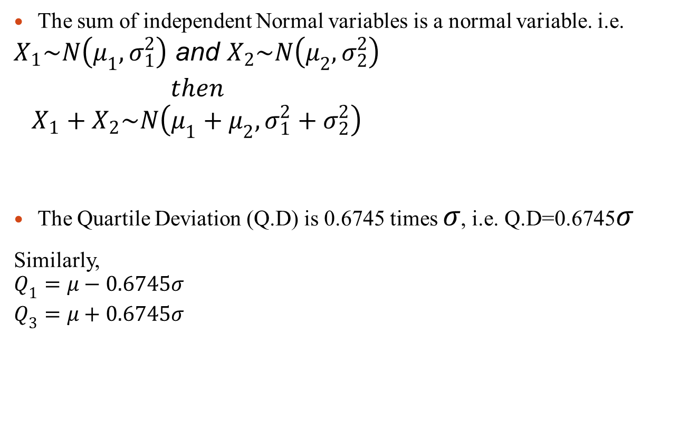
Properties of Normal Distribution
The sum of independent Normal variables is a normal variable. i.e.
$$\begin{matrix}X_{1}\sim N\left(μ_{1},σ_{1}^{2}\right) \text{and} X_{2}\sim N\left(μ_{2},σ_{2}^{2}\right) \\ then \\ X_{1}+X_{2}\sim N\left(μ_{1}+μ_{2},σ_{1}^{2}+σ_{2}^{2}\right)\end{matrix}$$
The Quartile Deviation (Q.D) is 0.6745 times $σ$, i.e. Q.D=0.6745$σ$
Similarly,
$$\begin{matrix}Q_{1}=μ−0.6745σ \\ Q_{3}=μ+0.6745σ\end{matrix}$$

Slide 16

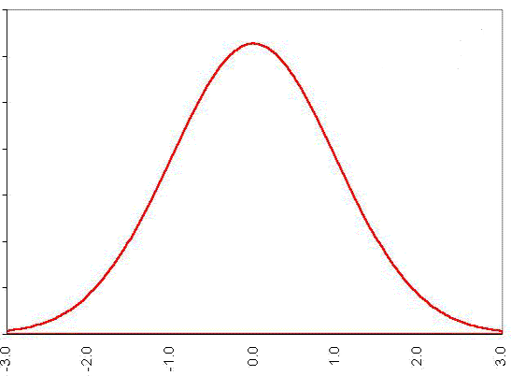
Properties of Normal Distribution
The Normal curve is asymptotic to the horizontal axis as
i.e. Normal Curve approaches but never really touches, the horizontal axis on either sides of the mean towards plus and minus infinity.

Slide 17

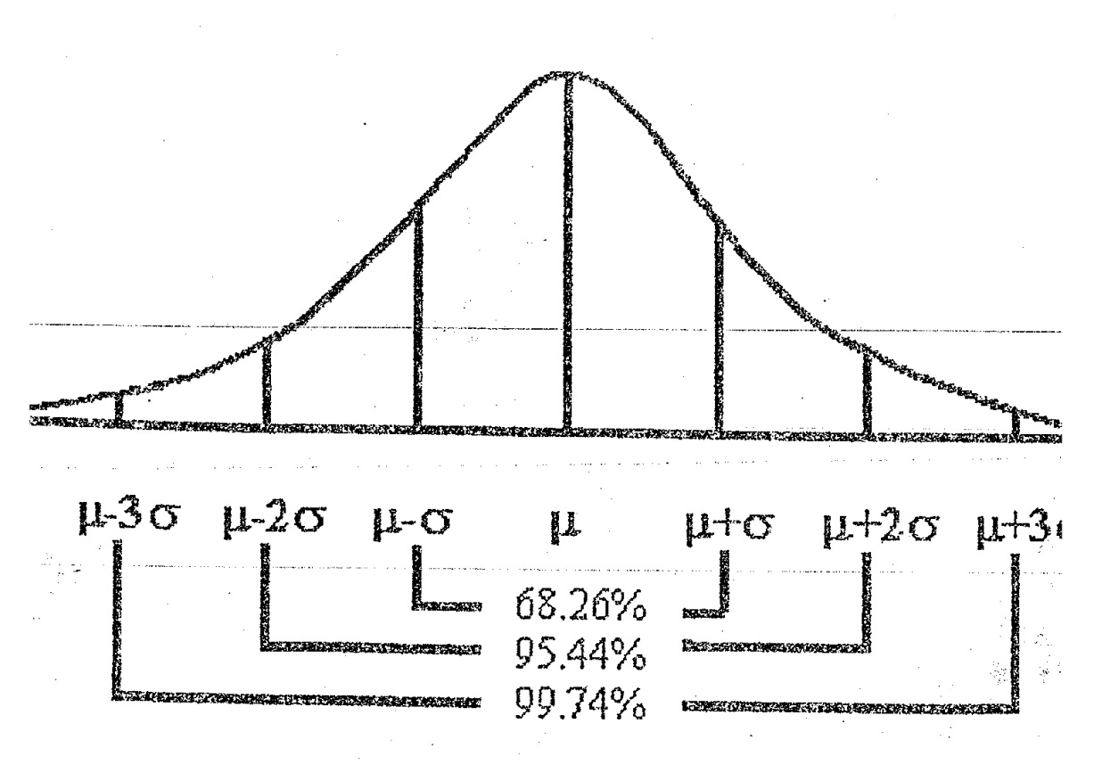
Properties of Normal Distribution
Empirical Rule:

Slide 18
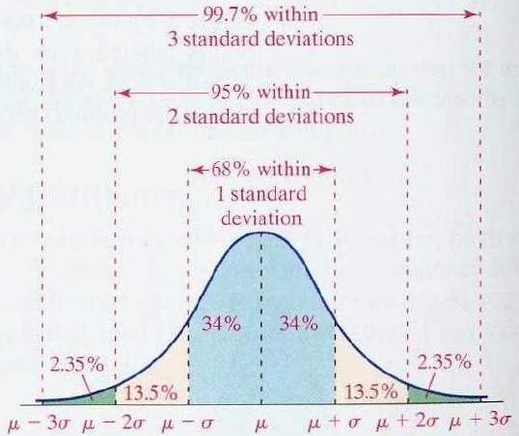
Properties of Normal Distribution
Empirical Rule:

Slide 19
Review
Let’s review the main concepts:
Normal Distribution
  Probability Density Function of Normal Distribution
  Properties of Normal Distribution
  Related examples

Slide 20
Next Lecture
In next lecture, we will study:
Finding Area under the Normal Distribution
Related examples
Normal Approximation to Binomial Distribution
Related examples

