Slide 1
MTH 161: Introduction To Statistics
Lecture 24
Dr. MUMTAZ AHMED

Slide 2
Review of Previous Lecture
In last lecture we discussed:
Poisson Probability Distribution
Related examples
Hypergeometric Distribution
Multinomial Distribution
Negative Binomial Distribution

Slide 3
Objectives of Current Lecture
In the current lecture:
Probability distributions of a Continuous random variable
Uniform Distribution
Related examples

Slide 4
Continuous Probability Distributions
Some important Continuous Probability Distributions are:
Uniform or Rectangular Distribution
Normal Distribution
t-Distribution
Exponential Distribution
Chi-square Distribution
Beta Distribution
Gamma Distribution

Slide 5
Uniform Distribution
A uniform distribution is a type of continuous random variable such that each possible value of X has exactly the same probability of occurring.
As a result the graph of the function is a horizontal line and forms a rectangle with the X axis. Hence, its secondary name the rectangular distribution.
In common with all continuous random variables the area under the
function between all the possible values of X is equal to 1 and as a result
it is possible to work out the probability density function of X, for all
uniform distributions using a simple formula.

Slide 6
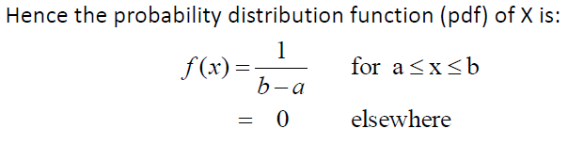
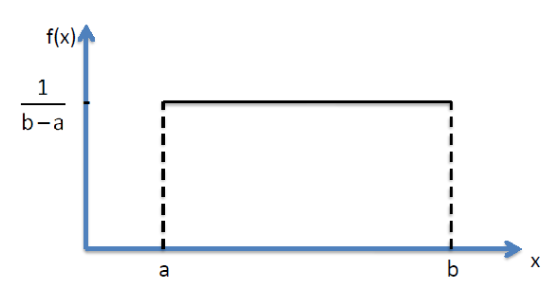
Uniform Distribution
Definition: Given that a continuous random variable X has possible values from a ≤ X ≤ b such that all possible values are equally likely, it is said to be uniformly distributed. i.e. X~U(a,b).
Note: Uniform Distribution has TWO parameters: ‘a’ and ‘b’.

Slide 7
Properties of Uniform Distribution
Properties:
Let X~U(a,b):
Mean of X is: (a+b)/2

Slide 8
Properties of Uniform Distribution
Properties:
Let X~U(a,b):
Variance of X is: (b-a)²/12

Slide 9
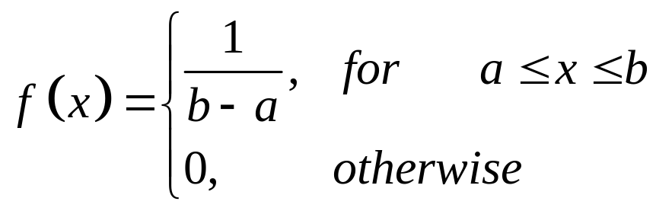
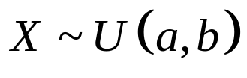
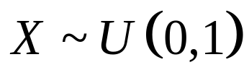
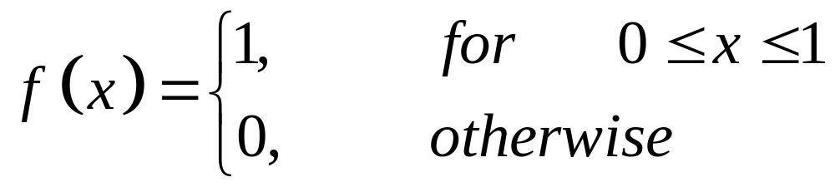
Standard Uniform Distribution
If then
When a=0 and b=1, i.e. then the Uniform distribution is called Standard Uniform Distribution and its probability density function is given by:

Slide 10
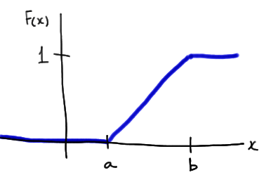
Cumulative Distribution Function of a Uniform R.V
The cumulative distribution function of a uniform random variable X is:
F(x)=(x−a)/(b−a)
for two constants a and b such that a < x < b.
From fig:
F(x) = 0 when x is less than the lower endpoint of the support (a, in this case).
F(x) = 1 when x is greater than the upper endpoint of the support (b, in this case).
The slope of the line between a and b is, 1/(b−a).

Slide 11
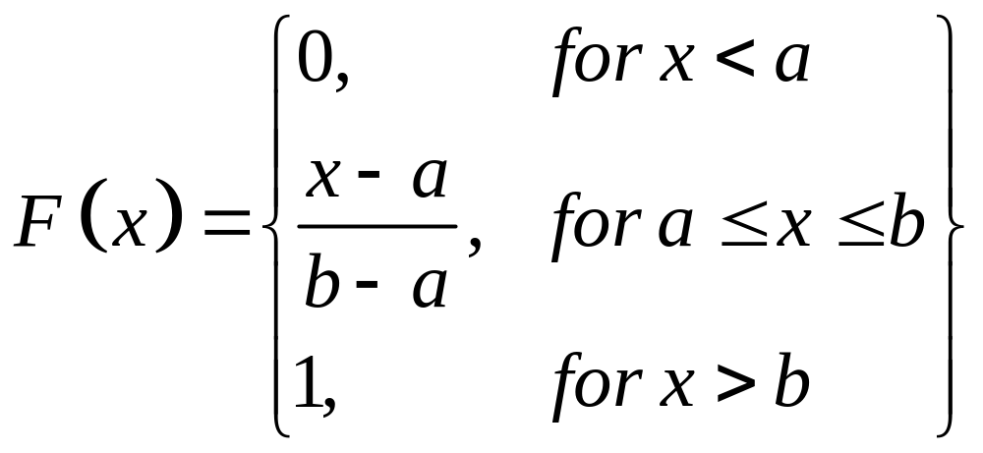
Cumulative Distribution Function of a Uniform R.V
The cumulative distribution function of a uniform random variable X is:
F(x)=(x−a)/(b−a)
for two constants a and b such that a < x < b.

Slide 12
Uniform Applications
Perhaps not surprisingly, the uniform distribution is not particularly useful in describing much of the randomness we see in the natural world.
Its claim to fame is instead its usefulness in random number generation.
That is, approximate values of the U(0,1) distribution can be simulated on most computers using a random number generator.
The generated numbers can then be used to randomly assign people to treatments in experimental studies, or to randomly select individuals for participation in a survey.

Slide 13
Uniform Applications
Before we explore the above-mentioned applications of the U(0,1) distribution, it should be noted that the random numbers generated from a computer are not technically truly random, because they are generated from some starting value (called the seed).
If the same seed is used again and again, the same sequence of random numbers will be generated.
It is for this reason that such random number generation is sometimes referred to as pseudo-random number generation.
Yet, despite a sequence of random numbers being pre-determined by a seed number, the numbers do behave as if they are truly randomly generated, and are therefore very useful in the above-mentioned applications.
They would probably not be particularly useful in the applications of internet security, however!

Slide 14
Generating Random Numbers in MS-Excel
Generate uniform Random numbers between 0 and 1, using Excel built-in function: ‘=Rand()’
Generate uniform Random numbers between A and B, using Excel command: ‘=A+Rand()*(B-A)’
For example:
To generate random numbers b/w 10 and 20, replace A by 10 and B by 20 in the above formula.
Do the Demo in Excel.

Slide 15
Generating Random Numbers in MS-Excel
Generating Random numbers using ‘Analysis Tool Pack’.
Activate Data analysis tool pack (if it is not already active).
Open Data Analysis tool Pack from ‘Data’ Tab.
Select Random Numbers Generation.
Select appropriate options from the dialogue box.
Do the demo in Excel.

Slide 16
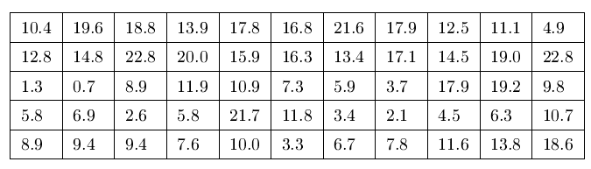
Uniform Applications
Example: Consider the data on 55 smiling times in seconds of an eight week old baby.
We assume that smiling times, in seconds, follow a uniform distribution between 0 and 23 seconds, inclusive.
This means that any smiling time from 0 to and including 23 seconds is Equally Likely.

Slide 17
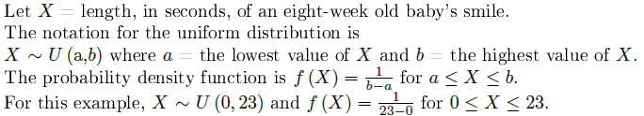
Uniform Applications
Example: Consider the data on 55 smiling times in seconds of an eight week old baby.

Slide 18
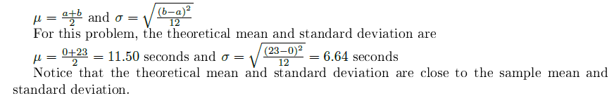
Uniform Applications
Example: Consider the data on 55 smiling times in seconds of an eight week old baby.

Slide 19
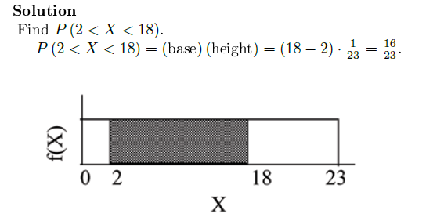
Uniform Applications

Slide 20
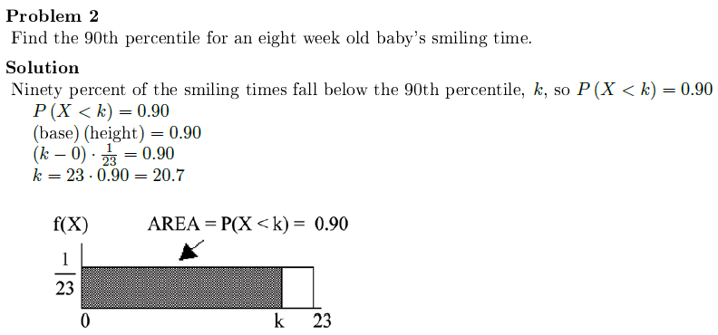
Uniform Applications

Slide 21
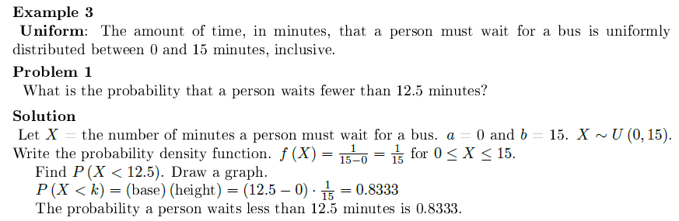
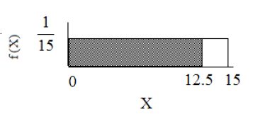
Uniform Applications

Slide 22
Review
Let’s review the main concepts:
Probability distributions of a Continuous random variable
Uniform Distribution
Properties of Uniform Distribution
Generating Random numbers in MS-Excel
Related examples

Slide 23
Next Lecture
In next lecture, we will study:
Normal Distribution
Probability Density Function of Normal Distribution
Properties of Normal Distribution
Related examples

