Slide 1
MTH 161: Introduction To Statistics
Lecture 21
Dr. MUMTAZ AHMED

Slide 2
Review of Previous Lecture
In last lecture we discussed:
Introduction to Random variables
Distribution Function
Discrete Random Variables
Continuous Random Variables

Slide 3
Objectives of Current Lecture
In the current lecture:
Continuous Random Variables
Mathematical Expectation of a random variable
Law of large numbers
Related examples

Slide 4
Continuous Random Variable
A random variable X is said to be continuous if it can assume every possible value in an interval [a, b], a<b.
Examples:
The height of a person
The temperature at a place
The amount of rainfall
Time to failure for an electronic system

Slide 5
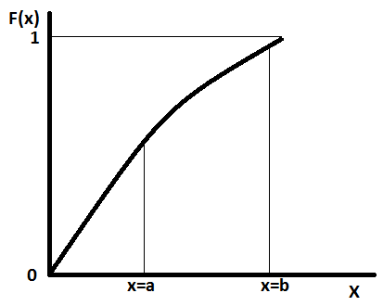

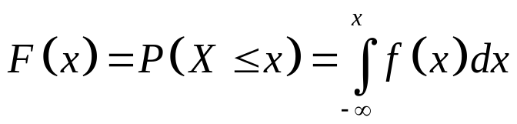
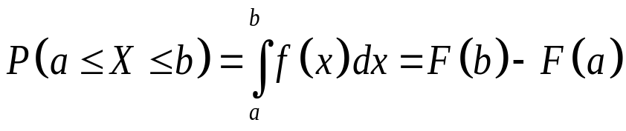
Probability Density Function of a Continuous Random Variable
The probability density function of a continuous random variable is a function which can be integrated to obtain the probability that the random variable takes a value in a given interval.
More formally, the probability density
function, f(x), of a continuous random
variable X is the derivative of the
cumulative distribution function F(x), i.e.
Where,

Slide 6
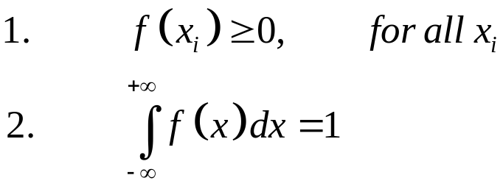
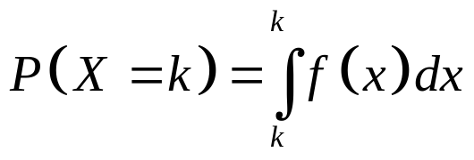
Probability Density Function of a Continuous Random Variable
Properties:
Note: The probability of a continuous r.v. X taking any particular value ‘k’ is always zero.
That is why probability for a continuous r.v. is measurable only over a given interval.
Further, since for a continuous r.v. X, P(X=x)=0, for every x, the four probabilities are regarded the same.

Slide 7
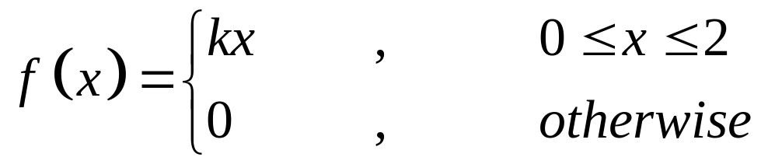
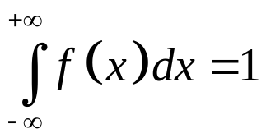
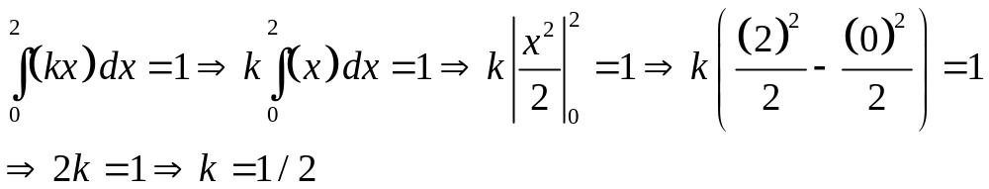
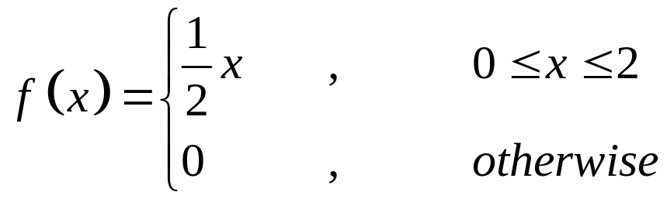
Probability Density Function of a Continuous Random Variable
Example: Find the value of k so that the function f(x) defined as follows, may be a density function.
Solution: Since we have,
So,
Hence the density function becomes,

Slide 8

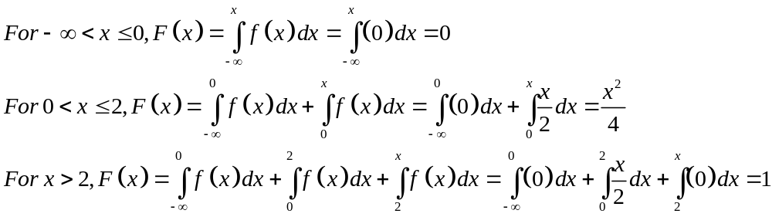
Probability Density Function of a Continuous Random Variable
Example: Find the distribution function of the following probability density function.
Solution: The distribution function is:
So,

Slide 9
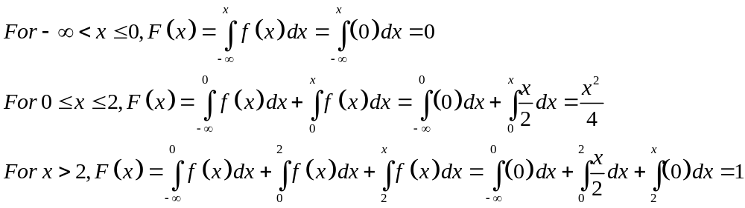
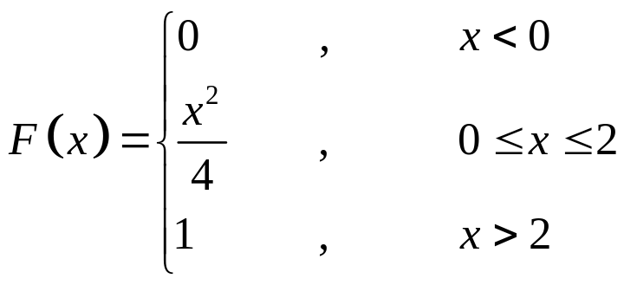
Probability Density Function of a Continuous Random Variable
So the distribution function is:

Slide 10
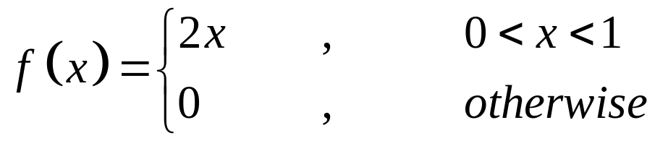
Probability Density Function of a Continuous Random Variable
Example: A r.v. X is of continuous type with p.d.f.
Calculate:
P(X=1/2)
P(X<=1/2)
P(X>1/4)

Slide 11
Probability Density Function of a Continuous Random Variable
Example: A r.v. X is of continuous type with p.d.f.
Calculate:
P(1/4<=X<=1/2)

Slide 12
Probability Density Function of a Continuous Random Variable
Example: A r.v. X is of continuous type with p.d.f.
Calculate:
P(X<=1/2 | 1/3<=X<=2/3)

Slide 13
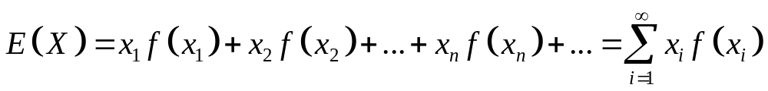
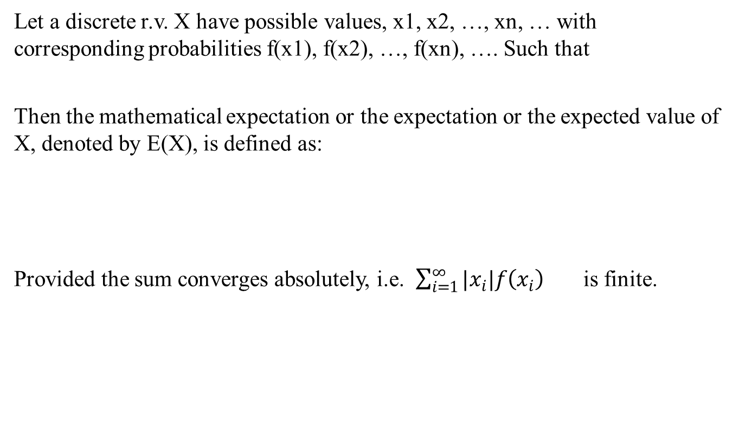
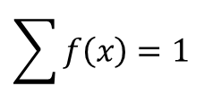
Mathematical Expectation of a Random Variable
Let a discrete r.v. X have possible values, x1, x2, …, xn, … with corresponding probabilities f(x1), f(x2), …, f(xn), …. Such that
Then the mathematical expectation or the expectation or the expected value of X, denoted by E(X), is defined as:
Provided the sum converges absolutely, i.e. $\sum_{i=1}^{∞}{|x_{i}|f\left(x_{i}\right)}$ is finite.
$$\sum{f\left(x\right)=1}$$

Slide 14
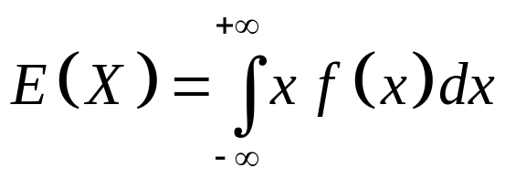
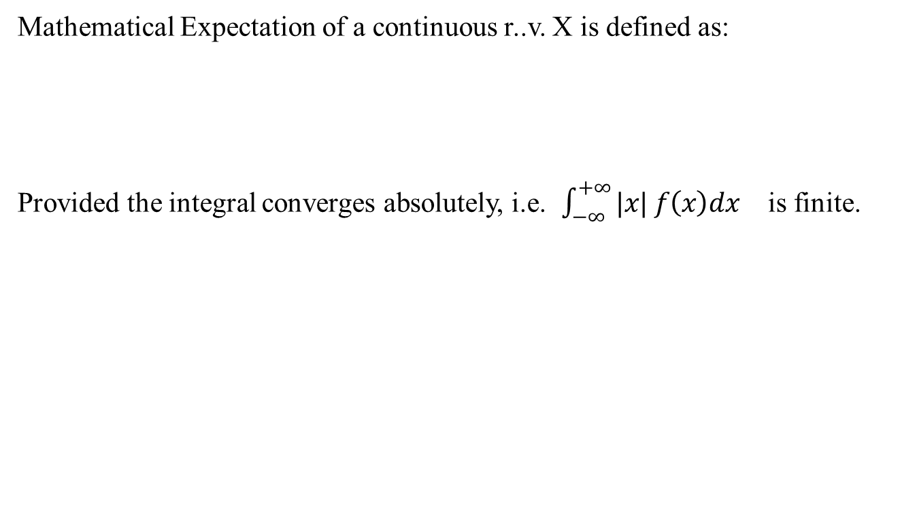
Mathematical Expectation of a Random Variable
Mathematical Expectation of a continuous r..v. X is defined as:
Provided the integral converges absolutely, i.e. $\int_{−∞}^{+∞}{|x| f\left(x\right)dx}$ is finite.

Slide 15
Properties of Mathematical Expectation
Properties of mathematical Expectation of a random variable:
E(a)=a, where ‘a’ is any constant.
E(aX+b)=a E(X)+b , where a and b both are constants
E(X+Y)=E(X)+E(Y)
E(X-Y)=E(X)-E(Y)
If X and Y are independent r.v’s then
E(XY)=E(X). E(Y)

Slide 16
Mathematical Expectation: Examples
Example: What is the mathematical expectation of the number of heads when 3 fair coins are tossed?
Solution: Here S={HHH, HHT, HTH, THH, HTT, THT, TTH, TTT}
Let X= number of heads then x=0,1,2,3
Then X has the following p.d.f:
(xi) | f(xi)
0 | 1/8
1 | 3/8
2 | 3/8
3 | 1/8

Slide 17
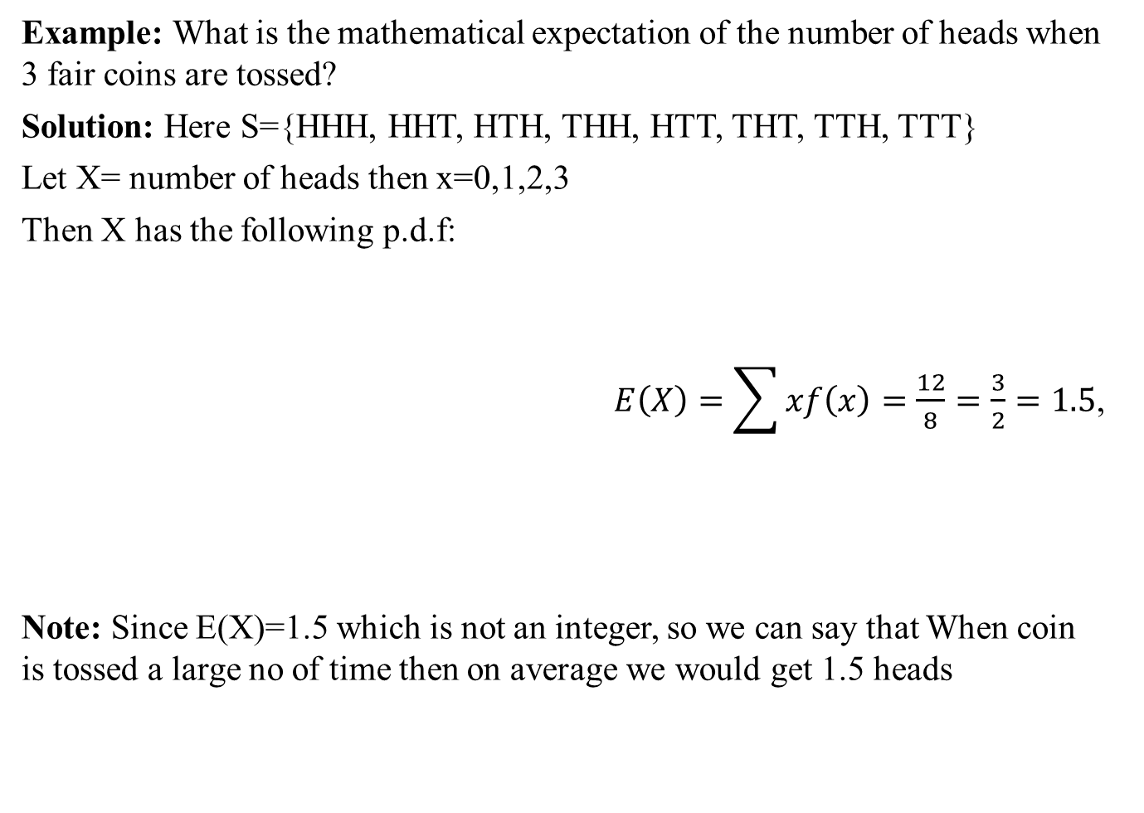
Mathematical Expectation: Examples
Example: What is the mathematical expectation of the number of heads when 3 fair coins are tossed?
Solution: Here S={HHH, HHT, HTH, THH, HTT, THT, TTH, TTT}
Let X= number of heads then x=0,1,2,3
Then X has the following p.d.f:
$E\left(X\right)=\sum{xf\left(x\right)=\frac{12}{8}=\frac{3}{2}=1.5}$,
Note: Since E(X)=1.5 which is not an integer, so we can say that When coin is tossed a large no of time then on average we would get 1.5 heads
(xi) | f(xi) | x*f(x)
0 | 1/8 | 0
1 | 3/8 | 3/8
2 | 3/8 | 6/8=3/4
3 | 1/8 | 3/8
Total |  | 12/8

Slide 18
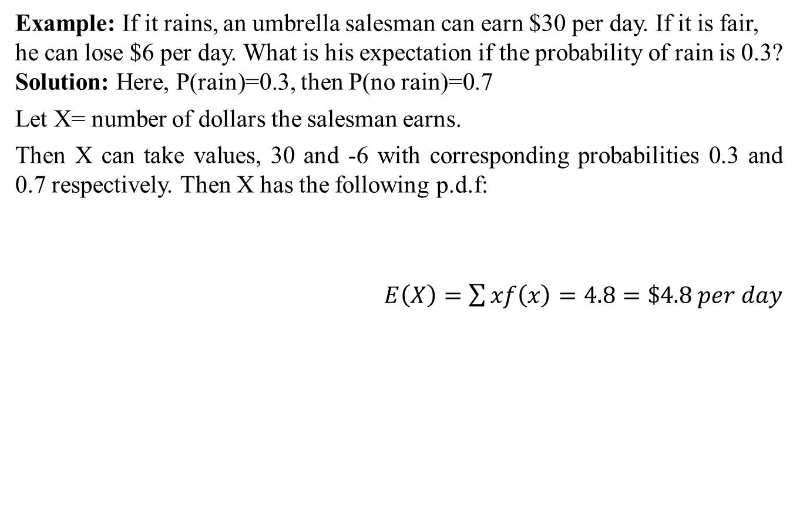
Mathematical Expectation: Examples
Example: If it rains, an umbrella salesman can earn $30 per day. If it is fair, he can lose $6 per day. What is his expectation if the probability of rain is 0.3? Solution: Here, P(rain)=0.3, then P(no rain)=0.7
Let X= number of dollars the salesman earns.
Then X can take values, 30 and -6 with corresponding probabilities 0.3 and 0.7 respectively. Then X has the following p.d.f:
$E\left(X\right)=\sum{xf\left(x\right)=4.8=\$4.8 per day}$
(xi) | f(xi) | x*f(x)
30 | 0.3 | 9
-6 | 0.7 | -4.2
Total |  | 4.8

Slide 19
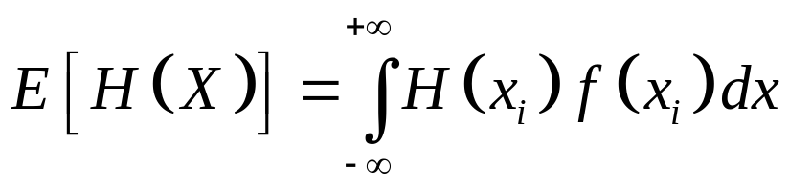
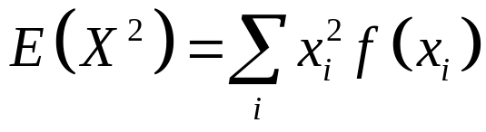
Expectation of a Function of Random Variable
Let H(X) be a function of the r.v. X. Then H(X) is also a r.v. and also has an expected value (as any function of a r.v. is also a r.v.).
If X is a discrete r.v. with p.d f(x) then
If X is a continuous r.v. with p.d.f. f(x) then
If H(X)=X², then

Slide 20
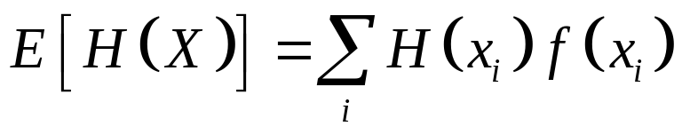
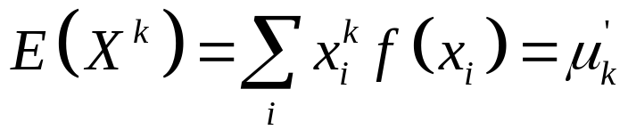
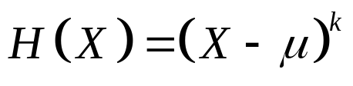
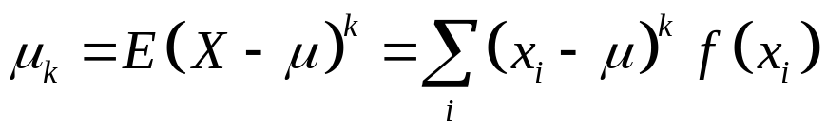
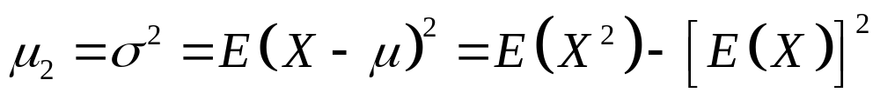
Expectation of a Function of Random Variable
We havef
If H(X)=X², then
If H(X)=X^{k}, then
This is called ‘k-th moment about origin of the r.v. X.
If , then
This is called ‘k-th moment about Mean of the r.v. X
Variance:

Slide 21
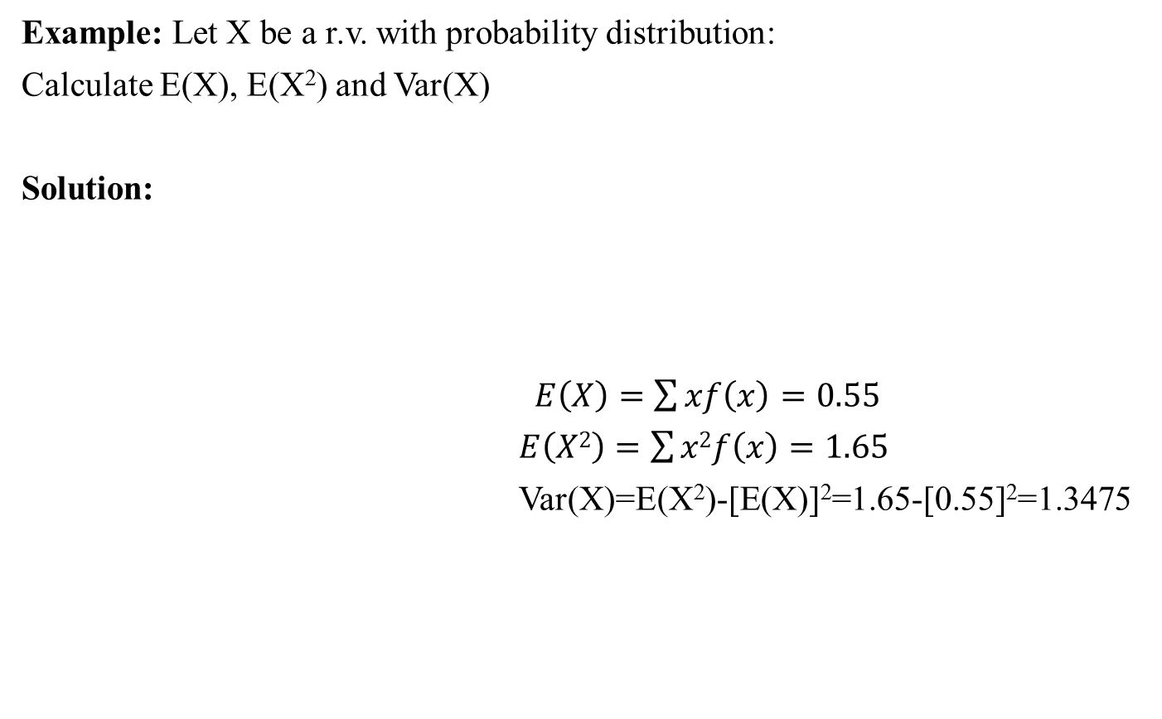
Mathematical Expectation: Examples
Example: Let X be a r.v. with probability distribution:
Calculate E(X), E(X²) and Var(X)
Solution:
$E\left(X\right)=\sum{xf\left(x\right)=0.55}$
$E\left(X2\right)=\sum{x2f\left(x\right)=1.65}$
Var(X)=E(X²)-[E(X)]²=1.65-[0.55]²=1.3475
x | f(x)
-1 | 0.125
0 | 0.5
1 | 0.2
2 | 0.05
3 | 0.125
x | f(x) | x*f(x) | x²*f(x)
-1 | 0.125 | -0.125 | 0.125
0 | 0.5 | 0 | 0
1 | 0.2 | 0.2 | 0.2
2 | 0.05 | 0.1 | 0.2
3 | 0.125 | 0.375 | 1.125
Total= |  | 0.55 | 1.65

Slide 22
Review
Let’s review the main concepts:
Continuous Random Variable
Mathematical Expectation of a random variable
Related examples

Slide 23
Next Lecture
In next lecture, we will study:
Law of large numbers
Probability distribution of a discrete random variable
Binomial Distribution
Related examples

