Slide 1
MTH 161: Introduction To Statistics
Lecture 19
Dr. MUMTAZ AHMED

Slide 2
Review of Previous Lecture
In last lecture we discussed:
Definition of Probability and its properties
Some basic questions related to probability
Laws of probability
More examples of probability

Slide 3
Objectives of Current Lecture
In the current lecture:
Some More Examples of Probability
Conditional Probability
Independent and Dependent Events
Related Examples

Slide 4
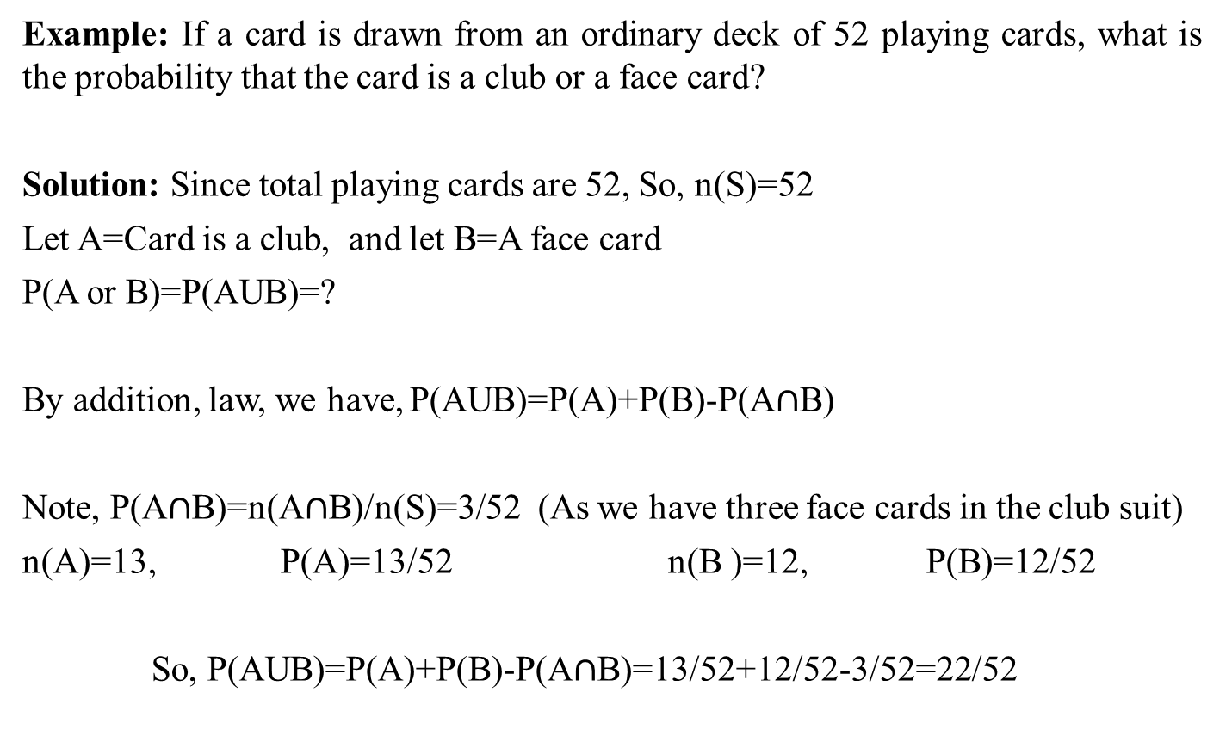
Probability: Card Example

Slide 5
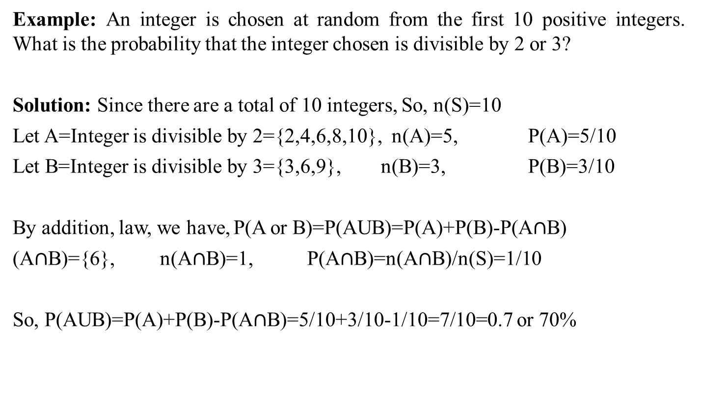
Probability: Examples

Slide 6
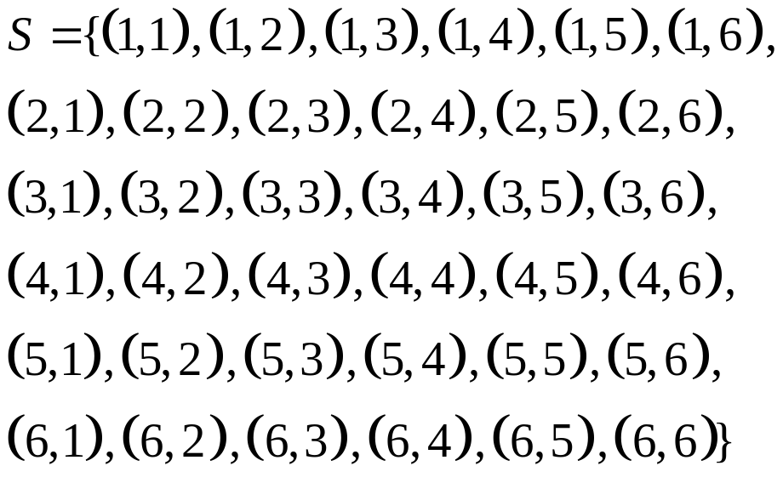
Probability: Examples
Example: A pair of dice are thrown, what is the probability of getting a total of either 5 or 11?
Solution: Here n(S)=36
Let A=a total of 5 occurs
={(1,4), (2,3), (3,2), (4,1)}
n(A)=4, P(A)=4/36
Let B= a total of 11 occurs
B={(5,6), (6,5)}, n(B)=2
P(B)=2/36
Note that A & B are mutually exclusive events,
So
P(AUB)=P(A)+P(B)=4/36+2/36=6/36=1/6

Slide 7
Probability: Examples
Example: Three horses A, B and C are in a race; A is twice as likely to win as B and B is also twice as likely to win as C. What is the probability that either A or B wins?
Solution: Let P(C)=p then P(B)=2P(C)=2p and P(A)=2P(B)=2(2p)=4p
Since A, B and C are mutually exclusive and collectively exhaustive events,
So P(A)+P(B)+P(C)=1
p+2p+4p=1, 7p=1, or p=1/7
So, P(C)=p=1/7, P(B)=2p=2/7, P(A)=4p=4/7
P(A or B wins)= P(AUB)=P(A)+P(B)=4/7+2/7=6/7

Slide 8
Conditional Probability
The sample space for an experiment must often be changed when some additional information related to the outcome of the experiment is received.
The effect of such additional information is to reduce the sample space by excluding some outcomes as being impossible which before receiving the information were believed possible.
The probabilities associated with such a reduced sample space are called conditional probabilities.

Slide 9
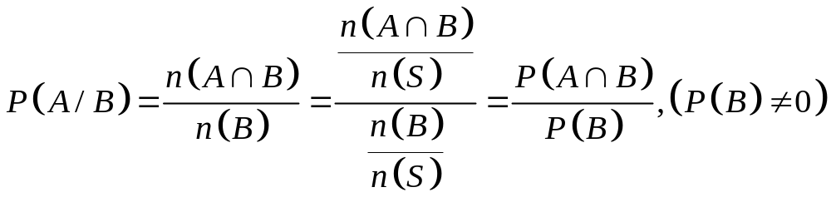
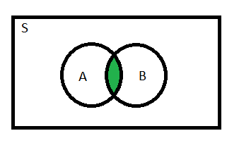
Conditional Probability
Example: Let us consider the die throwing experiment with sample space=S={1,2,3,4,5,6}
Suppose we wish to know the probability of the outcome that the die shows 6, say event A. So, P(A)=1/6=0.166
If before seeing the outcome, we are told that the die shows an even number of dots, say event B. Then this additional information that the die shows an even number excludes the outcomes 1,3 and 5 and thereby reduces the original sample space to only three numbers {2,4,6}. So P(6)=1/3=0.333
We call 1/3 or 0.333 as the conditional probability of event A because it is computed under the condition that the die has shown even number of dots.
P(Die shows 6/die shows even numbers)=P(A/B)=1/3=0.333

Slide 10
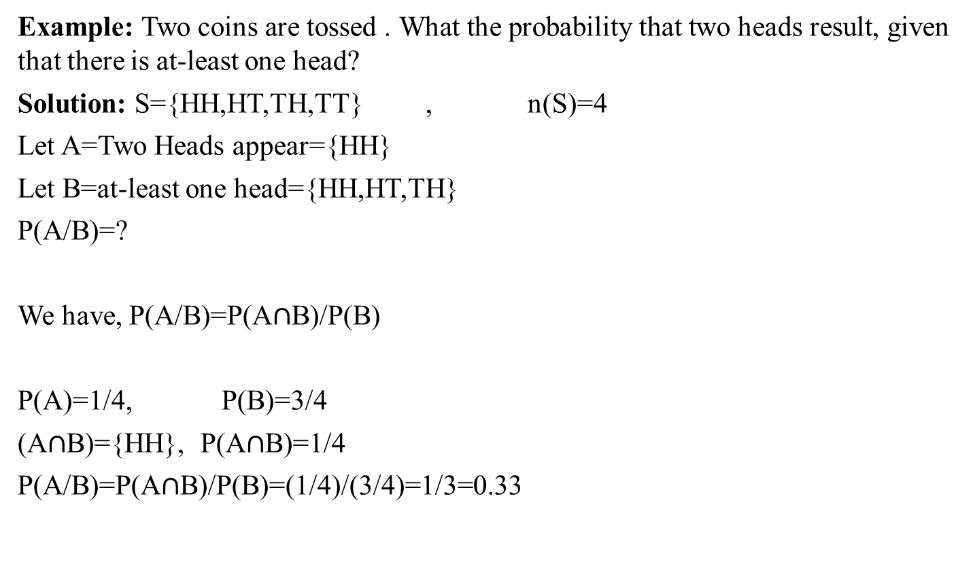
Conditional Probability: Examples
Example: Two coins are tossed . What the probability that two heads result, given that there is at-least one head?
Solution: S={HH,HT,TH,TT} , n(S)=4
Let A=Two Heads appear={HH}
Let B=at-least one head={HH,HT,TH}
P(A/B)=?
We have, P(A/B)=P(A$∩$B)/P(B)
P(A)=1/4, P(B)=3/4
(A$∩$B)={HH}, P(A$∩$B)=1/4
P(A/B)=P(A$∩$B)/P(B)=(1/4)/(3/4)=1/3=0.33

Slide 11
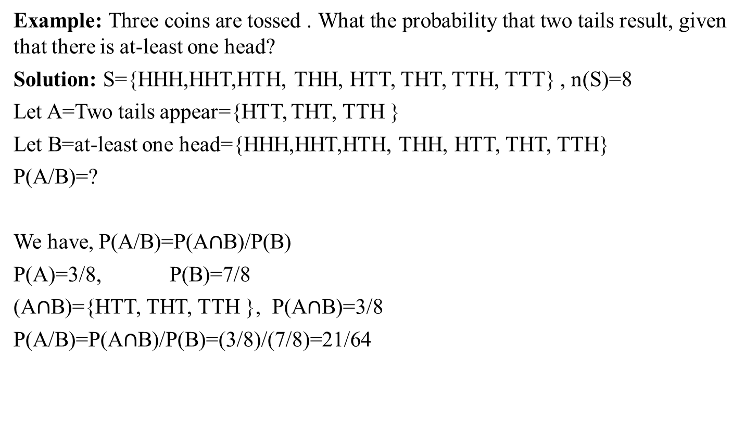
Conditional Probability: Examples
Example: Three coins are tossed . What the probability that two tails result, given that there is at-least one head?
Solution: S={HHH,HHT,HTH, THH, HTT, THT, TTH, TTT} , n(S)=8
Let A=Two tails appear={HTT, THT, TTH }
Let B=at-least one head={HHH,HHT,HTH, THH, HTT, THT, TTH}
P(A/B)=?
We have, P(A/B)=P(A$∩$B)/P(B)
P(A)=3/8, P(B)=7/8
(A$∩$B)={HTT, THT, TTH }, P(A$∩$B)=3/8
P(A/B)=P(A$∩$B)/P(B)=(3/8)/(7/8)=21/64

Slide 12
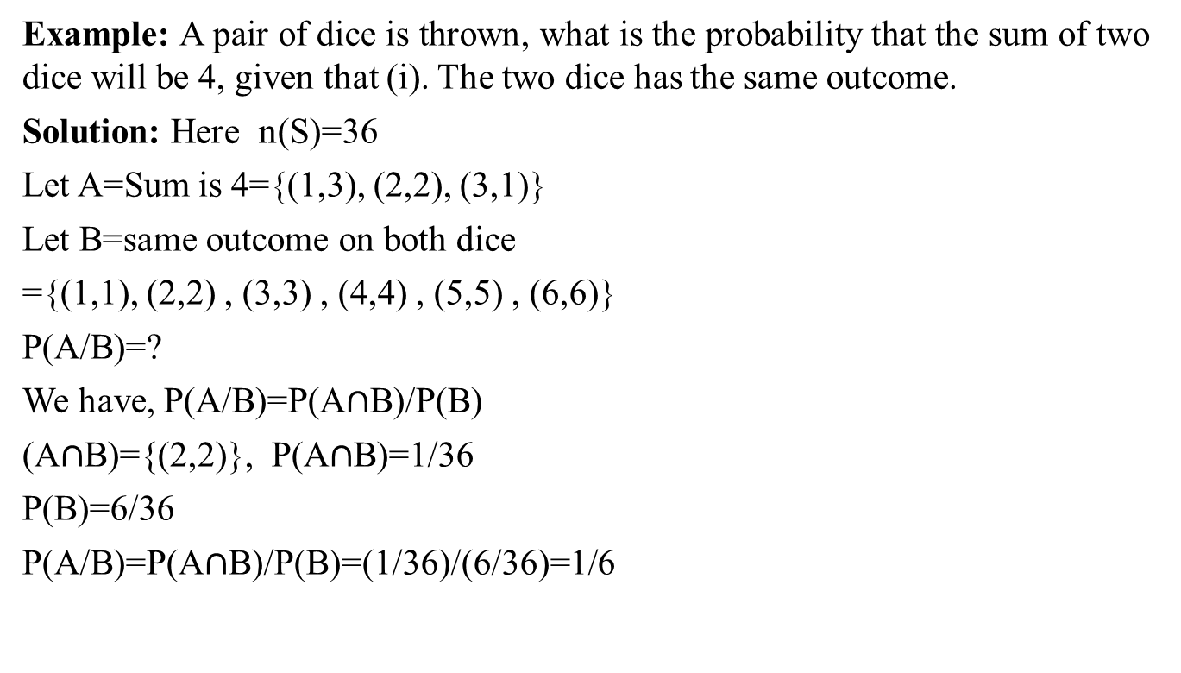
Conditional Probability: Examples
Example: A pair of dice is thrown, what is the probability that the sum of two dice will be 4, given that (i). The two dice has the same outcome.
Solution: Here n(S)=36
Let A=Sum is 4={(1,3), (2,2), (3,1)}
Let B=same outcome on both dice
={(1,1), (2,2) , (3,3) , (4,4) , (5,5) , (6,6)}
P(A/B)=?
We have, P(A/B)=P(A$∩$B)/P(B)
(A$∩$B)={(2,2)}, P(A$∩$B)=1/36
P(B)=6/36
P(A/B)=P(A$∩$B)/P(B)=(1/36)/(6/36)=1/6

Slide 13
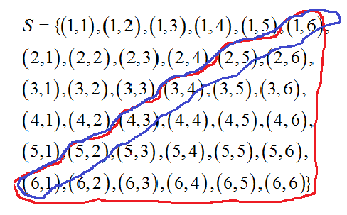
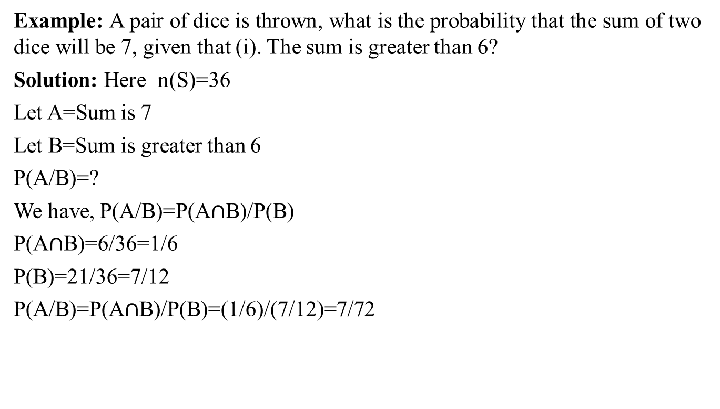
Conditional Probability: Examples
Example: A pair of dice is thrown, what is the probability that the sum of two dice will be 7, given that (i). The sum is greater than 6?
Solution: Here n(S)=36
Let A=Sum is 7
Let B=Sum is greater than 6
P(A/B)=?
We have, P(A/B)=P(A$∩$B)/P(B)
P(A$∩$B)=6/36=1/6
P(B)=21/36=7/12
P(A/B)=P(A$∩$B)/P(B)=(1/6)/(7/12)=7/72

Slide 14
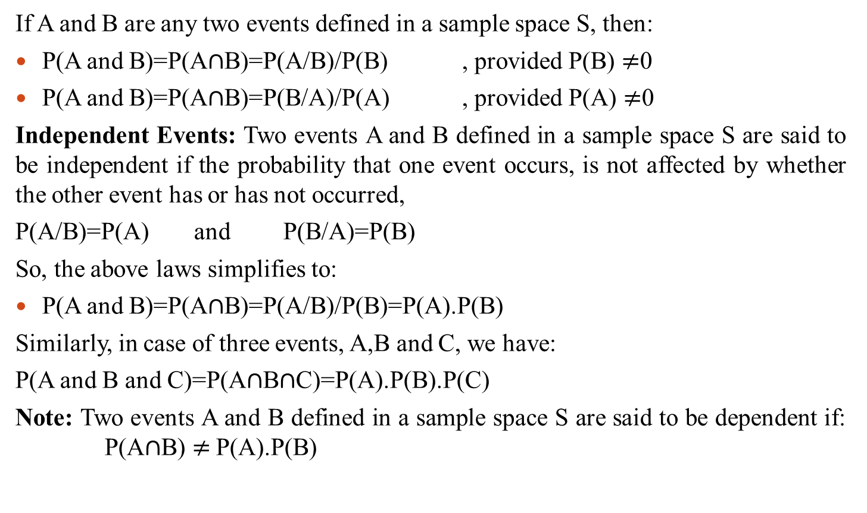
Multiplication Law
If A and B are any two events defined in a sample space S, then:
P(A and B)=P(A$∩$B)=P(A/B)/P(B) , provided P(B)$≠$0
P(A and B)=P(A$∩$B)=P(B/A)/P(A) , provided P(A) $≠$0
Independent Events: Two events A and B defined in a sample space S are said to be independent if the probability that one event occurs, is not affected by whether the other event has or has not occurred,
P(A/B)=P(A) and P(B/A)=P(B)
So, the above laws simplifies to:
P(A and B)=P(A$∩$B)=P(A/B)/P(B)=P(A).P(B)
Similarly, in case of three events, A,B and C, we have:
P(A and B and C)=P(A$∩$B$∩$C)=P(A).P(B).P(C)
Note: Two events A and B defined in a sample space S are said to be dependent if: P(A$∩$B)$≠$P(A).P(B)

Slide 15
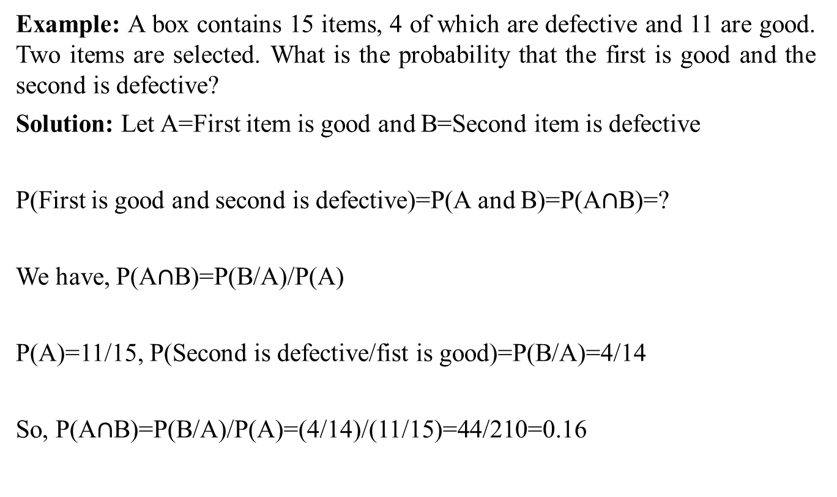
Multiplication Law: Examples
Example: A box contains 15 items, 4 of which are defective and 11 are good. Two items are selected. What is the probability that the first is good and the second is defective?
Solution: Let A=First item is good and B=Second item is defective
P(First is good and second is defective)=P(A and B)=P(A$∩$B)=?
We have, P(A$∩$B)=P(B/A)/P(A)
P(A)=11/15, P(Second is defective/fist is good)=P(B/A)=4/14
So, P(A$∩$B)=P(B/A)/P(A)=(4/14)/(11/15)=44/210=0.16

Slide 16
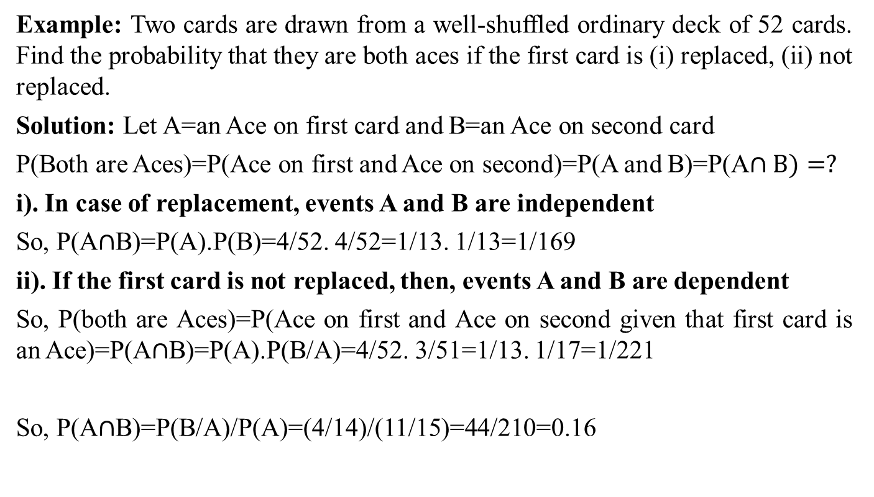
Multiplication Law: Examples
Example: Two cards are drawn from a well-shuffled ordinary deck of 52 cards. Find the probability that they are both aces if the first card is (i) replaced, (ii) not replaced.
Solution: Let A=an Ace on first card and B=an Ace on second card
P(Both are Aces)=P(Ace on first and Ace on second)=P(A and B)=P(A$∩B)=?$
i). In case of replacement, events A and B are independent
So, P(A$∩$B)=P(A).P(B)=4/52. 4/52=1/13. 1/13=1/169
ii). If the first card is not replaced, then, events A and B are dependent
So, P(both are Aces)=P(Ace on first and Ace on second given that first card is an Ace)=P(A$∩$B)=P(A).P(B/A)=4/52. 3/51=1/13. 1/17=1/221
So, P(A$∩$B)=P(B/A)/P(A)=(4/14)/(11/15)=44/210=0.16

Slide 17
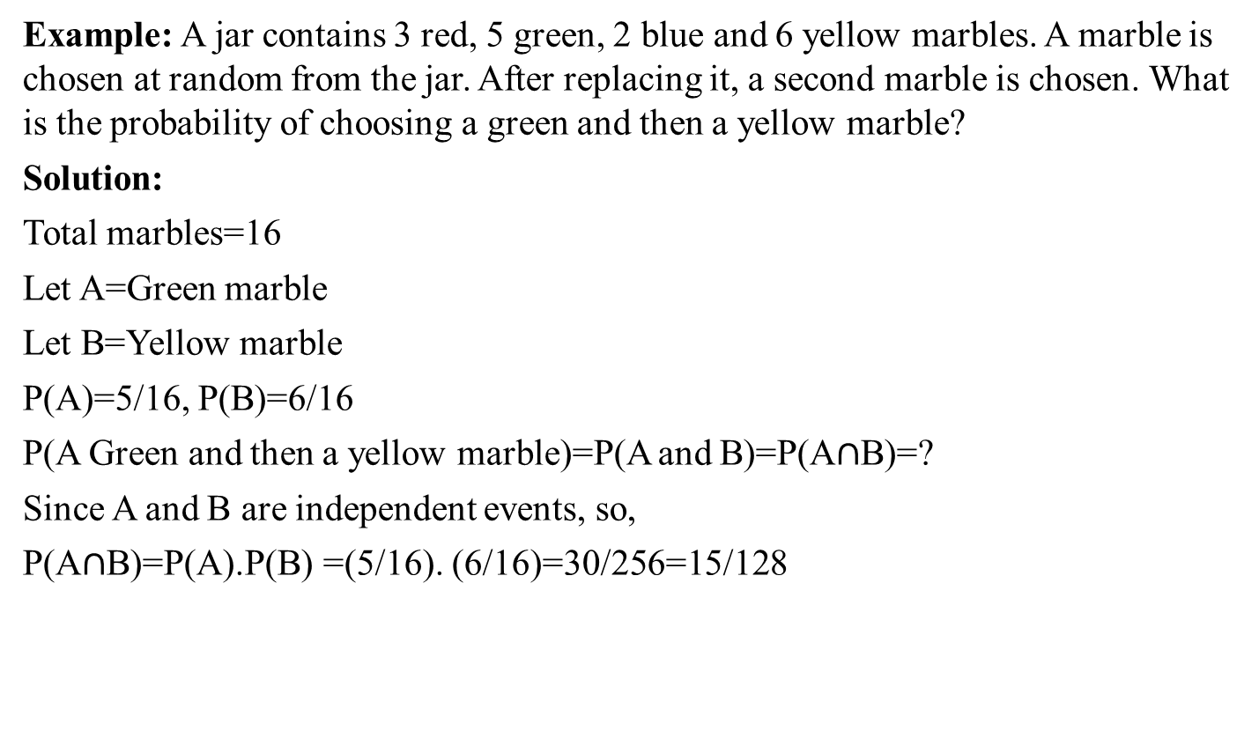
Multiplication Law: Examples
Example: A jar contains 3 red, 5 green, 2 blue and 6 yellow marbles. A marble is chosen at random from the jar. After replacing it, a second marble is chosen. What is the probability of choosing a green and then a yellow marble?
Solution:
Total marbles=16
Let A=Green marble
Let B=Yellow marble
P(A)=5/16, P(B)=6/16
P(A Green and then a yellow marble)=P(A and B)=P(A$∩$B)=?
Since A and B are independent events, so,
P(A$∩$B)=P(A).P(B) =(5/16). (6/16)=30/256=15/128

Slide 18
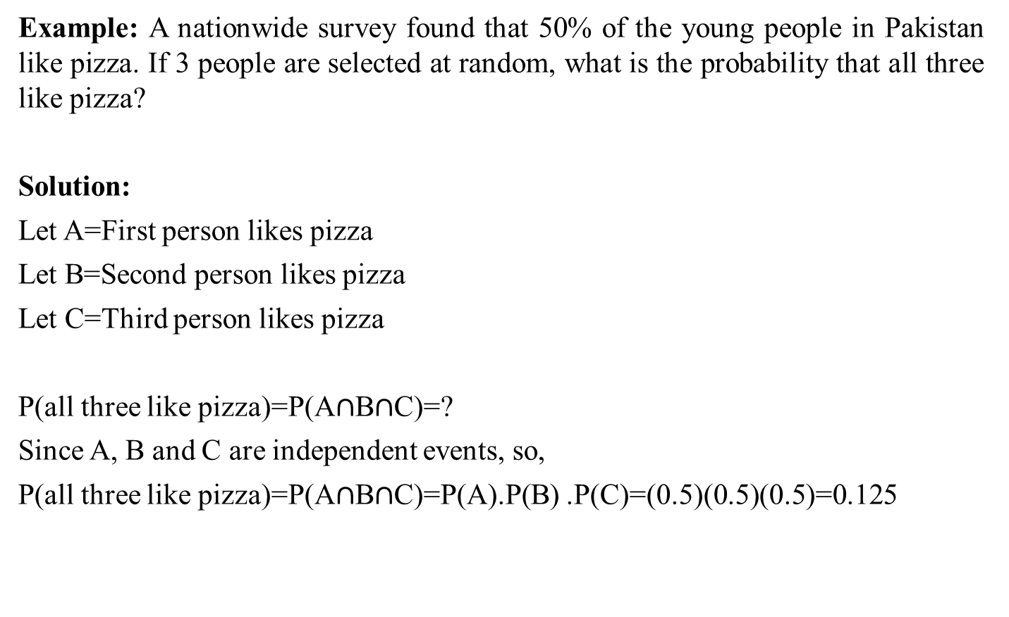
Multiplication Law: Examples
Example: A nationwide survey found that 50% of the young people in Pakistan like pizza. If 3 people are selected at random, what is the probability that all three like pizza?
Solution:
Let A=First person likes pizza
Let B=Second person likes pizza
Let C=Third person likes pizza
P(all three like pizza)=P(A$∩$B$∩$C)=?
Since A, B and C are independent events, so,
P(all three like pizza)=P(A$∩$B$∩$C)=P(A).P(B) .P(C)=(0.5)(0.5)(0.5)=0.125

Slide 19
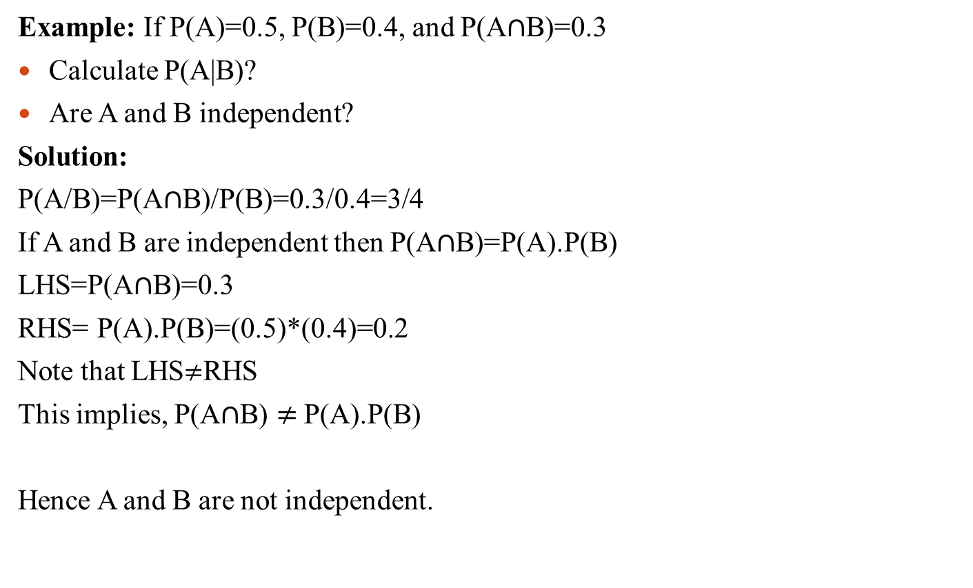
Multiplication Law: Examples
Example: If P(A)=0.5, P(B)=0.4, and P(A$∩$B)=0.3
Calculate P(A|B)?
Are A and B independent?
Solution:
P(A/B)=P(A$∩$B)/P(B)=0.3/0.4=3/4
If A and B are independent then P(A$∩$B)=P(A).P(B)
LHS=P(A$∩$B)=0.3
RHS= P(A).P(B)=(0.5)*(0.4)=0.2
Note that LHS$≠$RHS
This implies, P(A$∩$B) $≠$P(A).P(B)
Hence A and B are not independent.

Slide 20
Review
Let’s review the main concepts:
Conditional probability
Independent and Dependent Events
Related Examples

Slide 21
Next Lecture
In next lecture, we will study:
Introduction to Random variables
Discrete Random Variables
Continuous Random Variables
Distribution Function

