Slide 1
MTH 161: Introduction To Statistics
Lecture 18
Dr. MUMTAZ AHMED

Slide 2
Review of Previous Lecture
In last lecture we discussed:
Describing a Frequency Distribution
Introduction to Probability
Definition and Basic concepts of probability

Slide 3
Objectives of Current Lecture
In the current lecture:
Definition of Probability and its properties
Some basic questions related to probability
Laws of probability
More examples of probability

Slide 4

Probability
Probability of an event A:
Let S be a sample space and A be an event in the sample space. Then the probability of occurrence of event A is defined as:
P(A)=Number of sample points in A/ Total number of sample points
Symbolically, P(A)=n(A)/n(S)
Properties of Probability of an event:
P(S)=1 for the sure event S
For any event A,
If A and B are mutually exclusive events, then P(AUB)=P(A)+P(B)

Slide 5
Probability: Examples
Example: A fair coin is tossed once, Find the probabilities of the following events:
An head occurs
A tail occurs
Solution: Here S={H,T}, so, n(S)=2
Let A be an event representing the occurrence of an Head, i.e. A={H}, n(A)=1
P(A)=n(A)/n(S)=1/2=0.5 or 50%
Let B be an event representing the occurrence of a Tail, i.e. B={T}, n(B)=1
P(B)=n(B)/n(S)=1/2=0.5 or 50%.

Slide 6
Probability: Examples
Example: A fair die is rolled once, Find the probabilities of the following events:
An even number occurs
A number greater than 4 occurs
A number greater than 6 occurs
Solution: Here S={1,2,3,4,5,6}, n(S)=6
a). An even number occurs
Let A=An even number occurs={2,4,6}, n(A)=3
P(A)=n(A)/n(S)=3/6=1/2=0.5 or 50%
b). A number greater than 4 occurs
Let B=A number greater than 4 occurs={5,6}, n(B)=2
P(B)=n(B)/n(S)=2/6=1/3=0.3333 or 33.33%
c). A number greater than 6 occurs
Let C=A number greater than 6 occurs={}, n(C )=0
P(C)=n(C)/n(S)=0/6=0 or 0%

Slide 7
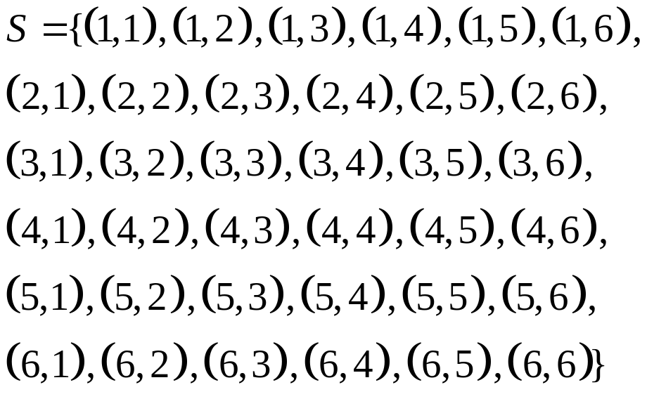
Probability: Examples
Example: If two fair dice are thrown, what is the probability of getting (i) a double six? (ii). A sum of 11 or more dots?
Solution: Here
n(S)=36
Let A=a double six={(6,6)}
n(A)=1
P(A)=1/36
Let B= a sum of 11 or more dots
B={(5,6), (6,5), (6,6)}, n(B)=3
P(B)=3/36

Slide 8
Probability: Examples
Example: A fair coin is tossed three times. What is the probability that:
At-least one head appears
More heads than tails appear
Exactly two tails appear
Solution: Here S={HHH, HHT, HTH, THH, HTT, THT, TTH, TTT}, n(S)=8
a). At-least one head appears
Let A=At-least one head appears={HHH, HHT, HTH, THH, HTT, THT, TTH}, n(A)=7
P(A)=n(A)/n(S)=7/8
b). More heads than tails appear
Let B= More heads than tails appear ={HHH, HHT, HTH, THH}, n(B)=4
P(B)=n(B)/n(S)=4/8=1/2=0.5 or 50%
c). Exactly two tails appear
Let C=Exactly two tails appear={HTT, THT, TTH}, n(C )=3
P(C)=n(C)/n(S)=3/8

Slide 9
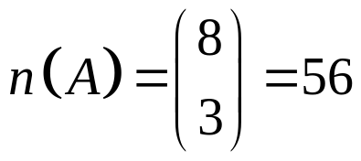
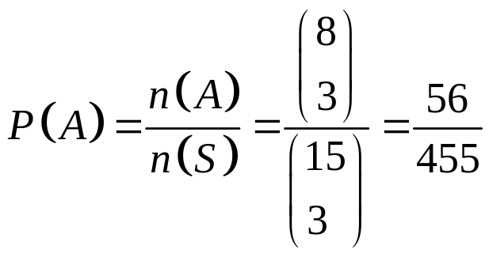
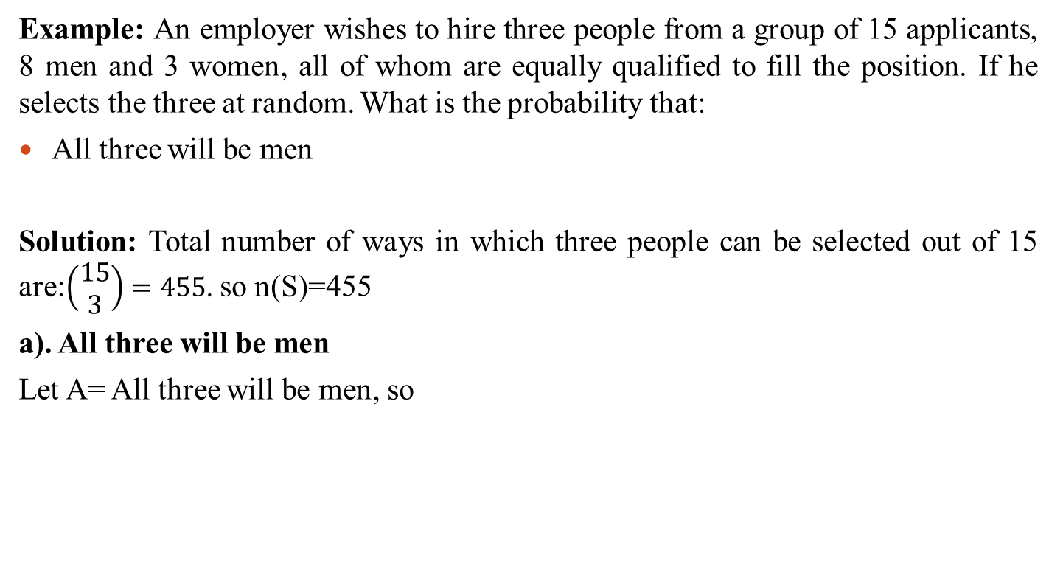
Probability: Examples
Example: An employer wishes to hire three people from a group of 15 applicants, 8 men and 3 women, all of whom are equally qualified to fill the position. If he selects the three at random. What is the probability that:
All three will be men
Solution: Total number of ways in which three people can be selected out of 15 are:$\left(\begin{matrix}15 \\ 3\end{matrix}\right)=455$. so n(S)=455
a). All three will be men
Let A= All three will be men, so

Slide 10
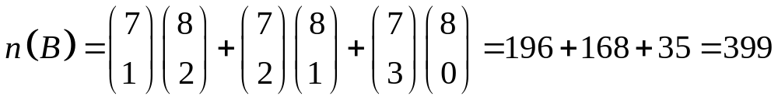
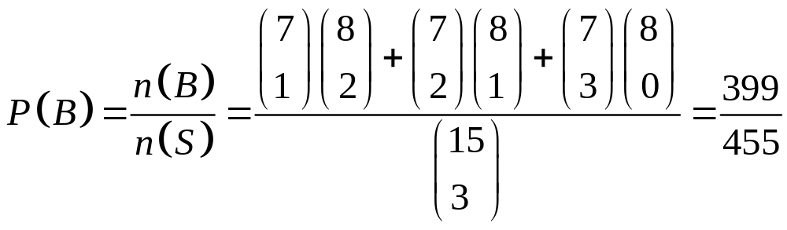
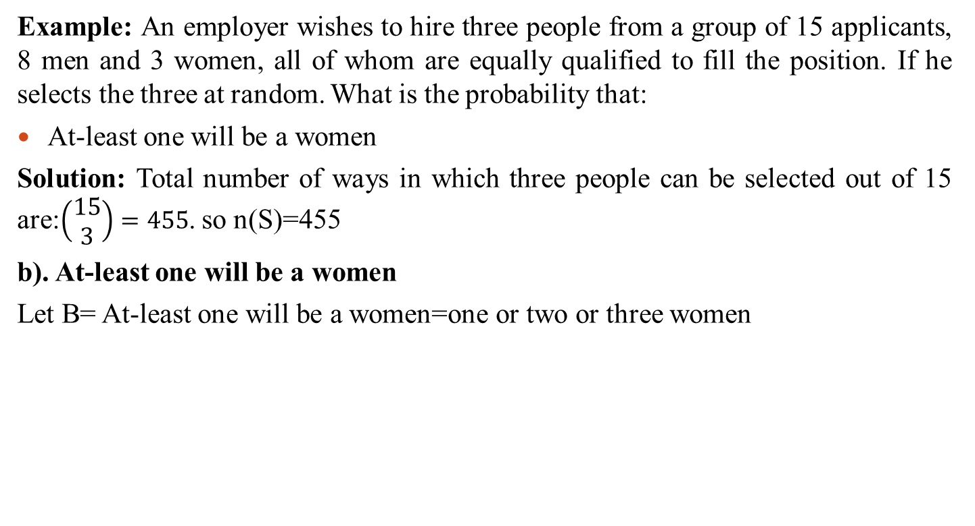
Probability: Examples
Example: An employer wishes to hire three people from a group of 15 applicants, 8 men and 3 women, all of whom are equally qualified to fill the position. If he selects the three at random. What is the probability that:
At-least one will be a women
Solution: Total number of ways in which three people can be selected out of 15 are:$\left(\begin{matrix}15 \\ 3\end{matrix}\right)=455$. so n(S)=455
b). At-least one will be a women
Let B= At-least one will be a women=one or two or three women

Slide 11
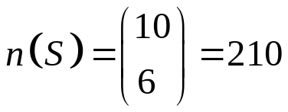
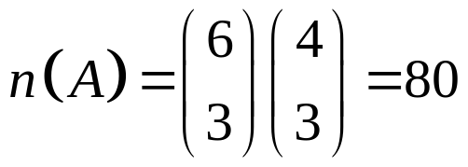
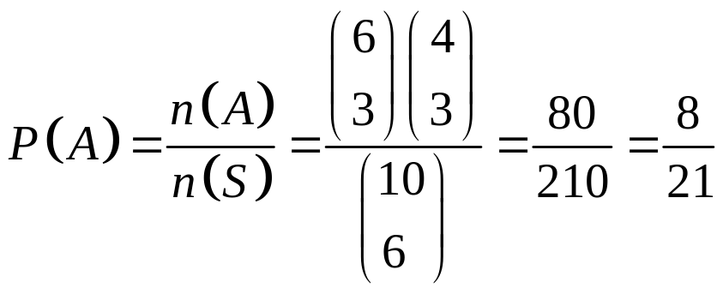
Probability: Examples
Example: Six white balls and four black balls, which are indistinguishable apart from color, are placed in a bag. If six balls are taken from the bag, find the probability of getting three white and three black balls?
Solution: Total number of possible equally likely outcomes are:
Let A=three white and three black balls

Slide 12
Laws of Probability
If A is an impossible event then P(A)=0
If A’ is complement of an event A relative
to Sample space S then P(A’)=1-P(A)
S
A

Slide 13
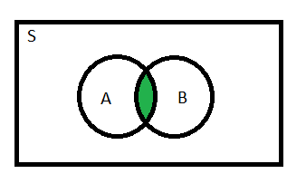
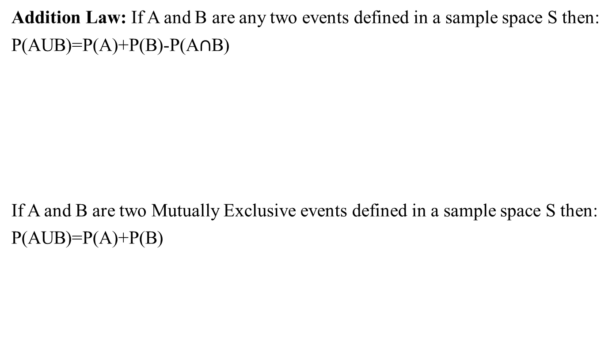
Laws of Probability
Addition Law: If A and B are any two events defined in a sample space S then:
P(AUB)=P(A)+P(B)-P(A$∩$B)
If A and B are two Mutually Exclusive events defined in a sample space S then:
P(AUB)=P(A)+P(B)
S
A
B

Slide 14
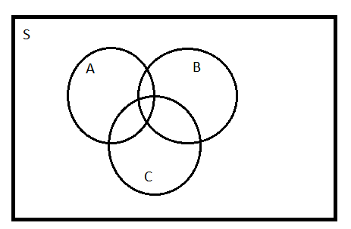
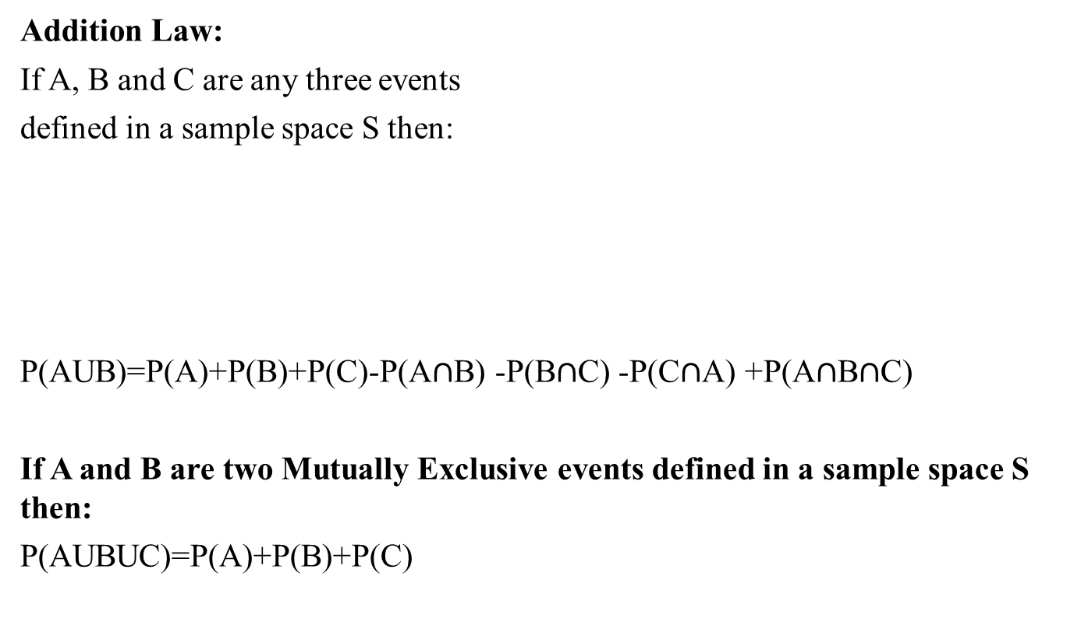
Laws of Probability
Addition Law:
If A, B and C are any three events
defined in a sample space S then:
P(AUB)=P(A)+P(B)+P(C)-P(A$∩$B) -P(B$∩$C) -P(C$∩$A) +P(A$∩$B$∩$C)
If A and B are two Mutually Exclusive events defined in a sample space S then:
P(AUBUC)=P(A)+P(B)+P(C)

Slide 15
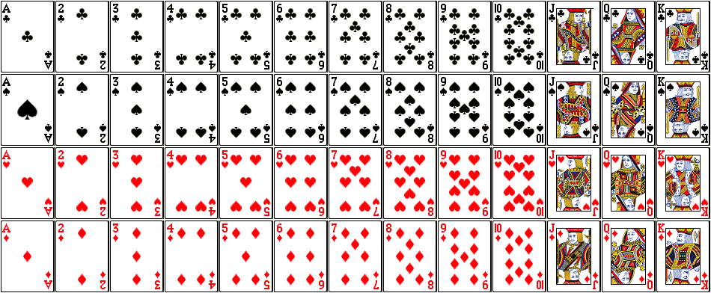
Structure of a Deck of Playing Cards
Total Cards in an ordinary deck: 52
Total Suits: 4 Spades (♠), Hearts (♥), Diamonds (♦), Clubs (♣)
Cards in each suit: 13
Face values of 13 cards in each suit are:
Ace, 2, 3, 4, 5, 6, 7, 8, 9, 10, Jack, Queen and King
Clubs (♣)
Spades (♠)
Hearts (♥)
Diamonds (♦)

Slide 16
Structure of a Deck of Playing Cards
Honor Cards are: Ace, 10, Jack, Queen and King
Face Cards are: Jack, Queen, King
Popular Games of Cards are: Bridge and Poker

Slide 17
Probability: Card Example
Example: If a card is drawn from an ordinary deck of 52 playing cards, find the probability that: a. It is a red card b. Card is a diamond c. Card is a 10 d. Card is a king e. A face card
Solution: Since total playing cards are 52, So, n(S)=52
a). A red Card
Let A=A red card, n(A)=26, P(A)=n(A)/n(S)=26/52=1/2
b). Card is a diamond
Let B= Card is a diamond, n(B)=13, P(B)=n(B)/n(S)=13/52=1/4
c). Card is a ten
Let C=Card is a ten, n(C )=3, P(C)=n(C)/n(S)=4/52=1/13
d). Card is a King
Let D=Card is a King, n(D )=4, P(D)=n(D)/n(S)=4/52=1/13
e). A face card
Let E=A face card, n(E )=12, P(E)=n(E)/n(S)=12/52=3/13

Slide 18
Review
Let’s review the main concepts:
Definition of Probability and its properties
Some basic questions related to probability
Laws of probability
More examples of probability

Slide 19
Next Lecture
In next lecture, we will study:
Conditional probability
Independent and Dependent Events
Related Examples

