Slide 1
MTH 161: Introduction To Statistics
Lecture 17
Dr. MUMTAZ AHMED

Slide 2
Review of Previous Lecture
In last lecture we discussed:
Relation b/w central moments and moments about origin
Moment Ratios
Skewness
Kurtosis

Slide 3
Objectives of Current Lecture
In the current lecture:
Describing a Frequency Distribution
Introduction to Probability
Definition and Basic concepts of probability

Slide 4
Describing a Frequency Distribution
To describe the major characteristics of a frequency distribution, we need to calculate the following five quantities:
The total number of observations in the data.
A measure of central tendency (e.g. mean, median etc.) that provides the information about the center or average value.
A measure of dispersion (e.g. variance, SD etc.) that indicates the spread of the data.
A measure of skewness that shows lack of symmetry in frequency distribution.
A measure of kurtosis that gives information about its peakedness.

Slide 5
Describing a Frequency Distribution
It is interesting to note that all these quantities can be derived from the first four moments.
For example,
The first moment about zero is the arithmetic mean
The second moment about mean is the variance.
The third standardized moment is a measure of skewness.
The fourth standardized moment is used to measure kurtosis.
Thus first four moments play a key role in describing frequency distributions.

Slide 6
Probability
Probability (or likelihood) is a measure or estimation of how likely it is that something will happen or that a statement is true.
For example, it is very likely to rain today or I have a fair chance of passing annual examination or A will probably win a prize etc.
In each of these statements the natural state of likelihood is expressed.
Probabilities are given a value between 0 (0% chance or will not happen) and 1 (100% chance or will happen). The higher the degree of probability, the more likely the event is to happen, or, in a longer series of samples, the greater the number of times such event is expected to happen.
Probability is used widely in different fields such as: mathematics, statistics, economics, management, finance, operation research, sociology, psychology, astronomy, physics, engineering, gambling and artificial intelligence/machine learning to, for example, draw inferences about the expected frequency of events.

Slide 7
Probability
Probability theory is best understood through the application of the modern set theory.
So first we are presenting some basic concepts, notations and operations of set theory that are relevant to probability.

Slide 8
Sets
A set is a well-defined collection of or list of distinct objects.
For example:
A group of students
Number of books in a library
Integers between 1and 100
The objects that are in a set are called members or elements on that set.
Sets are usually denoted by capital letters such as A, B, C, Z etc, while their elements are represented by small letters such as a, b, c and z etc.
Elements are enclosed by braces to represent a set, e.g.
A={a,b,c,z} or B={1,2,3,4,5}

Slide 9
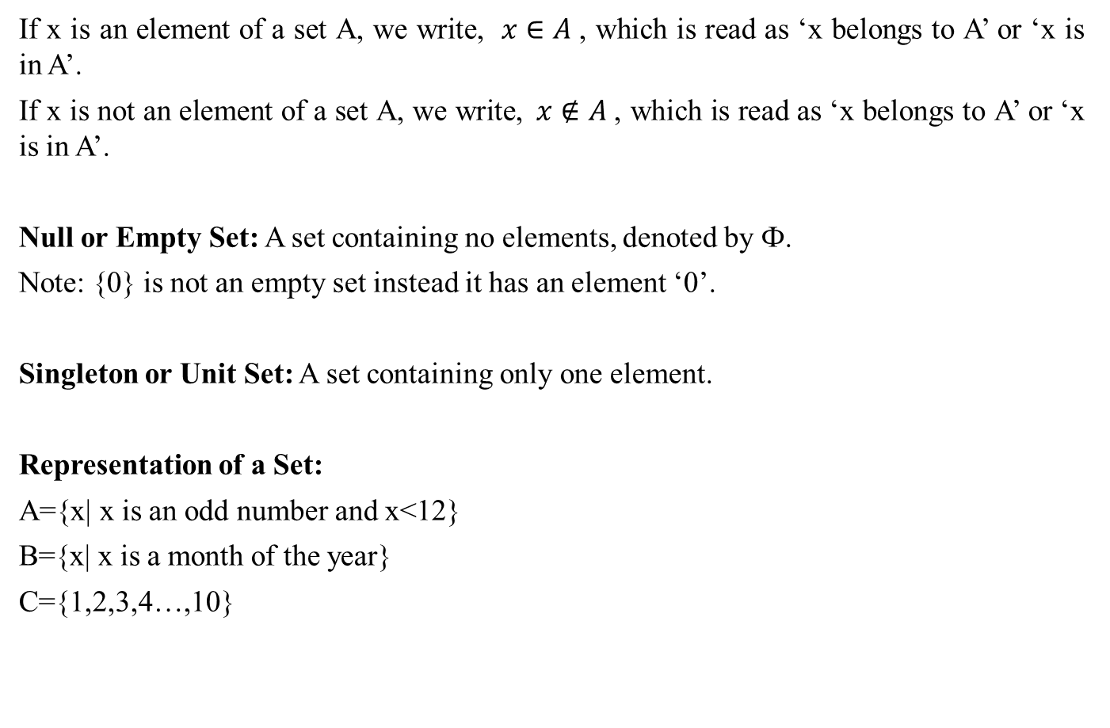
Sets
If x is an element of a set A, we write, $x∈A$, which is read as ‘x belongs to A’ or ‘x is in A’.
If x is not an element of a set A, we write,$x∉A$, which is read as ‘x belongs to A’ or ‘x is in A’.
Null or Empty Set: A set containing no elements, denoted by Ф.
Note: {0} is not an empty set instead it has an element ‘0’.
Singleton or Unit Set: A set containing only one element.
Representation of a Set:
A={x| x is an odd number and x<12}
B={x| x is a month of the year}
C={1,2,3,4…,10}

Slide 10
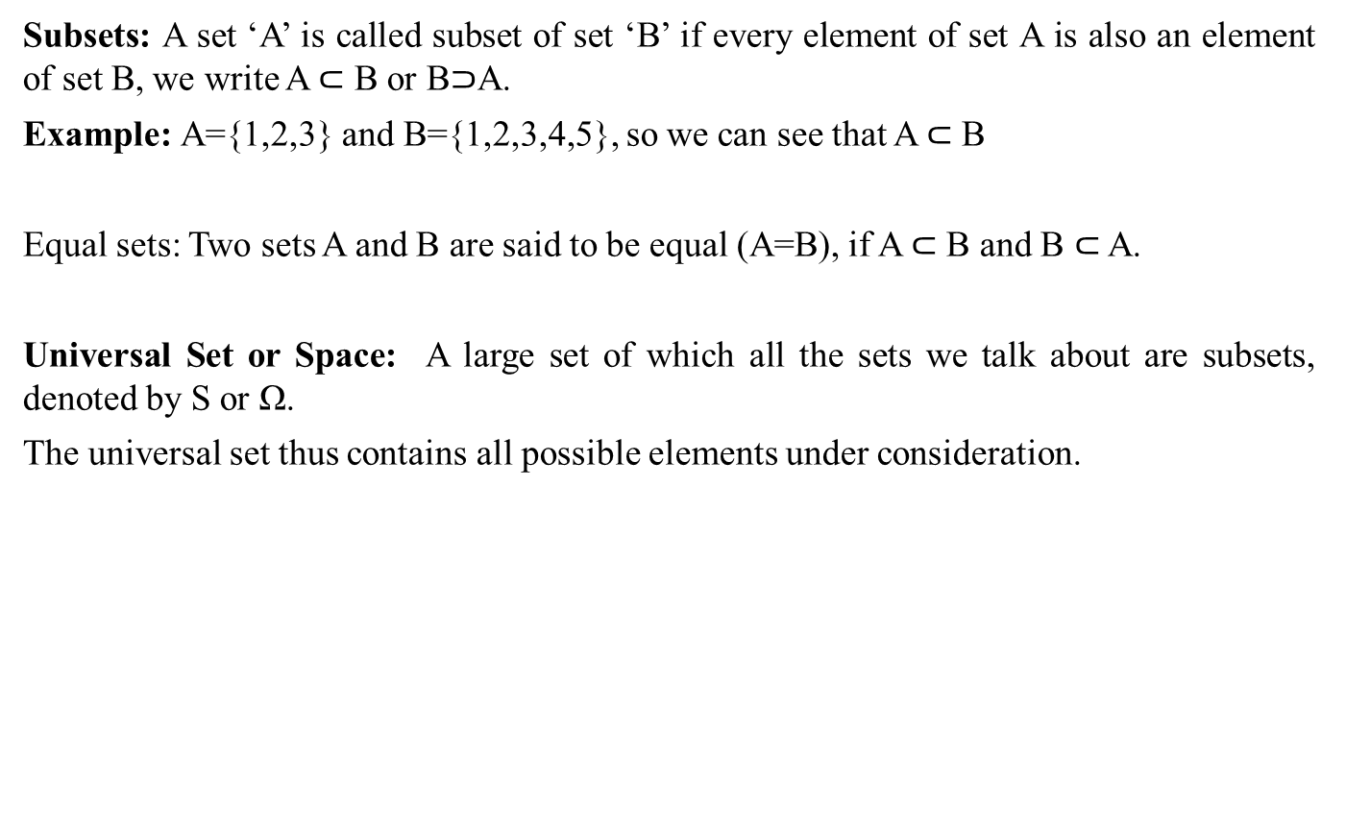
Sets
Subsets: A set ‘A’ is called subset of set ‘B’ if every element of set A is also an element of set B, we write A $⊂$ B or B$⊃$A.
Example: A={1,2,3} and B={1,2,3,4,5}, so we can see that A $⊂$ B
Equal sets: Two sets A and B are said to be equal (A=B), if A $⊂$ B and B $⊂$ A.
Universal Set or Space: A large set of which all the sets we talk about are subsets, denoted by S or Ω.
The universal set thus contains all possible elements under consideration.

Slide 11
Venn-Diagram
Venn-Diagrams are used to represent sets and subsets in a pictorial way and to verify the relationship among sets and subsets.
In venn-diagram, a rectangle is used to represent the universal set or space S, whereas the sets are represented by circular regions.
Example:
A simple venn-diagram
S
B
A

Slide 12

Operations on Sets
AUB
A$∩$B
S
A
B
S

Slide 13
Operations on Sets
A’
A-B or A difference B
S
A
B
S

Slide 14
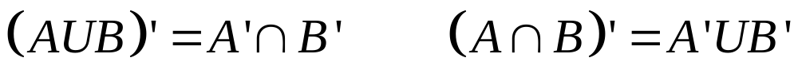
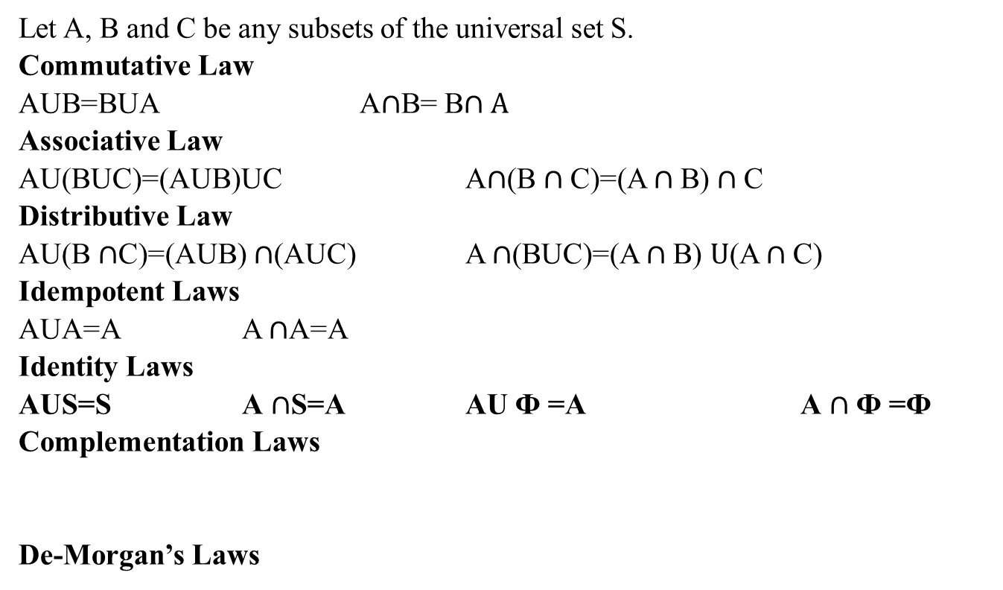
Laws of Sets
Let A, B and C be any subsets of the universal set S.
Commutative Law
AUB=BUA A$∩$B= B$∩A$
Associative Law
AU(BUC)=(AUB)UC A$∩$(B $∩$C)=(A $∩$B) $∩$C
Distributive Law
AU(B $∩$C)=(AUB) $∩$(AUC) A $∩$(BUC)=(A $∩$B) $U$(A $∩$C)
Idempotent Laws
AUA=A A $∩$A=A
Identity Laws
AUS=S A $∩$S=A AU Ф =A A $∩$ Ф =Ф
Complementation Laws
De-Morgan’s Laws

Slide 15
Sets
Class of Sets: A set of sets. E.g. A={ {1}, {2}, {3} }
Power Set: A set of all subsets of A is called power set of set A.
Example: Let A={H,T} then P(A)={Ф, {H}, {T}, {H,T} }
Cartesian Product of sets: The Cartesian product of sets A and B, denoted by AxB is a set that contains all ordered pairs (x,y) where x belongs to A and y belongs to B.
Symbolically, we write, AxB={ (x,y)| x A and y B}
Example: Let A={H,T}, B={1,2,3,4,5,6}
AxB={(H,1), (H,2), (H,3), (H,4), (H,5), (H,6), (T,1), (T,2), (T,3), (T,4), (T,5), (T,6) }

Slide 16
Random Experiment
Experiment: Experiment means a planned activity or process whose results yield a set of data.
Trial: A single performance of an experiment is called a trial.
Outcome: The result obtained from an experiment or a trial is called an outcome.
Random Experiment: An experiment which produces different results even though it is repeated a large number of times under essentially similar conditions, is called a random experiment.
Examples:
The tossing of a fair coin
The throwing of a balanced die
Drawing a card from a well shuffled deck of 52 playing cards etc.

Slide 17
Sample Space
Sample Space: A set consisting of all possible outcomes that can result from a random experiment is called sample space, denoted by S.
Sample Points: Each possible outcome is a member of the sample space and is called sample point in that space.
For instance, The experiment of tossing a coin results in either of the two possible outcomes: a head (H) or a tail (T), rolling on its edge is not considered.
The sample space is: S={H,T}
Sample space for tossing two coins once (or tossing a coin twice) is : S={HH,HT,TH,TT}

Slide 18
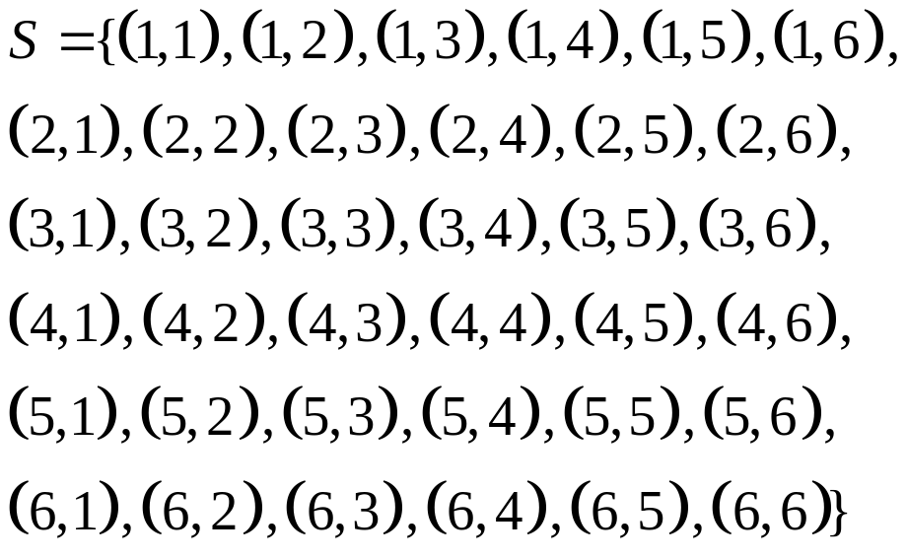
Sample Space
Sample Space for tossing a die is: S={1,2,3,4,5,6}
Sample space for tossing two dice or (tossing a die twice) is:

Slide 19
Event
Event: An event is an individual outcome or any number of outcomes of a random experiment.
In set terminology, any subset of a sample space S of the experiment is called an event.
Example: Let S={H,T}, then Head (H) is an event, tail (T) is another event, {H,T} is also an event.
Mutually Exclusive Events: Two events A and B of a single experiment are said to be mutually exclusive iff they can’t occur at the same time. i.e. they have no points in common.
Example1: Let S={H,T}
Let A={H}, B={T}, then A and B are mutually exclusive events
Example2: Let S={1,2,3,4,5,6}
Let A={2,4,6}, B={4,6}, here A and B are not mutually exclusive events.

Slide 20
Event
Exhaustive Events: Events are said to be collectively exhaustive when union of mutually exclusive events is the entire sample space S.
Example: In tossing a fair coin, S={H,T} and two events, A={H} and B={T} are mutually exclusive and also their union AUB is sample space S.
Equally likely events: Two sets are said to be equally likely when one event is as likely to occur as the other.
Example: In tossing of a fair coin, the two events Head and Tail are equally likely.

Slide 21
Counting Sample Points
When the number of sample points in a sample space S is very large, it becomes very inconvenient and difficult to list them all and to count the number of points in the sample space and in the subsets of S.
We then need some methods or rules which help us to count the number of all sample points without actually listing them.
A few of the basic rules frequently used are:
Rule of multiplication
Rule of Permutation
Rule of Combination

Slide 22
Rule of multiplication
If a compound experiment consists of two experiments such that the first experiment has exactly m distinct outcomes and if corresponding to each outcome of the first experiment there can be n distinct outcomes of the second experiment, then the compound experiment has exactly m*n outcomes.
Example: Compound experiment of tossing a coin and throwing a die together consists of two experiments: Coin tossing with two distinct outcomes (H, T) and the die throwing with six distinct outcomes (1,2,3,4,5,6).
The total number of possible distinct outcomes of the compound experiment is 2x6=12.
See the Cartesian product:
Let A={H,T}, B={1,2,3,4,5,6}
AxB={(H,1), (H,2), (H,3), (H,4), (H,5), (H,6), (T,1), (T,2), (T,3), (T,4), (T,5), (T,6) }, n(AxB)=12

Slide 23
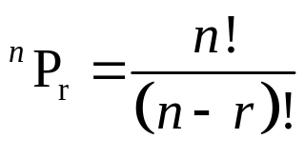
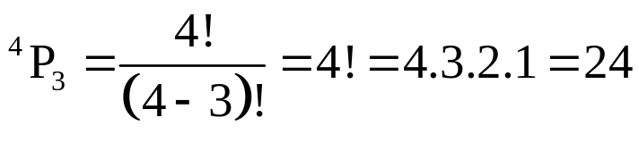
Rule of Permutation
A permutation is any ordered subset from a set of n distinct objects.
The number of permutations of r objects selected in a definite order from n distinct objects is denoted by ^{n}P_{r} and is given by:
Example: A club consists of four members. How many sample points are in the sample space when three officers: president, secretary and treasurer, are to be chosen?
Solution: Note that order in which three officers are to be chosen is of importance. Thus there are four choices for the first officer, 3 choices for the second officer and 2 choices for the third officer. Hence total number of sample points are 4x3x2x1=24.
The number of permutations is:

Slide 24
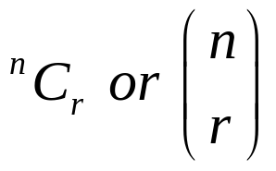
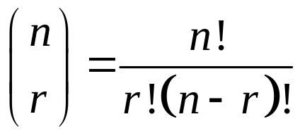
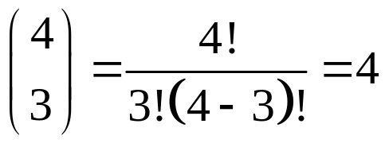
Rule of Combination
A combination is any subset of r objects, selected without regard to their order, from a set of n distinct objects.
The total number of such combinations is denoted by and is given by:
Example: A three person committee is to be formed from a list of four persons. How many sample points are associated with the experiment?
Solution: Since order doesn’t matter here, so total number of combinations are:

Slide 25
Review
Let’s review the main concepts:
Describing a Frequency Distribution
Introduction to Probability
Definition and Basic concepts of probability

Slide 26
Next Lecture
In next lecture, we will study:
Laws of probability
More examples of probability

Slide 27
Next Lecture
In next lecture, we will study:
Conditional probability
Independent and Dependent Events
Related questions

