Slide 1
MTH 161: Introduction To Statistics
Lecture 16
Dr. MUMTAZ AHMED

Slide 2
Review of Previous Lecture
In last lecture we discussed:
Moments
  Moments about Mean (Central Moments)
  Moments about any arbitrary Origin
  Moments about Zero
  Related Excel Demos

Slide 3
Objectives of Current Lecture
In the current lecture:
Relation b/w central moments and moments about origin
Moment Ratios
Skewness
Kurtosis

Slide 4
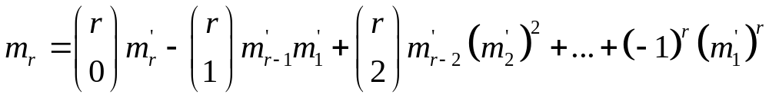
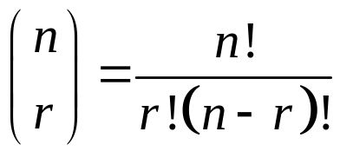

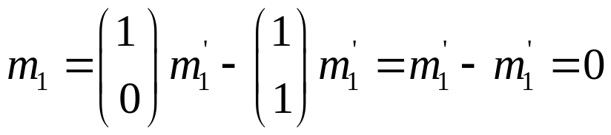
Conversion from Moments about Mean to Moments about Origin
Sample Moments about Mean in terms of Moments about Origin.
Where,
Replacing r by 1, we get first sample moment about mean in terms of moments about origin:

Slide 5
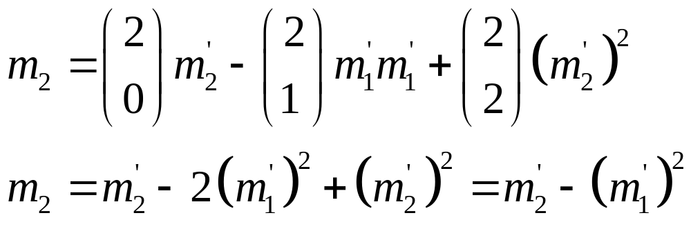
Conversion from Moments about Mean to Moments about Origin
Sample Moments about Mean in terms of Moments about Origin.
Replacing r by 2, we get second sample moment about mean in terms of moments about origin:

Slide 6
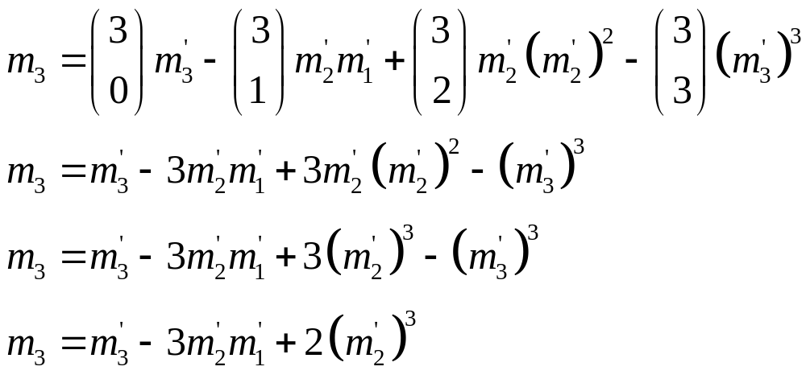
Conversion from Moments about Mean to Moments about Origin
Sample Moments about Mean in terms of Moments about Origin.
Replacing r by 3, we get third sample moment about mean in terms of moments about origin:

Slide 7
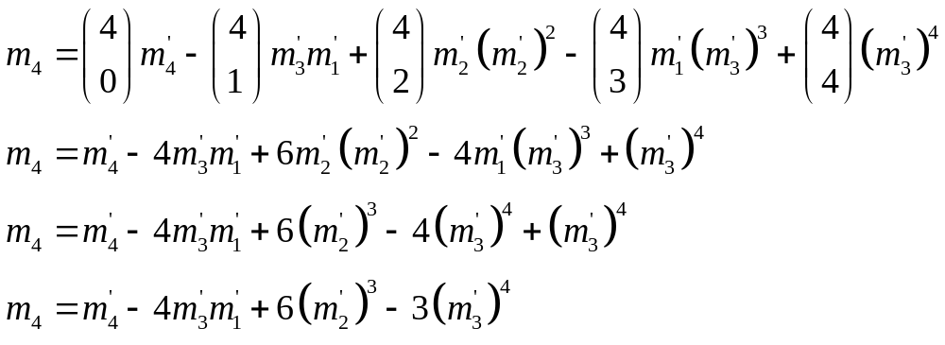
Conversion from Moments about Mean to Moments about Origin
Sample Moments about Mean in terms of Moments about Origin.
Replacing r by 4, we get fourth sample moment about mean in terms of moments about origin:

Slide 8
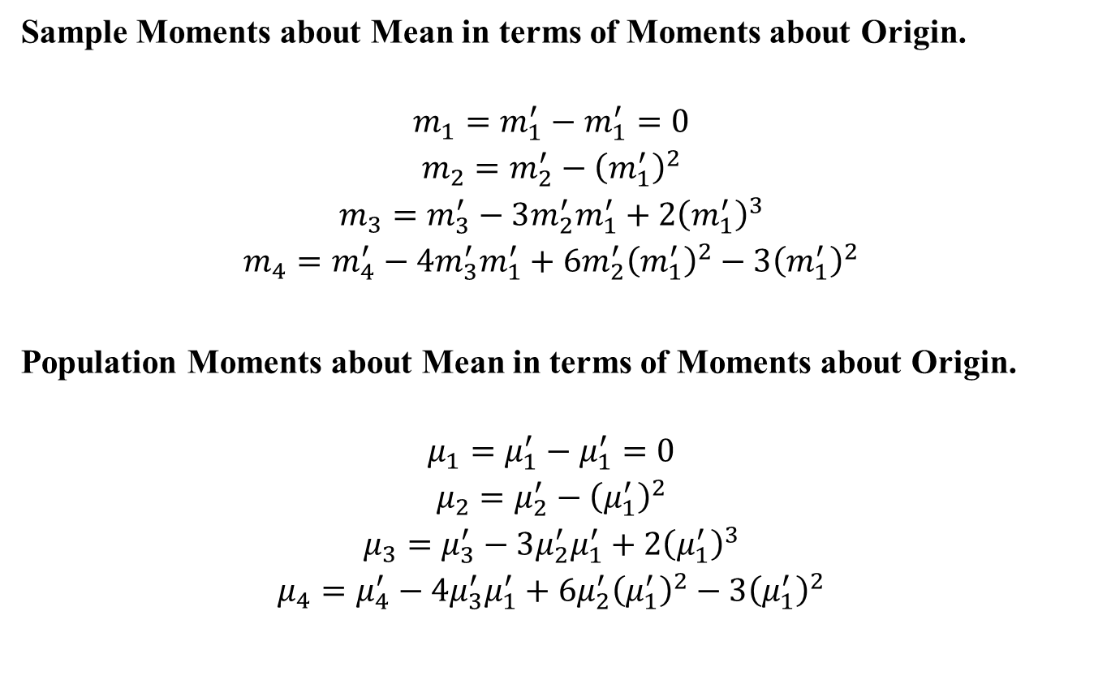
Summary
Sample Moments about Mean in terms of Moments about Origin.
$$\begin{matrix}m_{1}=m_{1}^{′}−m_{1}^{′}=0 \\ m_{2}=m_{2}^{′}−{\left(m_{1}^{′}\right)}^{2} \\ m_{3}=m_{3}^{′}−3m_{2}^{′}m_{1}^{′}+2{\left(m_{1}^{′}\right)}^{3} \\ m_{4}=m_{4}^{′}−4m_{3}^{′}m_{1}^{′}+6m_{2}^{′}{\left(m_{1}^{′}\right)}^{2}−3{\left(m_{1}^{′}\right)}^{2}\end{matrix}$$
Population Moments about Mean in terms of Moments about Origin.
$$\begin{matrix}μ_{1}=μ_{1}^{′}−μ_{1}^{′}=0 \\ μ_{2}=μ_{2}^{′}−{\left(μ_{1}^{′}\right)}^{2} \\ μ_{3}=μ_{3}^{′}−3μ_{2}^{′}μ_{1}^{′}+2{\left(μ_{1}^{′}\right)}^{3} \\ μ_{4}=μ_{4}^{′}−4μ_{3}^{′}μ_{1}^{′}+6μ_{2}^{′}{\left(μ_{1}^{′}\right)}^{2}−3{\left(μ_{1}^{′}\right)}^{2}\end{matrix}$$

Slide 9
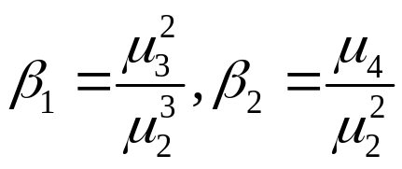
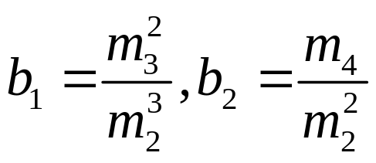
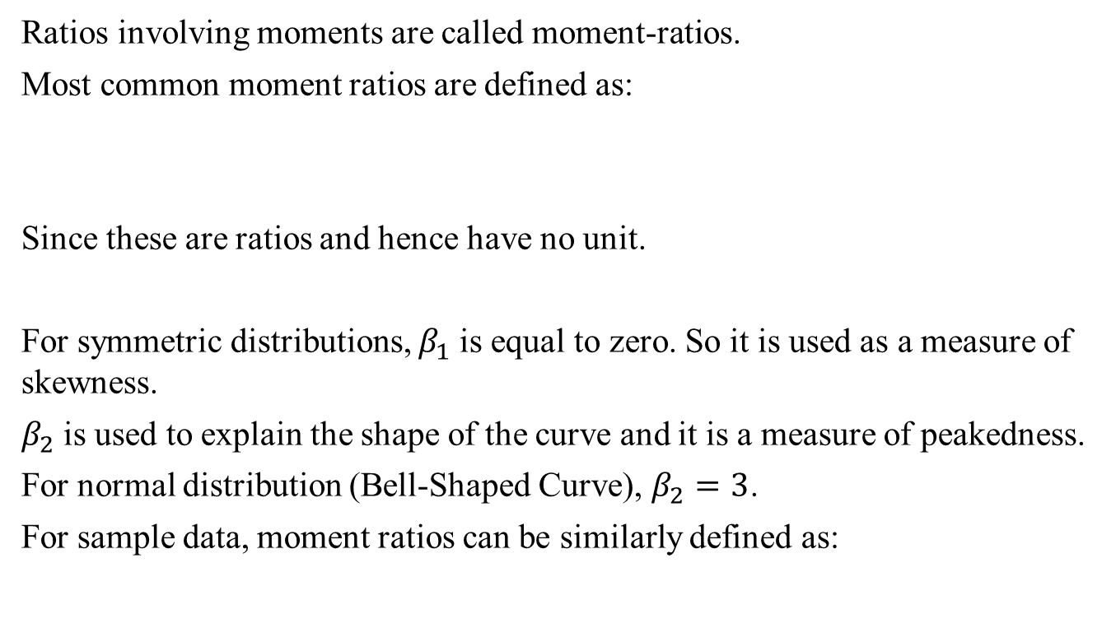
Moment Ratios
Ratios involving moments are called moment-ratios.
Most common moment ratios are defined as:
Since these are ratios and hence have no unit.
For symmetric distributions, $β_{1}$is equal to zero. So it is used as a measure of skewness.
$β_{2}$is used to explain the shape of the curve and it is a measure of peakedness.
For normal distribution (Bell-Shaped Curve), $β_{2}=3$.
For sample data, moment ratios can be similarly defined as:

Slide 10

Standardized Variable
It is often convenient to work with variables where the mean is zero and the standard deviation is one.
If X is a random variable with mean μ and standard deviation σ, we can define a second random variable Z such that Z will have a mean of zero and a standard deviation of one.
We say that X has been standardized, or that Z is a standard random variable.
In practice, if we have a data set and we want to standardize it, we first compute the sample mean and the standard deviation. Then, for each data point, we subtract the mean and divide by the standard deviation.
$$z=\frac{x−μ}{σ}$$

Slide 11
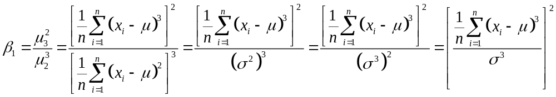
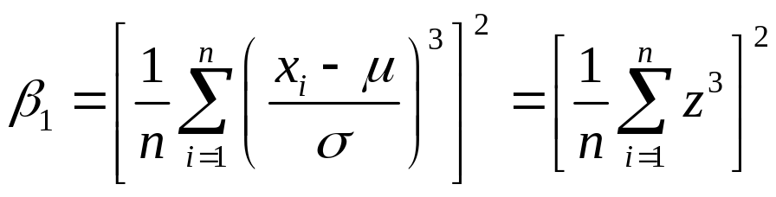
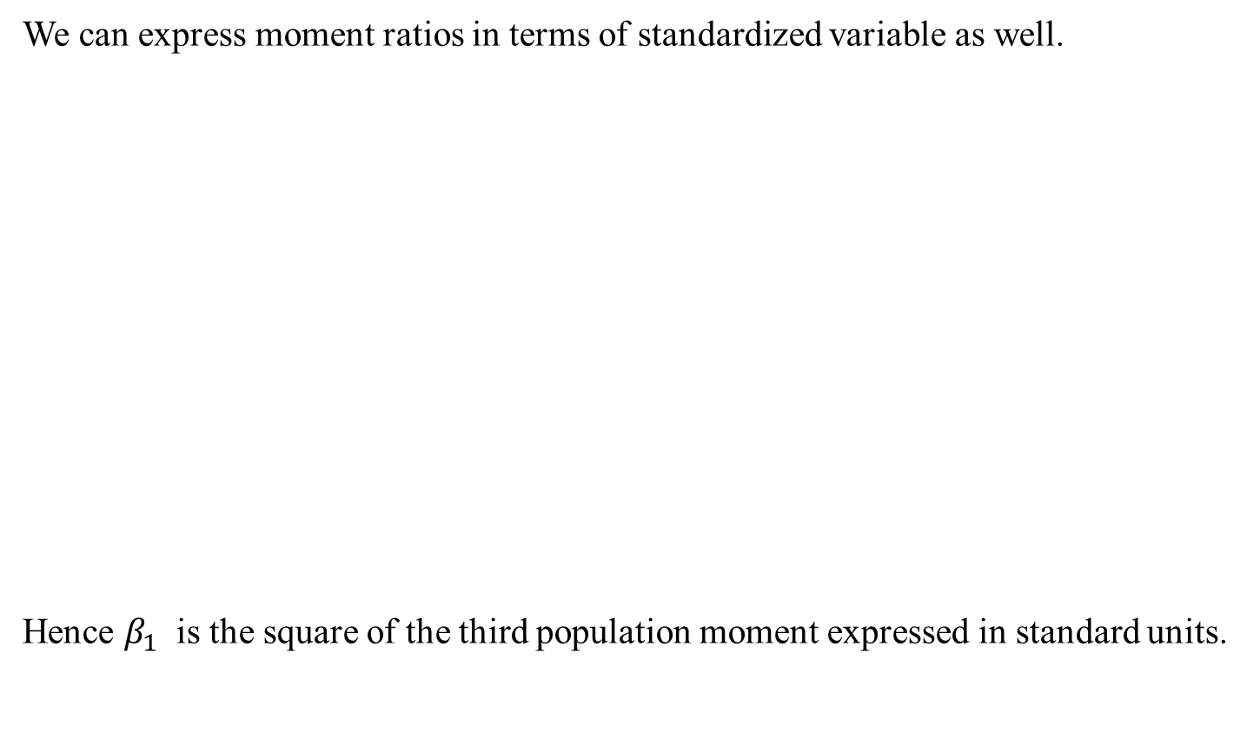
Moment Ratios
We can express moment ratios in terms of standardized variable as well.
Hence $β_{1}$ is the square of the third population moment expressed in standard units.

Slide 12
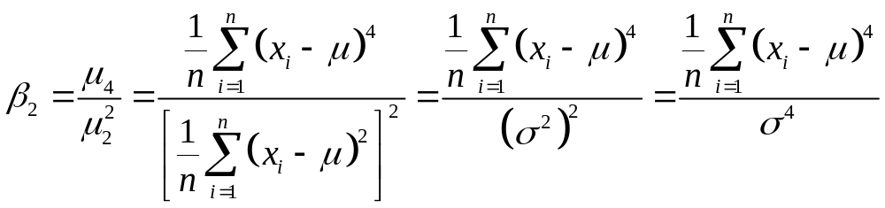
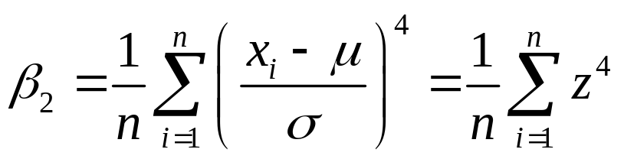
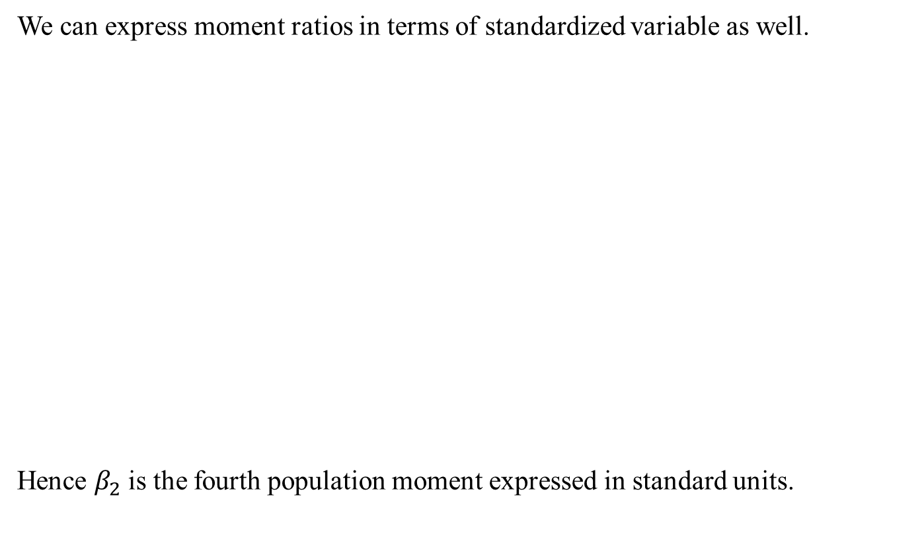
Moment Ratios
We can express moment ratios in terms of standardized variable as well.
Hence $β_{2}$is the fourth population moment expressed in standard units.

Slide 13
Skewness
A distribution in which the values equidistant from the mean have equal frequencies and is called Symmetric Distribution.
Any departure from symmetry is called skewness.
In a perfectly symmetric distribution, Mean=Median=Mode and the two tails of the distribution are equal in length from the mean. These values are pulled apart when the distribution departs from symmetry and consequently one tail become longer than the other.
If right tail is longer than the left tail then the distribution is said to have positive skewness. In this case, Mean>Median>Mode
If left tail is longer than the right tail then the distribution is said to have negative skewness. In this case, Mean<Median<Mode

Slide 14
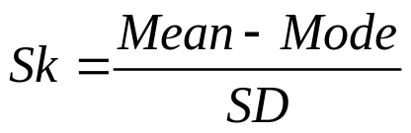

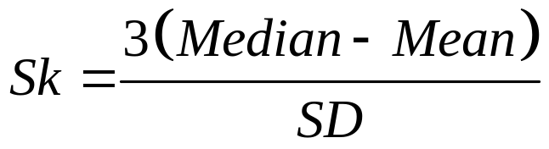
Skewness
When the distribution is symmetric, the value of skewness should be zero.
Karl Pearson defined coefficient of Skewness as:
Since in some cases, Mode doesn’t exist, so using empirical relation,
We can write,
(it ranges b/w -3 to +3)

Slide 15
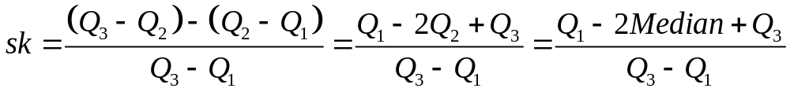
Skewness
According to Bowley (a British Statistician):
Bowley’s coefficient of skewness (also called Quartile skewness coefficient)
Example: Calculate Skewness, when median is 49.21, while the two quartiles are Q₁=37.15 and Q₃=61.27.
Using above formula, we have, sk=0 (because numerator is zero)

Slide 16
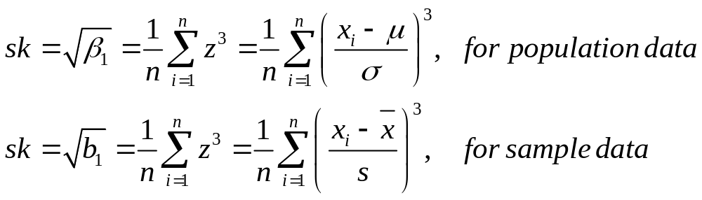
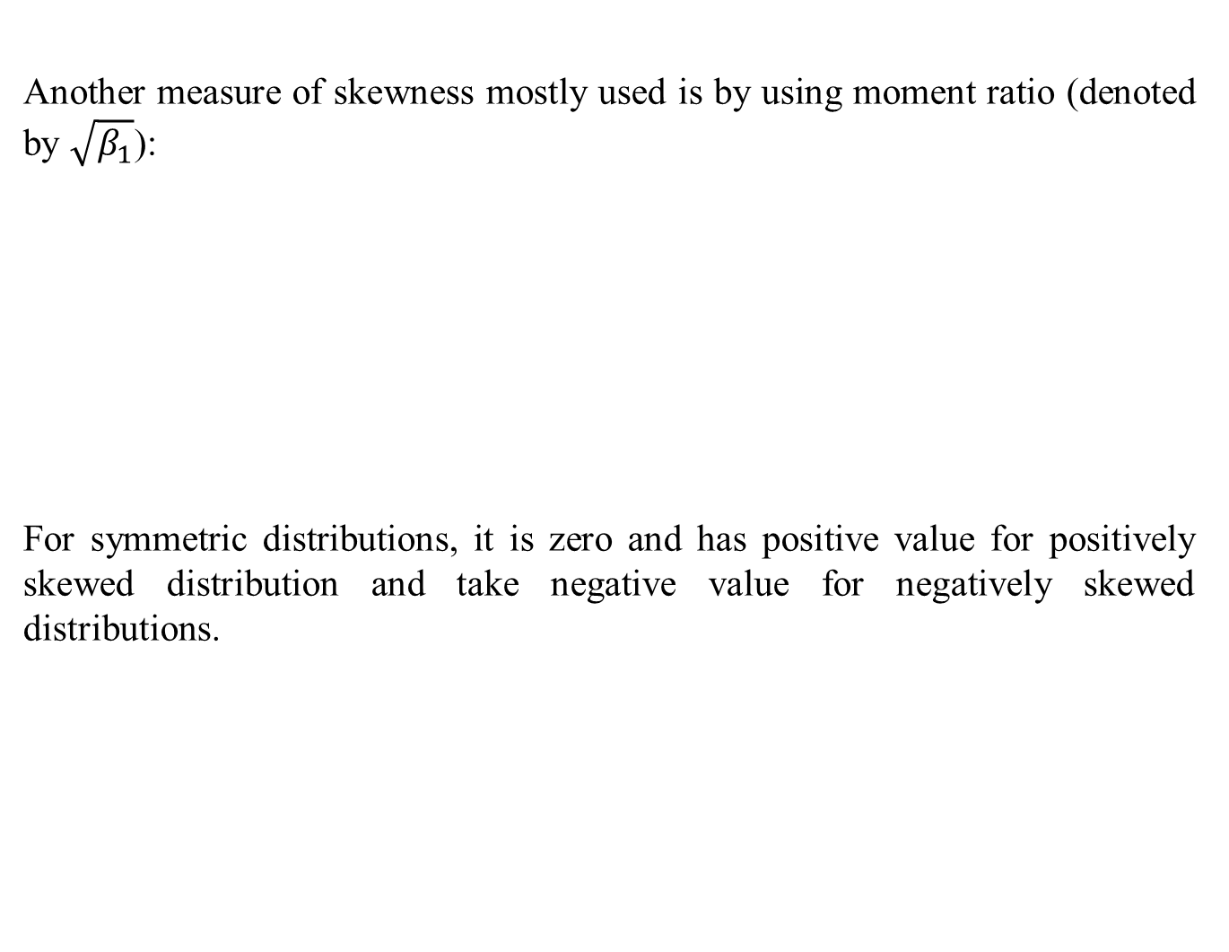
Skewness
Another measure of skewness mostly used is by using moment ratio (denoted by $\sqrt{β_{1}}$):
For symmetric distributions, it is zero and has positive value for positively skewed distribution and take negative value for negatively skewed distributions.

Slide 17
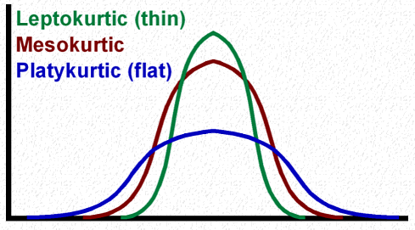
Kurtosis
Karl Pearson introduced the term Kurtosis (literally the amount of hump) for the degree of peakedness or flatness of a unimodal frequency curve.
When the peak of a curve becomes relatively high then that curve is called Leptokurtic.
When the curve is flat-topped, then it is called Platykurtic.
Since normal curve is neither very peaked nor very flat topped, so it is taken as a basis for comparison.
The normal curve is called Mesokurtic.

Slide 18
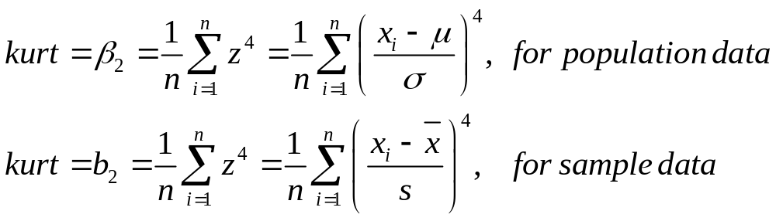
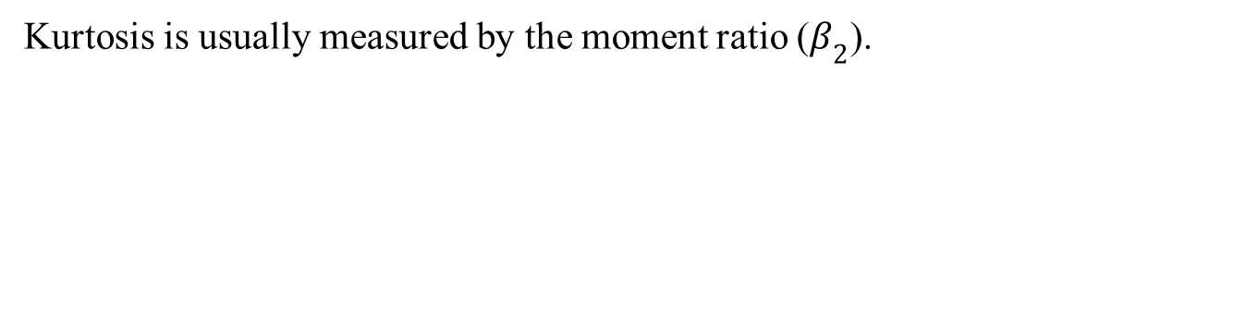
Kurtosis
Kurtosis is usually measured by the moment ratio ($β_{2}$).
For a normal distribution, kurtosis is equal to 3.
When is greater than 3, the curve is more sharply peaked and has narrower tails than the normal curve and is said to be leptokurtic.
When it is less than 3, the curve has a flatter top and relatively wider tails than the normal curve and is said to be platykurtic.

Slide 19
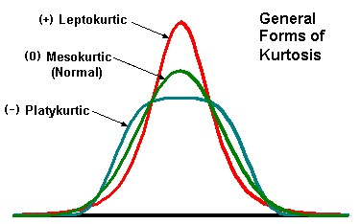
Kurtosis
Excess Kurtosis (EK): It is defined as:
EK=Kurtosis-3
For a normal distribution, EK=0.
When EK>0, then the curve is said to be Leptokurtic.
When EK<0, then the curve is said to be Platykurtic.

Slide 20
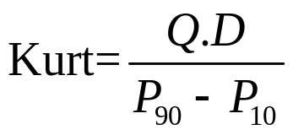
Kurtosis
Another measure of Kurtosis, known as Percentile coefficient of kurtosis is:
Where,
Q.D is semi-interquartile range=Q.D=(Q₃-Q₁)/2
P₉₀=90th percentile
P₁₀=10th percentile

Slide 21
Describing a Frequency Distribution
To describe the major characteristics of a frequency distribution, we need to calculate the following five quantities:
The total number of observations in the data.
A measure of central tendency (e.g. mean, median etc.) that provides the information about the center or average value.
A measure of dispersion (e.g. variance, SD etc.) that indicates the spread of the data.
A measure of skewness that shows lack of symmetry in frequency distribution.
A measure of kurtosis that gives information about its peakedness.

Slide 22
Describing a Frequency Distribution
It is interesting to note that all these quantities can be derived from the first four moments.
For example,
The first moment about zero is the arithmetic mean
The second moment about mean is the variance.
The third standardized moment is a measure of skewness.
The fourth standardized moment is used to measure kurtosis.
Thus first four moments play a key role in describing frequency distributions.

Slide 23
Review
Let’s review the main concepts:
Relation b/w central moments and moments about origin
Moment Ratios
Skewness
Kurtosis

Slide 24
Next Lecture
In next lecture, we will study:
Describing a Frequency Distribution
Introduction to Probability
Definition and Basic concepts of probability

