Slide 1
MTH 161: Introduction To Statistics
Lecture 15
Dr. MUMTAZ AHMED

Slide 2
Review of Previous Lecture
In last lecture we discussed:
Measures of Dispersion
    Variance and Standard Deviation
    Coefficient of Variation
    Properties of variance and standard deviation

Slide 3
Objectives of Current Lecture
In the current lecture:
Moments
  Moments about Mean (Central Moments)
  Moments about any arbitrary Origin
  Moments about Zero
  Related Excel Demos

Slide 4
Objectives of Current Lecture
In the current lecture:
Relation b/w central moments and moments about origin
Moment Ratios
Skewness
Kurtosis

Slide 5
Moments
A moment is a quantitative measure of the shape of a set of points.
The first moment is called the mean which describes the center of the distribution.
The second moment is the variance which describes the spread of the observations around the center.
Other moments describe other aspects of a distribution such as how the distribution is skewed from its mean or peaked.
A moment designates the power to which deviations are raised before averaging them.

Slide 6
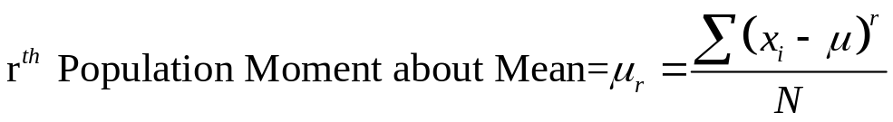
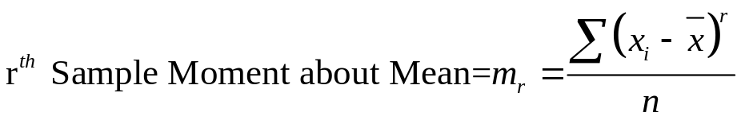
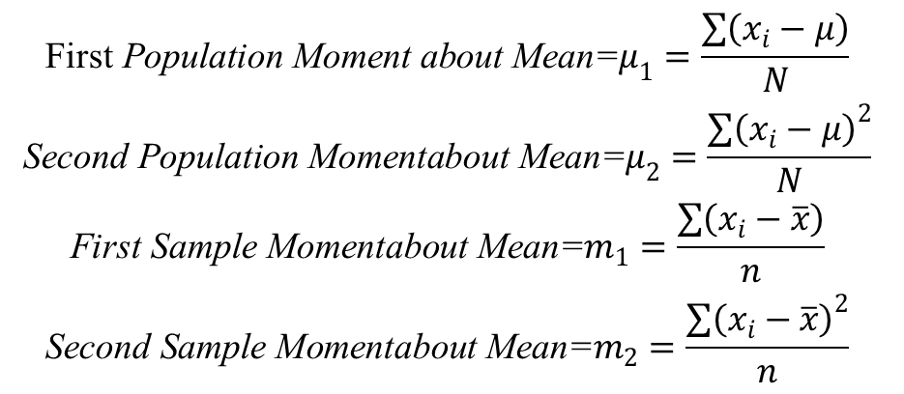
Central (or Mean) Moments
In mean moments, the deviations are taken from the mean.
For Ungrouped Data:
In General,
$$\begin{matrix}\text{First} \text{Population} \text{Moment} \text{about} \text{Mean}\text{=}μ_{1}=\frac{\sum{\left(x_{i}−μ\right)}}{N} \\ \text{Second} \text{Population} \text{Momentabout} \text{Mean}\text{=}μ_{2}=\frac{{\sum{\left(x_{i}−μ\right)}}^{2}}{N} \\ \text{First} \text{Sample} \text{Momentabout} \text{Mean}\text{=}m_{1}=\frac{\sum{\left(x_{i}−\overline{x}\right)}}{n} \\ \text{Second} \text{Sample} \text{Momentabout} \text{Mean}\text{=}m_{2}=\frac{{\sum{\left(x_{i}−\overline{x}\right)}}^{2}}{n}\end{matrix}$$

Slide 7
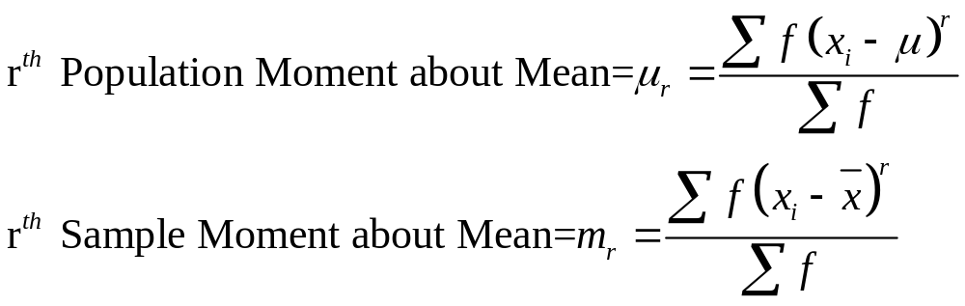
Central (or Mean) Moments
Formula for Grouped Data:

Slide 8
Central (or Mean) Moments
Example: Calculate first four moments about the mean for the following set of examination marks:
Solution: For solution, move to MS-Excel.
X
45
32
37
46
39
36
41
48
36

Slide 9
Central (or Mean) Moments
Example: Calculate: first four moments about mean for the following frequency distribution:
Solution: For solution, move to MS-Excel.
Weights (grams) | Frequency (f)
65-84 | 9
85-104 | 10
105-124 | 17
125-144 | 10
145-164 | 5
165-184 | 4
185-204 | 5
Total | 60

Slide 10
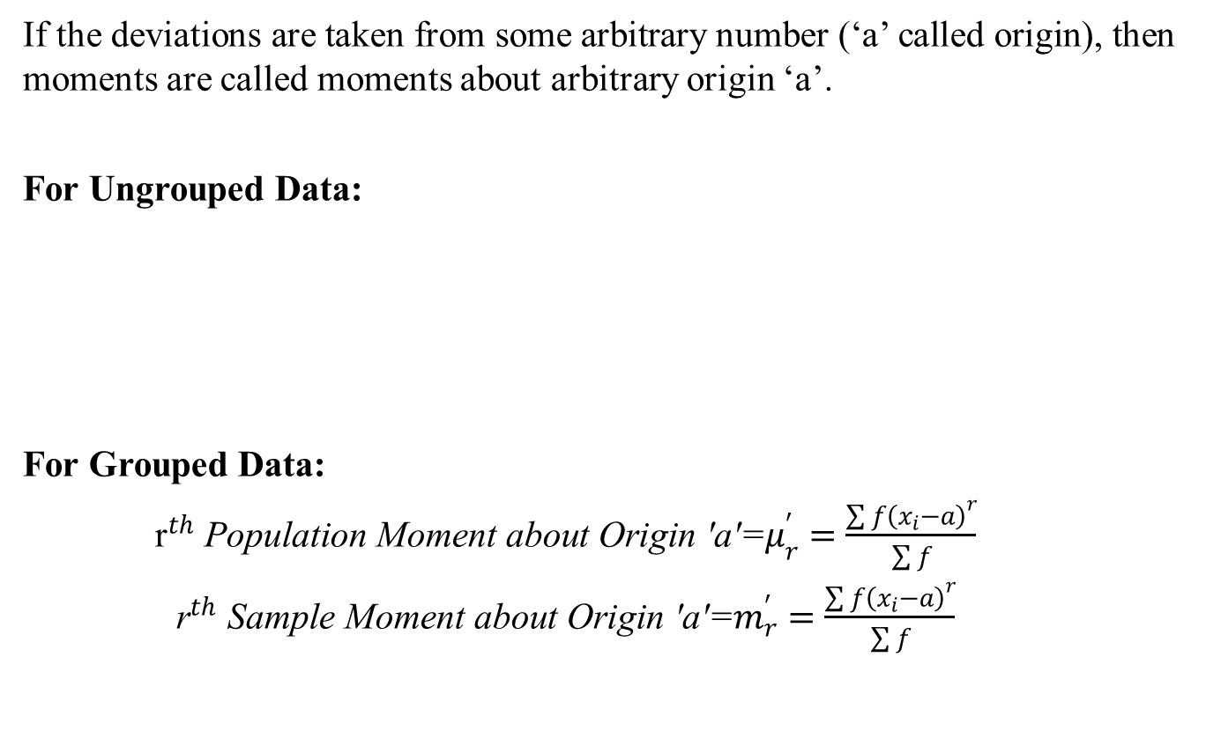
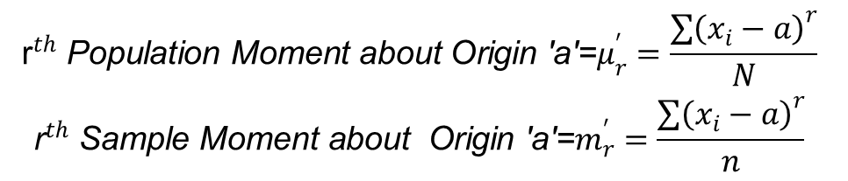
Moments about (arbitrary) Origin
If the deviations are taken from some arbitrary number (‘a’ called origin), then moments are called moments about arbitrary origin ‘a’.
For Ungrouped Data:
For Grouped Data:
$\begin{matrix}{\text{r}}^{th} \text{Population} \text{Moment} \text{about} \text{Origin}\text{ ′}\text{a}\text{′=}μ_{r}^{′}=\frac{{\sum{f\left(x_{i}−a\right)}}^{r}}{\sum{f}} \\ {\text{r}}^{th} \text{Sample} \text{Moment} \text{about} \text{Origin}\text{ ′}\text{a}\text{′=}m_{r}^{′}=\frac{{\sum{f\left(x_{i}−a\right)}}^{r}}{\sum{f}}\end{matrix}$
$$\begin{matrix}{\text{r}}^{th} \text{Population} \text{Moment} \text{about} \text{Origin}\text{ ′}\text{a}\text{′=}μ_{r}^{′}=\frac{{\sum{\left(x_{i}−a\right)}}^{r}}{N} \\ {\text{r}}^{th} \text{Sample} \text{Moment} \text{about} \text{Origin}\text{ ′}\text{a}\text{′=}m_{r}^{′}=\frac{{\sum{\left(x_{i}−a\right)}}^{r}}{n}\end{matrix}$$

Slide 11
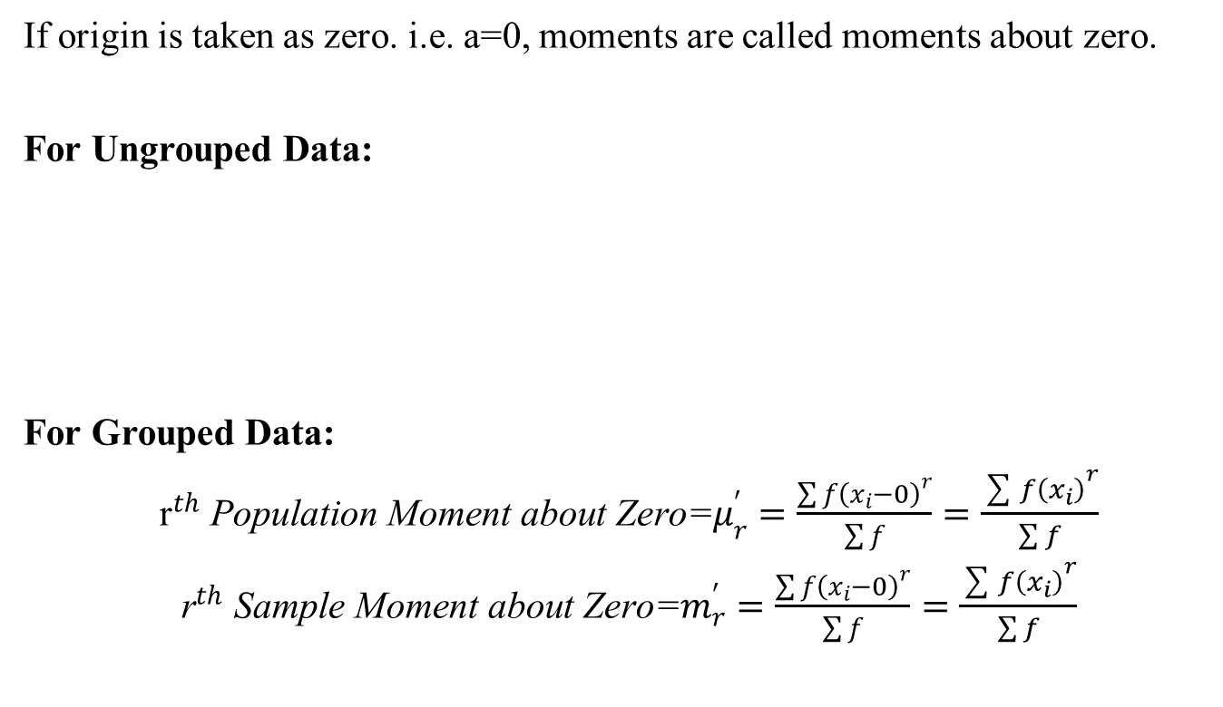
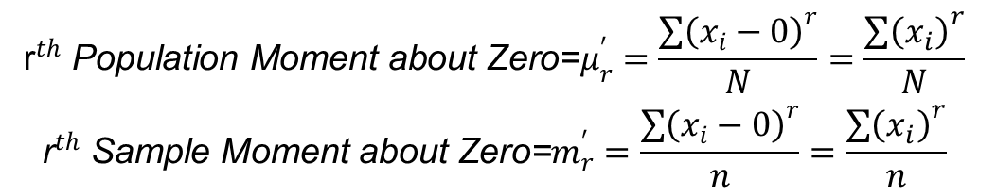
Moments about zero
If origin is taken as zero. i.e. a=0, moments are called moments about zero.
For Ungrouped Data:
For Grouped Data:
$\begin{matrix}{\text{r}}^{th} \text{Population} \text{Moment} \text{about} \text{Zero}\text{=}μ_{r}^{′}=\frac{{\sum{f\left(x_{i}−0\right)}}^{r}}{\sum{f}}=\frac{{\sum{f\left(x_{i}\right)}}^{r}}{\sum{f}} \\ {\text{r}}^{th} \text{Sample} \text{Moment} \text{about} \text{Zero}\text{=}m_{r}^{′}=\frac{{\sum{f\left(x_{i}−0\right)}}^{r}}{\sum{f}}=\frac{{\sum{f\left(x_{i}\right)}}^{r}}{\sum{f}}\end{matrix}$
$$\begin{matrix}{\text{r}}^{th} \text{Population} \text{Moment} \text{about} \text{Zero}\text{=}μ_{r}^{′}=\frac{{\sum{\left(x_{i}−0\right)}}^{r}}{N}=\frac{{\sum{\left(x_{i}\right)}}^{r}}{N} \\ {\text{r}}^{th} \text{Sample} \text{Moment} \text{about} \text{Zero}\text{=}m_{r}^{′}=\frac{{\sum{\left(x_{i}−0\right)}}^{r}}{n}=\frac{{\sum{\left(x_{i}\right)}}^{r}}{n}\end{matrix}$$

Slide 12
Moments about zero
Example: Calculate first four moments about zero (origin) for the following set of examination marks:
Solution: For solution, move to MS-Excel.
X
45
32
37
46
39
36
41
48
36

Slide 13
Moments about zero
Example: Calculate: first four moments about zero (origin) for the following frequency distribution:
Solution: For solution, move to MS-Excel.
Weights (grams) | Frequency (f)
65-84 | 9
85-104 | 10
105-124 | 17
125-144 | 10
145-164 | 5
165-184 | 4
185-204 | 5
Total | 60

Slide 14
Review
Let’s review the main concepts:
Moments
  Moments about Mean (Central Moments)
  Moments about any arbitrary Origin
  Moments about Zero
  Related Excel Demos

Slide 15
Next Lecture
In next lecture, we will study:
Relation b/w central moments and moments about origin
Moment Ratios
Skewness
Kurtosis

