Slide 1
MTH 161: Introduction To Statistics
Lecture 14
Dr. MUMTAZ AHMED

Slide 2
Review of Previous Lecture
In last lecture we discussed:
Measures of Dispersion
    Range
    Coefficient of Range
    Semi-Interquartile Range or Quartile Deviation
    Mean Deviation or the Average Deviation

Slide 3
Objectives of Current Lecture
In the current lecture:
Measures of Dispersion
    Variance and Standard Deviation
    Coefficient of Variation
    Properties of variance and standard deviation

Slide 4
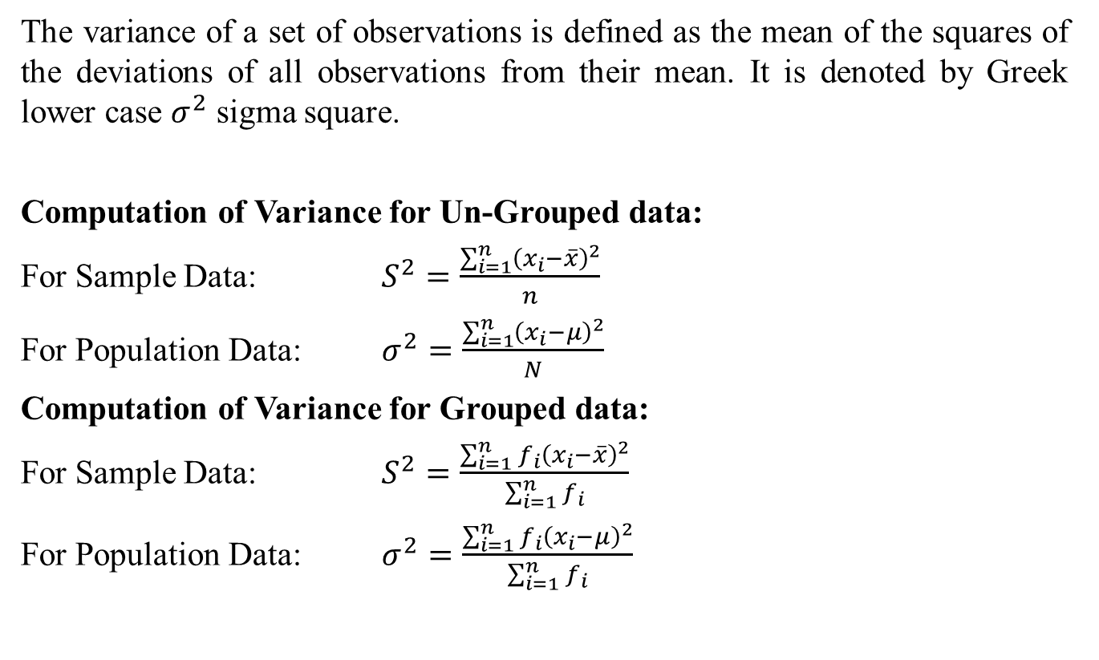
Variance
The variance of a set of observations is defined as the mean of the squares of the deviations of all observations from their mean. It is denoted by Greek lower case $σ^{2}$ sigma square.
Computation of Variance for Un-Grouped data:
For Sample Data: $S^{2}=\frac{\sum_{i=1}^{n}{{\left(x_{i}−\overline{x}\right)}^{2}}}{n}$
For Population Data: $σ^{2}=\frac{\sum_{i=1}^{n}{{\left(x_{i}−μ\right)}^{2}}}{N}$
Computation of Variance for Grouped data:
For Sample Data: $S^{2}=\frac{\sum_{i=1}^{n}{{f_{i}\left(x_{i}−\overline{x}\right)}^{2}}}{\sum_{i=1}^{n}{f_{i}}}$
For Population Data: $σ^{2}=\frac{\sum_{i=1}^{n}{{f_{i}\left(x_{i}−μ\right)}^{2}}}{\sum_{i=1}^{n}{f_{i}}}$

Slide 5
Variance
Note: Variance is in square of units in which the observations are expressed.
Because of some nice mathematical properties, variance assumes an extremely important role in statistics.
But Mean deviation due to absolute value of the deviations doesn’t have nice mathematical properties and hence its use is limited.

Slide 6
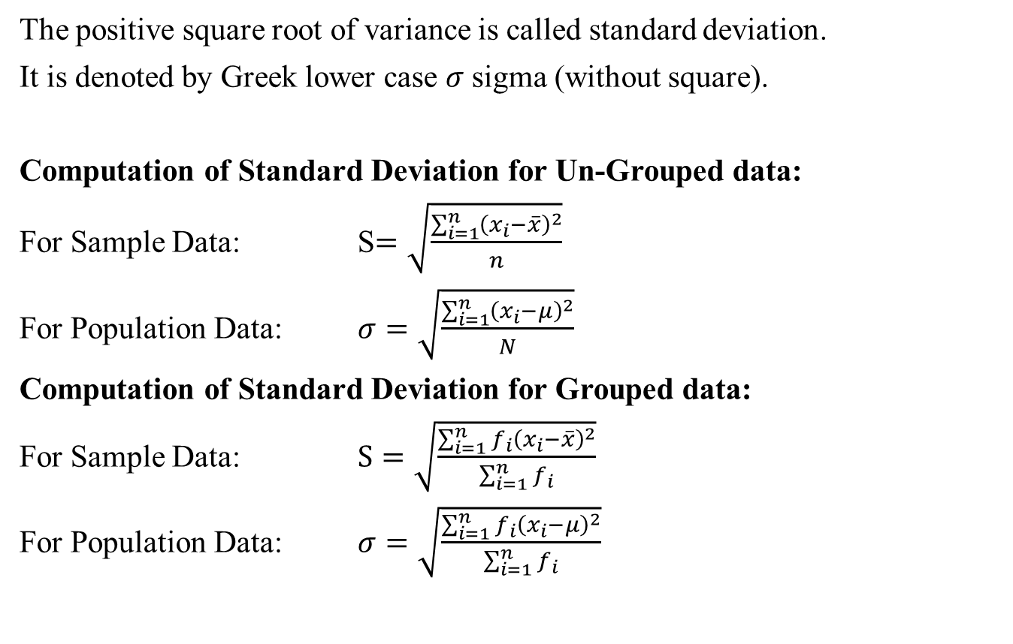
Standard Deviation
The positive square root of variance is called standard deviation.
It is denoted by Greek lower case $σ$sigma (without square).
Computation of Standard Deviation for Un-Grouped data:
For Sample Data: S$=\sqrt{\frac{\sum_{i=1}^{n}{{\left(x_{i}−\overline{x}\right)}^{2}}}{n}}$
For Population Data: $σ=\sqrt{\frac{\sum_{i=1}^{n}{{\left(x_{i}−μ\right)}^{2}}}{N}}$
Computation of Standard Deviation for Grouped data:
For Sample Data: $S=\sqrt{\frac{\sum_{i=1}^{n}{{f_{i}\left(x_{i}−\overline{x}\right)}^{2}}}{\sum_{i=1}^{n}{f_{i}}}}$
For Population Data: $σ=\sqrt{\frac{\sum_{i=1}^{n}{{f_{i}\left(x_{i}−μ\right)}^{2}}}{\sum_{i=1}^{n}{f_{i}}}}$

Slide 7
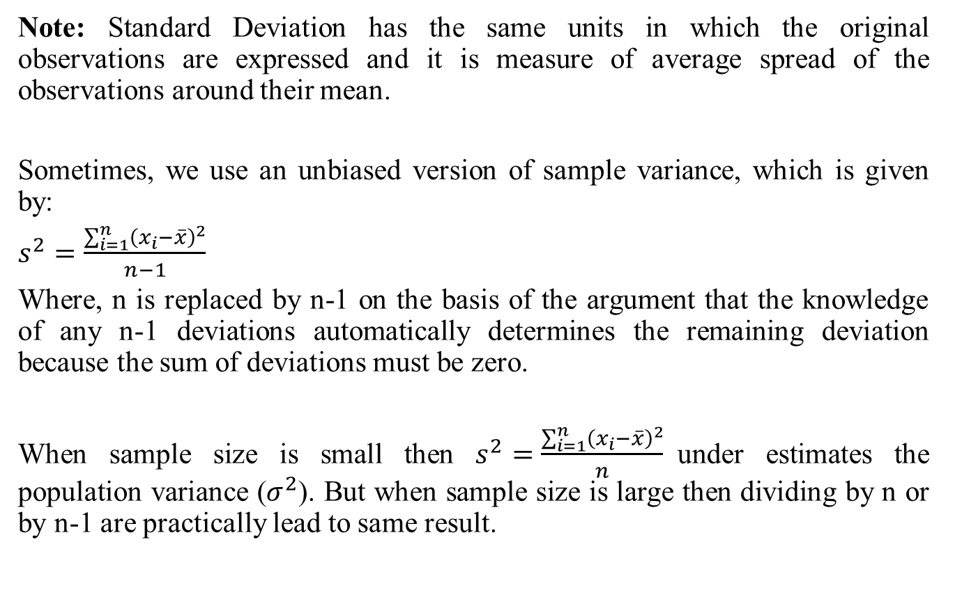
Standard Deviation
Note: Standard Deviation has the same units in which the original observations are expressed and it is measure of average spread of the observations around their mean.
Sometimes, we use an unbiased version of sample variance, which is given by:
$s^{2}=\frac{\sum_{i=1}^{n}{{\left(x_{i}−\overline{x}\right)}^{2}}}{n−1}$
Where, n is replaced by n-1 on the basis of the argument that the knowledge of any n-1 deviations automatically determines the remaining deviation because the sum of deviations must be zero.
When sample size is small then $s^{2}=\frac{\sum_{i=1}^{n}{{\left(x_{i}−\overline{x}\right)}^{2}}}{n}$under estimates the population variance ($σ^{2}$). But when sample size is large then dividing by n or by n-1 are practically lead to same result.

Slide 8
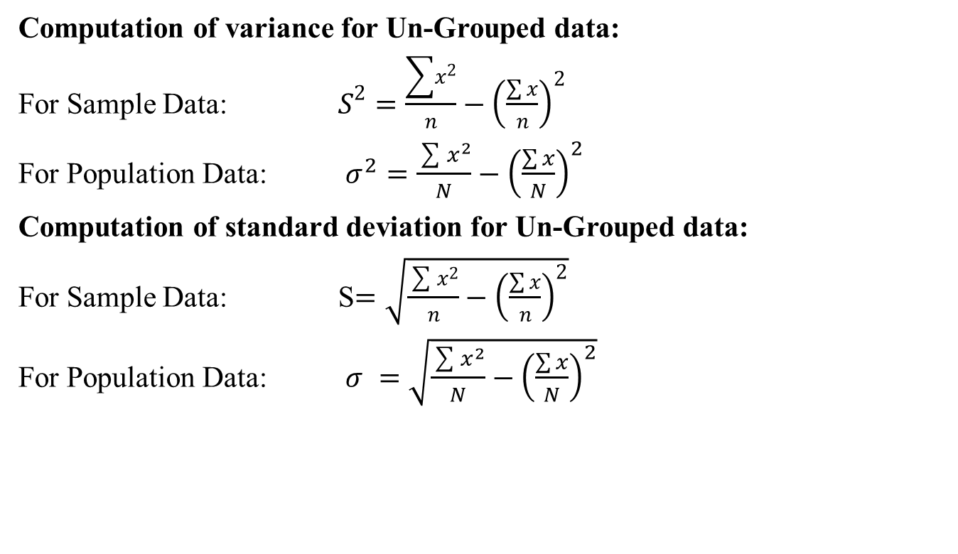
Alternative Formulas
Computation of variance for Un-Grouped data:
For Sample Data: $S^{2}=\frac{\sum{x^{2}}}{n}−{\left(\frac{\sum{x}}{n}\right)}^{2}$
For Population Data: $σ^{2}=\frac{\sum{x^{2}}}{N}−{\left(\frac{\sum{x}}{N}\right)}^{2}$
Computation of standard deviation for Un-Grouped data:
For Sample Data: S$=\sqrt{\frac{\sum{x^{2}}}{n}−{\left(\frac{\sum{x}}{n}\right)}^{2}}$
For Population Data: $σ =\sqrt{\frac{\sum{x^{2}}}{N}−{\left(\frac{\sum{x}}{N}\right)}^{2}}$

Slide 10
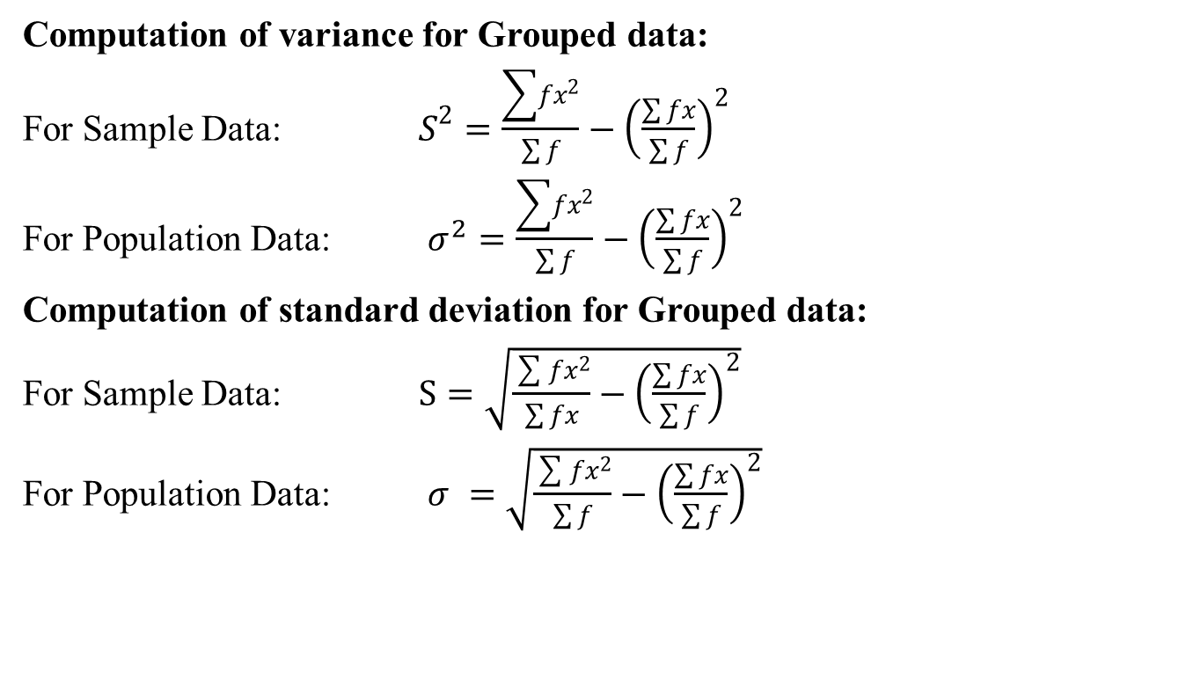
Alternative Formulas
Computation of variance for Grouped data:
For Sample Data: $S^{2}=\frac{\sum{fx^{2}}}{\sum{f}}−{\left(\frac{\sum{fx}}{\sum{f}}\right)}^{2}$
For Population Data: $σ^{2}=\frac{\sum{fx^{2}}}{\sum{f}}−{\left(\frac{\sum{fx}}{\sum{f}}\right)}^{2}$
Computation of standard deviation for Grouped data:
For Sample Data: $S=\sqrt{\frac{\sum{fx^{2}}}{\sum{fx}}−{\left(\frac{\sum{fx}}{\sum{f}}\right)}^{2}}$
For Population Data: $σ =\sqrt{\frac{\sum{fx^{2}}}{\sum{f}}−{\left(\frac{\sum{fx}}{\sum{f}}\right)}^{2}}$

Slide 11
Examples: Variance & SD
Example: The marks obtained by 9 students are given below:
45, 32, 37, 46, 39, 36, 41, 48, 36
Calculate:
a). Variance
b). Standard Deviation

Slide 12
Examples: Variance & SD
Solution:
Mean=Xbar=360/9
=40
Variance=
232/9=25.77
SD=5.077
 | X | X-Xbar | (x-xbar)^2
 | 45 | 5 | 25
 | 32 | -8 | 64
 | 37 | -3 | 9
 | 46 | 6 | 36
 | 39 | -1 | 1
 | 36 | -4 | 16
 | 41 | 1 | 1
 | 48 | 8 | 64
 | 36 | -4 | 16
Total | 360 | 0 | 232

Slide 13
Examples: Variance & SD
Example: Calculate: a). Variance b). Standard Deviation for the following frequency distribution:
Weights (grams) | Frequency (f)
65-84 | 9
85-104 | 10
105-124 | 17
125-144 | 10
145-164 | 5
165-184 | 4
185-204 | 5

Slide 14
Examples: Variance & SD
Mean=xbar=7350/60=122.5 grams
Weights (grams) | Frequency (f) | Mid Point (x) | f*x
65-84 | 9 | 74.5 | 670.5
85-104 | 10 | 94.5 | 945
105-124 | 17 | 114.5 | 1946.5
125-144 | 10 | 134.5 | 1345
145-164 | 5 | 154.5 | 772.5
165-184 | 4 | 174.5 | 698
185-204 | 5 | 194.5 | 972.5
Total | 60 |  | 7350

Slide 15
Examples: Variance & SD
Mean=xbar=7350/60=122.5 grams
variance= 72960/60=1216 SD=34.87
Weights (grams) | Frequency (f) | Mid Point (x) | f*x | x-xbar | (x-xbar)^2 | f*(x-xbar)^2
65-84 | 9 | 74.5 | 670.5 | -48 | 2304 | 20736
85-104 | 10 | 94.5 | 945 | -28 | 784 | 7840
105-124 | 17 | 114.5 | 1946.5 | -8 | 64 | 1088
125-144 | 10 | 134.5 | 1345 | 12 | 144 | 1440
145-164 | 5 | 154.5 | 772.5 | 32 | 1024 | 5120
165-184 | 4 | 174.5 | 698 | 52 | 2704 | 10816
185-204 | 5 | 194.5 | 972.5 | 72 | 5184 | 25920
Total | 60 |  | 7350 |  |  | 72960

Slide 16
Examples: using alternative formula
Example: Calculate: a). Variance b). Standard Deviation for the following data of marks using Alternative formula:
X
45
32
37
46
39
36
41
48
36

Slide 17
Examples: using alternative formula
Example: Calculate: a). Variance b). Standard Deviation for the following data of marks using Alternative formula:
X | X^2
45 | 2025
32 | 1024
37 | 1369
46 | 2116
39 | 1521
36 | 1296
41 | 1681
48 | 2304
36 | 1296

Slide 18
Examples: using alternative formula
Example: Calculate: a). Variance b). Standard Deviation for the following data of marks using Alternative formula:
X | X^2
45 | 2025
32 | 1024
37 | 1369
46 | 2116
39 | 1521
36 | 1296
41 | 1681
48 | 2304
36 | 1296
360 | 14632

Slide 19
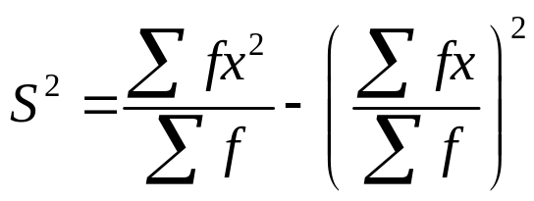
Examples: using alternative formula
Example: Calculate: a). Variance b). Standard Deviation for the following frequency distribution using Alternative formula:
Weights (grams) | Frequency (f)
65-84 | 9
85-104 | 10
105-124 | 17
125-144 | 10
145-164 | 5
165-184 | 4
185-204 | 5
Total | 60

Slide 20
Examples: using alternative formula
Example: Calculate: a). Variance b). Standard Deviation for the following frequency distribution using Alternative formula:
Weights (grams) | Frequency (f) | Mid Point (x) | f*x | x^2 | f*x^2
65-84 | 9 | 74.5 | 670.5 | 5550.25 | 49952.25
85-104 | 10 | 94.5 | 945 | 8930.25 | 89302.5
105-124 | 17 | 114.5 | 1946.5 | 13110.25 | 222874.3
125-144 | 10 | 134.5 | 1345 | 18090.25 | 180902.5
145-164 | 5 | 154.5 | 772.5 | 23870.25 | 119351.3
165-184 | 4 | 174.5 | 698 | 30450.25 | 121801
185-204 | 5 | 194.5 | 972.5 | 37830.25 | 189151.3
Total | 60 |  |  |  | 973335

Slide 21

Examples: using alternative formula
Example: Calculate: a). Variance b). Standard Deviation for the following frequency distribution using Alternative formula:
Weights (grams) | Frequency (f) | Mid Point (x) | f*x | x^2 | f*x^2
65-84 | 9 | 74.5 | 670.5 | 5550.25 | 49952.25
85-104 | 10 | 94.5 | 945 | 8930.25 | 89302.5
105-124 | 17 | 114.5 | 1946.5 | 13110.25 | 222874.3
125-144 | 10 | 134.5 | 1345 | 18090.25 | 180902.5
145-164 | 5 | 154.5 | 772.5 | 23870.25 | 119351.3
165-184 | 4 | 174.5 | 698 | 30450.25 | 121801
185-204 | 5 | 194.5 | 972.5 | 37830.25 | 189151.3
Total | 60 |  | 7350 |  | 973335
$$=1216$$

Slide 22
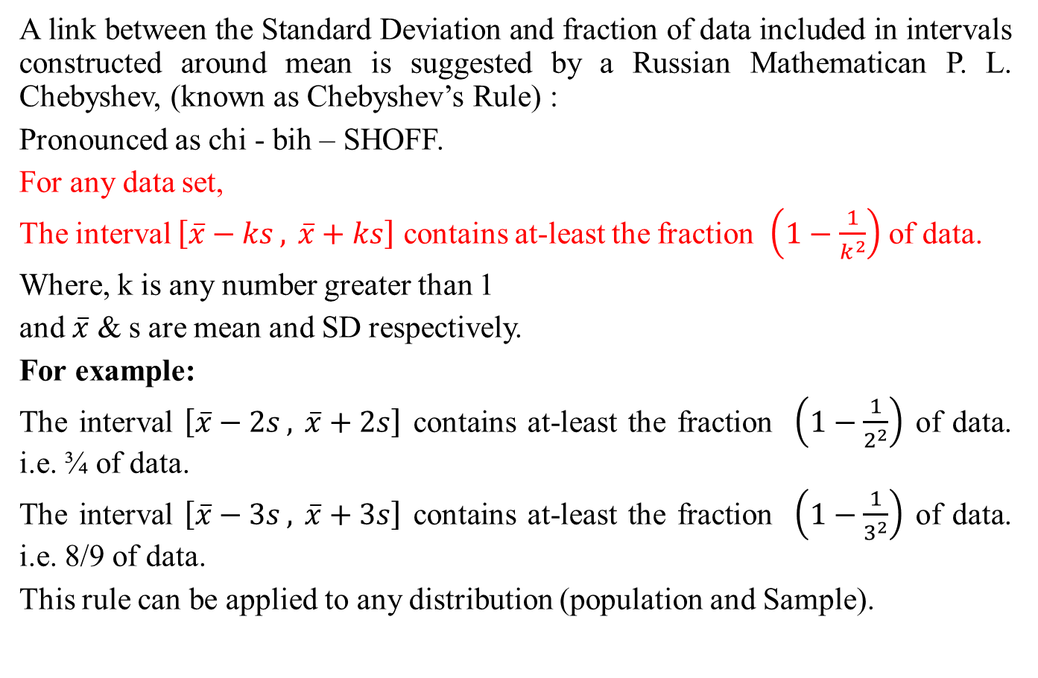
Chebyshev’s Rule
A link between the Standard Deviation and fraction of data included in intervals constructed around meanis suggested by a Russian Mathematican P. L. Chebyshev, (known as Chebyshev’s Rule) :
Pronounced as chi - bih– SHOFF.
For any data set,
The interval $\left[\overline{x}−ks , \overline{x}+ks\right]$ contains at-least the fraction $\left(1−\frac{1}{k^{2}}\right)$ of data.
Where, k is any number greater than 1
and $\overline{x}$& s are mean and SD respectively.
For example:
The interval $\left[\overline{x}−2s , \overline{x}+2s\right]$ contains at-least the fraction $\left(1−\frac{1}{2^{2}}\right)$ of data. i.e. ¾ of data.
The interval $\left[\overline{x}−3s , \overline{x}+3s\right]$ contains at-least the fraction $\left(1−\frac{1}{3^{2}}\right)$ of data. i.e. 8/9 of data.
This rule can be applied to any distribution (population and Sample).

Slide 23
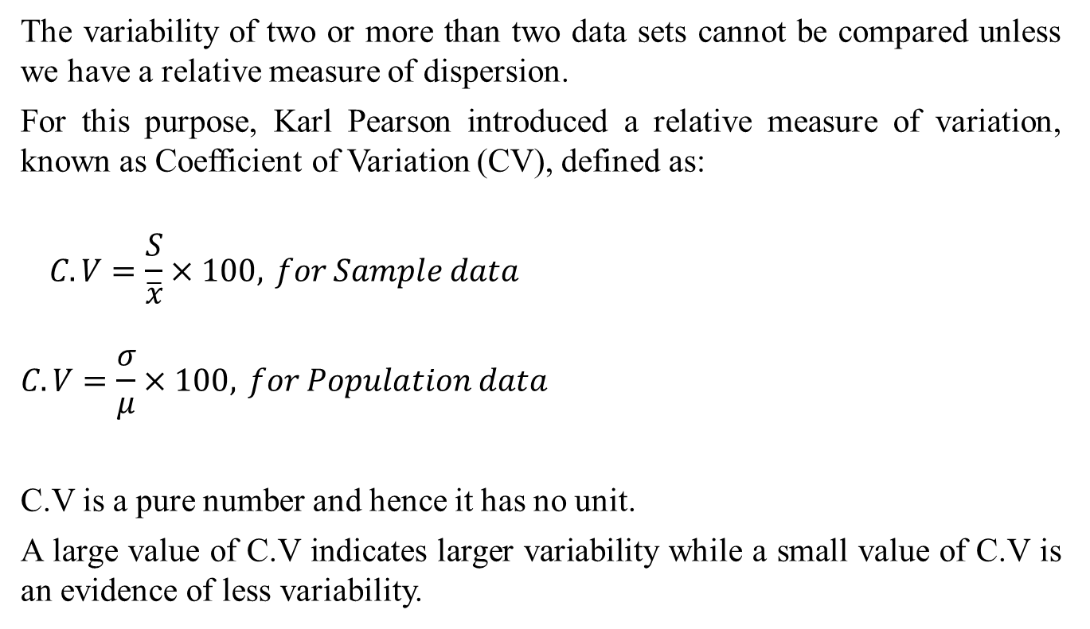
Coefficient of Variation
The variability of two or more than two data sets cannot be compared unless we have a relative measure of dispersion.
For this purpose, Karl Pearson introduced a relative measure of variation, known as Coefficient of Variation (CV), defined as:
$$\begin{matrix}\begin{aligned}C.V=\frac{S}{\overline{x}}×100, for Sample data \\ \end{aligned} \\ C.V=\frac{σ}{μ}×100, for Population data\end{matrix}$$
C.V is a pure number and hence it has no unit.
A large value of C.V indicates larger variability while a small value of C.V is an evidence of less variability.

Slide 24
Coefficient of Variation
We can use Coefficient of variation to compare the performance of two individuals (candidates, players etc.) in various situations (exams, games etc.).
The smaller the C.V is the more consistent the player or individual is.
Note: When mean is very small then C.V is UNRELIABLE.
Example: Data on goals scored by two teams (A & B) is given below:
Team A: 27, 9, 8, 5, 4
Team B: 17, 9, 6, 5, 3
By calculating C.V., find which team is more consistent.
Solution:
Note that C.V of Team A is larger than C.V of
Team B, so team B is more consistent than
Team A.
 | Team A | Team B
 | 27 | 17
 | 9 | 9
 | 8 | 6
 | 5 | 5
 | 4 | 3
Mean | 10.6 | 8
SD | 8.404761 | 4.898979
CV | 79.30% | 61.20%

Slide 25
Properties of variance
Some useful properties of variance are:
The variance of a constant is equal to zero.
Symbolically, Var(a)=0, where a is any constant.
The variance is independent of the origin, i.e. it remains unchanged when a constant is added to or subtracted from each observation of the variable X.
Symbolically, Var(X+a)=Var(X) or Var(X-a)=Var(X) where a is any constant.
The variance is multiplied or divided by the square of the constant when each observation of the variable X is either multiplied or divided by a constant.
Symbolically, Var(aX)=a²Var(X) and Var(X/a)=1/a² Var(X)

Slide 26
Properties of variance
The variance of the sum or difference of two independent variables (X and Y) is equal to sum of their respective variances.
Var(X+Y)=Var(X)+Var(Y)
Var(X-Y)=Var(X)+Var(Y)
But if X and Y are not independent then
Var(X+Y)=Var(X)+Var(Y)+2Cov(X,Y)
Var(X-Y)=Var(X)+Var(Y)-2Cov(X,Y)

Slide 27

Properties of SD
Since SD is the positive square root of variance, so all properties of variance are valid for SD as well.
SD(a)=0, where a is any constant.
SD(X+a)=SD(X) or SD(X-a)=SD(X) where a is any constant.
SD(aX)=|a| SD(X), since SD can’t be negative.
SD(X/a)=|1/a| SD(X) , since SD can’t be negative.
SD
$\left(X±Y\right)=\sqrt{Var\left(X\right)+Var\left(Y\right)}$

Slide 28
Review
Let’s review the main concepts:
Measures of Dispersion
    Variance and Standard Deviation
    Coefficient of Variation
    Properties of variance and standard deviation

Slide 29
Next Lecture
In next lecture, we will study:
Moments
  Moments about Mean (Central Moments)
  Moments about any arbitrary Origin
  Moments about Zero
  Related Excel Demos

Slide 30
Next Lecture
In next lecture, we will study:
Relation b/w central moments and moments about origin
Moment Ratios
Skewness
Kurtosis

