Slide 1
Lecture 32
APPLICATIONS OF BIVARIATE OPTIMIZATION

Slide 2
Last Lecture Summary
We covered section 20.3:
Optimization of Bivariate Functions
Critical Points and their types
Relative Maximum and Minimum
Test for critical points

Slide 3
Today
We will go over section 20.4:
Applications of Bivariate Optimization

Slide 4
Applications of Bivariate Optimization
This section presents some applications of the optimization of bivariate functions.

Slide 5
EXAMPLE:
Advertising Expenditures:
Example 9 involved a manufacturer who estimated annual sales (in units) to be a function of the expenditures made for radio and TV advertising. The function specifying this relationship was stated as

Slide 6
where z equals the number of units sold each year, x equals the amount spent for TV advertising and y equals the amount spent for radio advertising (x and y both in $1,000s). Determine how much money should be spent on TV and radio in order to maximize the number of units sold.

Slide 11
EXAMPLE:
Pricing Model
A manufacturer sells two related products, the demands for which are estimated by the following two demand functions:

Slide 12
where p_{j} equals the price (in dollars) of product j and q_{j} equals the demand (in thousands of units) for product j. Examination of these demand functions indicates that the two products are related. The demand for one product depends not only on the price charged for the product itself but also on the price charged for the other product.
The firm wants to determine the price it should charge for each product in order to maximize total revenue from the sale of the two products.

Slide 13
SOLUTION:
This revenue-maximizing problem is exactly like the single-product problems discussed in Chap. 17. The only difference is that there are two products and two pricing decisions to be made.
Total revenue from selling the two products is determined by the function

Slide 14
This function is stated in terms of four independent variables. As with the single-product problems, we can substitute the right side of Eqs. (20.14) and (20.15) into Eq. (20.16) to yield

Slide 15
We can now proceed to examine the revenue surface for relative maximum points.
The first partial derivatives are

Slide 18
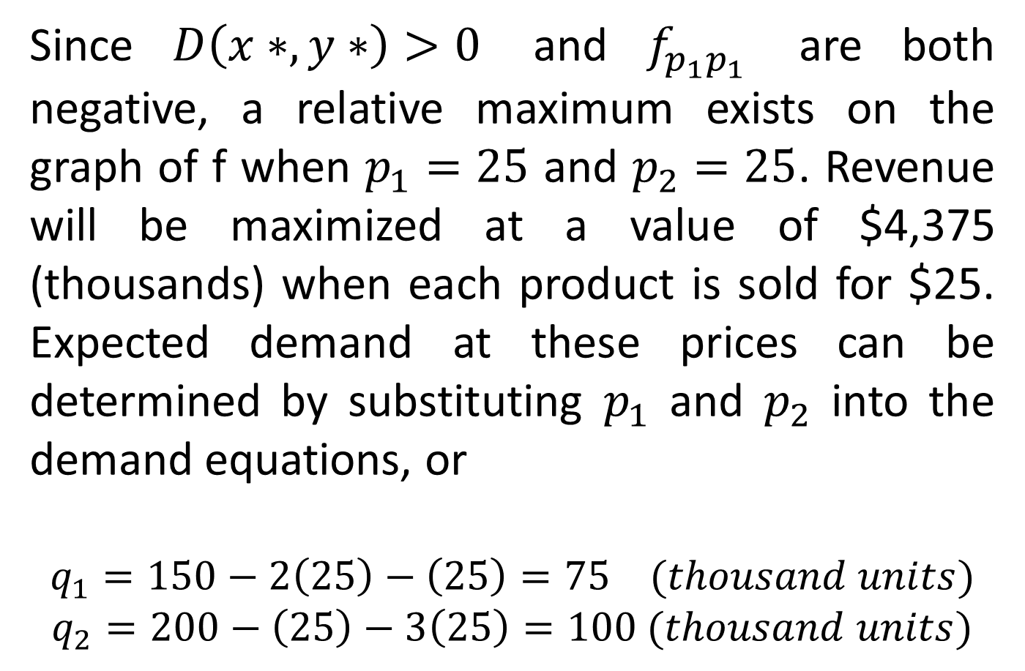
Since $D\left(x∗,y∗\right)>0$ and $f_{p_{1}p_{1}}$ are both negative, a relative maximum exists on the graph of f when $p_{1}=25$ and $p_{2}=25$. Revenue will be maximized at a value of $4,375 (thousands) when each product is sold for $25. Expected demand at these prices can be determined by substituting $p_{1}$ and $p_{2}$ into the demand equations, or
$$q_{1}=150−2\left(25\right)−\left(25\right)=75 (thousand units)$$
$$q_{2}=200−\left(25\right)−3\left(25\right)=100 (thousand units)$$

Slide 19
EXAMPLE:
Satellite Clinic Location
A large health maintenance organization (HMO) is planning to locate a satellite clinic in a location which is convenient to three suburban townships, the relative locations of which are indicated in Fig. 20.18. The HMO wants to select a preliminary site by using the following criterion: Determine the location (x, y) which minimize the sum of the squares of the distances from each township to the satallite clinic.

Slide 21
SOLUTION:
The unknown in this problem are x and y, the coordinates of the satellite clinic location we need to determine an expression for the square of the distance separating the clinic and each of the towns. The Pythagorean theorem* provide this for us. Given two points (x₁, y₁) and (x₂, y₂), the square of the distance d separating these two points is found using the equation

Slide 22
To illustrate, the square of the distance separating the clinic with location (x, y) and township A located at (40, 20) is

Slide 24
Finding similar expressions for the square of the distance separating township B and the clinic and summing for the three township, we get

Slide 27
EXAMPLE:
Method of Least Square: Finding the Best Fit to a Set of Data Points; Motivating Scenario
Organizations gather data regularly on a multitude of variables which are related to their operation. One major area of analysis deals with determining whether there are any patterns to the data – are there any apparent relationships among the variables of interest? For example, the demand functions to which we have continually referred have most likely been determined by gathering data on the demand

Slide 28
a product at different prices. And analysis of this data translate into an estimated demand function.
Consider the four data points (x₁, y₁), (x₂, y₂), (x₃, y₃), and (x₄, y₄) in the following figure, which have been gathered for the variables x and y. Suppose there is evidence suggesting that x and y are related and that the nature of the relationship is linear. And suppose that we would like to fit a straight line to these points, the equation of which would be used as an approximation of the actual relationship existing

Slide 30
between x and y. The question becomes, what line best fit the data points? There are an infinite number of straight lines which can be fit to these data points, each having the general form.
The difference between each line would be in the slope a and /or the y coordinate of the intercept b. Note the subscript on y_{p} in the following figure. This notation indicates that the line fit to the data points can be used to predict values of y, given a known value of x.

Slide 31
In the following figure, the predicted values of y, given the x coordinates of the four data points are indicated on the line. The vertical distance separating the actual data point and the corresponding point on the line is a measure of the error introduced by using the line to predict the location of the data point. The error, indicated by the d_{j} values in the following figure, is called the deviation between the actual value of y and the predicted value of y for the jth data point, or

Slide 33
Given that we wish to find the “best” line to fit to the data points, the next question is, How do you define best? One of the most popular methods of finding the line of best fit is the Least square model. The least squares model defines best as the line which minimizes the sum of the squared deviations for all the sample data points.
Given a set of n data points, the method of least squares seeks the line which minimizes

Slide 34
For any line y_{p} = ax + b chosen to fit the data points, The above equation can be rewritten as

Slide 35
The method of least square seeks the values of a and b which result in a minimum value for S.
In above figure we would seek the line which minimize.

Slide 36
Consider the simple case where a firm has observed the demand for its product at three different price levels. The following table indicates the price-demand combinations. The following figure is a graph of the data. Suppose that we wish to determine the line of best fit to these data points using the least squares model. The least squares function is generated using the following equation.

Slide 38
TABLE:
y (demand in thousands of units) 50 30 20
x (price in dollars) 5 10 15

Slide 39
To determine the values of a and b which minimize S, we find the partial derivatives with respect to a and b.

Slide 42
Review
We covered section 20.4:
Applications of Bivariate Optimization
Finshed Chapter 2.
Finished the material for the course
Business Mathematics-II

Slide 43
Review of the Course
Linear programming
Graphical Method
Simplex Method
Special Phenomenon
Computer Solution Method
Dual Problem
Transportation and Assignment Models
Solutions to Transportation Models, Assignment Model and method of Solution

Slide 44
CALCULUS
Limits, Average Rate of change, Differentiation
Additional Rules of Differentiation
Optimization, Identification of Maxima and Minima
Revenue, Cost, and Profit Applications
Integration and Techniques of integration
Definite integral, Applications of integral Calculus
First order Differential Equations (Separable Variables and Linear equations)
Mathematical Modeling using first order differential equations
Functions of several variables, Partial Derivatives and its applications

Slide 45
Chapter wise contents from Budnick:
Chapter 10: Linear Programming
Chapter 11: The Simplex Method
Chapter 12: Transportation and Assignment Models

Slide 46
Course Outline Cont’d...
THE CALCULUS
Chapter 15: Differentiation
Chapter 16: Optimization; Methodology
Chapter 17: Optimization; Applications
Chapter 18: Integral Calculus; An Introduction
Chapter 19: Integral Calculus; Applications
Chapter 20: Functions of Several Variables

Slide 47
THANK YOU

