Slide 1
Lecture 31
OPTIMIZATION OF BIVARIATE FUNCTIONS

Slide 2
Last Lecture Summary
We covered section 20.2: Partial Derivatives
Partial Derivatives of Bivariate Functions
Interpreting Partial Derivatives
Second-Order Partrial Derivatives

Slide 3
Today
We will go over section 20.3:
Optimization of Bivariate Functions
Critical Points
Relative Maximum and Minimum
Necessary condition for Relative Extrema
Distinguishing among Critical Points
Test for critical points

Slide 4
Optimization of Bivariate Functions
The process of finding optimum values of bivariate functions is very similar to that used for single-variable functions. This section discusses the process.

Slide 5
Critical Points
As with single-variable functions, we will have a particular interest in identifying relative maximum and minimum points on the surface representing a function f(x,y).
Relative maximum and minimum points have the same meaning in three dimensions as in two dimensions.

Slide 6
DEFINITION: RELATIVE MAXIMUM
A function z = f (x, y) is said to have a relative maximum at x = a and y = b if for all points (x, y) “sufficiently close” (a, b)
f (a, b) ≥ f (x, y)
A relative maximum usually appears as the top or peak of a mound on the surface representing f (x, y).

Slide 7
DEFINITION: RELATIVE MINIMUM
A function z = f (x, y) is said to have a relative minimum at x = a and y = b if for all points (x, y) “sufficiently close” (a, b)
f (a, b) ≤ f (x, y)
A relative minimum usually appears as the bottom of a valley on the surface representing f (x, y).

Slide 9
NECESSARY CONDITION FOR RELATIVE EXTREMA
A necessary condition for the existence of a relative maximum or a relative minimum of a function f whose partial derivatives f_{x} and f_{y} both exist is that
f_{x} = 0 and f_{y} = 0

Slide 12
The values x* and y* at which f_{x} = 0 and f_{y} = 0 are critical values. The corresponding point (x*, y*, f (x*, y*)) is a candidate for a relative maximum or minimum on f and is called a critical point.

Slide 13
EXAMPLE:
Locate any critical points on the graph of the function.

Slide 15
EXAMPLE:
To locate any critical points on the graph of the function.

Slide 18
Distinguishing among Critical Points
Once a critical point has been identified, it is necessary to determine its nature. Aside from relative maximum and minimum points, there is one other situation in which f_{x} and f_{y} both equal 0. Which is referred to as a saddle point. A saddle point is a portion of a surface which has the shape of a saddle. At point A – “where you sit on the horse” – the value of f_{x} and f_{y} both equal 0. However, the function does not reach either a relative maximum or a relative minimum at A.

Slide 20
TEST OF CRITICAL POINT
Given that a critical point of f is located at (x*, y*, z) where all second partial derivatives are continuous, determine the value of D (x*, y*), where

Slide 21
I- If D(x*, y*)>0, the critical point is
a- a relative maximum if both f_{xx}(x*, y*) and f_{yy}(x*,y*) are negative,
b- a relative minimum if both f_{xx}(x*, y*) and f_{yy}(x*, y*) are positive.
II- If D(x*,y*)<0, the critical point is a saddle point.
III- If D(x*, y*)=0, other techniques (beyond the scope of this text) are required to determine the nature of the critical point.

Slide 23
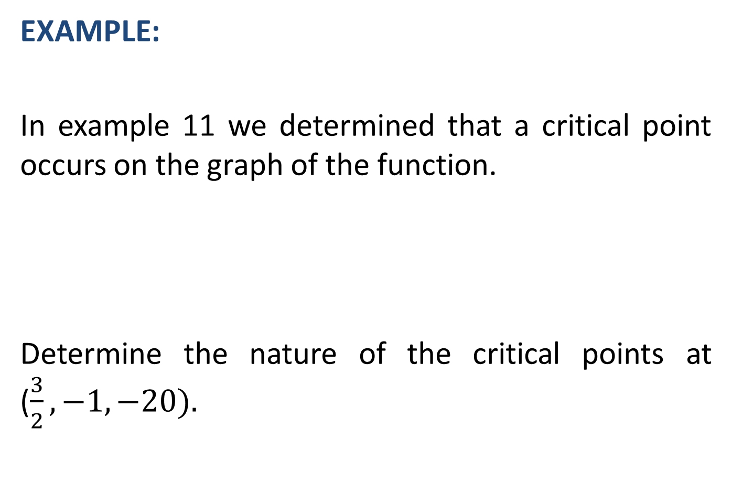
EXAMPLE:
In example 11 we determined that a critical point occurs on the graph of the function.
Determine the nature of the critical points at ($\frac{3}{2},−1,−20).$

Slide 26
EXAMPLE:
To determine the location and nature of any critical points for the function

Slide 29
EXAMPLE:
In example 13 we determined that critical points occur on the graph of the function at (0, 1, 0) and (4, 3, 16).

Slide 33
EXAMPLE:
Given the function
determine the location and nature of all critical points.

Slide 37
Review
We covered section 20.3:
Optimization of Bivariate Functions
Critical Points and their types
Relative Maximum and Minimum
Test for critical points
Next, Applications of Bivariate Optimization

