Slide 1
Lecture 28
Linear Differential Equations

Slide 2
Last Lecture Summary
Last time, we covered the topic:
Separable Differential Equations
Separable Equations
Method of Solution

Slide 3
Today
We will cover the topic:
Linear Differential Equations
Applications of Differential Equation – Mathematical Modeling

Slide 4
Linear Equations
An equation of the form
is called a (1st Order) Linear Differential Equation.
1st Order – because the highest derivative appearing in the equation is of order 1.

Slide 5
The equation can be rewritten in the following famous form
where and are continuous functions.

Slide 7
Method of solution
The general solution of the first order linear differential equation is given by
The function is called the integrating factor.
If there is an IC given, then we use it to find the constant C.

Slide 8
Summary:
Identify that the equation is 1st order linear equation. Rewrite it in the form
if the equation is not already in this form.
2. Find the integrating factor

Slide 9
3. Write down the general solution
4. If you are given an IVP, use the initial condition to find the constant C.
5. Plug in the calculated value to write the particular solution of the problem.

Slide 10
Example
Solve
Solution: This is already in the standard form
Where and

Slide 11
Now the integrating factor is
Multiplying with the , we get

Slide 14
Example
Solve

Slide 19
Modeling with Differential Equations
By the term mathematical modeling we mean the process whereby the behavior of a real – life system or phenomenon, whether physical, sociological, or even economics is described by a set of mathematical relations, after approximation and idealizations. Construction of mathematical model starts with

Slide 20
Identification of the system for modeling. This requires selection of some variables as important to understanding or describing the behavior of the system and ignoring other as marginal or irrelevant to this understanding.
Making some realistic assumption, or hypothesis, about the system we are describing. These assumptions will also include any empirical laws that may be applicable of the system.

Slide 21
Modeling steps are the steps that lead from the physical situation to a mathematical formulation and solution, then physical interpretation of the result.
Now, let’s solve some models that are described by linear first order differential equations.

Slide 22
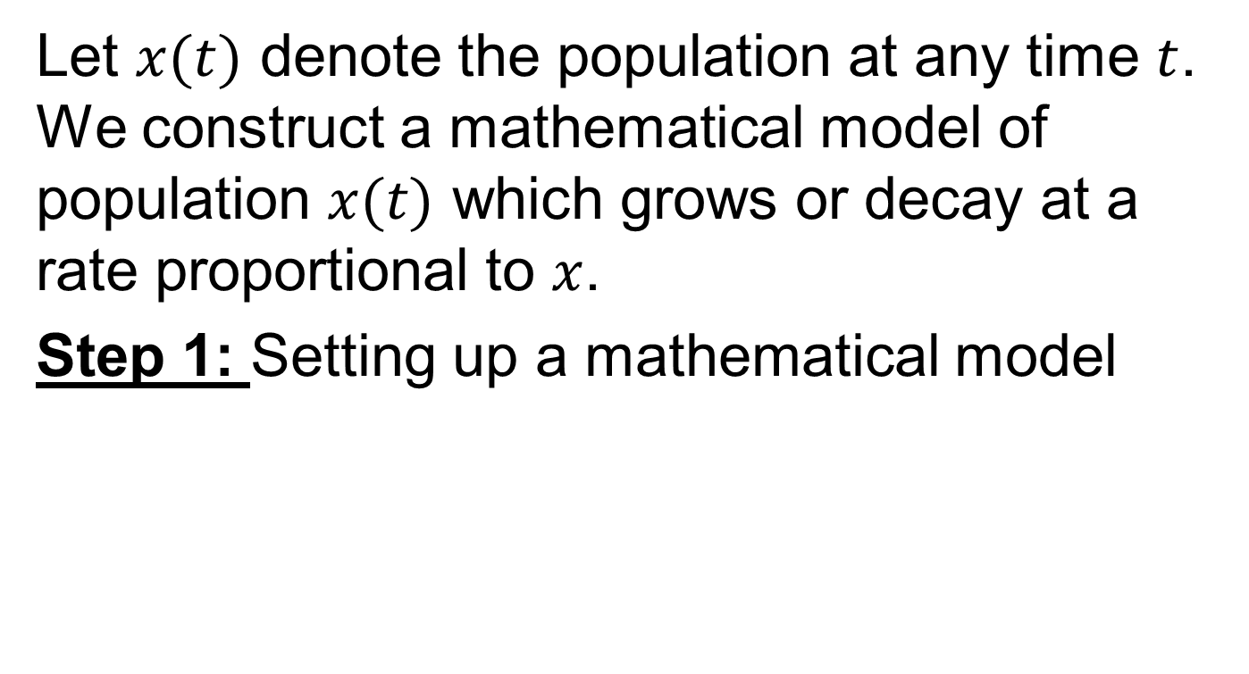
Growth and Decay :

Slide 23
Step 2: Solving the differential equation obtained
………………..(1)
Integrating (1), we obtain

Slide 24
…………………(2)
K > 0, for growth
K < 0, for decay
C is an arbitrary constant and can be determined by using initial condition and value of k changes from problem to problem.
Step 3: Interpretation of the result.

Slide 25
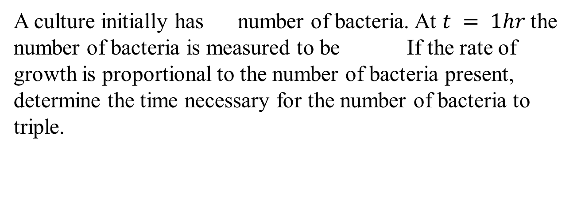
Example (Bacterial Growth)
Solution:
We first solve the differential equation
…………………..(1)

Slide 26
Subject to . Then we use the empirical condition to determine the constant of proportionality k. Now Eq. (1) is both separable and linear. When it is put into the form
……...(2)
We can see by inspection that the integrating factor is .
Multiplying (2) with , we get
……………….(3)
Integrating (3)
……………….(4)

Slide 28
It follows from , that
so equation (4) takes the form
……………….(5)
at , we have

Slide 29
Thus
To find the time at which the bacteria have tripled we solve

Slide 31
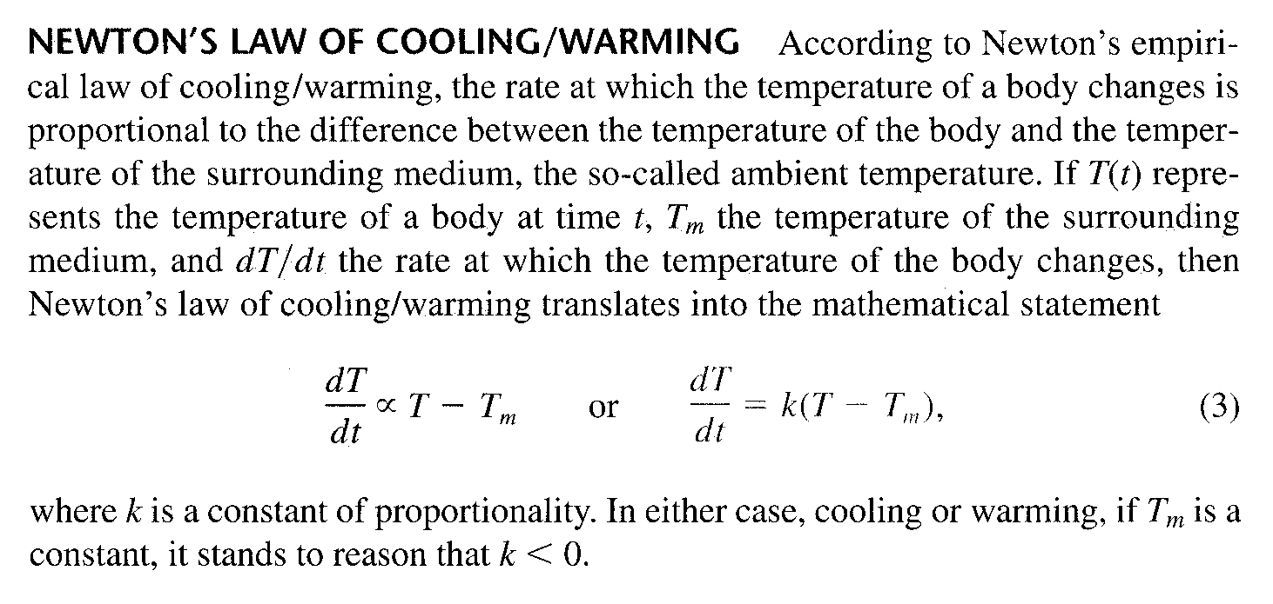

Slide 32
Example (Cooling of a Cake)
When a cake is removed from an oven, its temperature is measured at 300ºF. Three minutes later its temperature is 200ºF. How long will it take for the cake to cool off to a room temperature of 70ºF?
Solution:

Slide 40
Review
We covered the topic:
Linear Differential Equations
Applications of Differential Equations – Mathematical Modelig
Next time, we will start Chapter 20:
Functions of Several Variables

