Slide 1
Lecture 27
Separable Differential Equations

Slide 2
Last Lecture Summary
We covered section 19.5:
Integral Calculus and Probability
Finished Chapter 19.

Slide 3
Today
We will cover the topic:
Separable Differential Equations
Method of their Solutions

Slide 4
REVIEW MATERIAL
Basic integration formulas
Techniques of integration

Slide 5
Separable Equations
Recall that the general form of a 1st order differential equation is
Now, if , then the function f is said to be a separable function and hence the above DE is said to be a separable differential equation.

Slide 6
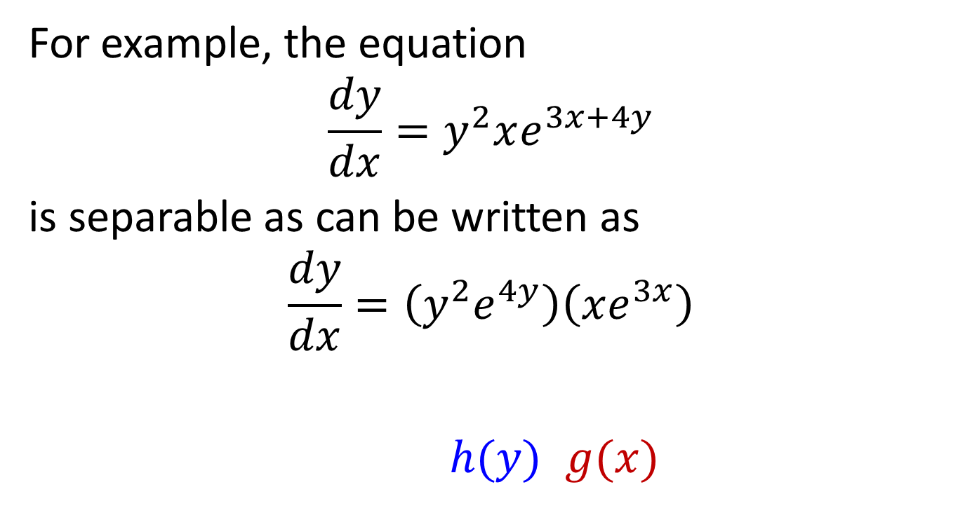
For example, the equation
$$\frac{dy}{dx}=y^{2}xe^{3x+4y}$$
is separable as can be written as
$$\frac{dy}{dx}=\left(y^{2}e^{4y}\right)\left(xe^{3x}\right)$$
$h(y)$ $g(x)$

Slide 7
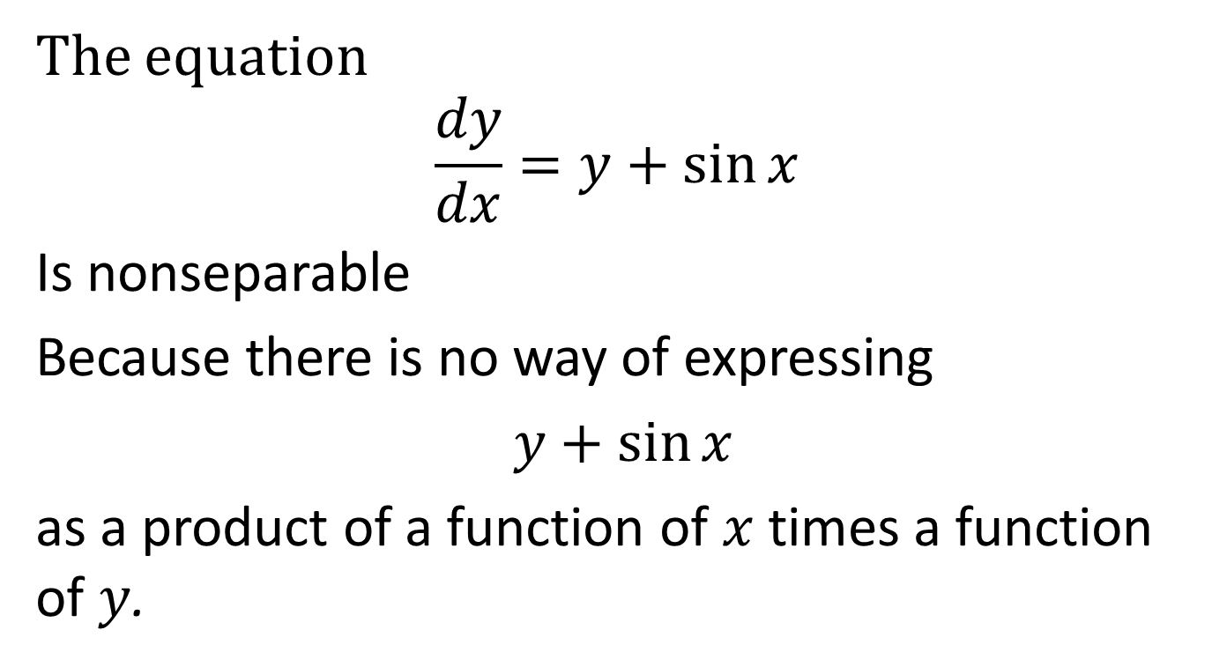
The equation
$$\frac{dy}{dx}=y+\sin{x}$$
Is nonseparable
Because there is no way of expressing
$y+\sin{x}$
as a product of a function of $x$ times a function of $y$.

Slide 8
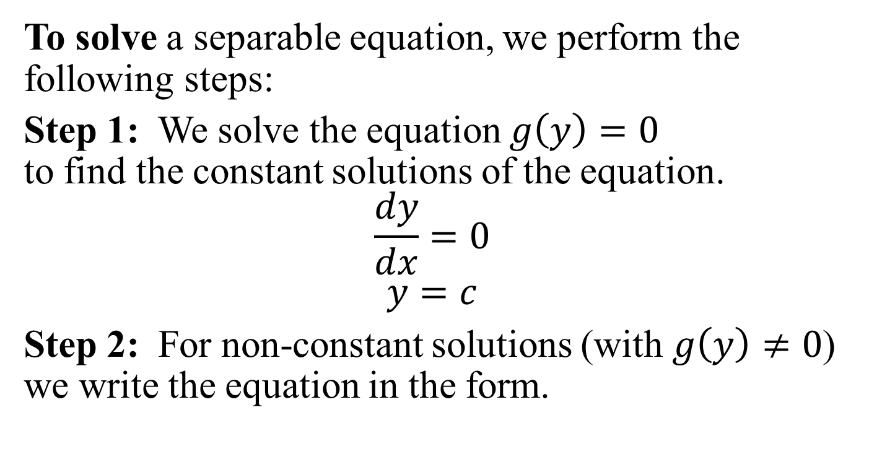
Solution of Separable Equation
To solve a separable equation, we perform the following steps:
Step 1: We solve the equation $g\left(y\right)=0$ to find the constant solutions of the equation.
$$\frac{dy}{dx}=0$$
$$y=c$$
Step 2: For non-constant solutions (with $g\left(y\right)≠0$) we write the equation in the form.

Slide 9
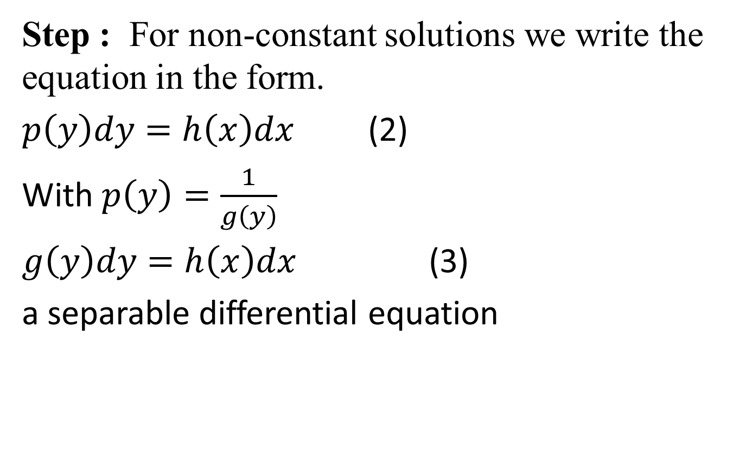
Step : For non-constant solutions we write the equation in the form.
$p\left(y\right)dy=h\left(x\right)dx$ (2)
With $p\left(y\right)=\frac{1}{g\left(y\right)}$
$g\left(y\right)dy=h\left(x\right)dx$ (3)
a separable differential equation

Slide 10
‘y’ only
‘x’ only
Now, integrating both sides
A function of y, say G(y)
A function of x, say H(x)

Slide 11
to obtain a solution of the form
Step3: We list the entire constant and the non-constant solutions of the equation.
Step 4: If you are given an IVP, use the initial condition to find the particular solution.

Slide 13
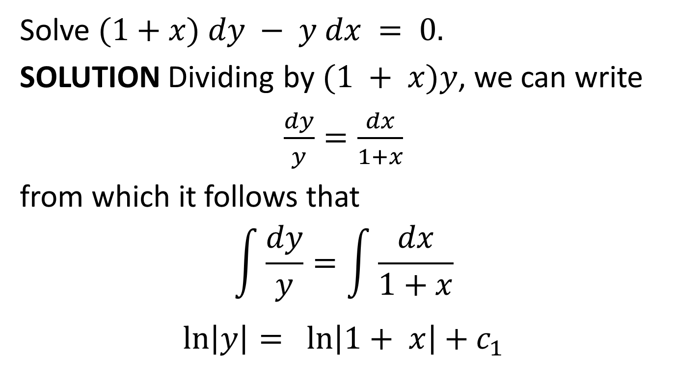
Solving a Separable DE
Solve $(1+x) dy − y dx = 0.$
SOLUTION Dividing by $(1 + x)y$, we can write
$\frac{dy}{y}=\frac{dx}{1+x}$
from which it follows that
$$\int{\frac{dy}{y}}=\int{\frac{dx}{1+x}}$$
$$\ln\left|y\right|= \ln\left|1+ x\right|+c_{1}$$

Slide 14
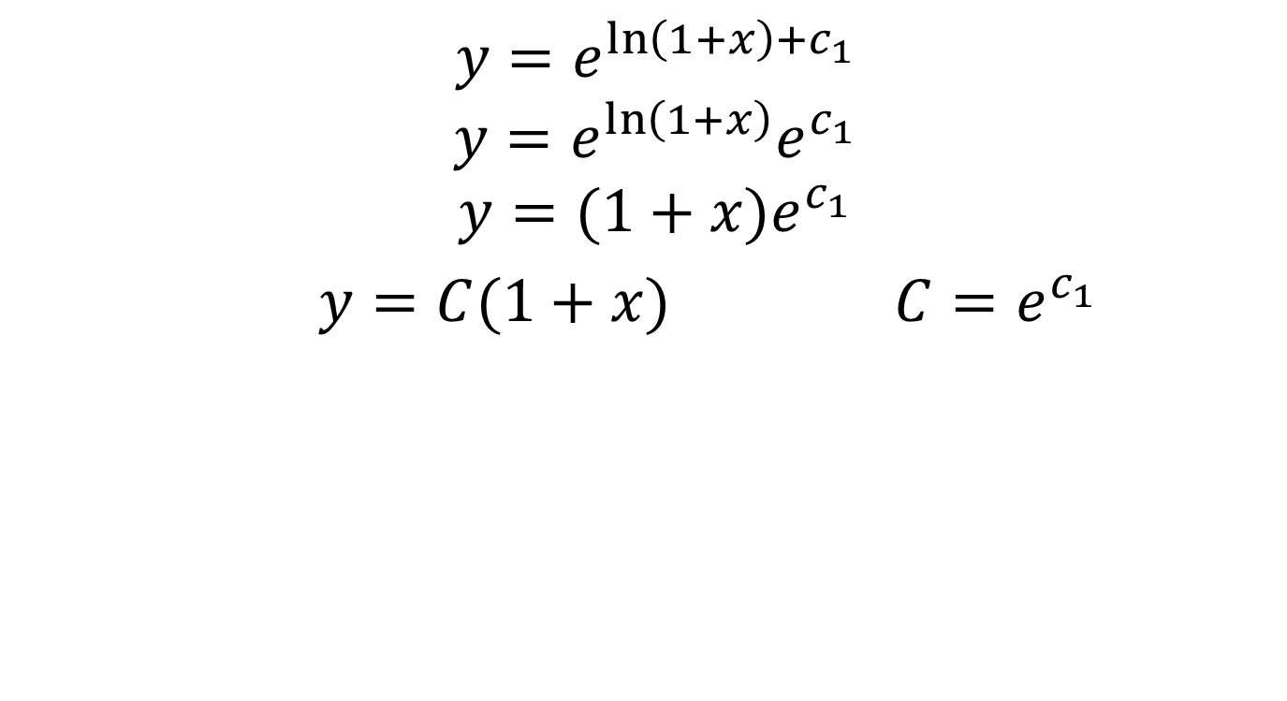
$$y=e^{\ln\left(1+x\right)+c_{1}}$$
$$y=e^{\ln\left(1+x\right)}e^{c_{1}}$$
$$y=(1+x)e^{c_{1}}$$
$y=C(1+x)$ ${C=e}^{c_{1}}$

Slide 15
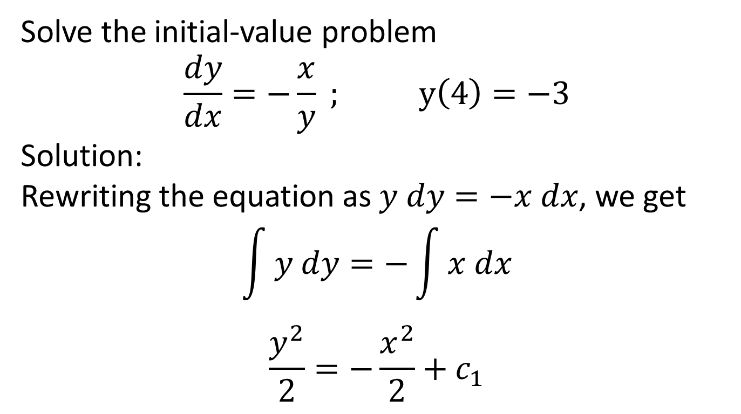
Example
Solve the initial-value problem
$$\frac{dy}{dx}=−\frac{x}{y} ; y\left(4\right)=−3$$
Solution:
Rewriting the equation as $y dy=−x dx$, we get
$$\int{y dy}=−\int{x dx}$$
$$\frac{y^{2}}{2}=−\frac{x^{2}}{2}+c_{1}$$

Slide 16
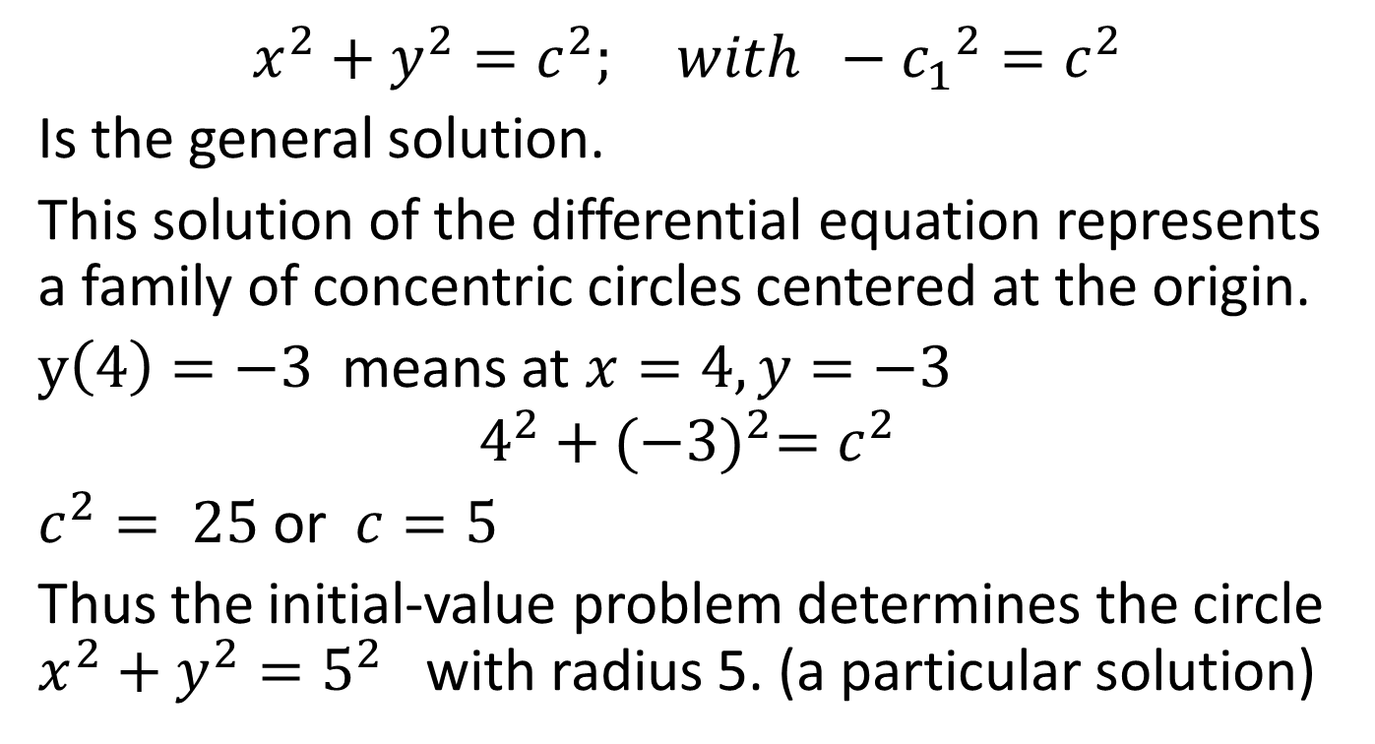
$$x^{2}+y^{2}=c^{2}; with −{c_{1}}^{2}{=c}^{2}$$
Is the general solution.
This solution of the differential equation represents a family of concentric circles centered at the origin.
$y\left(4\right)=−3$ means at $x=4, y=−3$
$$4^{2}+{(−3)}^{2}=c^{2}$$
$c^{2}= 25$ or $c=5$
Thus the initial-value problem determines the circle $x^{2}+y^{2}=5^{2}$ with radius 5. (a particular solution)

Slide 17
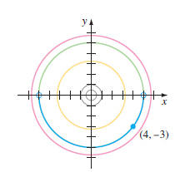
Family of circles

Slide 18
Example
Solve

Slide 21
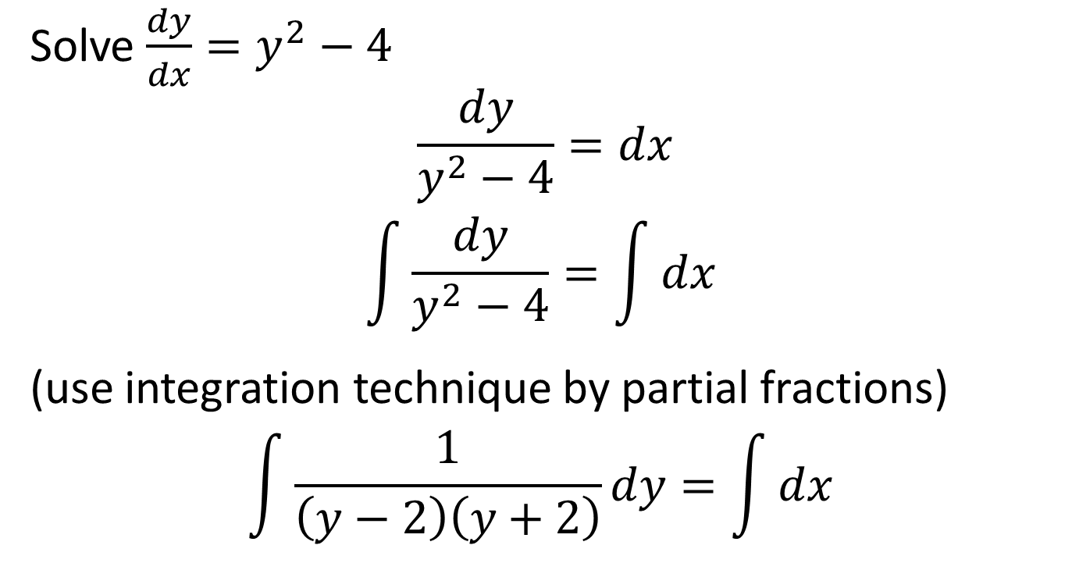
Example
Solve $\frac{dy}{dx}=y^{2}−4$
$$\frac{dy}{y^{2}−4}=dx$$
$$\int{\frac{dy}{y^{2}−4}}=\int{dx }$$
(use integration technique by partial fractions)
$$\int{\frac{1}{\left(y−2\right)\left(y+2\right)}}dy=\int{dx }$$

Slide 22
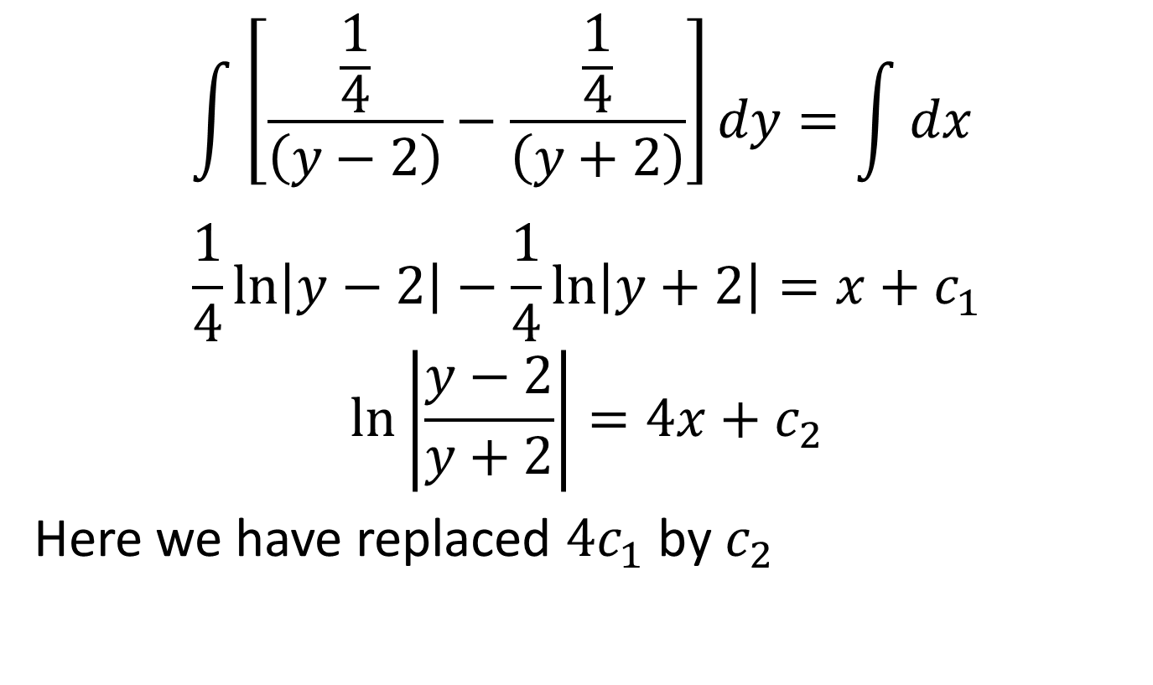
a
$$\int{\left[\frac{\frac{1}{4}}{\left(y−2\right)}−\frac{\frac{1}{4}}{\left(y+2\right)}\right]}dy=\int{dx }$$
$$\frac{1}{4}\ln\left|y−2\right|−\frac{1}{4}\ln\left|y+2\right|=x+c_{1}$$
$$\ln\left|\frac{y−2}{y+2}\right|=4x+c_{2}$$
Here we have replaced ${4c}_{1}$ by $c_{2}$

Slide 23
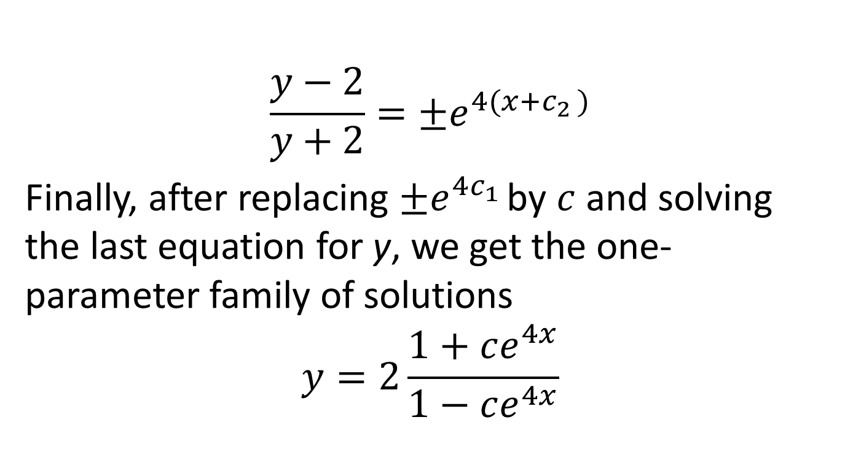
$$\frac{y−2}{y+2}=±e^{4(x+c_{2 })}$$
Finally, after replacing $±e^{4c_{1 }}$by $c$ and solving the last equation for y, we get the one-parameter family of solutions
$$y=2\frac{1+ce^{4x}}{1−ce^{4x}}$$

Slide 26
Initial Value Problem (IVP)
Solve the IVP:

Slide 30
Example
Solve

Slide 43
Review
We covered the topic:
Separable Differential Equations
Separable Equations
Method of Solution
Next time, Linear Differential Equations and Applications of Differential Equations

