Slide 1
Lecture 26
Integral Calculus and
Probability

Slide 2
Last Lecture Summary
Last time, we did an example for the topic approximating integrals.
We also covered section 19.4:
Applications of Integral Calculus

Slide 3
Today
We will go over section 19.5:
Integral Calculus and Probability

Slide 7
Integral Calculus and Probability
A mathematical function which determines the probability of each possible outcome of an experiment is called a probability density function (pdf). Compared with probability distributions which display each outcome and its probability, density functions can be thought of as the mathematical functions used to compute the probability. If ‘x’ is a continuous random variable, its density function ‘f’ must satisfy the two conditions.

Slide 8
The first condition prohibits negative probabilities for any event, and the second guarantees that the events are mutually exclusive and connectively exhaustive.

Slide 9
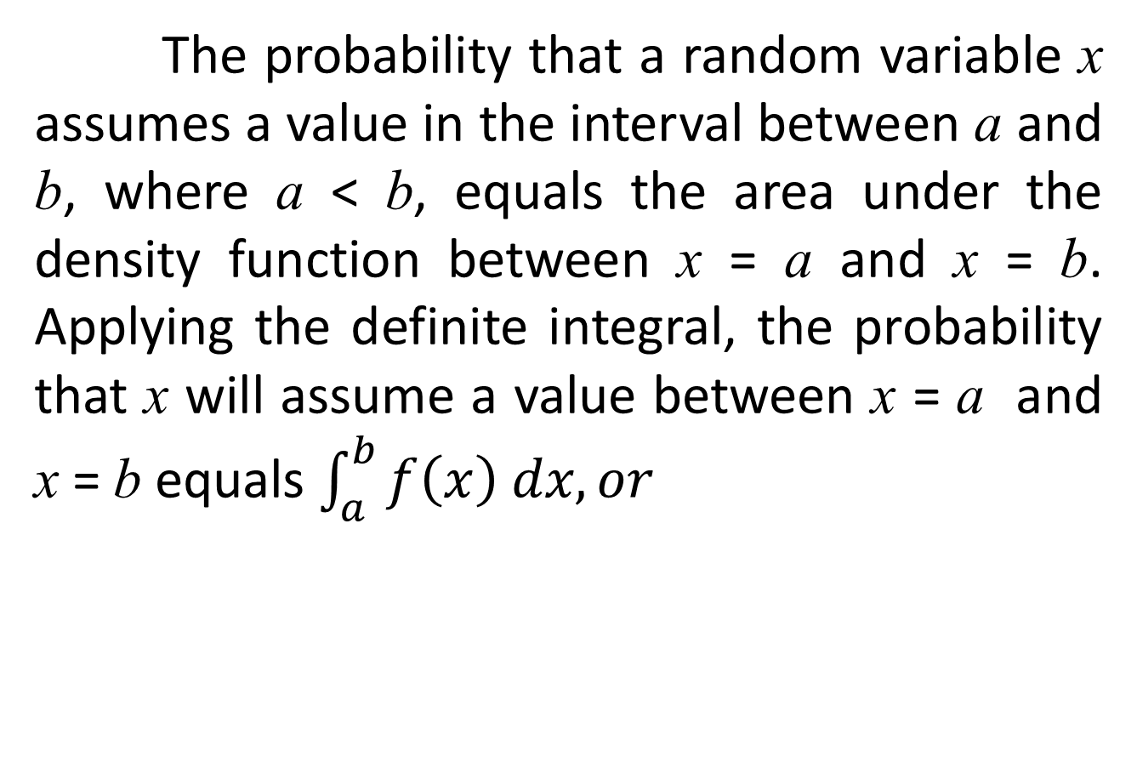
The probability that a random variable x assumes a value in the interval between a and b, where a < b, equals the area under the density function between x = a and x = b. Applying the definite integral, the probability that x will assume a value between x = a and x = b equals $\int_{a}^{b}{f\left(x\right) dx, or}$

Slide 12
Technically, if we wanted to determine the probability that a normally distributed variable x, having a mean µ and standard deviation , will assume a value between x = a and x = b (a < b), we could determine the probability by integration the density function, or

Slide 13
Fortunately, the equivalent conversion to the standard normal distribution and the availability of tables such as Table 14.25 eliminate any need to perform what appears to be a cumbersome integration.

Slide 17
EXAMPLE:
Consider the probability density function for the random variable x
Determine the probability that x will assume a value between 2 and 5.

Slide 20
EXAMPLE:
A 3-hour examination is given to all prospective salespeople of a national retail chain. The time x in hours required to complete the examination has been found to be random with a density function
Determine the probability that someone will complete the test in 1 hour or less.

Slide 27
Review
We covered section 19.5:
Integral Calculus and Probability
Finished Chapter 19.
Next time, we will cover the topic Separable and Linear Differential Equations

