Slide 1
Lecture 24
METHODS OF
APPROXIMATION

Slide 2
Last Lecture’s Summary
We covered Section 19.2:
Definite Integrals and Areas
Area between a function and x-axis
Area between two Curves

Slide 3
Today
We will go over section 19.3: Approximate Integrals
Rectangle Rule
Trapezoidal Rule
Simpson’s Rule

Slide 4
There are situations in which there may not exist a rule of integration to evaluate a particular integrand, even using tables of integration rules. If one needs to evaluate a definite integral for such a function, there are methods for approximating the value of the definite integral. In this section we will examine three numerical approximation methods which might be used to evaluate.

Slide 6
Rectangle Rule
If we think of evaluating the definite integral in terms of computing the area beneath a curve, one method involves dividing the interval a ≤ x ≤ b, into n equal subintervals, each having a width (b – a)/n. If x_{i} is defined as the midpoint of interval i, we can construct a set of n rectangles each having width (b – a)/n and height equal to f (x_{i}) as shown in the following figure.

Slide 8
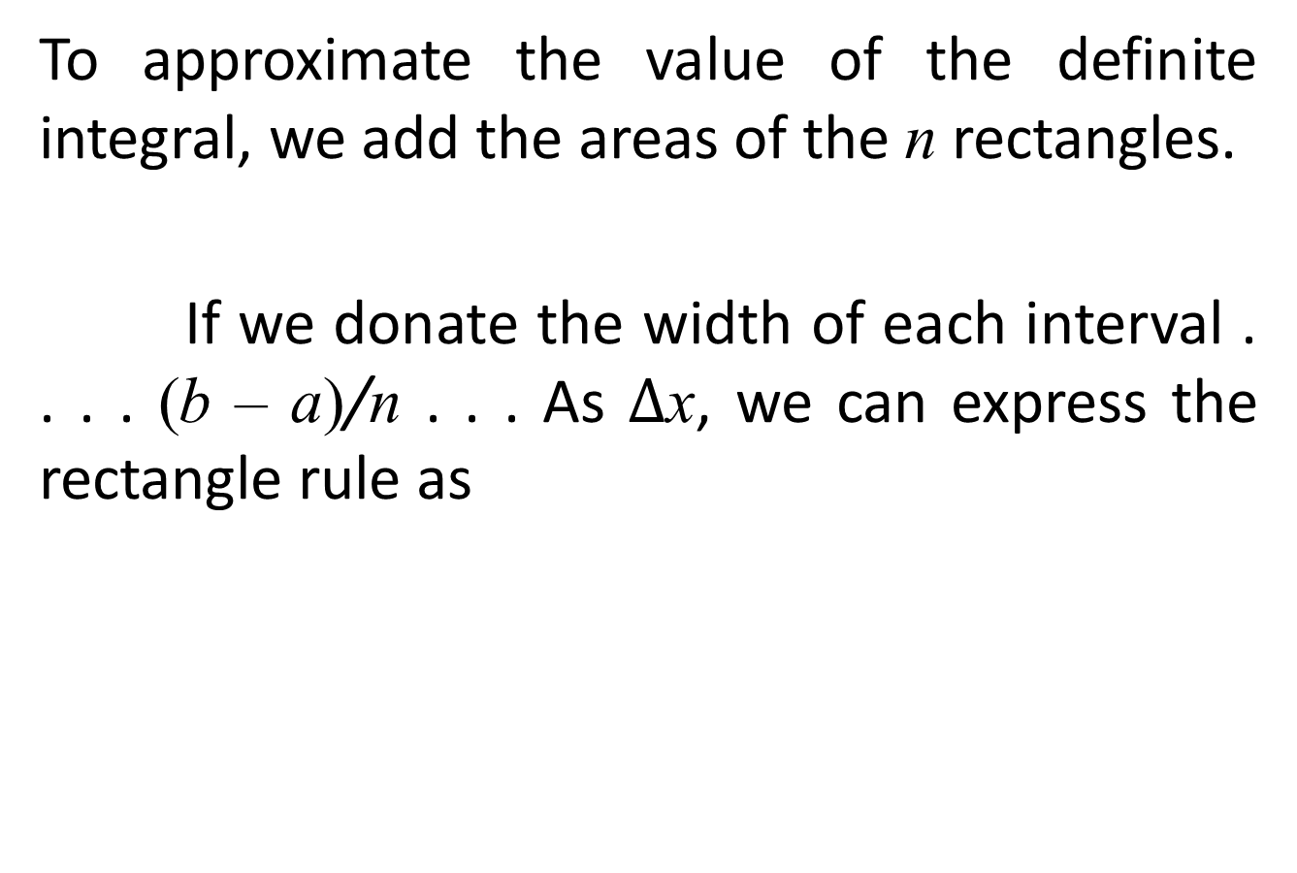
To approximate the value of the definite integral, we add the areas of the n rectangles.
If we donate the width of each interval . . . . (b – a)/n . . . As $∆$x, we can express the rectangle rule as

Slide 9
for n chosen sufficiently large.

Slide 10
EXAMPLE:
Let’s illustrate the use of this rule for a relatively simple function f (x) = x³. Let’s use the rectangle rule, dividing the interval into four equal subintervals having widths equal to 1. The midpoint values for the four subintervals are 0.5, 1.5, 2.5, and 3.5. Applying the rectangle rule, the numerical approximation of the definite integral is

Slide 13
Trapezoidal Rule
Another numerical approximation method for definite integrals is the trapezoidal rule. As with the rectangle rule, the interval a ≤ x ≤ b is divided into n subintervals of equal width. As shown in the following figure, the approximation consists of adding the areas of the n trapezoids defined by these subintervals. The heights of the n trapezoids are defined by the endpoints of the subintervals.

Slide 15
Given A trapezoid as shown in the above figure, the area of the trapezoid is defined as the product of the base of the trapezoid and the average height of the trapezoid, or

Slide 16
Thus if we use the areas of the n trapezoids in the above figure to approximate the definite integral, the definite integral is evaluated as

Slide 17
for n chosen sufficiently large
Let’s illustrate the use of the trapezoidal rule to evaluate the same definite integral as in the above example.

Slide 18
Example
Using the same subinterval definitions as in above example, the endpoints are 0, 1, 2, 3, and 4. Therefore, y_{o} = f(0) = 0, = y₁ = y(1) = 1, y₂ = y(2) = 8, y₃ = f(3) = 27 and y₄ = y(4) = 64.

Slide 20
Simpson’s Rule
The third numerical approximation method is called Simpson’s rule. As opposed to using rectangles or trapezoids to approximate the value of a definite integral, Simpson’s rule is based upon parabolic estimation. Graphically, the interval a ≤ x ≤ b is divided into an even number of n subintervals which are of equal width. Then, a series of parabolas are fit to the graph, one for each pair of subintervals.

Slide 22
This is illustrated in the above figure. Do you remember that three data points define a quadratic function of the form f(x) = ax² + bx + c? With Simpson’s rule, a parabola is fit to the data points (x₀, y₀), (x₁, y₁), and (x₂, y₂) over the first two subintervals and another parabola is fit to the three data points (x₂, y₂), (x₃, y₃), and (x₄, y₄) over the second two subintervals in the above figure. These parabolas are used to approximate the function f(x) over the interval a ≤ x ≤ b. The area under f(x) over this interval is then approximated by finding the areas under the two parabolas.

Slide 23
Given the case where x₁ – x₀ = x₂ – x₁, a formula exists for determining the area under a parabola which passes through (x₀, y₀), (x₁, y₁), and (x₂, y₂). The formula does not require the actual determination of the quadratic function passing through these points.
If x₁ – x₀ = x₂ – x₁ = w,

Slide 25
For the purpose of approximating the definite integral, w = (b – a)/n. Thus, if f(x) is continuous over the interval a ≤ x ≤ b, and the number of subintervals ‘n’ is even,
for n chosen sufficiently large (n even).

Slide 26
Example
Lets use Simpson’s rule to approximate the definite integral from the last two examples. Given that the subintervals are defined the same (x₀, y₀) = (0, 0), (x₁, y₁) = (1, 1), (x₂, y₂) = (2, 8), (x₃, y₃) = (3, 27), and (x₄, y₄) = (4, 64). With a = 0 and b = 4,

Slide 28
The definite integral is estimated as

Slide 29
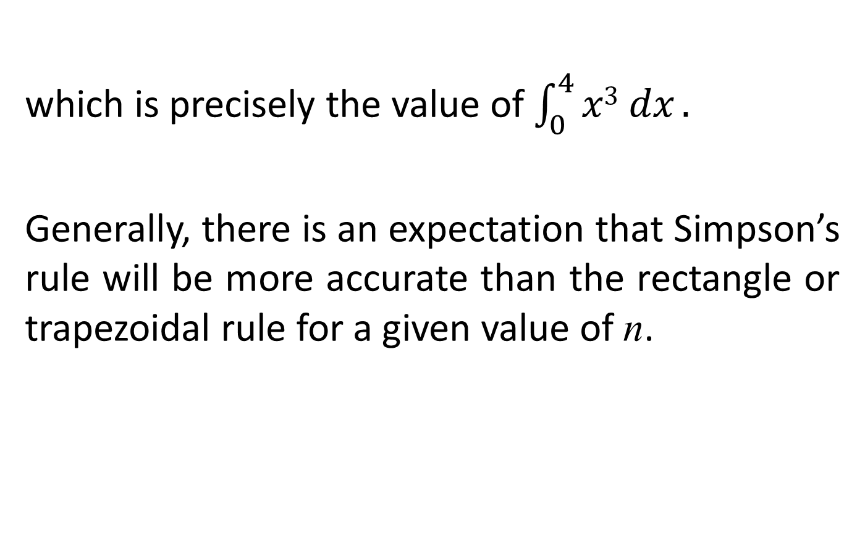
which is precisely the value of $\int_{0}^{4}{x3 dx}.$
Generally, there is an expectation that Simpson’s rule will be more accurate than the rectangle or trapezoidal rule for a given value of n.

Slide 32
Review
We covered section 19.3:
Approximate Integrals
Rectangle Rule
Trapezoidal Rule
Simpson’s Rule

