Slide 1
Lecture 22
Definite Integrals

Slide 2
Last Lecture’s Summary
We covered sections 18.3 and 18.5:
Additional Rules of Integration
Differential Equations
Exponential Growth and Decay Models

Slide 3
Today
We’ll start chapter 19 and cover section 19.1:
Definite Integrals
Fundamental Theorem of Calculus
Properties of Definite Integrals

Slide 5
Chapter 19
Integral Calculus:
Applications

Slide 6
CHAPTER OBJECTIVES
Introduce the definite integral.
Illustrate the application of the definite integral in measuring areas.
Provide a wide variety of applications of integral calculus.
Illustrate the relationship between integral calculus and probability theory.

Slide 7
Main Topics
Definite integrals
Definite integrals and areas
Methods of approximation
Applications of integral calculus
Integral calculus and probability (Optional)

Slide 8
DEFINITE INTEGRALS
In this section we will introduce the definite integral, which forms the basis for many applications of integral calculus.

Slide 9
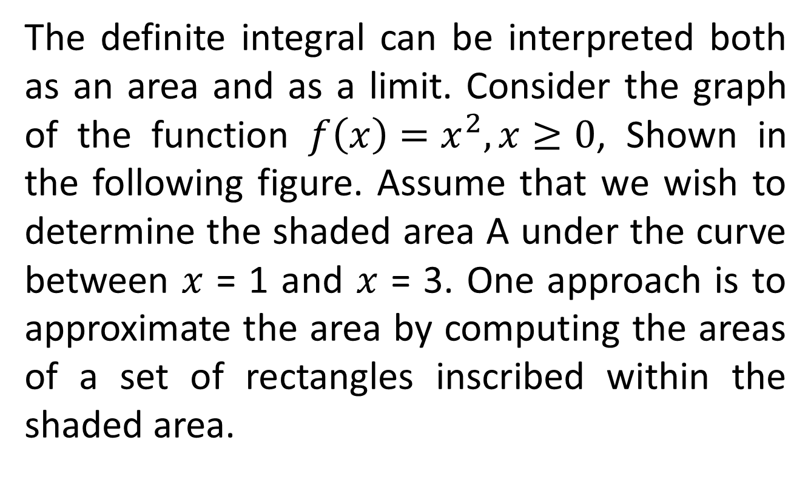
The Definite Integral
The definite integral can be interpreted both as an area and as a limit. Consider the graph of the function $f\left(x\right)=x^{2}, x≥0$, Shown in the following figure. Assume that we wish to determine the shaded area A under the curve between $x$ = 1 and $x$ = 3. One approach is to approximate the area by computing the areas of a set of rectangles inscribed within the shaded area.

Slide 13
DEFINITE INTEGRAL
If f is a bounded function on the interval (a, b), we shall define the definite integral of f as
Provided this limit exists, as the size of all the intervals in the subdivision approaches zero and hence the number of intervals n approaches infinity

Slide 14
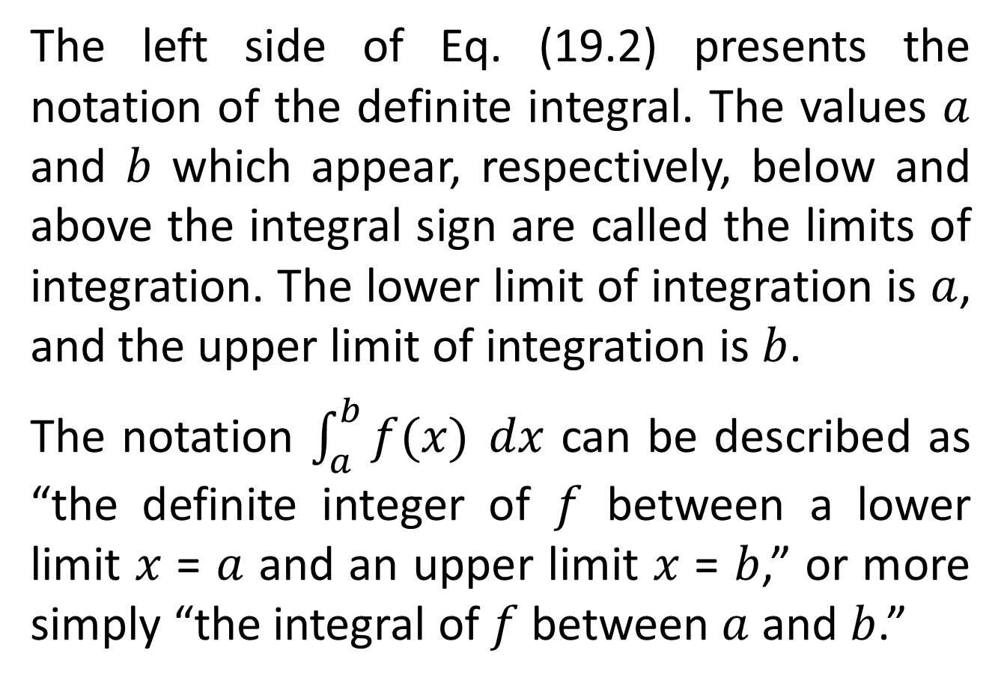
The left side of Eq. (19.2) presents the notation of the definite integral. The values $a$ and $b$ which appear, respectively, below and above the integral sign are called the limits of integration. The lower limit of integration is $a$, and the upper limit of integration is $b$.
The notation $\int_{a}^{b}{f(x)} dx$ can be described as “the definite integer of $f$ between a lower limit $x$ = $a$ and an upper limit $x$ = $b$,” or more simply “the integral of $f$ between $a$ and $b$.”

Slide 15
Evaluating Definite Integrals
The evaluation of definite integrals is facilitated by the following important theorem.

Slide 16
FUNDAMENTAL THEOREM OF INTEGRAL CALCULUS
If a function f is continuous over an interval and F is any antiderivative of f, then for any points x = a and x = b on the interval, where a ≤ b,

Slide 17
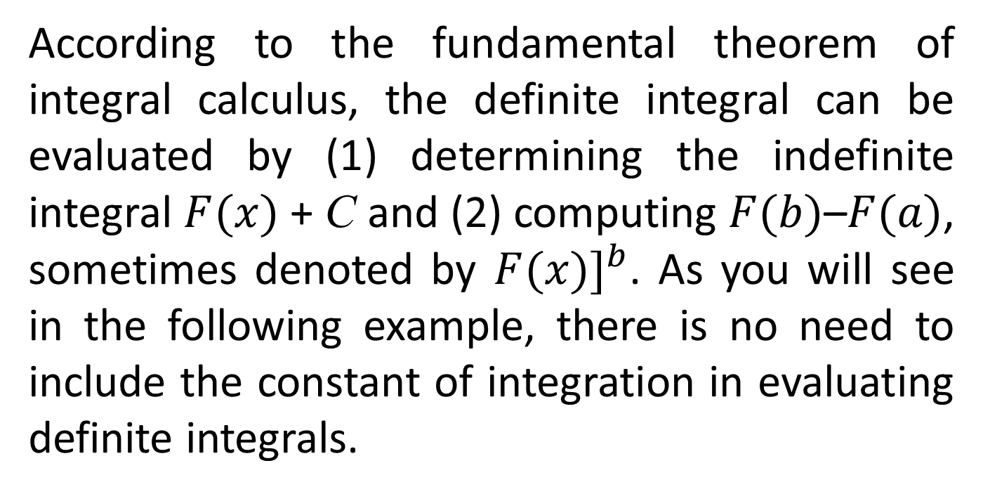
According to the fundamental theorem of integral calculus, the definite integral can be evaluated by (1) determining the indefinite integral $F(x)$ + C and (2) computing $F(b)$–$F(a)$, sometimes denoted by $F(x)]_{}^{b}$. As you will see in the following example, there is no need to include the constant of integration in evaluating definite integrals.

Slide 18
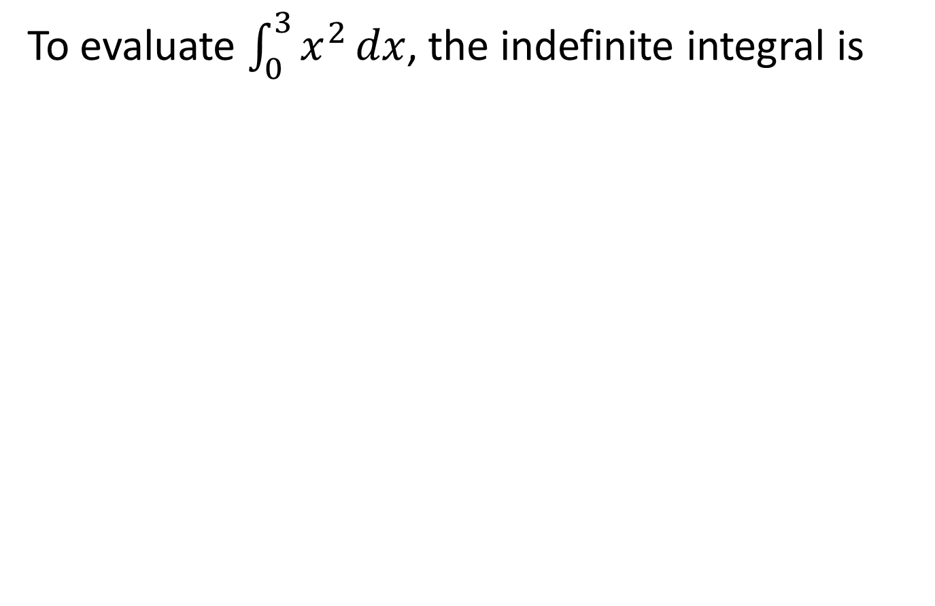
To evaluate $\int_{0}^{3}{x^{2}}dx$, the indefinite integral is

Slide 23
Properties of Definite Integrals
PROPERTY-1
If f is defined and continuous on the interval (a, b),

Slide 25
PROPERTY-2

Slide 26
PROPERTY-3
If f is continuous on the interval (a, c) and a<b<c,

Slide 28
PROPERTY-4
where c is constant.

Slide 30
PROPERTY-5

Slide 39
Review
We started chapter 19 and covered section 19.1:
Definite Integrals
Fundamental Theorem of Calculus
Properties of Definite Integrals
Next time, we will cover definite integral as areas.

