Slide 1
Lecture 21
ADDITIONAL RULES OF
INTEGRATION

Slide 2
Last Lecture’s Summary
We started chapter 18 and covered sections 18.1 and 18.2:
Anti-derivatives
Rules of Integration
Examples

Slide 3
Today
We’ll go over sections 18.3 and 18.5:
Additional Rules of Integration with examples
Differential Equations

Slide 4
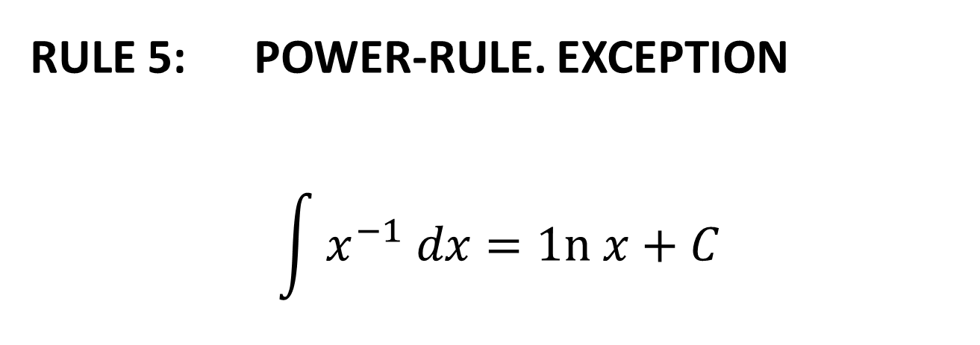
ADDITIONAL RULES OF INTEGRATION
RULE 5: POWER-RULE. EXCEPTION
$$\int{x^{−1} dx=1n x+C}$$

Slide 5
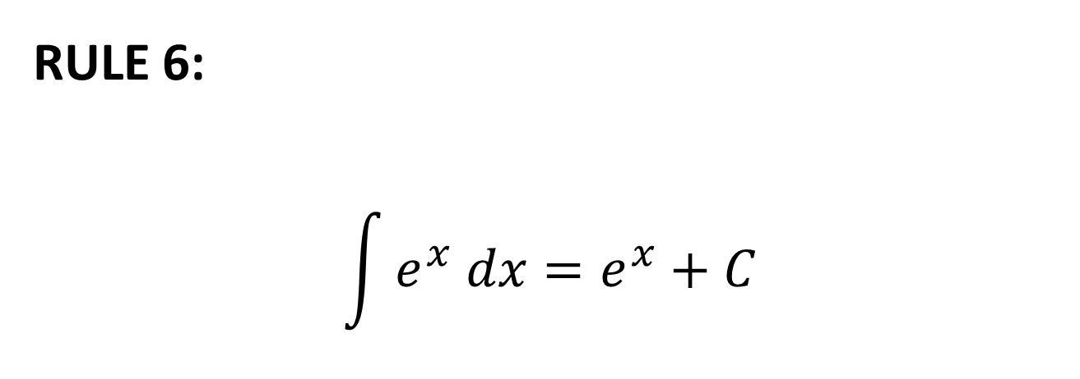
RULE 6:
$$\int{e^{x} dx=e^{x}+C}$$

Slide 6
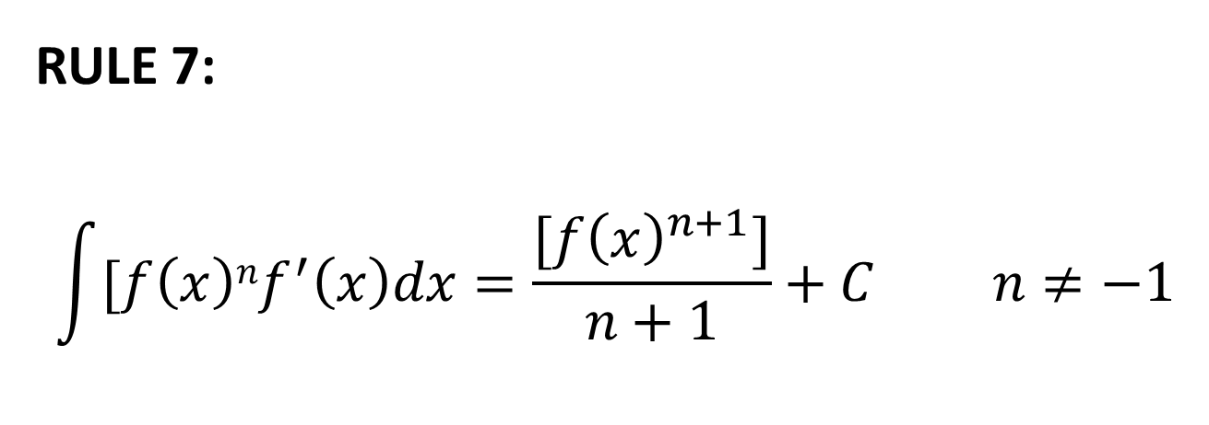
RULE 7:
$$\int{[f\left(x\right)nf^{′}\left(x\right)dx=\frac{{[f\left(x\right)}^{n+1}]}{n+1}}+C n≠−1$$

Slide 11
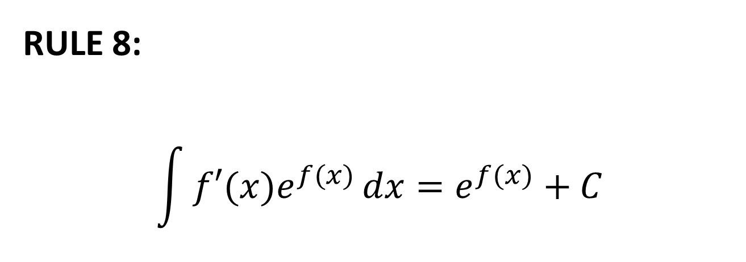
RULE 8:
$$\int{f′(x)e^{f(x)}}dx=e^{f(x)}+C$$

Slide 14
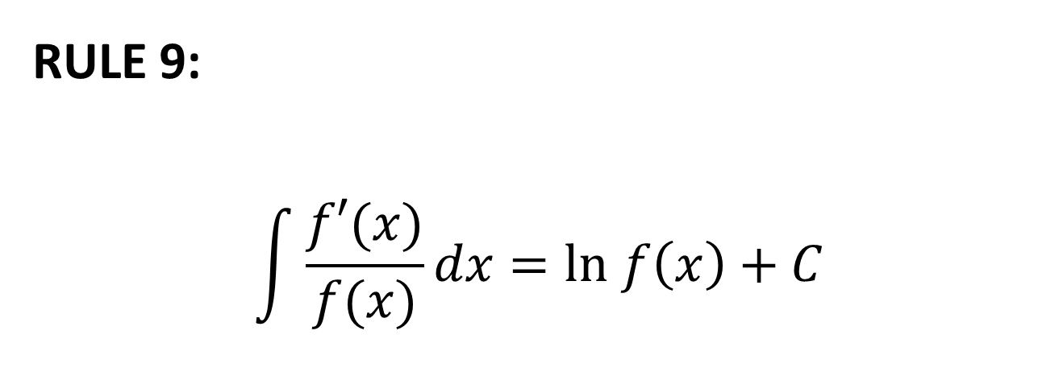
RULE 9:
$$\int{\frac{f′(x)}{f(x)}}dx=ln f\left(x\right)+C$$

Slide 19
DIFFERENTIAL EQUATIONS
A differential equation is an equation which involves derivatives and/or differentials. In Sec. 18.1. we examined differential equations (without calling them by that name) when going from a derivative f’ to the corresponding anti-derivative f. We solved the differential equation when we found the anti-derivative.

Slide 20
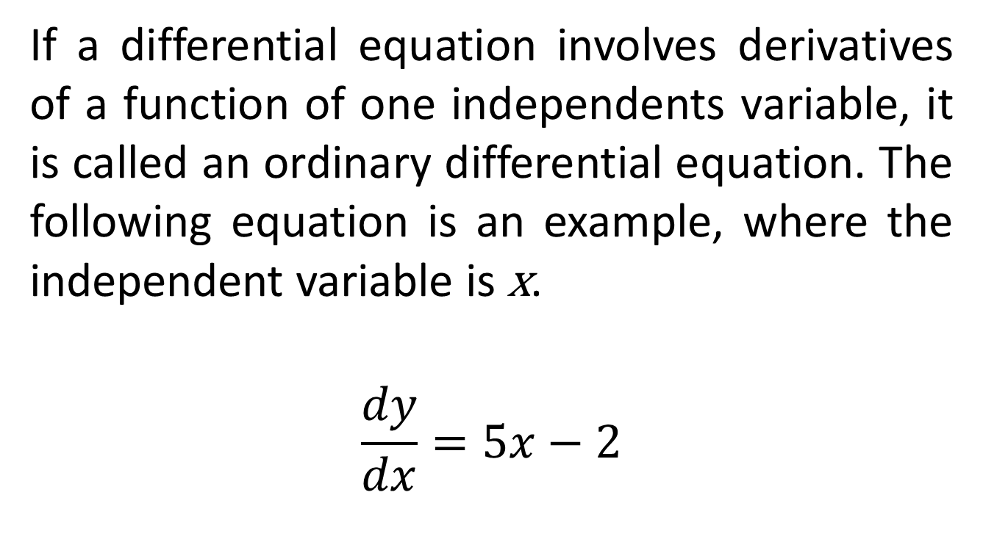
Ordinary Differential Equations
If a differential equation involves derivatives of a function of one independents variable, it is called an ordinary differential equation. The following equation is an example, where the independent variable is x.
$$\frac{dy}{dx}=5x−2$$

Slide 21
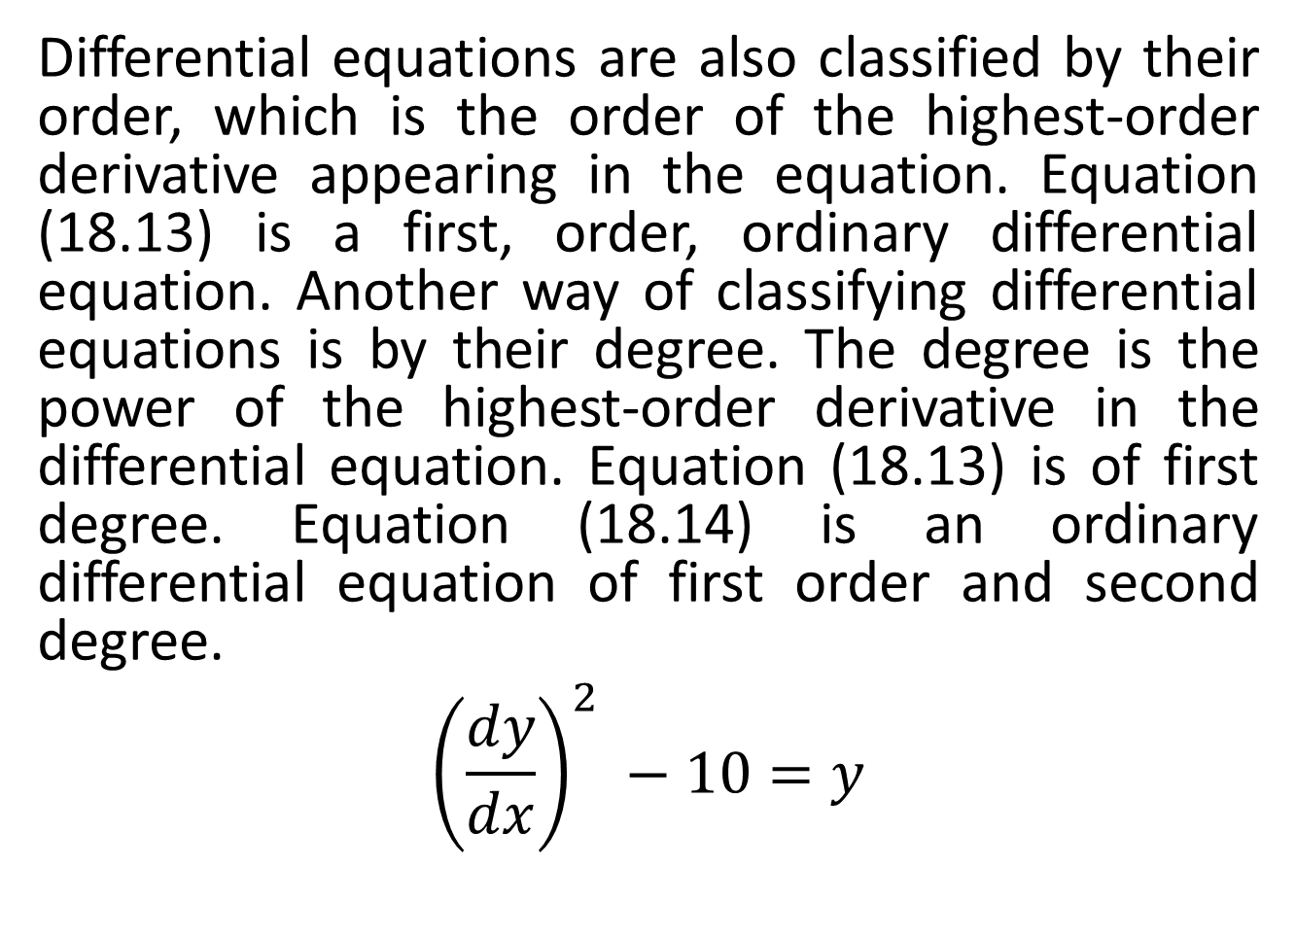
Differential equations are also classified by their order, which is the order of the highest-order derivative appearing in the equation. Equation (18.13) is a first, order, ordinary differential equation. Another way of classifying differential equations is by their degree. The degree is the power of the highest-order derivative in the differential equation. Equation (18.13) is of first degree. Equation (18.14) is an ordinary differential equation of first order and second degree.
$${\left(\frac{dy}{dx}\right)}^{2} −10=y$$

Slide 22
Solutions of Ordinary Differential Equations
A solution to a differential equation is a function not containing derivatives or differentials which satisfies the original differential equation.

Slide 23
Solution to differential equations can be classified into general solutions and particular solutions.
A general solution is one which contains arbitrary constants of integration. A particular solution is one which is obtained from the general solution.
For particular solutions, specific values are assigned to the constants of integration based on initial conditions or boundary conditions.

Slide 24
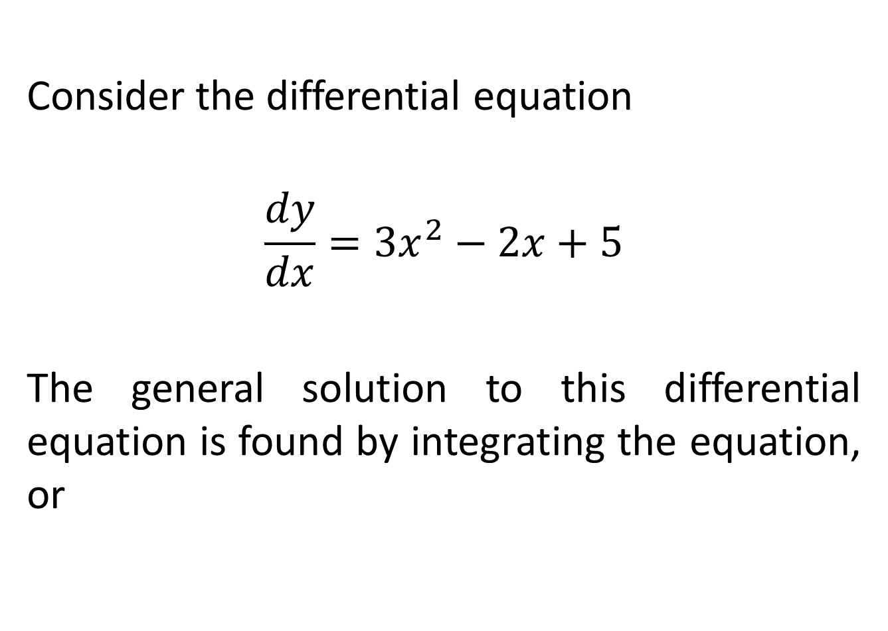
Consider the differential equation
$$\frac{dy}{dx}={3x}^{2}−2x+5$$
The general solution to this differential equation is found by integrating the equation, or

Slide 25
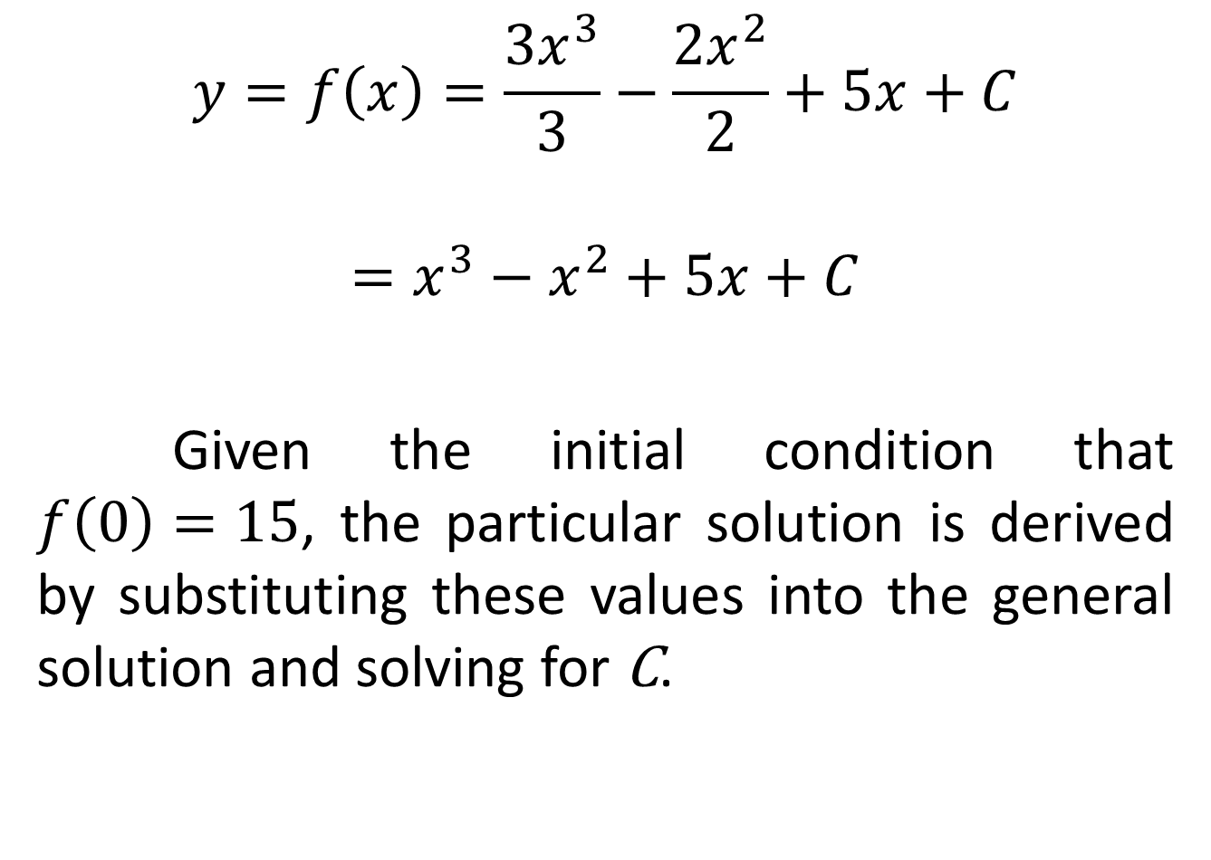
$$y=f\left(x\right)=\frac{{3x}^{3}}{3}−\frac{{2x}^{2}}{2}+5x+C$$
$$=x^{3}−x^{2}+5x+C$$
Given the initial condition that $f\left(0\right)=15$, the particular solution is derived by substituting these values into the general solution and solving for C.

Slide 26
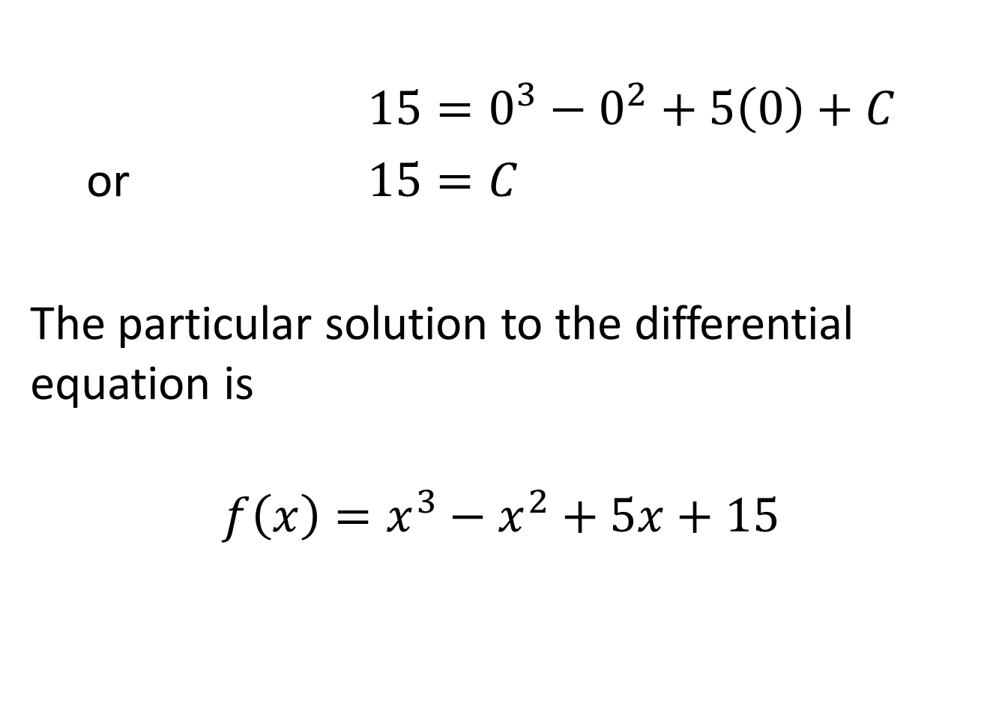
$15=0^{3}−0^{2}+5\left(0\right)+C$
or $15=C$
The particular solution to the differential equation is
$$f\left(x\right)=x^{3}−x^{2}+5x+15$$

Slide 28
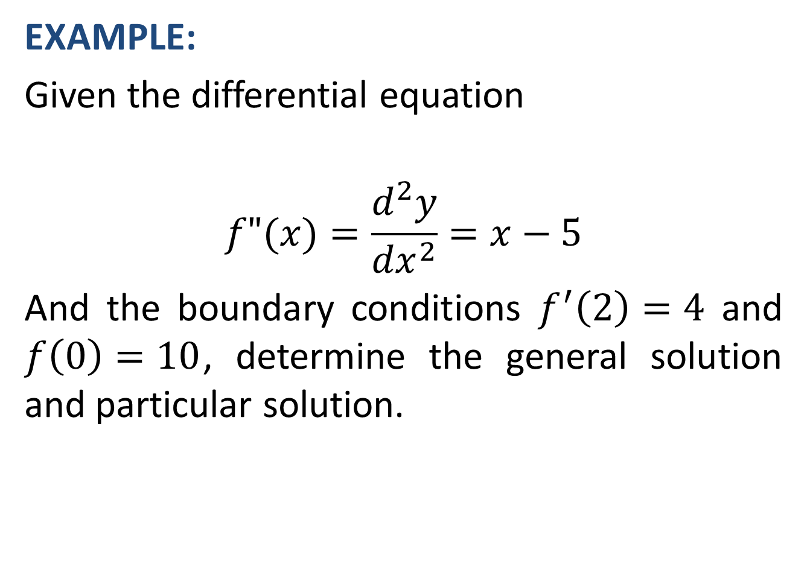
EXAMPLE:
Given the differential equation
$$f"(x)=\frac{d^{2}y}{{dx}^{2}}=x−5$$
And the boundary conditions $f^{′}\left(2\right)=4$ and $f\left(0\right)=10$, determine the general solution and particular solution.

Slide 32
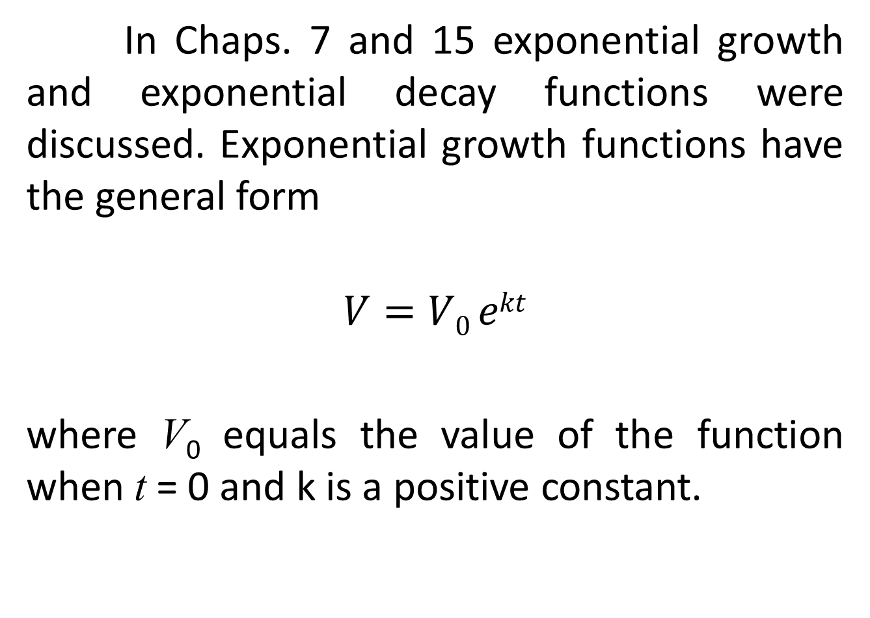
In Chaps. 7 and 15 exponential growth and exponential decay functions were discussed. Exponential growth functions have the general form
$$V=V0 ekt$$
where V₀ equals the value of the function when t = 0 and k is a positive constant.

Slide 33
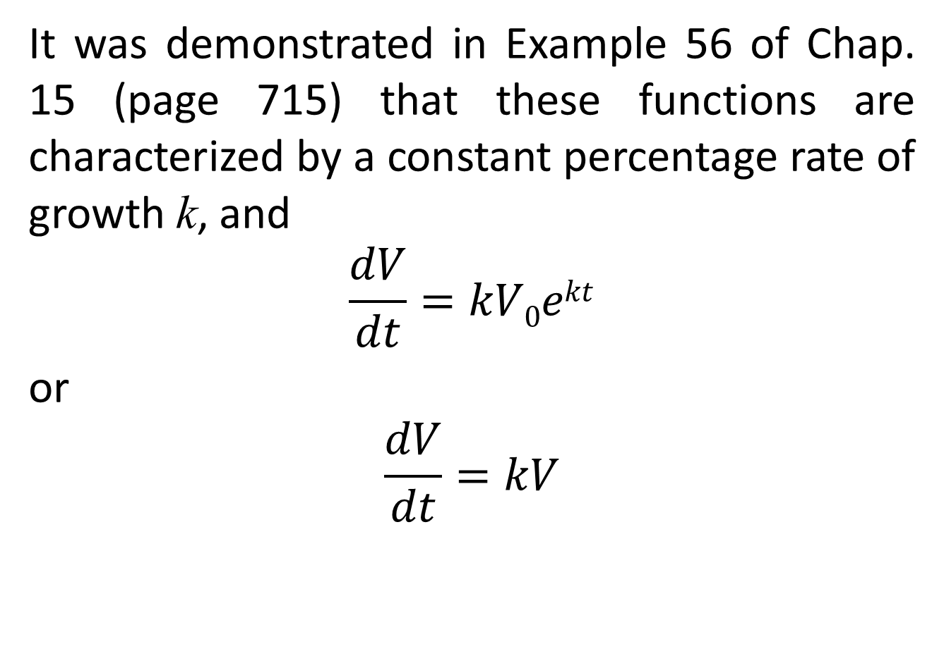
It was demonstrated in Example 56 of Chap. 15 (page 715) that these functions are characterized by a constant percentage rate of growth k, and
$$\frac{dV}{dt}=kV0ekt$$
or
$$\frac{dV}{dt}=kV$$

Slide 34
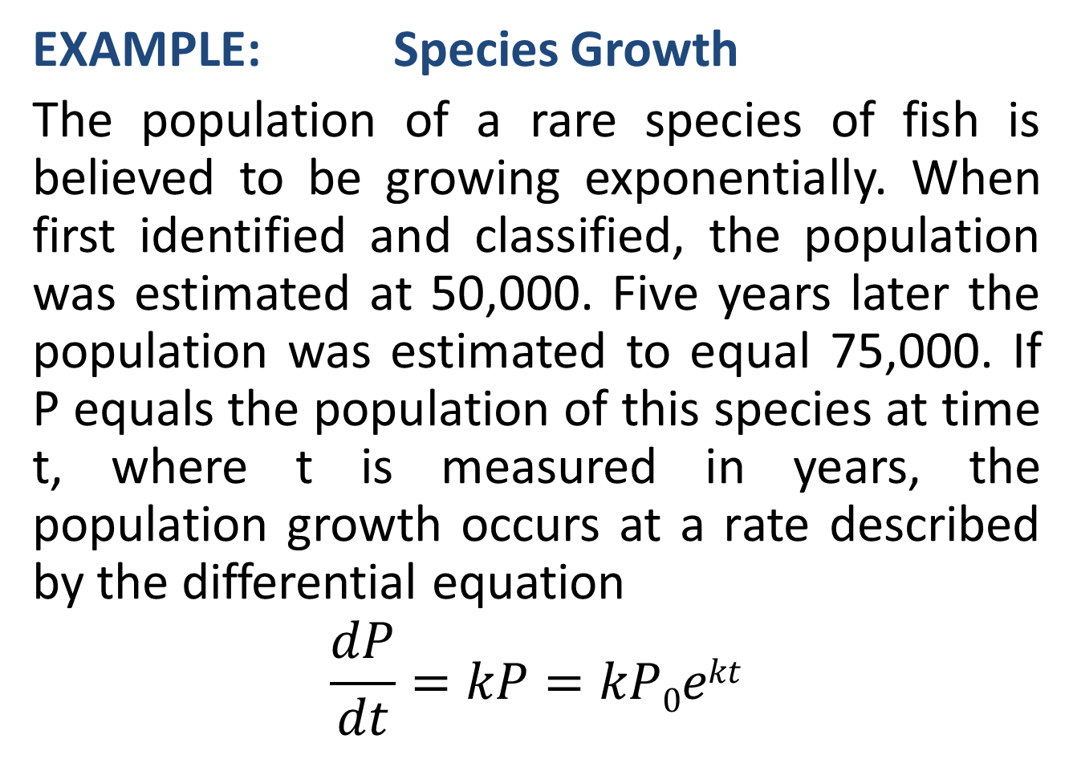
EXAMPLE: Species Growth
The population of a rare species of fish is believed to be growing exponentially. When first identified and classified, the population was estimated at 50,000. Five years later the population was estimated to equal 75,000. If P equals the population of this species at time t, where t is measured in years, the population growth occurs at a rate described by the differential equation
$$\frac{dP}{dt}=kP=kP0ekt$$

Slide 40
Review
We covered sections 18.3 and 18.5:
Additional Rules of Integration with examples
Differential Equations
Next time, Applications of Integral Calculus

