Slide 1
Lecture 20
Anti-Derivatives;
Rules of Integration

Slide 2
Last Lecture’s Summary
Covered Sec 17.2:
Optimization: Additional Applications
Did a few examples of some application of optimization techniques that we learned in previous sections.

Slide 3
Today
We’ll start chapter 18 and will cover sections 18.1 and 18.2:
Anti-derivatives
Rules of Integration
Examples

Slide 4
Chapter 18
INTEGRAL CALCULUS:
AN INTRODUCTION

Slide 5
Chapter Objectives
Introduce the nature and methods of integral calculus.
Present selected rules of integration and illustrate their use.
Illustrate other methods of integration which may be appropriate when basic rules are not.

Slide 6
Main Topics
ANTIDERIVATIVES
RULES OF INTEGRATION
ADDITIONAL RULES OF INTEGRATION
OTHER TECHNIQUES OF INTEGRATION
DIFFERENTIAL EQUATIONS

Slide 7
In this chapter we will introduce a second major area of study within the calculus – integral calculus.
An important concern of integral calculus is the determination of areas which occur between curves and other defined boundaries. Also, if the derivative of an unknown function is known, integral calculus may provide a way of determining the original function.

Slide 8
ANTIDERIVATIVES
THE ANTIDERIVATIVE CONCEPT
Given a function f, we are acquainted with how to find the derivative f’. There may be occasions in which we are given the derivative f’ and wish to determine the original function f. Since the process of finding the original function is the reverse of differentiation, f is said to be an anti-derivative of f’

Slide 9
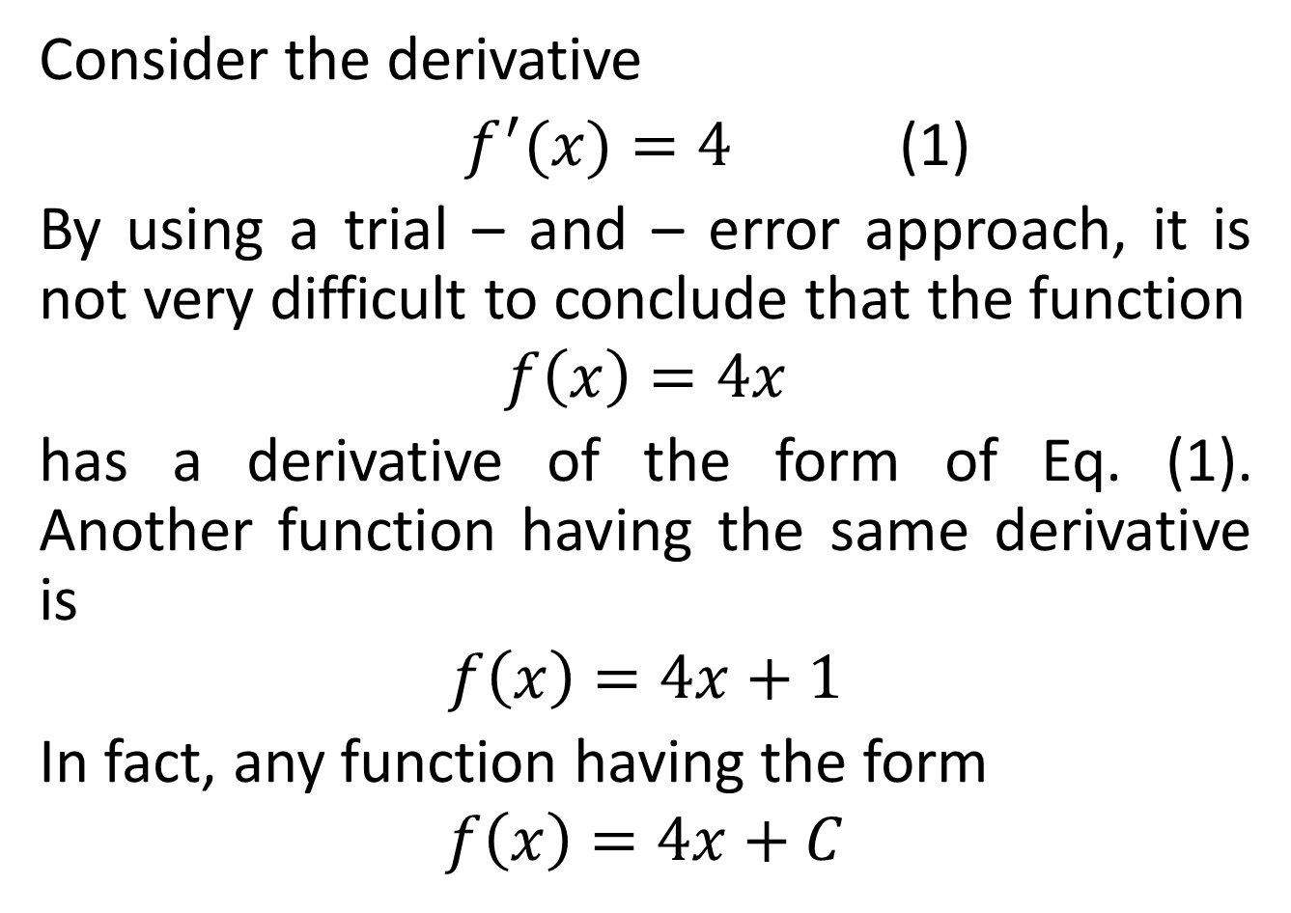
Consider the derivative
$f^{′}(x)=4$ (1)
By using a trial – and – error approach, it is not very difficult to conclude that the function
$$f\left(x\right)=4x$$
has a derivative of the form of Eq. (1). Another function having the same derivative is
$$f\left(x\right)=4x+1$$
In fact, any function having the form
$$f\left(x\right)=4x+C$$

Slide 11
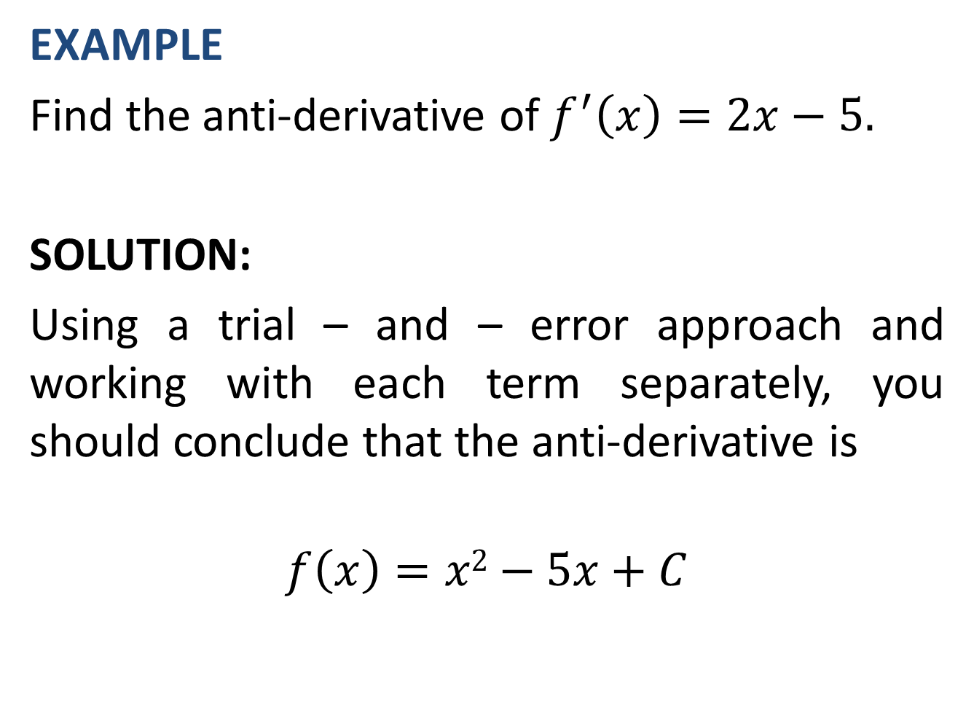
EXAMPLE
Find the anti-derivative of $f^{′}\left(x\right)=2x−5.$
SOLUTION:
Using a trial – and – error approach and working with each term separately, you should conclude that the anti-derivative is
$$f\left(x\right)=x2−5x+C$$

Slide 12
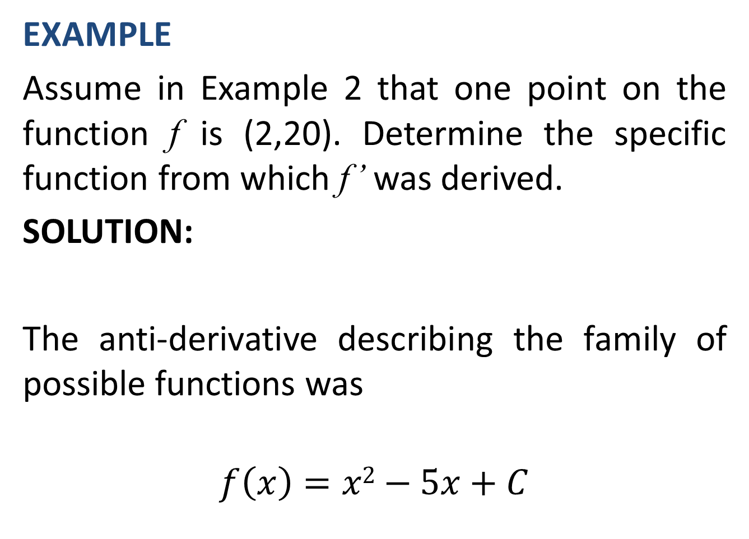
EXAMPLE
Assume in Example 2 that one point on the function f is (2,20). Determine the specific function from which f’ was derived.
SOLUTION:
The anti-derivative describing the family of possible functions was
$$f\left(x\right)=x2−5x+C$$

Slide 14
REVENUE AND COST FUNCTIONS
If we have an expression for either marginal revenue or marginal cost, the respective anti-derivatives will be the total revenue and total cost functions.

Slide 15
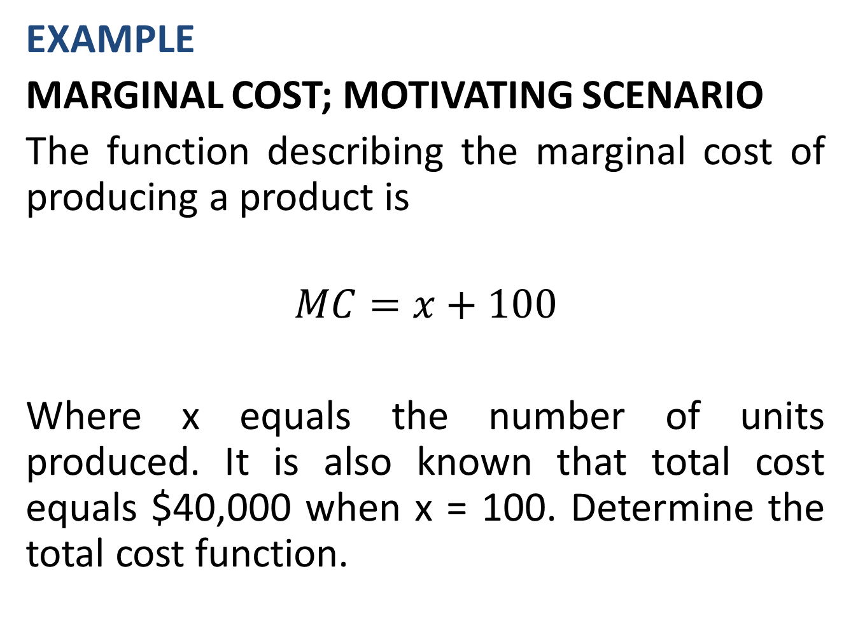
EXAMPLE
MARGINAL COST; MOTIVATING SCENARIO
The function describing the marginal cost of producing a product is
$$MC=x+100$$
Where x equals the number of units produced. It is also known that total cost equals $40,000 when x = 100. Determine the total cost function.

Slide 16
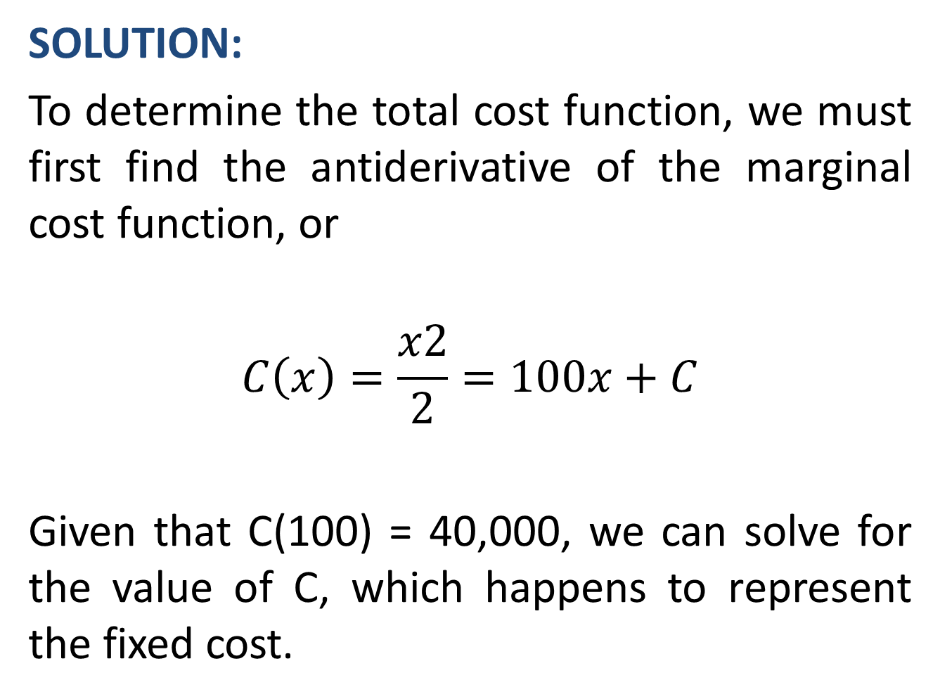
SOLUTION:
To determine the total cost function, we must first find the antiderivative of the marginal cost function, or
$$C\left(x\right)=\frac{x2}{2}=100x+C$$
Given that C(100) = 40,000, we can solve for the value of C, which happens to represent the fixed cost.

Slide 18
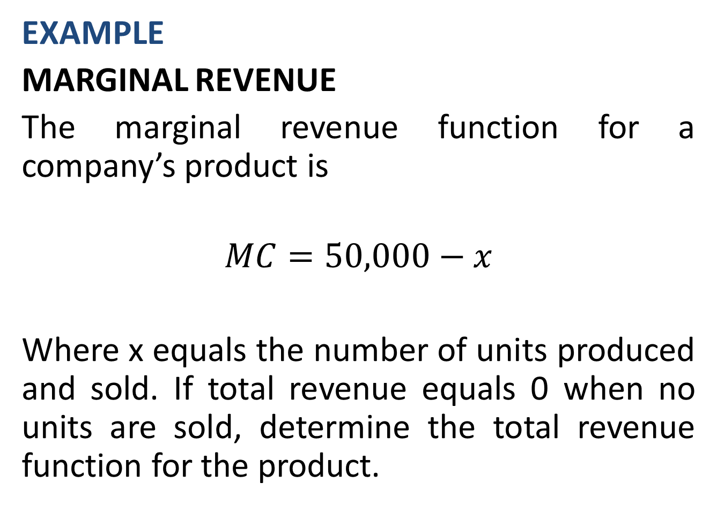
EXAMPLE
MARGINAL REVENUE
The marginal revenue function for a company’s product is
$$MC=50,000−x$$
Where x equals the number of units produced and sold. If total revenue equals 0 when no units are sold, determine the total revenue function for the product.

Slide 21
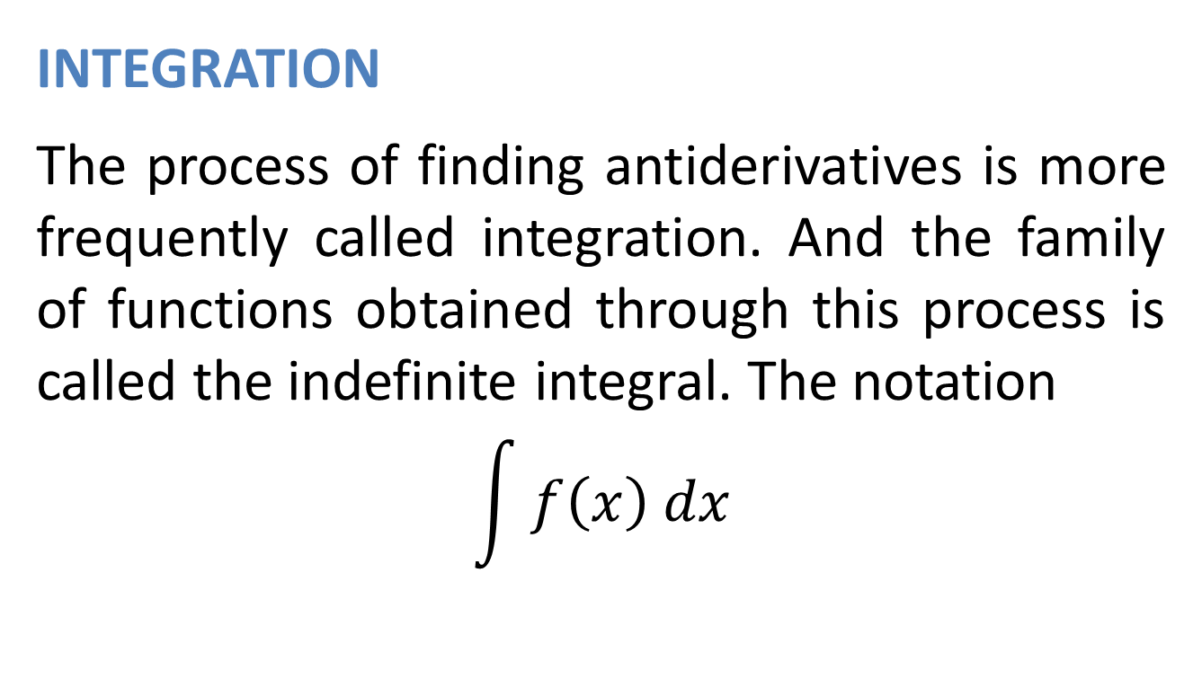
RULES OF INTEGRATION
INTEGRATION
The process of finding antiderivatives is more frequently called integration. And the family of functions obtained through this process is called the indefinite integral. The notation
$$\int{f\left(x\right) dx}$$

Slide 22
is often used to indicate the indefinite integral of the function f. The symbol ∫ is the integral sign; f is the integrand, and dx, as we will deal with it, indicates the variable with respect to which the integration process is performed. Two verbal descriptions of the process “integrate the function f with respect to the variable x” or “find the indefinite integral of f with respect to x”.

Slide 23
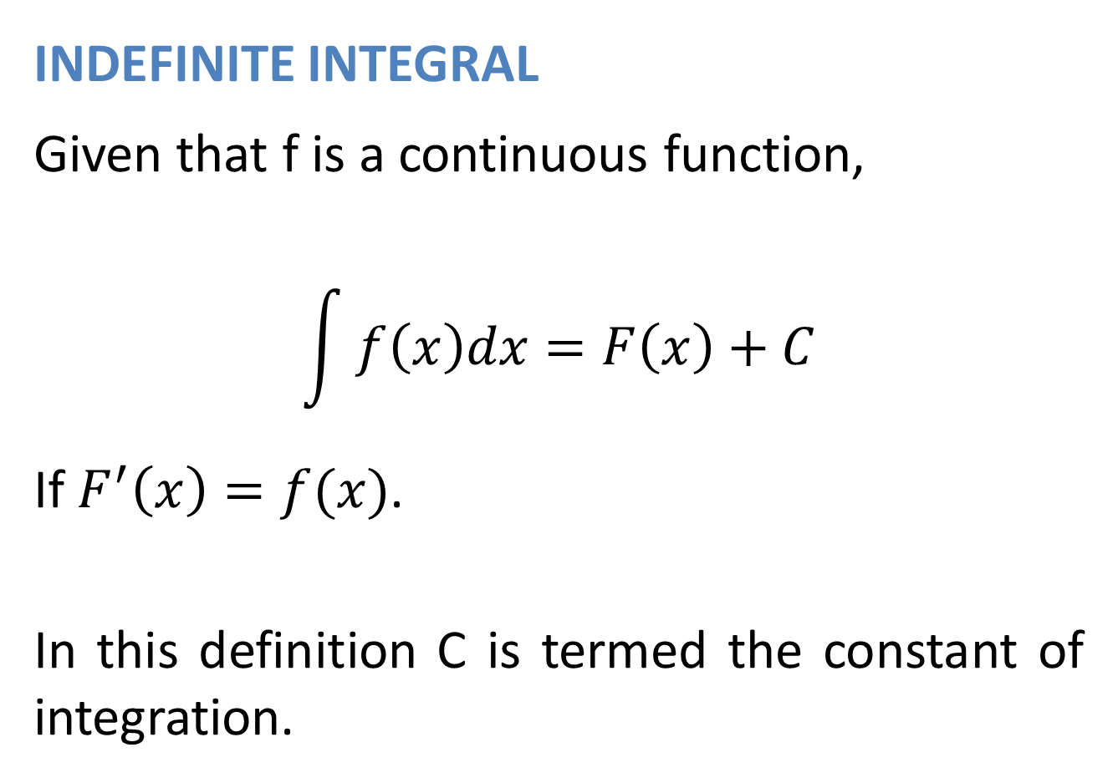
INDEFINITE INTEGRAL
Given that f is a continuous function,
$$\int{f\left(x\right)dx=F\left(x\right)+C}$$
If $F^{′}\left(x\right)=f(x)$.
In this definition C is termed the constant of integration.

Slide 24
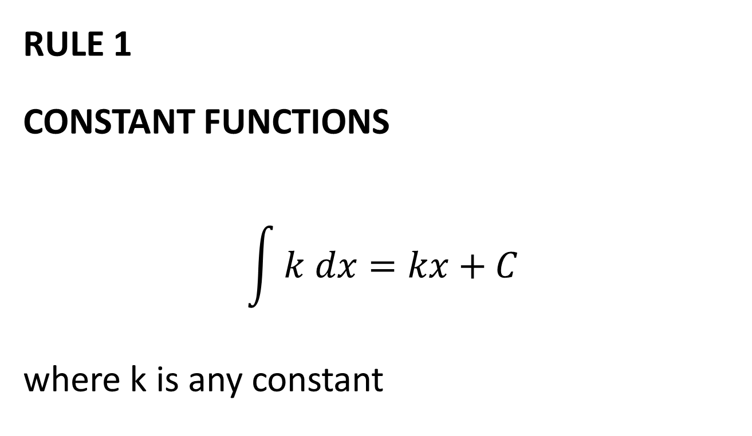
Rules of Integration
RULE 1
CONSTANT FUNCTIONS
$$\int{k dx=kx+C}$$
where k is any constant

Slide 26
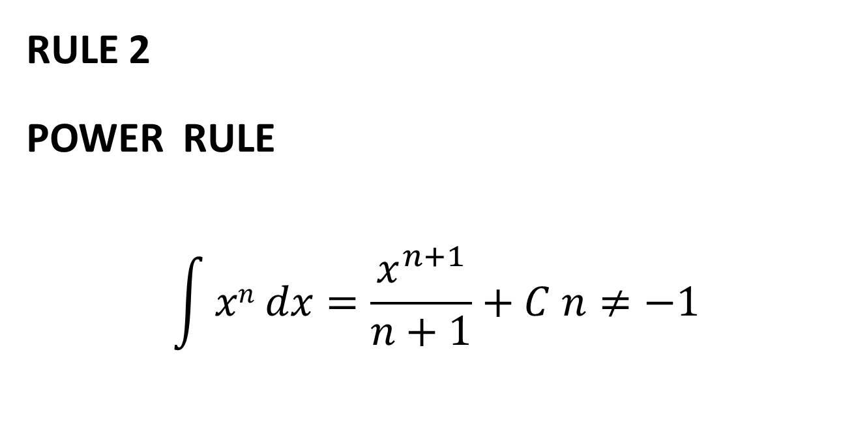
RULE 2
POWER RULE
$$\int{xn dx=\frac{x^{n+1}}{n+1}+C n≠−1}$$

Slide 28
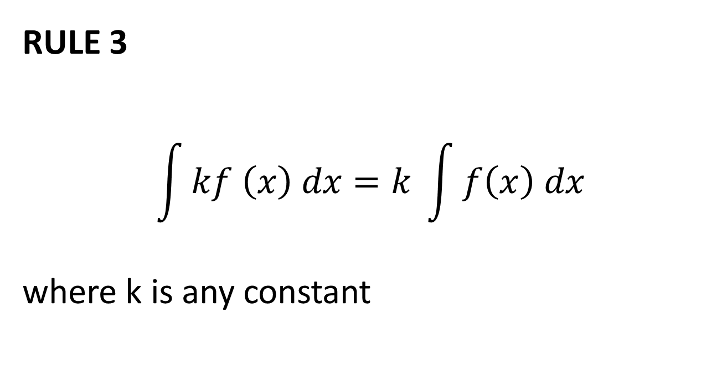
RULE 3
$$\int{kf \left(x\right) dx=k }\int{f\left(x\right) dx}$$
where k is any constant

Slide 31
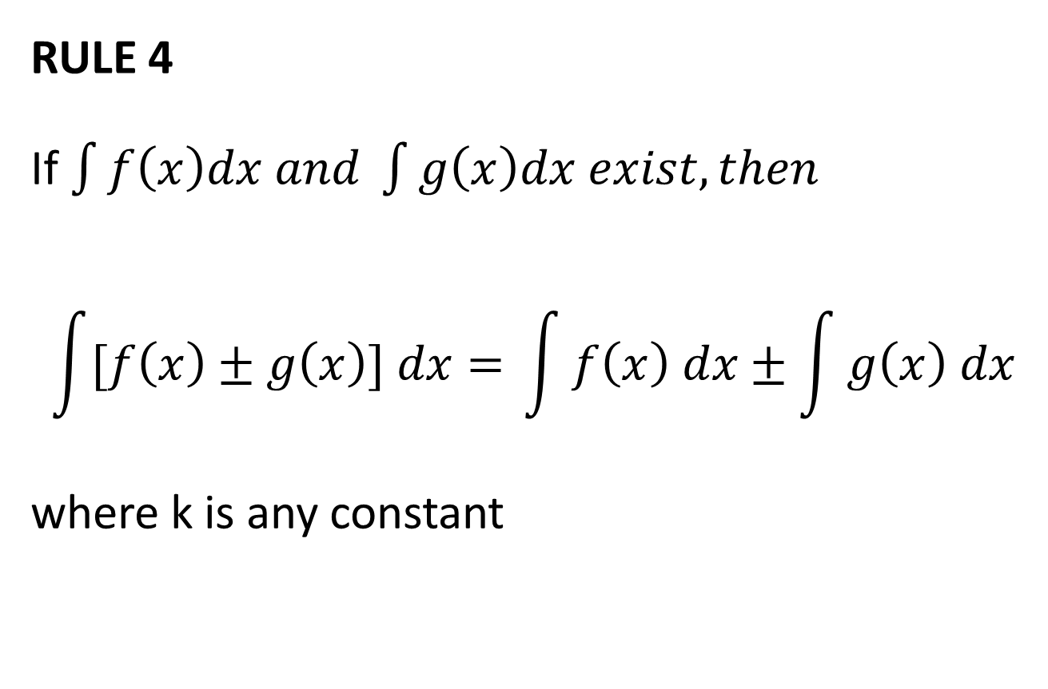
RULE 4
If $\int{f\left(x\right)dx and \int{g\left(x\right)dx exist, then}}$
$$\int{[f\left(x\right)±g\left(x\right)] dx= }\int{f\left(x\right) dx±\int{g\left(x\right) dx}}$$
where k is any constant

Slide 42
Review
We started chapter 18 and covered sections 18.1 and 18.2:
Anti-derivatives
Rules of Integration
Examples
Next, we will continue with the rules of integration.

