Slide 1
Lecture 19
ADDITIONAL
APPLICATIONS

Slide 2
Last Lecture’s Summary
Covered Sec 17.1: Optimization: Applications
Revenue Applications
Cost Applications
Profit Applications
Marginal Approach to Profit Maximization

Slide 3
Today
We’ll go over Sec 17.2:
Optimization: Additional Applications
We will go over several examples that cover applications of optimization techniques we learned in precious lectures.

Slide 4
Additional Applications
Read Estate:
A large multinational conglomerate is interested in purchasing some prime boardwalk real estate at a major ocean resort, The conglomerate is interested in acquiring a rectangular lot which is located on the boardwalk. The only restriction is that the lot have an area of 100,000 square feet. Figure 17.11 presents a sketch of the layout with x

Slide 5
equaling the boardwalk frontage for the lot and y equaling the depth of the lot (both measured in feet).
The seller of the property is pricing the lots at $5,000 per foot of frontage along the boardwalk and $2,000 per foot of depth away from the boardwalk. The conglomerate is interested in determining the dimensions of the lot which will minimize the total purchase cost.

Slide 7
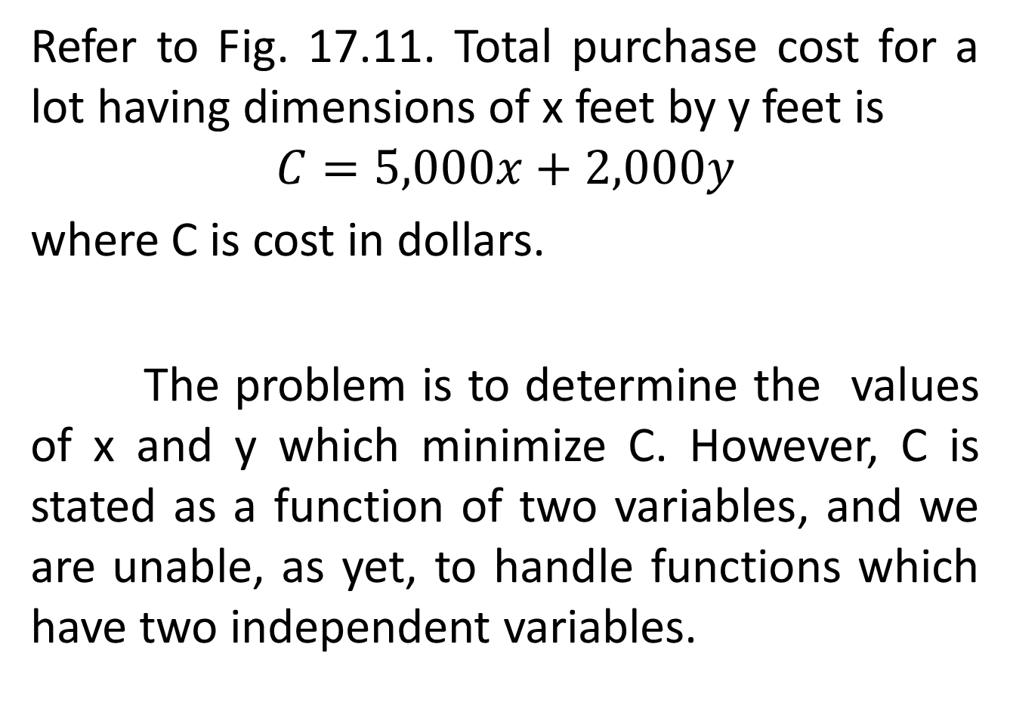
Refer to Fig. 17.11. Total purchase cost for a lot having dimensions of x feet by y feet is
$$C=5,000x+2,000y$$
where C is cost in dollars.
The problem is to determine the values of x and y which minimize C. However, C is stated as a function of two variables, and we are unable, as yet, to handle functions which have two independent variables.

Slide 8
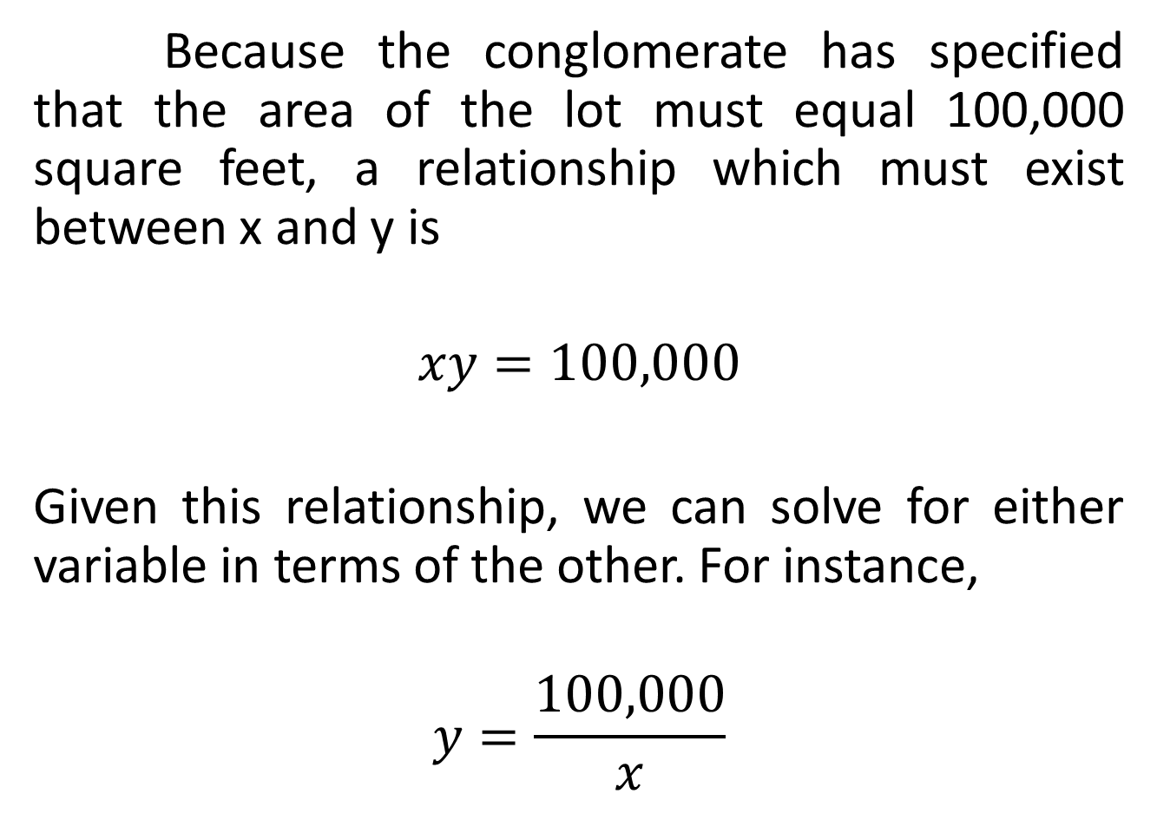
Because the conglomerate has specified that the area of the lot must equal 100,000 square feet, a relationship which must exist between x and y is
$$xy=100,000$$
Given this relationship, we can solve for either variable in terms of the other. For instance,
$$y=\frac{100,000}{x}$$

Slide 9
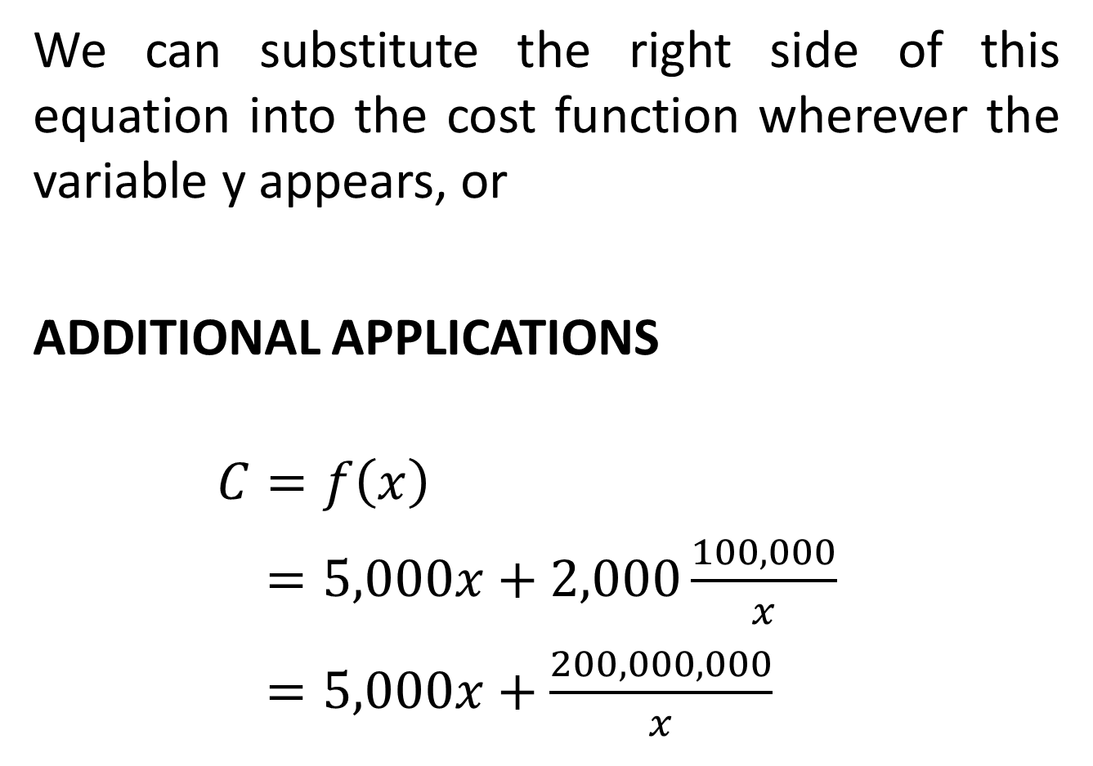
We can substitute the right side of this equation into the cost function wherever the variable y appears, or
ADDITIONAL APPLICATIONS
$$C=f\left(x\right)$$
$=5,000x+2,000\frac{100,000}{x}$
$=5,000x+\frac{200,000,000}{x}$

Slide 13
Emergency Response: Location Model
Example 13 in chap. 6 discussed a problem in which three resort cities had agreed jointly to build and support an emergency response facility which would house rescue trucks and trained paramedics. The key question dealt with the location of the facility. The criterion selected was to choose the location so as to minimize S, the sum of the products of the summer populations of each town and the square of the distance between the town and

Slide 14
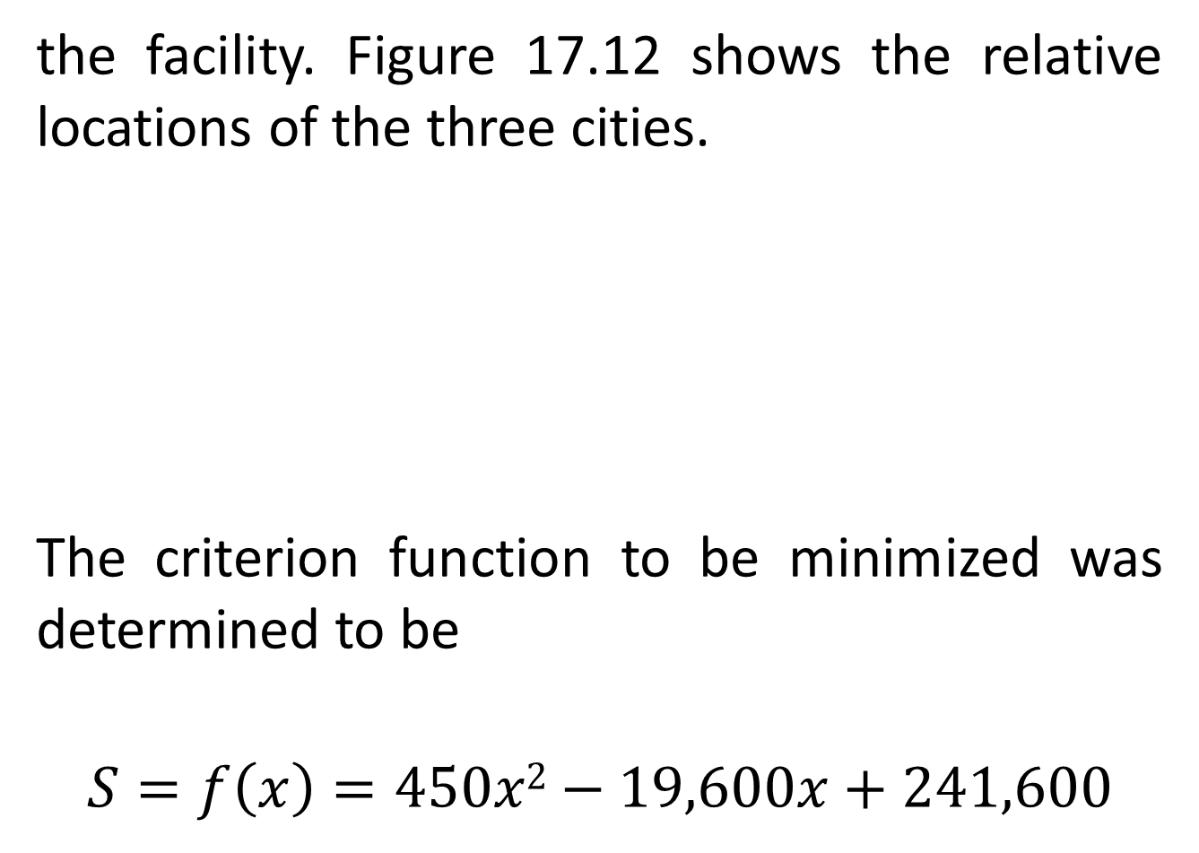
the facility. Figure 17.12 shows the relative locations of the three cities.
The criterion function to be minimized was determined to be
$$S=f\left(x\right)=450x2−19,600x+241,600$$

Slide 15
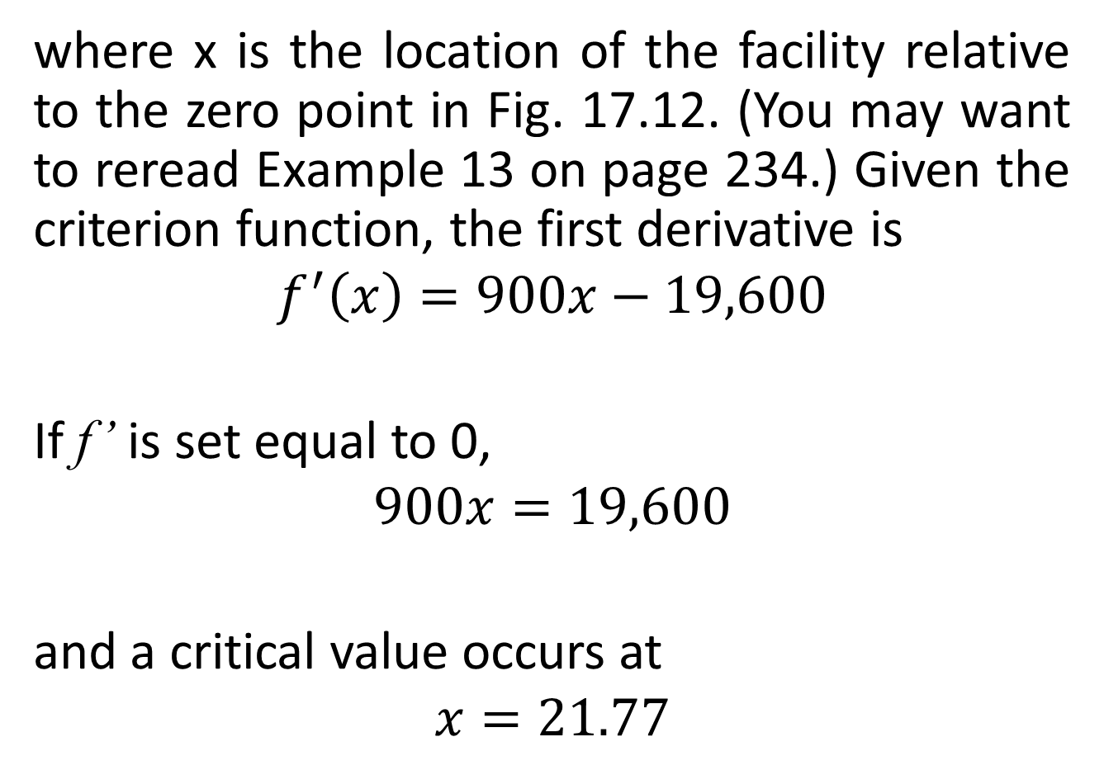
where x is the location of the facility relative to the zero point in Fig. 17.12. (You may want to reread Example 13 on page 234.) Given the criterion function, the first derivative is
$$f^{′}\left(x\right)=900x−19,600$$
If f’ is set equal to 0,
$$900x=19,600$$
and a critical value occurs at
$$x=21.77$$

Slide 16
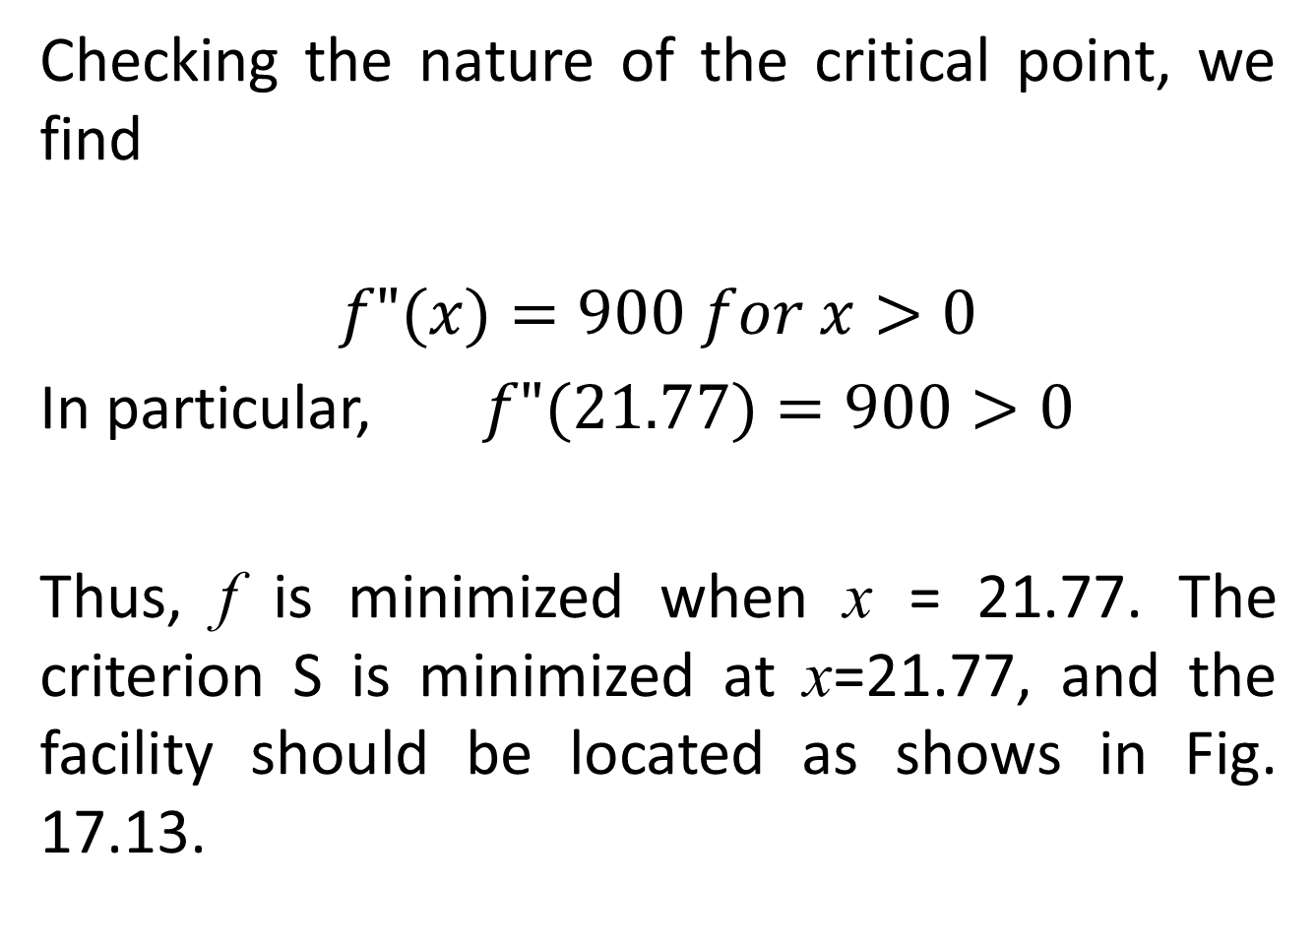
Checking the nature of the critical point, we find
$$f"(x)=900 for x>0$$
In particular, $f"(21.77)=900>0$
Thus, f is minimized when x = 21.77. The criterion S is minimized at x=21.77, and the facility should be located as shows in Fig. 17.13.

Slide 18
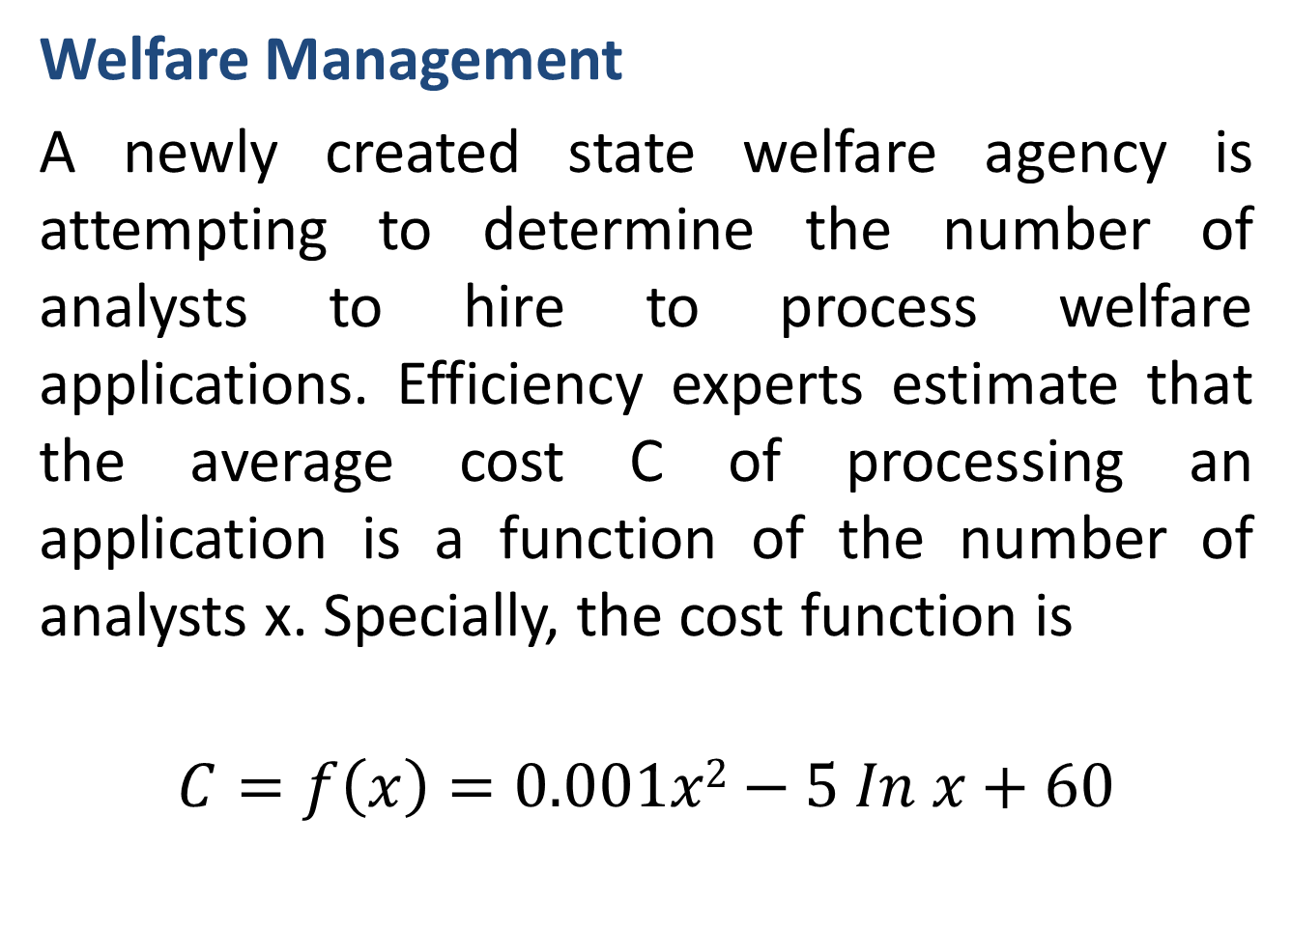
Welfare Management
A newly created state welfare agency is attempting to determine the number of analysts to hire to process welfare applications. Efficiency experts estimate that the average cost C of processing an application is a function of the number of analysts x. Specially, the cost function is
$$C=f\left(x\right)=0.001x2−5 In x+60$$

Slide 19
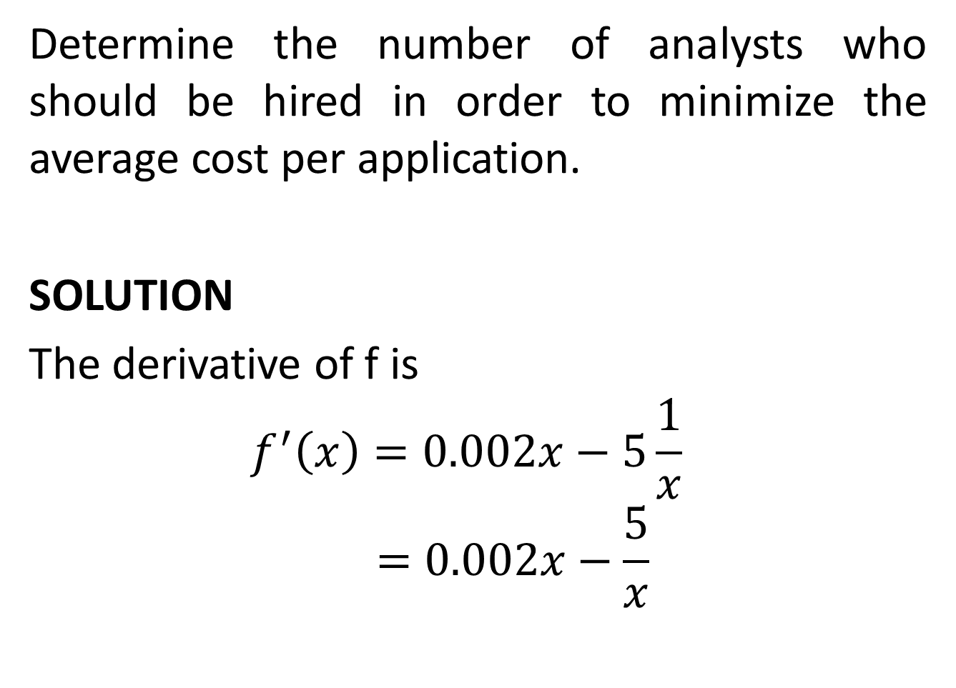
Determine the number of analysts who should be hired in order to minimize the average cost per application.
SOLUTION
The derivative of f is
$$f^{′}\left(x\right)=0.002x−5\frac{1}{x}$$
$$=0.002x−\frac{5}{x}$$

Slide 21
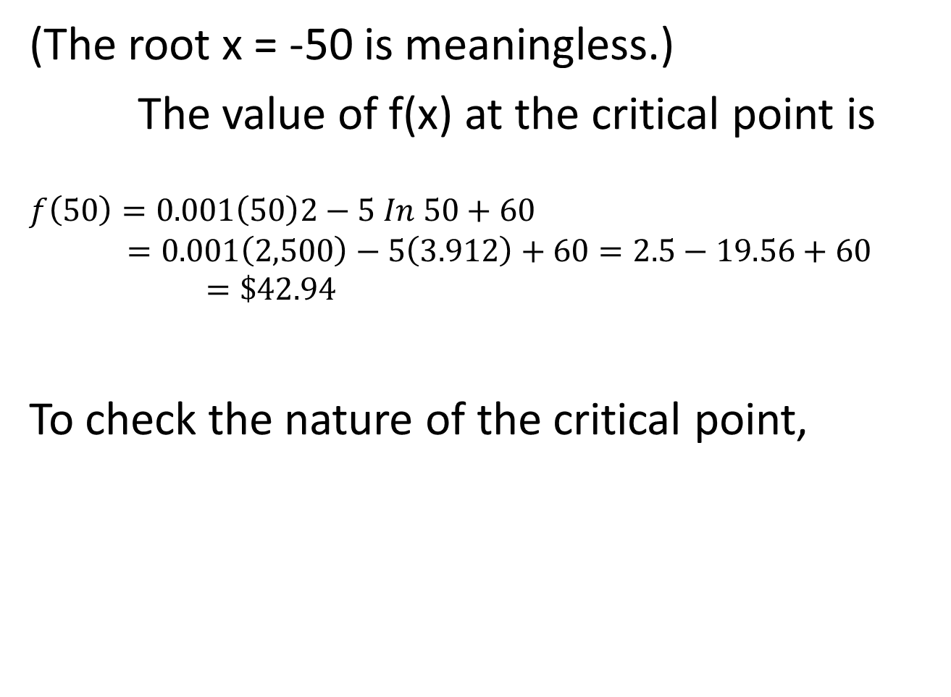
(The root x = -50 is meaningless.)
The value of f(x) at the critical point is
$$f\left(50\right)=0.001\left(50\right)2−5 In 50+60$$
$$=0.001\left(2,500\right)−5\left(3.912\right)+60=2.5−19.56+60=\$42.94$$
To check the nature of the critical point,

Slide 24
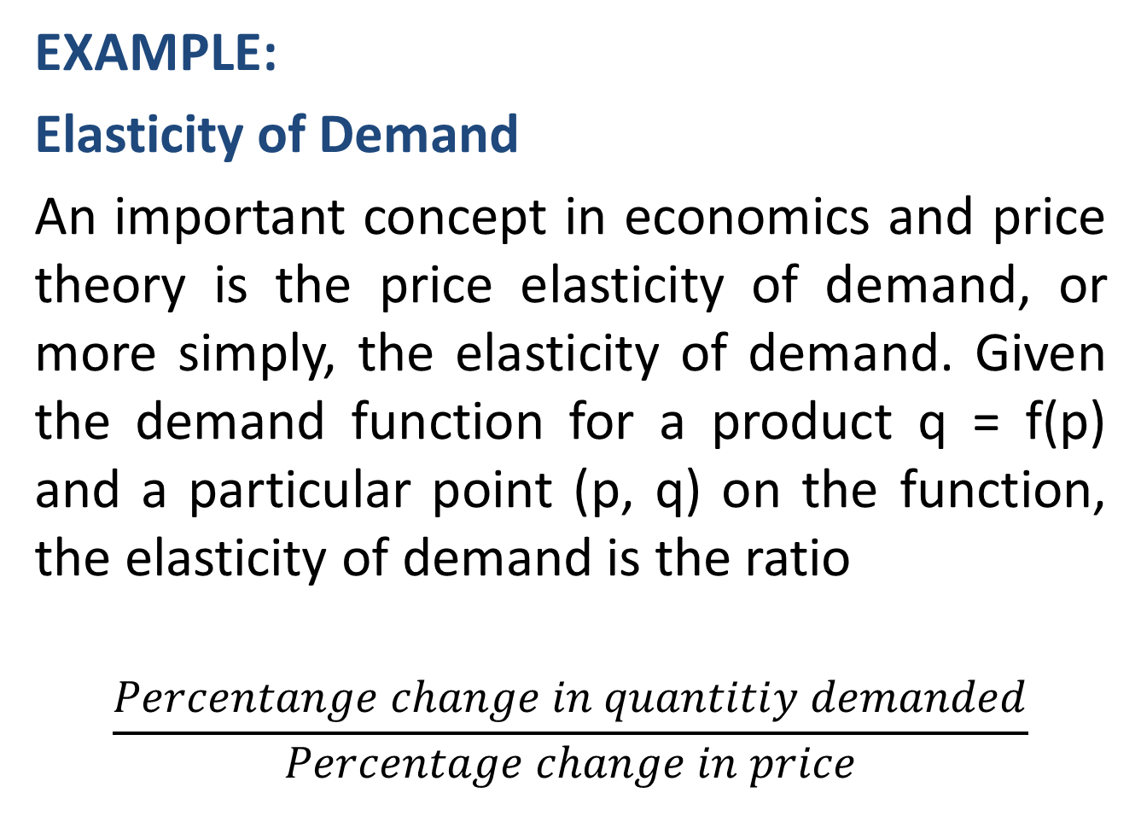
EXAMPLE:
Elasticity of Demand
An important concept in economics and price theory is the price elasticity of demand, or more simply, the elasticity of demand. Given the demand function for a product q = f(p) and a particular point (p, q) on the function, the elasticity of demand is the ratio
$$\frac{Percentange change in quantitiy demanded}{Percentage change in price}$$

Slide 25
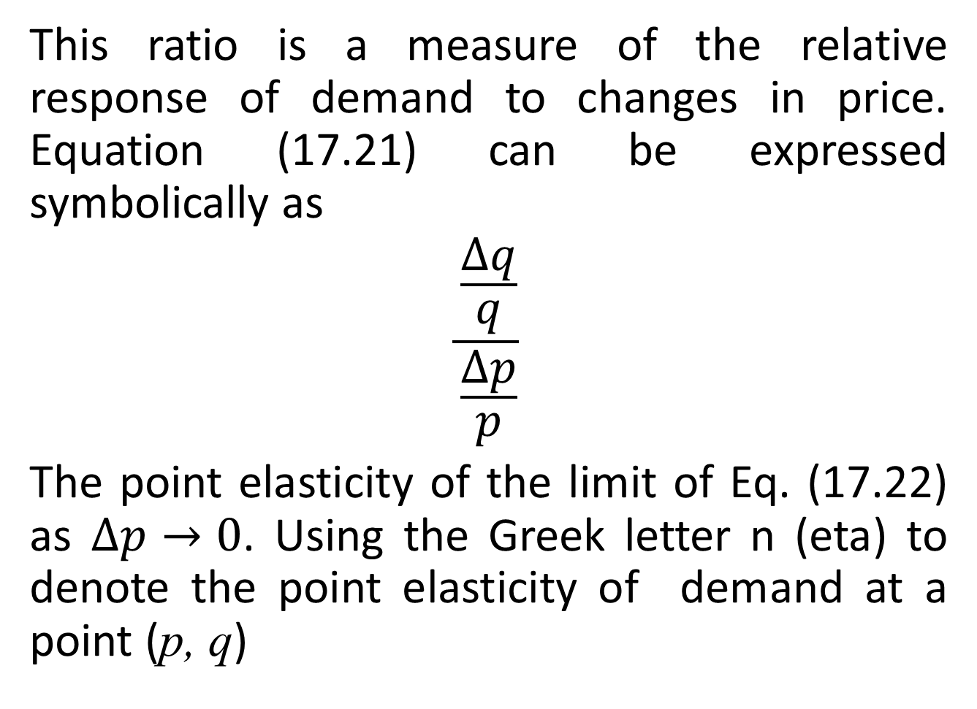
This ratio is a measure of the relative response of demand to changes in price. Equation (17.21) can be expressed symbolically as
$$\frac{\frac{∆q}{q}}{\frac{∆p}{p}}$$
The point elasticity of the limit of Eq. (17.22) as $∆p→0$. Using the Greek letter n (eta) to denote the point elasticity of demand at a point (p, q)

Slide 29
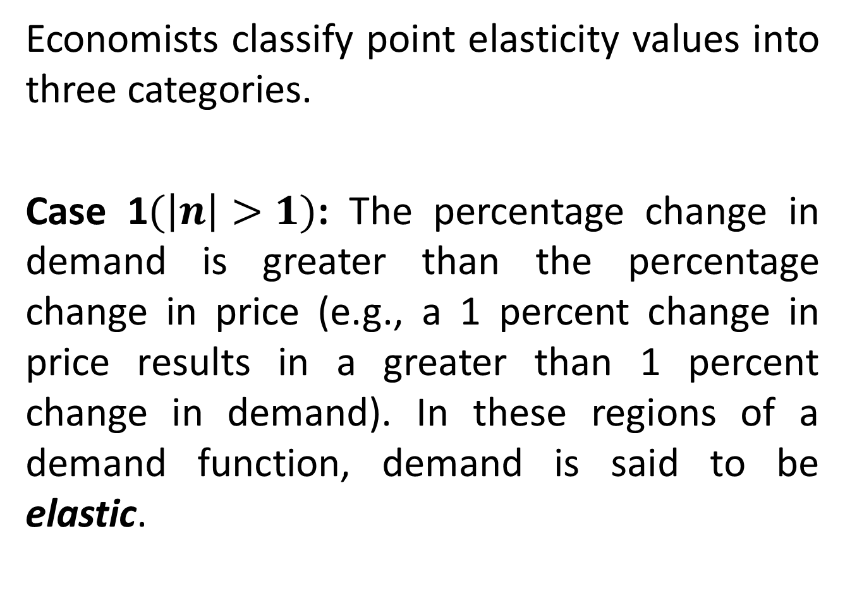
Economists classify point elasticity values into three categories.
Case 1$(\left|n\right|>1)$: The percentage change in demand is greater than the percentage change in price (e.g., a 1 percent change in price results in a greater than 1 percent change in demand). In these regions of a demand function, demand is said to be elastic.

Slide 30
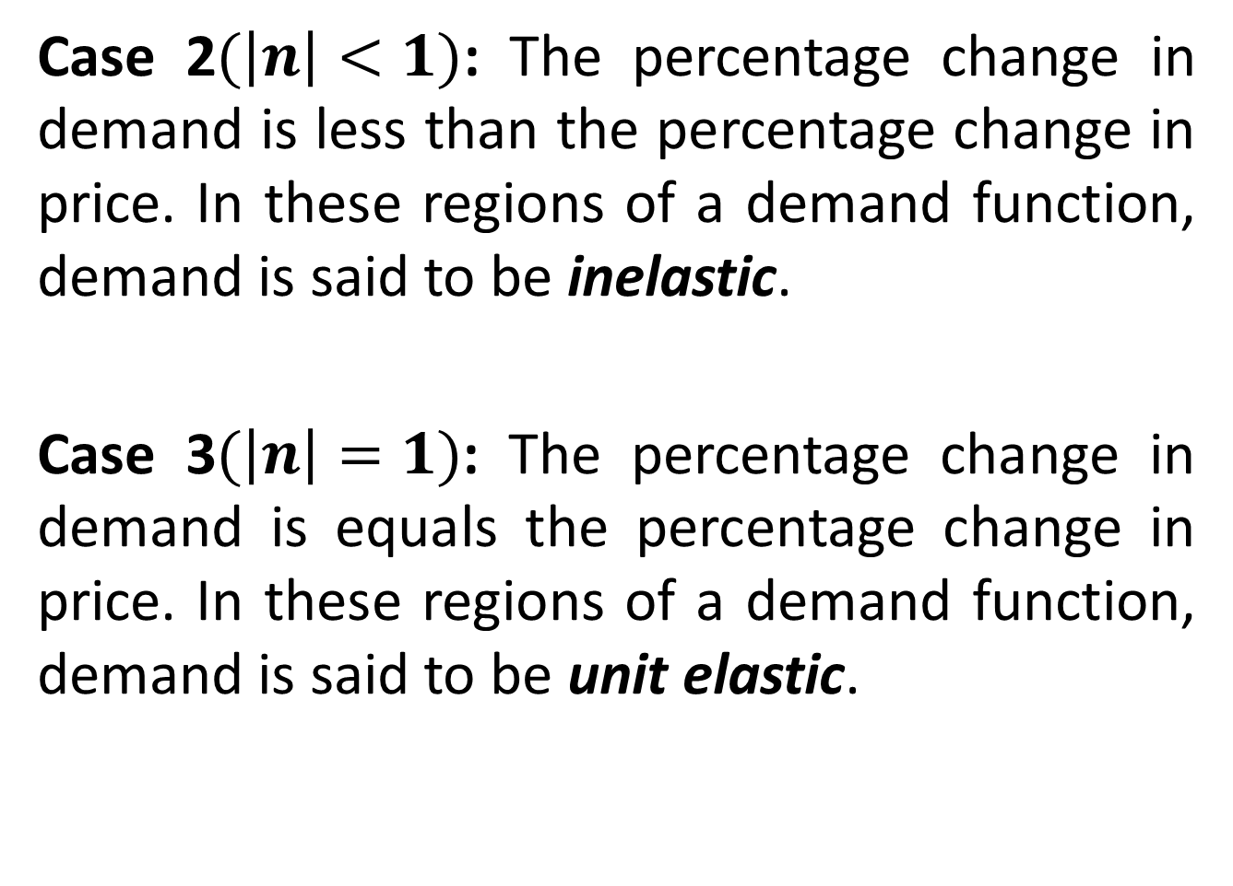
Case 2$(\left|n\right|<1)$: The percentage change in demand is less than the percentage change in price. In these regions of a demand function, demand is said to be inelastic.
Case 3$(\left|n\right|=1)$: The percentage change in demand is equals the percentage change in price. In these regions of a demand function, demand is said to be unit elastic.

Slide 32
Review
We covered Sec 17.2:
Optimization: Additional Applications
Finished Chapter 17
Next, Integral Calculus

