Slide 1
Lecture 18
Optimization:
Revenue, Cost, and Profit Applications

Slide 2
Last Lecture’s Summary
We covered sections 16.3 and 16.4:
Curve Sketching
Restricted Domain Optimization Problems
Procedure for finding Absolute Maxima and Absolute Minima
Finished Chapter 16

Slide 3
Today
We start chapter 17 and go over Sec 17.1:
Optimization: Applications
Revenue Applications
Cost Applications
Profit Applications
Marginal Approach to Profit Maximization

Slide 4
Chapter Objectives
Illustrate a wide variety of applications of optimization procedures.
Reinforce skills in problem formulation.
Reinforce skills of interpretation of mathematical results.

Slide 5
Main Topics
Revenue, Cost, and Profit Applications
Additional Applications

Slide 6
Chapter 16 provided the tools of classical optimization. That is, it gave us a method for examining functions in order to locate maximum and minimum points. This chapter will be devoted to illustrating the use of these procedures in a variety of application.

Slide 8
Revenue Applications
The following applications focus on revenue maximization. Recall that the money which flows into an organization from either selling products or providing services in referred to as revenue. The most fundamental way of computing total revenue from selling a product (or service) is
Total revenue = (price per unit)(quantity sold)
An assumption in this relationship is that the selling price is the same for all units sold.

Slide 9
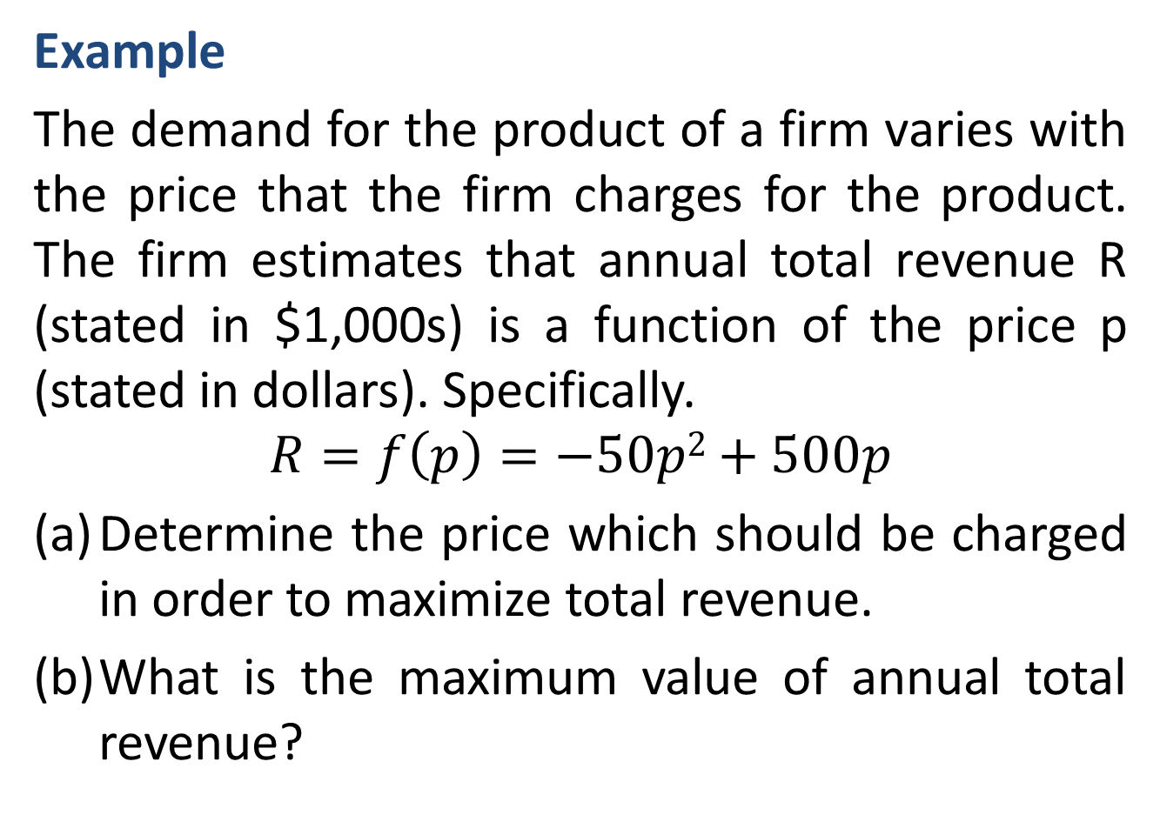
Example
The demand for the product of a firm varies with the price that the firm charges for the product. The firm estimates that annual total revenue R (stated in $1,000s) is a function of the price p (stated in dollars). Specifically.
$$R=f\left(p\right)=−50p2+500p$$
(a) Determine the price which should be charged in order to maximize total revenue.
(b) What is the maximum value of annual total revenue?

Slide 13
Cost Applications
Example: Inventory Management
A common problem in organizations is determining how much of a needed item should be kept on hand. For retailers, the problem may relate to how many units of each product should be kept in stock. For producers, the problem may involve how much of each raw material should be kept available. This problem is identified with an area called inventory control, or inventory

Slide 14
management. Concerning the question of how much “inventory” to keep on hand, there may be costs associated with having too little or too much inventory on hand.
A retailer of motorized bicycles has examined cost data and has determined a cost function which expresses the annual cost of purchasing, owning, and maintaining inventory as a function of the size (number of units) of each order it places for the bicycles. The cost function is

Slide 15
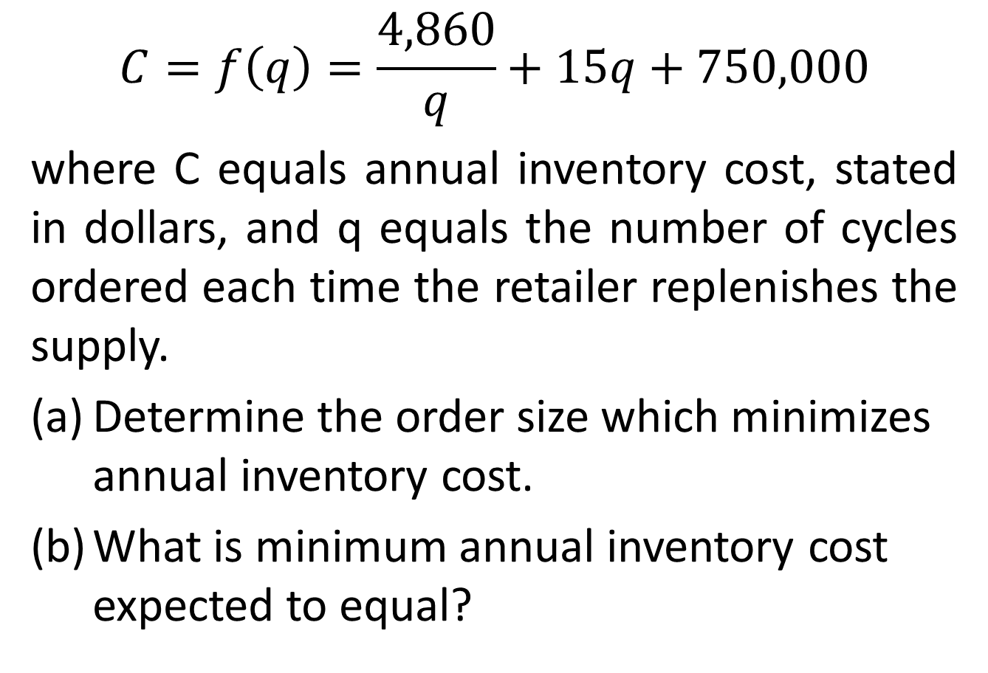
$$C=f\left(q\right)=\frac{4,860}{q}+15q+750,000$$
where C equals annual inventory cost, stated in dollars, and q equals the number of cycles ordered each time the retailer replenishes the supply.
Determine the order size which minimizes annual inventory cost.
What is minimum annual inventory cost expected to equal?

Slide 19
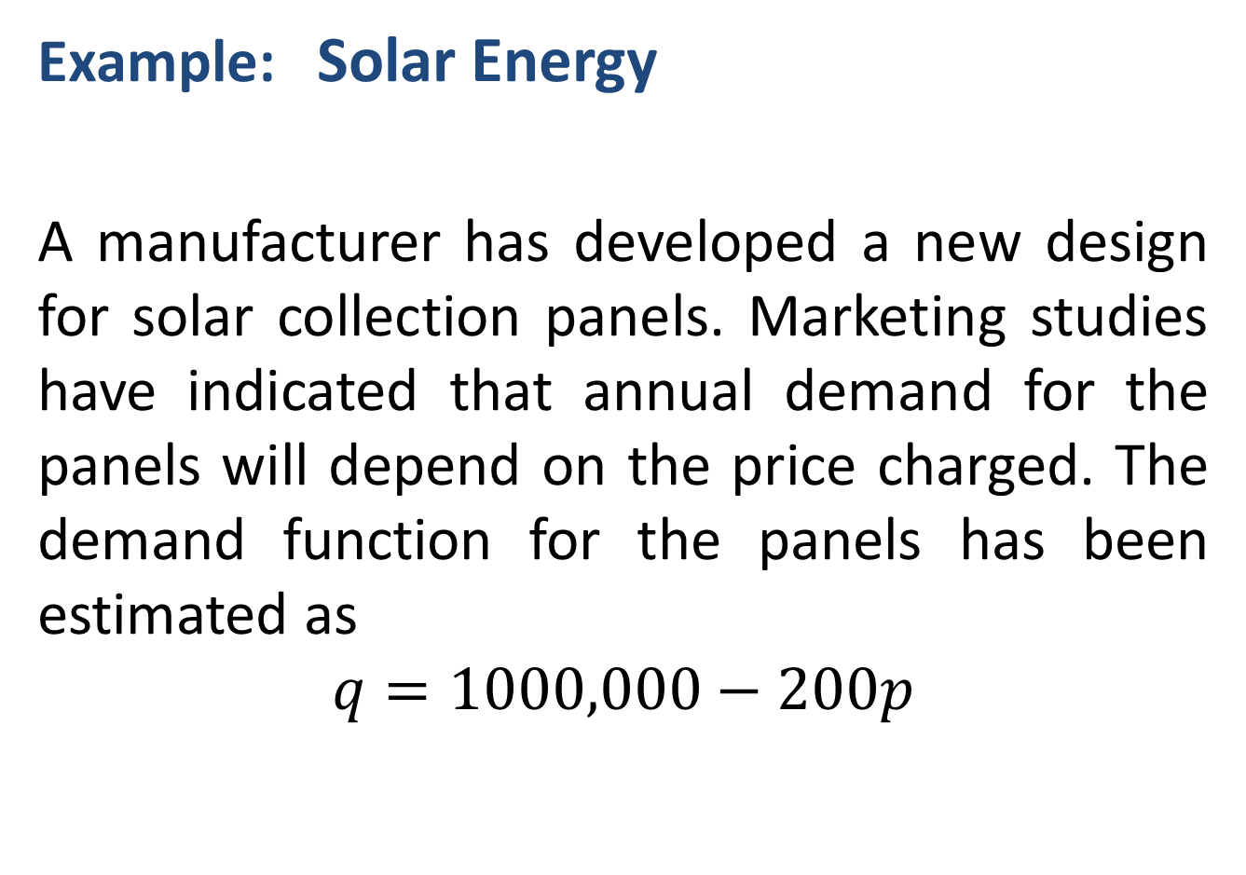
Example: Solar Energy
A manufacturer has developed a new design for solar collection panels. Marketing studies have indicated that annual demand for the panels will depend on the price charged. The demand function for the panels has been estimated as
$$q=1000,000−200p$$

Slide 20
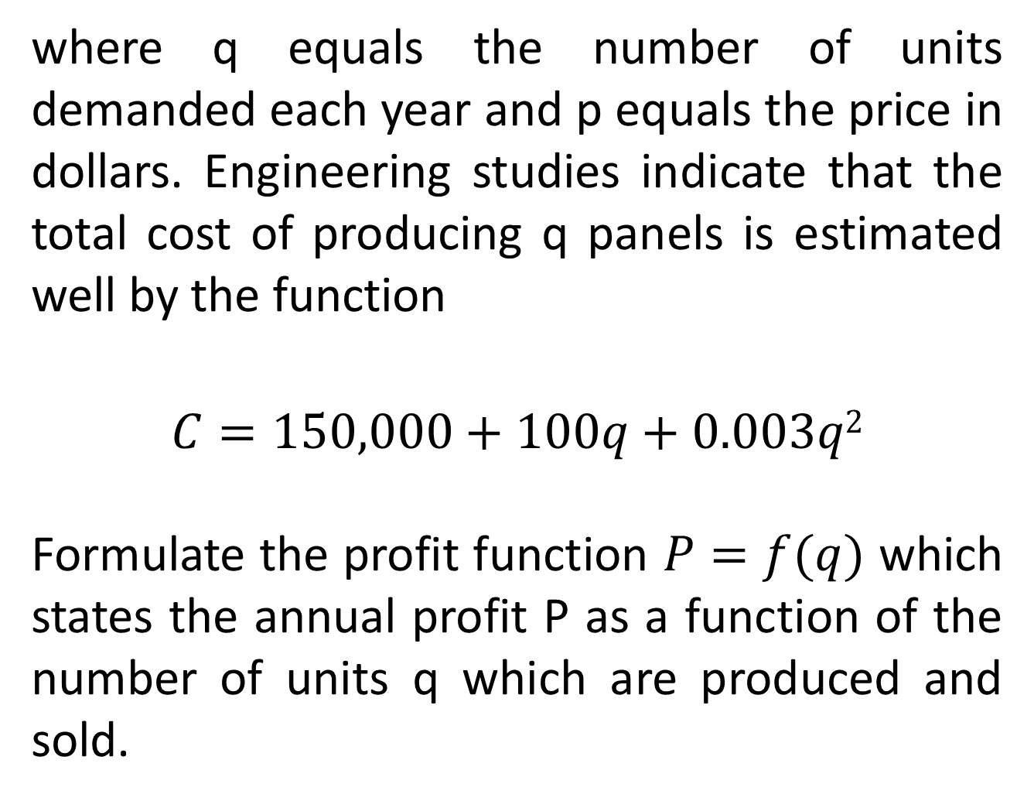
where q equals the number of units demanded each year and p equals the price in dollars. Engineering studies indicate that the total cost of producing q panels is estimated well by the function
$$C=150,000+100q+0.003q2$$
Formulate the profit function $P=f(q)$ which states the annual profit P as a function of the number of units q which are produced and sold.

Slide 21
SOLUTION
We have been asked to develop a function which states profit P as a function of q. As opposed to example 5, we must construct the profit function. The total cost function is stated in terms of q. However, we need to formulate a total revenue function stated in terms of q. The basic structure for computing total revenue is

Slide 23
Example: Restricted Domain
Assume in the last example that the manufacturer’s annual production capacity is 20,000 units. Re-solve Example 6 with this added restriction.

Slide 24
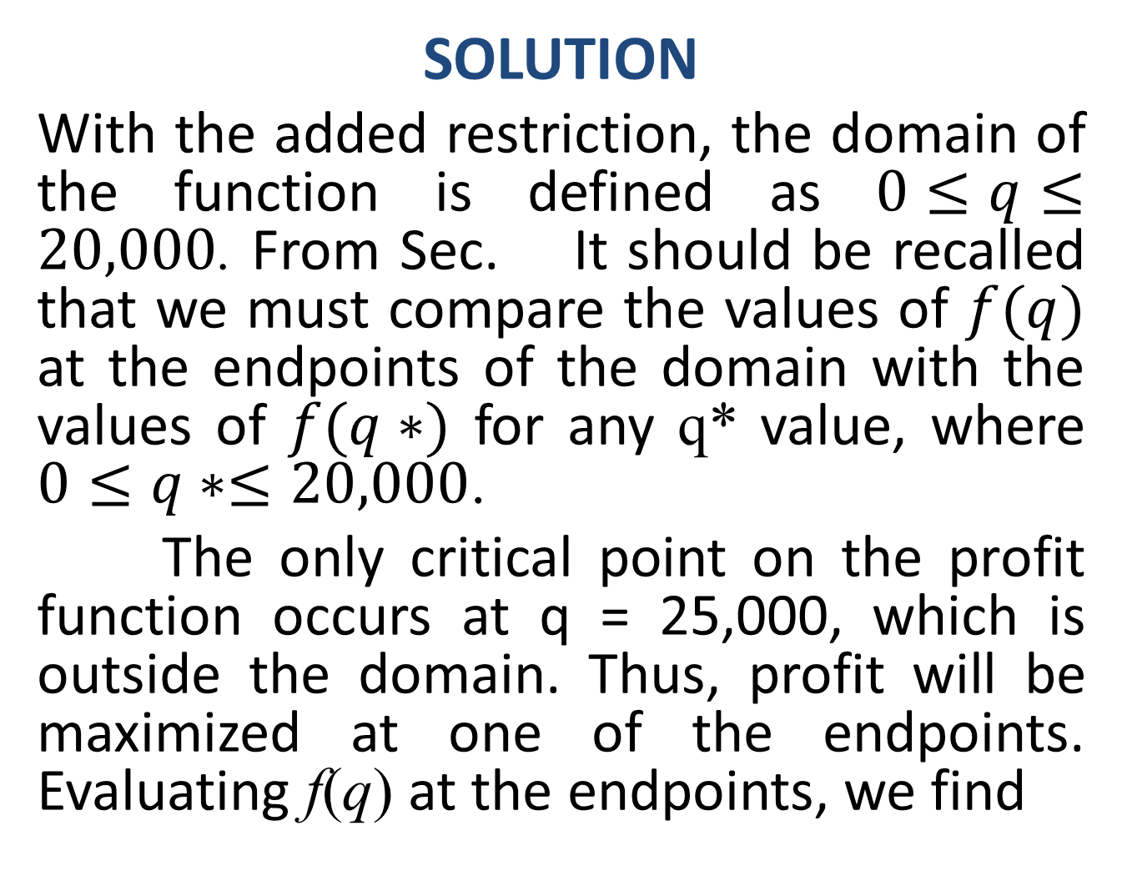
SOLUTION
With the added restriction, the domain of the function is defined as $0≤q≤20,000$. From Sec. It should be recalled that we must compare the values of $f(q)$ at the endpoints of the domain with the values of $f(q∗)$ for any q* value, where $0≤q∗≤20,000$.
The only critical point on the profit function occurs at q = 25,000, which is outside the domain. Thus, profit will be maximized at one of the endpoints. Evaluating f(q) at the endpoints, we find

Slide 25
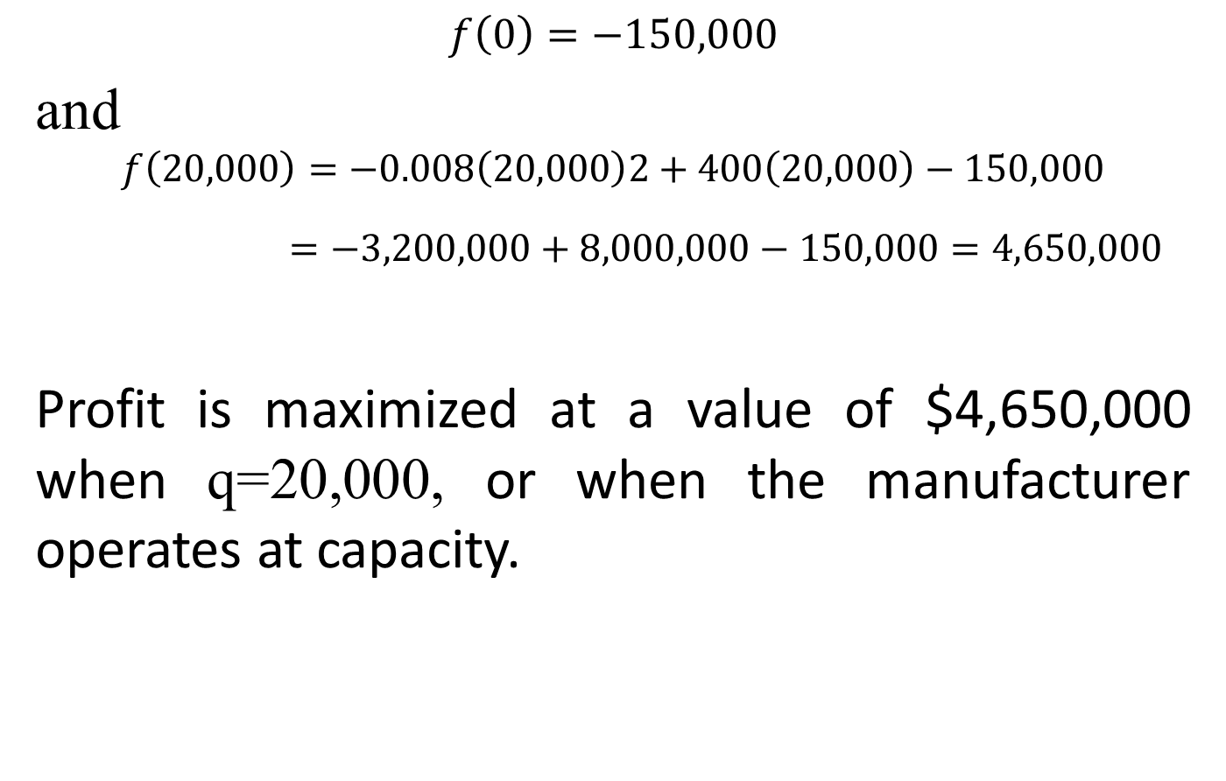
$$f\left(0\right)=−150,000$$
and
$$f\left(20,000\right)=−0.008\left(20,000\right)2+400\left(20,000\right)−150,000$$
$=−3,200,000+8,000,000−150,000=4,650,000$
Profit is maximized at a value of $4,650,000 when q=20,000, or when the manufacturer operates at capacity.

Slide 27
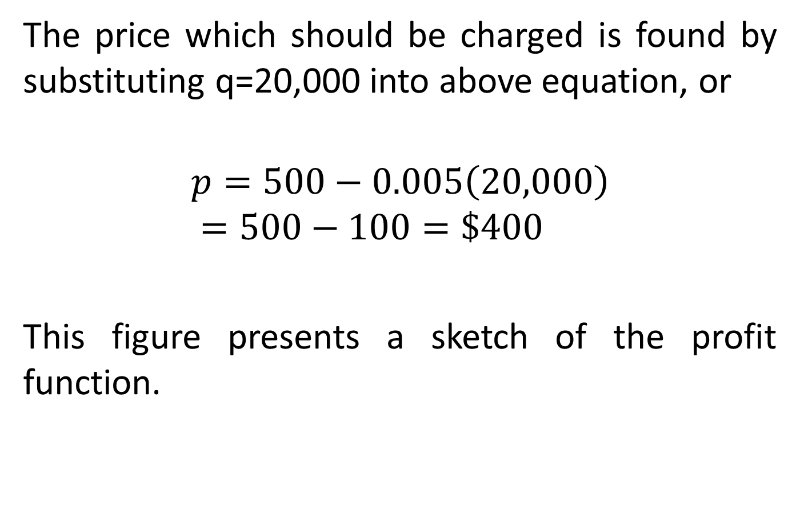
The price which should be charged is found by substituting q=20,000 into above equation, or
$$p=500−0.005\left(20,000\right)$$
$$=500−100=\$400$$
This figure presents a sketch of the profit function.

Slide 29
Marginal Approach to Profit Maximization
An alternative approach to finding the profit maximization point involve marginal analysis. Popular among economists, marginal analysis examines incremental effects on profitability. Given that a firm is producing a certain number of units each year, marginal analysis would be concerned with the effect on profit if one additional unit is produced and sold.

Slide 30
To utilize the marginal approach to profit maximization, the following conditions must hold.
REQUIREMENTS FOR USING THE MARGINAL APPROACH
I It must be possible to identify the total revenue function and the total cost function, separately.
II The revenue and cost functions must be stated in terms of the level of output or number of units produced and sold.

Slide 31
Marginal Revenue
One of the two important concepts in marginal analysis is marginal revenue. Marginal revenue is the additional revenue derived from selling one more unit of a product or service.
For a total revenue function R(q), the derivative R’(q) represents the instantaneous rate of change in total revenue given a change in the number of units sold.

Slide 32
R’ also represents a general expression for the slope of the graph of the total revenue function. For purposes of marginal analysis, the derivative is used to represent the marginal revenue, or
MR = R’ (q)

Slide 33
Marginal Cost
The other important concept in marginal analysis is marginal cost. Marginal cost is the additional cost incurred as a result of producing and selling one more unit of a product or service.
For a total cost function C(q), the derivative C’(q) represents the instantaneous rate of change in total cost given a change in the number of units produced.

Slide 34
C’(q) also represents a general expression for the slope of the graph of the total cost function. For purposes of marginal analysis, the derivative is used to represent the marginal cost, or
MC = C’(q)

Slide 42
Review
We started chapter 17 and covered Sec 17.1:
Optimization: Applications
Revenue Applications
Cost Applications
Profit Applications
Marginal Approach to Profit Maximization
Next, Optimization: Additional Applications

