Slide 1
Lecture 17
Curve Sketching

Slide 2
Last Lecture’s Summary
We covered Sec 16.2:
Identification of Maxima and Minima
Relative Extrema (maxima and minima)
Absolute Maxima and Minima
Critical Points
First and Second Derivative Tests for Relative Extrema

Slide 3
Today
We will cover sections 16.3 and 16.4:
Curve Sketching
Restricted Domain Considerations
Procedure for Identifying Absolute Maxima and Minima

Slide 4
Curve Sketching
Sketching functions is facilitated with the information we have acquired in this chapter. One can get a feeling for the general shape of the graph of a function without determining and plotting a large number of ordered pairs.

Slide 5
Key Data Points
In determining the general shapes of the graph of a function, the following attributes are the most significant.
Relative maxima and minima.
Inflection points.
x and y intercepts.
Ultimate direction

Slide 6
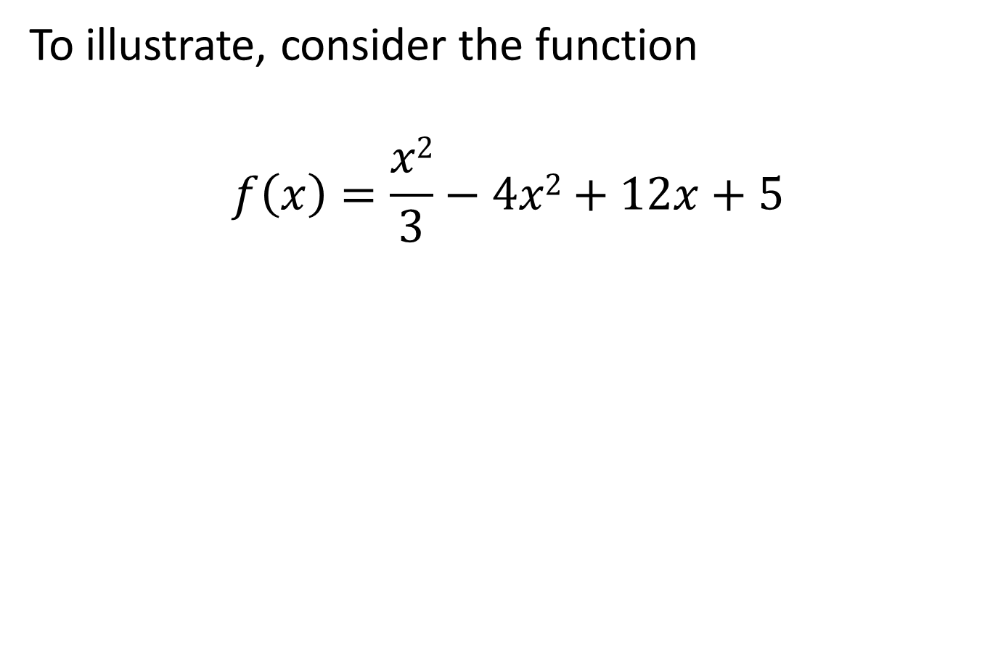

Slide 7
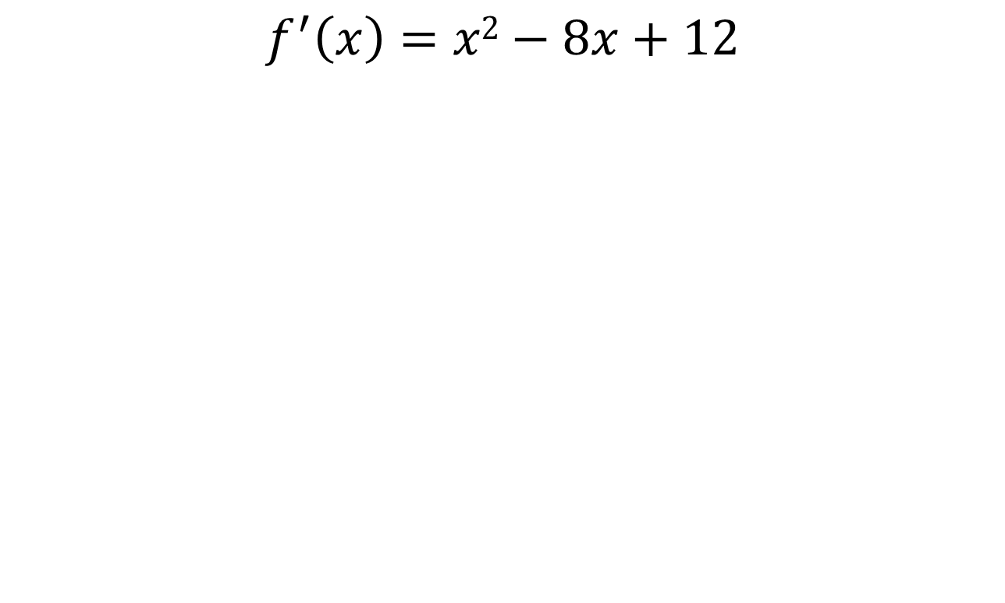
1- Relative Maxima and Minima
$$f^{′}\left(x\right)=x2−8x+12$$

Slide 10
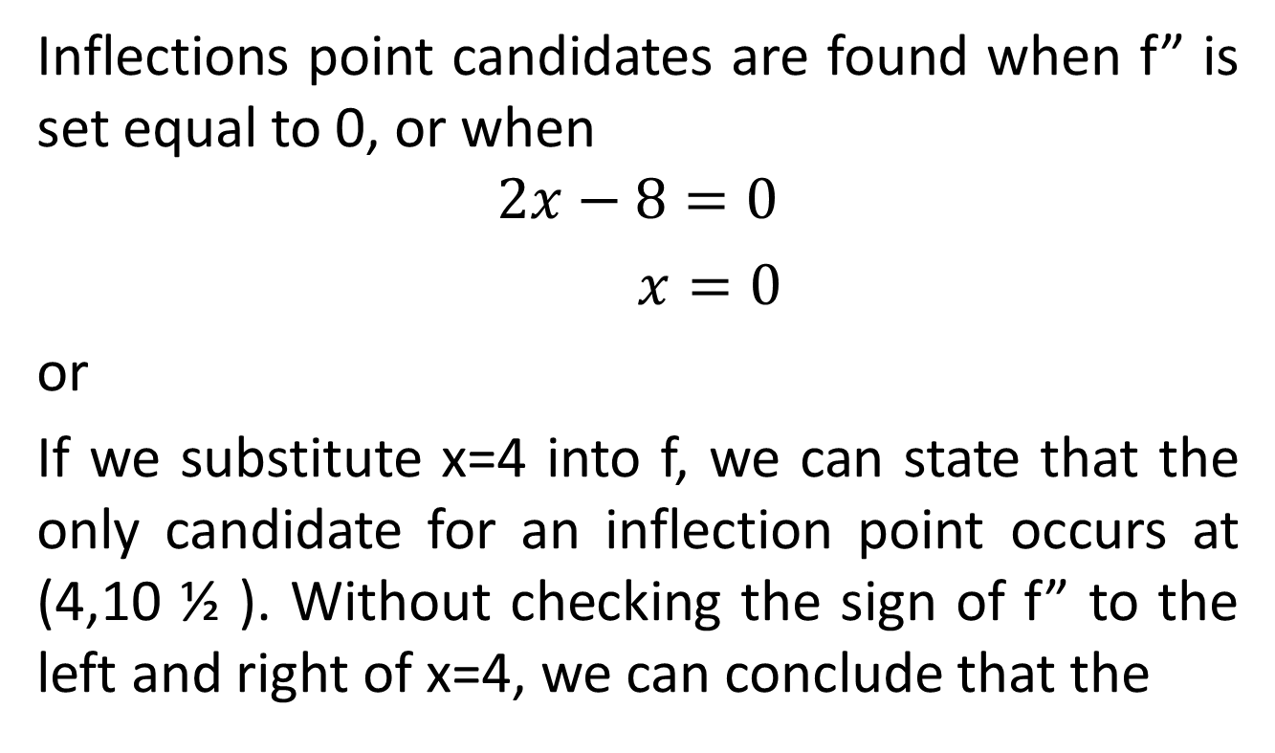
2- Inflection Points

Slide 12
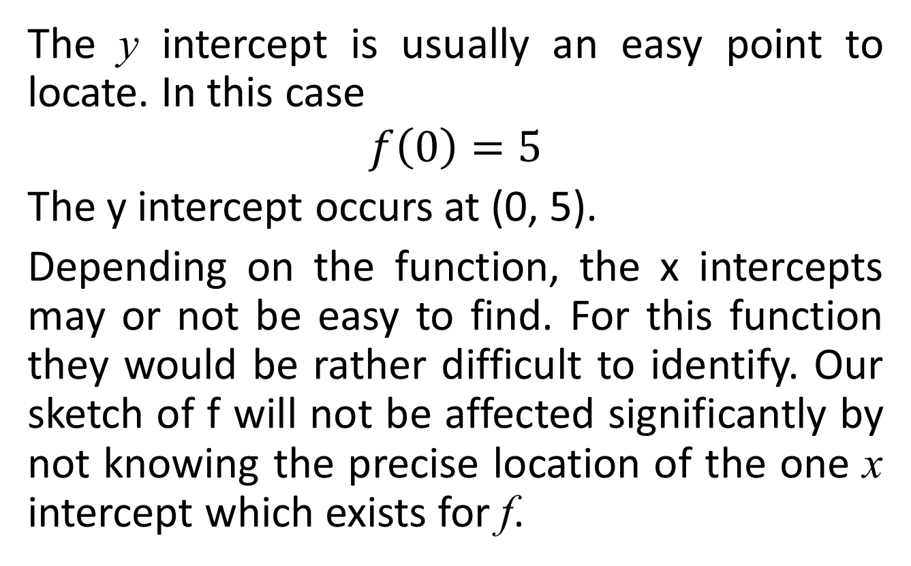
3- Intercepts
The y intercept is usually an easy point to locate. In this case
$$f\left(0\right)=5$$
The y intercept occurs at (0, 5).
Depending on the function, the x intercepts may or not be easy to find. For this function they would be rather difficult to identify. Our sketch of f will not be affected significantly by not knowing the precise location of the one x intercept which exists for f.

Slide 13
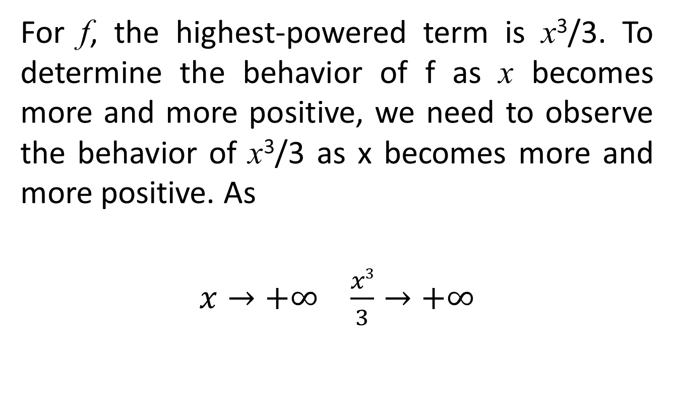
4- Ultimate Direction
For f, the highest-powered term is x³/3. To determine the behavior of f as x becomes more and more positive, we need to observe the behavior of x³/3 as x becomes more and more positive. As
$x→+∞$$\frac{x3}{3}→+∞$

Slide 15
RESTRICTED-DOMAIN CONSIDERATIONS
In this section we will examine procedures for identifying absolute maxima and minima when the domain of a function is restricted.

Slide 16
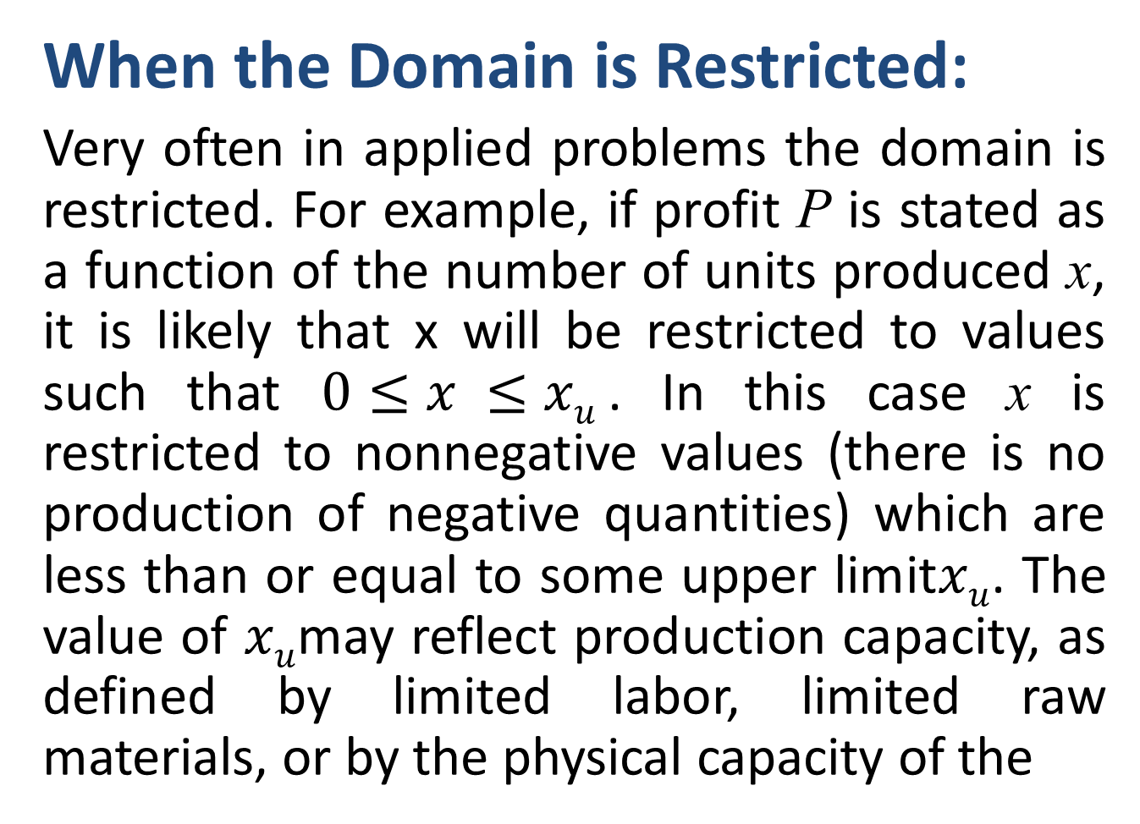
When the Domain is Restricted:
Very often in applied problems the domain is restricted. For example, if profit P is stated as a function of the number of units produced x, it is likely that x will be restricted to values such that $0≤x ≤xu$. In this case x is restricted to nonnegative values (there is no production of negative quantities) which are less than or equal to some upper limit$xu$. The value of $xu$may reflect production capacity, as defined by limited labor, limited raw materials, or by the physical capacity of the

Slide 17
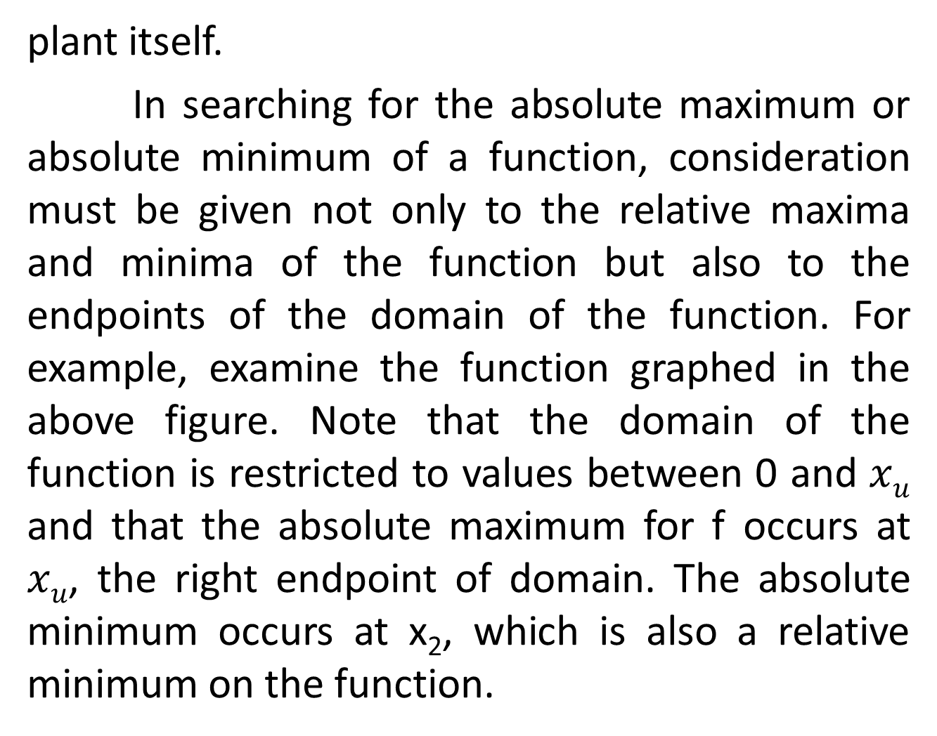
plant itself.
In searching for the absolute maximum or absolute minimum of a function, consideration must be given not only to the relative maxima and minima of the function but also to the endpoints of the domain of the function. For example, examine the function graphed in the above figure. Note that the domain of the function is restricted to values between 0 and $xu$ and that the absolute maximum for f occurs at $xu$, the right endpoint of domain. The absolute minimum occurs at x₂, which is also a relative minimum on the function.

Slide 19
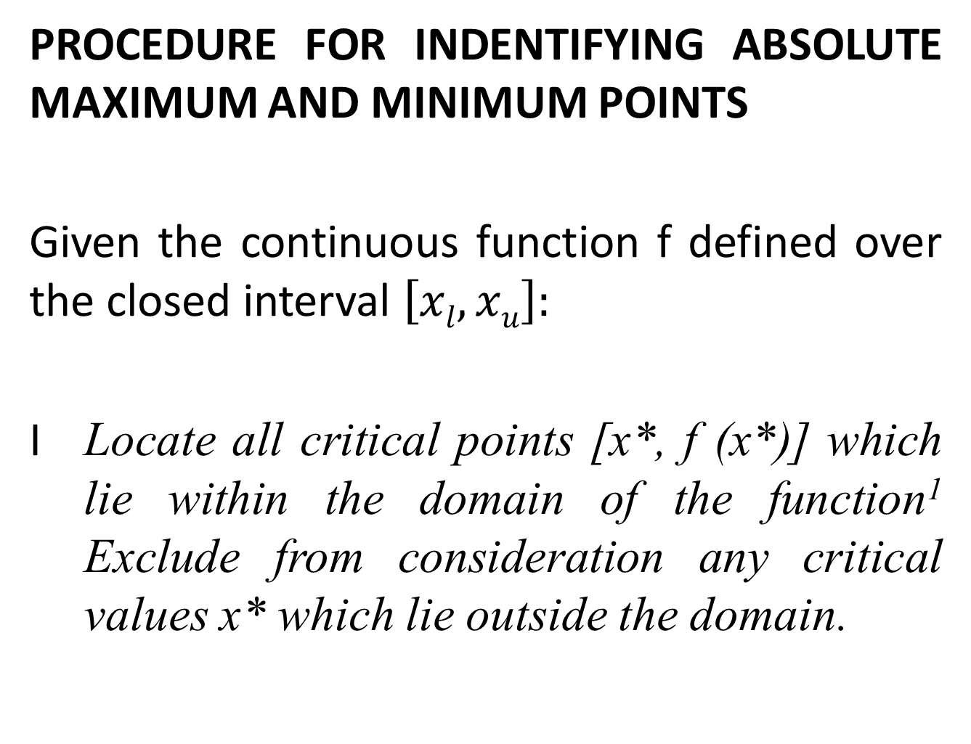
PROCEDURE FOR INDENTIFYING ABSOLUTE MAXIMUM AND MINIMUM POINTS
Given the continuous function f defined over the closed interval $\left[xl, xu\right]:$
I Locate all critical points [x*, f (x*)] which lie within the domain of the function¹ Exclude from consideration any critical values x* which lie outside the domain.

Slide 20
II Compute the values of f(x) at the two endpoints of the domain [f(x_{l}) and f(x_{u}).
III Compare the values of f(x*) for all relevant critical points with (x_{l}) and (x_{u}). The absolute maximum in the largest of these values. The absolute minimum is the smallest of these values.

Slide 21
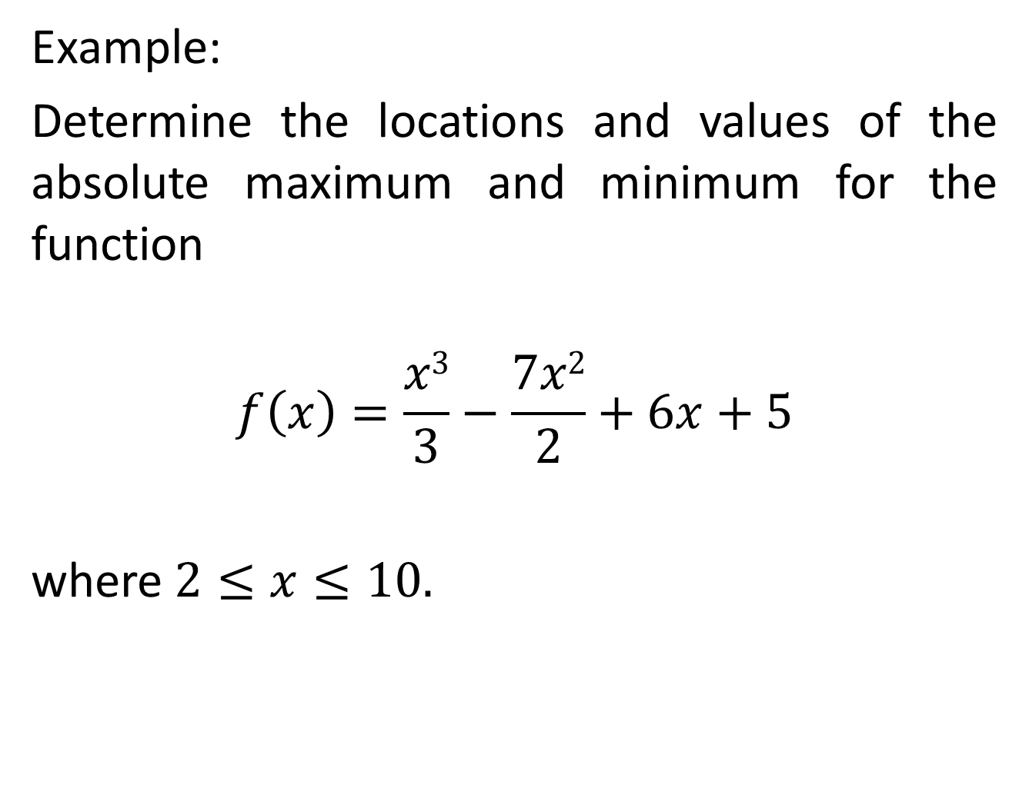
Example:
Determine the locations and values of the absolute maximum and minimum for the function
$$f\left(x\right)=\frac{x3}{3}−\frac{7x2}{2}+6x+5$$
where $2≤x≤10.$

Slide 24
Step II The values of f (x) at the endpoints of the domain are

Slide 25
Step III Comparing f (2), f (6), and f (10), we find the absolute minimum of -13 occurs when x = 6 and the absolute maximum of 48¹/₃ occurs when x = 10. The figure presents a sketch of the function.

Slide 35
Review
Covered sections 16.3 and 16.4:
Curve Sketching
Restricted Domain Considerations
Procedure for Identifying Absolute Maxima and Minima
Next, we’ll start Chapter 17: Application of Optimization.

