Slide 1
Lecture 16
Identification of Maxima and Minima

Slide 2
Last Lecture’s Summary
We covered Sec 16.1:
Derivatives: Additional Interpretations
Increasing and Decreasing Functions
Concavity, and
Inflection Points

Slide 3
Today
We will go over Sec 16.2:
Identification of Maxima and Minima
Relative Extrema (maxima and minima)
Absolute Maxima and Minima
Critical Points
Tests for Relative Extrema

Slide 4
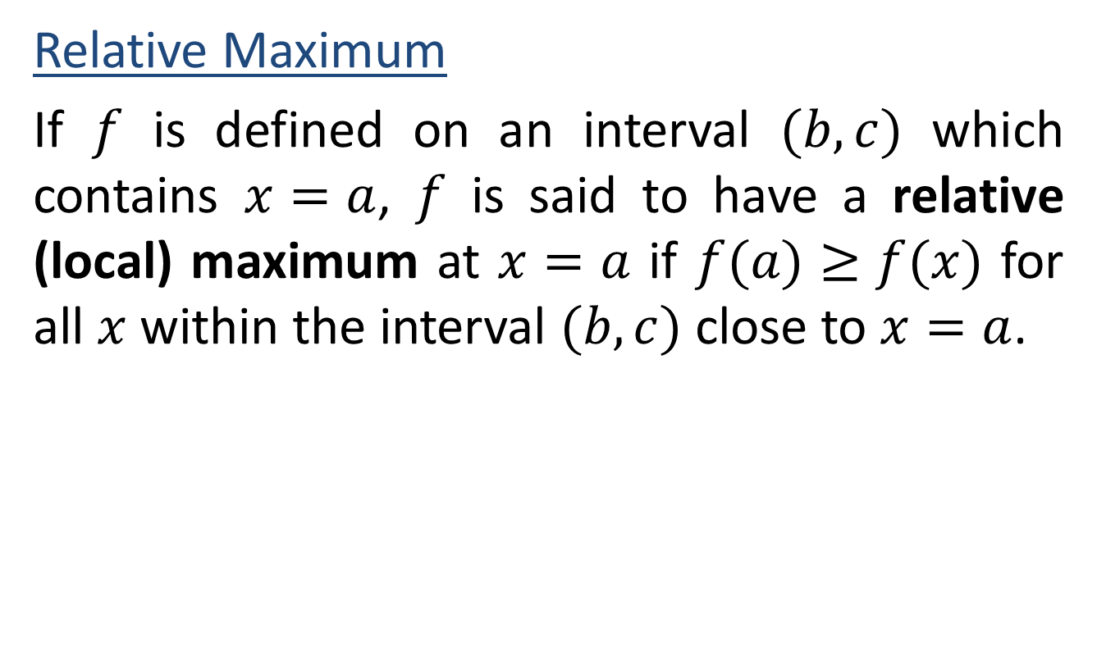
Relative Extrema
Relative Maximum
If $f$ is defined on an interval $(b,c)$ which contains $x=a$, $f$ is said to have a relative (local) maximum at $x=a$ if $f(a)≥f(x)$ for all $x$ within the interval $(b,c)$ close to $x=a$.

Slide 5

Relative Minimum
If $f$ is defined on an interval $(b,c)$ which contains $x=a$, $f$ is said to have a relative (local) maximum at $x=a$ if $f\left(a\right)≤f(x)$ for all $x$ within the interval $(b,c)$ close to $x=a$.

Slide 6
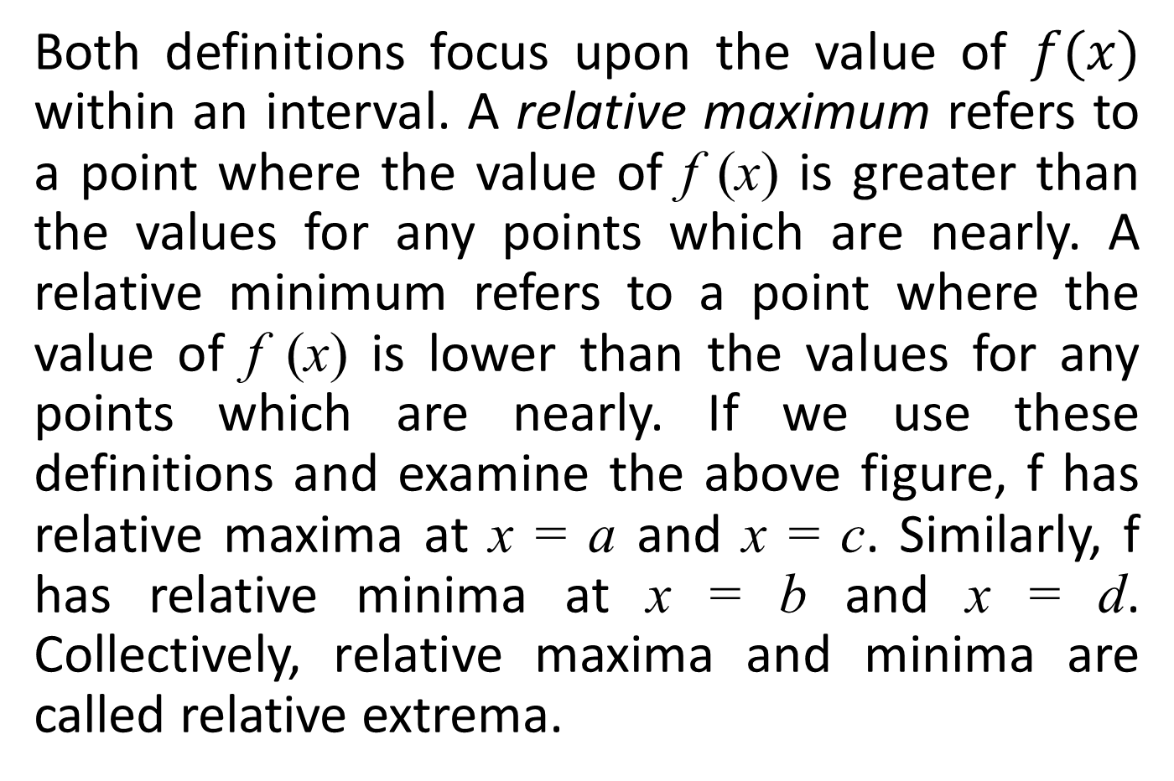
Both definitions focus upon the value of $f(x)$ within an interval. A relative maximum refers to a point where the value of f (x) is greater than the values for any points which are nearly. A relative minimum refers to a point where the value of f (x) is lower than the values for any points which are nearly. If we use these definitions and examine the above figure, f has relative maxima at x = a and x = c. Similarly, f has relative minima at x = b and x = d. Collectively, relative maxima and minima are called relative extrema.

Slide 8
Absolute Maximum
A function f is said to reach an absolute maximum at x = a if f (a) > f (x) for any other x in the domain of f.

Slide 9
Absolute Minimum
A function f is said to reach an absolute minimum at x = a if f (a) < f (x) for any other x in the domain of f.

Slide 10
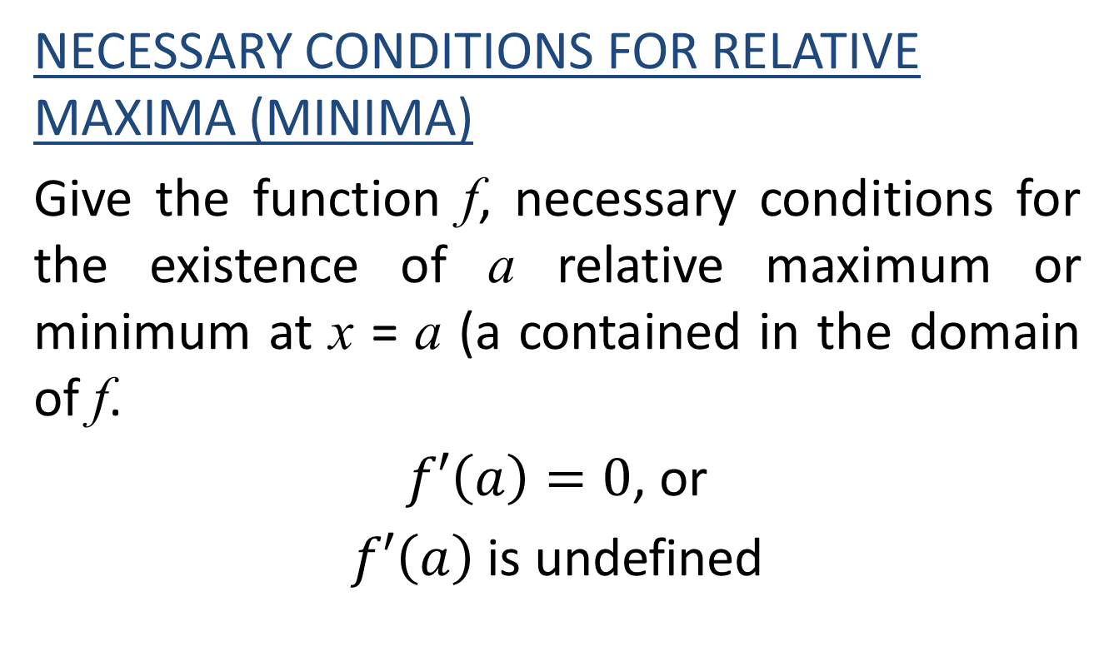
Critical Points
NECESSARY CONDITIONS FOR RELATIVE MAXIMA (MINIMA)
Give the function f, necessary conditions for the existence of a relative maximum or minimum at x = a (a contained in the domain of f.
$f′\left(a\right)=0$, or
$f′\left(a\right)$ is undefined

Slide 11
Points which satisfy either of the conditions in this definition are candidates for relative maxima (minima). Such points are often referred to as critical points.

Slide 13
Points which satisfy condition 1 are those on the graph of f where the slope equals 0. Points satisfying condition 2 are exemplified by discontinuities on f or points where f’ (x) cannot be evaluated. Values of x in the domain of f which satisfy either condition 1 or condition 2 are called critical values. These are denoted with an asterisk (x*) in order to distinguish them from other values of x. Given a critical value for f, the corresponding critical point is (x*, f (x*)].

Slide 17
Any critical point where f’(x) =0 will be a relative maximum, a relative minimum, or an inflection point.

Slide 18
The First-Derivative Test
After the locations of critical points are identified, the first-derivative test requires an examination of slope conditions to the left and right of the critical point.

Slide 21
Above figure illustrates the four critical point possibilities and their slope conditions to either side of x*. For a relative maximum, the slope is positive to the left (x₁) and negative to the right (x_{r}). For a relative minimum, the slope is negative to the left and positive to the right. For the inflection points, the slope has the same sign to the left or the right of the critical point.

Slide 22
The First-Derivative Test
I- Locate all critical values x*.
II- For any critical value x*, determine the value of f’ (x) to the left (x₁) and right (x_{r}) of x*.
(a) If f’ (x_{l}) > 0 and f’ (x_{r}) < 0, there is a relative maximum for f at [x*,f(x*)].
(b) If f’(x_{l}) < 0 and f’ (x_{r}) > 0, there is a relative minimum for f at [x*,f(x*)]
(c) If f’(x) has the same sign of both x₁ and x_{r}, an inflection point exists at [x*,f (x*)].

Slide 23
EXAMPLE:
Determine the location(s) of any critical points on the graph of f(x)=2x²–12x–10, and determine their nature.

Slide 25
EXAMPLE:
In Example 8 we determined that the graph of the function
has critical points at (3,86½) and (–2, 107½). The determine the nature of these critical points, we examine the first derivative.

Slide 29
The Second-Derivative Test
For critical points, where f’(x)=0, the most expedient test in the second-derivative test. Intuitively, the second-derivative test attempts to determine the concavity of the function at the critical point (x*,f(x*)).

Slide 30
The Second-Derivative Test
I- Find all critical values x*, such that f’(x) = 0.
II- For any critical value x*, determine the value of f”(x*).
(a) If f”(x*) > 0 , the function is concave up at x* and there is a relative minimum for f at [x*, f(x*)]
(b) If f”(x*) < 0, the function is concave down at x* and there is a relative maximum for f at [x*, f(x*)].
(c) If f”(x*) = 0, no conclusions can be drawn about the concavity at x* nor the nature of the critical point. Another test such as the first-derivative test is necessary.

Slide 31
EXAMPLE:
Examine the following function for any critical points and determine their nature.

Slide 35
EXAMPLE:
Examine the following function for any critical points and determine their nature.

Slide 39
When the Second-Derivative Test Fails
If f”(x*)=0, the second derivative does not allow for any conclusion about the behavior of f at x*. Consider the following example.
Example:
Examine the following function for any critical points and determine their nature.

Slide 43
Review
We covered Sec 16.2:
Identification of Maxima and Minima
Relative Extrema (maxima and minima)
Absolute Maxima and Minima
Critical Points
First and Second Tests for Relative Extrema

