Slide 1
Lecture 15
Derivatives:
Additional Interpretations

Slide 2
Last Lecture’s Summary
Covered sections 15.7 and 15.8:
Instantaneous-rate-of-change Interpretations
Second-order, third-order and higher-order derivatives

Slide 3
Today
We will start Chapter 16 and cover Sec 16.1:
Derivatives: Additional Interpretations
Increasing and decreasing functions
Concavity, and
Inflection points

Slide 4
Chapter 16
OPTIMAZATION: METHODOLOGY

Slide 5
Chapter Objectives
Enhance understanding of the meaning of first and second derivatives.
Reinforce understanding of the nature of concavity.
Provide a methodology for determining optimization conditions for mathematical functions.
Illustrate methods for sketching the general shape of mathematical functions.
Illustrate a wide variety of applications of optimization procedures.

Slide 6
Main Topics
DERIVATIVES: ADDITIONAL INTERPRETATIONS
IDENTIFICATION OF MAXIMA AND MINIMA
CURVE SKETCHING
RESTRICTED-DOMAIN CONSIDERATIONS

Slide 7
DERIVATIVES: ADDITIONAL INTERPRETATIONS
The First Derivative
INCREASING FUNCTION
The function f is said to be an increasing function on an interval I if for any x₁ and x₂ within the interval, x₁ < x₂ implies that
f (x₁) < f (x₂)

Slide 8
Increasing functions can be identified by slope conditions. If the first derivative of f is positive throughout an interval, then the slope is positive and f is an increasing function on the interval. That is, at any point within the interval, a slight increase in the value of x will be accompanied by an increase in the value of f(x).

Slide 9
DECREASING FUNCTION
The function f is said to be a decreasing function on an interval I if for any x₁ and x₂, within the interval, x₁ < x₂ implies that
f(x₁) > f(x₂)

Slide 10
As with increasing functions, decreasing functions can be identified by tangent slope conditions. If the first derivative of f is negative throughout an interval, then the slope is negative and f is a decreasing function on the interval. That is, at any point within the interval a slight increase in the value of x will be accompanied by a decrease in the value of f(x).

Slide 12
NOTE
If a function is increasing (decreasing) on an interval, the function is increasing (decreasing) at every point within the interval.

Slide 13
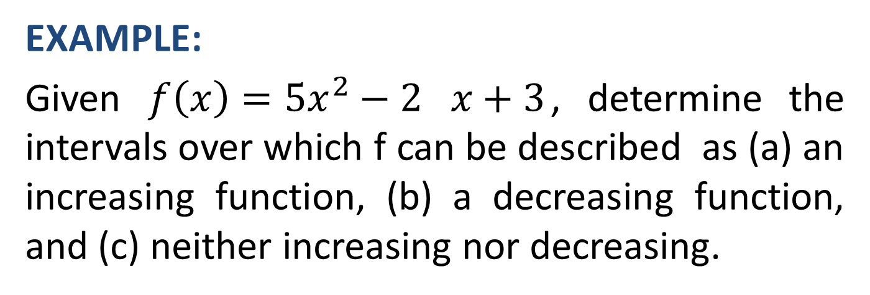
EXAMPLE:
Given $f\left(x\right)={5x}^{2}−2 x+3$, determine the intervals over which f can be described as (a) an increasing function, (b) a decreasing function, and (c) neither increasing nor decreasing.

Slide 16
If f”(x) is negative on an interval I of f, the first derivative is decreasing on I. Graphically, the slope is decreasing in value on the interval. If f”(x) is positive on an interval I of f, the first derivative is increasing on I. Graphically, the slope is increasing on the interval.

Slide 18
Concavity and Inflection Points
CONCAVITY:
The graph of a function f is concave up (down) on an interval if f’ increases (decreases) on the entire interval.

Slide 19
This definition suggests that the graph of a function is concave up on an interval if the slope increases over the entire interval. For any point within such an interval the curve representing f will lie above the tangent line drawn at the point. Similarly, the graph of a function is concave down on an interval if the slope decreases over the entire interval. For any point within such an interval the curve representing f will lie below the tangent line drawn at the point.
A point at which the concavity changes is called an inflection point.

Slide 22
RELATIONSHIPS BETWEEN THE SECOND DERIVATIVE AND CONCAVITY
I- If f”(x) < 0 on an interval a ≤ x ≤ b, the graph of f is concave down over that interval. For any point x = c within the interval, f is said to be concave down at [c, f(c)].
II- If f”(x) > 0 on any interval a ≤ x ≤ b, the graph of f is concave up over that interval. For any point x = c within the interval, f is said to be concave up at [c, f(c)].

Slide 23
III- If f”(x) = 0 at any point x = c in the domain of f, no conclusion can be drawn about the concavity at [c, f(c)]

Slide 28
LOCATING INFLECTION POINTS
I- Find all points a where f”(a) = 0.
II- If f”(x) change sign when passing through x = a, there is an inflection point at x = a.

Slide 32
Review
We started Chapter 16 and covered Sec 16.1:
Derivatives: Additional Interpretations
Increasing and decreasing functions
Concavity, and
Inflection points
Next time, we’ll go over Maxima and Minina.

