Slide 1
Lecture 14
Instantaneous Rate of Change Interpretations; Higher Order Derivatives

Slide 2
Last Lecture Summary
We covered sections 15.5 and 15.6:
Differentiation
Rules of Differentiation
Implementation and examples

Slide 3
Today
We’ll cover sections 15.7 and 15.8:
Instantaneous Rate of Change Interpretations
Second Order, Third Order and Higher Order Derivatives

Slide 5
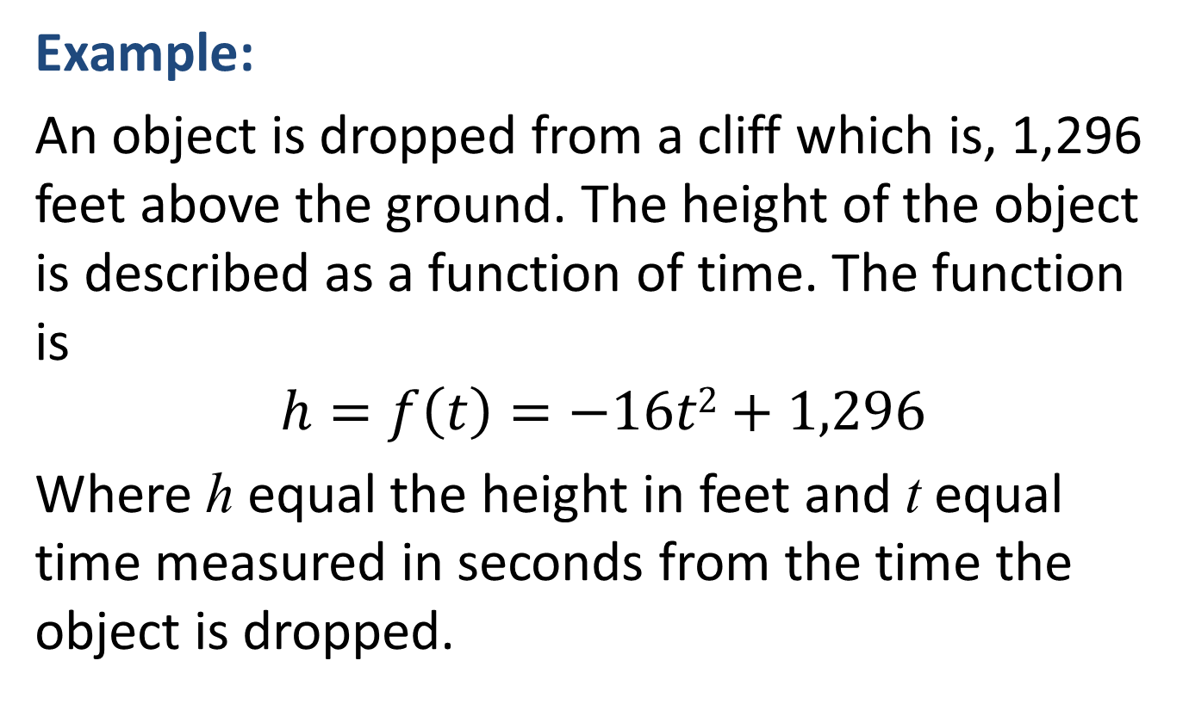
INSTANTANEOUS-RATE-OF-CHANGE INTERPRETATION
Example:
An object is dropped from a cliff which is, 1,296 feet above the ground. The height of the object is described as a function of time. The function is
$$h=f\left(t\right)=−16t2+1,296$$
Where h equal the height in feet and t equal time measured in seconds from the time the object is dropped.

Slide 6
How far will be object drop 2 seconds?
What is the instantaneous velocity of the object at t = 2?
What is the velocity of the object at the instant it hits the ground?

Slide 7
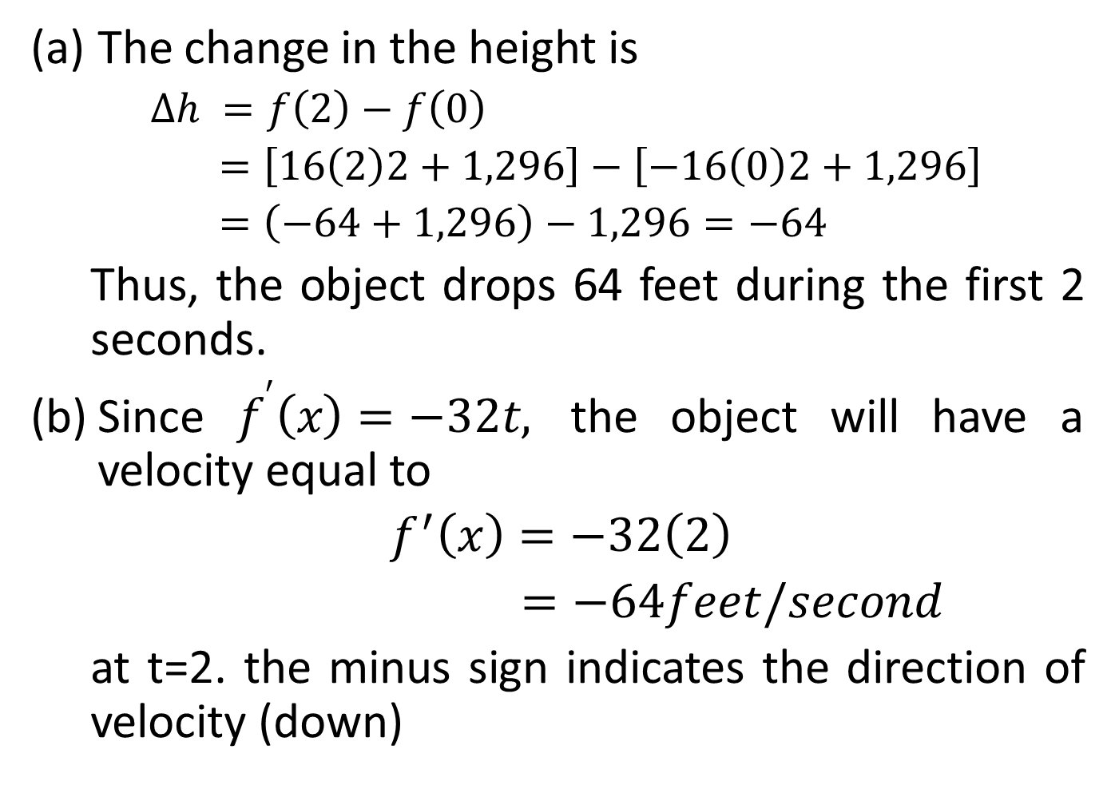
The change in the height is
$∆h =f\left(2\right)−f\left(0\right)$
$=\left[16\left(2\right)2+1,296\right]−\left[−16\left(0\right)2+1,296\right]$
$=\left(−64+1,296\right)−1,296=−64$
Thus, the object drops 64 feet during the first 2 seconds.
Since $f^{′}\left(x\right)=−32t,$ the object will have a velocity equal to
$f^{′}\left(x\right)=−32\left(2\right)$
$=−64feet/second$
at t=2. the minus sign indicates the direction of velocity (down)

Slide 8
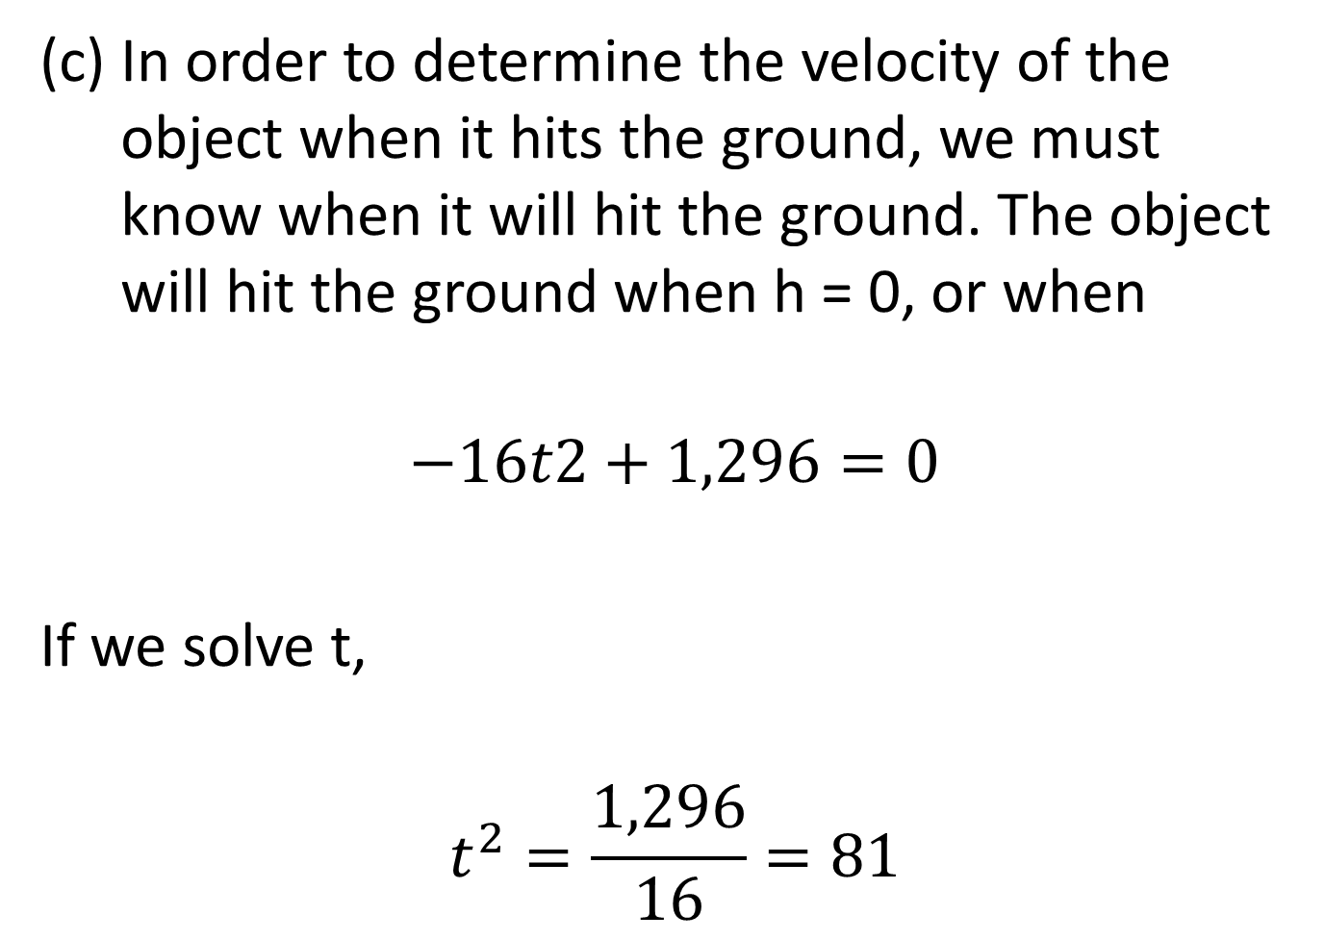
In order to determine the velocity of the object when it hits the ground, we must know when it will hit the ground. The object will hit the ground when h = 0, or when
$$−16t2+1,296=0$$
If we solve t,
$$t^{2}=\frac{1,296}{16}=81$$

Slide 9
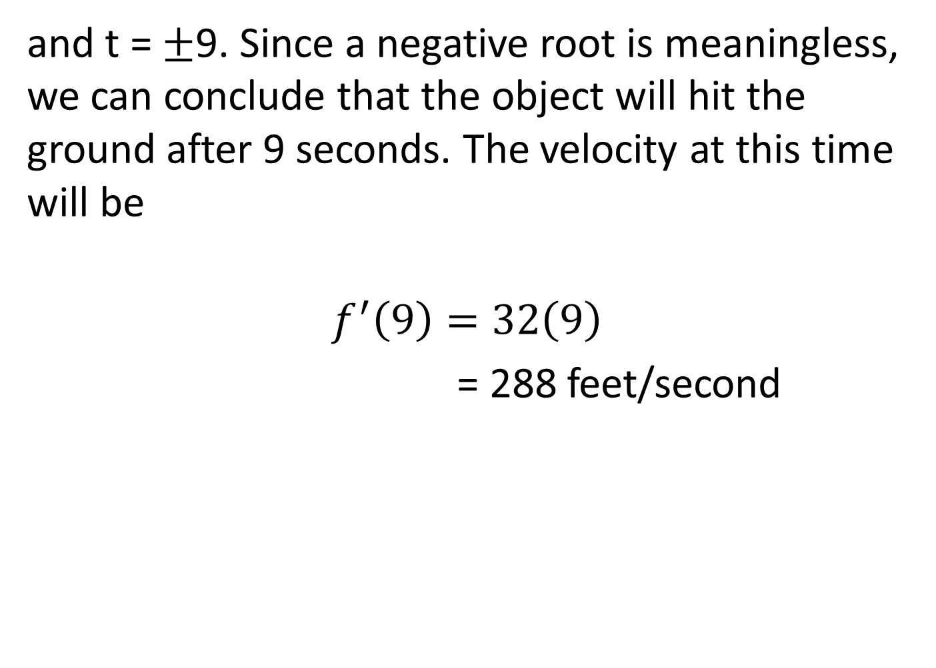
and t = ±9. Since a negative root is meaningless, we can conclude that the object will hit the ground after 9 seconds. The velocity at this time will be
$$f^{′}\left(9\right)=32\left(9\right)$$
= 288 feet/second

Slide 10
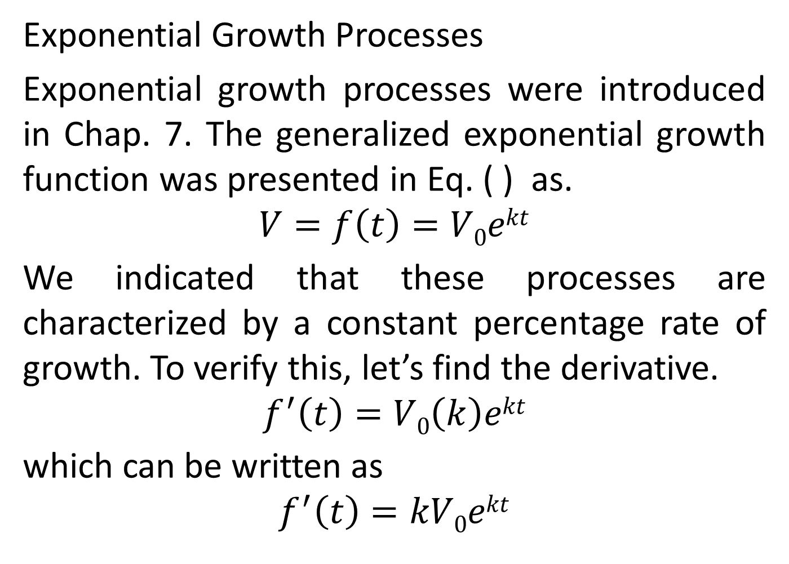

Slide 12
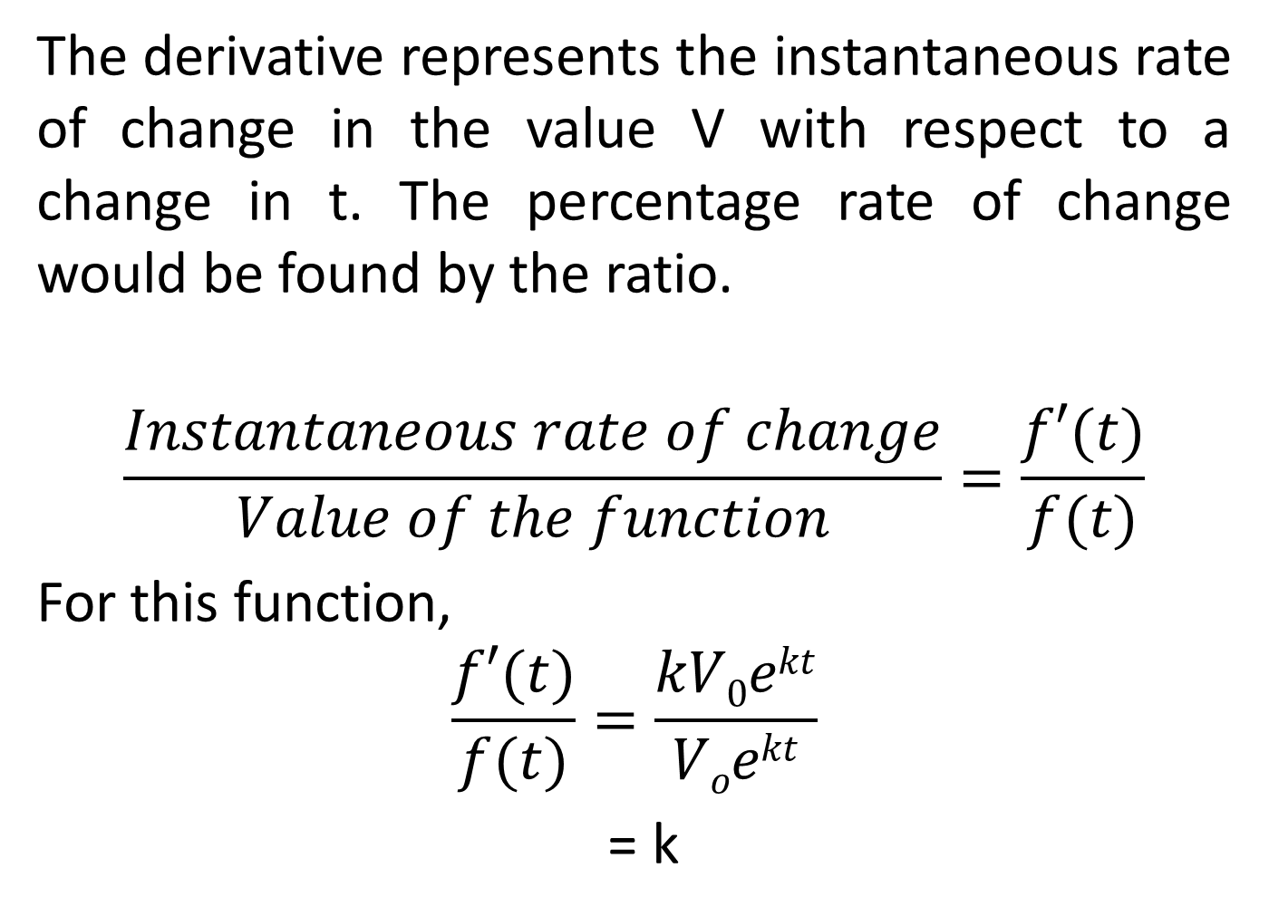
The derivative represents the instantaneous rate of change in the value V with respect to a change in t. The percentage rate of change would be found by the ratio.
$$\frac{Instantaneous rate of change}{Value of the function}=\frac{f′(t)}{f(t)}$$
For this function,
$$\frac{f′(t)}{f(t)}=\frac{kV0ekt}{Voekt}$$
= k

Slide 13
This confirms that for an exponential growth function of the form of Eq. (7.9), k represents the percentage rate of growth. Given that k is a constant, the percentage rate of growth is the same for all values t.

Slide 18
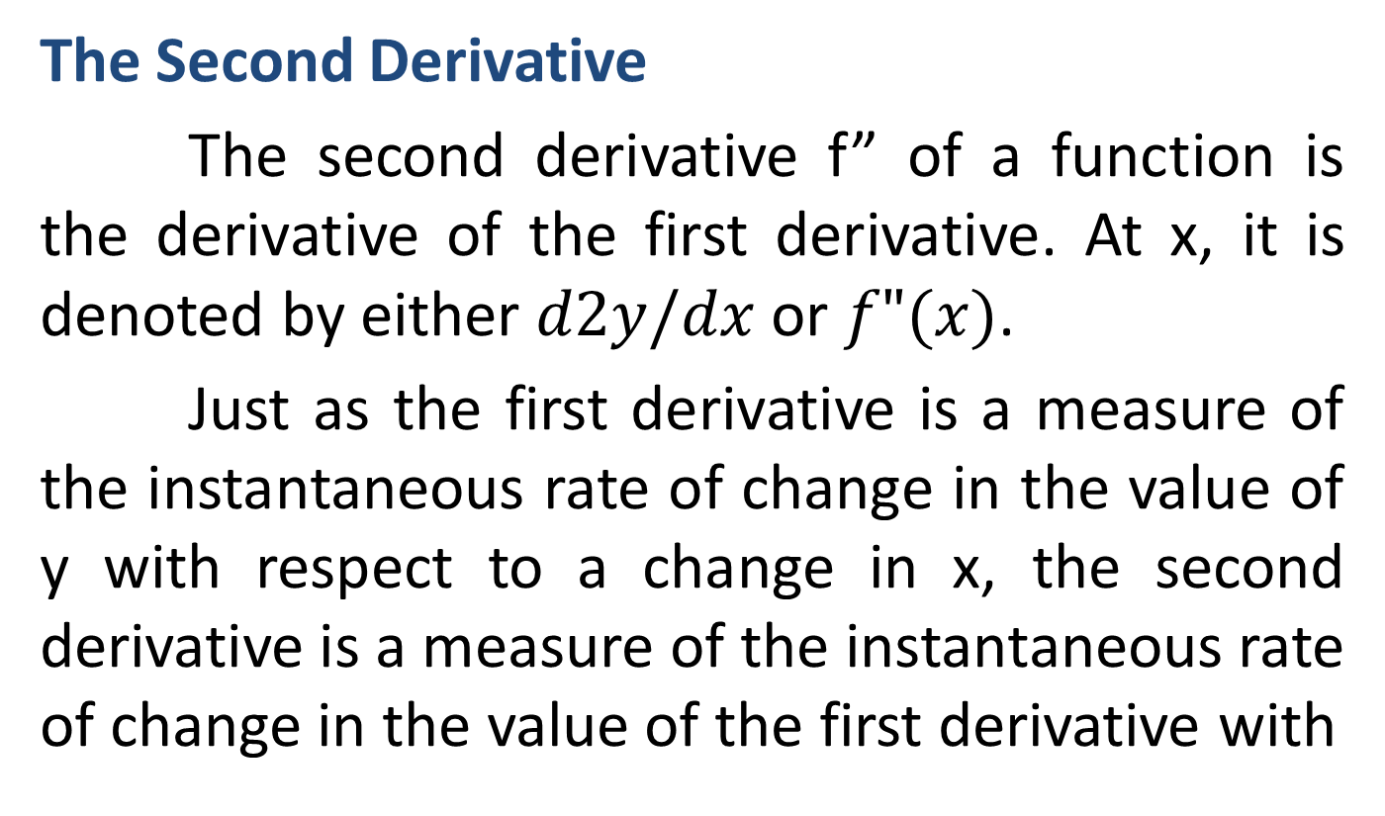
HIGHER-ORDER DERIVATIVES

Slide 19
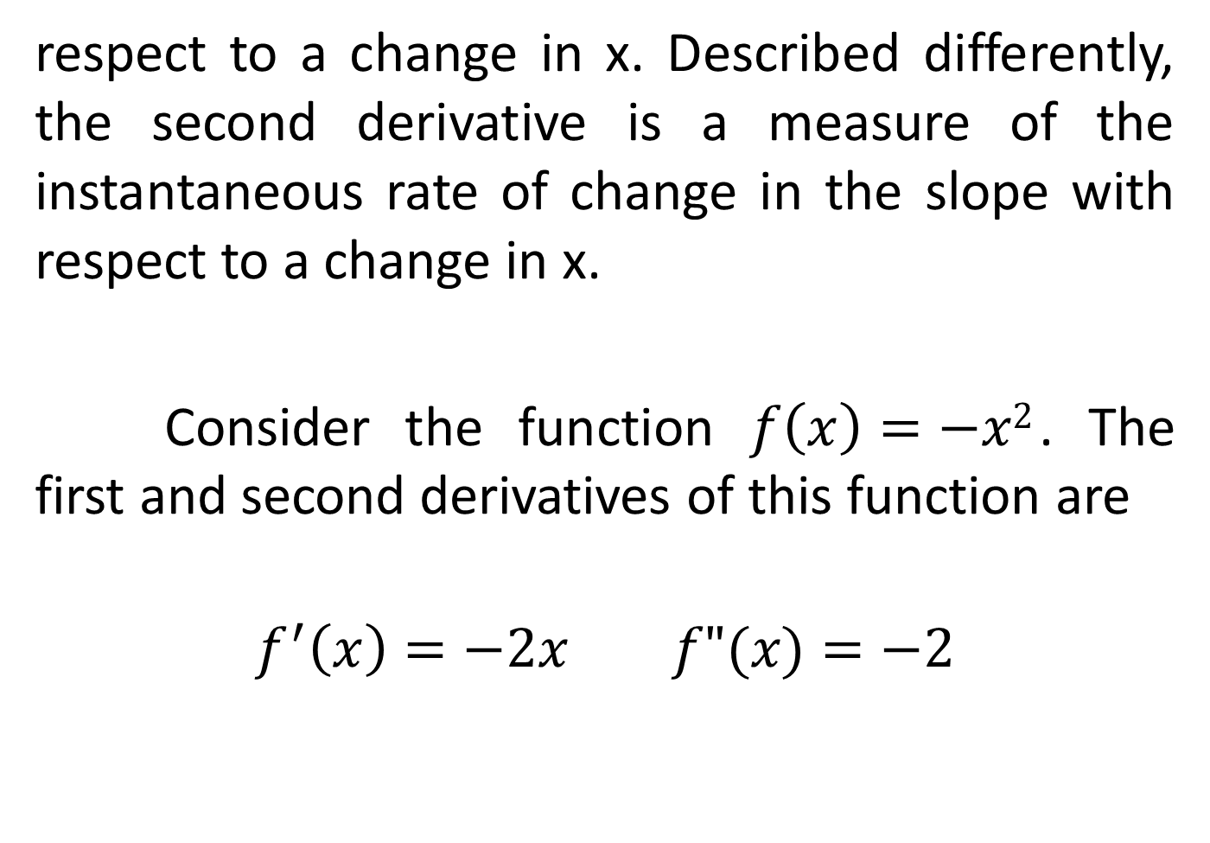
respect to a change in x. Described differently, the second derivative is a measure of the instantaneous rate of change in the slope with respect to a change in x.
Consider the function $f\left(x\right)=−x2$. The first and second derivatives of this function are
$$f^{′}\left(x\right)=−2x f"(x)=−2$$

Slide 21
The following figure illustrates the graphs of f, f’ and f”.
The function f is a parabola which is concave down with the vertex at (0, 0). The tangent slope is positive to the left of the vertex but becomes less positive as x approaches 0. To the right of the vertex the tangent slope is negative, becoming more negative (decreasing) as x increases. The graph of f’ indicates the value of the slope at any point on f.
Note that values of f’(x) are positive, but becoming less positive, as x approaches 0 from

Slide 22
the left, And f’(x) becomes more and more negative as the value of x becomes more positive. Thus, the graph of f’ is consistent with our observation of the sketch of f.

Slide 25
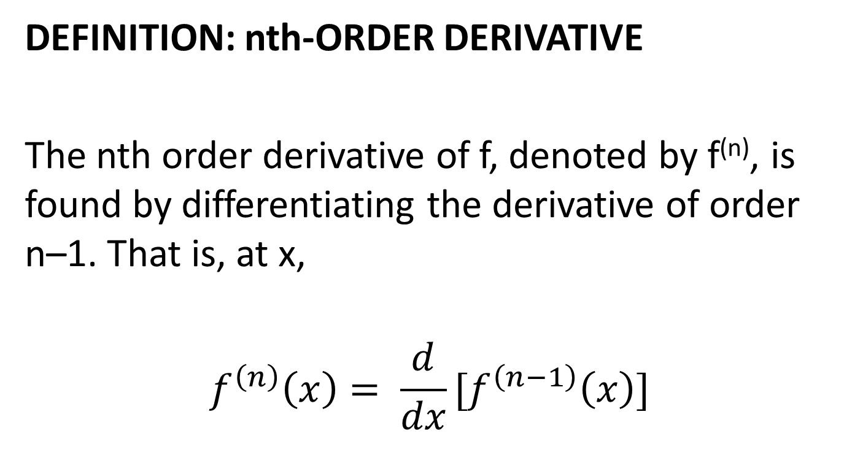
Third and Higher-Order Derivatives
DEFINITION: nth-ORDER DERIVATIVE
The nth order derivative of f, denoted by f^{(n)}, is found by differentiating the derivative of order n–1. That is, at x,
$$f^{\left(n\right)}\left(x\right)= \frac{d}{dx}[f^{\left(n−1\right)}\left(x\right)]$$

Slide 30
Review
We covered sections 15.7 and 15.8:
Instantaneous Rate of Change Interpretations
Second Order, Third Order and Higher Order Derivatives
Finished Chapter 15
Next time, we’ll start Chapter 16

