Slide 1
Lecture 13
Differentiation
Rules of Differentiation

Slide 2
Last Lecture’s Summary
Covered sections 15.3 and 15.4:
Average rate of change
The difference quotient
Instantaneous rate of change
Slope of a curve
The derivative
Using and interpreting the derivative

Slide 3
Today
We will cover sections 15.5 and 15.6:
Differentiation
Rules of Differentiation
Implementation and examples

Slide 4
Differentiation
The process of finding the derivative is called differentiation.
A set of rules of differentiation exists for finding the derivative of many common functions.
Although there are many functions for which the derivative does not exist, our concern will be with functions which are differentiable.

Slide 5
An alternate to notation is to let represent the derivative of the function f at x.

Slide 6
RULE 1: CONSTANT FUNCTION
If f(x) = c, where c is any constant
f’(x) = 0
RULE 2: POWER RULE
If f(x) = x^{n}, where n is a real number
f’(x) = nx^{n-1}

Slide 8
ALGEBRA FLASHBACK

Slide 10
ALGEBRA FLASHBACK

Slide 12
RULE 3: CONSTANT TIMES A FUNCTION
If f(x) = c . g(x), where c is a constant and g is a differentiable function.

Slide 14
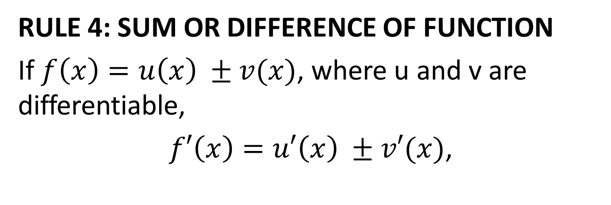
RULE 4: SUM OR DIFFERENCE OF FUNCTION
If $f\left(x\right)=u\left(x\right) ±v(x)$, where u and v are differentiable,
$f′\left(x\right)=u′\left(x\right) ±v′(x)$,

Slide 17
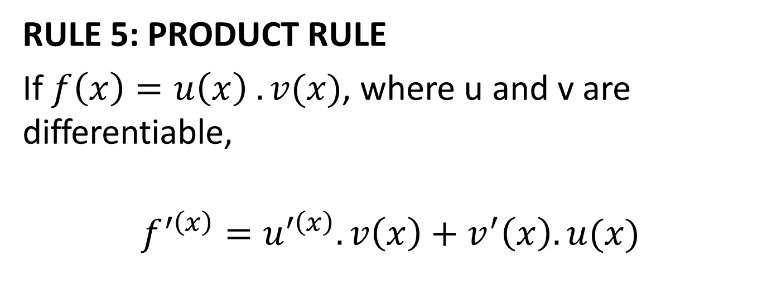
RULE 5: PRODUCT RULE
If $f\left(x\right)=u\left(x\right) .v(x)$, where u and v are differentiable,
$$f^{′\left(x\right)}=u^{′\left(x\right)}.v\left(x\right)+v^{′}\left(x\right).u(x)$$

Slide 20
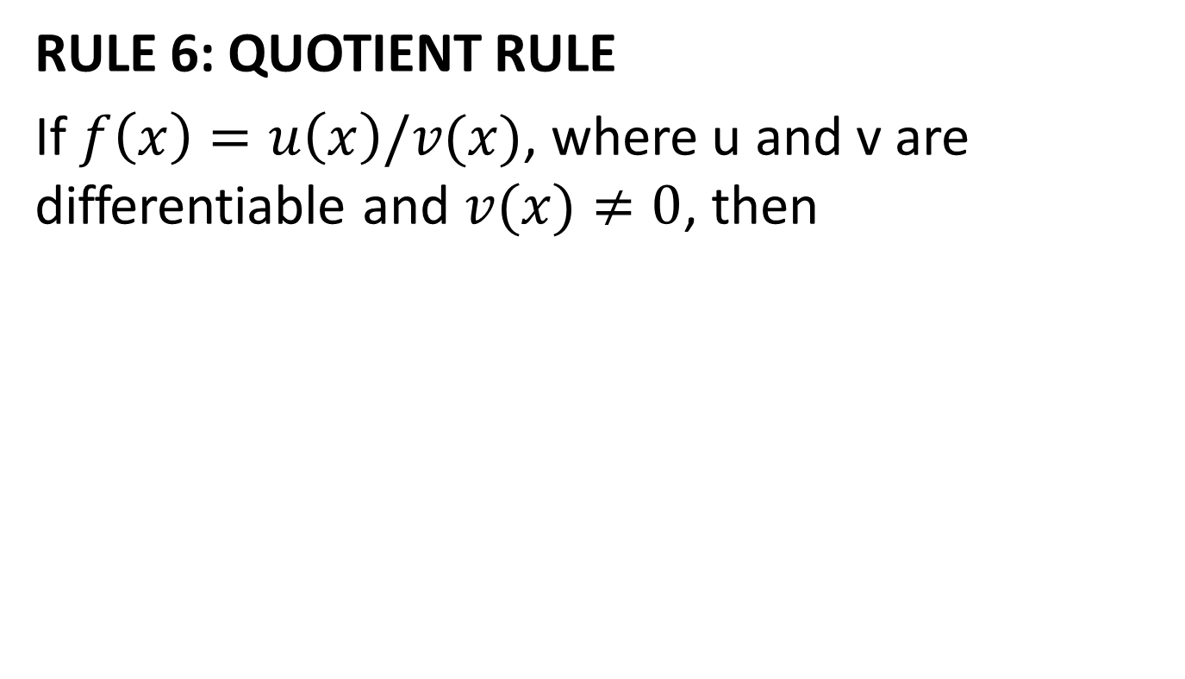
RULE 6: QUOTIENT RULE
If $f\left(x\right)=u\left(x\right)/v(x)$, where u and v are differentiable and $v(x)≠0$, then

Slide 24
ADDITIONAL RULES OF DIFFERENTIATION
In this section we present some additional rules of differentiation which build upon the rules we studies so far.

Slide 25
Rule 7: Power of a Function
If f(x) = [u(x)]^{n}, where u(x) is a differentiable function and n is a real number, then
f’(x) = n[u(x)]^{n-1}.u’(x)

Slide 28
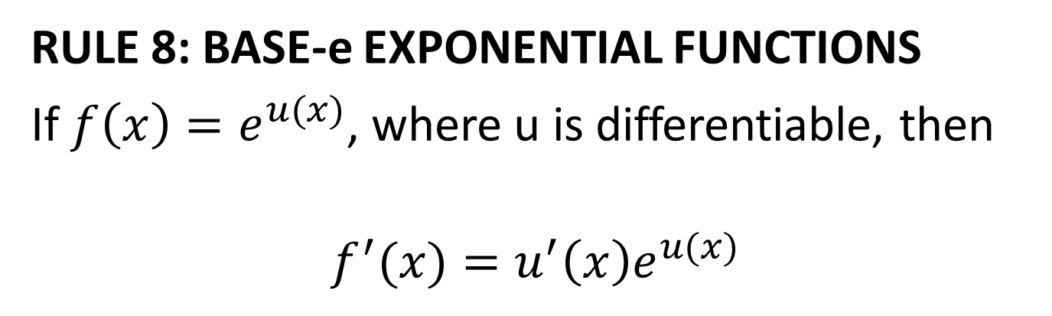
RULE 8: BASE-e EXPONENTIAL FUNCTIONS
If $f\left(x\right)=e^{u(x)}$, where u is differentiable, then
$$f^{′}(x)=u^{′}\left(x\right)e^{u(x)}$$

Slide 30
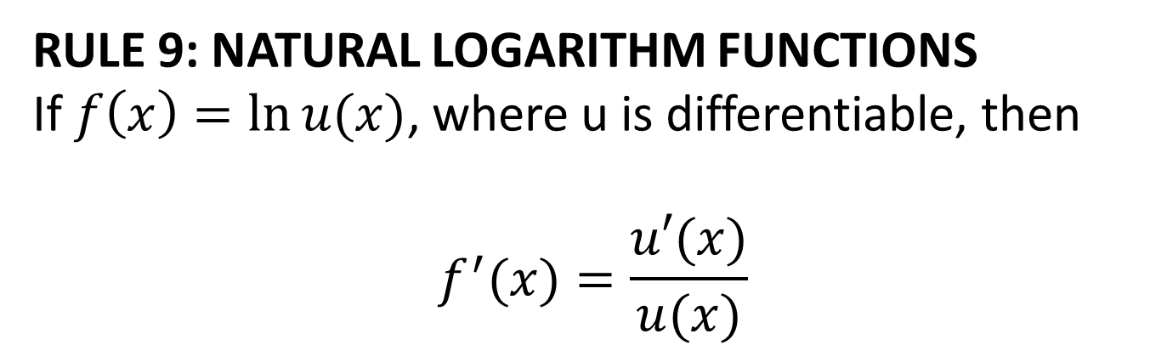
RULE 9: NATURAL LOGARITHM FUNCTIONS
If $f\left(x\right)=\ln{u(x)}$, where u is differentiable, then
$$f^{′}(x)=\frac{u′(x)}{u(x)}$$

Slide 32
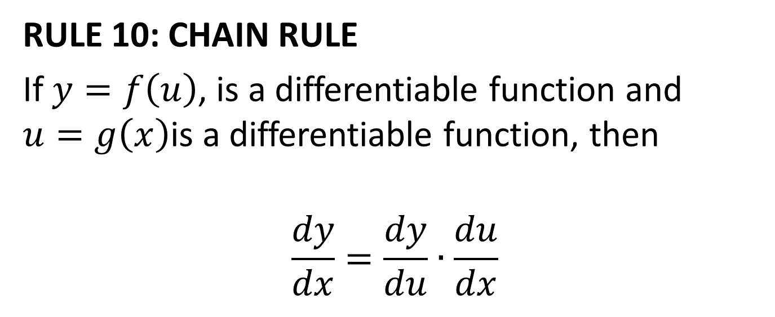
RULE 10: CHAIN RULE
If $y=f\left(u\right)$, is a differentiable function and $u=g\left(x\right)$is a differentiable function, then
$$\frac{dy}{dx}=\frac{dy}{du}∙\frac{du}{dx}$$

Slide 36
Review
Covered sections 15.5 and 15.6:
Differentiation
Rules of Differentiation
Implementation and examples
Next, we’ll go over Instantaneous Rate of Change Interpretations
Second Order, Third Order and Higher Order Derivatives

Slide 37
Lecture 14
Instantaneous Rate of Change Interpretations; Higher Order Derivatives

Slide 38
Last Lecture Summary
We covered sections 15.5 and 15.6:
Differentiation
Rules of Differentiation
Implementation and examples

Slide 39
Today
We’ll cover sections 15.7 and 15.8:
Instantaneous Rate of Change Interpretations
Second Order, Third Order and Higher Order Derivatives

Slide 40
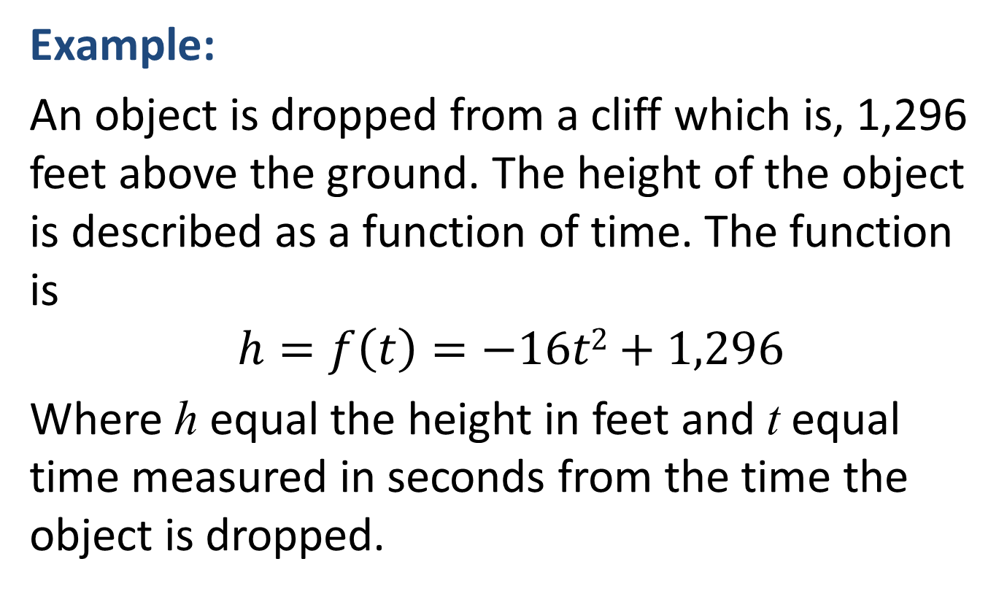
INSTANTANEOUS-RATE-OF-CHANGE INTERPRETATION
Example:
An object is dropped from a cliff which is, 1,296 feet above the ground. The height of the object is described as a function of time. The function is
$$h=f\left(t\right)=−16t2+1,296$$
Where h equal the height in feet and t equal time measured in seconds from the time the object is dropped.

Slide 41
How far will be object drop 2 seconds?
What is the instantaneous velocity of the object at t = 2?
What is the velocity of the object at the instant it hits the ground?

Slide 42
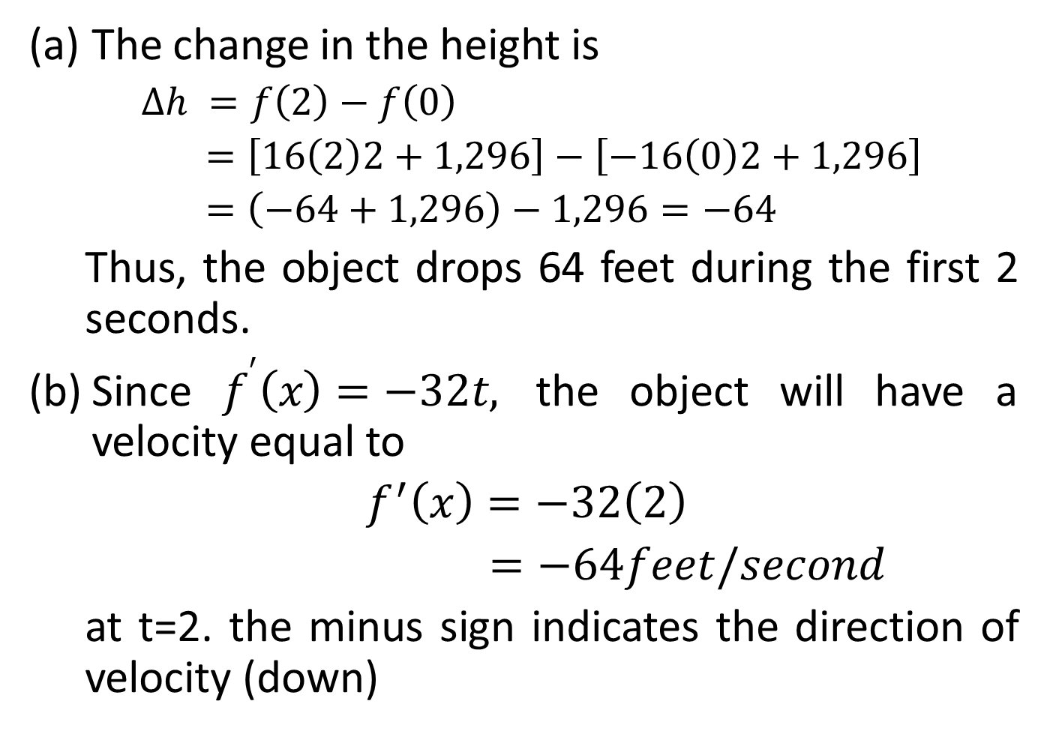
The change in the height is
$∆h =f\left(2\right)−f\left(0\right)$
$=\left[16\left(2\right)2+1,296\right]−\left[−16\left(0\right)2+1,296\right]$
$=\left(−64+1,296\right)−1,296=−64$
Thus, the object drops 64 feet during the first 2 seconds.
Since $f^{′}\left(x\right)=−32t,$ the object will have a velocity equal to
$f^{′}\left(x\right)=−32\left(2\right)$
$=−64feet/second$
at t=2. the minus sign indicates the direction of velocity (down)

Slide 43
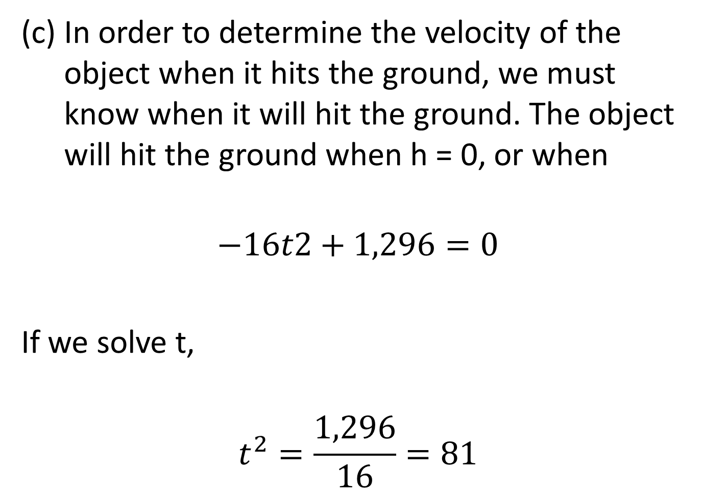
In order to determine the velocity of the object when it hits the ground, we must know when it will hit the ground. The object will hit the ground when h = 0, or when
$$−16t2+1,296=0$$
If we solve t,
$$t^{2}=\frac{1,296}{16}=81$$

Slide 44
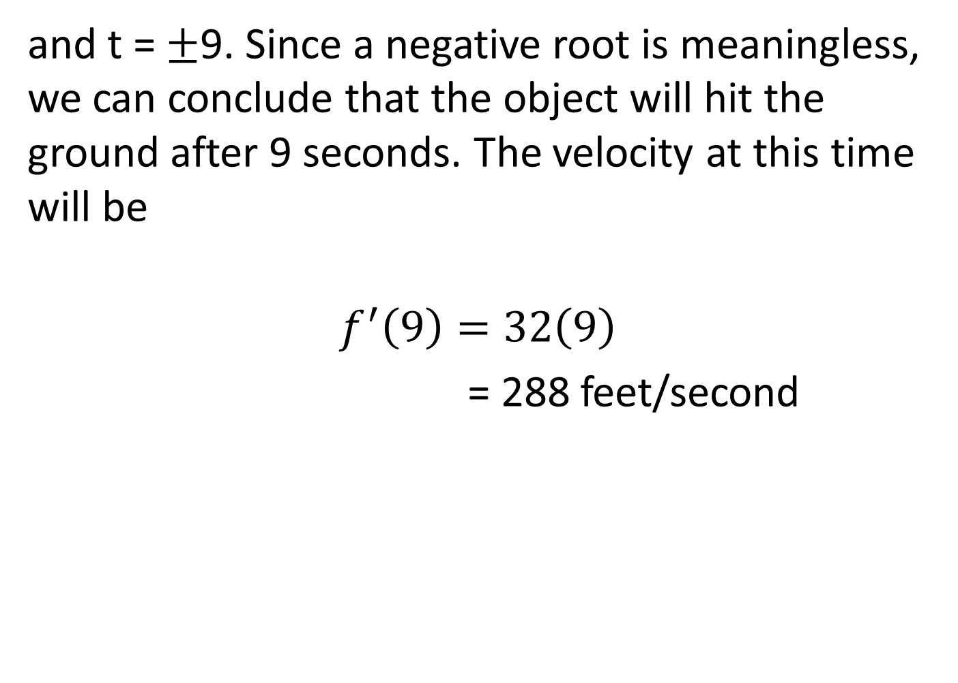
and t = ±9. Since a negative root is meaningless, we can conclude that the object will hit the ground after 9 seconds. The velocity at this time will be
$$f^{′}\left(9\right)=32\left(9\right)$$
= 288 feet/second

Slide 45
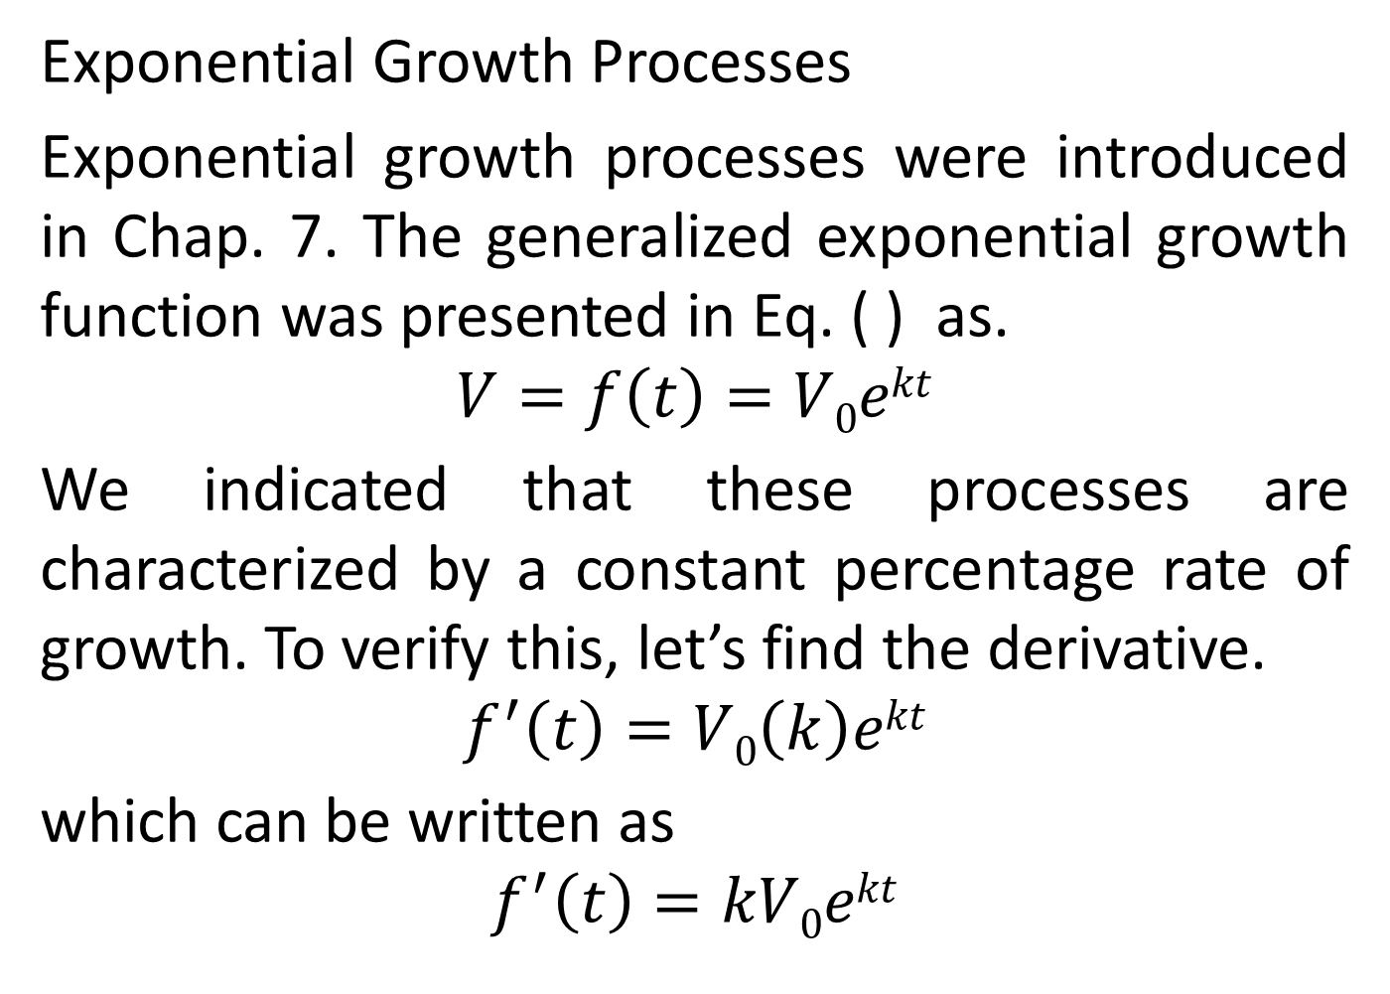
Exponential Growth Processes
Exponential growth processes were introduced in Chap. 7. The generalized exponential growth function was presented in Eq. ( ) as.
$$V=f\left(t\right)=V0ekt$$
We indicated that these processes are characterized by a constant percentage rate of growth. To verify this, let’s find the derivative.
$$f^{′}\left(t\right)=V0\left(k\right)ekt$$
which can be written as
$$f^{′}\left(t\right)=kV0ekt$$

Slide 46
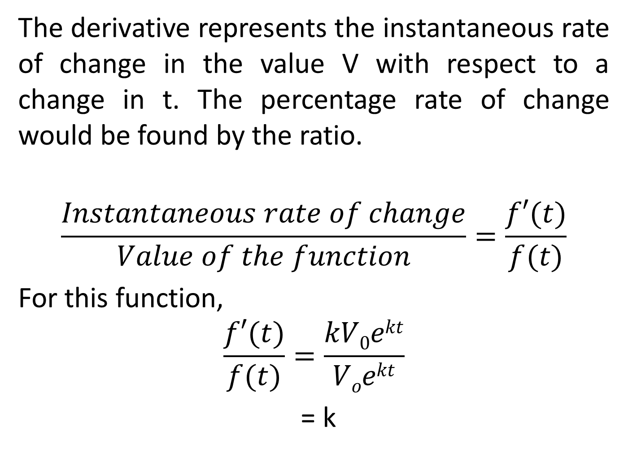
The derivative represents the instantaneous rate of change in the value V with respect to a change in t. The percentage rate of change would be found by the ratio.
$$\frac{Instantaneous rate of change}{Value of the function}=\frac{f′(t)}{f(t)}$$
For this function,
$$\frac{f′(t)}{f(t)}=\frac{kV0ekt}{Voekt}$$
= k

Slide 47
This confirms that for an exponential growth function of the form of Eq. (7.9), k represents the percentage rate of growth. Given that k is a constant, the percentage rate of growth is the same for all values t.

Slide 49
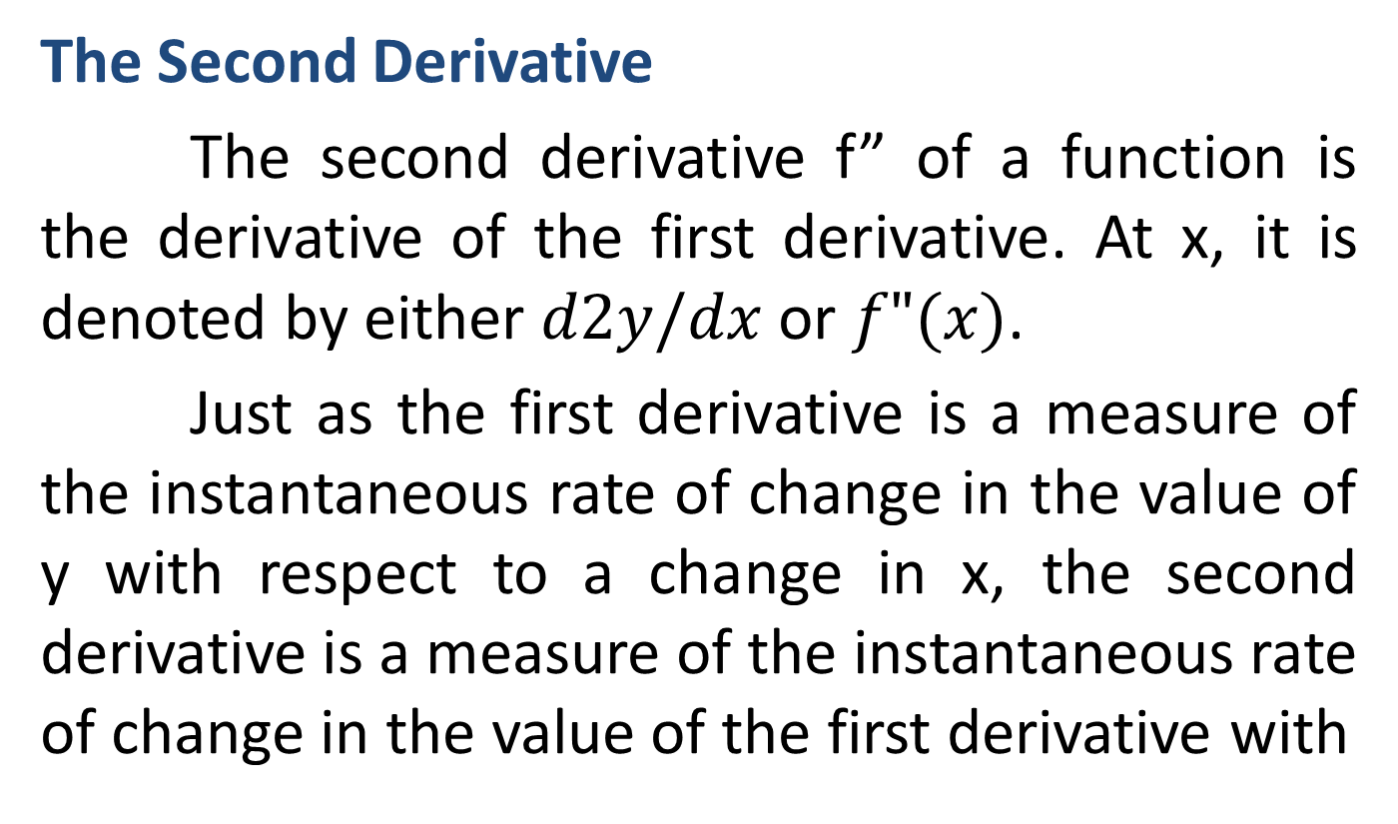
HIGHER-ORDER DERIVATIVES
The Second Derivative
The second derivative f” of a function is the derivative of the first derivative. At x, it is denoted by either $d2y/dx$ or $f"(x)$.
Just as the first derivative is a measure of the instantaneous rate of change in the value of y with respect to a change in x, the second derivative is a measure of the instantaneous rate of change in the value of the first derivative with

Slide 50
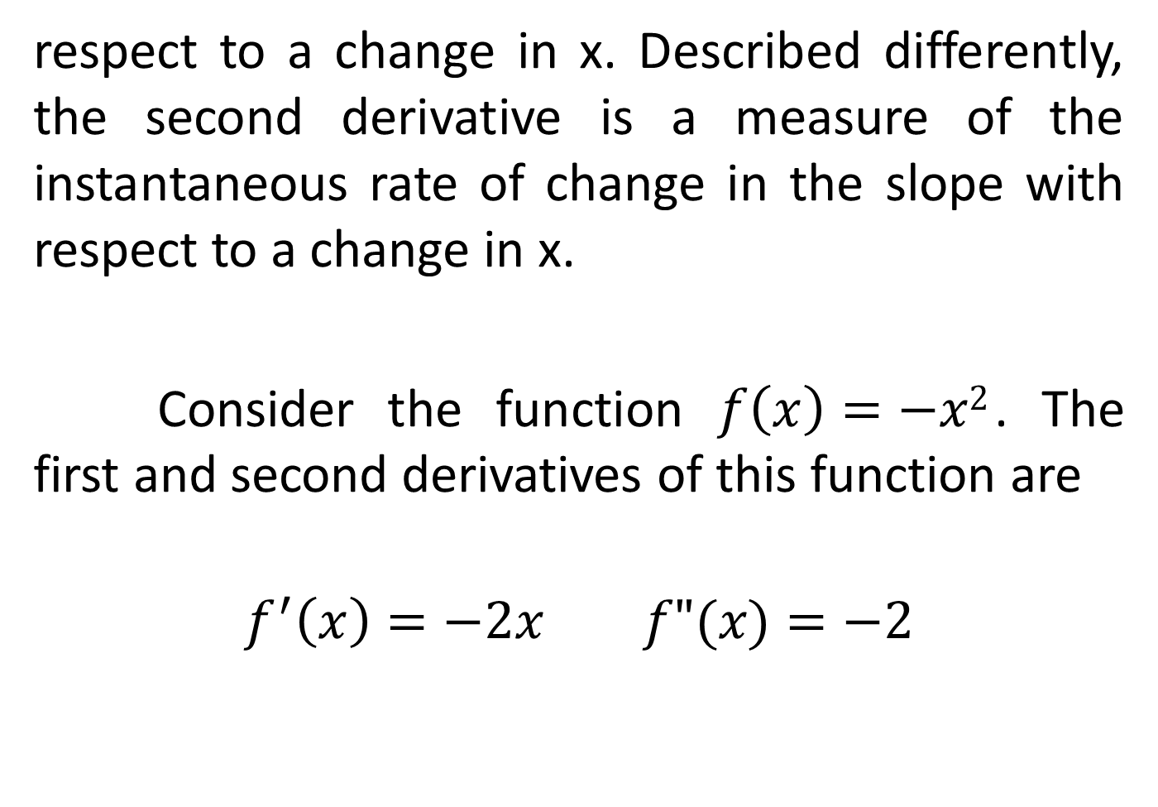
respect to a change in x. Described differently, the second derivative is a measure of the instantaneous rate of change in the slope with respect to a change in x.
Consider the function $f\left(x\right)=−x2$. The first and second derivatives of this function are
$$f^{′}\left(x\right)=−2x f"(x)=−2$$

Slide 52
The following figure illustrates the graphs of f, f’ and f”.
The function f is a parabola which is concave down with the vertex at (0, 0). The tangent slope is positive to the left of the vertex but becomes less positive as x approaches 0. To the right of the vertex the tangent slope is negative, becoming more negative (decreasing) as x increases. The graph of f’ indicates the value of the slope at any point on f.
Note that values of f’(x) are positive, but becoming less positive, as x approaches 0 from

Slide 53
the left, And f’(x) becomes more and more negative as the value of x becomes more positive. Thus, the graph of f’ is consistent with our observation of the sketch of f.

Slide 55
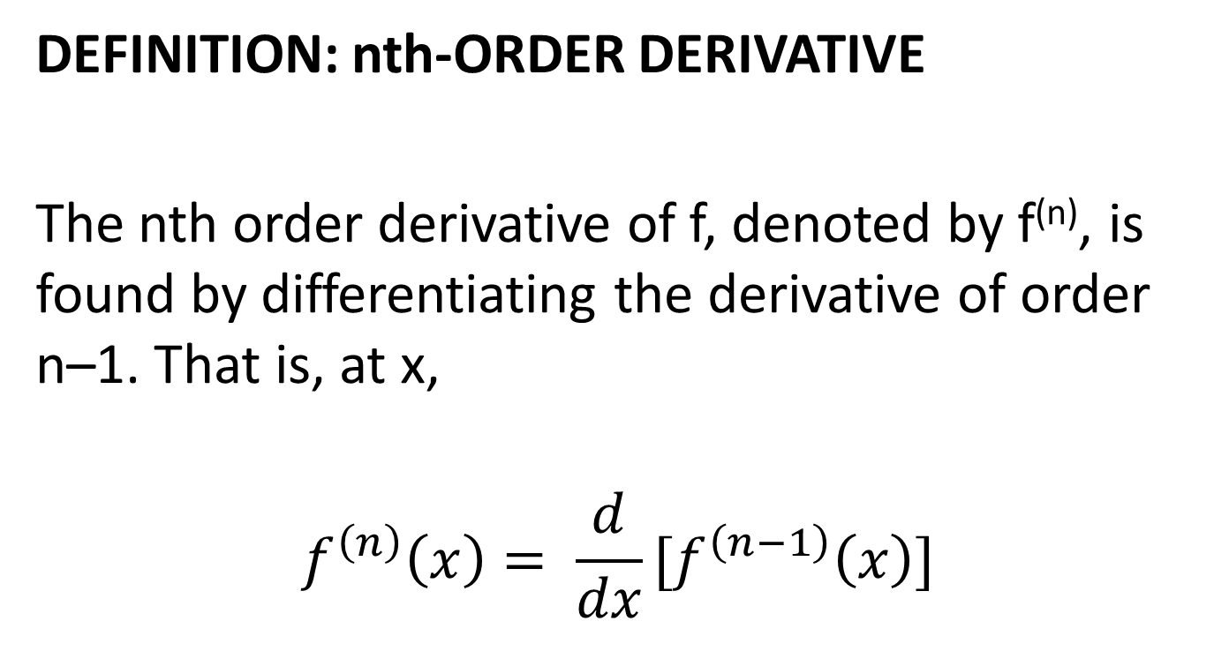
Third and Higher-Order Derivatives
DEFINITION: nth-ORDER DERIVATIVE
The nth order derivative of f, denoted by f^{(n)}, is found by differentiating the derivative of order n–1. That is, at x,
$$f^{\left(n\right)}\left(x\right)= \frac{d}{dx}[f^{\left(n−1\right)}\left(x\right)]$$

