Slide 1
MTH108 Business Math I
Lecture 5

Slide 2
Chapter 2
Linear Equations

Slide 3
Objectives
Provide a thorough understanding of the algebraic and graphical characteristics of linear equations
Provide the tools which allow one to determine the equation which represents a linear relationship
Illustrate some applications

Slide 4
Review
Importance of Linear Equations
Characteristics of Linear Equations
Definition, Examples
Solution set of an equation
method, examples
Linear Equations with n-variables
definition, examples
solution set, examples

Slide 5
Review(contd.)
Graphing Equations of two variables
Method, Examples
Intercepts
X-intercept, Y-intercept
Examples with graphical representation

Slide 6
Today’s Topics
Slope of an equation
Two-point form
Slope-intercept form
One-point form
Parallel and perpendicular lines
Linear equations involving more than two variables
Some applications

Slide 7
Slope
Any straight line with the exception of vertical lines can be characterized by its slope.
Slope --- inclination of a line and rate at which the
line rises or fall
(whether it rises or fall)
(how steep the line is)

Slide 8
Graphically

Slide 9
Explanation
The slope of a line may be positive, negative, zero or undefined. The line with slope
Positive
rises from left to right
Negative
falls from left to right
Zero
horizontal line
Undefined
vertical line

Slide 10
Expl. (contd., graphically)

Slide 11
Inclination and steepness
The slope of a line is quantified by a real number.
The magnitude (absolute value) indicates the relative steepness of the line
The sign indicates the inclination

Slide 12
Inclination and steepness (contd.)
CD has bigger magnitude NP has more magnitude
than AB than LM
=> CD more steeper => NP more steeper

Slide 13
Two point formula (slope)
The slope tells us the rate at which the value of y changes relative to changes in the value of x.
Given any two point which lie on a (non-vertical) straight line, the slope can be computed as the ratio of change in the value of y to the change in the value of x.
Slope = change in y =
change in x
= change in the value of y
= change in the vale of x

Slide 14
Two point formula (mathematically)
The slope m of a straight line connecting two points (x₁, y ₁) and (x ₂, y ₂) is given by the formula

Slide 15
Examples
Compute the slope of the line connecting (2,4) and (5,12)

Slide 16
Note Along any straight line the slope is constant.
The line connecting any two points will have the same slope

Slide 17
Examples (contd.)
Compute the slope of the line connecting (2,4) and (5,4). (horizontal line, y=k)
Compute the slope of the line connecting (2,4) and (2,5). (verticaltal line, x=k)
Exercise 2.2

Slide 18
Slope Intercept form
Consider the general form of two variable equation as
ax+by=c
Re-writing the above equation we get:
The above equation is called the slope-intercept form.
Generally, it is written as:
y=mx+c
m= slope, c = y-intercept

Slide 19
Examples
5x+y=10
y= 2x/3
y=k

Slide 20
Applications
Salary equation
y=3x+25
y= weekly salary
x= no. of units sold during 1 week
Cost equation
C = 0.04x+18000
c = total cost
x=no. of miles driven
Section 2.3 , Q.1-24, Q.26-32

Slide 21
Determining the equation of a straight line
Slope and Intercept
m= -5, k = 15
Slope and one point
m= -2, (2,8)

Slide 22
Point slope formula
Given a non-vertical straight line with slope m and containing the point (x₁, y₁), the slope of the line connecting (x₁, y₁) with any other point (x, y) is given by
Rearranging gives: y- y₁ = m(x-x₁)

Slide 23
Two points
Given two points (x₁, y₁) and (x₂, y₂) connecting a line. Then, the equation of line will be:
e.g. (-4,2) and (0,0)

Slide 24
Alternatively,

Slide 25
Parallel and perpendicular lines
Two lines are parallel if they have the same slope, i.e.
Two lines are perpendicular if their slopes are equal to the negative reciprocal of each other, i.e.

Slide 26
Example

Slide 27
Example (contd.)
Section 2.4 Q.1--40

Slide 28
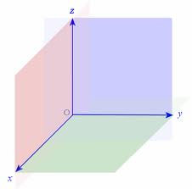
Linear equations involving more than two variables

Slide 29
Three dimensional
Three dimensional coordinate system
Three coordinate axes which are perpendicular to one another, intersecting at their respective zero points called the origin (0,0,0).
Linear equations involving three variables is of the form
Solution set of this equation are all ordered tuples
which satisfy the above equation

Slide 30
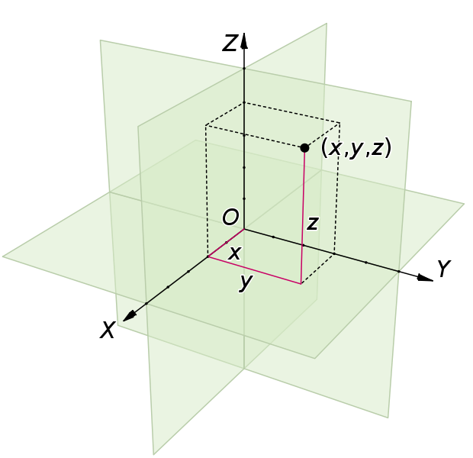
Representation of a point

Slide 31
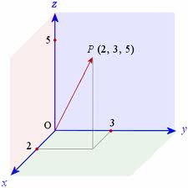
Example

Slide 32
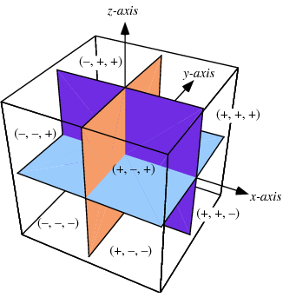
Octants

Slide 33
Summary
Slope
Inclination, steepness, graphically
Two point form
Slope intercept form
Slope point form
Examples, applications
Linear equations in more than two variables ( a glimpse)

Slide 34
Next lecture
Systems of linear equations
Two-variable systems of equations
Guassian elimination method
N-variable systems

