Slide 1
Calculus and Analytical
Geometry
MTH 104
Lecture # 26

Slide 5
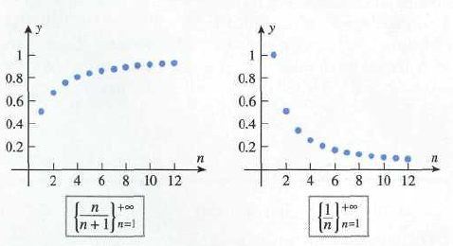

Slide 6
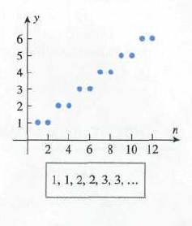

Slide 7
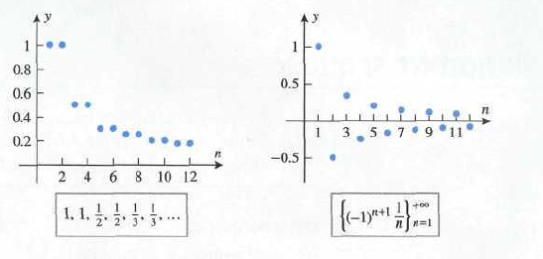

Slide 8
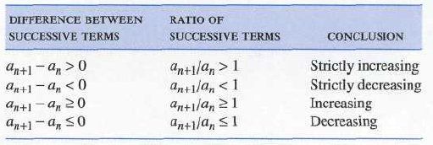
Testing for monotoncity
Example Use (a) difference of successive terms (b) ratio of successive terms to show that
is strictly increasing.

Slide 15
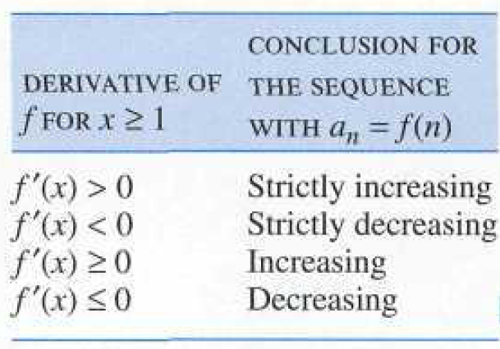
We can use the following results to investigate the monotoncity of the sequence.

