Slide 1
Calculus and Analytical
Geometry
MTH 104
Lecture # 24

Slide 2
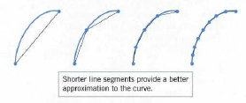
Length of a plane curve
Arc length formula

Slide 4
