Slide 1
Calculus and Analytical
Geometry
MTH 104
Lecture # 23

Slide 5
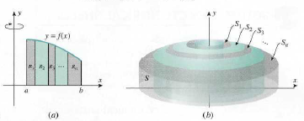

Slide 6
