Slide 1
Calculus and Analytical
Geometry
MTH 104
Lecture # 22

Slide 2
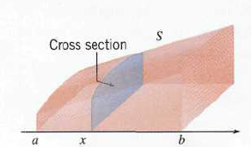
Volume by slicing
Let S be a solid that extends along the x-axis and is bounded on the left and right, respectively, by the planes that are perpendicular to the x-axis at x=a and x=b. Find the volume V of the solid, assuming that its cross-sectional area A(x) is known at each x in the interval [a, b].

Slide 3
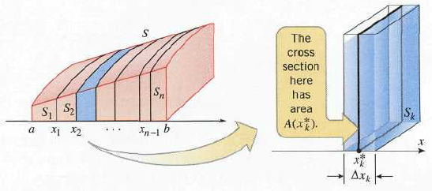

Slide 7
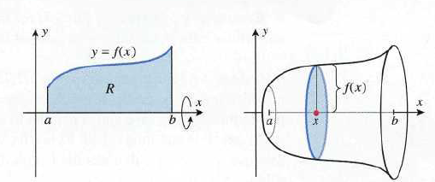
Volume by disks perpendicular to x-axis
Let f be continuous and non-negative on [a, b], and let R be the region bounded above by y=f(x), below by the x-axis, and on the sides by the lines x=a and x=b. Find the volume of the solid of revolution that is generated by revolving the region R about the x-axis.

Slide 11
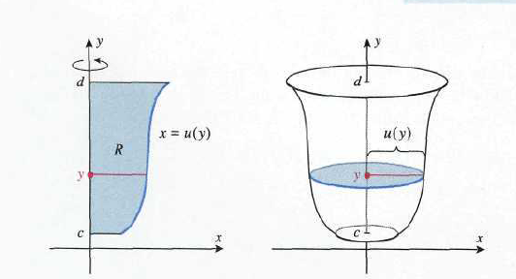

Slide 12
Volume by washers perpendicular to x-axis

Slide 13
