Slide 1
Calculus and Analytical
Geometry
MTH 104
Lecture # 21

Slide 2
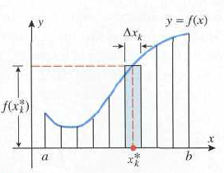

Slide 4
