Slide 1
Calculus and Analytical
Geometry
MTH 104
Lecture # 15

Slide 2
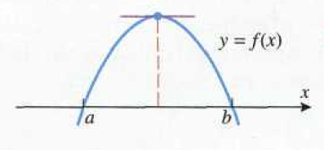
Rolle’s theorem
Let f be continuous on the closed interval [a, b] and differentiable on the open interval (a, b). If
f(a)=0 and f(b)=0
then there is at least one point c in the interval (a, b) such that

Slide 3
When working with Rolle’s make sure
1. The function f(x) is continuous on [a, b] and differentiable on (a, b).
2. Show that f(a) =0 and f(b)=0.
3. State that there exists at least one x = c in (a, b) such that f ’(c) = 0.
Example Find the two x-intercepts of the function
and confirm that f’(c)=0 at some point c between these intercepts

Slide 4
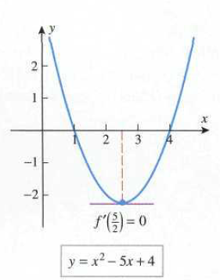
solution

Slide 7
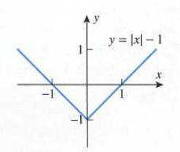

Example
Does Rolle’s Theorem apply?

Slide 8
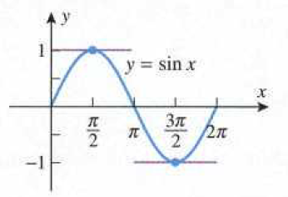
Example
Does Rolle’s Theorem apply?
If so, find all the values of c.

Slide 10
Example
Does Rolle’s Theorem apply?
If so, find all values of c.

Slide 14
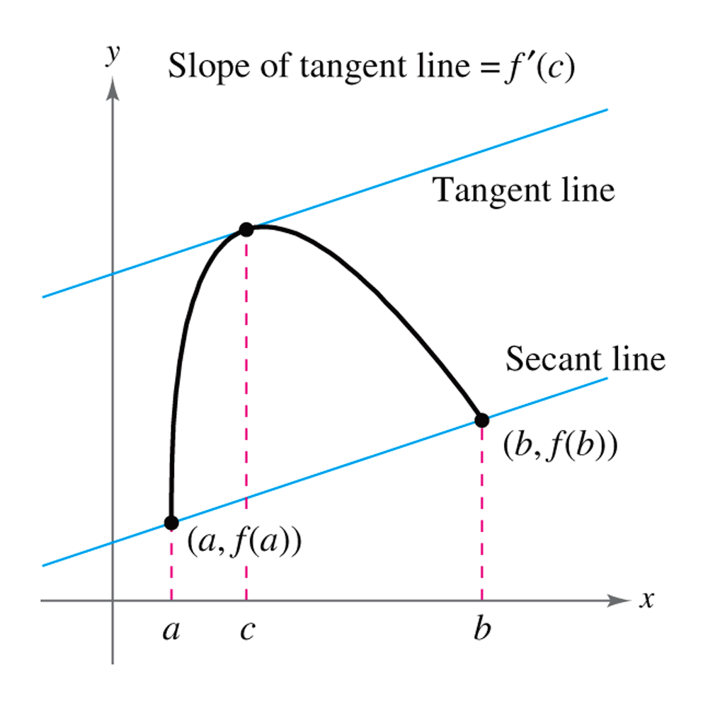
Mean Value Theorem
Let f be continuous on the closed interval [a, b] and differentiable on the open interval (a, b). Then there is at least one point c in (a, b) such that
The slope of secant line joining (a, f(a)) and (b,f(b)) is
The slope of tangent line at c is

Slide 15
Example
Show that the function
satisfies the hypotheses of the Mean Value Theorem over the interval [0, 2], and find all values of c in the interval (0, 2) at which the tangent line to the graph of f is parallel to the secant line joining points (0, f(0)) and (2, f(2)).

Slide 18
Verify that the hypotheses of the Mean Value Theorem are satisfied on the given interval, and find all values of c in that interval that satisfy the conclusion of the theorem.

Slide 22
