Slide 1
Calculus and Analytical
Geometry
MTH 104
Lecture # 14

Slide 2
Apllied Maximum and Minimum Problems
A Procedure for solving Applied Maximum and Minimum Problems
Step 1. Draw an appropriate figure and label the quantities relevent to the problem.
Step 2. Find a formula for the quantity to be maximized or minimized
Step 3. Using the conditions stated in the problem to eliminate variables, express the quantity to be maximized or minimized as a function of one variable.
Step 4. If applicable, use the techniques of the preceding lecture to obtain the maximum or minimum

Slide 3
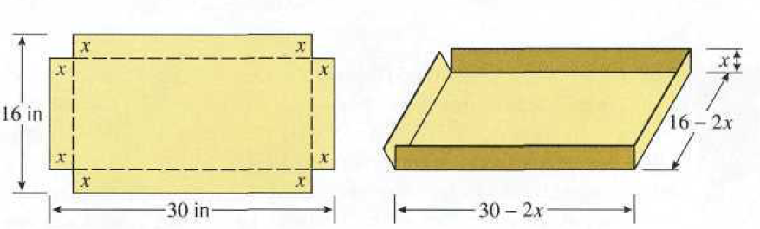
Example
An open box is to be made from a 16-inch by 30-inch piece of card board by cutting out squres of equal size from the four corners and bending up the sides. What size should the squares be to obtain a box with the largest volume.
solution

Slide 7
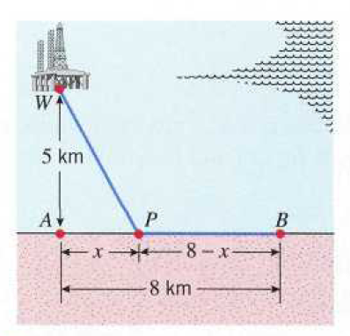
Example
Figure shows an offshore oil well located at a point W that is 5km from the closest point A on a straight shoreline. Oil is to be piped from W to a shore point B that is 8km from A by piping it on a straight line under water from W to some shore point P between A and B and then on to B via pipe along the shoreline. If the cost of laying pipe is $ 1,000,000/km under water and $ 500,000/km over land, where should the point P be located to minimize the cost of laying the pipe?
solution

Slide 12
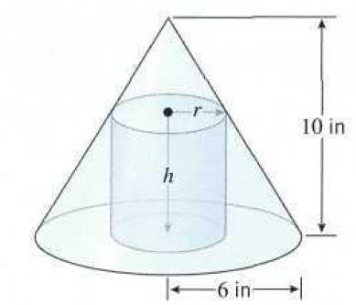
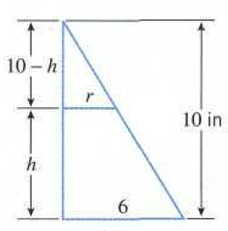
Example
Find the radius and height of the right circular cylinder of largest volume that can be inscribed in a right circular cone with radius 6 inches and height 10 inches.
solution

Slide 16
Example
A rectangular field is bounded by a fence on 3 sides and a straight stream on the fourth side. Find the dimensions of the field with the maximum area that can be enclosed with 1000 feet of fence.
let
x = width
y = length
2x + y = 1000
A = x y
then
x
x
1000 - 2x
Thus maximum area=500x250 squre ft

Slide 17
Example
Find the dimensions of the biggest rectangle that can be inscribed in the right triangle with dimensions of 6 cm, 8 cm, and 10 cm.
8 - y
10 cm
x
8 cm
y
y
x
6 cm

